Slide 1
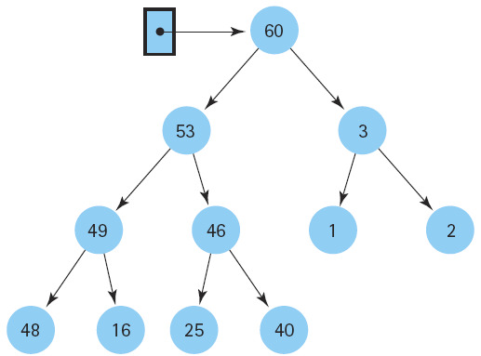
Data Structure and
Algorithm I

Slide 2
Class Outlines
Week 2 Lecture
  Data Structures and Algorithms

Slide 3
Goals
To learn the commonly used data structures
To learn the concept that every data structure has costs and benefits
To learn how to measure the effectiveness of a data structure or algorithm

Slide 4
Introduction
The main goals of the computer program design:
  To design an algorithm that is easy to understand, code, and debug.
  To design an algorithm that makes efficient use of the computer’s resources.
Resource Constraints
  Total space available to store data
  The time allowed to perform each subtask

Slide 5
Selecting a Data Structure
Select a data structure as follows:
Analyze the problem to determine the basic operations.
Quantify the resource constraints for each operation.
Select the data structure that best meets these requirements.

Slide 6
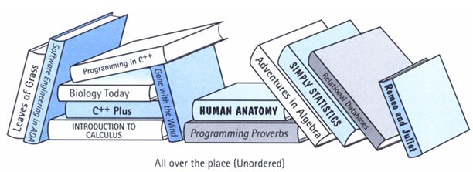
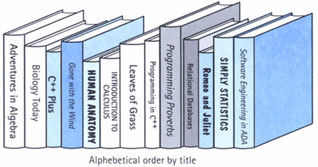
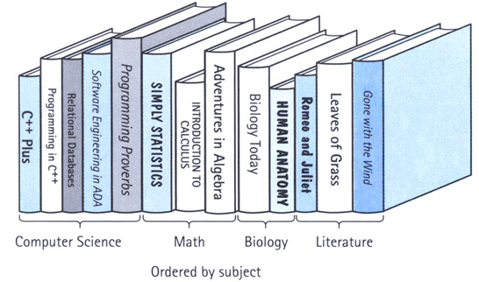
Data Structure
Example: Library
  is composed of elements (books)
  Accessing a particular book requires knowledge of the arrangement of the books
  Users access books only through the librarian

Slide 7
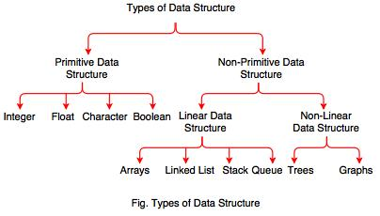

Slide 8
Categories of Data Structure
Linear Data Structure:
  A data structure is said to be linear if its elements form any sequence.
  e.g. Arrays, Queues, Stacks, Linked lists
Non-linear Data Structure:
  This structure is mainly used to represent data containing a hierarchical relationship between elements.
  e.g. graphs, family trees

Slide 9
Data Structure Operations
Traversing: accessing each record/node exactly once so that certain items in the record may be processed. (This accessing and processing is sometimes called “visiting” the record.)
Searching: Finding the location of the desired node with a given key value, or finding the locations of all such nodes which satisfy one or more conditions.
Inserting: Adding a new node/record to the structure.
Deleting: Removing a node/record from the structure.

Slide 10
2
4
6
1
3
5
7
What is an Algorithm?
1
2
3
4
5
6
7
An algorithm is a finite set of instructions or logic, written in order, to accomplish a certain predefined task. Algorithm is not the complete code or program, it is just the core logic(solution) of a problem, which can be expressed either as an informal high level description as pseudocode or using a flowchart.
Every Algorithm must satisfy the following properties:
  Input- There should be 1 or more inputs supplied externally to the algorithm.
  Output- There should be at least 1 output obtained.
  Definiteness- Every step of the algorithm should be clear and well defined.
  Finiteness- The algorithm should have finite number of steps.
  Correctness- Every step of the algorithm must generate a correct output.

Slide 11
What is an Algorithm? (cont.)
An algorithm is said to be efficient and fast, if it takes less time to execute and consumes less memory space.
The performance of an algorithm is measured on the basis of following properties :
  Space Complexity
  Time Complexity

Slide 12
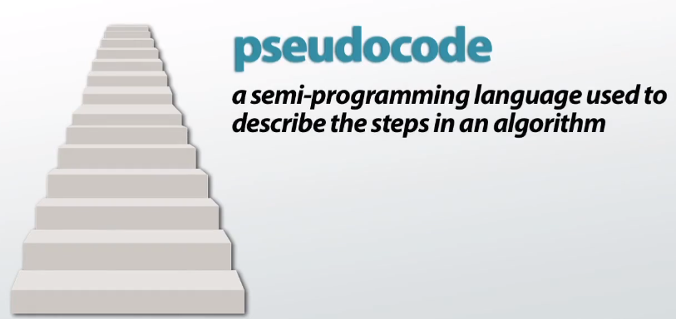
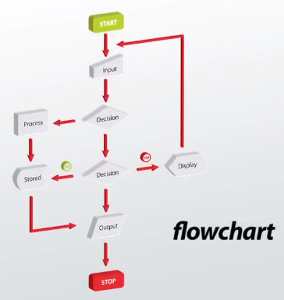
Pseudocode and Flowchart

Slide 13
Space Complexity
It is the amount of memory space required by the algorithm, during the course of its execution. Space complexity must be taken seriously for multi-user systems and in situations where limited memory is available.
  Instruction Space: It is the space required to store the executable version of the program. This space is fixed, but varies depending upon the number of lines of code in the program.
  Data Space: It is the space required to store all the constants and variables(including temporary variables) value.
  Environment Space: It is the space required to store the environment information needed to resume the suspended function.

Slide 14
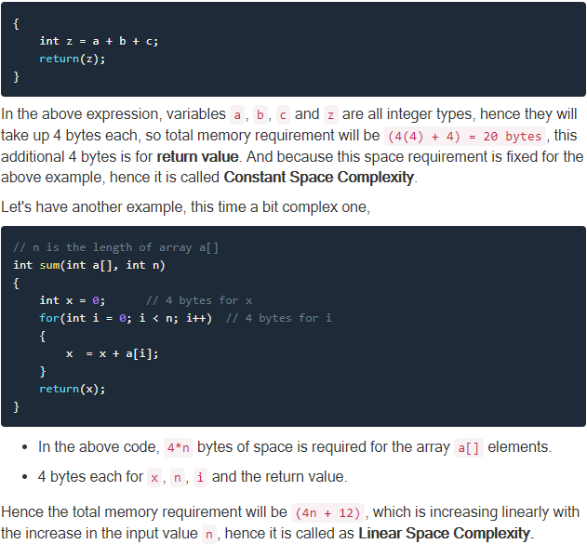
Calculating the Space Complexity

Slide 15
Time Complexity
Time Complexity is a way to represent the amount of time required by the program to run till its completion.
It's generally a good practice to try to keep the time required minimum, so that the algorithm completes it's execution in the minimum time possible.

Slide 16

How do we use algorithms in
our everyday lives?
I need to make a cake
  The algorithm here is a cake recipe. You can find the algorithm to solve this problem in a cookbook!
I can’t find the park
  The algorithm you need is a set of directions to get to the park. There might be different ways to the park so you can have different algorithms!
I need to build a toy
  The algorithm to follow here is the list of instructions that tell you how to make the toy!

Slide 17
Data Structure and
Algorithm
List, Stacks, Queues,
Heaps
Binary Search Trees
Hash Tables
Graphs
.
.
.
Insert
Delete
Find
Merge
Shortest Paths
.
.
.
Data Structures
Algorithms

Slide 18

What is a Program?
A program is the expression of an algorithm in a programming language.
A set of instructions which the computer will follow to solve a problem.
Data Structures
Algorithms
Programs
Data Structures
Algorithms

Slide 19
Difference between Algorithm,
Pseudocode and Program
Algorithm : Systematic logical approach which is a well-defined, step-by-step procedure that allows a computer to solve a problem.
Pseudocode : It is a simpler version of a programming code in plain English which uses short phrases to write code for a program before it is implemented in a specific programming language.
Program : It is exact code written for problem following all the rules of the programming language.

Slide 20
End of the Lecture
Next Lecture: 10.6.2026

Slide 21
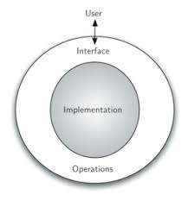
Abstract Data Type (ADT)
Abstract Data Type (ADT) is the realization of a data type as a software component.
ADT, is a logical description of how we view the data and the operations that are allowed without regard to how they will be implemented.
Encapsulation: by encapsulating the details of the implementation, we are hiding them from the user’s view. This is called information hiding.

Slide 22
Logical vs Physical Form
Data items have both a logical and a physical form.
Logical form: definition of the data item within an ADT.
  Eg: Integers in mathematical sense: +, -
Physical form: implementation of the data item within a data structure.
  Eg: 16/32 bit integers, overflow.

Slide 23
Logical vs Physical Form (cont.)
Data Type
ADT:
Type
Operations
Data Items:
Logical Form
Data Structure:
Storage Space
Subroutines
Data Items:
Physical Form

Slide 24
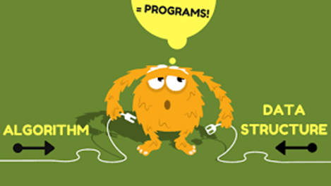
Algorithm/ Data Structure
Philosophy
Each data structure requires:
  space to store each item, including overhead
  time to perform basic operations
  programming effort
Algorithms are closely related:
  poor data structure choice can make higher complexity algorithm
  good data structure choice can make the algorithm trivial

Slide 25
Problems, Algorithms, and Programs
Problem: a task to be performed
  One view: a set of inputs and matching outputs
  Problem definition includes resource constraints
Problems are analogous to mathematical functions
  Function: mapping of inputs (domain) to outputs (range)
  The input to a function can vary:
    single number
    multiple numbers
    set of information
Parameters: the values making up an input
A given input must always map to the same output

Slide 26
Problems, Algorithms, and
Programs (Cont.)
Algorithm: a method or process followed to solve a problem
  Algorithm transforms the input of a problem to its output
Algorithm properties:
It must be correct.
It must be composed of a series of concrete steps.
There can be no ambiguity about which step is next.
It must be finite in length.
It must terminate.
Program: an instance of an algorithm, written in some programming language
Cont.

Slide 27
Why need Algorithm analysis?
The reason for analyzing an algorithm is to discover its characteristics in order to evaluate its suitability for various applications or compare it with other algorithms for the same application.
The more complicated the algorithm, the more difficult the analysis.
The characteristics of interest are most often the primary resources of time and space.
If the program is run on a large data set, then the running time becomes an issue.

Slide 28
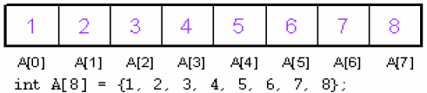
Array
The simplest type of data structure is a linear (or one dimensional) array.
A list of a finite number n of similar data referenced respectively by a set of n consecutive numbers, usually 1, 2, 3 . . . . . . . n. a set of n consecutive numbers.

Slide 29
Array (Cont.)
A finite collection of similar elements stored in adjacent memory
locations
An array with n number of elements is referenced using an index that ranges 0 to n-1.
The lowest index of an array is called its lower bound.
The highest index is called upper bound.
The number of elements in an array is called its range.
The elements of an array A[n] containing n elements are referenced as A[0], A[1], A[2],…, A[n-1], 0 is the lower bound and n-1 is the upper bound.
Cont.

Slide 30
Array (Cont.)
A collection of data elements in which all elements are of the same data type.
  An array of students’ marks
  An array of students’ names
For example:
int A[10] - {5,6,12,4,15,45,87,1,9,13};
Base Address

Slide 31
Declaration of the Arrays
Array name
Element type
Array size
Examples
  int a[20], b [3], c[7];
  float f[5], c[2];
  char m[4], n[20];
Initialization of an array
  The process of assigning initial values
  float b[3]={2.0,5.5,3.14};
  char name[4]={‘E’, ‘m’, ‘r’, ‘e’};
  int c[10]={0};

Slide 32
Operations on Array
Traversing: means to visit all the elements of the array in an operation.
Insertion: means to put values into an array.
Deletion/ Remove: to delete a value from an array.
Sorting: Rearrangement of values in an array in a specific order (ascending/descending) is called sorting.
Searching: the process of finding the location of a particular element in an array is called searching. There are two popular searching techniques/mechanisms: linear search and binary search.

Slide 33
Traversing in Linear Array
It means processing or visiting each element in the array exactly once;
Let A is an array stored in the computer’s memory.
If we want to display the contents of A, it has to be traversed i.e. by accessing and processing each element of A exactly once.

Slide 34
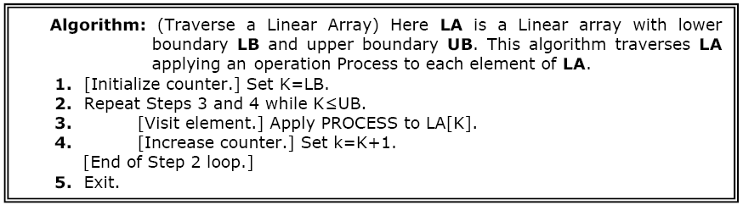
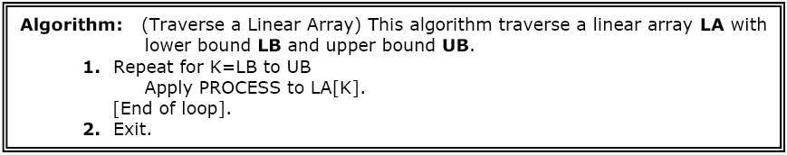
Traversing in Linear Array (cont.)
The alternate algorithm for traversing (using for loop) is :

Slide 35
Traversing in Linear Array (cont.)
This program will traverse each element of the array to calculate the sum and then calculate and print the average of the following array of integers.
(4,3,7,-1,7,2,0,4,2,13)
#include <iostream.h>
#define size 10
int main ()
{
int x[10]={4,3,7,-1,7,2,0,4,2,13}, i, sum=0,LB=0, UB=size;
float av;
for(i=LB,i<UB;i++)
sum = sum + x[i];
av = (float)sum/size;
cout<< “The average of the numbers= “<<av<<endl;
return 0;
}

Slide 36
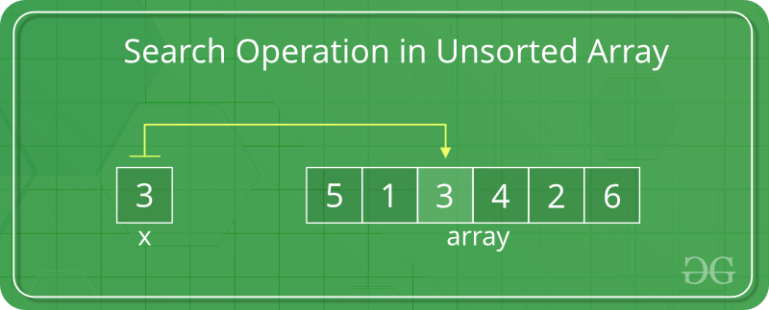
Searching

Slide 37
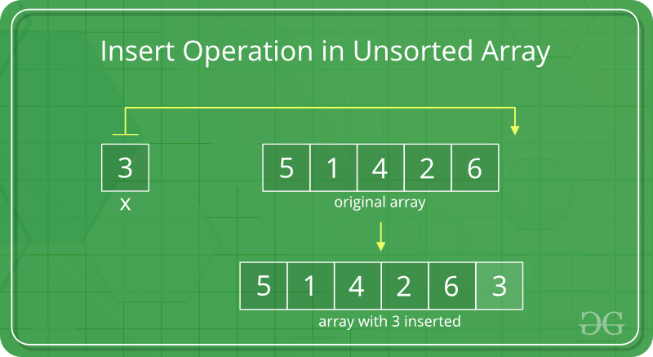
Insertion

Slide 38
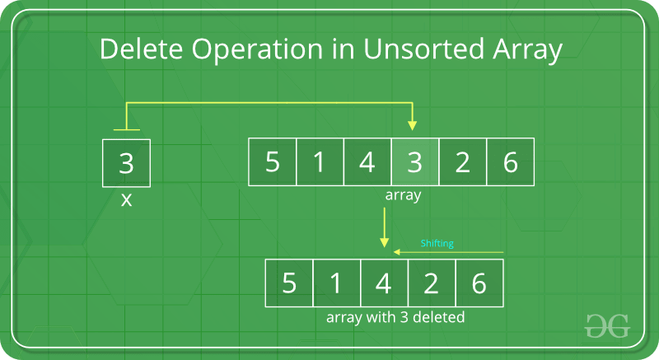
Deletion

Slide 39
#include<iostream>
using namespace std;
#include<conio.h>
void traversing (int*,int);
void searching (int*,int,int);
void insertion (int*,int,int,int);
int deletion (int*,int,int);
int main()
{
int array[30],choice,location,item,i,length,position;
cout<<"Program for Operation of Array by-Tarun Rawat \n";
cout<<"\nEnter length of array : ";
cin>>length;
cout<<"Enter element of array \n";
for(i=0;i<=length-1;i++)
{ cin>>array[i];
}

Slide 40
case 4: cout<<"Enter position to delete \n";
cin>>position;
length =deletion(array,length,position);
cout<<"New array after delete \n";
for(i=0;i<length;i++)
{cout<<array[i]<<"\n";}
break;
case 5: break;
default: cout<<"wrong value\n";
goto again;
}
getch();
}
void traversing(int array[],int length)
{ for(int i=0;i<=length-1;i++)
{cout<<array[i]<<" ";}
}
again:
cout<<"Travers= 1\nSearch = 2\nInsert = 3\nDelete = 4\nExit = 5 \n";
cout<<"Enter choice: ";
cin>>choice;
switch(choice)
{ case 1: traversing(array,length);
break;
case 2: searching(array,item,length);
break;
case 3: cout<<"Enter Item and Position to add \n";
cin>>item>>position;
insertion(array,length,item,position);
for(i=0;i<=length;i++)
{cout<<array[i]<<endl;
}
break;

Slide 41
void searching(int array[],int item,int length)
{ int i;
cout<<"\nEnter item to search \n";
cin>>item;
int location =-1;
for( i=0;i<=length-1;i++)
{ if ( array[i]==item)
{ location=i;
}
}
if (location==-1)
{cout<<"\nItem not found ";
}
else{cout<<" \nItem is present at (index value): "<<location;
}
}
void insertion(int array[],int length,int item,int position)
{ int j=length-1;
while(j>=position)
{ array[j+1]=array[j];
j=j-1;
}
array[position]=item;
length=length+1;
}
int deletion(int array[],int length,int position)
{
while(position<length)
{ array[position]=array[position+1];
position=position+1;
}
length=length-1;
return length;
}

Slide 42
Next Week Lecture (Week 3)
Tutorial I

