Slide 1
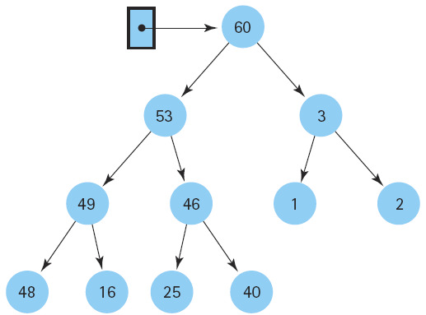
Data Structure and
Algorithm I

Slide 2

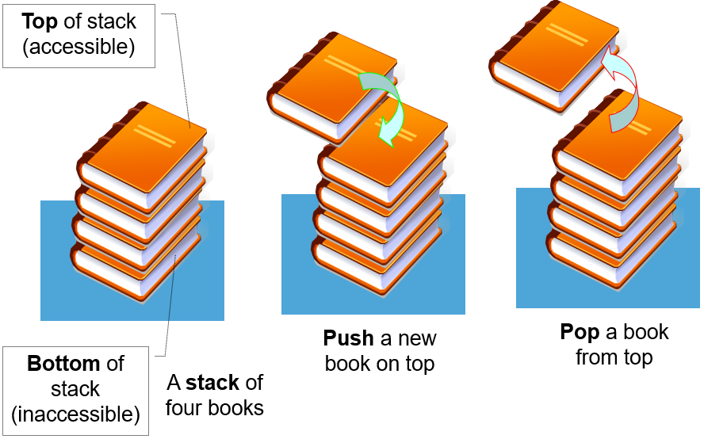

Class Outlines
Week 6 Lecture
  Lists, Stacks, and Queues

Slide 3
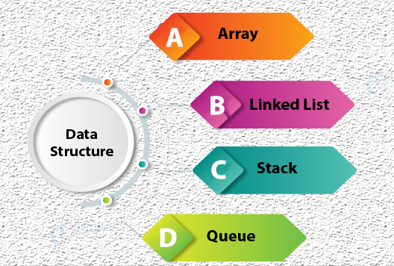
Linear Data Structure

Slide 4
What is List?
A list is a sequential data structure
It differs from the stack and queue data structure in that additions and removals can be made at any position in the list.

Slide 5

Lists
  Position (a first element in the list, a second element, and so on.)
  Finite, ordered sequence of data items known as elements (not sorted by value)
  The list ADT do not depend on the elemental data type (used for lists of integers, lists of characters, lists of payroll records, lists of lists, ……)
  Empty (List contains no elements)
  Length of the list (The number of elements currently stored)
  Head (The beginning of the list)
  Tail (The end of the list)

Slide 6
Lists (cont.)
Relationship between the value of an element and its position in the list
  sorted lists (elements positioned in ascending order of value)
  unsorted lists (no particular relationship between element values and positions)
To indicate the list of four elements, with the current position being to the right of the bar at element 12
  <20, 23⏐12, 15>
Calling insert with value 10
  <20, 23⏐10, 12, 15>
getValue method
  Returns a pointer to the current element

Slide 7
List operations
Add : adds a new node
Set : update the contents of a node
Remove : removes a node
IsEmpty : reports whether the list is empty
IsFull : reports whether the list is full
Initialize : creates/initializes the list

Slide 8
Iteration for a list
for (L.moveToStart(); L.currPos()<L.length(); L.next())
{
it = L.getValue();
doSomething(it);
}

Slide 9
Find Method
// Return true if "K" is in list "L", false otherwise
bool find(List<int>& L, int K)
{
int it;
for (L.moveToStart(); L.currPos()<L.length();
L.next())
{
it = L.getValue();
if (K == it) return true; // Found K
}
return false; // K not found
}

Slide 10
Two Major Implementation
  Two standard approaches to implement lists
    the array-based list
    the linked list
  General steps:
  1. Choose an internal data structure
  e.g. Array or linked list
  2. Figure out the algorithm needed for each of the
  major operations in List ADT:
  insert, remove, and retrieve
  3. Implement the algorithm from step (2)

Slide 11
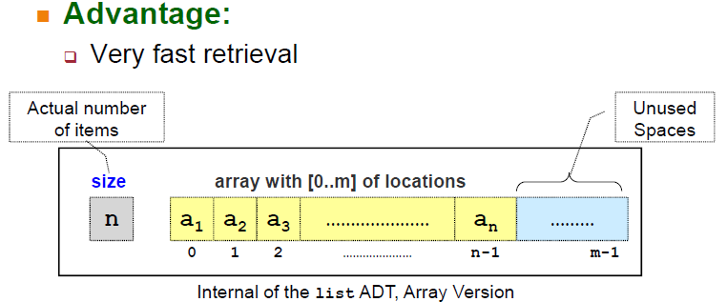
Implement List ADT: Using Array

Slide 12
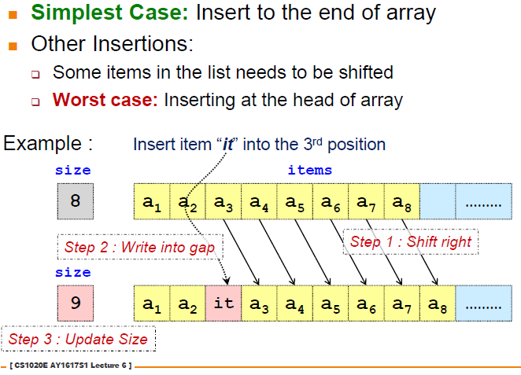
Insertion: Using Array

Slide 13
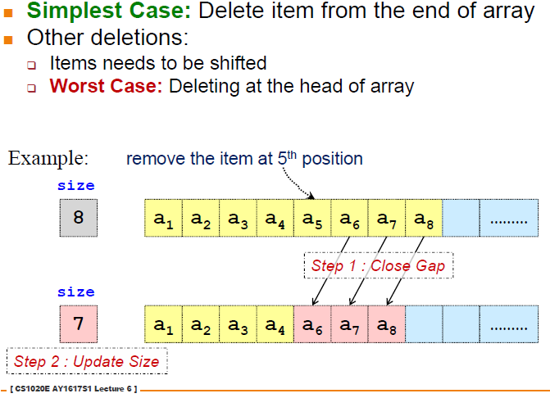
Deletion: Using Array

Slide 14
Array-based List Implementation
In Array-based List Implementation, AList Inherits from abstract class List
Class AList’s portion contains the data members for the array-based list.
Allocated at some fixed size (the size of the array must be known when the list object is created)
“=defaultsize” (the parameter is optional)
Data members
  listArray: the array which holds the list elements
  maxSize: maximum permitted size
  listSize: actual hold value (number of list items)
  Curr: current position

Slide 15
Array-based List Implementation (cont.)
Store list elements in contiguous cells of the array
Inserting or removing elements at the tail of the list is easy (append operation)
To insert an element at the head of the list, all elements currently in the list must shift one position toward the tail to make room
To insert at position i within a list of n elements, then n−i elements must shift toward the tail
To remove an element from the head of the list, all remaining elements must shift toward the head by one position
To remove the element at position i, n- i -1 elements must shift toward the head.

Slide 16
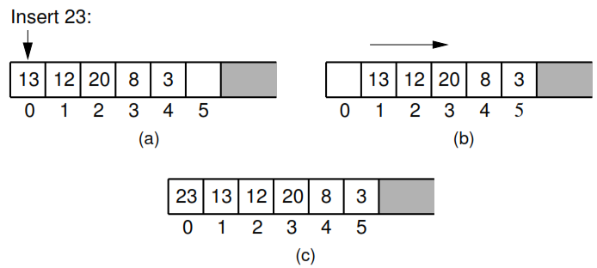
Array-based List Implementation (cont.)
Figure 4.3 Inserting an element at the head of an array-based list requires shifting all existing elements in the array by one position toward the tail.
(a) A list containing ﬁve elements before inserting an element with value 23.
(b) The list after shifting all existing elements one position to the right.
(c) The list after 23 has been inserted in array position 0. Shading indicates
the unused part of the array.

Slide 17
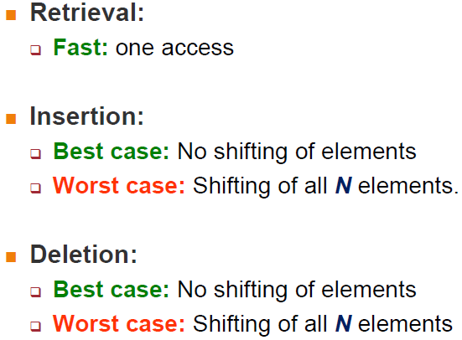
Array Implementation: Efficiency (time)

Slide 18
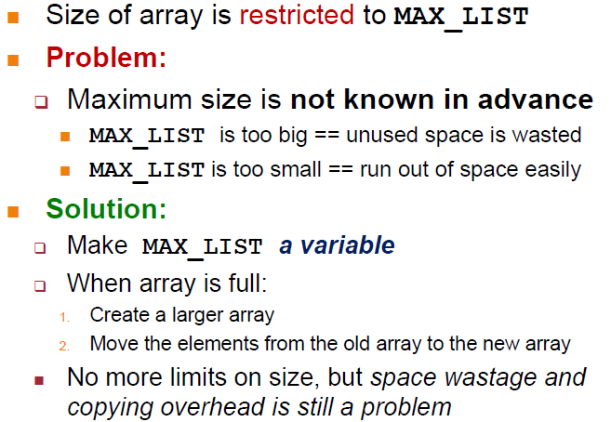
Array Implementation: Efficiency (space)

Slide 19
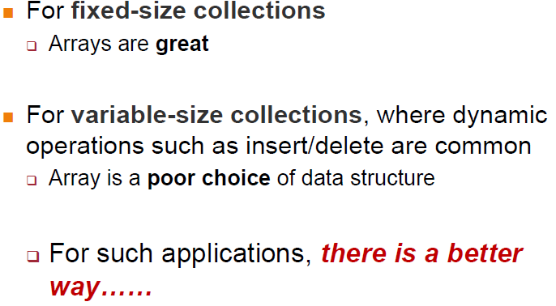
Array Implementation : Observations

Slide 20
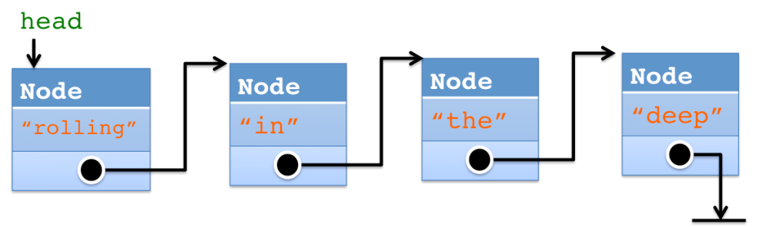
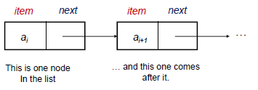
Linked Lists
Use of pointers
Use dynamic memory allocation (allocates memory for new list elements as needed)
Allow elements to be non-contiguous in memory
Order the elements by associating each with its neighbour(s) through pointers
Made up of a series of objects called nodes of the list

Slide 21
Linked Lists (cont.)
Linked List Node Implementation
  Link class
  Element field (to store the element value)
  Next field (to store a pointer to the next node on the list)
  NULL (points nowhere, i.e; for the last list node’s next field)
  head (point to the list’s first node)
  tail (point to the last link of the list)
  curr (point to the current element)
  Singly linked list or one-way list ( each list node has a single pointer to the next node on the list)

Slide 22
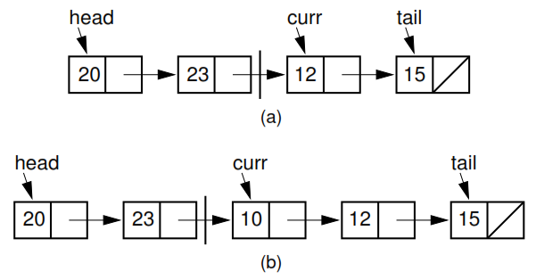
Linked Lists (cont.)
Figure 4.5 Illustration of a faulty linked-list implementation where curr points directly to the current node.
(a) Linked list prior to inserting element with value 10.
(b) Desired effect of inserting element with value 10.

Slide 23
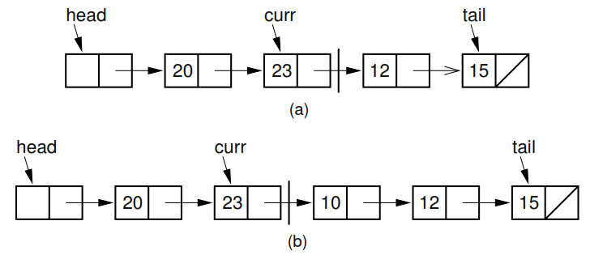
Linked Lists (cont.)
Figure 4.6 Insertion using a header node, with curr pointing one node head of the current element.
(a) Linked list before insertion. The current node contains 12.
(b) Linked list after inserting the node containing 10.

Slide 24
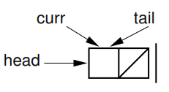
Linked Lists (cont.)
Figure 4.7 Initial state of a linked list when using a header node.

Slide 25
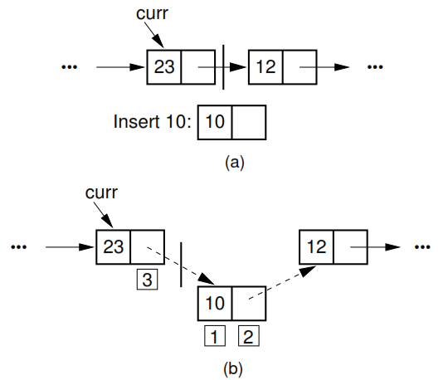
Linked List Insertion Process
Figure 4.9 The linked list insertion process. (a) The linked list before insertion. (b) The linked list after insertion.
1. marks the element ﬁeld of the new link node.
2. marks the next ﬁeld of the new link node, which is set to point to what used to be the current node (the node with value 12).
3. marks the next ﬁeld of the node preceding the current position. It used to point to the node containing 12; now it points to the new node containing 10.

Slide 26
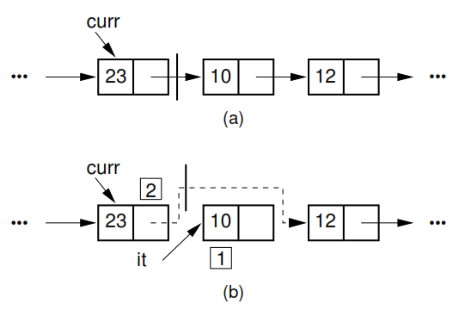
Linked List Removal Process
Figure 4.10 The linked list removal process. The linked list before removing the node with value 10. (b) The linked list after removal.
1. marks the list node being removed. it is set to point to the element.
2. marks the next ﬁeld of the preceding list node, which is set to point to the node following the one being deleted.

Slide 27
Freelists
Instead of making repeated calls to new and delete, the Link class can handle its own freelist.
A freelist holds those list nodes that are not currently being used.
When a node is deleted from a linked list, it is placed at the head of the freelist.
When a new element is to be added to a linked list, the freelist is checked to see if a list node is available. If so, the node is taken from the freelist.
If the freelist is empty, the standard new operator must be called.
Freelists are particularly useful for linked lists that periodically grow and then shrink.

Slide 28
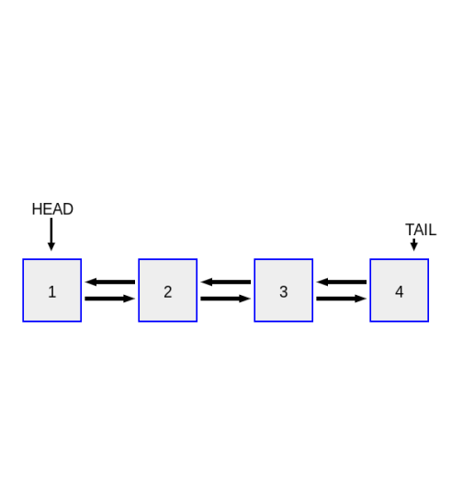
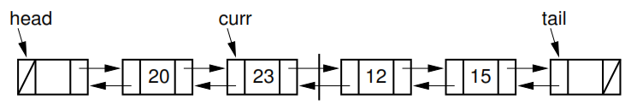
Doubly Linked Lists
The singly linked list allows for direct access from a list node only to the next node in the list.
A doubly linked list allows convenient access from a list node to the next node and also to the preceding node on the list.
Allow traversal in either direction
Two pointers: one to the node following it (as in the singly linked list), and a second pointer to the node preceding it.
The header and the tailer: nodes that contain no value
Figure 4.12 A doubly linked list.

Slide 29
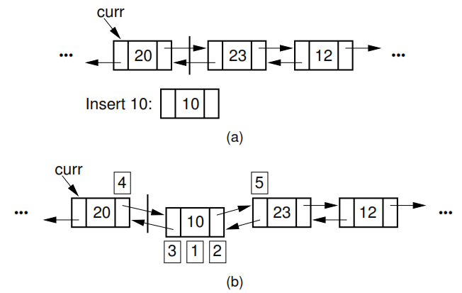
Insertion for Doubly Linked Lists
Figure 4.15 Insertion for doubly linked lists. The labels 1 , 2 , and 3 correspond to assignments done by the linked list node constructor. 4 marks the assignment to curr->next. 5 marks the assignment to the prev pointer of the node following the newly inserted node.

Slide 30
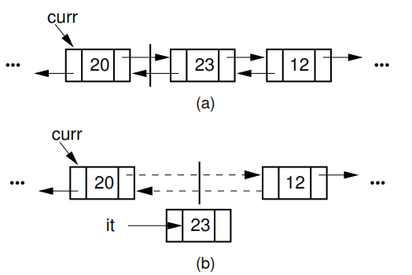
Doubly Linked List Removal
Figure 4.16 Doubly linked list removal. Element it stores the element of the node being removed. Then the nodes to either side have their pointers adjusted.

Slide 31
Linked List Implementation : Observations
Data storage must now contain both item and pointer to next item.
These are called ‘nodes’
This can be made dynamic
Dynamic memory allocation allows a program to allocate memory at runtime.
Much more efficient for insertion and deletion

Slide 32
End of the lecture
  Next week lecture: Stacks and Queues

