Slide 1
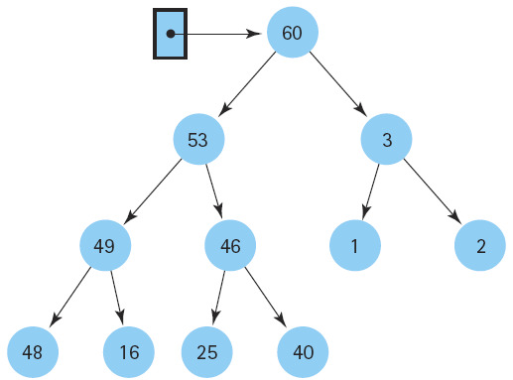
Data Structure and
Algorithm I

Slide 2

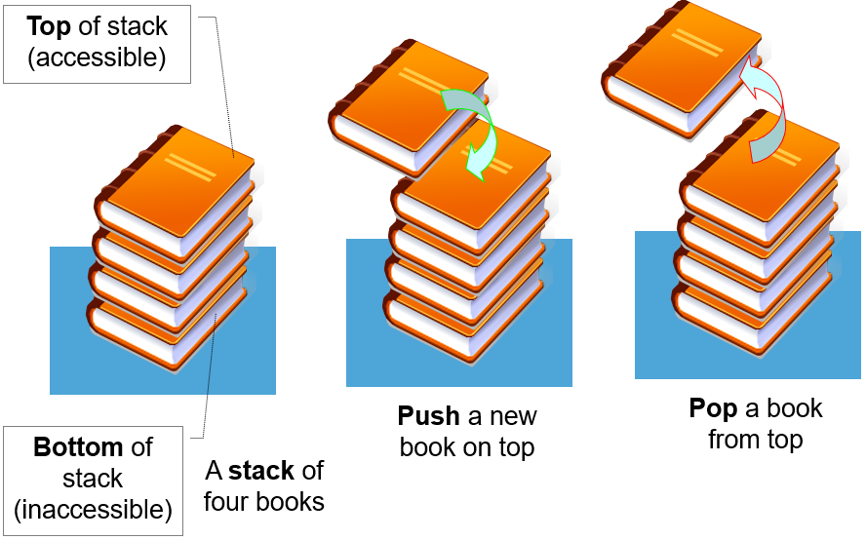

Class Outlines
Week 6 Lecture
  Lists, Stacks, and Queues

Slide 3
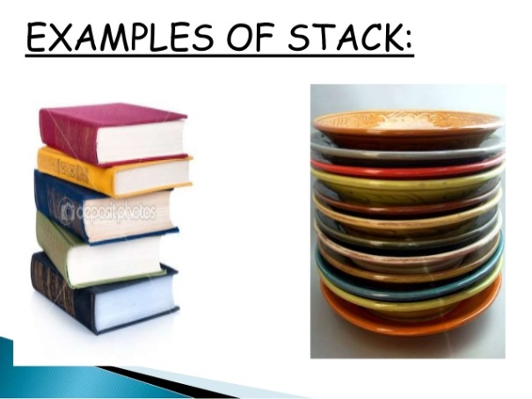
Stack
A stack is a sequence of items (list-like structure) that are accessible at only one end of the sequence.
A stack is called a last-in-first-out (LIFO) collection. This mean that the last thing we added (pushed) is the first thing that gets pulled (popped) off.
The accessible element of the stack is called the top element.
In programming terms, putting an item on top of the stack is called "push" and removing an item is called "pop".

Slide 4
Stack (cont.)
The two approaches: array-based and linked stacks
There are basically three operations that can be performed on stacks . They are (1)inserting an item into a stack (push). (2) deleting an item from the stack (pop). (3) displaying the contents of the stack(pip).

Slide 5
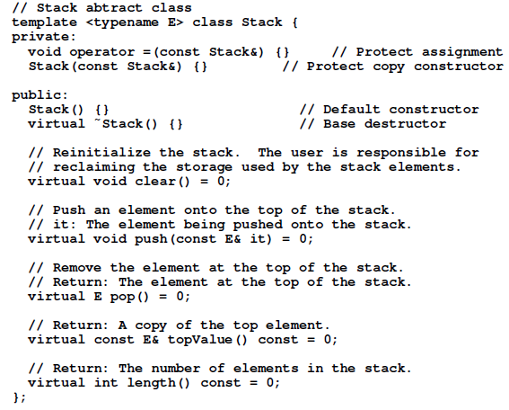
The C⁺⁺ ADT for a Stack

Slide 6
push() function
push() function is used to insert an element at the top of the stack.
The element is added to the stack container and the size of the stack is increased by 1.

Slide 7
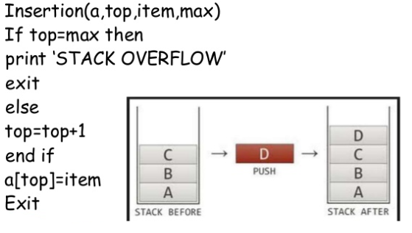
Algorithm of Insertion in Stack (Push)
1.
2.
3.
4.
5.

Slide 8
pop() function
pop() function is used to remove an element from the top of the stack(newest element in the stack).
The element is removed to the stack container and the size of the stack is decreased by 1.

Slide 9
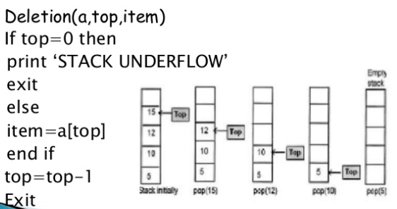
Algorithm of Deletion in Stack (Pop)
1.
2.
3.
4.
5.

Slide 10
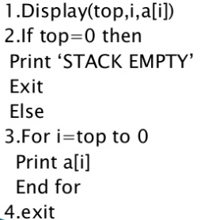
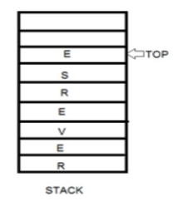
Algorithm of Display in Stack

Slide 11
Stack Specification
A stack is an object or more specifically an abstract data structure (ADT) that allows the following operations:
  Push: Add element to top of stack
  Pop: Remove element from top of stack
  IsEmpty: Check if stack is empty
  IsFull: Check if stack is full
  Peek: Get the value of the top element without removing it

Slide 12
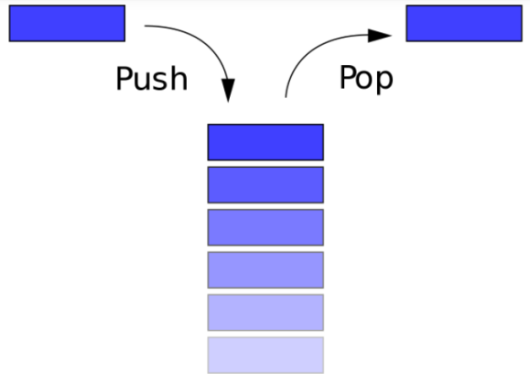
How stack works
The operations work as follows:
A pointer called TOP is used to keep track of the top element in the stack.
When initializing the stack, we set its value to -1 so that we can check if the stack is empty by comparing TOP == -1.
On pushing an element, we increase the value of TOP and place the new element in the position pointed to by TOP.
On popping an element, we return the element pointed to by TOP and reduce its value.
Before pushing, we check if stack is already full
Before popping, we check if stack is already empty

Slide 13
Use of stack
Although stack is a simple data structure to implement, it is very powerful. The most common uses of a stack are:
To reverse a word - Put all the letters in a stack and pop them out. Because of LIFO order of stack, you will get the letters in reverse order.
In programming - In the case of parentheses when a left parenthesis is encountered it is pushed on the stack and when a right parenthesis is encountered its matching left parenthesis is popped from the stack. If the stack has no left parenthesis, that means the parentheses don’t match, there is an extra right parenthesis.
In browsers - The back button in a browser saves all the urls you have visited previously in a stack. Each time you visit a new page, it is added on top of the stack. When you press the back button, the current URL is removed from the stack and the previous url is accessed.

Slide 14
Array Based Stack
Stack's capacity is limited to a certain value and overfilling the stack will cause an error.
In spite of capacity limitation, array-based implementation is widely applied in practice.
In a number of cases, required stack capacity is known in advance and allocated space exactly satisfies the requirements of a particular task.

Slide 15
Array Based Stack (cont.)
Advantages
  best performance
Disadvantage
  fixed size
Basic implementation
  initially empty array
  field to record where the next data gets placed into
  if array is full, push() returns false
    otherwise adds it into the correct spot
  if array is empty, pop() returns null
    otherwise removes the next item in the stack

Slide 16
Linked Stack
The major problem with the stack implemented using array is, it works only for fixed number of data values. That means the amount of data must be specified at the beginning of the implementation itself. Stack implemented using array is not suitable, when we don't know the size of data which we are going to use.
One disadvantage of using an array to implement a stack is the wasted space---most of the time most of the array is unused.
The stack implemented using linked list can work for unlimited number of values. That means, stack implemented using linked list works for variable size of data.
So, there is no need to fix the size at the beginning of the implementation. The Stack implemented using linked list can organize as many data values as we want.

Slide 17
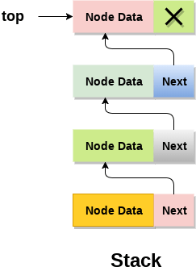
Linked Stack (cont.)
In linked list implementation of a stack, every new element is inserted as 'top' element. That means every newly inserted element is pointed by 'top'.
Whenever we want to remove an element from the stack, simply remove the node which is pointed by 'top' by moving 'top' to its next node in the list.
The next field of the first element must be always NULL.

Slide 18
End of the lecture
  Next week lecture: Queues

