Slide 1
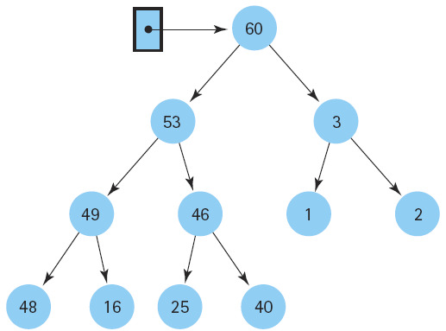
Data Structure and
Algorithm I

Slide 2

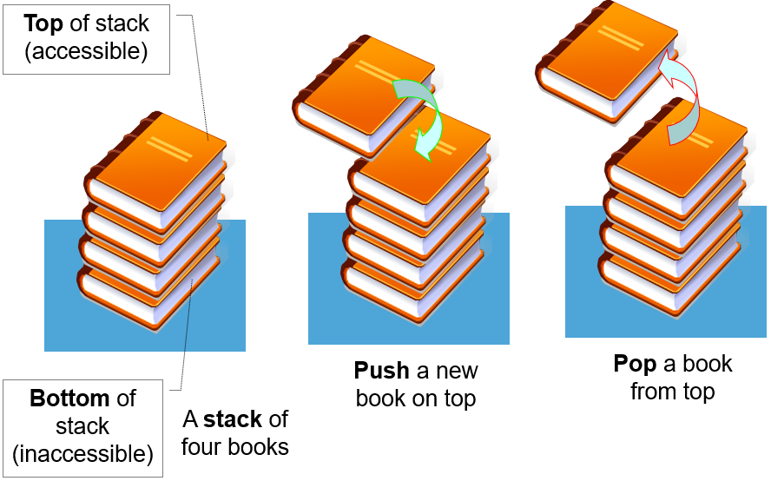

Class Outlines
Week 8 Lecture
  Lists, Stacks, and Queues

Slide 3
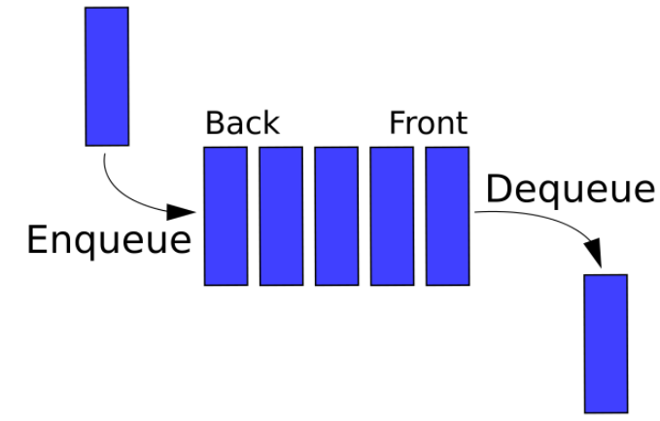
Queue
Like the stack, the queue is a list-like structure that provides restricted access to its elements. Queue elements may only be inserted at the back and removed from the front.
A queue is a useful data structure in programming. It is similar to the ticket queue outside a cinema hall, where the first person entering the queue is the first person who gets the ticket.
Queue follows the First In First Out (FIFO) rule - the item that goes in first is the item that comes out first too.
In programming terms, putting an item in the queue is called an "enqueue" and removing an item from the queue is called "dequeue".
Two implementations for queues: the array-based queue and the linked queue

Slide 4
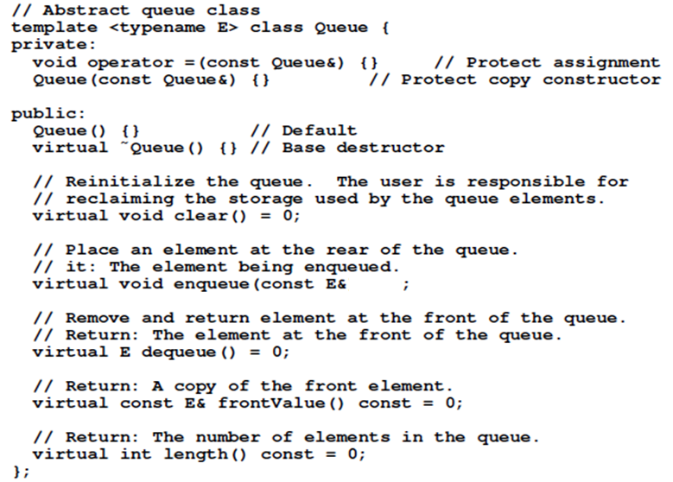
The C⁺⁺ ADT for a Queue
it ) = 0

Slide 5
Queue Specifications
A queue is an object or more specifically an abstract data structure(ADT) that allows the following operations:
Enqueue: Add element to end of queue
Dequeue: Remove element from front of queue
IsEmpty: Check if queue is empty
IsFull: Check if queue is full
Peek: Get the value of the front of queue without removing it

Slide 6
The Queue Operations
A queue is like a line of people waiting for a bank teller. The queue has a front and a rear.
$ $
Rear
Front
Notes:
When you think of a computer science queue, you can imagine a line of people waiting for a teller in a bank. The line has a front (the next person to be served) and a rear (the last person to arrive.

Slide 7
The Queue Operations
New people must enter the queue at the rear. This is usually called an enqueue operation.
$ $
Front
Rear
Notes:
Don’t ask me why the C++ STL used the name push. It only confuses matters with a stack. In any case, when a new item enters a queue, it does so at the rear.

Slide 8
The Queue Operations
When an item is taken from the queue, it always comes from the front. This is usually called a dequeue operation.
$ $
Front
Rear
Notes:
When an item is removed from a queue, the removal occurs at the front.

Slide 9
Implementation of Queue Data Structure
Initially the head(FRONT) and the tail(REAR) of the queue points at the first index of the array (starting the index of array from 0).
As we add elements to the queue, the tail keeps on moving ahead, always pointing to the position where the next element will be inserted, while the head remains at the first index.

Slide 10
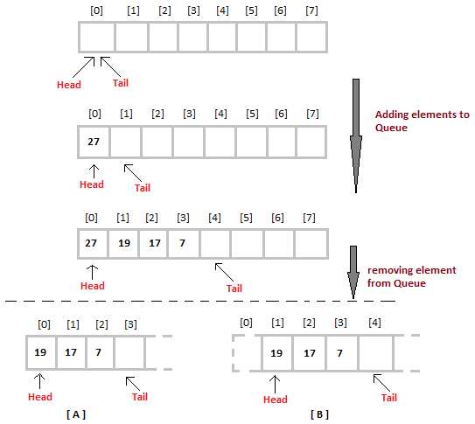

Slide 11
How Queue Works
Queue operations work as follows:
Two pointers called FRONT and REAR are used to keep track of the first and last elements in the queue.
When initializing the queue, we set the value of FRONT and REAR to -1.
On enqueuing an element, we increase the value of REAR index and place the new element in the position pointed to by REAR.
On dequeuing an element, we return the value pointed to by FRONT and increase the FRONT index.
Before enqueuing, we check if queue is already full.
Before dequeuing, we check if queue is already empty.
When enqueuing the first element, we set the value of FRONT to 0.
When dequeuing the last element, we reset the values of FRONT and REAR to -1 (initial state).

Slide 12
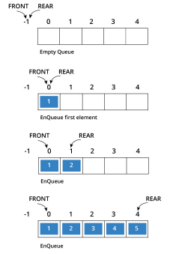
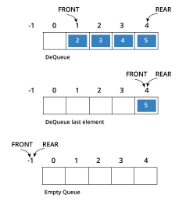
How Queue Works (cont.)

Slide 13
Array Implementation
A queue can be implemented with an array, as shown here. For example, this queue contains the integers 4 (at the front), 8 and 6 (at the rear).
[ 0 ]
[1]
[ 2 ]
[ 3 ]
[ 4 ]
[ 5 ]
. . .
4
8
6
An array of integers to implement a queue of integers
We don't care what's in
this part of the array.
Notes:
Just like our stack implementation in the previous chapter, one way to implement a queue is to store the elements in an array.

Slide 14
Array Implementation
The easiest implementation also keeps track of the number of items in the queue and the index of the first element (at the front of the queue), the last element (at the rear).
3
size
0
first
2
last
[ 0 ]
[1]
[ 2 ]
[ 3 ]
[ 4 ]
[ 5 ]
. . .
4
8
6
Notes:
The easiest implementation also keeps track of three numbers. The size could be as small as zero or as large as the number of items in the array. The index of the front element is stored in the first member variable. The front item in the queue is at that index of the array. The next item is after the first one and so on until the rear of the queue that occurs at the index stored in a member variable called last.

Slide 15
A Dequeue Operation
When an element leaves the queue, size is decremented, and first changes, too.
2
size
1
first
2
last
[ 0 ]
[1]
[ 2 ]
[ 3 ]
[ 4 ]
[ 5 ]
. . .
4
8
6
Notes:
This shows how the member variables change when an item leaves the queue.

Slide 16
Algorithm for DEQUEUE operation
Check if the queue is empty or not.
If the queue is empty, then print underflow error and exit the program.
If the queue is not empty, then print the element at the head and increment the head.

Slide 17
An Enqueue Operation
When an element enters the queue, size is incremented, and last changes, too.
3
size
1
first
3
last
[ 0 ]
[1]
[ 2 ]
[ 3 ]
[ 4 ]
[ 5 ]
. . .
8
6
2
Notes:
And this shows how the member variables change when a new item enters the queue. For a fixed size array, a new item may enter only if the current size of the queue is less than the size of the array. For a dynamic array, we could increase the size of the array when the queue grows beyond the current array size.

Slide 18
Algorithm for ENQUEUE operation
Check if the queue is full or not.
If the queue is full, then print overflow error and exit the program.
If the queue is not full, then increment the tail and add the element.

Slide 19
Array Implementation
Easy to implement
But it has a limited capacity with a fixed array
Or you must use a dynamic array for an unbounded capacity

Slide 20
Linked List Implementation
A queue can also be implemented with a linked list with both a head and a tail pointer.
13
15
10
7
null
head_ptr
tail_ptr
Notes:
A linked list can also be used to implement a queue, but we must maintain both a head and a tail pointer because we need access to both the front and the rear of the queue.

Slide 21
Linked List Implementation
Which end do you think is the front of the queue?
The head_ptr points to the front of the list and the tail_ptr points to the rear of the list.
Front
13
15
10
7
null
head_ptr
Rear
tail_ptr
Notes:
Of course, we could put the front of the queue at the end of the linked list, but it would be hard to remove an item. Do you see why?

Slide 22
Applications of Queue
Queue, as the name suggests is used whenever we need to manage any group of objects in an order in which the first one coming in, also gets out first while the others wait for their turn, like in the following scenarios:
Serving requests on a single shared resource, like a printer, CPU task scheduling etc.
In real life scenario, Call Center phone systems uses Queues to hold people calling them in an order, until a service representative is free.
Handling of interrupts in real-time systems. The interrupts are handled in the same order as they arrive i.e First come first served.

Slide 23
Key Differences Between Stack and Queue
Stack follows LIFO mechanism on the other hand Queue follows FIFO mechanism to add and remove elements.
In a stack, the same end is used to insert and delete the elements. On the contrary, two different ends are used in the queue to insert and delete the elements.
As Stack have only one open end that is the reason for using only one pointer to refer to the top of the stack. But queue uses two pointers to refer front and the rear end of the queue.
Stack performs two operations known as push and pop while in Queue its known as enqueue and dequeue.
Stack implementation is easier whereas Queue implementation is tricky.
Queue has variants like circular queue, priority queue, doubly ended queue, etc. In contrast, stack does not have variants.

Slide 24
Dictionaries
The most common objective of computer programs is to store and retrieve data.
The data structure can be implemented efficient ways to organize collections of data records so that they can be stored and retrieved quickly.
A simple interface is described for such a collection, called a dictionary. The dictionary ADT provides operations for storing records, finding records, and removing records from the collection.
At first, define the concepts of a key and comparable objects. If we want to search for a given record in a database, how should we describe what we are looking for? A database record could simply be a number, or it could be quite complicated, such as a payroll record with many fields of varying types.

Slide 25
Dictionaries (cont.)
For example, if searching for payroll records, we might wish to search for the record that matches a particular ID number. In this example the ID number is the search key.
To implement the search function, we require that keys be comparable.

Slide 26
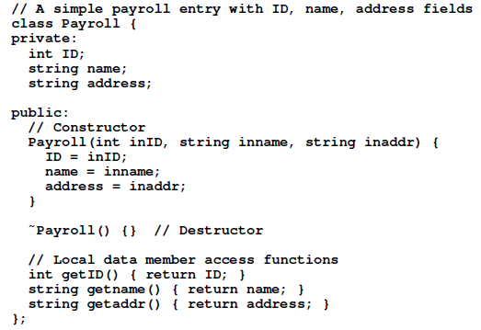
A payroll record implementation

Slide 27
Next Week (Week 9)
  Tutorial III

