Slide 1
CHAPTER 3 ALGORITHM ANALYSIS
Data Structure and Algorithm I

Slide 2
Introduction
Introduces the motivation, basic notation, and fundamental techniques of algorithm analysis
Focus on a methodology known as asymptotic algorithm analysis, or simply asymptotic analysis.
Asymptotic analysis
attempts to estimate the resource consumption of an algorithm,
allows to compare the relative costs of two or more algorithms for solving the same problem,
gives algorithm designers a tool for estimating whether a proposed solution is likely to meet the resource constraints for a problem before they implement an actual program.
The running time of an algorithm depends on the “size” and “complexity” of the input.
In the simplest terms, for a problem where the input size is n:

Slide 3
Algorithm
An algorithm is a set of instructions to be followed to solve a problem.
There can be more than one solution (more than one algorithm) to solve a given problem.
An algorithm can be implemented using different programming languages on different platforms.
An algorithm must be correct. It should correctly solve the problem.
Once we have a correct algorithm for a problem, we have to determine the efficiency of that algorithm.

Slide 4
Asymptotic Analysis
Given two algorithms for a task, how do we find out which one is better?
One way of doing this is – implement both the algorithms and run the two programs on your computer for different inputs and see which one takes less time.
There are many problems with this approach for analysis of algorithms.
1) It might be possible that for some inputs, first algorithm performs better than the second. And for some inputs second performs better.
2) It might also be possible that for some inputs, first algorithm perform better on one machine and the second works better on other machine for some other inputs.

Slide 5
Asymptotic Analysis (cont.)
In Asymptotic Analysis, evaluate the performance of an algorithm in terms of input size (we don’t measure the actual running time) and calculate, how does the time (or space) taken by an algorithm increases with the input size.
When analyzing the running time or space usage of programs, try to estimate the time or space as function of the input size.

Slide 6
Algorithmic Performance
There are two aspects of algorithmic performance:
Time
Instructions take time.
How fast does the algorithm perform?
What affects its runtime?
Space
Data structures take space
What kind of data structures can be used?
How does choice of data structure affect the runtime?
focus on time:
How to estimate the time required for an algorithm

Slide 7
Algorithmic Performance (cont.)
Many factors affect the running time of a program.
Some relate to the environment in which the program is compiled and run. Such factors include the speed of the computer’s CPU, bus, and peripheral hardware.
Competition with other users for the computer’s (or the network’s) resources can make a program slow to a crawl.
The programming language and the quality of code generated by a particular compiler can have a significant effect.
The “coding efficiency” of the programmer who converts the algorithm to a program can have a tremendous impact as well.
Of primary consideration when estimating an algorithm’s performance is the number of basic operations required by the algorithm to process an input of a certain size.

Slide 8
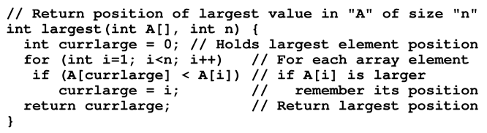
Example 3.1
Consider a simple algorithm to solve the problem of ﬁnding the largest value in an array of n integers. The algorithm looks at each integer in turn, saving the position of the largest value seen so far. This algorithm is called the largest-value sequential search and is illustrated by the following function:
The size of the problem is A.length, the number of integers stored in array A
The basic operation is to compare an integer’s value to that of the largest value seen.
The time T to run the algorithm as a function of n (n= input size), written as T(n): non-negative value
c is the amount of time required to compare two integers in function largest
Running time expressed by the equation T(n) = cn . This equation describes the growth rate for the running time of the largest value sequential search algorithm.

Slide 9
Example 3.2
The running time of a statement that assigns the ﬁrst value of an integer array to a variable is simply the time required to copy the value of the ﬁrst array value.
Takes a constant amount of time regardless of the value. Let us call c1, the amount of time necessary to copy an integer.
No matter how large the array on a typical computer, the time to copy the value from the ﬁrst position of the array is always c1
The equation for this algorithm is simply T(n) = c1, indicating that the size of the input n has no effect on the running time. This is called a constant running time.

Slide 10
Example 3.3
Consider the following code:
sum = 0;
for (i=1; i<=n; i++)
for (j=1; j<=n; j++)
sum++;
What is the running time for this code fragment?
It takes longer to run when n is larger.
The basic operation in this example is the increment operation for variable sum. We can assume that incrementing takes constant time; call this time c₂.
The total number of increment operations is n². Thus, the running time is T(n) = c₂n².

Slide 11
Algorithm Growth Rates
Asymptotic Notations are languages that allow us to analyze an algorithm's running time by identifying its behavior as the input size for the algorithm increases. This is also known as an algorithm's growth rate.
The asymptotic behavior of a function f(n) (such as f(n)=c*n or f(n)=c*n², etc.) refers to the growth of f(n) as n gets large. We typically ignore small values of n, since we are usually interested in estimating how slow the program will be on large inputs.
The slower the asymptotic growth rate, the better the algorithm .
We measure an algorithm’s time requirement as a function of the problem size.
Problem size depends on the application: e.g. number of elements in a list for a sorting algorithm, the number of disks for towers of Hanoi.

Slide 12
Algorithm Growth Rates (cont.)
So, for instance, we say that (if the problem size is n)
Algorithm A requires 5*n² time units to solve a problem of size n.
Algorithm B requires 7*n time units to solve a problem of size n.
The most important thing to learn is how quickly the algorithm’s time requirement grows as a function of the problem size.
Algorithm A requires time proportional to n².
Algorithm B requires time proportional to n.
An algorithm’s proportional time requirement is known as growth rate.
We can compare the efficiency of two algorithms by comparing their growth rates.

Slide 13
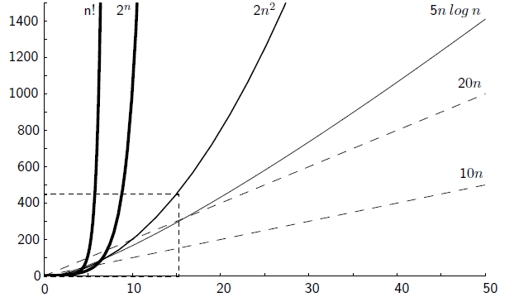
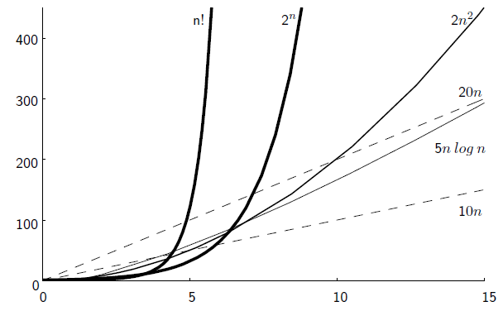
Figure 3.1 Growth Rate

Slide 14
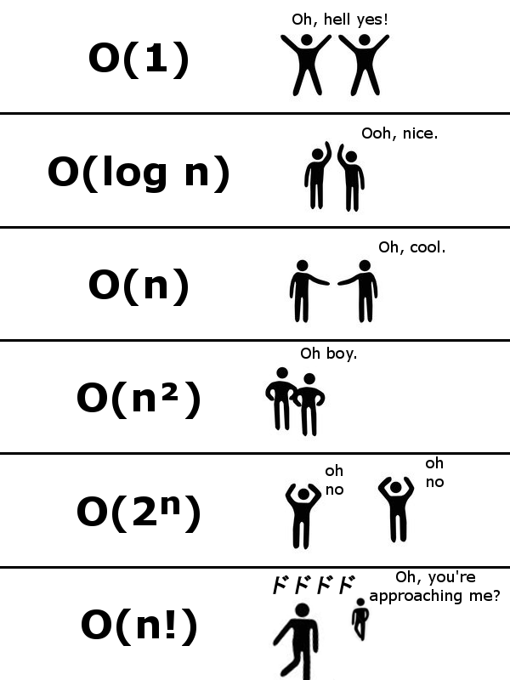

Slide 15
Common Growth Rates
Function | Growth Rate Name
c | Constant
log n | Logarithmic
log²n | Log-squared
n | Linear
n² | Quadratic
n³ | Cubic
2^{n} | Exponential

Slide 16
Best, Worst, and Average Cases
Best case: fastest time to complete, For example, the best case for a sorting algorithm would be data that's already sorted.
Best Case Analysis: In the best case analysis, we calculate lower bound on running time of an algorithm. We must know the case that causes minimum number of operations to be executed.
Worst case: slowest time to complete, For example, the worst case for a sorting algorithm might be data that's sorted in reverse order.
Worst Case Analysis: In the worst case analysis, we calculate upper bound on running time of an algorithm. We must know the case that causes maximum number of operations to be executed.
Average case: arithmetic mean. Run the algorithm many times, using many different inputs of size n that come from some distribution that generates these inputs, compute the total running time, and divide by the number of trials.
Average Case Analysis: In average case analysis, we take all possible inputs and calculate computing time for all of the inputs. Sum all the calculated values and divide the sum by total number of inputs.

Slide 17
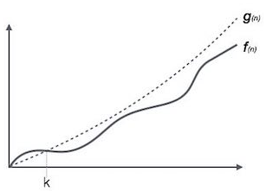
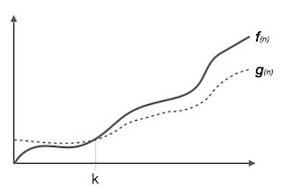
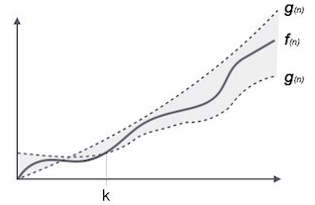
Asymptotic Notations
Asymptotic notations are mathematical tools to represent time complexity of algorithms for asymptotic analysis.
Following are the commonly used asymptotic notations to calculate the running time complexity of an algorithm.
Ο Notation
Ω Notation
θ Notation

Slide 18
Upper Bounds ( O Notation)
Several terms are used to describe the running-time equation for an algorithm.
One is the upper bound for the growth of the algorithm’s running time.
It measures the worst case time complexity or the longest amount of time an algorithm can possibly take to complete. (big-O notation).
If the upper bound for an algorithm’s growth rate is f(n), then this algorithm is “in the set O(f(n))in the worst case”
For example, if n² grows as fast as T(n) for the worst-case input, we would say the algorithm is “in O(n²) in the worst case.”
The worst case provides an upper bound for an algorithm.

Slide 19
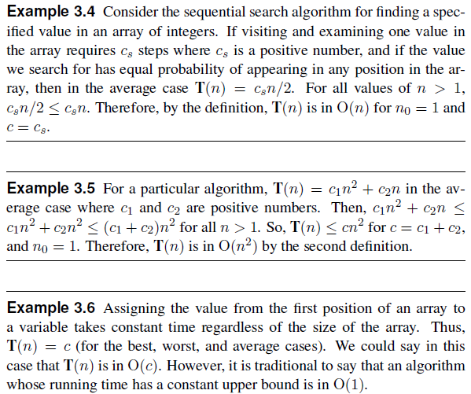

Slide 20
Upper Bounds (cont.)
Complexity and running time are often expressed in "Big O notation," which is used to describe the approximate amount of time an algorithm requires to complete, based the size of its input.
The most commonly used Big O descriptions are
O(1) always terminates in about the same amount of time, regardless of the input size.
O(N) takes twice as long to finish if the input size doubles.
O(N²) takes four times as long if the input size doubles.
O(2^{N}) increases exponentially as the input size increases.

Slide 21
The Execution Time and Cost of Algorithms
Each operation in an algorithm (or a program) has a cost.
Each operation takes a certain of time.
count = count + 1; take a certain amount of time, but it is constant.
A sequence of operations:
count = count + 1; Cost: c1
sum = sum + count; Cost: c2
Total Cost = c1 + c2 + ……..
.
.
.
.

Slide 22
The Execution Time and Cost of Algorithms (cont.)
Example: Simple If-Statement
Cost Times
if (n < 0) c1 1
var= -n c2 1
else
var = n; c3 1
Total Cost = c1 + max(c2,c3)
Contd.

Slide 23
The Execution Time and Cost of Algorithms (cont.)
Example: Simple Loop
Cost Times
i = 1; c1 1
sum = 0; c2 1
while (i <= n) { c3 n+1
i = i + 1; c4 n
sum = sum + i; c5 n
}
Total Cost = c1 + c2 + (n+1)*c3 + n*c4 + n*c5
The time required for this algorithm is proportional to n
Contd.

Slide 24
The Execution Time and Cost of Algorithms (cont.)
Example: Nested Loop
Cost Times
i=1; c1 1
sum = 0; c2 1
while (i <= n) { c3 n+1
j=1; c4 n
while (j <= n) { c5 n*(n+1)
sum = sum + i; c6 n*n
j = j + 1; c7 n*n
} c8 n
i = i +1;
}
Total Cost = c1 + c2 + (n+1)*c3 + n*c4 + n*(n+1)*c5+n*n*c6+n*n*c7+n*c8
The time required for this algorithm is proportional to n2
Contd.

Slide 25
Lower Bounds (Ω Notation)
Like big-Oh notation, it works for any resource, but often measure the least amount of time required. Like big-Oh notation, we are measuring the resource required for some particular class of inputs: input of size n.
The lower bound for an algorithm (or a problem) is denoted by the symbol Ω, pronounced “big-Omega” or just “Omega.”
It measures the best case time complexity or the best amount of time an algorithm can possibly take to complete.
The best case provides an lower bound for an algorithm.

Slide 26
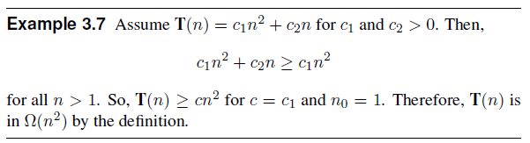
Lower Bounds (cont.)
This running time is in (n²).

Slide 27
ϴ Notation
The definitions for big-O and Ω give us ways to describe the upper bound for an algorithm (if we can find an equation for the maximum cost of a particular class of inputs of size n) and the lower bound for an algorithm (if we can find an equation for the minimum cost for a particular class of inputs of size n).
When the upper and lower bounds are the same within a constant factor, we indicate this by using ϴ(big-Theta) notation.
An algorithm is said to be ϴ(h(n)) if it is in O(h(n)) and it is in Ω(h(n)).
In other words, if f(n) is ϴ(g(n)), then g(n) is ϴ(f(n)).
Because the sequential search algorithm is both in O(n) and in Ω(n) in the average case, we say it is ϴ(n) in the average case.

Slide 28
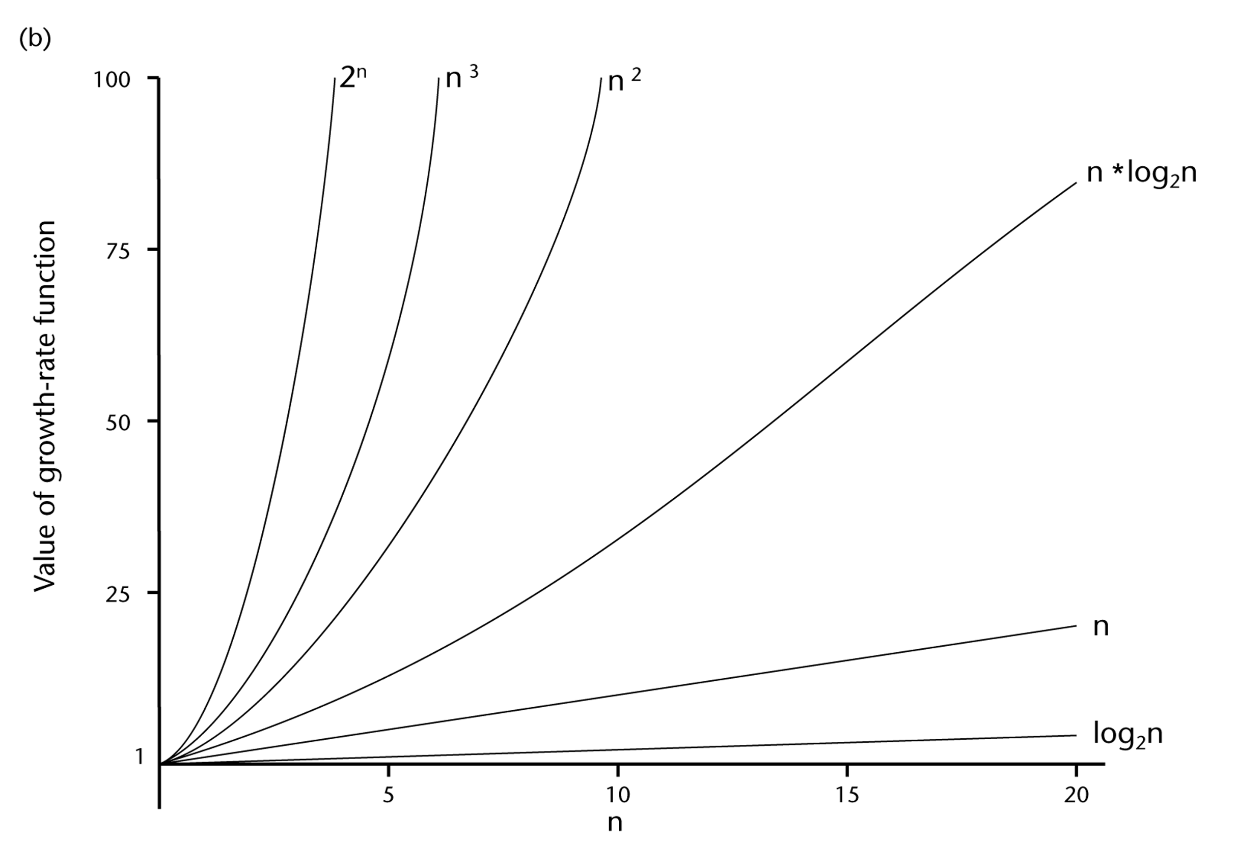
A Comparison of Growth-Rate Functions
Some common orders of growth seen often in complexity analysis are
O(1) | constant
O(log n) | logarithmic
O(n) | linear
O(n log n) | "n log n"
O(n²) | quadratic
O(n³) | cubic
O(2^{n}) | exponential
Contd.

Slide 29
Growth-Rate Functions
O(1) Time requirement is constant, and it is independent of the problem’s size.
O(log2n) Time requirement for a logarithmic algorithm increases slowly as the problem size increases.
O(n) Time requirement for a linear algorithm increases directly with the size
of the problem.
O(n*log2n) Time requirement for a n*log2n algorithm increases more rapidly than
a linear algorithm.
O(n2) Time requirement for a quadratic algorithm increases rapidly with the
size of the problem.
O(n3) Time requirement for a cubic algorithm increases more rapidly with the
size of the problem than the time requirement for a quadratic algorithm.
O(2n) As the size of the problem increases, the time requirement for an
exponential algorithm increases too rapidly to be practical.

Slide 30
Properties of Growth-Rate Functions
We can ignore low-order terms in an algorithm’s growth-rate function.
If an algorithm is O(n3+4n2+3n), it is also O(n3).
We only use the higher-order term as algorithm’s growth-rate function.
We can ignore a multiplicative constant in the higher-order term of an algorithm’s growth-rate function.
If an algorithm is O(5n3), it is also O(n3).
O(f(n)) + O(g(n)) = O(f(n)+g(n))
We can combine growth-rate functions.
If an algorithm is O(n3) + O(4n2), it is also O(n3 +4n2) ➔ So, it is O(n3).
Similar rules hold for multiplication.

Slide 31
Growth-Rate Functions – Example1
Cost Times
i = 1; c1 1
sum = 0; c2 1
while (i <= n) { c3 n+1
i = i + 1; c4 n
sum = sum + i; c5 n
}
T(n) = c1 + c2 + (n+1)*c3 + n*c4 + n*c5
= (c3+c4+c5)*n + (c1+c2+c3)
= a*n + b
So, the growth-rate function for this algorithm is O(n).

Slide 32
Growth-Rate Functions – Example2
Cost Times
i=1; c1 1
sum = 0; c2 1
while (i <= n) { c3 n+1
j=1; c4 n
while (j <= n) { c5 n*(n+1)
sum = sum + i; c6 n*n
j = j + 1; c7 n*n
} c8 n
i = i +1; }
T(n) = c1 + c2 + (n+1)*c3 + n*c4 + n*(n+1)*c5+n*n*c6+n*n*c7+n*c8
= (c5+c6+c7)*n² + (c3+c4+c5+c8)*n + (c1+c2+c3)
= a*n² + b*n + c
➔ So, the growth-rate function for this algorithm is O(n²)

Slide 33
Growth-Rate Functions – Example3
Cost Times
for (i=1; i<=n; i++) c1 n+1
for (j=1; j<=i; j++) c2
for (k=1; k<=j; k++) c3
x=x+1; c4
T(n) = c1*(n+1) + c2*( ) + c3* ( )+ c4*( )
= a*n³ + b*n² + c*n + d
So, the growth-rate function for this algorithm is O(n³)

Slide 34
What to Analyze
An algorithm can require different times to solve different problems of the same size.
Eg. Searching an item in a list of n elements using sequential search. ➔ Cost: 1,2,...,n
Worst-Case Analysis –The maximum amount of time that an algorithm require to solve a problem of size n.
This gives an upper bound for the time complexity of an algorithm.
Normally, we try to find worst-case behavior of an algorithm.
Best-Case Analysis –The minimum amount of time that an algorithm require to solve a problem of size n.
The best case behavior of an algorithm is NOT so useful.
Average-Case Analysis –The average amount of time that an algorithm require to solve a problem of size n.
Sometimes, it is difficult to find the average-case behavior of an algorithm.
We have to look at all possible data organizations of a given size n, and their distribution probabilities of these organizations.
Worst-case analysis is more common than average-case analysis.

Slide 35
Example of Case Analysis (Sequential Search)
int sequentialSearch(const int a[], int item, int n){
for (int i = 0; i < n && a[i]!= item; i++);
if (i == n)
return –1;
return i;
}
Unsuccessful Search: ➔ O(n)
Successful Search:
Best-Case: item is in the first location of the array ➔O(1)
Worst-Case: item is in the last location of the array ➔O(n)
Average-Case: The number of key comparisons 1, 2, ..., n ➔ O(n)

Slide 36
Tutorial IV
Next Week ,
Lab and Revision

