Slide 1
Programming Language III

Slide 2
Learning Outcomes
1. Create Java application programs using sound OOP practices and proper program structuring
2. Realize and use basic program controls and operators
3. Have competence in the use of the Java programming language for the development of small to medium sized application programs
4. Understand basic principles of the object oriented development process and apply this understanding to the analysis and design of solutions for small scale problems.

Slide 3
Exam and Grading System
Task | Mark
Final Exam | 60%
Practical Assignments (Project + Assignments) | 20%
Lab Test | 20%

Slide 4
Lecture 1 Overview of Java, Variables, Data Types and Arrays

Slide 5
Outline of Class (Lecture 1)
Overview of Java
Data types
Variables
Arrays

Slide 6
Topic 1 Overview of Java

Slide 7
What is Java?
A programming language and a computing platform to develop applications
An object-oriented language similar to C++ with advanced and simplified features
Platform independent, “Write once, Run anywhere”
Developed by Sun Microsystems
Designed for easy Web/Internet applications
Widespread acceptance
Derive much characters from C and C++

Slide 8
Java Platform
The computing platform from Oracle that helps users to run and develop Java applications
Consists of two essential parts
Java Runtime Environment (JRE), which is needed to run Java applications and applets; and,
Java Development Kit (JDK), which is needed to develop those Java applications and applets

Slide 9

Java Runtime Environment (JRE) (cont’)
Just-in-time Compiler (JIT Compiler)
A more robust JVM introduced since version 1.2
Instead of interpreting byte-code, it down-right converts the code straight into equivalent native code for the local system, called JIT-compilation.
This process only occurs when the byte-code is executed for the first time.
Unless the byte-code itself is changed, the JVM uses the compiled version of the byte-code on every successive execution.
Saves a lot of time and processor effort, allowing applications to execute much faster at the cost of a small delay on first execution.
Java Runtime Environment
JIT Compiler
Native App
Local
Machine
First Use
Successive Use
Java Byte-code
Bypass compilation
Java Virtual Machine

Slide 10
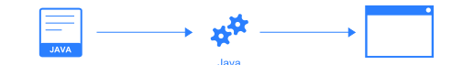
Java Development Kit (JDK)
For writing pure code in Java which can then be converted into Java byte-code for mass deployment
A tool to compile, document and package java programs.
Java Compiler
The Java compiler tool (named javac in the JDK) is the most important utility found with the JDK to compile Java Source files to Java Byte-code.
This process of converting Java source files into their equivalent byte-codes is known as compilation.
e.g,
javac SampleProgram.java → SampleProgram.class
SampleProgram.java
SampleProgram.class
Java Source
Java Compiler
Java Byte-Code

Slide 11
Major Editions of Java
Java 2 Standard Edition (J2SE): This is the most commonly used form of Java technology. Also referred to as Java Development Kit (JDK), J2SE is a software development kit that includes a set of APIs, tools, and a runtime for developing general-purpose applications.
Java 2 Enterprise Edition (J2EE): J2EE is the basis for Java-based enterprise applications which specifies a standard for developing multi-tier distributed component-based applications. It provides an integrated technical framework for developing Internet-enabled enterprise, and e-commerce applications.
Java 2 Micro Edition (J2ME): J2ME provides a lightweight and optimized Java environment for developing applications for mobile devices.

Slide 12
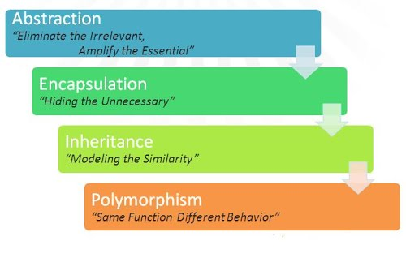
Four Main OOP Principles
Abstraction
Encapsulation
Inheritance and
Polymorphism

Slide 13
Basic Syntax of Java
Case Sensitivity − Java is case sensitive, which means identifier Hello and hello would have different meaning in Java.
Class Names − For all class names the first letter should be in Upper Case. If several words are used to form a name of the class, each inner word's first letter should be in Upper Case. Eg. class MyFirstJavaClass
Method Names − All method names should start with a Lower Case letter. If several words are used to form the name of the method, then each inner word's first letter should be in Upper Case. Eg. public void myMethodName()
Program File Name − Name of the program file should exactly match the class name.(if the file name and the class name do not match, your program will not compile). E.g Assume 'MyFirstJavaProgram' is the class name. Then the file should be saved as 'MyFirstJavaProgram.java'
public static void main(String args[]) − Java program processing starts from the main() method which is a mandatory part of every Java program.

Slide 14
A Simple Java Program
Basic syntax of a Java Class
< modifier> class < name>
{
< attribute_declaration>*
< constructor_declaration>*
< method_declaration>*
}

Slide 15
A Simple Java Program
/*
This is a simple Java program.
Call this file "Example.java".
*/
class Example {
// Your program begins with a call to main().
public static void main(String args[]) {
System.out.println("This is a simple Java program.");
}
}
Block comments
Class name
Single line Comment
Main Method

Slide 16
Programming Errors
Syntax Error or Compiled Error
Errors that are detected by the compiler
Runtime Errors
Runtime errors are errors that cause a program to terminate abnormally
Eg. input error, division by zero
Logic Errors
Logic errors occur when a program does not perform the way it was intended to
public class ShowSyntaxErrors {
public static main(String[] args) {
System.out.println("Welcome to Java);
}
}
missing void
missing closing quotation mark

Slide 17
Topic 2 Variables, Data Types and Arrays

Slide 18
Identifiers
Identifiers are the names that identify the elements such as classes, methods, and variables in a program.
Eg. class MyProgram
All identifiers must obey the following rules:
A sequence of characters that consists of letters, digits, underscores (_), and dollar signs ($).
Must start with a letter, an underscore (_), or a dollar sign ($). It cannot start with a digit.
Cannot be a reserved word.
Cannot be true, false, or null.
Can be of any length.

Slide 19
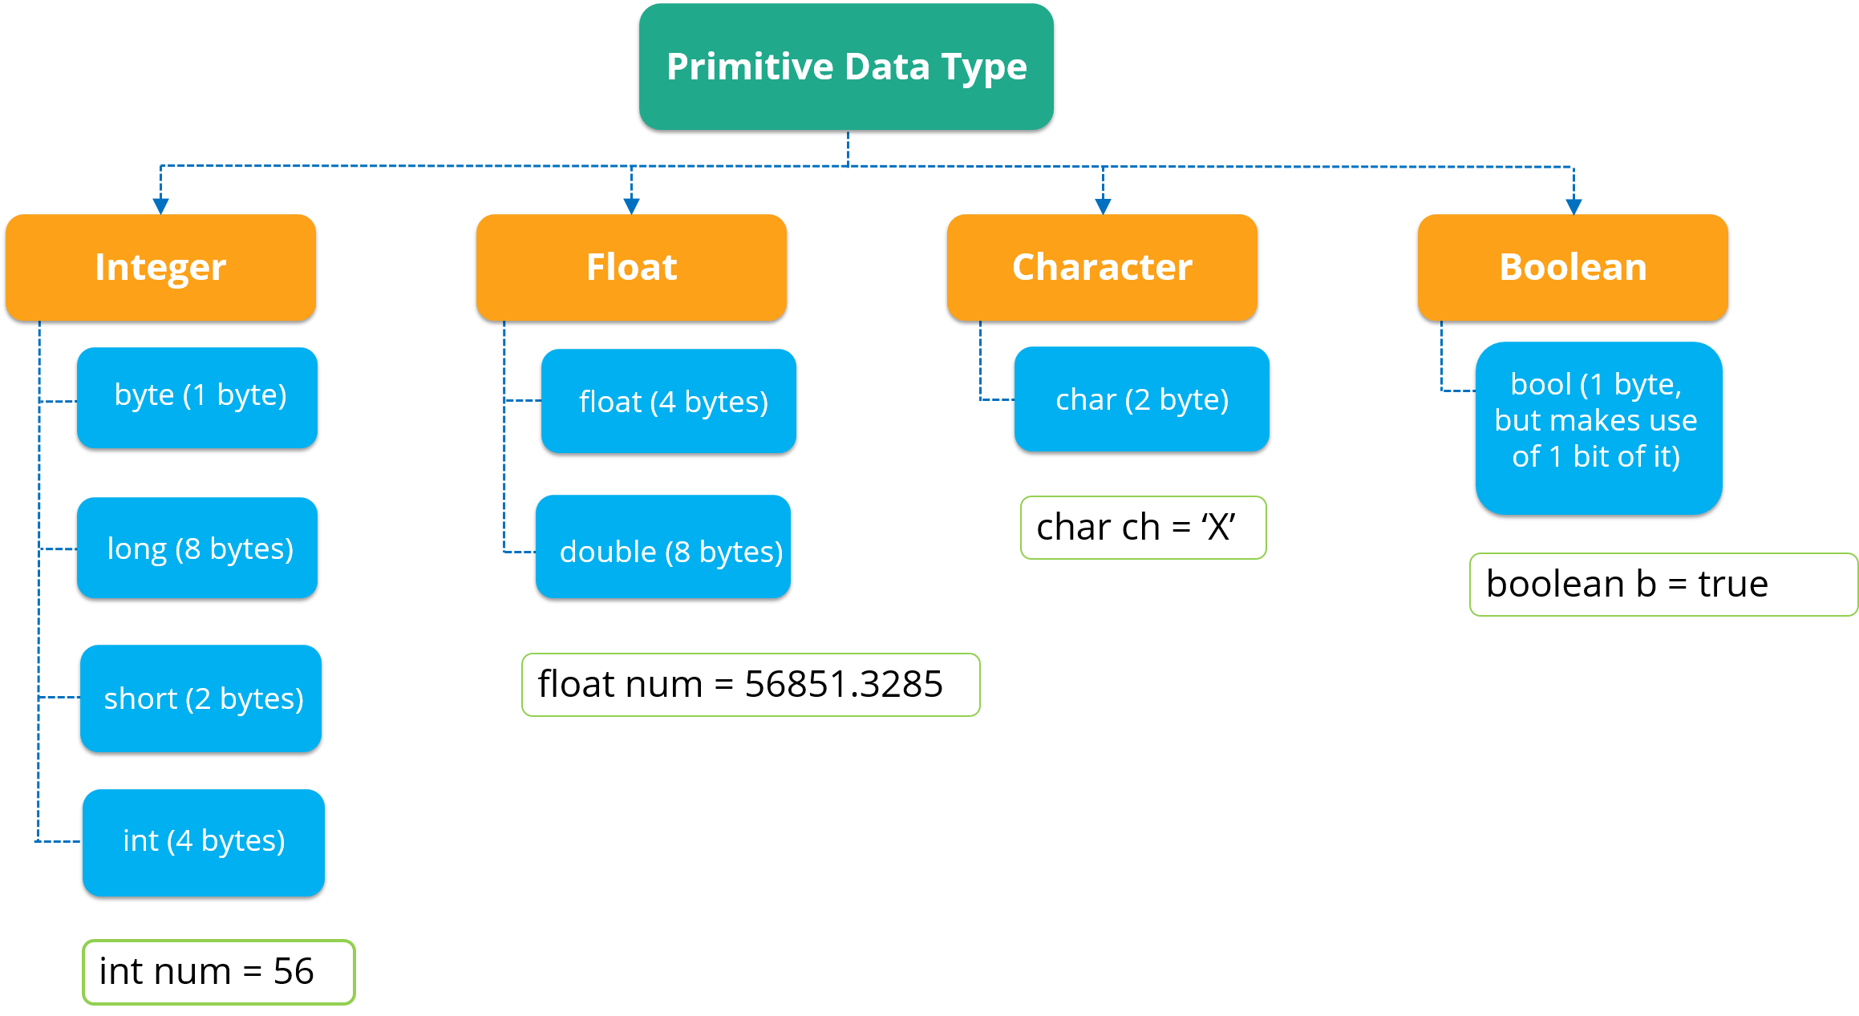
Primitive Data Types

Slide 20
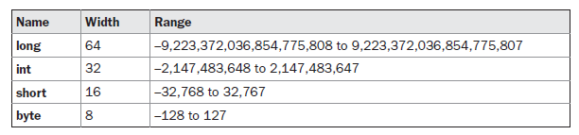

Range of Data Types
Integer
Floating-point

Slide 21
Example 1: Write a program that computes the number of miles that light will travel in 1000 days. Approximate speed of light in miles per second is 186000.
// Compute distance light travels using long variables.
class Light {
public static void main(String args[]) {
int lightspeed;
long days;
long seconds;
long distance;
// approximate speed of light in miles per second
lightspeed = 186000;
days = 1000; // specify number of days here
seconds = days * 24 * 60 * 60; // convert to seconds
distance = lightspeed * seconds; // compute distance
System.out.print("In " + days);
System.out.print(" days light will travel about ");
System.out.println(distance + " miles.");
}
}
Output
In 1000 days light will travel about 16070400000000 miles.

Slide 22
Example 2: Write a program to compute the area of the circle. Size of radius is 10.
// Compute the area of a circle.
class Area {
public static void main(String args[]) {
double pi, r, a;
r = 10.8; // radius of circle
pi = 3.1416; // pi, approximately
a = pi * r * r; // compute area
System.out.println("Area of circle is " + a);
}
}
Output
Area of circle is 366.436224

Slide 23
Variables
A memory location with a name and can be manipulated by programs
For representing data of a certain type
datatype identifier;
datatype identifier1, identifier2, … , identifier_n;
int a, b, c; // declares three ints, a, b, and c.
int d = 3, e, f = 5; // declares three more ints, initializing d and f.
Four kinds of variables in Java
Static
Non-static
Local
Parameters

Slide 24
Variables (cont’)
Static
Variables declared inside the class and outside methods, with the modifier “static”
Any changes on static variable by an instance of the class is reflected in all other instances of the class
“final” modifier should be used during variable declaration to avoid changing the value and to keep it constant
Non-static
Variables declared inside the class and outside methods, without the modifier “static”
Variable value could differ from one instance to another instance of the same class
Local
Variables declared inside methods
Parameters
These variables are declared in the signature of a method or constructor or even in exception handlers

Slide 25
Variables (cont’)
public class Employee {
public String name; //Non-static variable
static final String dept= “IT”; //Static variable which cannot be changed
private double salary; //Non-static variable
public Employee (String empName) //Parameter
{
name = empName;
}
public void setSalary(double empSal) {
int rate=40; //Local variable
salary = empSal * rate;
}
public static void main(String args[]) {
Employee empOne = new Employee("Ransika");
empOne.setSalary(1000);
}
}

Slide 26
The Scope and Lifetime of Variables
class Scope {
int z; //Known to all instances of the class
public static void main(String args[]) {
int x; // known to all code within main
x = 10;
if(x == 10) {
int y = 20; // known only to this block
// x and y both known here.
System.out.println("x and y: " + x + " " + y);
x = y * 2;
}
y = 100; // Error! y not known here
int y=100; //Error! Cannot declare a variable to have
the same name as one in an outer scope
// x is still known here.
System.out.println("x is " + x);
}
}
“ Variables declared inside a scope are not visible (that is, accessible) to
code that is defined outside that scope”

Slide 27
The Scope and Lifetime of Variables (cont’)
// Demonstrate lifetime of a variable.
class LifeTime
{
public static void main(String args[])
{
int x;
for(x = 0; x < 3; x++)
{
int y = -1; // y is initialized each time block is entered
System.out.println("y is: " + y); // this always prints -1
y = 100;
System.out.println("y is now: " + y);
}
}
}

Slide 28
Type Conversion and Casting
Automatic Conversion
The two types are compatible
The destination type is larger than the source type
eg. double d;
int i=90;
d=i;
Casting Incompatible Types
(target type) value
int a;
byte b;
b=(byte) a;
Automatic Type Promotion
All byte and short values are promoted to int.
If one operand is a long, the whole expression is promoted to long.
If one operand is a float, the entire expression is promoted to float.
If any of the operands is double, the result is double.

Slide 29
// Demonstrate Type casts.
class Conversion{
public static void main(String args[]) {
byte b;
int i = 257;
double d = 323.142;
System.out.println("\n Conversion of int to byte.");
b = (byte) i;
System.out.println("i and b " + i + " " + b);
System.out.println("\nConversion of double to int.");
i = (int) d;
System.out.println("d and i " + d + " " + i);
System.out.println("\n Conversion of double to byte.");
b = (byte) d;
System.out.println("d and b " + d + " " + b);
}
}
i and b 257 1
d and i 323.142 323
d and b 323.142 67

Slide 30
//Demonstrate type promotion
class Promote {
public static void main(String args[])
{
byte b = 42;
char c = 'a';
short s = 1024;
int i = 50000;
float f = 5.67f;
double d = .1234;
double result = (f * b) + (i / c) - (d * s);
System.out.println((f * b) + " + " + (i / c) + " - " + (d * s));
System.out.println("result = " + result);
}
}
float
int
double
result = double

Slide 31
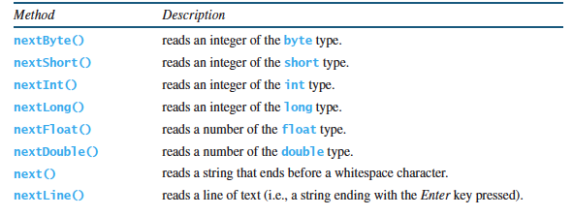
Reading Input from the Console
System.out : the standard output device (display monitor )
System.in : the standard input device (the keyboard)
Console input is not directly supported in Java, but can use the Scanner class to create an object to read input from System.in
Scanner input = new Scanner(System.in);
Methods for Scanner Object

Slide 32
Example 3: Write a program that reads radius input from the keyboard and computes the area of the circle.
//Read radius input from keyboard and compute area of circle.
import java.util.*;
public class ComputeArea{
public static void main(String[] args) {
// Create a Scanner object
Scanner input = new Scanner(System.in);
// Prompt the user to enter a radius
System.out.print("Enter a number for radius: ");
// Read double input
double radius =input.nextDouble();
// Compute area
double area = radius * radius * 3.14159;
// Display results
System.out.println("The area for the circle of radius " +
radius + " is " + area);
}
}

Slide 33
Next Week Lecture
Operators
Control Statements
Thank you!

