Slide 1
Programming Language III

Slide 2
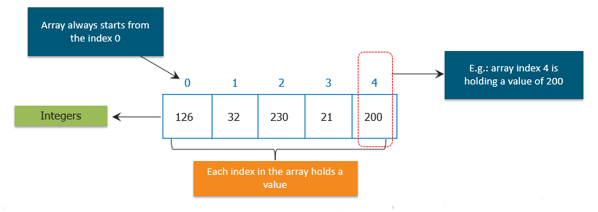
Arrays
A group of like-typed variables that are referred to by a common name.
May have one or more dimensions.
A specific element in an array is accessed by its index.
Offer a convenient means of grouping related information.

Slide 3
Declaring and Creating Arrays
Declare an array variable
dataType[] arrayName; //preferred) (or)
dataType arrayName[ ];
int[ ] days; or int days[ ];
Creating an array via the new keyword
arrayName = new dataType[size];
days=new int[5];
Steps 1+2 →
dataType arrayNam[ ]=new dataType[size];
int days[ ]=new int[5];

Slide 4
Initializing Arrays
When an array is created, the elements are assigned default values for its primitive types: 0 for int, 0.0 for double, ‘\u0000’ for char, and false for Boolean type.
Assigning new values to the elements:
or
Getting size/length of array
arrayName.length( ) eg. days.length( )
days[0] = 11;
days [1] = 12;
days [2] = 13;
days [3] = 14;
days [4] = 15;
int[ ] days = {11,12,13,14,15};

Slide 5
Processing Arrays
1. Initializing arrays with input values:
2. Displaying arrays
double[ ] myList = new double[10];
java.util.Scanner input = new java.util.Scanner(System.in);
System.out.print("Enter " + myList.length + " values: ");
for (int i = 0; i < myList.length; i++)
myList[i] = input.nextDouble();
for (int i = 0; i < myList.length; i++)
{
System.out.print(myList[i] + " ");
}

Slide 6
Processing Arrays (cont’)
3. Summing all elements
4. Finding the largest element
double total = 0;
for (int i = 0; i < myList.length; i++)
{
total += myList[i];
}
double max = myList[0];
for (int i = 1; i < myList.length; i++)
{
if (myList[i] > max)
max = myList[i];
}

Slide 7
// Demonstrate a one-dimensional array. A program that creates an array of number of days in each month
class OneDArray
{
public static void main(String args[])
{
int month_days[]= new int[ 12];
month_days[0] = 31;
month_days[1] = 28;
month_days[2] = 31;
month_days[3] = 30;
month_days[4] = 31;
month_days[5] = 30;
month_days[6] = 31;
month_days[7] = 31;
month_days[8] = 30;
month_days[9] = 31;
month_days[10] = 30;
month_days[11] = 31;
System.out.println("April has " + month_days[3] + " days.");
}
}
int month_days[] = { 31, 28, 31, 30, 31, 30, 31, 31, 30, 31, 30, 31 };

Slide 8
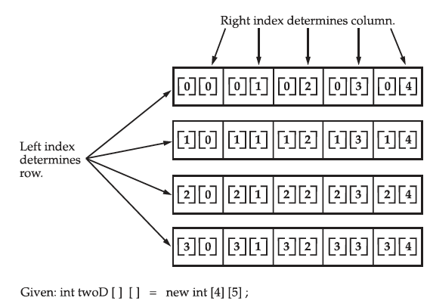
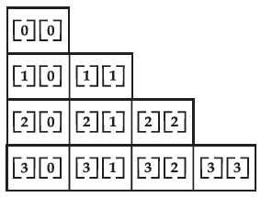
Multidimensional Array
Array of arrays
dataType arrayName[ ][ ]=new dataType[row][column]
Right index determines column
Left index determines row
Given: int twoD [ ] [ ] = new int [4][5];
int twoD[ ][ ]=new int[4][ ];
Two dimensional arrays with equal sized second dimension
Two dimensional arrays with unequal sized second dimension

Slide 9
Output
0 1 2 3 4
5 6 7 8 9
10 11 12 13 14
15 16 17 18 19
//Demonstrate a two-dimensional array.
class TwoDArray
{ public static void main(String args[])
{
int twoD[][]= new int[4][5];
int i, j, k = 0;
for(i=0; i<4; i++)
for(j=0; j<5; j++)
{
twoD[i][j] = k;
k++;
}
for(i=0; i<4; i++)
{
for(j=0; j<5; j++)
System.out.print(twoD[i][j] + " ");
System.out.println();
}
}
}

Slide 10
//Demonstrate an unequal size two-dimensional array.
class TwoDAgain
{
public static void main(String args[])
{
int twoD[][] = new int[4][];
twoD[0] = new int[1];
twoD[1] = new int[2];
twoD[2] = new int[3];
twoD[3] = new int[4];
int i, j, k = 0;
for(i=0; i<4; i++)
for(j=0; j<i+1; j++)
{
twoD[i][j] = k;
k++;
}
for(i=0; i<4; i++)
{
for(j=0; j<i+1; j++)
System.out.print
(twoD[i][j] + " ");
System.out.println();
}
}
}
Output
0
1 2
3 4 5
6 7 8 9

Slide 11
Example 4. Write a program to find an element of an array using the sequential search algorithm.
public class SquentialSearch{
public static void main(String[] args){
int[] arr={23,2,4,56,80,23,4,5,6,10};
int pos=seqsearch(arr,56, arr.length); //call method for sequential search
if(pos!=-1)
System.out.println(" The values is found at the position of "+ pos);
}
//Method for sequential search
public static int seqsearch(int[ ] dataset,int target,int n){
int found=0;
int i;
int pos=-1;
for(i=0;i<n && found!=1;i++)
if(target==dataset[i])
{
pos=i;
found=1;
}
return pos;
}
}

Slide 12
Next Week Lecture
Operators
Control Statements
Thank you!

