Slide 1
Programming in Java

Slide 2
Topic 1 Inheritance

Slide 3
Inheritance
Object-oriented programming allows you to define new classes from existing classes, called inheritance.
It helps to reuse the code and establish a relationship between different classes.
A class can be defined as a "subclass" of another class.
The subclass inherits all data attributes of its superclass
The subclass inherits all methods of its superclass
The subclass inherits all associations of its superclass
The subclass can:
Add new functionality
Use inherited functionality
Override inherited functionality

Slide 4
Terms used in Inheritance
Class: A class is a group of objects which have common properties. It is a template or blueprint from which objects are created.
Sub Class/Child Class: Subclass is a class which inherits the other class. It is also called a derived class, extended class, or child class.
Super Class/Parent Class: Superclass is the class from where a subclass inherits the features. It is also called a base class or a parent class.
superclass
Person
- name: String
- dob: Date
subclass
Employee
- employeeID: int
- salary: int
- startDate: Date

Slide 5
How inheritance is used in Java
Inheritance is declared using the "extends" keyword
If inheritance is not defined, the class extends a class called Object
public class Person
{
private String name;
private Date dob;
[...]
Person
- name: String
- dob: Date
public class Employee extends Person
{
private int employeID;
private int salary;
private Date startDate;
[...]
Employee
- employeeID: int
- salary: int
- startDate: Date
Employee anEmployee = new Employee();

Slide 6
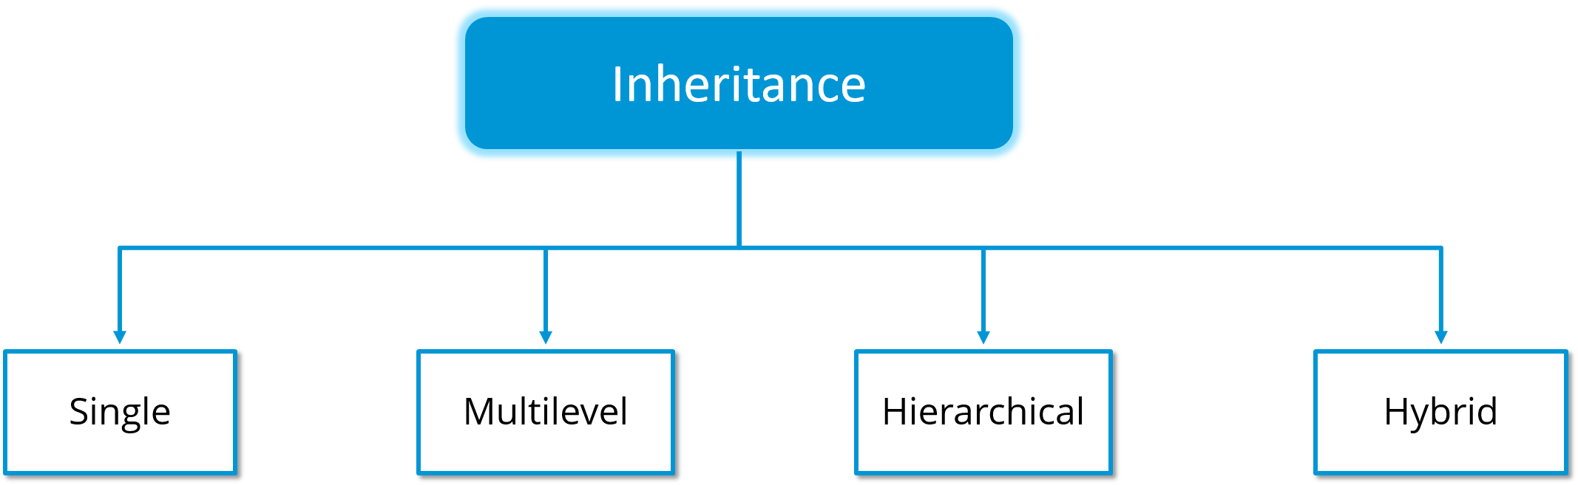
Types of Inheritance
Single
Multilevel
Hierarchical
Hybrid

Slide 7
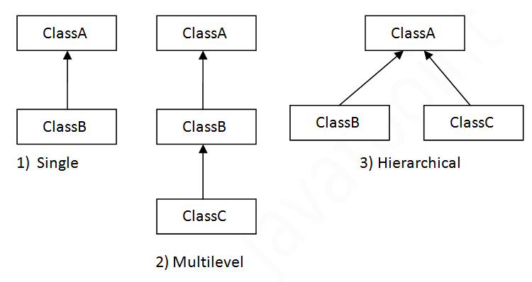
Types of Inheritance
Single Level Inheritance
class Animal{
void eat(){System.out.println("eating...");}
}
class Dog extends Animal{
void bark(){System.out.println("barking...");}
}
class TestInheritance{
public static void main(String args[]){
Dog d=new Dog();
d.bark();
d.eat();
}
}

Slide 8
Types of Inheritance
2. Multilevel Inheritance
class Animal{
void eat(){System.out.println("eating...");}
}
class Dog extends Animal{
void bark(){System.out.println("barking...");}
}
class BabyDog extends Dog{
void weep(){System.out.println("weeping...");}
}
class TestInheritance2{
public static void main(String args[]){
BabyDog d=new BabyDog();
d.weep();
d.bark();
d.eat();
}}

Slide 9
Types of Inheritance
3. Hierarchical Inheritance
class Animal{
void eat(){System.out.println("eating...");}
}
class Dog extends Animal{
void bark(){System.out.println("barking...");}
}
class Cat extends Animal{
void meow(){System.out.println("meowing...");}
}
class TestInheritance3{
public static void main(String args[]){
Cat c=new Cat();
c.meow();
c.eat();
//c.bark();//Error
}}

Slide 10
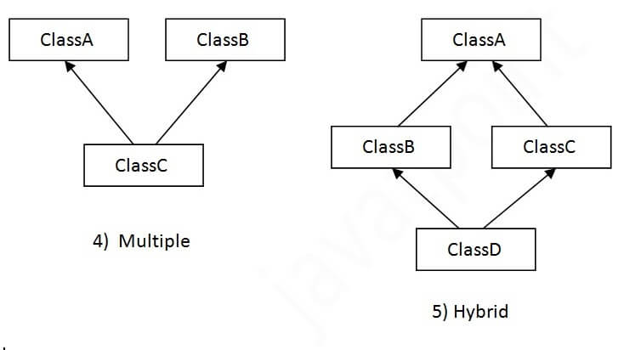
Types of Inheritance
4. Hybrid
Not supported in Java, only possible with ‘interfaces’
E.g. Class D inherits both Class B and Class C
If B and C classes have the same method and you call it from child class object, there will be ambiguity to call the method of A or B class
Java renders compile-time error if you inherit 2 classes
Hybrid

Slide 11
Using Super
The keyword super refers to the superclass and can be used to invoke the superclass’s methods and constructors
It can be used in two ways:
To call a superclass constructor
To call a superclass method
Calling Superclass Constructors
Unlike properties and methods, the constructors of a superclass are not inherited by a subclass.
They can only be invoked from the constructors of the subclasses using the keyword super. (*Default constructor of parent class is invoked by child class automatically)
super(), or super(parameters);
invokes the no-arg constructor of its superclass
invokes the superclass constructor that matches the arguments

Slide 12
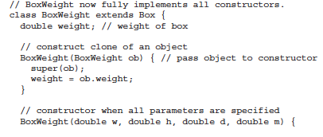
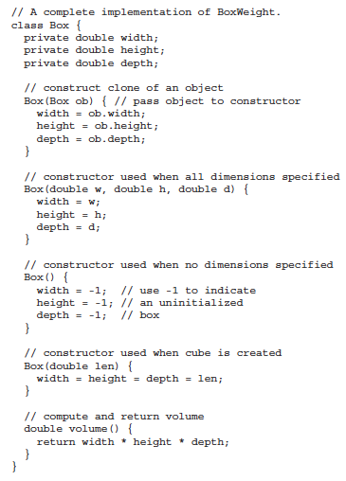
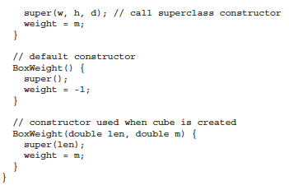
Example 4.1: Demonstrate the use of Super
width=w;
height=h;
depth=d;

Slide 13
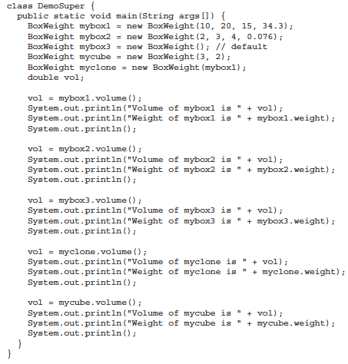

Slide 14

Example 4.2: Using super to access Superclass’s instance variables and methods
class A {
int i;
}
// Create a subclass by extending class A.
class B extends A {
int i; // this i hides the i in A
B(int a, int b) {
super.i = a; // i in A
i = b; // i in B
}
void show() {
System.out.println("i in superclass: " + super.i);
System.out.println("i in subclass: " + i);
}
}
class UseSuper {
public static void main(String args[]) {
B subOb = new B(1, 2);
subOb.show();
}
}
Output

Slide 15
Constructor Chaining
When constructing an object of a subclass
The subclass constructor first invokes its superclass constructor before performing its own tasks.
If the superclass is derived from another class, the superclass constructor invokes its parent-class constructor before performing its own tasks.
This process continues until the last constructor along the inheritance hierarchy is called. This is called constructor chaining .
If a call to super is not made, the system will automatically attempt to invoke the no-argument constructor of the superclass.
If a class is designed to be extended, it is better to provide a no-arg constructor to avoid programming errors.

Slide 16
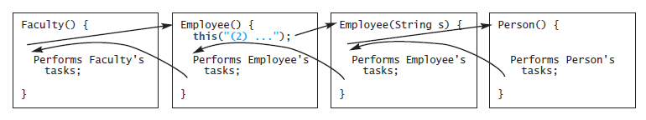
public class Faculty extends Employee{
public static void main(String[] args) {
new Faculty();
}
public Faculty() {
System.out.println("(4) Performs Faculty's tasks");
}
}
class Person {
public Person(){
System.out.println("(1) Performs Person's tasks");
}
}
class Employee extends Person {
public Employee(){
this("(2) Invoke Employee's overloaded constructor");
System.out.println("(3) Performs Employee's tasks ");
}
public Employee(String s){
System.out.println(s);
}
}
Constructor Chaining

Slide 17

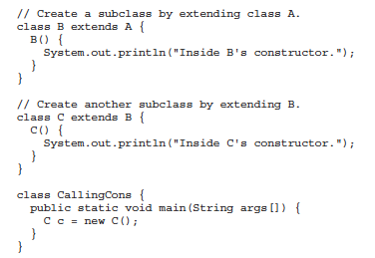
Example 4.3: Demonstrate constructor chaining
Output
Inside A’s constructor.
Inside B’s constructor.
Inside C’s constructor.

