Slide 1
Programming in Java

Slide 2
Polymorphism

Slide 3
Polymorphism
Polymorphism in Java is of two types:
Run time polymorphism
Refers to a process in which a call to an overridden method is resolved at runtime rather than at compile-time.
Method overriding is an example of run time polymorphism.
Compile time polymorphism
Refers to a process in which a call to an overloaded method is resolved at compile time rather than at run time
Method overloading is an example of compile time polymorphism

Slide 4
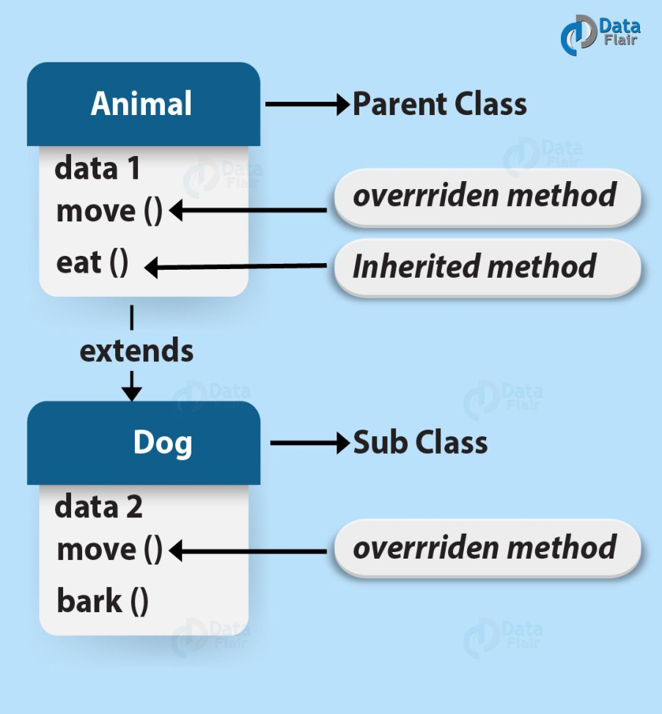
Method Overriding
Subclasses inherit all methods from their superclass
Sometimes, the implementation of the method in the superclass does not provide the functionality required by the subclass.
In these cases, the method must be overridden.
To override a method, provide an implementation in the subclass.
The method in the subclass MUST have the exact same signature as the method it is overriding.

Slide 5
Example 4.4: A program that demonstrates method overriding.
class Parent
{
void show()
{
System.out.println("Parent's show()");
}
}
class Child extends Parent
{
@Override
void show()
{
System.out.println("Child's show()");
}
class Main
{
public static void main(String[] args)
{
Parent obj1 = new Parent();
obj1.show();
Parent obj2 = new Child();
obj2.show();
}
}
← This method overrides show() of Parent
←Inherited class
If a Parent type reference refers to a Parent object, then Parent's show is called
If a Parent type reference refers a Child object Child's show() is called.

Slide 6
Rules for Method Overriding in Java
Final Methods cannot be Overridden Methods
When we don’t want the method to be overridden we declare it as final.
Static Methods cannot be Overridden
Private Methods cannot be Overridden Method
Overriding Method must have the same Return Type or Subtype
Invoking Overridden Method from Sub-Class
To call the parent class method during overriding we use the keyword super.

Slide 7
Method Overloading
Overloading is the Java method which allows the methods to have a similar name but with the difference in signatures which is by input parameters
Overloading supports compile (static) polymorphism in Java

Slide 8
Example 4.5: A program that demonstrates method overloading.
public class Sum
{
public int sum(int x, int y)
{
return (x + y);
}
public int sum(int x, int y, int z)
{
return (x + y + z);
}
public double sum(double x, double y)
{
return (x + y);
}
public static void main(String args[])
{
Sum s = new Sum();
System.out.println(s.sum(10, 20));
System.out.println(s.sum(10, 20, 30));
System.out.println(s.sum(10.5, 20.5));
}
}
Overloaded sum(). This sum takes two int parameters
Overloaded sum(). This sum takes three int parameters
Overloaded sum(). This sum takes two double parameters

Slide 9
Different Methods of Method Overloading
By number of parameters in two methods
public int add(int a, int b)
public int add(int a, int b, int c)
By data types of the parameters of methods
public int add(int a, int b, int c)
public double add(double a, double b, double c)
By order of the parameters of methods
public void display(String a, int b)
public void display(int b, String a)

Slide 10
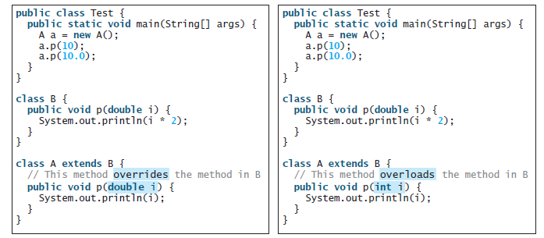
Method Overriding and Overloading
Overridden methods are in different classes related by inheritance; overloaded methods can be either in the same class or different classes related by inheritance.
Overridden methods have the same signature and return type; overloaded methods have the same name but a different parameter list.
Overriding
Overloading

Slide 11
Exercise 4.1. Design a class named BankAccount and its subclass OverdraftAccount.
BankAccount class has
instance variables: ownersName, accountNumber, balance,
three argument constructor and
methods: deposit(double anAmount), withdraw(double anAmount) and getBalance() which returns the current balance. deposit method adds deposit amount(anAmount) to the current balance if deposit amount is above 0.0. withdraw method updates the current balance by subtracting withdraw amount(anAmount) from it if the withdraw amount does not exceeds the current balance.
For OverdraftAccount,
there is one instance variable called limit which is used to limit the withdraw amount of OverdraftAccount holders.
Override the withdraw method of its superclass to add limit to the withdraw amount.
Then, write a main method which creates one BankAccount object and OverdraftAccount object, do deposits and printout balance, and do withdraws and printout balance.

Slide 12
class BankAccount
{
private String ownersName;
private int accountNumber;
protected float balance;
BankAccount(String oName,int accNumber, double b)
{
ownersName=oName;
accountNumber=accNumber;
balance=b;
}
public void deposit(float anAmount)
{
if (anAmount>0.0)
balance = balance + anAmount;
}
public void withdraw(double anAmount)
{
if ((anAmount>0.0) && (balance>anAmount))
balance = balance - anAmount;
}
public float getBalance()
{
return balance;
}
}

Slide 13
public class OverdraftAccount extends BankAccount
{
private double limit;
OverdraftAccount(String oName,int accNumber,double b,double l)
{
super(oName,accNumber,b);
limit=l;
}
@Override
public void withdraw(double anAmount)
{
if ((anAmount>0.0) && (getBalance()>anAmount) && anAmount<limit)
balance = balance - anAmount;
}
public static void main(String args[])
{
BankAccount ba=new BankAccount("Hla Hla", 123, 600);
OverdraftAccount oa=new OverdraftAccount("Mya Mya", 456, 6000, 1000);
ba.deposit(300000);
oa.deposit(600000);
System.out.println("Current balance of first account is "+ ba.getBalance());
System.out.println("Current balance of first account is "+ oa.getBalance());
ba.withdraw(300000);
oa.withdraw(600000);
System.out.println("Current balance of first account is "+ ba.getBalance());
System.out.println("Current balance of first account is "+ oa.getBalance());
}}

Slide 14
Topic 3 Abstraction

Slide 15
Using Abstract Classes
Define generalized form that will be shared by all of its subclasses, leaving it to each subclass to fill in the details
Determine the nature of the methods that the subclasses must implement
Java Abstract class is used for abstraction in Java
They are meant to hide the internal implementation and only showing the functionality to the users, i.e. showing what is works and hiding how it works.
When to use?
When some classes need to share some codes then we put these classes in abstract classes.
When a state of an object is to define because we need to define a non-static or non-final fields.
abstract type name (parameter-list)

Slide 16
Example 4.6: A program that demonstrates using Abstract class and methods.
// Using abstract methods and classes.
abstract class Figure {
double dim1;
double dim2;
Figure(double a, double b) {
dim1 = a;
dim2 = b;
}
// area is now an abstract method
abstract double area();
}
class Rectangle extends Figure {
Rectangle(double a, double b) {
super(a, b);
}
// override area for rectangle
double area() {
System.out.println("Inside Area for Rectangle.");
return dim1 * dim2;
}
}

Slide 17
class Triangle extends Figure {
Triangle(double a, double b) {
super(a, b);
}
// override area for right triangle
double area() {
System.out.println("Inside Area for Triangle.");
return dim1 * dim2 / 2;
}
}
class AbstractAreas {
public static void main(String args[]) {
// Figure f = new Figure(10, 10); // illegal now
Rectangle r = new Rectangle(9, 5);
Triangle t = new Triangle(10, 8);
Figure figref; // this is OK, no object is created
figref = r;
System.out.println("Area is " + figref.area());
figref = t;
System.out.println("Area is " + figref.area());
}
}

Slide 18
Using final
To prevent Overriding
Methods can be qualified with the final modifier
Final methods cannot be overridden.
This can be useful for security purposes.
public final boolean validatePassword(String username, String Password)
{
[...]
To prevent Inheritance
Classes can be qualified with the final modifier
The class cannot be extended
This can be used to improve performance.
public final class Color
{
[...]

Slide 19
Topic 4 Encapsulation

Slide 20
Encapsulation
The process in which we wrap the data into a single unit.
Encapsulation binds the data and code.
It basically creates a shield and code cannot be accessed outside the shield or by any code outside the shield
We can achieve encapsulation in Java by:
Declaring the variables of a class as private.
Providing public setter and getter methods to modify and view the variables values.

Slide 21
Data Field Encapsulation
Accessor and Mutator
To make a private data field accessible, provide a get method (accessor) to return the value of the data field.
To enable a private data field to be updated, provide a set method (mutator) to set a new value.
A get method is referred to as a getter (or accessor), and a set method is referred to as a setter (or mutator).
A get method has the following signature:
public returnType getPropertyName()
If the returnType is boolean, the get method should be defined as follows by convention:
public boolean isPropertyName()
A set method has the following signature:
public void setPropertyName(dataType propertyValue)

Slide 22
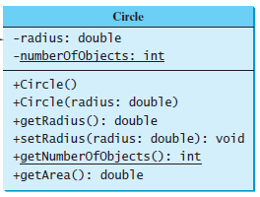
Exercise 3.2. Create a new circle class with a private data-field radius, numberOfObjects and its associated accessor and mutator methods for the class diagram shown in Figure.

Slide 23
public class CircleWithPrivateDataFields {
/** The radius of the circle */
private double radius = 1;
/** The number of the objects created */
private static int numberOfObjects = 0;
/** Construct a circle with radius 1 */
public CircleWithPrivateDataFields() {
numberOfObjects++;
}
/** Construct a circle with a specified radius */
public CircleWithPrivateDataFields(double newRadius) {
radius = newRadius;
numberOfObjects++;
}
Private Data Fields

Slide 24
/** Return radius */
public double getRadius() {
return radius;
}
/** Set a new radius */
public void setRadius(double newRadius) {
radius = (newRadius >= 0) ? newRadius : 0;
}
/** Return numberOfObjects */
public static int getNumberOfObjects() {
return numberOfObjects;
}
/** Return the area of this circle */
public double getArea() {
return radius * radius * Math.PI;
}
}
Accessor
Mutator
Accessor
Accessor

Slide 25
public class TestCircleWithPrivateDataFields {
/** Main method */
public static void main(String[] args) {
// Create a Circle with radius 5.0
CircleWithPrivateDataFields myCircle =
new CircleWithPrivateDataFields(5.0);
System.out.println("The area of the circle of radius "
+ myCircle.getRadius() + " is " + myCircle.getArea());
// Increase myCircle's radius by 10%
myCircle.setRadius(myCircle.getRadius() * 1.1);
System.out.println("The area of the circle of radius "
+ myCircle.getRadius() + " is " + myCircle.getArea());
}
}

Slide 26
Quiz
What keyword do you use to define a subclass?
What is single inheritance? What is multiple inheritance? Does Java support multiple inheritance?
True or false? You can override a private method defined in a superclass.
True or false? You can override a static method defined in a superclass.
How do you explicitly invoke a superclass’s constructor from a subclass?
extends
Single inheritance allows a subclass to extend only one superclass. Multiple inheritance allows a subclass to extend multiple classes. Java does not allow multiple inheritance.
false
false
Use super() or super(args)

Slide 27
How do you invoke an overridden superclass method from a subclass?
If a method in a subclass has the same signature as a method in its superclass with the same return type, is the method overridden or overloaded?
If a method in a subclass has the same signature as a method in its superclass with a different return type, will this be a problem?
If a method in a subclass has the same name as a method in its superclass with different parameter types, is the method overridden or overloaded?
True or false? When invoking a constructor from a subclass, its superclass’s no-arg constructor is always invoked.
Use super.method() or super.method(args).
method overridden
No
method overloaded
No

Slide 28
11. What is the printout of running the class C in Figure.
class A {
public A() {
System.out.println(
"A's no-arg constructor is invoked");
}
}
class B extends A {
}
public class C {
public static void main(String[] args) {
B b = new B();
}
}
A's no-arg constructor is invoked

Slide 29
12. What is the printout of the following codes.
public class Test {
public static void main(String[] args) {
A a = new A(3);
}
}
class A extends B {
public A(int t) {
System.out.println("A's constructor is invoked");
}
}
class B {
public B() {
System.out.println("B's constructor is invoked");
}
}

Slide 30

13. Identify the problems in the following codes.
this.radius=radius
super(radius)
this.length=length
super.getArea( )

Slide 31
14. What may be the error occurred in the following program? Why?
class A
{
final void meth()
{
System.out.println("This is a final method.");
}
}
class B extends A
{
void meth()
{
System.out.println("Illegal!");
}
}
Answer: meth( ) is declared as final, it cannot be overridden in B. A compile-time error will result.

Slide 32
15.. Can error be happened in the following codes? If error, why?
class A
{
int i;
private int j;
void setij(int x, int y)
{
i = x;
j = y;
}
}
class B extends A
{
int total;
void sum()
{
total = i + j;
}
}
Answer: Error can be occurred in class B when the variable j is calling. Because j is the private member of class A, it is not accessible from class B.

Slide 33
16. Given these classes:
public class Person{
public void talk(){ System.out.print("I am a Person "); }
}
public class Student extends Person {
public void talk(){ System.out.print("I am a Student "); }
}
What is the result of this piece of code:
public class Test{
public static void main(String args[]){
Person p = new Student();
p.talk();
}
}
Answer: I am a student.

