Slide 1
Programming in Java

Slide 2
Classes, A Closer Look at Methods and Classes

Slide 3
Outline of Class
Introduction to Classes
A close look on Objects and Methods

Slide 4
Introduction to Class
A class defines the properties and behaviors for objects
Object-oriented programming (OOP) involves programming using objects.
An object represents an entity in the real world.
An object has a unique identity, state, and behavior.
The state of an object (also known as its properties or attributes ) is represented by data fields with their current values.
The behavior of an object (also known as its actions ) is defined by methods. To invoke a method on an object is to ask the object to perform an action.
Circle
Rectangle
data: height, width
method: getArea()
data: radius
method: getArea()

Slide 5
Why Use Classes?
Why not just primitives?
// student Alex
String nameAlex;
int idAlex;
// student david
String nameDavid;
int idDavid;
// student david
String nameDavid2;
int idDavid2;
500 students?
That Sucks!

Slide 6
Why Use Classes?
Name
ID
Sex
…
Student
Name
ID
Sex
…
Name
ID
Sex
…
Name
ID
Sex
…
… 497
Students
Student1
Student2
Student3

Slide 7
Defining Classes
class Box {
double width;
double height;
double depth;
/** construct a box object using default constructor*/
Box(){
}
/* construct a box object using constructor parameterized*/
Box(double w, double h, double d)
{
width=w;
height=h;
depth=d;
}
double volume( )
{
return width*height*depth;
}
}
Data fields
Constructors
Method
Sample Box Class

Slide 8
Constructors- Creating Objects
Constructors are a special kind of method. They have three peculiarities:
A constructor must have the same name as the class itself
Constructors do not have a return type—not even void .
Constructors are invoked using the new operator when an object is created. Constructors play the role of initializing objects.
Two types
Default Constructor
Parameterized Constructors
A constructor is invoked to create an object using the new operator.

Slide 9
Constructors
public class CLASSNAME{
CLASSNAME ( ) { } //Default
CLASSNAME ([ARGUMENTS]) { } //Parameterized
}
//Constructing Objects Using Constructors
CLASSNAME obj1 = new CLASSNAME();
CLASSNAME obj2 = new CLASSNAME([ARGUMENTS])
Box(){ }
Box(double w, double h, double d)
{
width=w;
height=h;
depth=d;
}
Box b1=new Box();
Box b2=new Box(2,3,4)

Slide 10
Accessing an Object’s Data and Methods
An object’s member refers to its data fields and methods.
After an object is created, its data can be accessed and its methods invoked using the dot operator (.), als o known as the object member access operator.
objectRefVar.dataField references a data field in the object.
objectRefVar.method(arguments) invokes a method on the object

Slide 11
Example 3.1. Create two box objects mybox1 and mybox2 using default constructor and parameterized constructor respectively. Assign dimensions of mybox1 and compute volumes of each box.
class BoxDemo {
public static void main(String args[]) {
Box mybox1 = new Box(); //Create box object using default constructor
Box mybox2 = new Box(3,6,9); //Using parameterized constructor
double vol;
// assign values to mybox1's instance variables
mybox1.width = 10;
mybox1.height = 20;
mybox1.depth = 15;
// compute volume of first box
vol = mybox1.width * mybox1.height * mybox1.depth;
System.out.println("Volume of box 1 is " + vol);
// compute volume of second box using object's method
System.out.println("Volume of box 2 is " + mybox2.volume());
}
}
Accessing fields:
object.FieldName
Accessing method:
object.MethodName
Output
Volume of box 1 is 3000.0
Volume of box 2 is 162.0

Slide 12
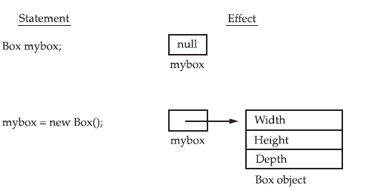
A closer look at new
class → logical construct
object → physical reality
The object’s location is called a reference

Slide 13
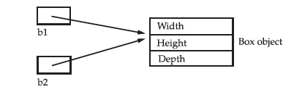
Assigning Object Reference Variables
== operator compares the references
Box b1=new Box (2,3,4);
Box b2= new Box(2,3,4);
Does b1==b2? → No
Box b3=new Box();
Box b4=b3;
Does b3==b4? → Yes
b3 and b4 refer to the same object
Any changes made to the object through b3 will affect the object to which b3 is referring
b3
b4

Slide 14
Example 3.2. Demonstrate Object Reference Variables
class BoxDemo {
public static void main(String args[]) {
Box box1=new Box (2,3,4);
Box box2= new Box(2,3,4);
Box box3=box1;
if(box1==box2)
System.out.println("Memory references of Box 1 and box 2 are same." );
if(box1==box3)
System.out.println("Memory references of Box 1 and box 3 are same." );
System.out.println("Box 1 : "+box1.width+"\t"+box1.height+"\t"+box1.depth);
System.out.println("Box 2 : "+box2.width+"\t"+box2.height+"\t"+box2.depth);
System.out.println("Box 3 : "+box3.width+"\t"+box3.height+"\t"+box3.depth);
// Update box1's instance variables
box1.width = 10;
box1.height = 20;
box1.depth = 15;
System.out.println("After updating box 1:\n");
System.out.println("Box 1 : "+box1.width+"\t"+box1.height+"\t"+box1.depth);
System.out.println("Box 2 : "+box2.width+"\t"+box2.height+"\t"+box2.depth);
System.out.println("Box 3 : "+box3.width+"\t"+box3.height+"\t"+box3.depth);
}
}

Slide 15
Output
Memory references of Box 1 and box 3 are same.
Box 1 : 2.0 3.0 4.0
Box 2 : 2.0 3.0 4.0
Box 3 : 2.0 3.0 4.0
After updating box 1:
Box 1 : 10.0 20.0 15.0
Box 2 : 2.0 3.0 4.0
Box 3 : 10.0 20.0 15.0

Slide 16
Introducing Methods
A method is a program module that contains a series of statements that carry out a task.
Any class can contain an unlimited number of methods, and each method can be called an unlimited number of times
type: specifies the type of data returned by the method
No return → void
type name (parameter-list) {
// body of method
}

Slide 17
class Box {
double width;
double height;
double depth;
// Method that computes and returns volume
//No parameter, return type ‘double’
double volume() {
return width * height * depth;
}
// Method that sets dimensions of box, no return
//Three parameters, no return
void setDim(double w, double h, double d) {
width = w; height = h;
depth = d;
}
}
Sample Box Class with Methods

Slide 18
Example 3.3. Create two box objects mybox1 and mybox2 using default constructor and set dimensions of them using setDim method of Box class. Finally, compute volumes of each box.
class BoxDemo5 {
public static void main(String args[]) {
Box mybox1 = new Box();
Box mybox2 = new Box();
double vol;
// initialize each box
mybox1.setDim(10, 20, 15);
mybox2.setDim(3, 6, 9);
// get volume of first box
vol = mybox1.volume();
System.out.println("Volume is " + vol);
// get volume of second box
vol = mybox2.volume();
System.out.println("Volume is " + vol);
}
}

Slide 19
Static Variables, Constants, and Methods
Static Variable
Shared by all objects of the class
It is a variable which belongs to the class and not to object(instance)
Static variables are initialized only once, at the start of the execution. These variables will be initialized first, before the initialization of any instance variables
A single copy to be shared by all instances of the class
A static variable can be accessed directly by the class name and doesn’t need any object
Static Methods
It is a method which belongs to the class and not to the object(instance)
A static method can access only static data. It can not access non-static data (instance variables)
A static method can call only other static methods and can not call a non-static method from it.
A static method can be accessed directly by the class name and doesn’t need any object
A static method cannot refer to "this" or "super" keywords in anyway

Slide 20

Static Variables, Constants, and Methods
Declare static variable
Declare static method
Static or Instance, how to decide?
A variable or method that is dependent on a specific instance of the class should be an instance variable or method.
A variable or method that is not dependent on a specific instance of the class should be a static variable or method
Notes:
static method → global variable (class own) → static variable
local variable → instance also ok

Slide 21
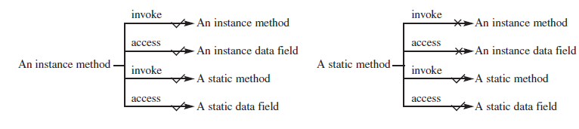
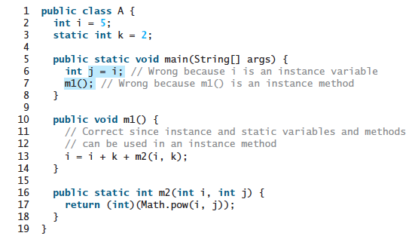
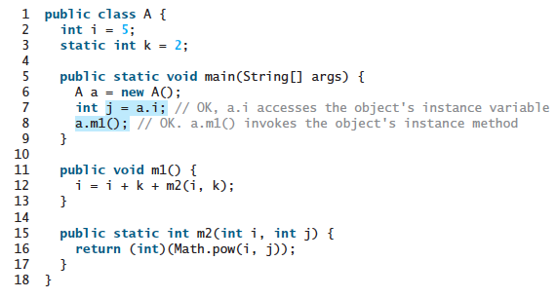

Slide 22
Example 3.4. Demonstrate the use of Static and Instance Variables and Methods
class Student {
int a; //initialized to zero
static int b; //initialized to zero only when class is loaded, not for each object created.
Student(){
//Constructor incrementing static variable b
b++;
}
public void showData(){
System.out.println("Value of a = "+a);
System.out.println("Value of b = "+b); //can access static variable from non-static method
}
public static void increment(){
a++;
}
}
Error block: static method cannot access instance variable

Slide 23
public class Demo{
public static void main(String args[]){
Student s1 = new Student();
s1.showData();
Student s2 = new Student();
s2.showData();
Student.b++;
s1.showData();
}
}
directly access by the class name

Slide 24
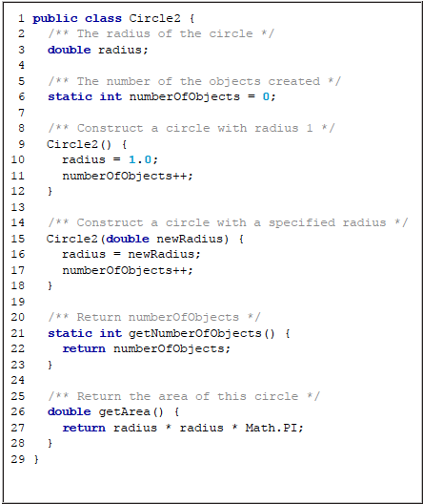
Example 3.5: Demonstrate the use of static variable using Circle Class

Slide 25
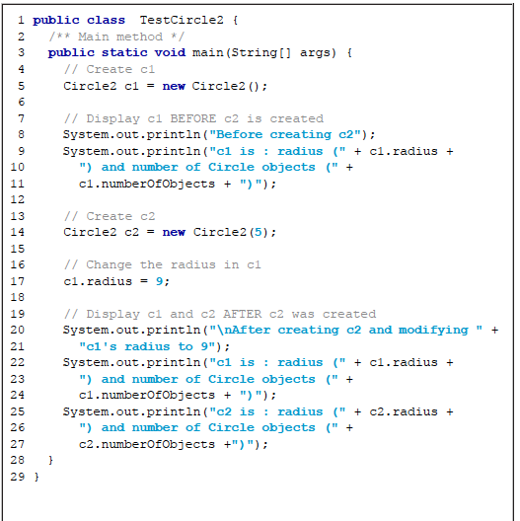
c1 is : radius (1.0) and number of Circle objects (1)
After creating c2 and modifying c1's radius to 9
c1 is : radius (9.0) and number of Circle objects (2)
c2 is : radius (5.0) and number of Circle objects (2)

Slide 26
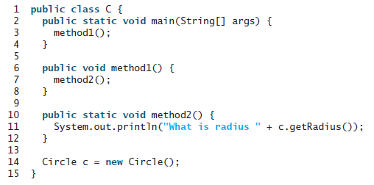
3. Can you invoke an instance method or reference an instance variable from a static method? Can you invoke a static method or reference a static variable from an instance method? What is wrong in the following code?

Slide 27
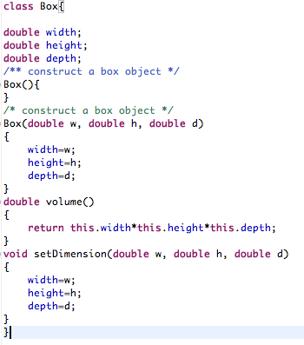
Exercise 3.1. Write a JAVA class named “Box” which has three double variables for the dimension of the box: width, height and depth, default constructor, three argument constructors which will initialize the variables values, the method “volume” which will calculate the volume of boxes and return the double value, and the method “setDimension” which will be used by the objects to set dimensions of the box. Write another JAVA class “BoxDemo” to create two objects, one by using default constructor, another by using argument constructor. And then set the dimension of the first object by calling setDimension method and compute volumes of boxes.

Slide 28
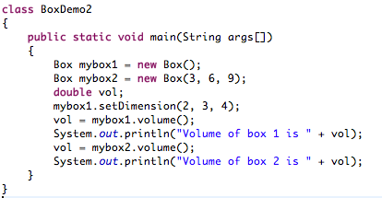

Slide 29


The ‘this’ Keyword
Can be used inside any method to refer to the current object
Perfectly correct, but redundant
To resolve name collisions

Slide 30
Exercise 3.2. Write a JAVA class “Stack” which defines an integer stack that can hold 10 values, push and pop methods. Write another JAVA class which will create the two objects of Stack Class , calling push method to assign the integer values 1 to 10 and 11 to 20 to the Stack and calling pop method to print out the data from stacks.
class Stack {
int stck[] = new int[10];
int tos;
Stack() {
tos = -1;
}
void push(int item) {
if(tos==9)
System.out.println("Stack is full.");
else
stck[++tos] = item;
}
int pop(){
if(tos < 0) {
System.out.println("Stack underflow.");
return 0;
}
else
return stck[tos--];
}
}
Initialize top-of-stack
Push an item onto the stack
Pop an item from the stack

Slide 31
class TestStack {
public static void main(String args[]) {
Stack mystack1 = new Stack();
Stack mystack2 = new Stack();
// push some numbers onto the stack
for(int i=0; i<10; i++) mystack1.push(i);
for(int i=10; i<20; i++) mystack2.push(i);
// pop those numbers off the stack
System.out.println("Stack in mystack1:");
for(int i=0; i<10; i++)
System.out.println(mystack1.pop());
System.out.println("Stack in mystack2:");
for(int i=0; i<10; i++)
System.out.println(mystack2.pop());
}
}

Slide 32
Method Overloading
Define two or more methods within the same class that share the same name, as long as their parameter declarations are different.
class Box{
double width, height;
Box(){
width=0;height=0;
}
Box(double w, double h){
width=w;
height=h;
}
void test( ){
System.out.println(“No Parameter”);
}
void test(int a)
{
System.out.println(“a=“+a);
}
}
overloading constructors
overloading methods

Slide 33
Argument Passing
Call-by-value
copies the value of an argument into the formal parameter of the subroutine
Call-by-reference
a reference to an argument (not the value of the argument) is passed to the parameter
changes made to the parameter will affect the argument used to call the subroutine

Slide 34
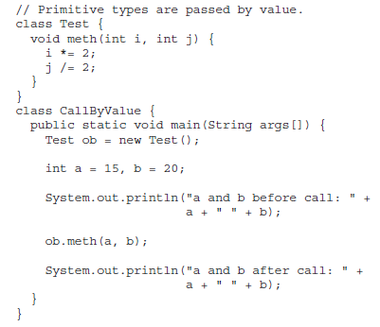
Example 3.6: Demonstrate call-by-value parameter passing

Slide 35
Example 3.7: Demonstrate call-by-reference parameter passing
// Objects are passed by reference.
class Test {
int a, b;
Test(int i, int j) {
a = i;
b = j;
}
// pass an object
void meth(Test o) {
o.a *= 2;
o.b /= 2;
}
}
class CallByRef {
public static void main(String args[]) {
Test ob = new Test(15, 20);
System.out.println("ob.a and ob.b before call: " +
ob.a + " " + ob.b);
ob.meth(ob);
System.out.println(“After call:”+
ob.a + " " + ob.b);
}
}

Slide 36
Returning Objects
A method can return any type of data, including class types that you create
// Returning an object.
class Test {
int a;
Test(int i) {
a = i;
}
Test incrByTen() {
Test temp = new Test(a+10);
return temp;
}
}
class RetOb {
public static void main(String args[]) {
Test ob1 = new Test(2);
Test ob2;
ob2 = ob1.incrByTen();
System.out.println("ob1.a: " + ob1.a);
System.out.println("ob2.a: " + ob2.a);
ob2 = ob2.incrByTen();
System.out.println("ob2.a after second increase: "
+ ob2.a);
}
}

Slide 37
Recursion
Process of defining something in terms of itself
A method that calls itself is said to be recursive.
returntype methodname(){
//code to be executed
methodname();//calling same method
}

Slide 38
Exercise 3.3. Write a program that computes factorial of a number.
class Factorial {
// this is a recursive method
int fact(int n) {
int result;
if(n==1) return 1;
result = fact(n-1) * n;
return result;
}
}
class Recursion {
public static void main(String args[]) {
Factorial f = new Factorial();
System.out.println("Factorial of 3 is " + f.fact(3));
System.out.println("Factorial of 4 is " + f.fact(4));
System.out.println("Factorial of 5 is " + f.fact(5));
}
}

Slide 39
Nested and Inner Classes
Nested Class
A class within another class
Two types
Non-static nested class / Inner class
has access to all of the variables and methods of its outer class
Static nested class
A static nested class is one that has the static modifier applied
it must access the members of its enclosing class through an object.

Slide 40
Example 3.8: Demonstrate Inner Class
class Outer_Demo {
int num;
class Inner_Demo //Inner Class
{
public void print() {
System.out.println("This is an inner class");
}
}
void display_Inner() {
Inner_Demo inner = new Inner_Demo();
inner.print();
}
}
public class My_class {
public static void main(String args[]) {
// Instantiating the outer class
Outer_Demo outer = new Outer_Demo();
// Accessing the display_Inner() method.
outer.display_Inner();
}
}

Slide 41
Example 3.9: Demonstrate Inner Class and scope of its variables
class Outer {
int outer_x = 100;
void test() {
Inner inner = new Inner();
inner.display();
}
// this is an inner class
class Inner {
int y = 10; // y is local to Inner
void display() {
System.out.println("display: outer_x = " + outer_x);
}
}
void showy() {
System.out.println(y); // error, y not known here! Outside scope of y
}
}
class InnerClassDemo {
public static void main(String args[]) {
Outer outer = new Outer();
outer.test();
}
}

Slide 42
Next Week Lecture
Inheritance, Method Overriding and Polymorphism
Thank you!

