Slide 1
Programming in Java

Slide 2
Lecture 5 Packages and Interfaces

Slide 3
Outline of Class (Lecture 5)
Packages
Interfaces

Slide 4
Lecture Objectives
To simplify structuring the program using packages and interfaces
To make searching and locating of classes with the help of packages
To understand various access modifiers
To define different access controls to the classes
To define interfaces and define classes that implement interfaces

Slide 5
Topic 1 Packages

Slide 6
Packages
Packages in Java are a way to encapsulate interfaces, Java classes and also subclasses. They are used for the following tasks –
Java Packages are used to prevent the naming conflicts which can occur between the classes.
Packages in Java make the searching and locating of classes or enumerations or annotations much easier.
Java Packages provide access control to the classes.
Packages in Java are used for data encapsulation.

Slide 7
Packages
Defining a package
Choose a name for the package and simply include a package command as the first statement in a Java source file.
package nameofpackage;
More than one file can include the same package statement.
A hierarchy of packages can also be created.
The general form of a multileveled package statement is shown here:
package pkg1[.pkg2[.pkg3]];
eg. java.util.Scanner;

Slide 8
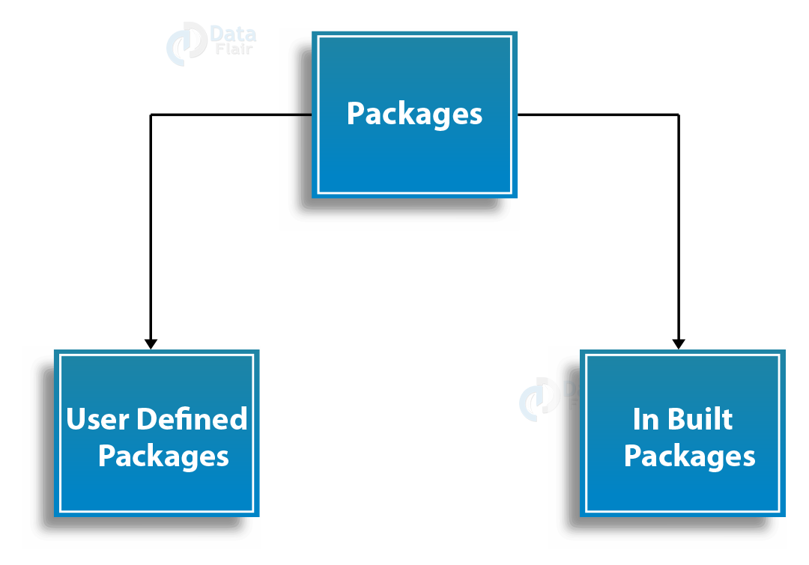
Types of Packages in Java
Built-in
Built-in Java packages are a part of Java API
lang – Automatically imported and it contains language support classes.
io – Contains classes for input and output operations.
util – Contains utility classes for implementing data structures.
applet – This package contains classes that create applets.
awt – Contain classes that implement compounds for GUI.
net – This package contains classes that support networking operations.
User Defined
Java User creates these Java packages

Slide 9
Finding Packages and CLASSPATH
How does the Java run-time system know where to look for packages that you create?
By default, the Java run-time system uses the current working directory as its starting point.
Thus, if your package is in a subdirectory of the current directory, it will be found.
Second, you can specify a directory path or paths by setting the CLASSPATH environmental variable.
Third, you can use the -classpath option with java and javac to specify the path to your classes.
For example,
package MyPack
path to MyPack is
C:\MyPrograms\Java\MyPack
Then the class path to MyPack is
C:\MyPrograms\Java

Slide 10
Example 5.1. Design a class named Balance which has one string data field called ‘name’ and one double field called ‘bal’, two argument constructor that creates the Balance object with specified name and balance, one method named ‘show’ to display the balance. Write a test program to create three balance objects and display their current balances. Create a ‘MyPack’ package and include Balance class inside it.
package MyPack;
class Balance {
String name;
double bal;
Balance(String n, double b) {
name = n;
bal = b;
}
void show() {
if(bal<0)
System.out.print("--> ");
System.out.println(name + ": $" + bal);
}
}
class AccountBalance {
public static void main(String args[]) {
Balance current[] = new Balance[3];
current[0] = new Balance("K. J. Fielding", 123.23);
current[1] = new Balance("Will Tell", 157.02);
current[2] = new Balance("Tom Jackson", -12.33);
for(int i=0; i<3; i++) current[i].show();
}
}

Slide 11
Importing Packages
Java includes the import statement to bring certain classes, or entire packages, into visibility.
import pkg1[.pkg2].(classname|*);
pkg1 is the name of a top-level package, and pkg2 is the name of
a subordinate package inside the outer package separated by a dot (.).
Once imported, a class can be referred to directly, using only its name. import package → import java.util.Scanner;
Scanner input=new Scanner(System.in)
Without import → java.util.Scanner input=new
java.util.Scanner(System.in);
Import statements occur immediately following the package statement (if it exists) and before any class definitions.

Slide 12
Example 5.2. An example demonstrating how to access class from different package.
package MyPack;
public class Balance {
String name;
double bal;
public Balance(String n, double b) {
name = n;
bal = b;
}
public void show() {
if(bal<0)
System.out.print("--> ");
System.out.println(name + ": $" + bal);
}
}
package Pack2;
import MyPack.*;
class TestBalance {
public static void main(String args[]) {
/* Because Balance is public, you may use Balance class and call its constructor. */
Balance test = new Balance("J. J. Jaspers", 99.88);
test.show();}
}

Slide 13
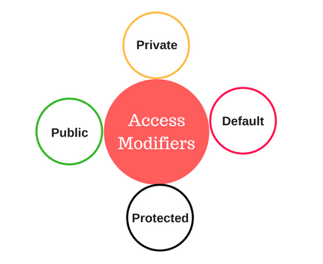
Access Modifiers
Modifiers control access to data fields, methods, and classes
There are four types:
Default
Private
Protected
Public

Slide 14
Access Modifiers
Default
Used to define access when no other modifier is specified for the class or function
With this modifier, they are accessible only within the same package
Private (Keyword ‘private’)
Used to define access to a Java datatypes or method
Only accessible in the same class, i.e. any other class of the same package won’t be able to access it.
Classes cannot be defined with this access type.
Protected (Keyword ‘protected’)
Can be accessed within the same package or subclass of a different package
Public (Keyword ‘public’)
There is no restriction, i.e. Java datatypes or methods can be accessed from anywhere in the program

Slide 15
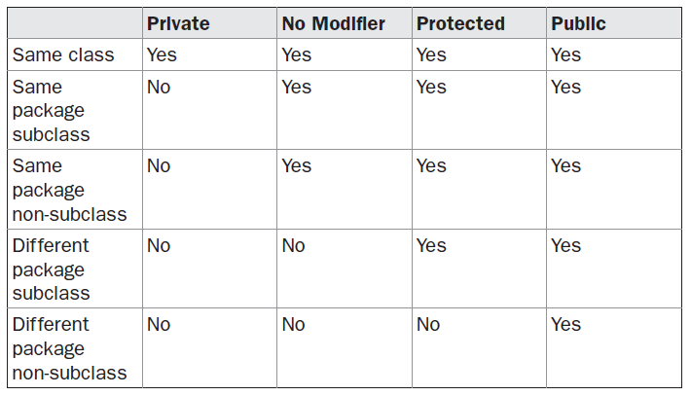
Access Protection Rules

Slide 16
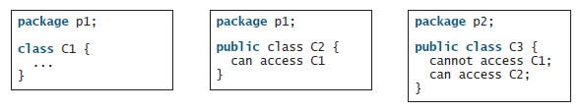
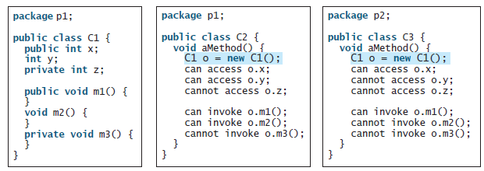
Access Protection Rules

Slide 17
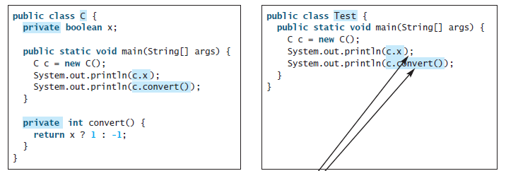
This is okay because object c is used inside the class C.
This is wrong because x and convert are private in class C.

Slide 18
Example 5.3. This program demonstrates the difference between
public and private
class Test {
int a; // default access
public int b; // public access
private int c; // private access
// methods to access c
void setc(int i) { // set c's value
c = i;
}
int getc() { // get c's value
return c;
}
}
class AccessTest {
public static void main(String args[]) {
Test ob = new Test();
ob.a = 10;
ob.b = 20;
// ob.c = 100; // Error! Private Data
// You must access c through its methods
ob.setc(100); // OK
System.out.println("a, b, and c: " + ob.a + " " + ob.b + " " + ob.getc());
}
}

Slide 19
Quiz on Access Protection
Examine at which lines error may occur.
package p1;
public class Protection {
int n = 1;
private int n_pri = 2;
protected int n_pro = 3;
public int n_pub = 4;
public Protection() {
System.out.println("base constructor");
System.out.println("n = " + n);
System.out.println("n_pri = " + n_pri);
System.out.println("n_pro = " + n_pro);
System.out.println("n_pub = " + n_pub);
}
}
package p1;
class Derived extends Protection {
Derived() {
System.out.println("derived constructor");
System.out.println("n = " + n);
System.out.println("n_pri = "4 + n_pri);
System.out.println("n_pro = " + n_pro);
System.out.println("n_pub = " + n_pub);
}
}

Slide 20
package p1;
class SamePackage {
SamePackage() {
Protection p = new Protection();
System.out.println("same package constructor");
System.out.println("n = " + p.n);
System.out.println("n_pri = " + p.n_pri);
System.out.println("n_pro = " + p.n_pro);
System.out.println("n_pub = " + p.n_pub);
}
}
package p2;
class Protection2 extends P1.Protection {
Protection2() {
System.out.println("derived other
package constructor");
System.out.println("n = " + n);
System.out.println("n_pri = " + n_pri);
System.out.println("n_pro = " + n_pro);
System.out.println("n_pub = " + n_pub);
}
}
package p2;
class OtherPackage {
OtherPackage() {
p1.Protection p = new p1.Protection();
System.out.println("other package constructor");
System.out.println("n = " + p.n);
System.out.println("n_pri = " + p.n_pri);
System.out.println("n_pro = " + p.n_pro);
System.out.println("n_pub = " + p.n_pub);
}
}

Slide 21
Topic 2 Interfaces

Slide 22
Interfaces
An interface in java is a blueprint of a class.
It has static constants and abstract methods.
The interface in Java is a mechanism to achieve abstraction. There can be only abstract methods in the Java interface, not method body.
It is used to achieve abstraction and multiple inheritance in Java.
It cannot be instantiated just like the abstract class.
Since Java 8, we can have default and static methods in an interface.
Since Java 9, we can have private methods in an interface.
A class implements an interface, thereby inheriting the abstract methods of the interface.
The class that implements interface must implement all the methods of that interface

Slide 23
Interfaces
An interface is similar to a class in the following ways:
An interface can contain any number of methods.
An interface is written in a file with a .java extension, with the name of the interface matching the name of the file.
The byte code of an interface appears in a .class file.
Interfaces appear in packages, and their corresponding bytecode file must be in a directory structure that matches the package name.
However, an interface is different from a class in several ways, including:
You cannot instantiate an interface.
An interface does not contain any constructors.
All of the methods in an interface are abstract.
An interface cannot contain instance fields. The only fields that can appear in an interface must be declared both static and final.
An interface is not extended by a class; it is implemented by a class.
One class can implement multiple interfaces.
Interface allows you to fully utilize the “one interface, multiple methods” aspect of polymorphism.

Slide 24
Defining an Interface
interface InterfaceName
{
/* All the methods are public abstract by default
* Note down that these methods are not having body
*/
//Any number of final, static fields
//Any number of abstract method declarations
public void method1();
public void method2();
}

Slide 25

Implementing Interfaces
Once an interface has been defined, one or more classes can implement that interface.
To implement an interface, include the implements clause in a class definition, and then create the methods defined by the interface.
The general form of a class that includes the implements clause looks like this:

Slide 26
Example 5.4. Simple Program implementing Interface
interface Callback {
void callback(int param);
}
class Client implements Callback {
// Implement Callback's interface
public void callback(int p) {
System.out.println("callback called with " + p);
}
void nonIfaceMeth() {
System.out.println("Classes that implement interfaces " +
"may also define other members, too.");
}
}
class TestIface {
public static void main(String args[]) {
Callback c = new Client();
c.callback(42);
}
}
Output
callback called with 42

Slide 27
Example 5.5. Another implementation of Callback Interface
class AnotherClient implements Callback {
// Implement Callback's interface
public void callback(int p) {
System.out.println("Another version of callback");
System.out.println("p squared is " + (p*p));
}
}
class TestIface2 {
public static void main(String args[]) {
Callback c = new Client();
AnotherClient ob = new AnotherClient();
c.callback(42);
c = ob; // c now refers to AnotherClient object
c.callback(42);
}
}
Output
callback called with 42
Another version of callback
p squared is 1764

Slide 28
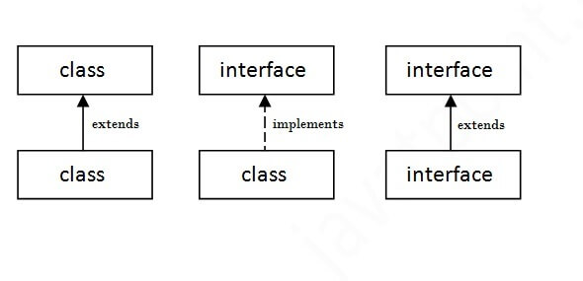
Relationship between classes and interfaces
A class extends another class
An interface extends another interface,
But a class implements an interface.

Slide 29
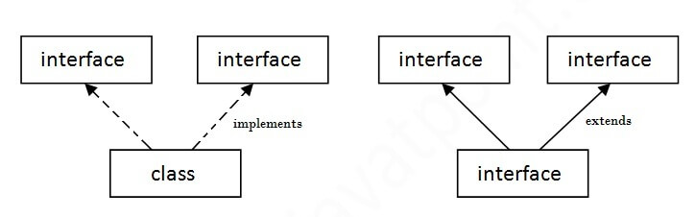
Multiple inheritance in Java by interface
If a class implements multiple interfaces, or an interface extends multiple interfaces, it is known as multiple inheritance.

Slide 30
Example 5.6. Multiple inheritance by Interfaces
interface Printable{
void print();
}
interface Showable{
void print();
}
class TestInterface implements Printable, Showable{
public void print(){System.out.println("Hello");}
public static void main(String args[]){
TestInterface obj = new TestInterface();
obj.print();
}
}

Slide 31
Extending Interfaces
// One interface can extend another.
interface A {
void meth1();
void meth2();
}
// B now includes meth1() and meth2() -- it adds meth3().
interface B extends A {
void meth3();
}
// This class must implement all of A and B
class MyClass implements B {
public void meth1() {
System.out.println("Implement meth1().");
}
public void meth2() {
System.out.println("Implement meth2().");
}
public void meth3() {
System.out.println("Implement meth3().");
}
}
class IFExtend {
public static void main(String arg[]) {
MyClass ob = new MyClass();
ob.meth1();
ob.meth2();
ob.meth3();
}
}

Slide 32
Key Points of Interfaces
We can’t instantiate an interface in java.
Interface provides complete abstraction as none of its methods can have body. On the other hand, abstract class provides partial abstraction as it can have abstract and concrete(methods with body) methods both.
implements keyword is used by classes to implement an interface.
While providing implementation in class of any method of an interface, it needs to be mentioned as public.
Class implementing any interface must implement all the methods, otherwise the class should be declared as “abstract”.
Interface cannot be declared as private or protected.
All the interface methods are by default abstract and public.
Variables declared in interface are public, static and final by default.

Slide 33
(ix) Interface variables must be initialized at the time of declaration otherwise compiler will through an error.
(x)Inside any implementation class, you cannot change the variables declared in interface because by default, they are public, static and final.
interface Try
{
int x; //Compile-time error
}
Class Sample implements Try
{
public static void main(String arg[])
{
x=20; //compile time error
}
}

Slide 34
Quiz on Interfaces
1. Which of the following is correct way of implementing an interface salary by class manager?
a) class manager extends salary {}
b) class manager implements salary {}
c) class manager imports salary {}
d) None of the mentioned.
2. What is wrong with the following interface?
public interface SomethingIsWrong {
void aMethod(int aValue) {
System.out.println("Hi Mom");
}
}

Slide 35
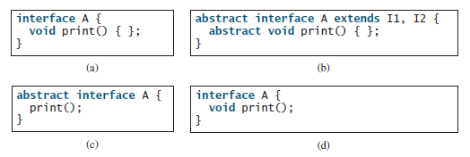
3. Which of the following is a correct interface?
Answer: d

Slide 36
Next Week Lecture
Exception Handling
Multithreading
Thank you!

