Slide 1
GUI Basics
Programming Language IV

Slide 2
Outline of Class
Swing and AWT
GUI API Hierarchy
GUI Components

Slide 3
Java Graphical User Interface
There are two sets of Java APIs for graphics programming:
AWT (Abstract Windowing Toolkit) and Swing.
AWT API was introduced in JDK 1.0. AWT is fine for developing simple graphical user interfaces, but not for developing comprehensive GUI projects. Most of the AWT components have become obsolete and should be replaced by newer Swing components.
Swing API introduces a much more comprehensive set of graphics libraries that enhances the AWT

Slide 4
Java GUI API
The GUI API contains classes that can be classified into three groups:
Component classes
Components are elementary GUI entities (such as Button, Label, and TextField.)
Container classes
Containers (such as Frame and Panel) are used to hold components in a specific layout
Helper classes
classes, such as Graphics , Color , Font , FontMetrics , and Dimension , are called helper classes used to support GUI components

Slide 5
(1) Containers
An instance of Container can hold instances of Component
javax.swing.Jframe
a top-level container for holding other Swing user-interface components in Java GUI applications.
javax.swing.Jpanel
an invisible container for grouping user-interface components. Panels can be nested. You can place panels inside another panel. JPanel is also often used as a canvas to draw graphics.
javax.swing.Japplet
a base class for creating a Java applet using Swing components.
javax.swing.Jdialog
a popup window generally used as a temporary window to receive additional information from the user or to provide notification to the user.

Slide 6
(2) Components

Slide 7
(3) GUI Helper Classes
The helper classes are not subclasses of Component. They are used to describe the properties of GUI components such as graphics context, colors, fonts, and dimension.
java.awt.Graphics
an abstract class that provides the methods for drawing strings, lines, and simple shapes.
java.awt.Color
deals with the colors of GUI components. For example, you can specify background or foreground colors in components like JFrame and JPanel, or you can specify colors of lines, shapes, and strings in drawings.
java.awt.Font
specifies fonts for the text and drawings on GUI components. For example, you can specify the font type (e.g., SansSerif), style (e.g., bold), and size (e.g., 24 points) for the text on a button.
java.awt.FontMetrics
an abstract class used to get the properties of the fonts.
java.awt.Dimension
encapsulates the width and height of a component (in integer precision) in a single object.
java.awt.LayoutManager
specifies how components are arranged in a container.

Slide 8
Basic GUI Programming Steps in Java
Declare a container and components
Add components to one or more containers using a layout manager
Register event listener(s) with the components
Create event listener method(s)

Slide 9
Frames
A frame is a window for holding other GUI components
setSize

Slide 10
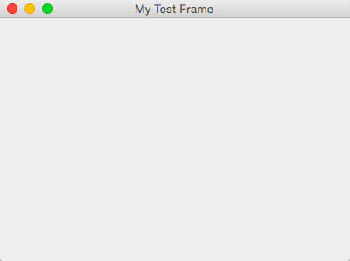
Example: JFrame
import javax.swing.*;
public class MyFrame {
public static void main(String[] args) {
JFrame frame = new JFrame("MyFrame"); // Create a frame
frame.setSize(400, 300); // Set the frame size
frame.setLocationRelativeTo(null); // New since JDK 1.4
frame.setDefaultCloseOperation(JFrame.EXIT_ON_CLOSE);
frame.setVisible(true); // Display the frame
}
}

Slide 11
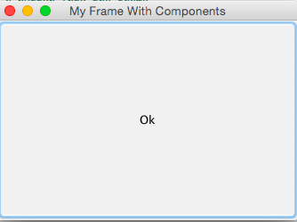
Adding components to a frame
import javax.swing.*;
public class MyFrameWithComponents {
public static void main(String[] args) {
JFrame frame = new JFrame("My Frame With Components");
// Add a button into the frame
JButton jbtOK = new JButton("OK");
frame.add(jbtOK);
frame.setSize(400, 300);
frame.setDefaultCloseOperation(JFrame.EXIT_ON_CLOSE);
frame.setLocationRelativeTo(null); // Center the frame
frame.setVisible(true);
}
}
Notes:
Jframe default layout is Border Layout, that’s why when you are adding a button, it is adding to the center and expanding the whole frame
Border layout does not respect setSize( ) method.
Change to FlowLayout or GridLayout and use SetPreferredSize( ) method.

Slide 12
Layout Managers
Provided for arranging GUI components
Provide basic layout capabilities
Processes layout details
Interface LayoutManager

Slide 13
(i) FlowLayout
FlowLayout has alignment, hgap, and vgap properties.
Use setAlignment, setHgap, and setVgap methods to specify the alignment and the horizontal and vertical gaps.

Slide 14
Exercise 1. Write a program that adds three labels and text fields into the frame with a FlowLayout to accept user’s First Name, Middle Name and Last name.
import javax.swing.*;
import java.awt.FlowLayout;
public class ShowFlowLayout extends JFrame {
public ShowFlowLayout() {
// Set FlowLayout, aligned left with horizontal gap 10 and vertical gap 20 between components
setLayout(new FlowLayout(FlowLayout.LEFT, 10, 20));
// Add labels and text fields to the frame
add(new JLabel("First Name"));
add(new JTextField(8));
add(new JLabel("MI"));
add(new JTextField(1));
add(new JLabel("Last Name"));
add(new JTextField(8));
}

Slide 15
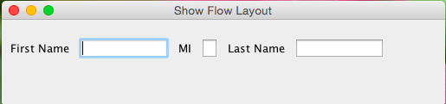
/** Main method */
public static void main(String[] args) {
ShowFlowLayout frame = new ShowFlowLayout();
frame.setTitle("ShowFlowLayout");
frame.setSize(200, 200);
frame.setLocationRelativeTo(null); // Center the frame
frame.setDefaultCloseOperation(JFrame.EXIT_ON_CLOSE);
frame.setVisible(true);
}
}

Slide 16
(ii) GridLayout
The GridLayout manager arranges components in a grid (matrix) formation.
The components are placed in the grid from left to right, starting with the first row, then the second, and so on, in the order in which they are added.

Slide 17
Exercise 2. Write a program that adds three labels and text fields into the frame with a GridLayout to accept user’s First Name, Middle Name and Last name.
import javax.swing.*;
import java.awt.GridLayout;
public class ShowFlowLayout extends JFrame {
public ShowFlowLayout() {
// Set FlowLayout, aligned left with horizontal gap 10 and vertical gap 20 between components
setLayout(new GridLayout(3,2,5,5));
// Add labels and text fields to the frame
add(new JLabel("First Name"));
add(new JTextField(8));
add(new JLabel("MI"));
add(new JTextField(1));
add(new JLabel("Last Name"));
add(new JTextField(8));
}

Slide 18
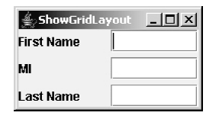
/** Main method */
public static void main(String[] args) {
ShowFlowLayout frame = new ShowFlowLayout();
frame.setTitle("ShowGridLayout");
frame.setSize(200, 200);
frame.setLocationRelativeTo(null); // Center the frame
frame.setDefaultCloseOperation(JFrame.EXIT_ON_CLOSE);
frame.setVisible(true);
}
}

Slide 19
(iii) BorderLayout
Divide the container into five areas: East, South, West, North, and Center. Components are added to a BorderLayout by using the add method.
add(Component, constraint), where constraint is BorderLayout.EAST, BorderLayout.SOUTH, BorderLayout.WEST, BorderLayout.NORTH, or BorderLayout.CENTER.
North
West
Center
East
South

Slide 20
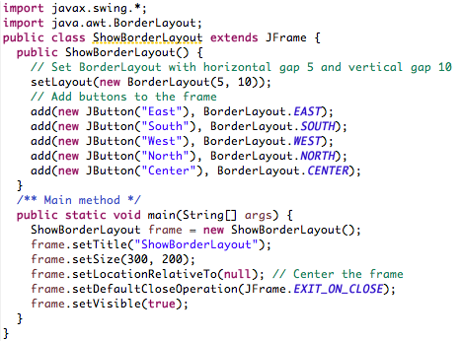
Exercise 3: Write a program that adds five buttons labeled East , South , West , North , and Center to the frame with a BorderLayout manager.

Slide 21
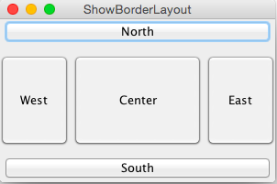
Output

Slide 22
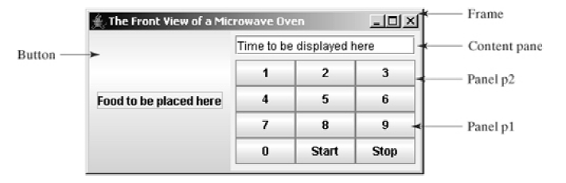
Using Panels as Sub-Containers
Panels act as sub-containers for grouping user interface components.
It is recommended that you place the user interface components in panels and place the panels in a frame. You can also place panels in a panel.

Slide 23
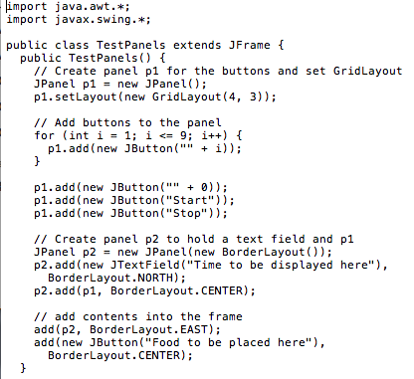
Example: Panel Demo

Slide 24
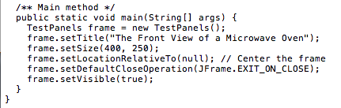

Slide 25
Components
Button
Check Box
Radio Button
Labels
Text Fields
Text Areas
Combo Boxes
Lists
Scroll Bars
Sliders
Tables

Slide 26
Button
To create a push button, use the JButton class
Constructors
Icons, Pressed Icons, and Rollover Icons
Default icon
Pressed icon: display when a button is pressed
Rollover icon: displayed when the mouse is over the button but not pressed
+JButton() +JButton(icon: javax.swing.Icon) +JButton(text: String) +JButton(text: String, icon: Icon) | Creates a default button without any text or icons. Creates a button with an icon. Creates a button with text. Creates a button with text and an icon.

Slide 27
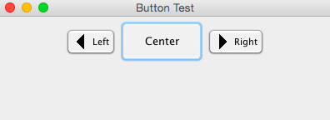
Example: JButton
import javax.swing.*;
import java.awt.*;
public class TestSwing extends JFrame
{
TestSwing()
{
ImageIcon left=new ImageIcon("images/left.gif");
ImageIcon right=new ImageIcon("images/right.gif");
JButton bt1 = new JButton("Left",left); //Button with Icon
JButton bt2 = new JButton("Right",right); //Button with Icon
JButton bt3=new JButton("Center"); //Default Button
bt3.setPreferredSize(new Dimension(100,50)); //Define prefer size
setDefaultCloseOperation(JFrame.EXIT_ON_CLOSE); //setting close operation.
setLayout(new FlowLayout()); //setting layout using FlowLayout object
setTitle("Button Test");
setSize(400, 400); //setting size of Jframe
add(bt1);
add(bt3);//adding Yes button to frame.
add(bt2); //adding No button to frame.
setVisible(true);
}
public static void main(String[] args)
{
new TestSwing();
}
}

Slide 28
ii. Check Box
To create a check box button, use the JCheckBox class
Constructors
+JCheckBox() +JCheckBox(text: String) +JCheckBox(text: String, selected: boolean) +JCheckBox(icon: Icon) +JCheckBox(text: String, icon: Icon) +JCheckBox(text: String, icon: Icon, selected: boolean) | Creates a default check box without any text or icon. Creates a check box with text. Creates a check box with text and specifies whether the check box is initially selected. Creates a check box with an icon. Creates a check box with text and an icon. Creates a check box with text and an icon, and specifies whether the check box is initially selected.

Slide 29
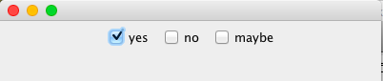
Example: JCheckBox
import javax.swing.*;
import java.awt.*;
public class CheckBox extends JFrame
{
public CheckBox()
{
JCheckBox jcb = new JCheckBox("yes",true); //creating
JCheckBox with default selected
add(jcb); //adding JCheckBox to frame.
jcb = new JCheckBox("no");
add(jcb);
jcb = new JCheckBox("maybe");
add(jcb);
setLayout(new FlowLayout());
setDefaultCloseOperation(JFrame.EXIT_ON_CLOSE);
setSize(400, 400);
setVisible(true);
}
public static void main(String[] args)
{
new CheckBox();
}
}

Slide 30
iii. Radio Button
To create a radio button, use the JRadioButton class
Constructors
To group radio buttons, you need to create an instance of java.swing.ButtonGroup
+JRadioButton() +JRadioButton(text: String) +JRadioButton(text: String, selected: boolean) +JRadioButton(icon: Icon) +JRadioButton(text: String, icon: Icon) +JRadioButton(text: String, icon: Icon, selected: boolean) | Creates a default radio button without any text or icon. Creates a radio button with text. Creates a radio button with text and specifies whether the radio button is initially selected. Creates a radio button with an icon. Creates a radio button with text and an icon. Creates a radio button with text and an icon, and specifies whether the radio button is initially selected.

Slide 31
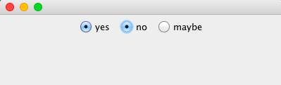
Example: JRadioButton
import javax.swing.*;
import java.awt.*;
public class RadioButton extends JFrame
{
public RadioButton()
{
JRadioButton jcb = new JRadioButton("yes",true);
JRadioButton jcb2 = new JRadioButton(“no”);
JRadioButton jcb3 = new JRadioButton(“maybe”);
add(jcb);
add(jcb2);
add(jcb3);
setLayout(new FlowLayout());
setDefaultCloseOperation(JFrame.EXIT_ON_CLOSE);
setSize(400, 400);
setVisible(true);
}
public static void main(String[] args)
{
new RadioButton();
}
}
ButtonGroup g=new ButtonGroup();
g.add(jcb);
g.add(jcb2);
g.add(jcb3);

Slide 32
iv. Label
To create a label, use the JLabel class.
Constructors
+JLabel() +JLabel(icon: javax.swing.Icon) +JLabel(icon: Icon, hAlignment: int) +JLabel(text: String) +JLabel(text: String, icon: Icon, hAlignment: int) +JLabel(text: String, hAlignment: int) | Creates a default label without any text or icons. Creates a label with an icon. Creates a label with an icon and the specified horizontal alignment. Creates a label with text. Creates a label with text, an icon, and the specified horizontal alignment. Creates a label with text and the specified horizontal alignment.

Slide 33
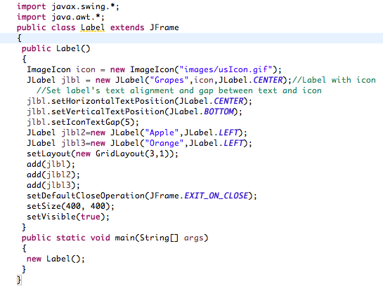
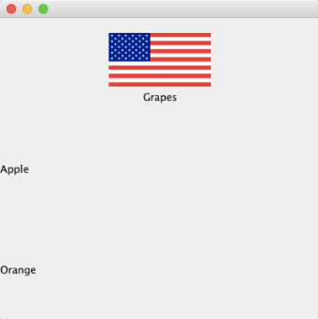
Example: JLabel

Slide 34
v. Text Field
To create a text field, use the JTextField class.
Constructors
Password Field
Use for password inputs
JPasswordField extends JTextField
JPasswordField value = new JPasswordField();
+JTextField() +JTextField(column: int) +JTextField(text: String) +JTextField(text: String, columns: int) | Creates a default empty text field with number of columns set to 0. Creates an empty text field with a specified number of columns. Creates a text field initialized with the specified text. Creates a text field initialized with the specified text and columns.

Slide 35
Example: Text Field
import javax.swing.*;
import java.awt.*;
public class TxtTield extends JFrame
{
public TxtTield()
{
setLayout(new FlowLayout());
JTextField jtf = new JTextField(20); //creating JTextField.
JTextField jtf1 = new JTextField("Input Here");
jtf1.setPreferredSize(new Dimension(200,50));
add(jtf);
add(jtf1);
setDefaultCloseOperation(JFrame.EXIT_ON_CLOSE);
setSize(400, 400);
setVisible(true);
}
public static void main(String[] args)
{
new TxtTield();
}
}

Slide 36
vi. Text Area
A JTextArea enables the user to enter multiple lines of text.
Constructors
+JTextArea() +JTextArea(rows: int, columns: int) +JTextArea(text: String) +JTextArea(text: String, rows: int, columns: int) +getLineCount(): int | Creates a default empty text area. Creates an empty text area with the specified number of rows and columns. Creates a new text area with the specified text Creates a new text area with the specified text and number of rows and columns. Returns the actual number of lines contained in the text area.

Slide 37
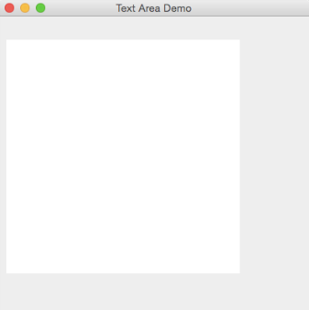
Example: Text Area
import javax.swing.*;
public class TextArea {
JTextArea area;
JFrame f;
TextArea(){
f=new JFrame();
area=new JTextArea(300,300);
area.setBounds(10,30,300,300);
area.setLineWrap(true);
area.setWrapStyleWord(true);
f.add(area);
f.setSize(400,400);
f.setLayout(null);
f.setVisible(true);
}
public static void main(String[] args) {
new TextArea();
}
}

Slide 38
vii. Combo Box
A combo box , also known as a choice list or drop-down list , contains a list of items from which the user can choose
+JComboBox() +JComboBox(items: Object[]) +addItem(item: Object): void +getItemAt(index: int): Object +getItemCount(): int +getSelectedIndex(): int +setSelectedIndex(index: int): void +getSelectedItem(): Object +setSelectedItem(item: Object): void +removeItem(anObject: Object): void +removeItemAt(anIndex: int): void +removeAllItems(): void | Creates a default empty combo box. Creates a combo box that contains the elements in the specified array. Adds an item to the combo box. Returns the item at the specified index. Returns the number of items in the combo box. Returns the index of the selected item. Sets the selected index in the combo box. Returns the selected item. Sets the selected item in the combo box. Removes an item from the item list. Removes the item at the specified index in the combo box. Removes all the items in the combo box.

Slide 39
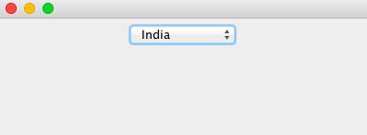
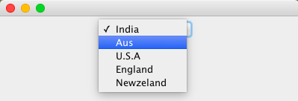
Example: Combo Box
import javax.swing.*;
import java.awt.*;
public class ComboBox extends JFrame
{
String name[] = {"India","Aus","U.S.A","England","Newzeland"}; //list of name.
public ComboBox()
{
JComboBox jc = new JComboBox(name); //initialzing combo box
with list of name.
add(jc); //adding JComboBox to frame.
setLayout(new FlowLayout());
setDefaultCloseOperation(JFrame.EXIT_ON_CLOSE);
setSize(400, 400);
setVisible(true);
}
public static void main(String[] args)
{
new ComboBox();
}
}

Slide 40
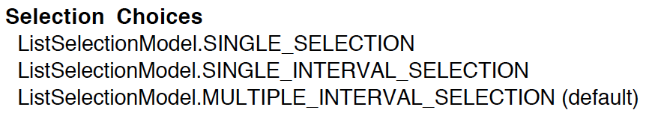
viii. List
A list is a component that basically performs the same function as a combo box, but it enables the user to choose a single value or multiple values
This component contains list of items from which a user can select one or several items at a time.
JList methods
getSelectedIndex() or getSelectedValues(); Returns index or values of selected item
setSelectionMode(SelectionChoices)
+JList() +JList(items: Object[]) | Creates a default empty list. Creates a list that contains the elements in the specified array.

Slide 41
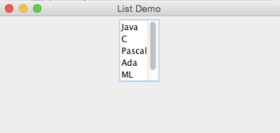
Example: List
import java.awt.FlowLayout;
import javax.swing.*;
public class List{
public static void main(String[] args)
{
JFrame f=new JFrame("List Demo");
f.setLayout(new FlowLayout());
String [] list = { "Java", "C", "Pascal", "Ada", "ML", "Prolog" };
JList lang = new JList(list);
JScrollPane jsp = new JScrollPane(lang);
lang.setVisibleRowCount(5);
lang.setSelectionMode(ListSelectionModel.SINGLE_SELECTION);
f.add(jsp);
f.setSize(400, 300); // Set the frame size
f.setLocationRelativeTo(null); // New since JDK 1.4
f.setDefaultCloseOperation(JFrame.EXIT_ON_CLOSE);
f.setVisible(true); // Display the frame
}
}

Slide 42
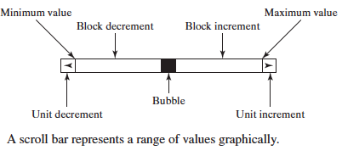
IX. Scroll Bar
JScrollBar is a component that enables the user to select from a range of values
+JScrollBar() +JScrollBar(orientation: int) +JScrollBar(orientation: int, value: int, extent: int, min: int, max: int) | Creates a default vertical scroll bar. Creates a scroll bar with the specified orientation. Creates a scroll bar with the specified orientation, value, extent, minimum, and maximum value - the starting position of the knob of Scrollbar on the track of a Scrollbar. extent - the width of the knob of Scrollbar. min - the minimum width of the track on which Scrollbar moves. max - the maximum width of the track.

Slide 43
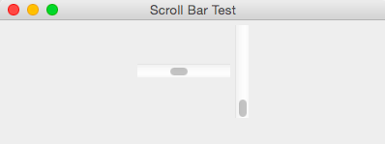
Example: Scroll Bar
import java.awt.FlowLayout;
import javax.swing.*;
public class ScrollBar {
public static void main(String[] args) {
// TODO Auto-generated method stub
JFrame f=new JFrame("Scroll Bar Test");
f.setLayout(new FlowLayout());
JScrollBar scb=new JScrollBar(JScrollBar.HORIZONTAL);
JScrollBar scb2=new JScrollBar(JScrollBar.VERTICAL);
scb.setMaximum(200);
scb.setMinimum(1);
scb2.setMaximum(100);
scb2.setMinimum(1);
f.add(scb);
f.add(scb2);
f.setSize(400, 300); // Set the frame size
f.setLocationRelativeTo(null); // New since JDK 1.4
f.setDefaultCloseOperation(JFrame.EXIT_ON_CLOSE);
f.setVisible(true); // Display the frame
}
}

Slide 44
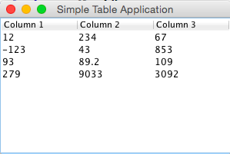
X. Table
Jtable class is used to display the data on two dimensional tables of cells.
JTable(): creates a table with empty cells.
JTable(Object[][] rows, Object[] columns): creates a table with the specified data.

Slide 45
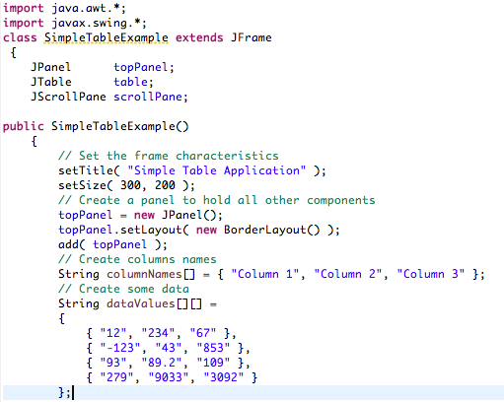
Example: Table

Slide 46
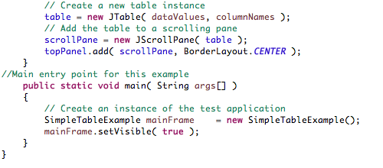

Slide 47
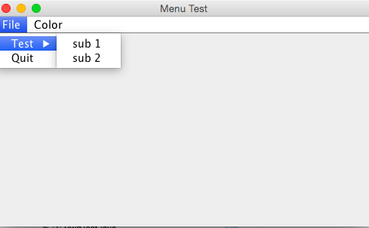
xi. Menu Bar
Java provides several classes—JMenuBar, JMenu, JMenuItem, which will implement menus in a frame.
A menu bar holds menus; the menu bar can only be added to a frame.
Building Menu
1. Create a menu bar as follows:
JMenuBar mb=new JMenuBar();
2. Creat the menu objects as follows:
JMenu file=new JMenu(“File”);
3. Creating the menuItem object as follows:
JMenuItem newItem=new JMenuItem(”Quit");
4. Creating sub menu items
JMenu Test=new JMenu("Test");
JMenuItem one=new JMenuItem("sub 1");
JMenuItem two=new JMenuItem("sub 2");
Test.add(one);
Test.add(two);
file.add(Test);

Slide 48
Example: Menu Bar
import javax.swing.*;
class Menu
{
JMenu menu1,menu2, submenu;
JMenuItem i1, i2, i3, i4, i5;
Menu(){
JFrame f= new JFrame("Menu and MenuItem Example");
JMenuBar mb=new JMenuBar();
menu1=new JMenu("Menu 1");
menu2=new JMenu("Menu 2");
submenu=new JMenu("Sub Menu");
i1=new JMenuItem("Item 1");
i2=new JMenuItem("Item 2");
i3=new JMenuItem("Item 3");
i4=new JMenuItem("Item 4");
i5=new JMenuItem("Item 5");

Slide 49
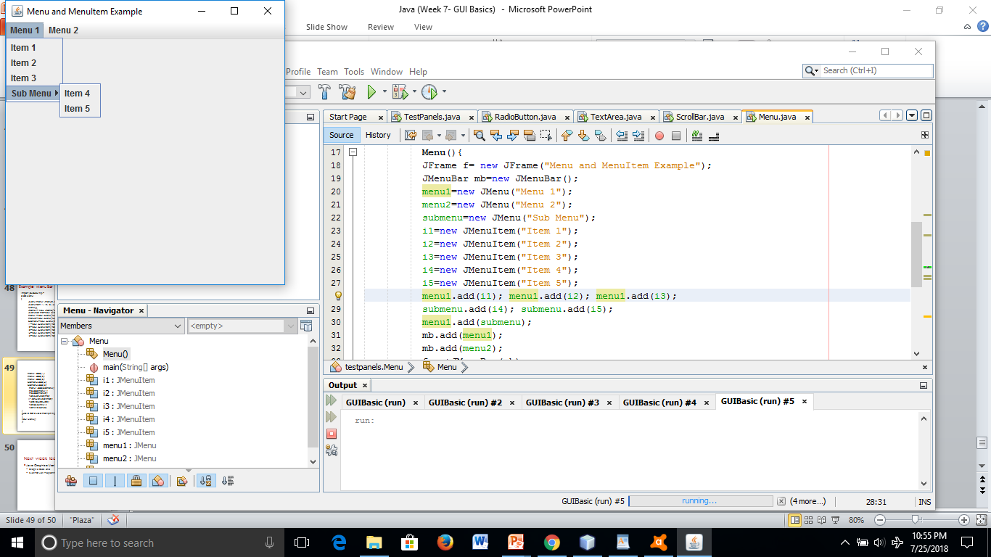
menu1.add(i1);
menu1.add(i2);
menu1.add(i3);
submenu.add(i4);
submenu.add(i5);
menu1.add(submenu);
mb.add(menu1);
mb.add(menu2);
f.setJMenuBar(mb);
f.setSize(400,400);
f.setLayout(null);
f.setVisible(true);
}
public static void main(String args[])
{
new Menu();
}}

Slide 50
Next week lecture
Java Graphical User Interface
Graphic Class and
Event-Driven Programming

