Slide 1
NAYPYITAW STATE POLYTECHNIC UNIVERSITY Department of Language (English) E – 4032
UNIT 6
TRAVEL
Taught by
Daw Zin Mar Lwin

Slide 2
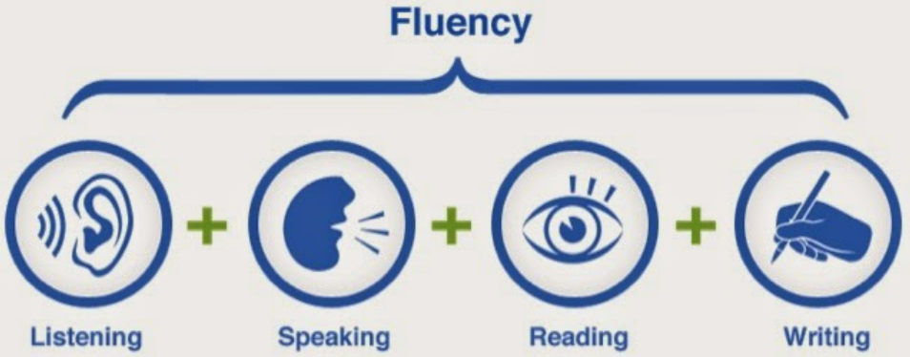
LESSON PLAN for TODAY

Slide 3
OBJECTIVES
To improve four skills (Listening, Speaking, Writing & Reading)
To create critical thinking (deeply thinking)
To understand about Grammar ( Participle clauses and relative clauses)
To know reading about ( The Galapagos Islands)
To have vocabulary ( Describing places (1))
To have listening about ( Interview with a travel writer)

Slide 4
UNIT 6 TRAVEl
6 A Unique places 1 Work with a partner. Look at the photo above of the Galapagos Islands. What do you know about them? Think about the ideas in the box. PG 60
Read the article and check your ideas.
Read the article again and answer the questions.
Which country do the islands belong to?
When did people first move to the islands to make a home there?
Before going there, what had most interested Darwin about the islands?
What activities do the sealions engage in?
What happened in 1959?
How many people live on the islands now?
What problems are there now with food and drink on the islands?
history location wildlife economy

Slide 5
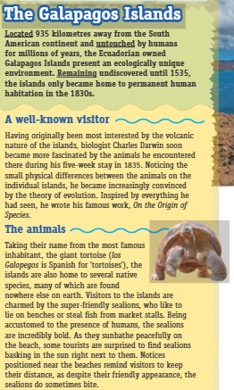
4 Look at the underlined past and present participles in the first paragraph. Find and underline participles in the rest of the article. PG 60

Slide 6
Living on the islands PG 60
Recognizing the importance of protecting the unique ecosystem, officials designated 97% of the land on the islands as a national park in 1959.Visitors can only explore the national park by singing up to official tours with registered guides. Having been restricted to the use of only 3% of the land, the 25,000 people who reside permanently on the islands face high living costs. Most residents work in tourisms or fishing and due to the limited agricultural activity, they are heavily reliant on food imported from the mainland. Freshwater sources are also in low supply , so access to clean water is a constant concern. Despite these difficulties , islanders enjoy a unique way of life. The locals living on the islands have so many wonderful things to do in their free time. They can snorkel in crystal clear Pacific waters, dine on freshly caught seafood, or simply observe the unrivalled wildlife. It’s an amazing places to live.

Slide 7
5 Work with a partner. Read the grammar box and match uses 1-4 with sentences a-d below. PG 61
GRAMMAR : Participle clauses PG 122
We use Present and Past Participles:
1 Instead of relative clauses: Notices positioned near the beaches remind visitors to keep their distance. ( notices which are positioned…)
2 to add extra information: Located 935 kilometers away ….., the Ecuadorian owned Galapagos Islands present an ecologically unique environment.
3 to give a reason for something : Being accustomed to the presence of humans, the sealions are incredibly bold. (because they are accustomed….)
Note that Present Participles have an active meaning and Past Participles have a passive meaning.
We use Perfect Participles:
4 to show that something happened earlier: Having become accustomed to people, the animals are no longer afraid.

Slide 8
a Inspired by everything he had seen , he wrote his famous work, On the Origin of Species. PG 61
b Having been restricted to the use of only 3% of the land, the islanders face high living costs.
c The locals living on the island have so many wonderful things to do in their free time.
d Taking their name from the giant tortoise, the islands are home to several native species.
6 Rewrite the sentences using a participle clause instead of the relative clause.
1 People who are interested in the environment and conservation shouldn’t travel by plane.
…………………………………………………………………………………………… .
2 Islands which are located many kilometres from the mainland can be difficult to live on.
……………………………………………………………………………………………. .
3 Tourists who swim in the sea can expect to be joined by sealions.
……………………………………………………………………………………………. .
4 The language which is spoken on the island is Spanish.
……………………………………………………………………………………………. .

Slide 9
5 Cargo ships that arrive weekly in the harbor bring much – needed supplies. PG 61
6 People who drop litter on the ground will be fined.
Rewrite each pair of sentences as one sentence, using a participle clause. PG 61
I noticed the sealion was in a bad mood. That’s why I sat far away from him on the beach.
……………………………………………………………………………………………….
Rats were accidently introduced to the islands by humans. They have damaged the natural wildlife.
I applied to study Biochemistry at university. I was encouraged by my Science teacher.
I saw so many amazing photos of the island. Then I decided to book a holiday there.
I realized how limited the water supply at the hotel was. I only had a two-minute shower.

Slide 10
8 Think about interesting holiday ideas. Complete the sentences about you or someone you know. PG 61
1 Being interested in volcanoes, my uncle decided to travel to Iceland.
2 Inspired by ……………………………………………………………
3 Having seen ………………………………………………………….
4 Walking around ……………………………………………………….
9 Work in small groups. Discuss your answers to exercise 8. Did you write about
similar experiences?
10 034 Read about a radio programme.Who is the guest? What do you expect her to
talk about? Listen and check your ideas.

Slide 11
11 034 Listen again and answer the questions. PG 61
1 How long have people been living on the islands?
2 What did Judy do with her tour group to help sustain the environment of the islands?
3 In general, how do local people feel about tourism and why?
4 What useful activities did locals take part in to help feed themselves in 2020?
5 How do wild pigs and goats cause problems?
6 What is the biggest concern for the islands in the future? Why?
6A 12 035 Complete the sentences with the correct relative pronouns. Then listen and check. PG 62
1 It’s certainly on the list of places .................... I’d like to visit.
2 Human beings, ………………. are notorious for destroying the environment around them, have
only been living on the islands for a few hundred years.

Slide 12
3 It’s tourism ………………. pays most of their bills. PG 62
4 Just like the animals on the islands, ………………… evolved and adapted, the locals adjusted their behavior.
5 The majority of residents , ……………….livelihood depend on tourism, were facing serious problems.
6 People …………………. would normally work in the tourist industry relocated to highland farming areas.
7 The island authorities support hunters ………………… help keep the numbers of these animals under
control.
8 My best memory is from the time ………………… a sealion joined me for a swim.

Slide 13
14 Work with a partner. Read the pairs of sentences and discuss the questions. Pg 62
1 Both sentences are correct. Why does B use a defining relative clause.
A: My uncle, who is a conservationist, visits the islands once a year.
B: My uncle who is a conservationist visits the islands once a year.
2 Which sentences doesn’t need a relative pronoun? Why?
A: The sealions are the animals that I’d most like to see.
B; The sealions are the animals that are the most confident.
3 Which sentence definitely needs commas? If you add commas to the other sentence, how does the meaning change?
A: Tourists who leave rubbish everywhere are not welcome.
B: Tourism which generates a lot of money for the islands provides 70% of the jobs.

Slide 14
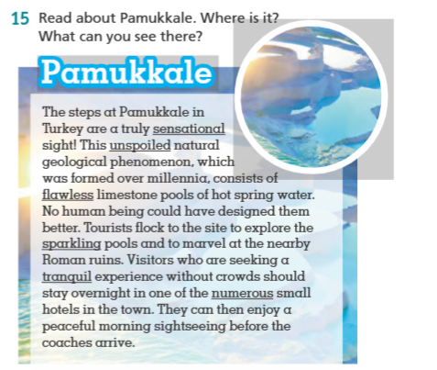
PG 62

Slide 15
16 Find two relative clauses in the article. What type are they? can you change them to participle clauses? PG 62
Match the underlined adjectives in the article to their meanings.
shining with small spots of light
existing in large numbers
still in good condition and not damaged
perfect, without any faults
calm and quiet
very exciting and surprising
18 Think of a beautiful or unique place you have visited. Write a short paragraph about it. Use one relative clause and one participle clause and adjectives from exercise 17. Compare with a partner.

