Slide 1
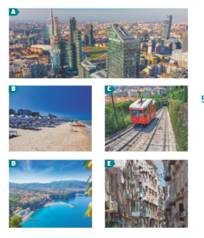
6 B New places 1 Work with a partner. Discuss the questions. PG 63 1 How do you usually decide where to go on holiday? 2 What do you use as your main source of information for holiday destinations? 3 Have you ever been on a holiday where you stopped in multiple locations? 2 036 Two friends are talking about a trip around Italy. Listen to their descriptions of where they went and match the place to the photos A-E. 1 Milan : ………………. 4 Naples: …………………….. 2 Bergamo : ………………. 5 Amalfi Coast …………………. 3 Pesaro : ………………….

Slide 2
036 Listen again and answer the questions. PG 63
Why was Katie disappointed with Milan?
How does she describe the two parts of Bergamo?
What differences does Katie mention between the inercity trains and the regional trains?
Why did they choose Pesaro rather than Rimini for their next stop?
What did they do in Pesaro?
What advantages of Naples does Katie mention?
Where did they stay in Sorrento?
Why did Katie buy her friend a present?

Slide 3
4 Complete the sentences from the audio with the words in the box. PG 63
bustling dated comparatively cheap luxurious
quaint scruffy stated of the art thriving
1 It’s clearly a …………………. business city because it was really busy and incredibly expensive!
2 The old town up on the hill was really ………………… , with beautiful buildings and old squares.
3 The intercity trains are …………………. airconditioned, fast and clean.
4 When you go on the small regional trains , they are pretty …………………. , like something from
the 1970s, and crammed full of people.
5 It’s a bit ………………….and clearly not as well maintained as somewhere like Milan.
6 It was also ………………… compared to the north .
7 It was my birthday while we were there , so we booked a really .................... spa hotel in Sorrento.
8 Places like Sorrento and the town of Amalfi are …………………… with tourists.

Slide 4
5 Work with a partner. Describe places you have visited or hotels you have stayed in. Use words from exercise 4. PG 63
6 Work with a partner. Discuss the questions. PG 64
1 Do you ever take a guidebook on holiday? Why? / Why not?
2 Why do you think guidebooks are less popular nowadays?
3 Do you think there is a future for guidebooks? Why ? / Why not?
7 Read the article. Does the author have the same opinions as you?
8 Read the article again and answer the questions.
1 How did the financial crash affect the sales of guidebooks?
We stayed in a hotel in Munich.
It was clean but a bit dated.
I love Valencia. It’s the third largest
city in Spain and is comparatively cheap compared to Madrid and Barcelona

Slide 5
2 Which two events seemed to suggest that the era of guidebooks was over? PG 64 3 What aspects of modern life mean that it is surprising guidebooks are becoming popular again? 4 What reasons are given for people turning to guidebooks again? 5 What disadvantages is mentioned of using your phone for travel information?
6 What future does the writer predict for e- readers?
7 Why is the market for traditional paper guidebooks unlikely to grow further in the
future?
Work with a partner. Discuss the questions.
Have you ever tried a digital detox? If so, what was the impact?
When you are on holiday, are you able to completely switch off from your work or studies? Why? / Why not?

Slide 6
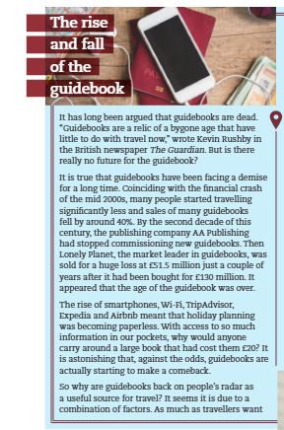
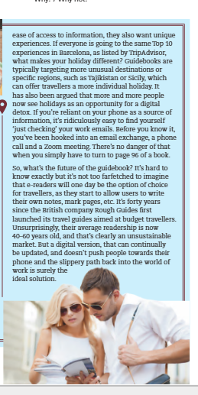

Slide 7
10. Look at the sentences from the article. Match each to a use in the grammar box. Pg 65 a It has long been argued that guidebooks are dead. b It appeared that the age of the guidebook was over. c It is astonishing that, against the odds, guidebooks are actually starting to make a comeback. d It’s hard to know exactly, but……
e It’s forty years since the British company Rough Guides first launched its travel
guides aimed at budget travellers.
GRAMMAR : INTRODUCTORY it PG 123
We use it at the start of sentences:
to talk about the weather, date, period of time, distance, etc. ( it+be ) : It’s twenty
kilometers from here to London.
to show our opinion or emotions ( it+be+ adjective+ clause): It’s unbelievable how
easy global travel has become.
to distance ourselves from evidence or to show what we understand from the
evidence ( it+ verb + clause): It seems that there was a combination of factors.

Slide 8
4 to report the findings or opinion of others ( it+ be+ Past Participle + clause) : It has been PG 65 suggested that e-books might be the future. 5 We also use it with a number of fixed expressions: It’s no wonder …. It’s no coincidence …. It’s easy to believe …..
11 Complete the sentences with the words in the box.
1 It ………………… more humid every summer.
2 It’s no ………………… that people took fewer foreign holidays as the pound became weaker.
3 It has been ………………. that the country’s economy is too reliant on tourism.
4 It’s ……………… how much tourism has increased in the last decade.
It’s ................... to believe that 50 years ago this area was largely desert.
It ……………… as if people’s travel habits are slowly changing.
coincidence gets hard seems
suggested remarkable

Slide 9
12 Complete the second sentence so it has a similar meaning to the first. Start with it and use the correct form of the word in brackets. PG 65
1 The hotel hasn’t had much money spent on it since we last stayed here.
……………………………… has been spent on the hotel since we last stayed
here. (appears)
2 Some people think placing your elbows on the table while eating is rude.
………………………………… place your elbows on the table while eating.
(consider)
3 They said that a number of flight companied may go bankrupt.
……………………. that a number of flight companies may go bankrupt.
(reported)
4 I’m not surprised local people are protesting about the number of
tourists.
…………………………….. local people are protesting about the number of tourists. (wonder)

Slide 10
5 I don’t like getting to the airport early as you just sit there waiting.
……………….. to the airport early as you just sit there waiting. (pointless)
6 The flight lasts around eight hours.
………………….. flight. (about)
13 Look at the ideas in the box and complete the sentences with your own ideas.
It’s no wonder ………..
It’s hard to know ………..
It’s easy to believe …………
It seems as if …………
It’s pointless …………..
14 Work in pairs. Compare your sentences and discuss your ideas.
international travel travel and the environment
digital detox space travel

