Slide 1
NAYPYITAW STATE POLYTECHNIC UNIVERSITY Department of Language (English) E – 4032 LETTER WRITING
Taught by
Daw Zin Mar Lwin

Slide 2
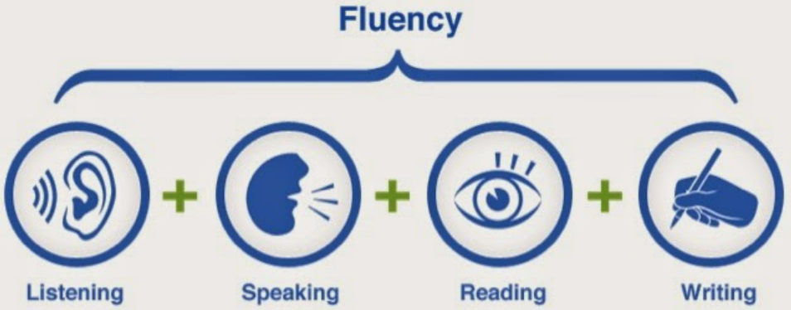
LESSON PLAN for TODAY

Slide 3
a. Letters of Request 1 You will hear two members of a pottery society discussing a letter which they plan to send to their local community centre. Look at the question below, then listen to the cassette and fill in the answers. PG 27
What is the main purpose of the letter?
What do they want to exhibit?
What explanation do they offer?
What are the expected benefits?
Which closing remark does the man suggest they use to end the letter?
A formal letter of request is written to ask for permission, help, information, advice,etc. It may also provide information, explain a situation, make suggestion, present arguments in support of an opinion, etc. as requested in the topic instructions.
Each point should be presented in a separate paragraph containing a clear topic sentence supported by examples and / or justification.
Useful Language for Letters of Request
To begin letters:
I am writing to ask if you would be so kind / generous as to…
request your assistance concerning the matter of …

Slide 4
I wonder if you could possibly / if it would be possible for you to help me….. PG 27 I would (greatly) appreciate if you could ….. I would be most grateful if you could …. I am writing to ask / enquire if / whether you could possibly tell inform me … I am writing to ask if/ whether I might (perhaps) be permitted / allowed to … request your (kind) permission for …. / for me) to … I wonder if I might ask you for request your valuable advice on / concerning……
To end letters:
I hope that my request will not inconvenience you too much.
I must apologise for troubling you with th’s matter.
I hope that you will forgive me for taking up your valuable time.
I look forward to hearing from you receiving your reply as soon as possible.
Thank [ing] you in anticipation of you in advance for your kind cooperation.

Slide 5
2. Read the instructions and the model below and insert the following topic sentences in the appropriate spaces in the letter. Then, complete the paragraph plan on the right, identifying the topic of each paragraph. PG 28
a I would like to offer certain suggestions as to how such a visit would be of benefit to your
company.
b It would likewise be valuable if we could tour the premises to get an overall impression of the
production system.
c It would be most useful to see how the theory we have been taught has been put into practice
in a real – life situation.
d In addition, I feel that your company might wish to use the visit as an opportunity for
interviewing the students.
Your economics class at school / college has chosen you to write to a local company asking permission to visit their premises. While the letter, explaining why your class would like to visit the company’s premises, and suggesting how the results of your study might be of benefit to them.

Slide 6
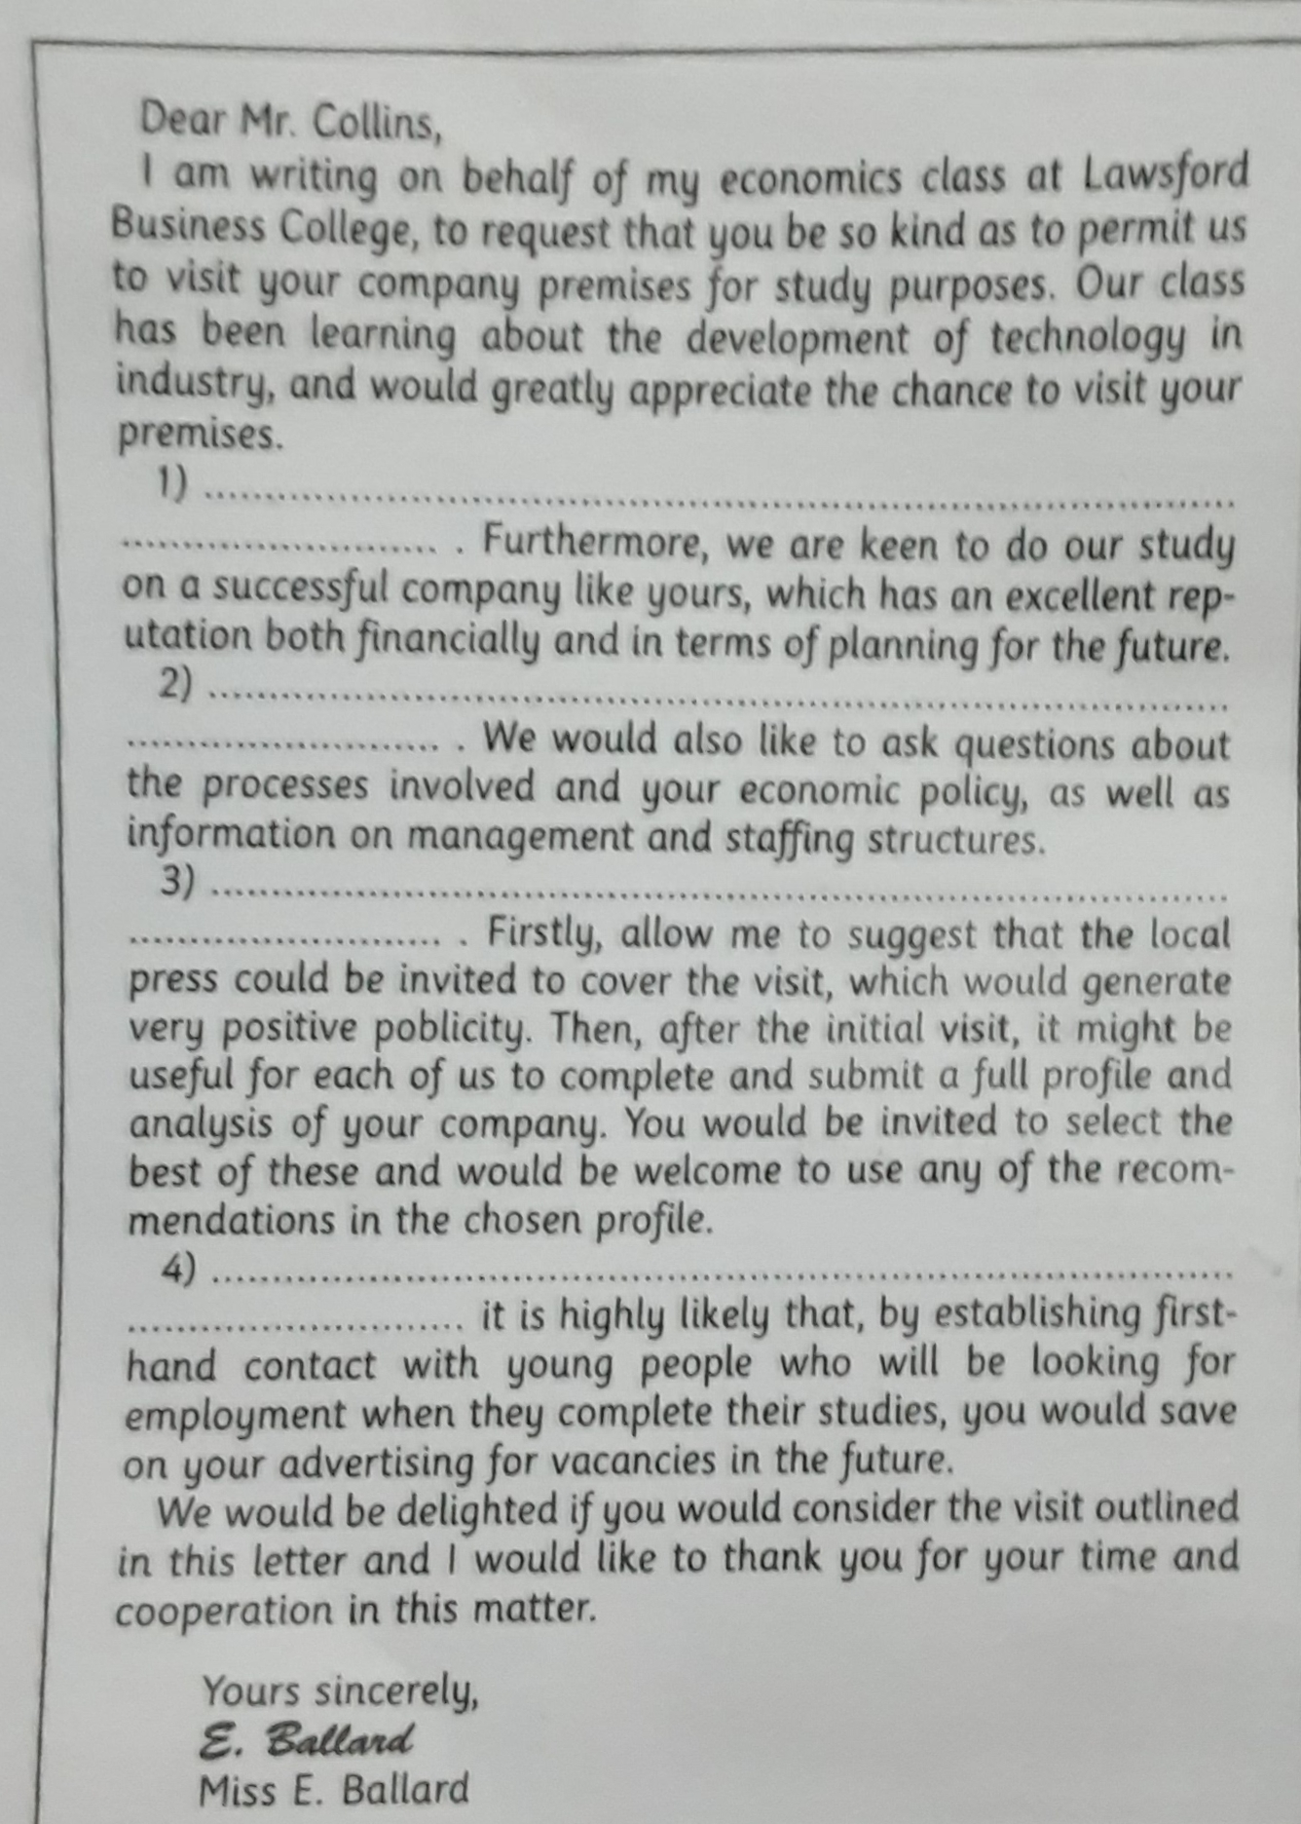

Slide 7
3 For each one of the situations below write a suitable beginning and ending using appropriate expressions. Then suggest reasons for writing them and the expected results of each request. PG 28
1. You want to request a loan from your bank manager for home improvements.
2. You want information from a college or university about a particular course of study you are
interested in.
3. You want the director of an art gallery to look at your work and consider the possibility of
holding an exhibition.
4. You want the town council to place special bins in your area to encourage recycling.
5. You want a travel agency to send you brochures concerning the package holidays they offer
for large groups.

Slide 8
