Slide 1

NAYPYITAW STATE POLYTECHNIC UNIVERSITY(NSPU)
Department of Computational Mathematics Academic Year 2025-2026
Engineering Mathematics IV
(Fourier Analysis and Complex Analysis)
(EM-4012)
Daw Soe Sanda Aye
Associate Professor
Email:soesandaraye1986@gmail.com

Slide 2
Contents,
Fourier Series
Objectives,
To understand Fourier Series
To apply problems by Theory
To solve problems by Theory

Slide 3
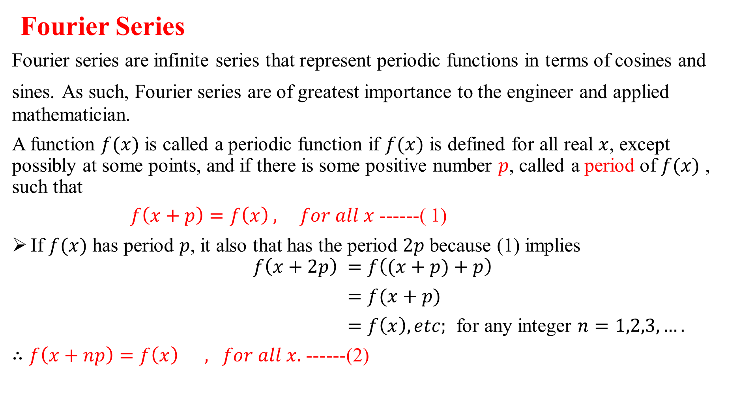
Fourier Series
Fourier series are infinite series that represent periodic functions in terms of cosines and
sines. As such, Fourier series are of greatest importance to the engineer and applied mathematician.
A function $f(x)$ is called a periodic function if $f(x)$ is defined for all real $x$, except possibly at some points, and if there is some positive number $p$, called a period of $f(x)$ , such that
$f\left(x+p\right)=f\left(x\right) , for all x$ ------( 1)
If $f(x)$ has period $p$, it also that has the period $2p$ because (1) implies
$$f\left(x+2p\right) =f\left((x+p)+p\right)$$
$=f(x+p)$
$=f\left(x\right),etc;$ for any integer $n=1,2,3,….$
$∴f\left(x+np\right)=f\left(x\right) , for all x.$ ------(2)

Slide 4
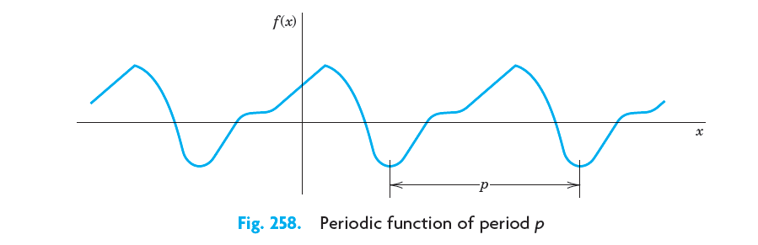
The graph of a periodic function has the characteristic that it can be obtained by periodic repetition of its graph in any interval of length p (Fig. 258).

Slide 5
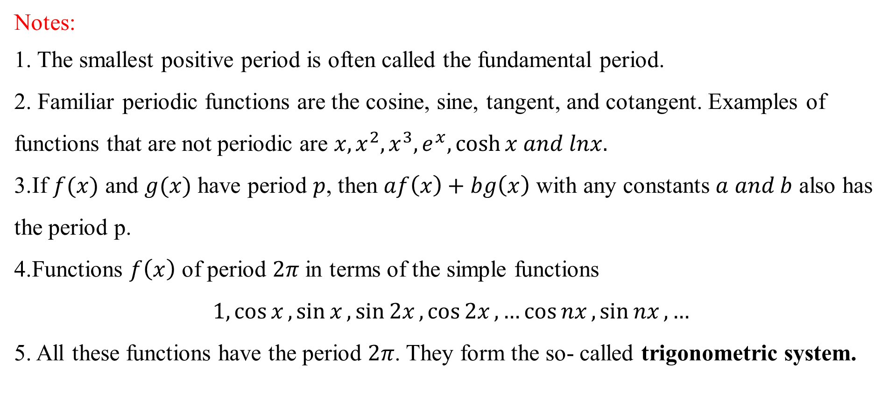
Notes:
1. The smallest positive period is often called the fundamental period.
2. Familiar periodic functions are the cosine, sine, tangent, and cotangent. Examples of
functions that are not periodic are $x, x^{2}, x^{3}, e^{x},\cosh{x and lnx.}$
3.If $f(x)$ and $g(x)$ have period $p$, then $af\left(x\right)+bg\left(x\right)$ with any constants $a and b$ also has the period p.
4.Functions $f\left(x\right)$ of period $2π$ in terms of the simple functions
$$1,\cos{x},\sin{x},\sin{2x},\cos{2x},…\cos{nx},\sin{nx},…$$
5. All these functions have the period $2π$. They form the so- called trigonometric system.

Slide 6
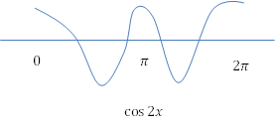
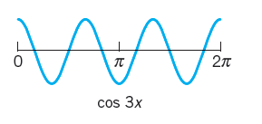

Slide 7
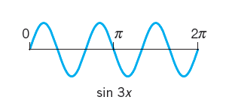
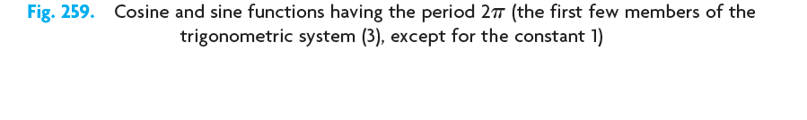

Slide 8

Fourier coefficients of $(x)$ , given by the Euler Formulas
$a_{0}=\frac{1}{2π}\int_{−π}^{π}{f\left(x\right)dx}$
$$a_{n}=\frac{1}{π}\int_{−π}^{π}{f\left(x\right)\cos{nx}dx}, n=1,2,…$$
$$b_{n}=\frac{1}{π}\int_{−π}^{π}{f\left(x\right)\sin{nx}dx},n=1,2,…$$
Fourier series for period $p=2π$ is
$$f\left(x\right)=a_{0}+\sum_{n=1}^{∞}{\left(a_{n}\cos{nx}+b_{n}\sin{nx}\right)}$$

Slide 9
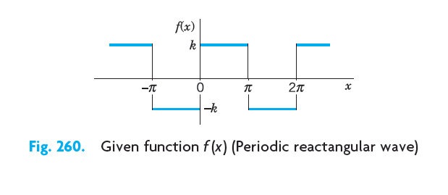
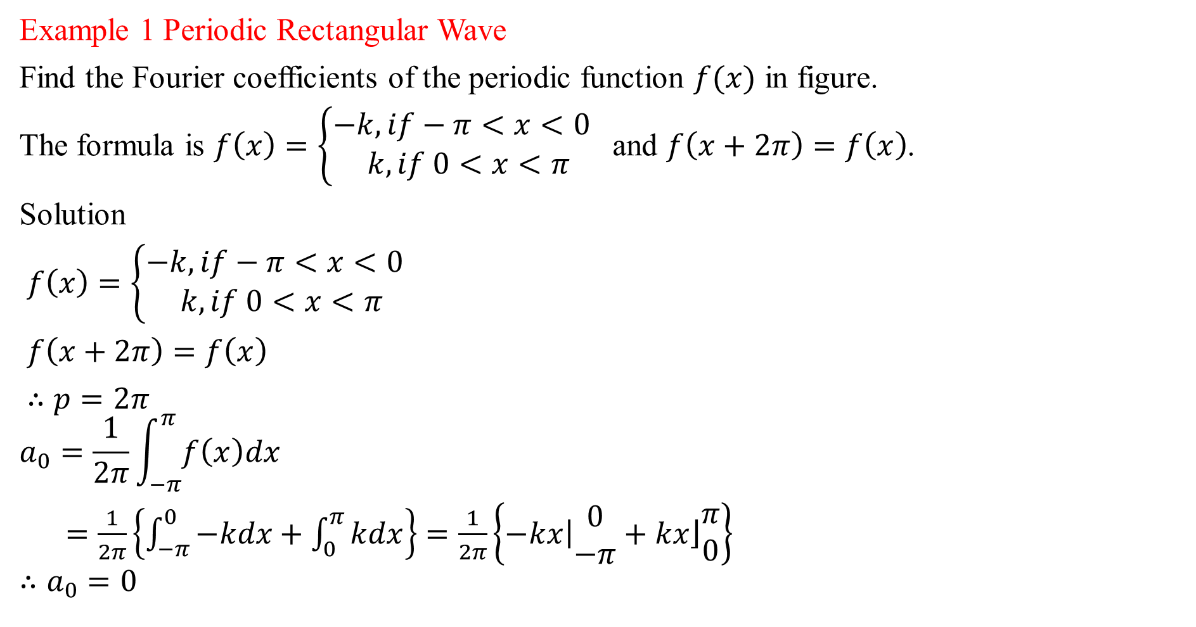
Example 1 Periodic Rectangular Wave
Find the Fourier coefficients of the periodic function $f(x)$ in figure.
The formula is $f\left(x\right)=\left\{\begin{aligned}−k, if−π<x<0 \\ k,if 0<x<π\end{aligned}\right.$ and $f\left(x+2π\right)=f\left(x\right)$.
Solution
$f\left(x\right)=\left\{\begin{aligned}−k, if−π<x<0 \\ k,if 0<x<π\end{aligned}\right.$
$f\left(x+2π\right)=f\left(x\right)$
$∴p=2π$
$$a_{0}=\frac{1}{2π}\int_{−π}^{π}{f\left(x\right)dx}$$
$=\frac{1}{2π}\left\{\int_{−π}^{0}{−kdx}+\int_{0}^{π}{kdx}\right\}$ $=\frac{1}{2π}\left\{\left.−kx\right|\begin{matrix}0 \\ −π\end{matrix}+\left.kx\right\rfloor \begin{matrix}π \\ 0\end{matrix}\right\}$
$$∴a_{0}=0$$

Slide 10

$$a_{n}=\frac{1}{π}\int_{−π}^{π}{f\left(x\right)\cos{nx}dx}, n=1,2,…$$
$=\frac{1}{π}\left\{\int_{−π}^{0}{−k\cos{nx}dx}+\int_{0}^{π}{k\cos{nx}dx}\right\}$
$=\frac{k}{π}\left\{\left.−\frac{\sin{nx}}{n}\right|\begin{matrix}0 \\ −π\end{matrix}+\left.\frac{\sin{nx}}{n}\right\rfloor \begin{matrix}π \\ 0\end{matrix}\right\}$
$$∴a_{n}=0$$
$$b_{n}=\frac{1}{π}\int_{−π}^{π}{f\left(x\right)\sin{nx}dx},n=1,2,…$$
$=\frac{1}{π}\left\{\int_{−π}^{0}{−k\sin{nx}dx}+\int_{0}^{π}{k\sin{nx}dx}\right\}$
$=\frac{k}{π}\left\{\left.\frac{\cos{nx}}{n}\right|\begin{matrix}0 \\ −π\end{matrix}−\left.\frac{\cos{nx}}{n}\right\rfloor \begin{matrix}π \\ 0\end{matrix}\right\}$
$b_{n}=\frac{k}{nπ}\left\{\cos{0}−\cos{nπ}−\cos{nπ+\cos{0}}\right\}$
$$∴b_{n}=\frac{2k}{nπ}\left\{1−\cos{nπ}\right\}$$

Slide 11

$$b_{1}=\frac{2k}{π}\left\{1−\cos{π}\right\}=\frac{4k}{π}$$
$$b_{2}=\frac{2k}{2π}\left\{1−\cos{2π}\right\}=0$$
$$b_{3}=\frac{2k}{3π}\left\{1−\cos{3π}\right\}=\frac{4k}{3π}$$
$b_{4}=\frac{2k}{4π}\left\{1−\cos{4π}\right\}=0$ ,………
The Fourier series of $f(x)$is
$$f\left(x\right)=a_{0}+\sum_{n=1}^{∞}{\left(a_{n}\cos{nx}+b_{n}\sin{nx}\right)}=\frac{4k}{π}\left(\sin{x}+\frac{1}{3}\sin{3x}+\frac{1}{5}\sin{5x}+…..\right).$$

Slide 12
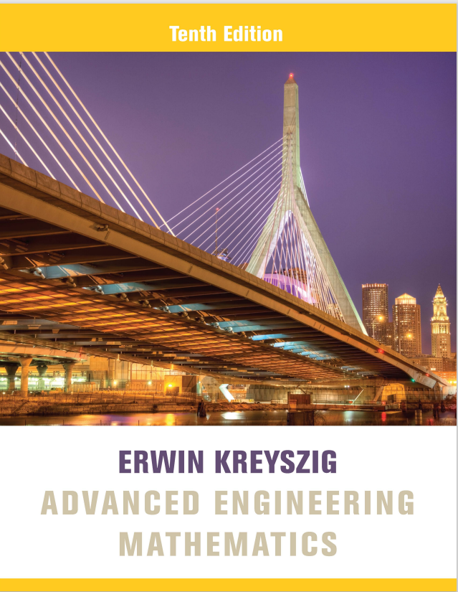
Reference Book
Advanced Engineering Mathematics, Erwin Kreyszig, $10^{th}$ Edition
Thank you

