Slide 1

NAYPYITAW STATE POLYTECHNIC UNIVERSITY(NSPU)
Department of Computational Mathematics Academic Year 2025-2026
Engineering Mathematics IV
(Fourier Analysis and Complex Analysis)
(EM-4012)
Daw Soe Sanda Aye
Associate Professor
Email:soesandaraye1986@gmail.com

Slide 2
Content
Arbitrary Period. Even and Odd Functions .
Half-Range Expansions
Objectives,
To understand Arbitrary Period. Even and Odd Functions
To apply problems by Theory
To solve problems by Theory

Slide 3
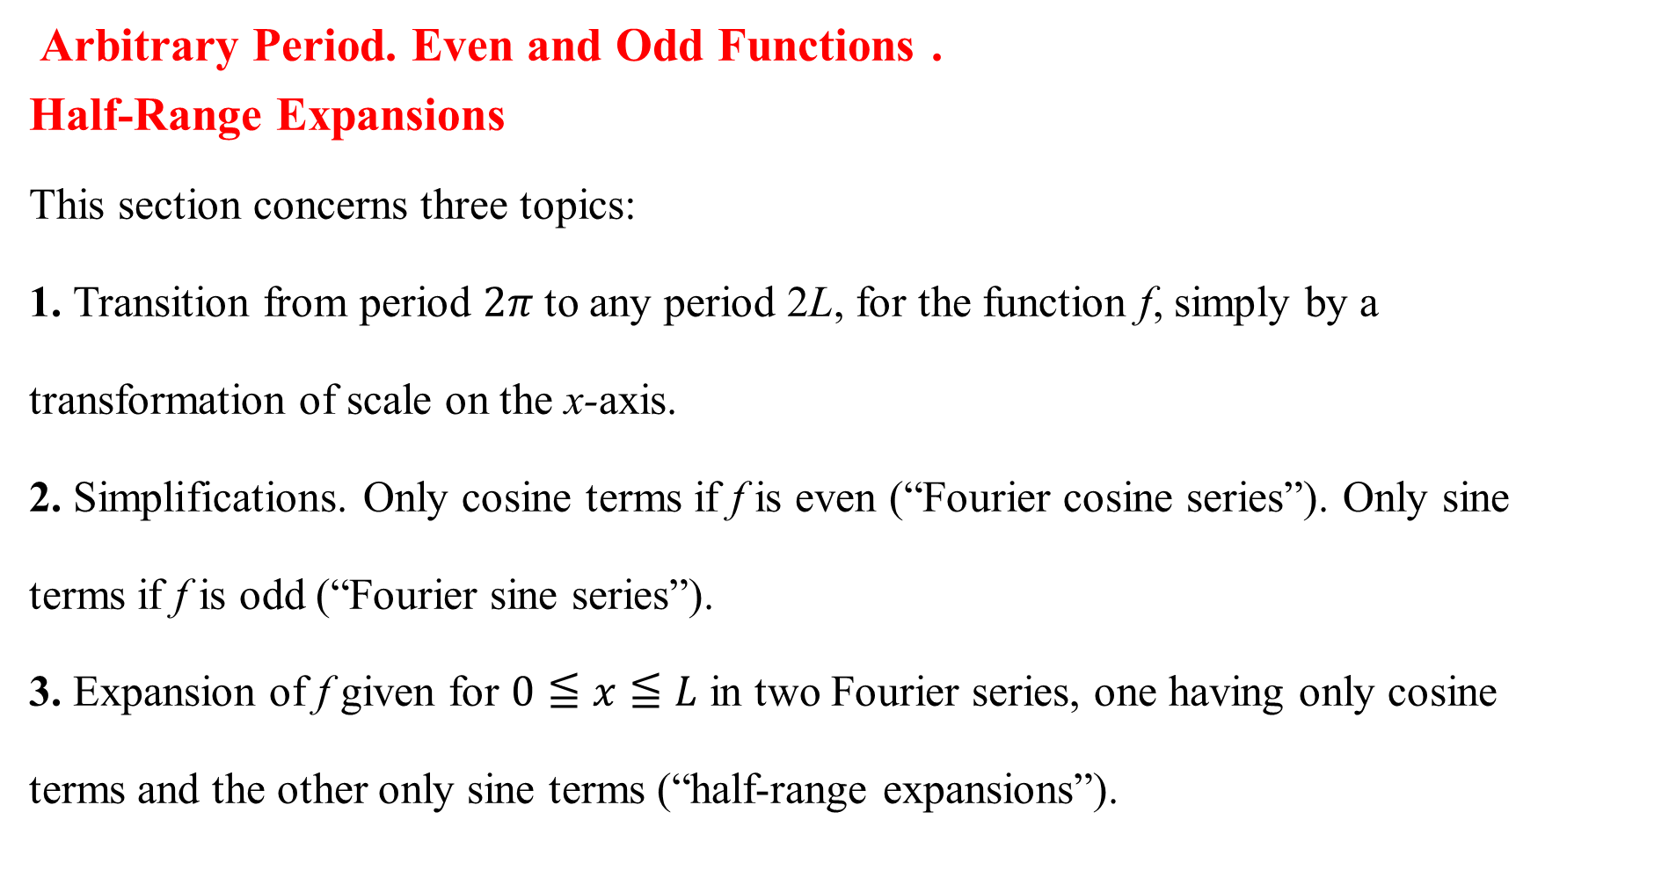
Arbitrary Period. Even and Odd Functions .
Half-Range Expansions
This section concerns three topics:
1. Transition from period $2π$ to any period 2L, for the function f, simply by a
transformation of scale on the x-axis.
2. Simplifications. Only cosine terms if f is even (“Fourier cosine series”). Only sine
terms if f is odd (“Fourier sine series”).
3. Expansion of f given for $0≦x≦L$ in two Fourier series, one having only cosine
terms and the other only sine terms (“half-range expansions”).

Slide 4

From Period to $2π$ to any Period $2L$
Fourier series for period $p=2L$
$$f\left(x\right)=a_{0}+\sum_{n=1}^{∞}{\left(a_{n}\cos{\frac{nπ}{L}}x+b_{n}\sin{\frac{nπ}{L}x}\right)}$$
$a_{0}=\frac{1}{2L}\int_{−L}^{L}{f\left(x\right)dx}$
$$a_{n}=\frac{1}{L}\int_{−L}^{L}{f\left(x\right)\cos{\frac{nπ}{L}x}dx}, n=1,2,…$$
$$b_{n}=\frac{1}{L}\int_{−L}^{L}{f\left(x\right)\sin{\frac{nπ}{L}x}dx},n=1,2,…$$

Slide 5
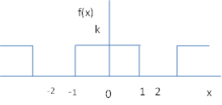

Example 1 Periodic Rectangular Wave
Find the fourier series of the function in the figure.
$$f\left(x\right)=\left\{\begin{aligned}0 if−2<x<−1 \\ k if−1<x<1 \\ 0 if 1<x<2\end{aligned}\right.$$
$p=2L=4,L=2$.

Slide 6

Solution
$$f\left(x\right)=\left\{\begin{aligned}0 if−2<x<−1 \\ k if−1<x<1 \\ 0 if 1<x<2\end{aligned}\right.$$
$p=2L=4,L=2$.
$$a_{0}=\frac{1}{2L}\int_{−L}^{L}{f\left(x\right)dx}$$
$=\frac{1}{4}\int_{−2}^{2}{f\left(x\right)dx}$
$=\frac{1}{4}\int_{−1}^{1}{kdx}$
$=\frac{1}{4}\left[kx\right]\begin{matrix}1 \\ −1\end{matrix}$
$$∴a_{0}=\frac{k}{2}$$

Slide 7

$$a_{n}=\frac{1}{L}\int_{−l}^{L}{f\left(x\right)\cos{\frac{nπ}{L}x}dx}, n=1,2,…$$
$$=\frac{1}{2}\int_{−2}^{2}{f\left(x\right)\cos{\frac{nπ}{2}x}dx}$$
$$=\frac{1}{2}\int_{−1}^{1}{k\cos{\frac{nπ}{2}xdx}}$$
$$=\frac{k}{2}\left[\sin{\frac{nπ}{2}x}×\frac{2}{nπ}\right]\begin{matrix}1 \\ −1\end{matrix}$$
$$∴a_{n}=\frac{2k}{nπ}\sin{\frac{nπ}{2}}$$
$$a_{1}=\frac{2k}{π}\sin{\frac{π}{2}=\frac{2k}{π}}$$
$$a_{2}=\frac{2k}{2π}\sin{\frac{2π}{2}=0}$$
$a_{3}=\frac{2k}{3π}\sin{\frac{3π}{2}=\frac{−2k}{3π}}$ and so on.

Slide 8
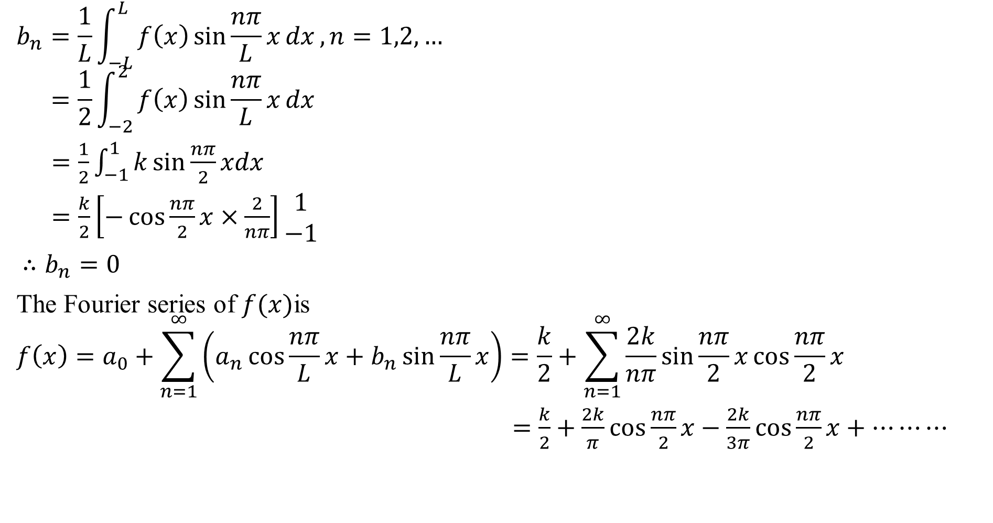
$$b_{n}=\frac{1}{L}\int_{−L}^{L}{f\left(x\right)\sin{\frac{nπ}{L}x}dx},n=1,2,…$$
$$=\frac{1}{2}\int_{−2}^{2}{f\left(x\right)\sin{\frac{nπ}{L}x}dx}$$
$=\frac{1}{2}\int_{−1}^{1}{k\sin{\frac{nπ}{2}xdx}}$
$=\frac{k}{2}\left[−\cos{\frac{nπ}{2}x}×\frac{2}{nπ}\right]\begin{matrix}1 \\ −1\end{matrix}$
$∴b_{n}=0$
The Fourier series of $f(x)$is
$$f\left(x\right)=a_{0}+\sum_{n=1}^{∞}{\left(a_{n}\cos{\frac{nπ}{L}}x+b_{n}\sin{\frac{nπ}{L}x}\right)}=\frac{k}{2}+\sum_{n=1}^{∞}{\frac{2k}{nπ}\sin{\frac{nπ}{2}x}\cos{\frac{nπ}{2}x}}$$
$=\frac{k}{2}+\frac{2k}{π}\cos{\frac{nπ}{2}x}−\frac{2k}{3π}\cos{\frac{nπ}{2}x}+⋯⋯⋯$

Slide 9
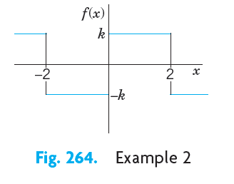
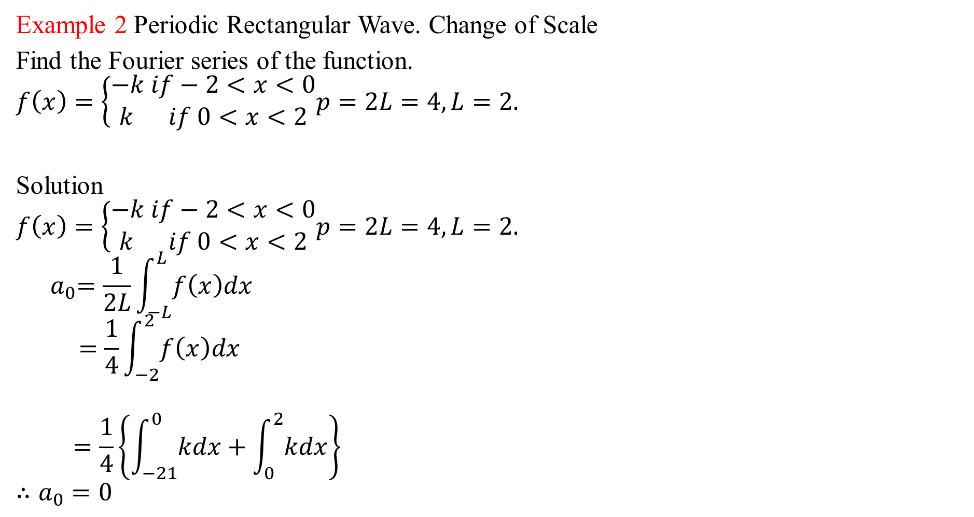
Example 2 Periodic Rectangular Wave. Change of Scale
Find the Fourier series of the function.
$$f\left(x\right)=\left\{\begin{aligned}−k if−2<x<0 \\ k if 0<x<2\end{aligned}p=2L=4,L=2.\right.$$
Solution
$$f\left(x\right)=\left\{\begin{aligned}−k if−2<x<0 \\ k if 0<x<2\end{aligned}p=2L=4,L=2.\right.$$
$${ a}_{0}=\frac{1}{2L}\int_{−L}^{L}{f\left(x\right)dx}$$
$$=\frac{1}{4}\int_{−2}^{2}{f\left(x\right)dx}$$
$$=\frac{1}{4}\left\{\int_{−21}^{0}{kdx}+\int_{0}^{2}{kdx}\right\}$$
$$∴a_{0}=0$$

Slide 10

$$a_{n}=\frac{1}{L}\int_{−l}^{L}{f\left(x\right)\cos{\frac{nπ}{L}x}dx}, n=1,2,…$$
$$=\frac{1}{2}\int_{−2}^{2}{f\left(x\right)\cos{\frac{nπ}{2}x}dx}$$
$=\frac{1}{2}\left\{\int_{−2}^{0}{k\cos{\frac{nπ}{2}xdx}}+\int_{0}^{2}{k\cos{\frac{nπ}{2}xdx}}\right\}$
$$∴a_{n}=0$$
$$b_{n}=\frac{1}{L}\int_{−L}^{L}{f\left(x\right)\sin{\frac{nπ}{L}x}dx},n=1,2,…$$
$=\frac{1}{2}\int_{−2}^{2}{f\left(x\right)\sin{\frac{nπ}{2}x}dx}$
$$=\frac{1}{2}\left\{\int_{−2}^{0}{f\left(x\right)\sin{\frac{nπ}{2}x}dx}+\int_{0}^{2}{f\left(x\right)\sin{\frac{nπ}{2}x}dx}\right\}$$
$$∴b_{n}=\frac{2k}{nπ}\left(1−\cos{nπ}\right)$$

Slide 11

$$b_{2}=\frac{2k}{2π}\left(1−\cos{2π}\right)=0$$
$$b_{3}=\frac{2k}{3π}\left(1−\cos{3π}\right)=\frac{4k}{3π}$$
$$b_{4}=\frac{2k}{4π}\left(1−\cos{4π}\right)=0 \text{and} \text{so} \text{on}\text{.}$$
$\text{The} \text{Fourier} \text{series} \text{of} f(x)\text{is}$
$$f\left(x\right)=a_{0}+\sum_{n=1}^{∞}{\left(a_{n}\cos{\frac{nπ}{L}}x+b_{n}\sin{\frac{nπ}{L}x}\right)}$$
$=\sum_{n=1}^{∞}{\frac{4k}{nπ}(1−\cos{nπ}})\sin{\frac{nπ}{2}x}$
$$=\frac{4k}{π}\left(\sin{\frac{π}{2}x}+\frac{1}{3}\sin{\frac{3π}{2}x+}⋯⋯\right)$$

Slide 12
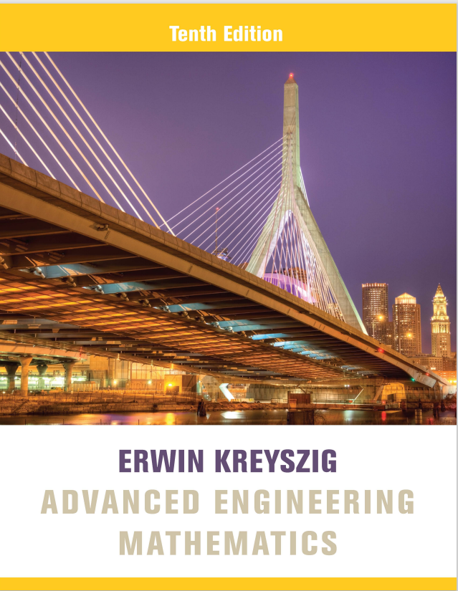
Reference Book
Advanced Engineering Mathematics, Erwin Kreyszig, $10^{th}$ Edition
Thank you

