Slide 1

NAYPYITAW STATE POLYTECHNIC UNIVERSITY(NSPU)
Department of Computational Mathematics Academic Year 2025-2026
Engineering Mathematics IV
(Fourier Analysis and Complex Analysis)
(EM-4012)
Daw Soe Sanda Aye
Associate Professor
Email:soesandaraye1986@gmail.com

Slide 2
Content
Fourier Integral
Objectives,
To understand Fourier Integral
To apply problems by Theory
To solve problems by Theory

Slide 3
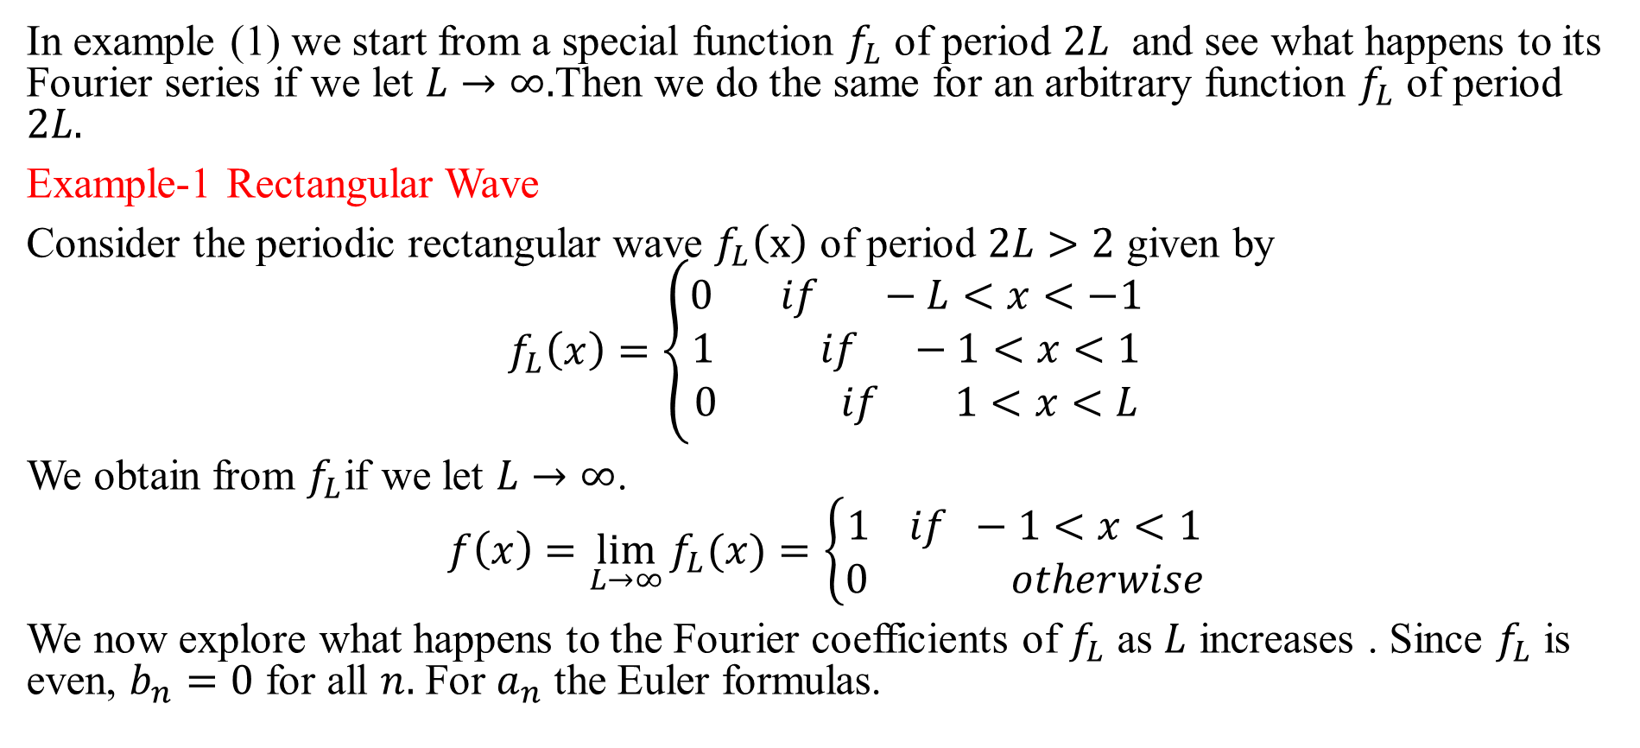
Fourier Integral
In example (1) we start from a special function $f_{L}$ of period $2L$ and see what happens to its Fourier series if we let $L→∞.$Then we do the same for an arbitrary function $f_{L}$ of period $2L.$
Example-1 Rectangular Wave
Consider the periodic rectangular wave $f_{L}\left(x\right)$ of period $2L>2$ given by
$$f_{L}\left(x\right)=\left\{\begin{matrix}0 if −L<x<−1 \\ 1 if −1<x<1 \\ 0 if 1<x<L\end{matrix}\right.$$
We obtain from $f_{L}$if we let $L→∞$.
$$f\left(x\right)=\lim_{L→∞}{f_{L}(x)}=\left\{\begin{matrix}1 if −1<x<1 \\ 0 otherwise\end{matrix}\right.$$
We now explore what happens to the Fourier coefficients of $f_{L}$ as $L$ increases . Since $f_{L}$ is even, $b_{n}=0$ for all $n.$ For $a_{n}$ the Euler formulas.

Slide 4
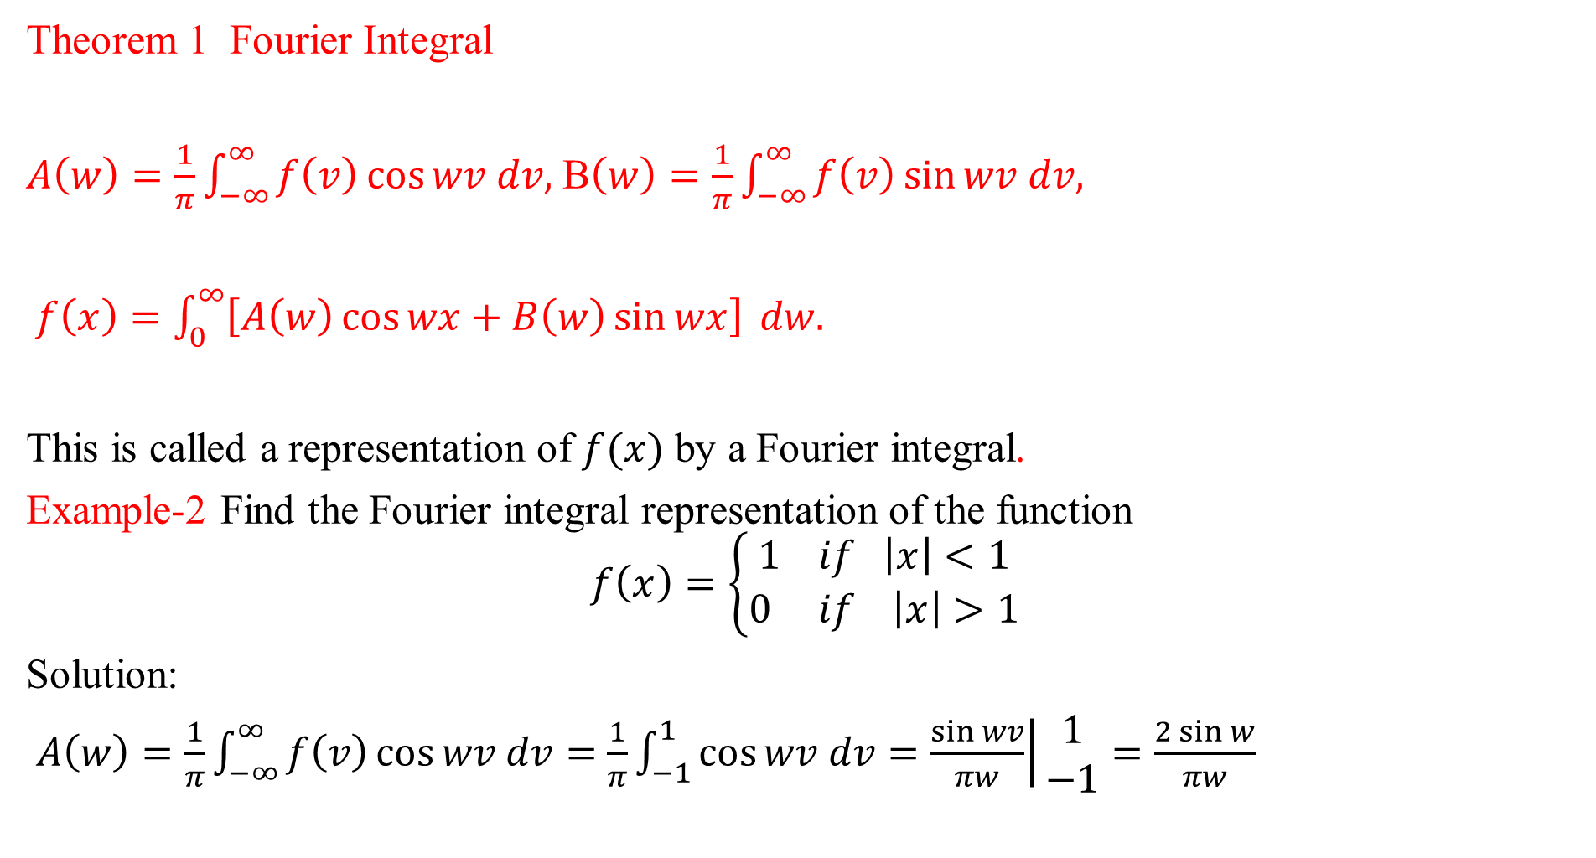
Theorem 1 Fourier Integral
$A\left(w\right)=\frac{1}{π}\int_{−∞}^{∞}{f\left(v\right)\cos{wv dv,}}$ B$\left(w\right)=\frac{1}{π}\int_{−∞}^{∞}{f\left(v\right)\sin{wv dv,}}$
$f\left(x\right)=\int_{0}^{∞}{\left[A\left(w\right)\cos{wx+B\left(w\right)\sin{wx}}\right]} dw.$
This is called a representation of $f(x)$ by a Fourier integral.
Example-2 Find the Fourier integral representation of the function
$$f\left(x\right)=\left\{\begin{matrix}1 if \left|x\right|<1 \\ 0 if \left|x\right|>1\end{matrix}\right.$$
Solution:
$A\left(w\right)=\frac{1}{π}\int_{−∞}^{∞}{f\left(v\right)\cos{wv dv}}=$ $\frac{1}{π}\int_{−1}^{1}{\cos{wv dv=\left.\frac{\sin{wv}}{πw}\right|}}\begin{matrix}1 \\ −1\end{matrix}=\frac{2\sin{w}}{πw}$

Slide 5

$B\left(w\right)=\frac{1}{π}\int_{−1}^{1}{\sin{wv dv=0}}$
$$f\left(x\right)=\frac{2}{π}\int_{0}^{∞}{\frac{\cos{wx\sin{w}}}{w}dw}$$
The average of the left and right-hand limits of $f(x)$ at $x=1$is equal to $\frac{(1+0)}{2}$, that is,$\frac{1}{2}$.
$$\int_{0}^{∞}{\frac{\cos{wx\sin{w}}}{w}dw=\left\{\begin{matrix}\frac{π}{2} if 0≤x<1. \\ \frac{π}{4} if x=1 \\ 0 if x>1\end{matrix}\right.}$$

Slide 6
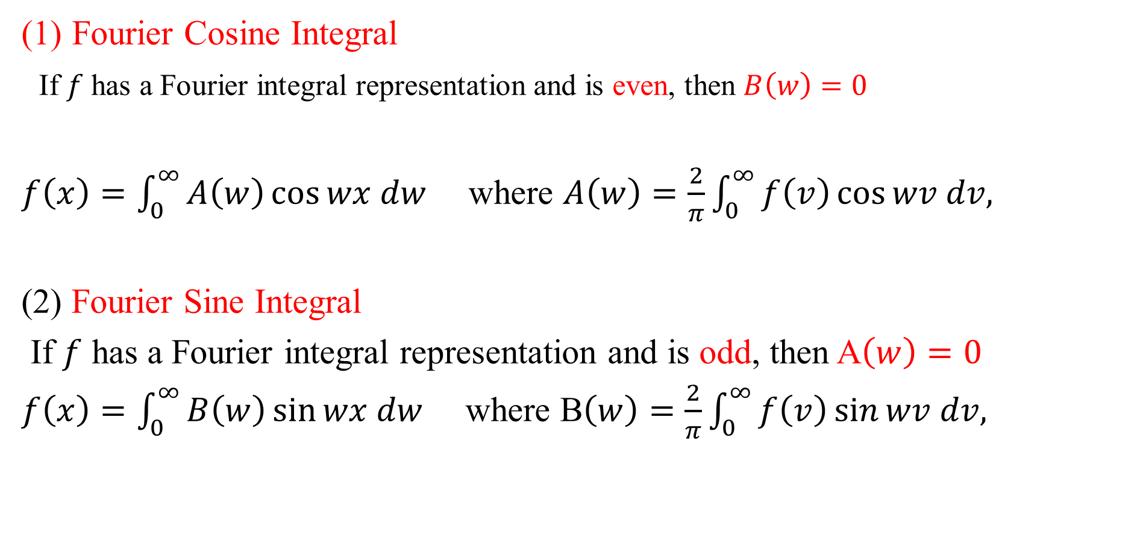
Fourier Cosine Integral and Fourier Sine Integral
Fourier Cosine Integral
If $f$ has a Fourier integral representation and is even, then $B\left(w\right)=0$
$f\left(x\right)=\int_{0}^{∞}{A\left(w\right)\cos{wx dw}}$ where $A\left(w\right)=\frac{2}{π}\int_{0}^{∞}{f\left(v\right)\cos{wv dv,}}$
(2) Fourier Sine Integral
If $f$ has a Fourier integral representation and is odd, then A$\left(w\right)=0$
$f\left(x\right)=\int_{0}^{∞}{B\left(w\right)\sin{wx dw}}$ where B$\left(w\right)=\frac{2}{π}\int_{0}^{∞}{f\left(v\right)\sin{wv dv,}}$

Slide 7
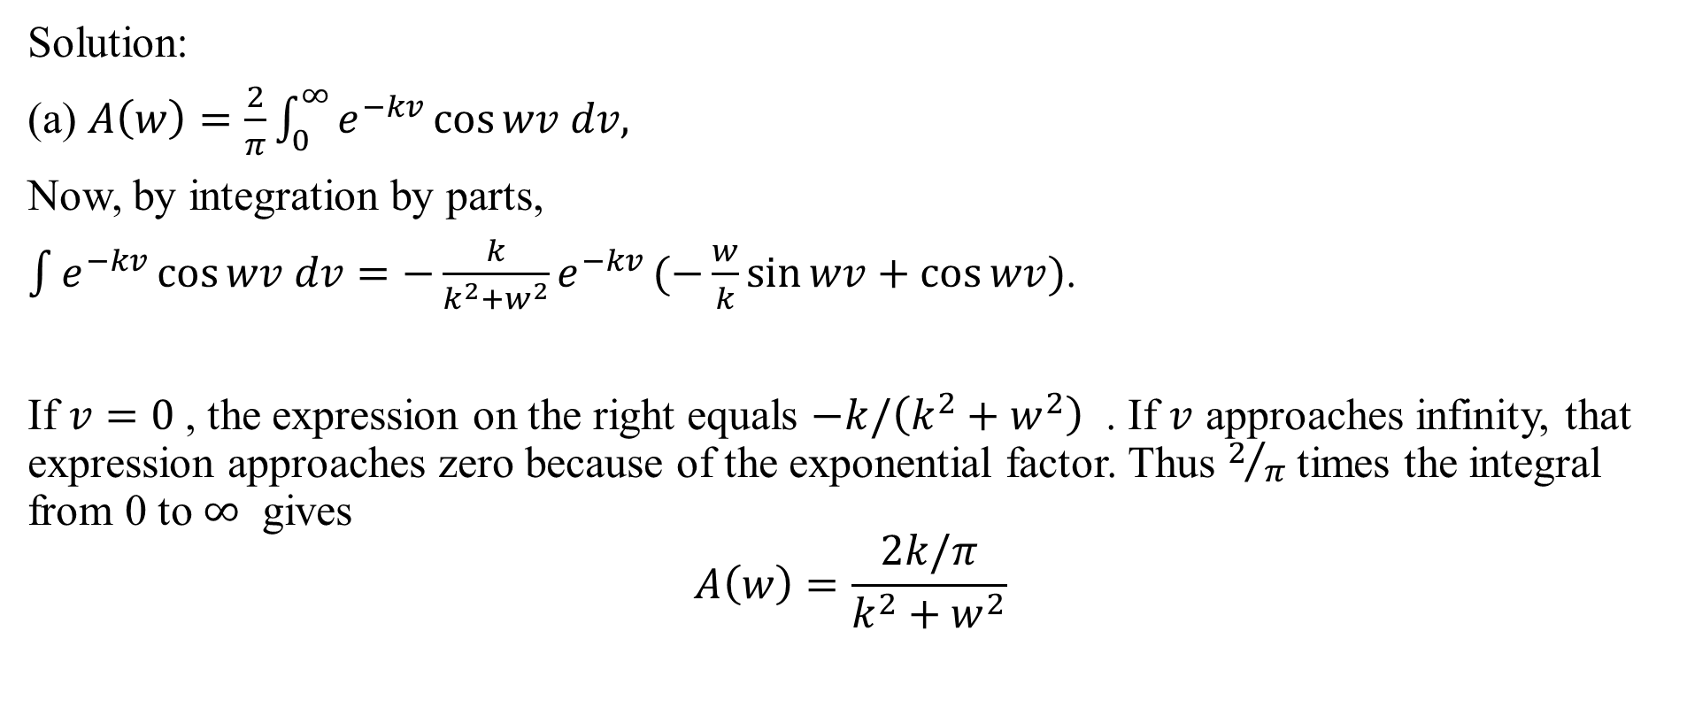
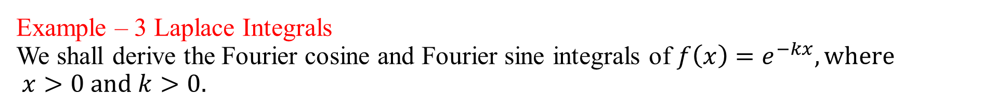
Example – 3 Laplace Integrals We shall derive the Fourier cosine and Fourier sine integrals of $f\left(x\right)=e^{−kx}, where$ $x>0 and k>0.$
Solution:
(a) $A\left(w\right)=\frac{2}{π}\int_{0}^{∞}{e^{−kv}\cos{wv dv,}}$
Now, by integration by parts,
$\int{e^{−kv}\cos{wv dv=−\frac{k}{k^{2}+w^{2}}e^{−kv}}}(−\frac{w}{k}\sin{wv+\cos{wv)}}$.
If $v=0$, the expression on the right equals $−k/\left(k^{2}+w^{2}\right)$ . If $v$ approaches infinity, that expression approaches zero because of the exponential factor. Thus $2/π$ times the integral from 0 to $∞$ gives
$$A\left(w\right)=\frac{2k/π}{k^{2}+w^{2}}$$

Slide 8
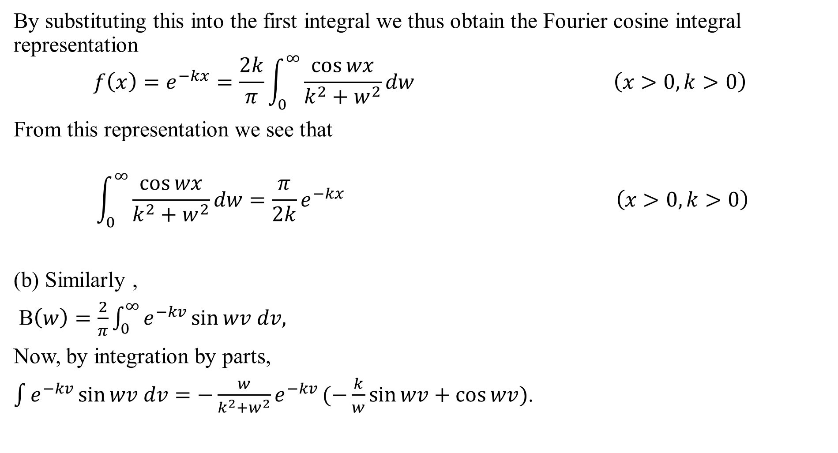
By substituting this into the first integral we thus obtain the Fourier cosine integral representation
$$f\left(x\right)=e^{−kx}=\frac{2k}{π}\int_{0}^{∞}{\frac{\cos{wx}}{k^{2}+w^{2}}}dw \left(x>0, k>0\right)$$
From this representation we see that
$$\int_{0}^{∞}{\frac{\cos{wx}}{k^{2}+w^{2}}}dw=\frac{π}{2k}e^{−kx} \left(x>0, k>0\right)$$
(b) Similarly ,
B$\left(w\right)=\frac{2}{π}\int_{0}^{∞}{e^{−kv}\sin{wv dv,}}$
Now, by integration by parts,
$\int{e^{−kv}\sin{wv dv=−\frac{w}{k^{2}+w^{2}}e^{−kv}}}(−\frac{k}{w}\sin{wv+\cos{wv)}}$.

Slide 9
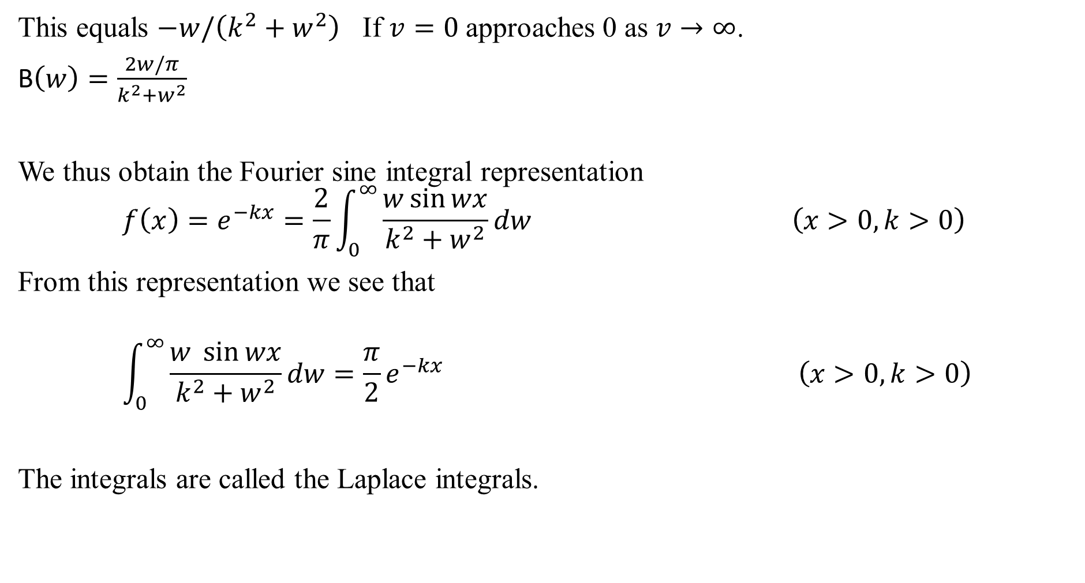
This equals $−w/\left(k^{2}+w^{2}\right)$ If $v=0$ approaches 0 as $v→∞$.
B$\left(w\right)=\frac{2w/π}{k^{2}+w^{2}}$
We thus obtain the Fourier sine integral representation
$$f\left(x\right)=e^{−kx}=\frac{2}{π}\int_{0}^{∞}{\frac{w\sin{wx}}{k^{2}+w^{2}}}dw \left(x>0, k>0\right)$$
From this representation we see that
$$\int_{0}^{∞}{\frac{w \sin{wx}}{k^{2}+w^{2}}}dw=\frac{π}{2}e^{−kx} \left(x>0, k>0\right)$$
The integrals are called the Laplace integrals.

Slide 10

Reference Book
Advanced Engineering Mathematics, Erwin Kreyszig, $10^{th}$ Edition
Thank you

