Slide 1

NAYPYITAW STATE POLYTECHNIC UNIVERSITY(NSPU)
Department of Computational Mathematics Academic Year 2025-2026
Engineering Mathematics IV
(Fourier Analysis and Complex Analysis)
(EM-4012)
Daw Soe Sanda Aye
Associate Professor
Email:soesandaraye1986@gmail.com

Slide 2
Contents;
Cauchy–Riemann Equations. Laplace’s Equation
Harmonic Functions
Objectives,
To understand Cauchy–Riemann Equations
To apply problems by Theory
To solve problems by Theory

Slide 3
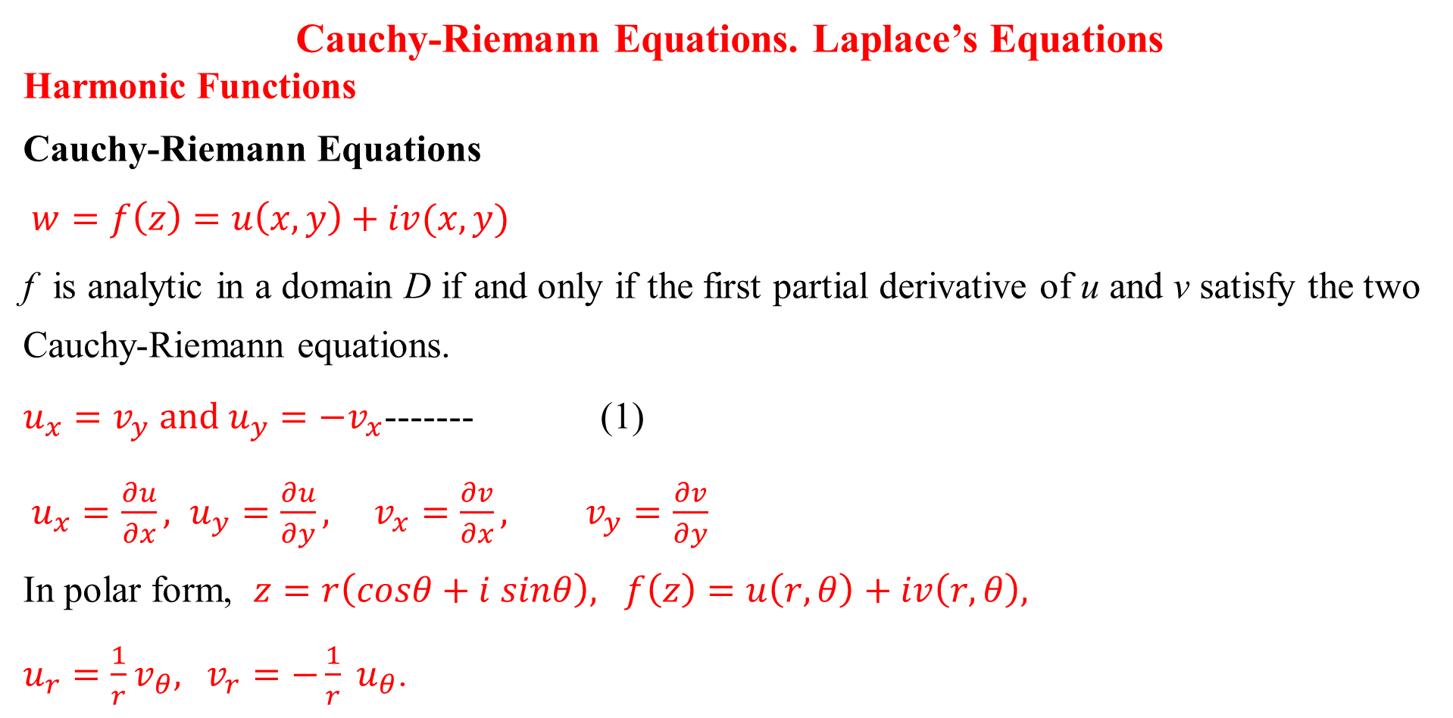
Cauchy-Riemann Equations. Laplace’s Equations
Harmonic Functions
Cauchy-Riemann Equations
$w=f\left(z\right)=u\left(x,y\right)+iv(x,y)$
f is analytic in a domain D if and only if the first partial derivative of u and v satisfy the two Cauchy-Riemann equations.
$u_{x}=v_{y} and u_{y}={−v}_{x}$------- (1)
$u_{x}=\frac{∂u}{∂x}, u_{y}=\frac{∂u}{∂y}, v_{x}=\frac{∂v}{∂x}, v_{y}=\frac{∂v}{∂y}$
In polar form, $z=r\left(cosθ+i sinθ\right), f\left(z\right)=u\left(r,θ\right)+iv\left(r,θ\right),$
$u_{r}=\frac{1}{r}v_{θ},$ $v_{r}=−\frac{1}{r} u_{θ}$.

Slide 4
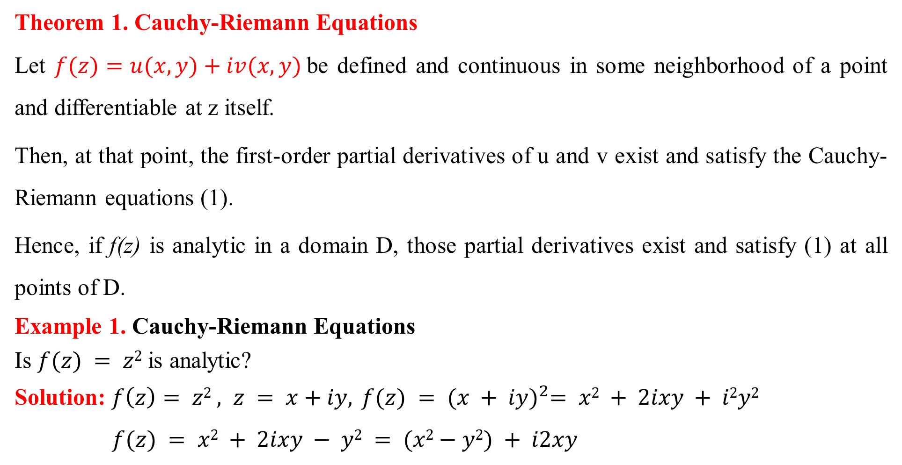
Theorem 1. Cauchy-Riemann Equations
Let $f(z)=u(x,y)+iv(x,y)$be defined and continuous in some neighborhood of a point and differentiable at z itself.
Then, at that point, the first-order partial derivatives of u and v exist and satisfy the Cauchy-Riemann equations (1).
Hence, if f(z) is analytic in a domain D, those partial derivatives exist and satisfy (1) at all points of D.
Example 1. Cauchy-Riemann Equations
Is $f(z) = z2$is analytic?
Solution: $f\left(z\right)= z2 , z = x+iy, f(z) = {(x + iy)}^{2}= x2 + 2ixy + i2y2$
$f(z) = x2 + 2ixy − y2 = (x2−y2) + i2xy$

Slide 5
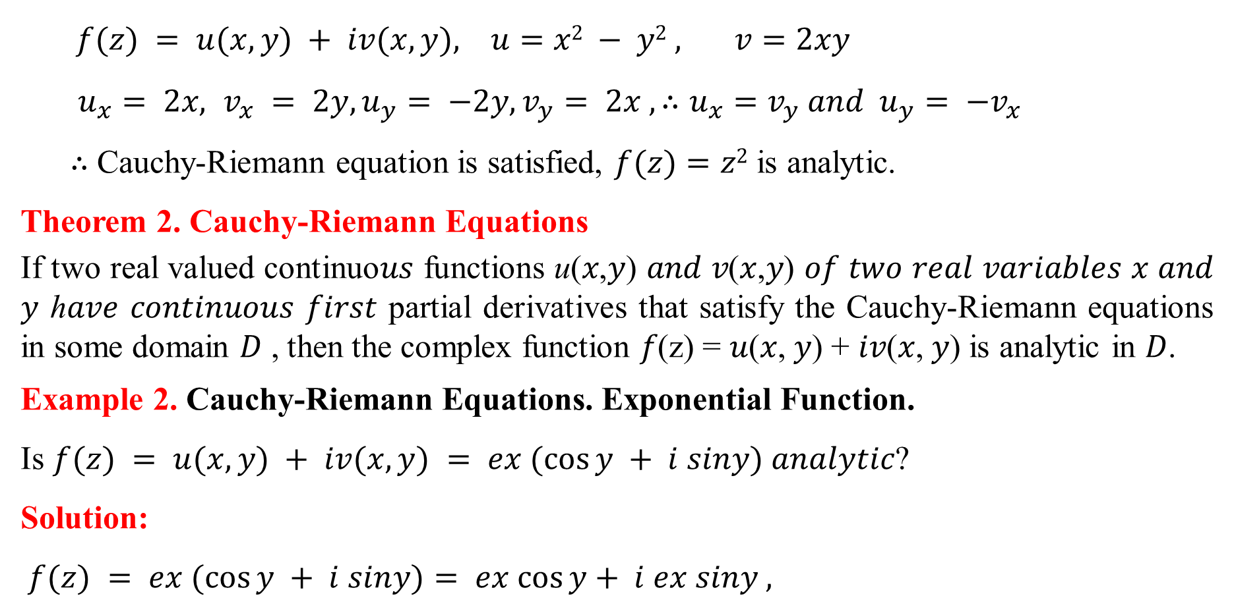
$f(z) = u(x, y) + iv(x, y), u=x2 − y2 , v=2xy$
$u_{x}= 2x, v_{x} = 2y, u_{y}= −2y, v_{y}= 2x , ∴u_{x}=v_{y} and{ u}_{y}= −v_{x}$
∴ Cauchy-Riemann equation is satisfied, $f(z)=z2$ is analytic.
Theorem 2. Cauchy-Riemann Equations
If two real valued continuo𝑢𝑠 functions u(𝑥,𝑦) 𝑎𝑛𝑑 𝑣(𝑥,𝑦) 𝑜𝑓 𝑡𝑤𝑜 𝑟𝑒𝑎𝑙 𝑣𝑎𝑟𝑖𝑎𝑏𝑙𝑒𝑠 𝑥 𝑎𝑛𝑑 𝑦 ℎ𝑎𝑣𝑒 𝑐𝑜𝑛𝑡𝑖𝑛𝑢𝑜𝑢𝑠 𝑓𝑖𝑟𝑠𝑡 partial derivatives that satisfy the Cauchy-Riemann equations in some domain 𝐷 , then the complex function 𝑓(z) = 𝑢(𝑥, 𝑦) + 𝑖𝑣(𝑥, 𝑦) is analytic in 𝐷.
Example 2. Cauchy-Riemann Equations. Exponential Function.
Is $f(z) = u(x, y) + iv(x, y) = ex (cos⁡y + i siny)$𝑎𝑛𝑎𝑙𝑦𝑡𝑖𝑐?
Solution:
$f(z) = ex (cos⁡y + i siny)= ex cos⁡y+ i ex siny ,$

Slide 6
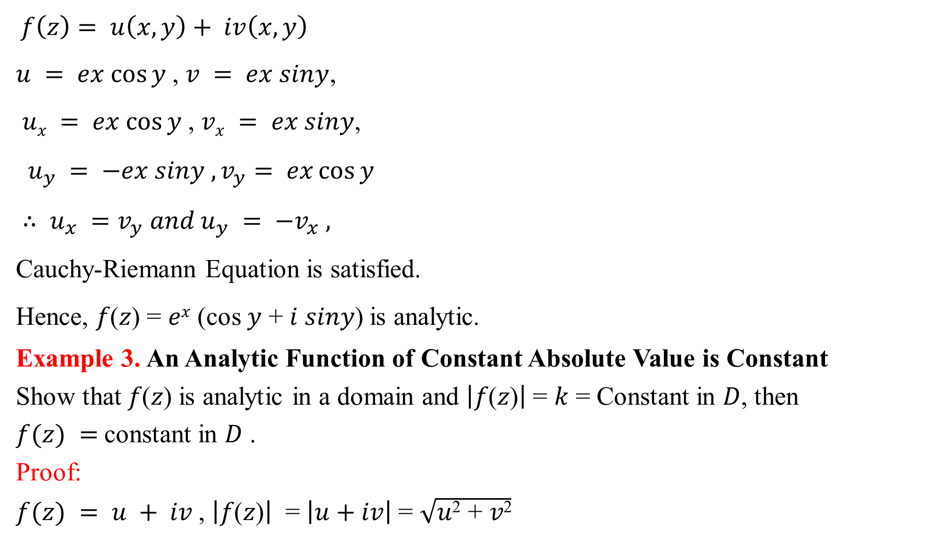
$f\left(z\right)= u\left(x, y\right)+ iv\left(x, y\right)$
$u = ex cos⁡y$, $v = ex siny$,
$ux = ex cos⁡y$, $vx = ex siny$,
$u_{y} = −ex siny , v_{y}= ex\cos{y}$
$∴ u_{x} =v_{y} and u_{y} = −v_{x} ,$
Cauchy-Riemann Equation is satisfied.
Hence, 𝑓(𝑧) = 𝑒^{𝑥} (cos 𝑦 + 𝑖 𝑠𝑖𝑛𝑦) is analytic.
Example 3. An Analytic Function of Constant Absolute Value is Constant
Show that 𝑓(𝑧) is analytic in a domain and $\left|\text{f}\text{(}\text{z}\text{)}\right|$= 𝑘 = Constant in 𝐷, then
$f(z) =$constant in 𝐷 .
Proof:
$f(z) = u + iv$, $\left|\text{f}\text{(}\text{z}\text{)}\right|$ = $\left|u+iv\right|$= $\sqrt{\text{u}\text{2}\text{ + }\text{v}\text{2}}$

Slide 7
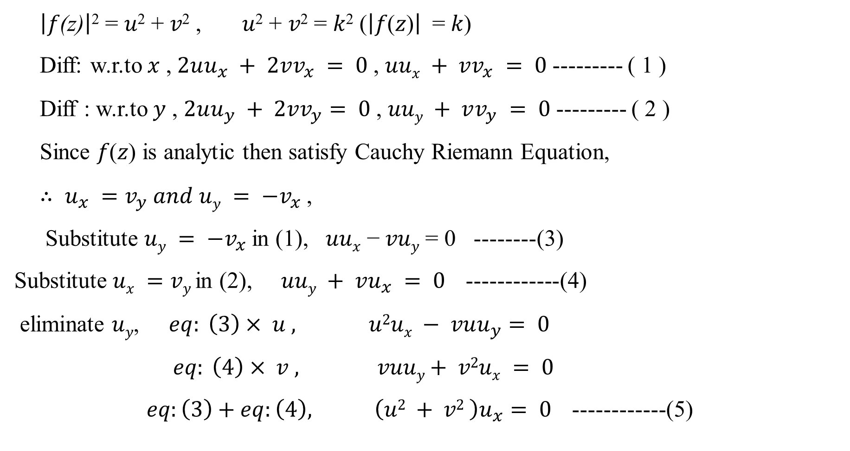
$\left|\text{f}\text{(}\text{z}\text{)}\right|$² = 𝑢² + 𝑣² , 𝑢² + 𝑣² = 𝑘² ($\left|\text{f}\text{(}\text{z}\text{)}\right|$ = 𝑘)
Diff: w.r.to 𝑥 , $2uu_{x} + 2vv_{x} = 0$, $uux + vv_{x} = 0$--------- ( 1 )
Diff : w.r.to 𝑦 , $2uu_{y} + 2vv_{y}= 0$, $uuy + vv_{y} = 0$--------- ( 2 )
Since 𝑓(𝑧) is analytic then satisfy Cauchy Riemann Equation,
$∴ u_{x} =v_{y}$𝑎𝑛𝑑 $uy = −v_{x}$,
Substitute $uy = −v_{x}$in (1), 𝑢𝑢_{𝑥} − 𝑣𝑢_{𝑦} = 0 --------(3)
Substitute $ux =vy$in (2), $uuy + vu_{x} = 0$------------(4)
eliminate 𝑢_{𝑦}, $eq: \left(3\right)× u , u2ux − vuu_{y}= 0$
$eq: \left(4\right)× v , vuuy+ v2ux = 0$
$eq:\left(3\right)+eq:\left(4\right), \left(u2 + v2 \right)u_{x}= 0$ ------------(5)

Slide 8
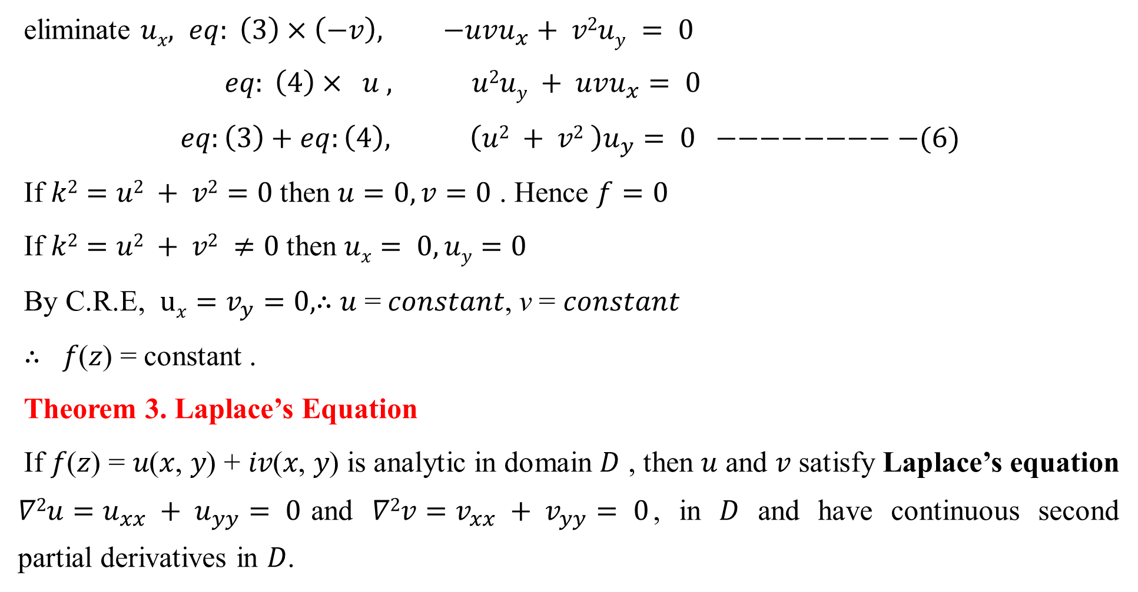
eliminate 𝑢_{𝑥}$, eq: \left(3\right)×\left(−v\right), −uvu_{x}+ v2uy = 0$
$eq: \left(4\right)× u , u2uy + uvu_{x}= 0$
$eq:\left(3\right)+eq:\left(4\right), \left(u2 + v2 \right)u_{y}= 0 −−−−−−−−−(6)$
If $k2=u2 + v2=0$then $u=0,v=0$ . Hence $f=0$
If $k2=u2 + v2 ≠0$then $ux= 0, uy=0$
By C.R.E, $ux=v_{y}=0,$∴ 𝑢 = 𝑐𝑜𝑛𝑠𝑡𝑎𝑛𝑡, v = 𝑐𝑜𝑛𝑠𝑡𝑎𝑛𝑡
∴ 𝑓(𝑧) = constant .
Theorem 3. Laplace’s Equation
If 𝑓(𝑧) = 𝑢(𝑥, 𝑦) + 𝑖𝑣(𝑥, 𝑦) is analytic in domain 𝐷 , then 𝑢 and 𝑣 satisfy Laplace’s equation $∇2u=u_{xx} + u_{yy}= 0$and $∇2v=v_{xx} + v_{yy}= 0$, in 𝐷 and have continuous second partial derivatives in 𝐷.

Slide 9
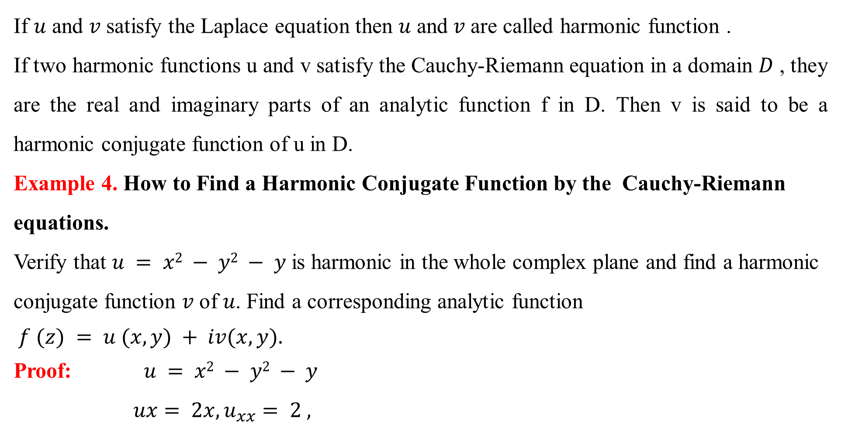
If 𝑢 and 𝑣 satisfy the Laplace equation then 𝑢 and 𝑣 are called harmonic function .
If two harmonic functions u and v satisfy the Cauchy-Riemann equation in a domain 𝐷 , they are the real and imaginary parts of an analytic function f in D. Then v is said to be a harmonic conjugate function of u in D.
Example 4. How to Find a Harmonic Conjugate Function by the Cauchy-Riemann equations.
Verify that $u = x2 − y2 − y$is harmonic in the whole complex plane and find a harmonic conjugate function 𝑣 of 𝑢. Find a corresponding analytic function
$f (z) = u (x, y) + iv(x, y).$
Proof: $u = x2 − y2 − y$
$ux= 2x,u_{xx}= 2 ,$

Slide 10

$uy= −2y − 1,u_{yy}= −2$
$∇2u =u_{xx}+u_{yy}= 2 − 2 = 0$
∴ 𝑢 𝑖𝑠 𝑠𝑎𝑡𝑖𝑠𝑡𝑖𝑒𝑑 𝑡ℎ𝑒 𝐿𝑎𝑝𝑙𝑎𝑐𝑒 ′ 𝑠 𝑒𝑞𝑢𝑎𝑡𝑖𝑜𝑛.
∴ 𝑢 𝑖𝑠 harmonic function.
∴ 𝑣 is harmonic conjugate function of 𝑢
𝑣 must satisfy the Cauchy-Riemann’s equation.
$u_{x} = v_{y} , u_{y}= −v_{x}$
$u_{x}= vy$
$∴v_{y}= 2x$

Slide 11

Integrating w.r.to $y$ , $v=2xy+k( x) −−−−−−−−−− (1)$
Differentiate equation(1) w.r.to 𝑥, $v_{x} = 2y + k′ (x) −−−−−−$(2)
Since $uy = −v_{x}$
$∴vx = − (− 2y − 1) = 2y + 1$
Substitute $vx = 2y + 1$into eq: (2), 𝑘′(𝑥) = 1
Integrating w.r.to $x,$ $k(x) = x + c$
Substitute $k(x) = x + c$into eq: (1), $v = 2xy + x + c$
The corresponding analytic function is $f\left(z\right)=u+iv$
$f(z)=\text{x}\text{2}\text{ − }\text{y}\text{2}\text{ − }\text{y}+i[\text{2}\text{xy}\text{ + }\text{x}\text{ + }\text{c}]$
$f\left(z\right)=\text{x}\text{2}\text{ − }\text{y}\text{2}\text{ − }\text{y}+2ixy+ix+ic$
$=\text{x}\text{2}\text{ − }\text{y}\text{2}\text{ + }\text{i}\text{2}\text{y}+2ixy+ix+ic$

Slide 12
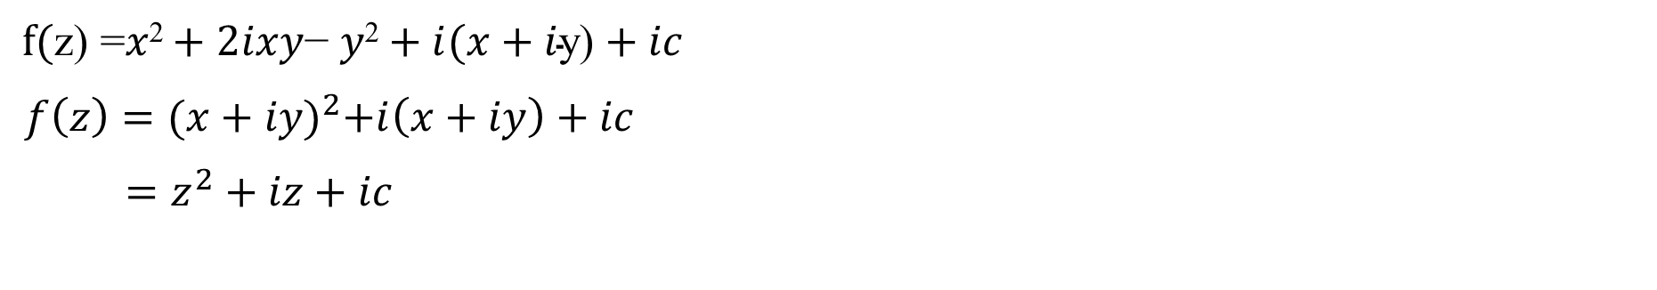
$f(\text{z}\text{) =}\text{x}\text{2}+2ixy\text{− }\text{y}\text{2}+i(x+i\text{y}\text{)}+ic$
$f\left(z\right)={(x+iy)}^{2}+i\left(x+iy\right)+ic$
$=z^{2}+iz+ic$

Slide 13

Reference Book
Advanced Engineering Mathematics, Erwin Kreyszig, $10^{th}$ Edition
Thank you

