Slide 1

NAYPYITAW STATE POLYTECHNIC UNIVERSITY(NSPU)
Department of Computational Mathematics Academic Year 2025-2026
Engineering Mathematics IV
(Fourier Analysis and Complex Analysis)
(EM-4012)
Daw Soe Sanda Aye
Associate Professor
Email:soesandaraye1986@gmail.com

Slide 2
Contents;
Logarithm
Objectives,
To understand Logarithm
To apply problems by Theory
To solve problems by Theory

Slide 3

Hyperbolic Functions
$\cosh{z=\frac{1}{2} \left(e^{z}+e^{−z}\right),}$ $\sinh{z=\frac{1}{2} (e^{z}−e^{−z})}$
$(cosh{z)′=sinh⁡z , }$ $(sinh{z)′=cosh⁡z }$
$\tanh{z=\frac{\sinh{z}}{\cosh{z}}}$ , $\coth{z=\frac{\cosh{z}}{\sinh{z}}}$
$\operatorname{sech}{z=\frac{1}{\cosh{z}}}$ , $\operatorname{csch}{z=\frac{1}{\sinh{z}}}$
$\cosh{iz=\cos{z ,\sinh{iz=i\sin{z}}}}$
cos iz = cosh z , sin iz = i sinh z

Slide 4

Logarithm Rules
$lnz=lnr+iθ, (θ=arg{z,r=\left|z\right|>0)},$The principal value of $lnz$ is $Lnz$.
L$nz=ln\left|z\right|+i Arg z, ,\ln{z}=\operatorname{Ln}{z}\text{±} 2n\text{π}\text{i}\text{ (}\text{n}\text{=1,2,3,..)}$
𝐴𝑟𝑔 𝑒 ^{𝑧} = 𝑦, 𝑎𝑟𝑔 𝑒 ^{𝑧} = 𝐴𝑟𝑔 𝑒 ^{𝑧} ± 2𝑛𝜋 = 𝑦 ± 2𝑛𝜋 , 𝑛 = 0,1,2, …
$ln⁡(e z )= z ± 2nπ$; $n = 0,1,2,$…,If $z=$positive real → $z = x$, $Arg z = 0$
∴ $Ln z = ln⁡z + iArgz = ln⁡z + 0i$,If $z=$negative real → $z = −x, Argz = π$
$Ln z=\ln\left|z\right|+i Arg z=\ln\left|z\right|+πi$
Example(1). Natural Logarithm. Principle value
(a) $Ln1 = 0 ln⁡1 = 0 ± 2nπi (n = 1,2, …)$
$(b) Ln4 = 1.386294 ln⁡4 = 1. 386294 ± 2nπi(n = 1,2, … )$
$(c) Ln(−1) = πi ln⁡(−1) = πi ± 3πi ± 5πi,..$

Slide 5
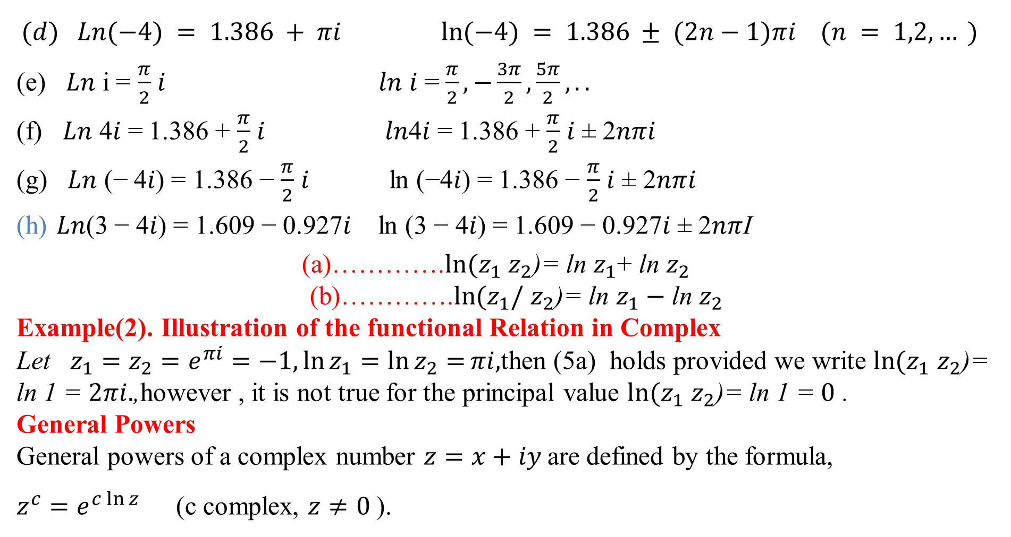
$(d) Ln(−4) = 1.386 + πi ln⁡(−4) = 1.386 ± (2n−1)πi (n = 1,2, … )$
(e) 𝐿𝑛 i = $\frac{π}{2}$ 𝑖 𝑙𝑛 𝑖 = $\frac{π}{2},−\frac{3π}{2},\frac{5π}{2},..$
(f) 𝐿𝑛 4𝑖 = 1.386 + $\frac{π}{2}$ 𝑖 𝑙𝑛4𝑖 = 1.386 + $\frac{π}{2}$ 𝑖 ± 2𝑛𝜋𝑖
(g) 𝐿𝑛 (− 4𝑖) = 1.386 − $\frac{π}{2}$ 𝑖 ln (−4𝑖) = 1.386 − $\frac{π}{2}$ 𝑖 ± 2𝑛𝜋𝑖
𝐿𝑛(3 − 4𝑖) = 1.609 − 0.927𝑖 ln (3 − 4𝑖) = 1.609 − 0.927𝑖 ± 2𝑛𝜋I
(a)………….$\ln{{(z}_{1}}$ $z_{2}$)= ln $z_{1}$+ ln $z_{2}$
(b)………….$\ln{{(z}_{1}/}$ $z_{2}$)= ln $z_{1}−$ ln $z_{2}$
Example(2). Illustration of the functional Relation in Complex
Let $z_{1}=z_{2}=e^{πi}=−1,\ln{z_{1}}=\ln{z_{2}=}πi,$then (5a) holds provided we write $\ln{{(z}_{1}}$ $z_{2}$)= ln 1 = $2πi.$,however , it is not true for the principal value $\ln{{(z}_{1}}$ $z_{2}$)= ln 1 = $0$ .
General Powers
General powers of a complex number $z=x+iy$ are defined by the formula,
$z^{c}=e^{c\ln{z}}$ (c complex, $z≠0$ ).

Slide 6
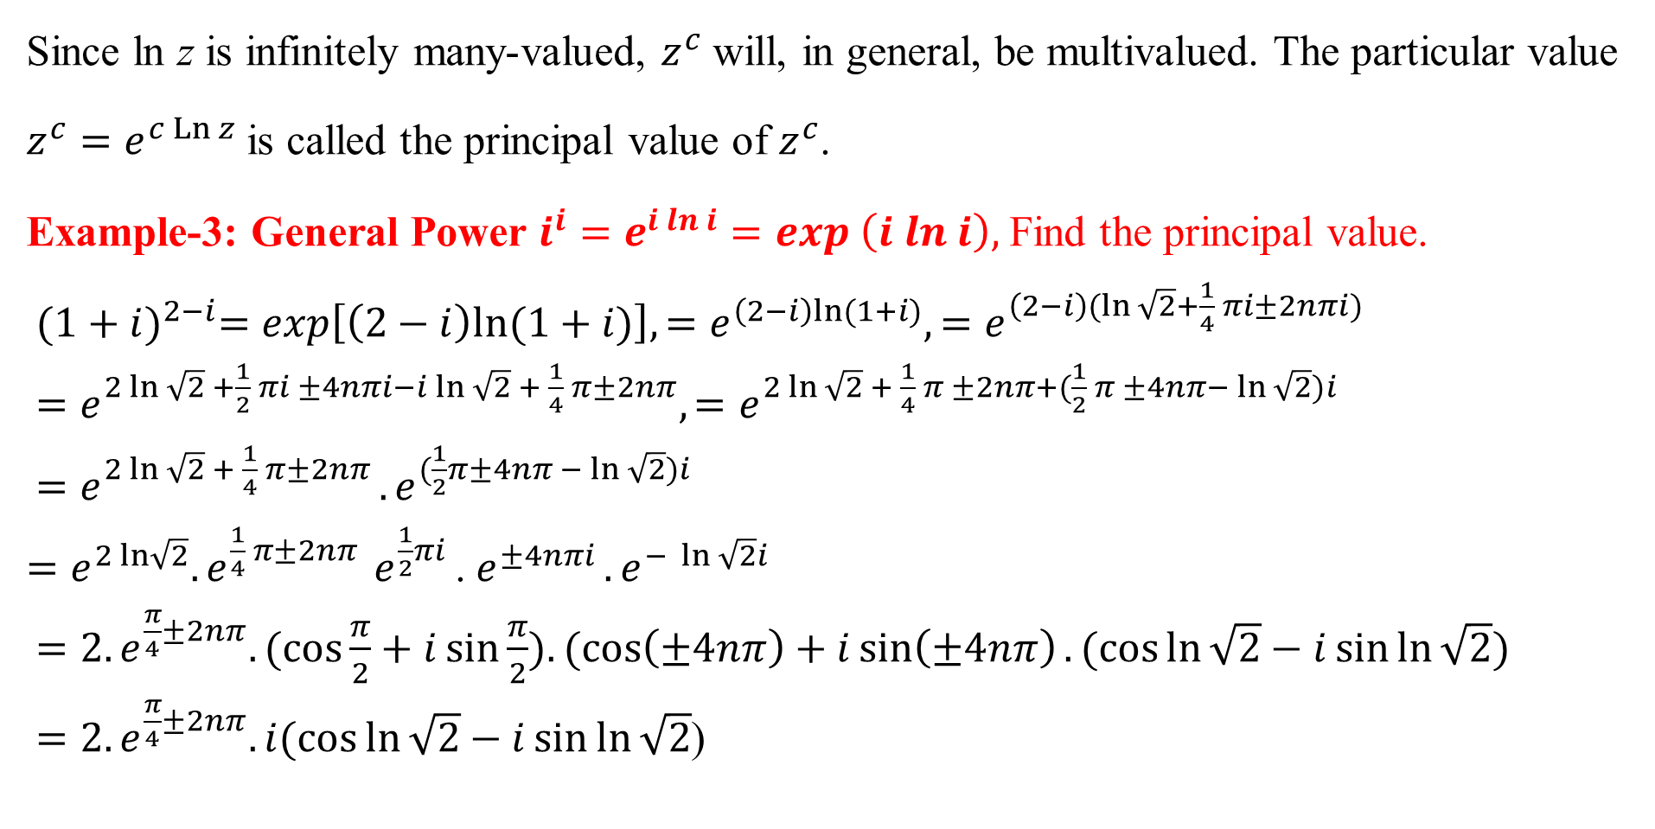
Since ln z is infinitely many-valued, $z^{c}$ will, in general, be multivalued. The particular value
$z^{c}=e^{c\operatorname{Ln}{z}}$is called the principal value of $z^{c}$.
Example-3: General Power $i^{i}=e^{i ln i}=exp \left(i ln i\right),$ Find the principal value.
${(1+i)}^{2−i}=exp\left[\left(2−i\right)ln⁡(1+i)\right],{=e}^{\left(2−i\right)ln⁡(1+i)},{=e}^{\left(2−i\right)(ln \sqrt{2}+\frac{1}{4} πi±2nπi)}$
${=e}^{2 ln\sqrt{2}{+\frac{1}{2}} πi ±4nπi−i\ln{\sqrt{2}} + \frac{1}{4} π±2nπ},{=e}^{2 ln\sqrt{2}{+ \frac{1}{4} π ±2nπ+(\frac{1}{2}} π ±4nπ− \ln{\sqrt{2}})i }$
${=e}^{2 ln\sqrt{2}{+ \frac{1}{4} π±2nπ }}.e^{(\frac{1}{2}π±4nπ − \ln{\sqrt{2}})i }$
${=e}^{2 ln\sqrt{2}}.e^{\frac{1}{4} π±2nπ{ }}e^{\frac{1}{2}πi }$. $e^{±4nπi }.e^{− \ln{\sqrt{2}}i }$
$=2.e^{\frac{π}{4}±2nπ}.(\cos{\frac{π}{2}+i\sin{\frac{π}{2}).(\cos\left(±4nπ\right)+i\sin\left(±4nπ\right).(\cos{\ln{\sqrt{2}}−i\sin{\ln{\sqrt{2}}}}}})$
$=2.e^{\frac{π}{4}±2nπ}. i(\cos{\ln{\sqrt{2}}−i\sin{\ln{\sqrt{2}}}}$)

Slide 7
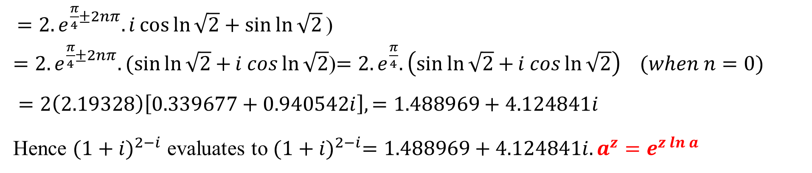
$=2.e^{\frac{π}{4}±2nπ}. i\cos{\ln{\sqrt{2}}+\sin{\ln{\sqrt{2}}}}\text{)}$
$=2.e^{\frac{π}{4}±2nπ}. (\sin{\ln{\sqrt{2}}}+{i cos{\ln{\sqrt{2}}}}$)$=2.e^{\frac{π}{4}}. \left(\sin{\ln{\sqrt{2}}}+{i cos{\ln{\sqrt{2}}}}\right) (when n=0)$
$=2\left(2.19328\right)\left[0.339677+0.940542i\right],=1.488969+4.124841i$
Hence ${(1+i)}^{2−i}$ evaluates to ${(1+i)}^{2−i}=1.488969+4.124841i.a^{z}=e^{z ln a}$

Slide 8

Reference Book
Advanced Engineering Mathematics, Erwin Kreyszig, $10^{th}$ Edition
Thank you

