Slide 1

NAYPYITAW STATE POLYTECHNIC UNIVERSITY(NSPU)
Department of Computational Mathematics Academic Year 2025-2026
Engineering Mathematics IV
(Fourier Analysis and Complex Analysis)
(EM-4012)
Daw Soe Sanda Aye
Associate Professor
Email:soesandaraye1986@gmail.com

Slide 2
Contents;
Line Integral in the Complex Plane
Cauchy’s Integral Theorem
Objectives,
To understand Line Integral in the Complex Plane
To understand Cauchy’s Integral Theorem
To apply problems by Theory
To solve problems by Theory

Slide 3
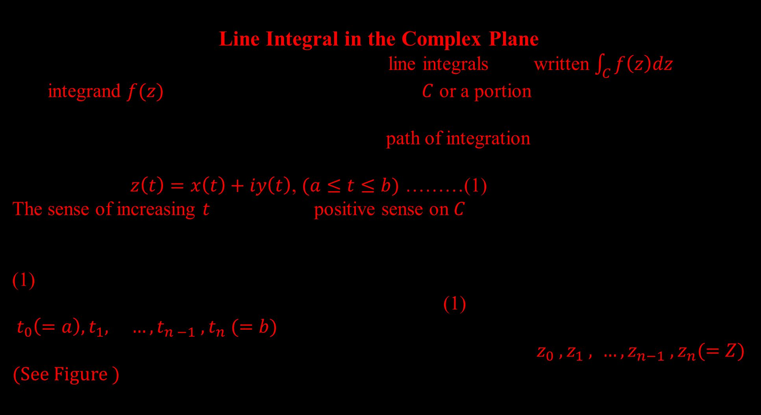
Line Integral in the Complex Plane
Complex definite integrals are called(complex) line integrals, are written $\int_{C}{f\left(z\right)dz}$.
The integrand $f(z)$ is integrated over a given curve $C$ or a portion of it (an arc, but shall say $"curve “$ ) .
This curve $C$ in the complex plane is called the path of integration.
We may represent $C$ by a parametric representation
$z\left(t\right)=x\left(t\right)+iy\left(t\right)$, $(a≤t≤b)$ ………(1)
The sense of increasing $t$ is called the positive sense on $C.$
Definition of the Complex Line integral : Let $C$ be a smooth curve in the complex plane by (1) , and let $f(z)$ be a continuous function given (at least) at each point of $C$ .We now subdivide (we “ partition “ ) the interval $a≦t ≦b$ in (1) by points
$t_{0}\left(=a\right), t_{1}, …, t_{n −1} ,t_{n} (=b)$ , where $t_{0} <t_{1}< …<t_{n}$
To this subdivision there corresponds a subdivision of $C$ by points $z_{0} , z_{1} , …,z_{n−1} , z_{n}(=Z)$
(See Figure )

Slide 4
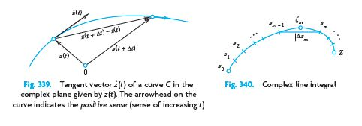
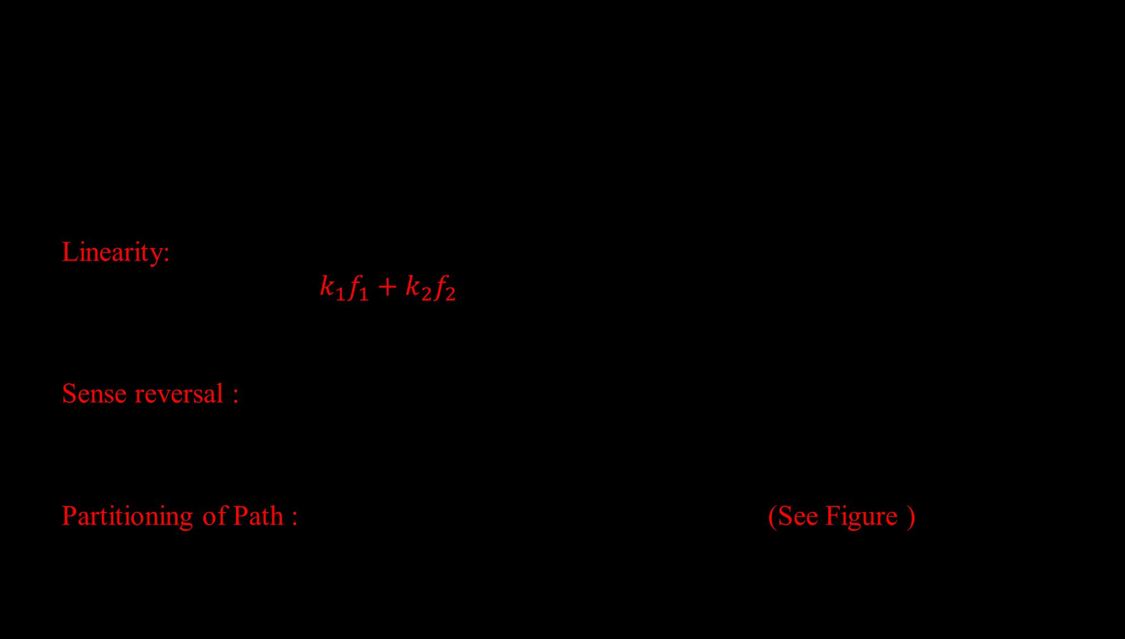
Basic Properties Directly Implied by the Definition
Linearity: Integration is a linear operation. If the integral of $f_{1}$ and $f_{2}$ over a path $C$ exist , so does the integral of $k_{1}f_{1}+k_{2}f_{2}$ over the same path and
$\int_{C}{\left[k_{1}f_{1}\left(z\right)+k_{2}f_{2}\left(z\right)\right]dz=}k_{1}\int_{C}{f_{1}\left(z\right)dz +}k_{2} \int_{C}{f_{2}\left(z\right)dz }$,where $k_{1}$ and $k_{2}$are constants.
Sense reversal : In integration over the same path , from $z_{0}$ to $Z$ (left) and from $Z$ to $z_{0}$ (right), introduces a minus sign as shown, $\int_{z_{0}}^{z}{f\left(z\right)dz=−\int_{z}^{z_{0}}{f\left(z\right)dz}}$.
Partitioning of Path : $\int_{C}{f\left(z\right)dz}=\int_{C_{1}}{f\left(z\right)dz +\int_{C_{2}}{f\left(z\right)dz}}$. (See Figure )

Slide 5
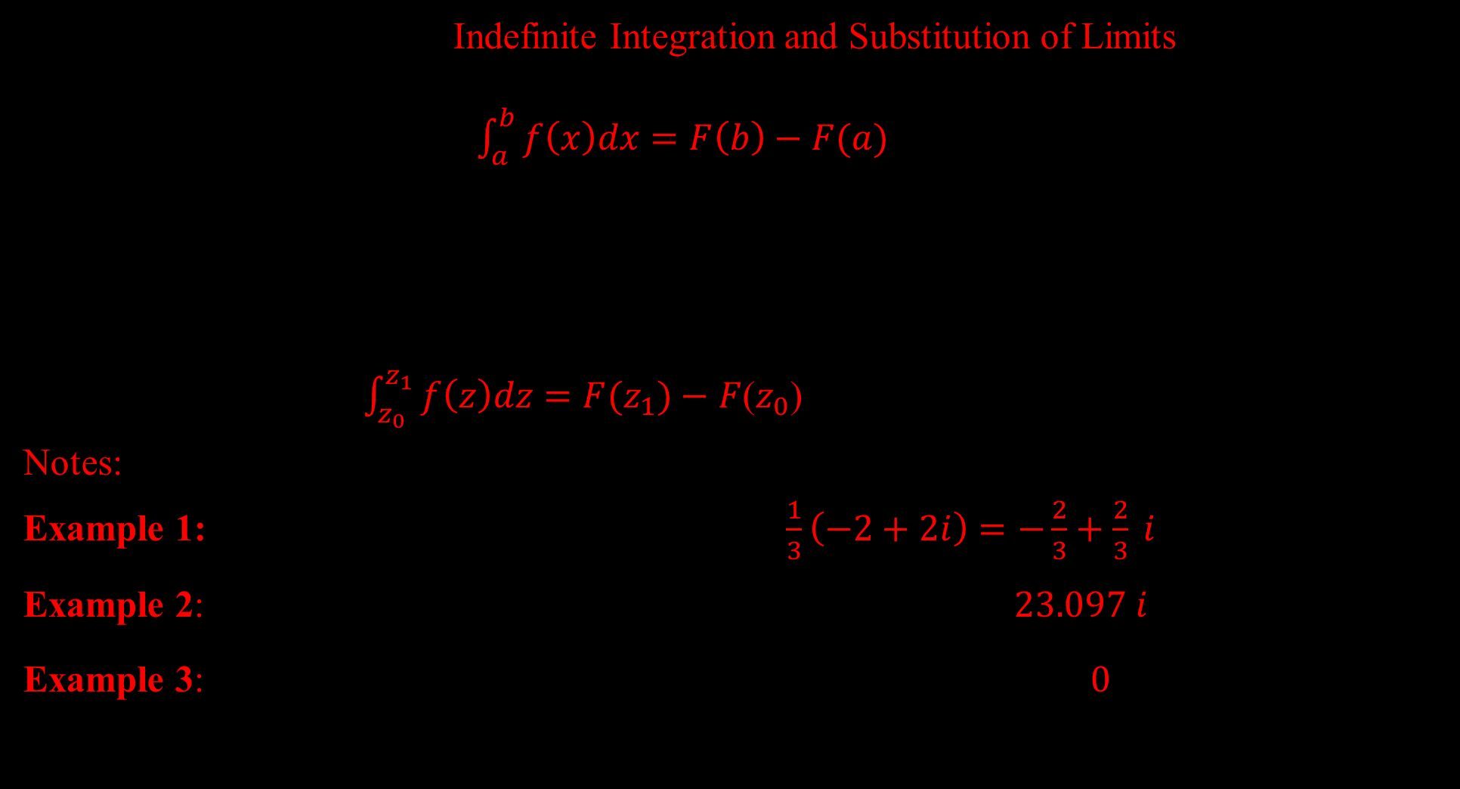
First Evaluation Method: Indefinite Integration and Substitution of Limits This method is the analog of the evaluation of definite integrals in calculus by the well-known formula $\int_{a}^{b}{f\left(x\right)dx=F\left(b\right)−F(a)}$ , where $[F^{′}\left(x\right)=f\left(x\right)]$
Theorem 1: Indefinite Integration of Analytic Functions
Let $f(z)$ be analytic in a simply connected domain $D$. Then there exists an indefinite integral of $f(z)$ in the domain $D$, that is, an analytic function $F(z)$ such that $F^{′}$(z) $=f(z)$in $D$ and for all paths in $D$ joining two points $z_{0}$ and $z_{1}$in $D$ we have
$\int_{z_{0}}^{z_{1}}{f\left(z\right)dz=F(z_{1})}−$ $F$($z_{0}$) [ $F^{′}$(z) =$f(z)$ ].
Notes: Write $z_{0}$ and $z_{1}$ instead of $C.$
Example 1:$\int_{0}^{1+i}{z^{2}dz=\frac{1}{3}{\left[z^{3}\right]}_{0}^{1+i}=\frac{1}{3}{\left[1+i\right]}^{3}=\frac{1}{3}\left(−2+2i\right)}=−\frac{2}{3}+\frac{2}{3} i$
Example 2:$\int_{−πi}^{πi}{\cos{z}dz={\left[\sin{z}\right]}_{−πi}^{πi}=2 \sin{πi}=2i \sinh{π=}23.097 i }$
Example 3: $\int_{8+πi}^{8−3πi}{e^{z/2} dz}=2{\left[e^{z/2}\right]}_{8+3i}^{8−3i}=2\left[e^{{4−3πi}/2} −e^{{4+3πi}/2}\right]=0$
since $e^{z}$ is periodic with period 2$πi$ .

Slide 6
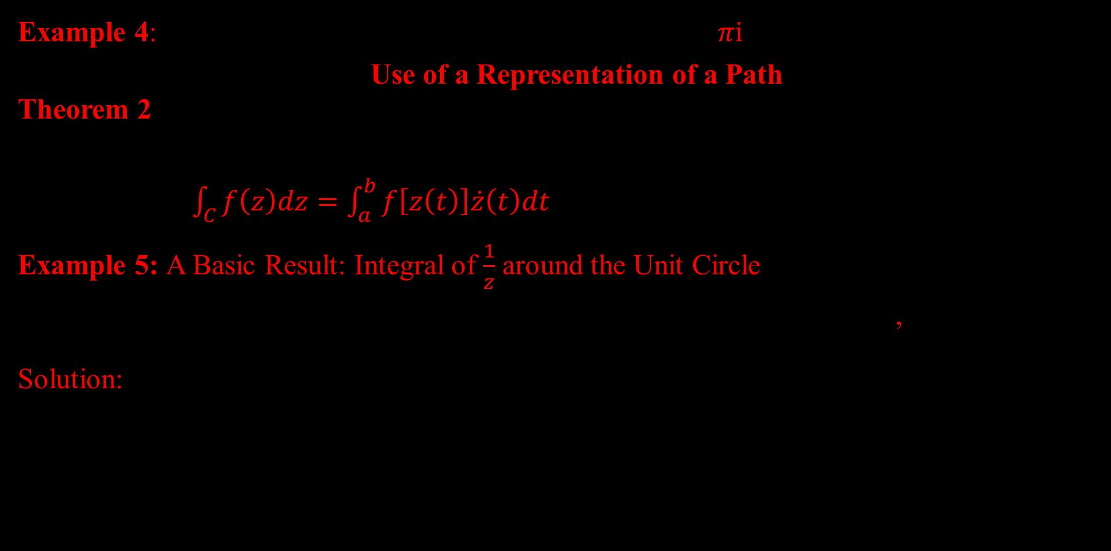
Example 4:$\int_{−i}^{i}{\frac{1}{z}dz={\left[\ln{z}\right]}_{−i}^{i}=\ln{i}−\ln\left(−i\right)=\frac{πi}{2}+\frac{πi}{2}=πi}$
Second Evaluation Method: Use of a Representation of a Path
Theorem 2: Integration by the Use of the Path, Let $C$ be a piecewise smooth path, represented by $z=z(t),$where$a≤t≤b.$ Let $f(z)$ be a continuous function on $C$.Then
$\int_{C}{f\left(z\right)dz=\int_{a}^{b}{f\left[z\left(t\right)\right]\dot{z}\left(t\right)dt}}$, $(\dot{z}\left(t\right)=$ $\frac{dz}{ dt}$)
Example 5: A Basic Result: Integral of $\frac{1}{z}$ around the Unit Circle, show that by integrating $\frac{1}{z}$ counterclockwise around the unit circle(the circle of radius $1$ and center $0)$, $\oint_{C}{\frac{dz}{z}} =2πi$.
Solution: $Let f\left(z\right)=\frac{1}{z}$ on $C \left(C the unit circle, C.C.W\right),$
$z\left(t\right)=\cos{t}+i \sin{t}=e^{it}$ (0$≤t≤2π),$ $z^{.} (t)$ = ${ie}^{it}$ , $f\left(z\right)$ = $\frac{1}{z}$ =${ e}^{−it}$
Therefore , $\oint_{c}{f\left(z\right)dz=\oint_{C}{f\left(z(t)\right) \dot{z}\left(t\right)dt=}\int_{0}^{2π}{e^{−it}}ie^{it}dt}$ , $=i\int_{0}^{2π}{dt=i{\left[t\right]}_{0}^{2π}=2πi }$

Slide 7





Example 6: Integral of $1/z^{m}$ with integer power $m,$Let $f\left(z\right)={(z−z_{0})}^{m}$ where $m$ is an integer and $z_{0}$ is a constant. Integrate counterclockwise around the circle $C$ of radius $ρ$ with center at${ z}_{0}$.(See Figure).
Solution: Let $f\left(z\right)={(z−z_{0})}^{m}$
$\text{any} \text{center}\text{,}\text{radius}⇒z=z\left(t\right)=z_{0}+ ρ\left(cos t+i sin t\right)=z_{0}+ρ e^{it}, 0≤t≤2π$
$\dot{ \dot{z}\left(t\right)=\frac{dz}{dt}=iρe^{it}, dz=iρe^{it}dt,}{ (z−z_{0})}^{m}$=${ (z_{0}+ρ e^{it}−z_{0})}^{m}$= $ρ^{m}e^{imt }$
$\oint_{c}{{(z−z_{0})}^{m}dz=\oint_{C}{ρ^{m}e^{imt}\dot{z}\left(t\right)dt}},$ $=\int_{0}^{2π}{ρ^{m}e^{imt }iρe^{it}dt }$
$=iρ^{m+1}\int_{0}^{2π}{e^{i(m+1)t }dt }$
$=iρ^{m+1}\left[\int_{0}^{2π}{\left(\cos\left(m+1\right)t+i\sin\left(m+1\right)t\right)dt}\right]$
$$y$$
$$ρ$$
$$C$$
$$z_{0}$$
$$x$$

Slide 8




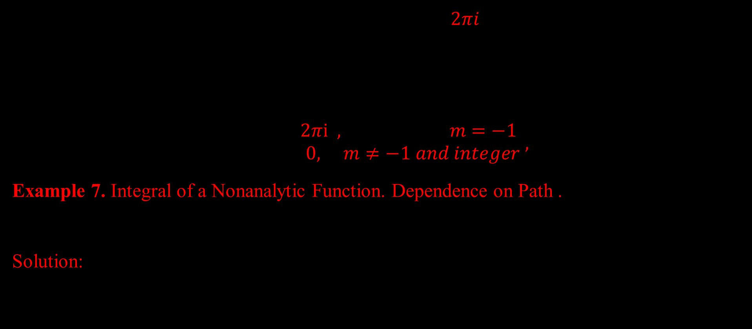


If $m=−1, ρ^{0}=1, \cos{0=1, \sin{0=0}}$, then we get $2πi$.
If $m≠−1,\text{each} \text{of} \text{the} \text{two} \text{integrals} \text{is} \text{zero} \text{because} \text{we} \text{integrate} \text{over} \text{an} \text{interval} \text{of} \text{length}\text{ , }\text{equal} \text{to} \text{a} \text{period} \text{of} \text{sine} \text{and} \text{cosine}$.
Hence $\oint_{c}{{\left(z−z_{0}\right)}^{m}dz=}\left\{\begin{matrix}2πi , m=−1 \\ 0, m≠−1 and integer\end{matrix}\right.$ $,$
Example 7. Integral of a Nonanalytic Function. Dependence on Path .
Integrate $f\left(z\right)=Re z=x$, from $0$ to $1+2i$ (a)along $C^{∗},$(b) along $C$ consisting of $C_{1}$ and $C_{2}$ .(See Figure )
Solution:
$$y$$
2
$$z=1+2i$$
$$C^{∗}$$
$$C_{2}$$
$$C_{1}$$
$$1$$
$$x$$

Slide 9

(a) $C^{∗}$ , $z\left(t\right)=x\left(t\right)+iy\left(t\right)=t+2it, 0≤t≤1$, then $f\left(z\left(t\right)\right)=Re z\left(t\right)=x\left(t\right)=t, \dot{z}\left(t\right)=1+2i, \int_{C^{∗}}{f\left(z\right)dz}=\int_{C^{∗}}{f\left(z\left(t\right)\right)\dot{z}\left(t\right)dt}=\int_{0}^{1}{Re z\left(t\right)\dot{z}\left(t\right)dt}$
$=\int_{0}^{1}{t\left(1+2i\right)dt}=\left(1+2i\right){\left[\frac{t^{2}}{2}\right]}_{0}^{1}=\frac{1}{2}\left(1+2i\right)$
(b) along $C_{1}$, From (0,0) to (1,0), $z\left(t\right)=x\left(t\right)+iy\left(t\right)=t, 0≤t≤1$, then
$f\left(z\left(t\right)\right)=Re z\left(t\right)=x\left(t\right)=t,$ $\dot{z}\left(t\right)=1$
$\int_{c_{1}}{f\left(z\right)dz=\int_{C_{1}}{f\left(z\left(t\right)\right)\dot{z}\left(t\right)dt}}=\int_{0}^{1}{Re z\left(t\right)\dot{z}\left(t\right)dt=}\int_{0}^{1}{tdt}={\left[\frac{t^{2}}{2}\right]}_{0}^{1}=\frac{1}{2}$
along $C_{2}$, From (1,0) to (1,2), $z\left(t\right)=x\left(t\right)+iy\left(t\right)=1+2it, 0≤t≤1$, then
$f\left(z\left(t\right)\right)=Re z(t)=x\left(t\right)=1, \dot{z}\left(t\right)=2i$,
$\int_{c_{2}}{f\left(z\right)dz=\int_{C_{2}}{f\left(z\left(t\right)\right)\dot{z}\left(t\right)dt}}=\int_{0}^{1}{Re z\left(t\right)\dot{z}\left(t\right)dt=}\int_{0}^{1}{2idt}={2i\left[t\right]}_{0}^{1}=2i$

Slide 10
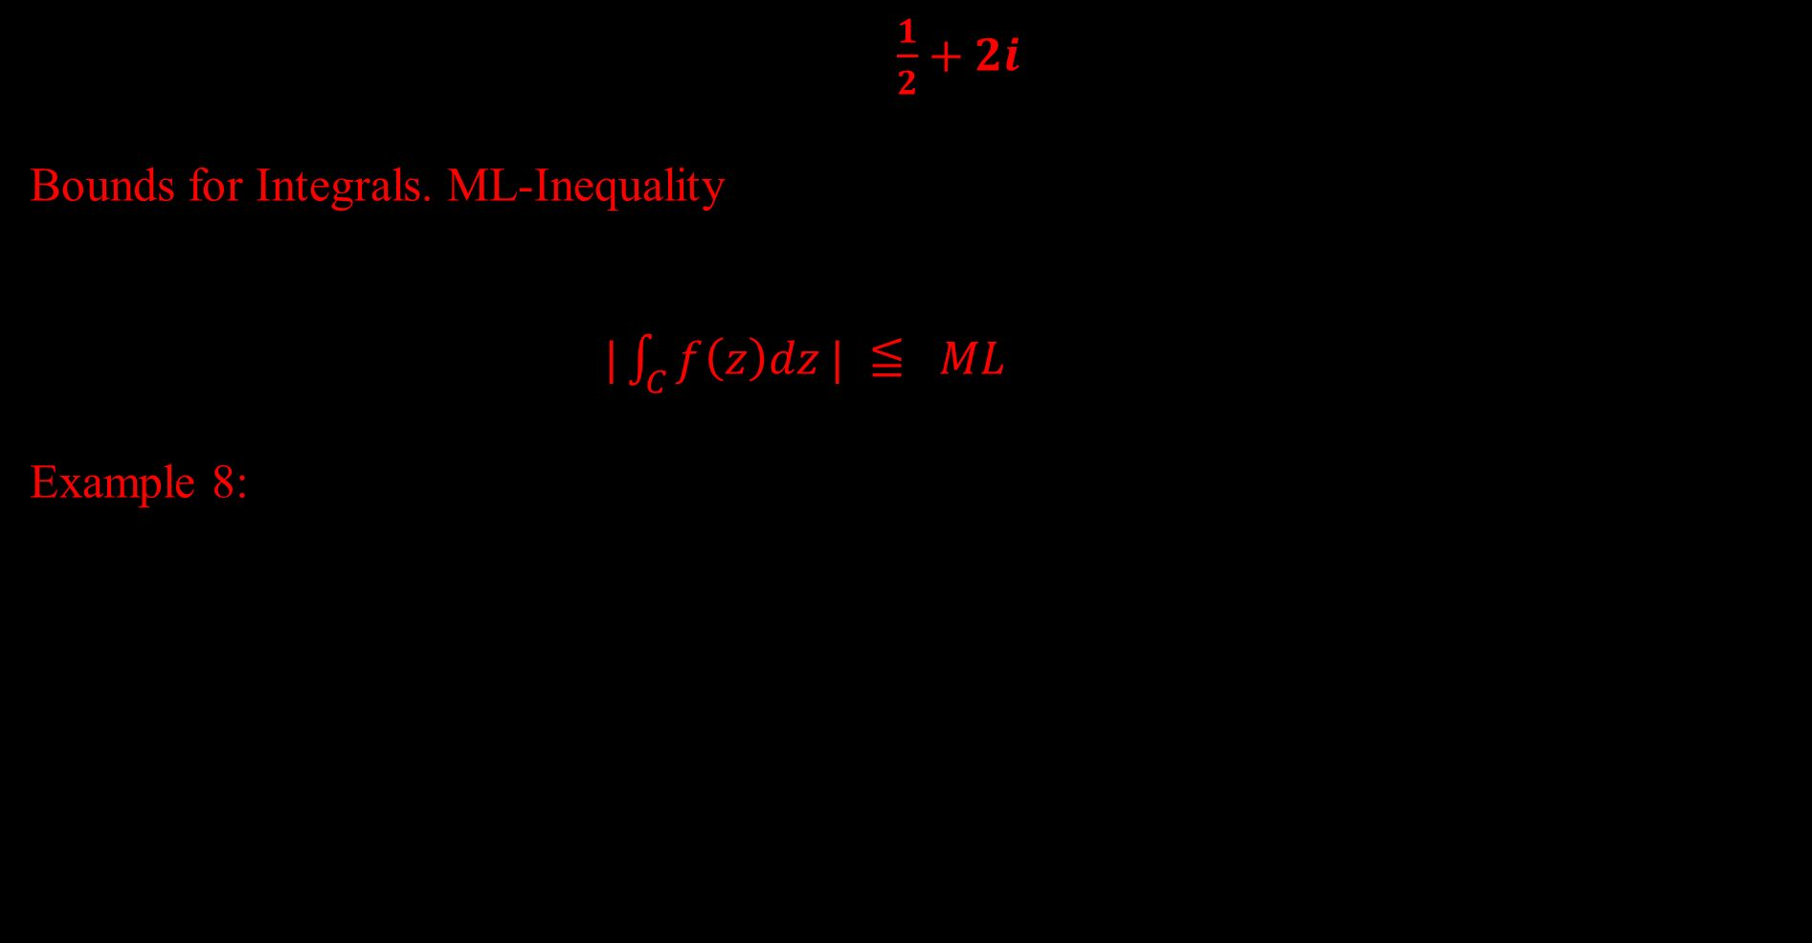

$∴\int_{C}{f\left(z\right)dz}=\int_{C_{1}}{f\left(z\right)dz}+\int_{C_{2}}{f\left(z\right)dz}=\frac{1}{2}+2i$
Bounds for Integrals. ML-Inequality There will be a frequent need for estimating the absolute value of complex line integrals . The basic formula is $|\int_{C}{f\left(z\right)dz | ≦ ML}$ ($ML$-inequality)
Example 8: Estimation of an Integral
Find an upper bound for the absolute value of the integral $\int_{C}{z^{2}dz}, C$ the straight-line segment from 0 to $1+i .$ (See Figure)
Solution:
$L=\sqrt{2}$ , $\left|f(z)\right|=\left|z^{2}\right|≤2$ on $C$
$\left|\int_{C}{f\left(z\right)dz}\right|≤ML$ $=\left|\int_{C}{z^{2}dz}\right|≤2\sqrt{2}=2.8284.$
The absolute value of the integral is $\left|−\frac{2}{3}+\frac{2}{3}i\right|=\frac{2}{3}\sqrt{2}=0.9428$.
_
1
$$°$$
C
I
1

Slide 11
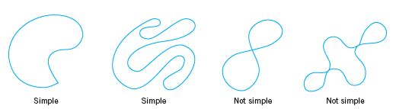

Cauchy’s Integral Theorem
A simple closed path is a closed path that does not intersect or touch itself as shown in Fig.
For example, a circle is simple, but a curve shaped like an 8 is not simple.
A simply connected domain D in the complex plane is a domain such that every simple closed path in D encloses only points of D. Examples: The interior of a circle (“open disk”), ellipse, or any simple closed curve. A domain that is not simply connected is called multiply connected. Examples: An annulus, a disk without the center, for example, $0<\left|z\right|<1$.See also Fig.
Closed paths

Slide 12
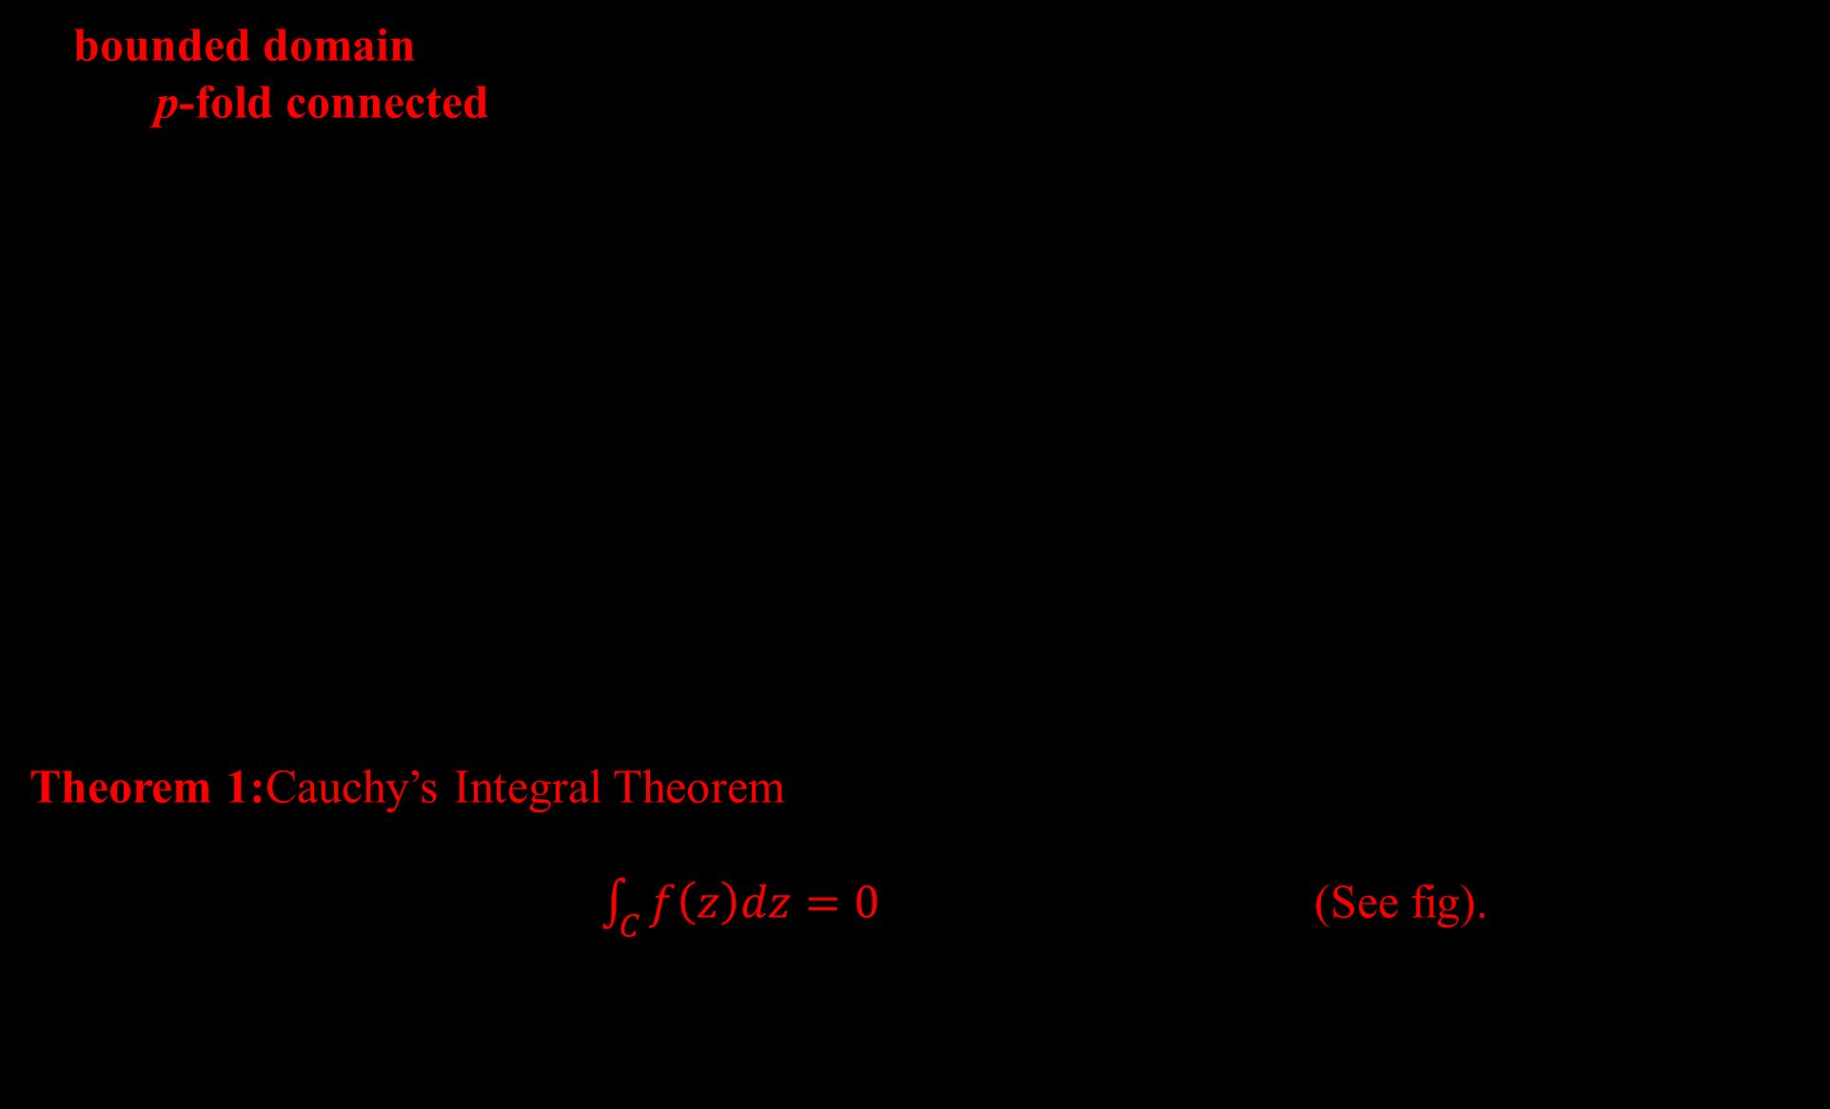
A bounded domain D (that is, a domain that lies entirely in some circle about the origin) is called p-fold connected if its boundary consists of p closed connected sets without common points. These sets can be curves, segments, or single points (such as $z=0$ for $0<\left|z\right|<1$ , for which $p=2$). Thus, D has $p−1$“holes ,” where “hole” may also mean a segment or even a single point. Hence an annulus is doubly connected $\left( p=2\right)$
Theorem 1:Cauchy’s Integral Theorem
If $f(z)$ is analytic in a simply connected domain D, then for every simple closed path $C$ in D, $\int_{C}{f\left(z\right)dz=0}$ (See fig).
Simply and multiply connected domains

Slide 13
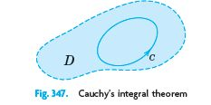
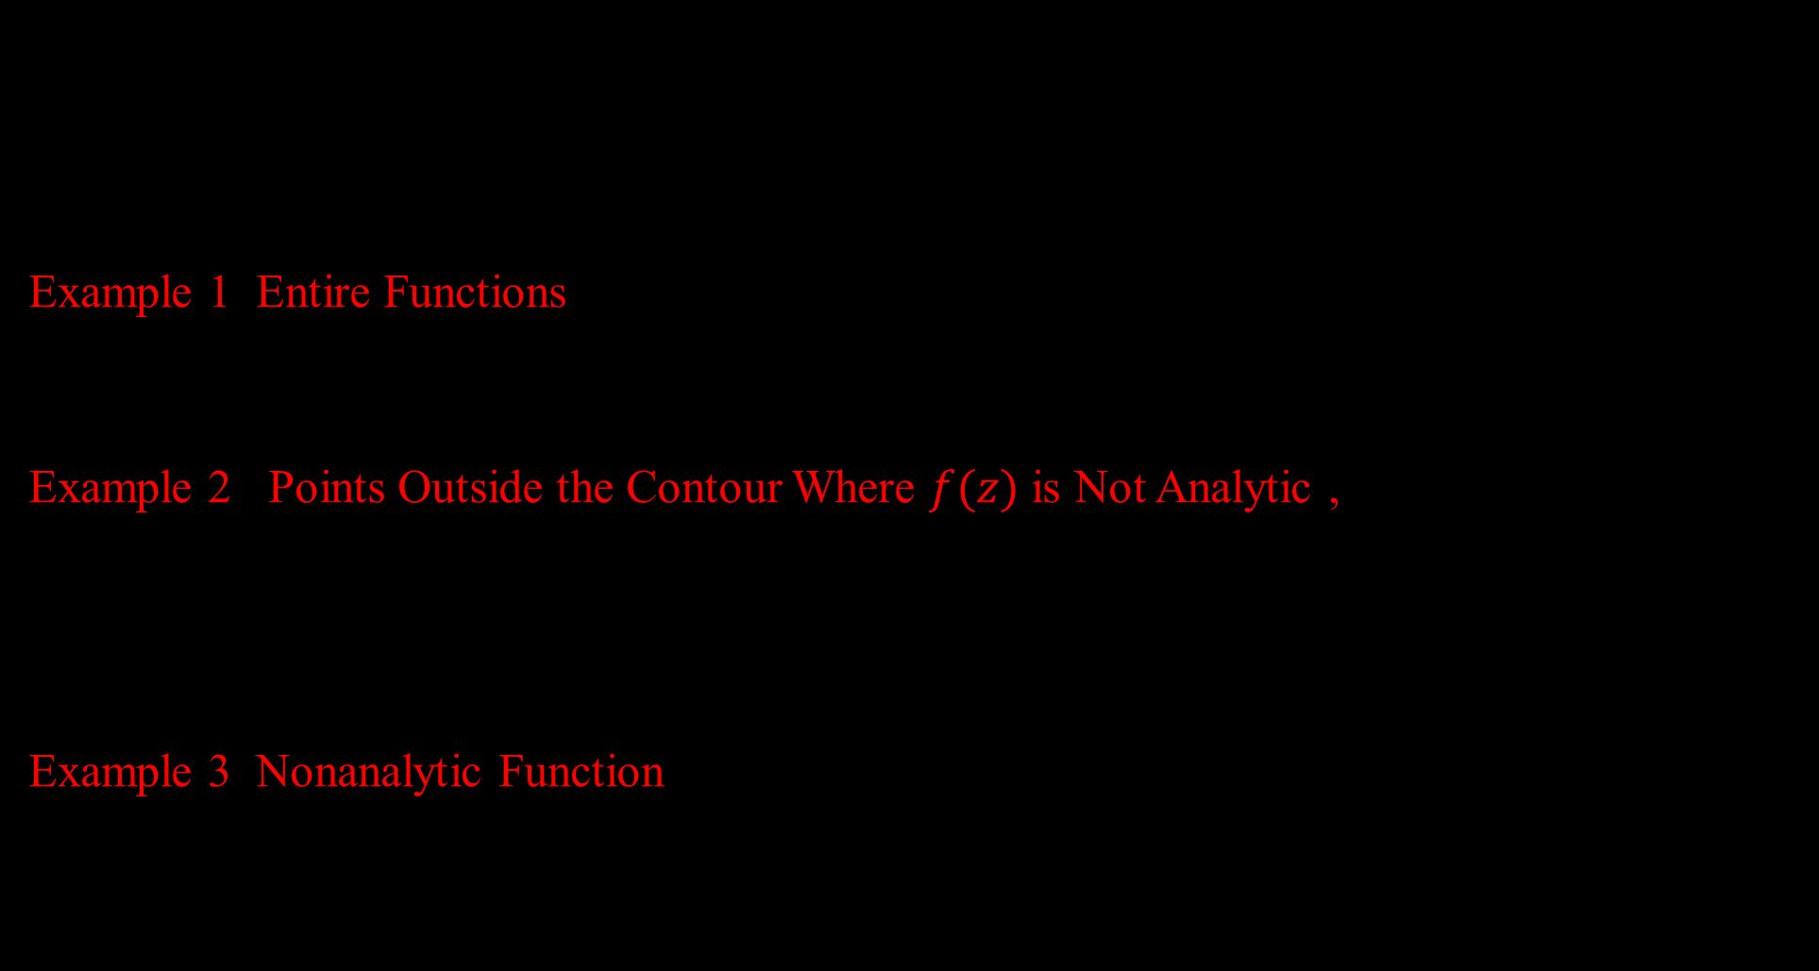
Example 1: Entire Functions
$\oint_{c}{e^{z} dz=0.}$ $\oint_{c}{\cos{z}dz=0.}$ $\oint_{c}{z^{n}dz=0}$ $(n=0,1,2,….)$
for any closed path, since these functions are entire (analytic for all z).
Example 2: Points Outside the Contour Where $f(z)$ is Not Analytic ,
$\oint_{c}{\sec{z}dz=0, }$ $\oint_{c}{ \frac{dz}{z^{2}+4}=0}$ ,where $C$ is the unit circle, $\sec{z}=\frac{1}{cos z}$ is not analytic at $z=±π/{2 }$,$±{3π}/2$,…, but all these points lie outside $C$; none lies on $C$ or inside $C$. Similarly for the second integral, whose integrand is not analytic at $z=±2i$ outside $C$.
Example 3: Nonanalytic Function ,$\oint_{c}{\overline{z}dz=}\int_{0}^{2π}{e^{−it}ie^{it}dt=2πi}$,
where $C:z(t)$ is the unit circle. This does contradict Cauchy’s theorem because $f\left(z\right)=\overline{z}$ is not analytic.

Slide 14

Example 4: Analyticity Sufficient, Not Necessary
$\oint_{c}{\frac{1}{z^{2}}}dz=0$, where C is the unit circle. This result does not follow from Cauchy’s theorem, because $f\left(z\right)=\frac{1}{z^{2}}$ is not analytic at $z=0$. Hence the condition that f be analytic in D is sufficient rather than necessary for (1) to be true .
Theorem 2: Independence of Path
If $f(z)$ is analytic in a simply connected domain D, then the integral of $f(z)$ is independent of path in D.
Example 6: A Basic Result: Integral of Integer Powers
From Example 6 in Sec. 14.1 and the principle of deformation of path it follows that
$$\oint_{c}{{\left(z−z_{0}\right)}^{m}dz=}\left\{\begin{matrix}2πi, m=−1 \\ 0, m≠−1 and integer\end{matrix}\right.$$
for counterclockwise integration around any simple closed path containing in its interior.

Slide 15
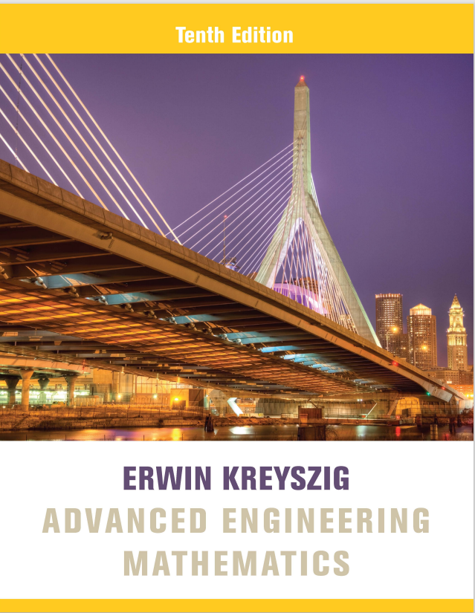
Reference Book
Advanced Engineering Mathematics, Erwin Kreyszig, $10^{th}$ Edition
Thank you

