Slide 1
EP60021
ENGINEERING B-PLAN DEVELOPMENT - 1
20MF10015 | Keerthi Sree Marrapu
20IM30013 | Oindrila Maji
20MT10016 | Baibhav Vikas
20EE10041 | Mayank Shukla

Slide 2


DocuSense
Explore and manage your PDF collection with ease
Your Personal Document Concierge

Slide 3
PROBLEM STATEMENT
A study to identify the factors that influence the food consumption in restaurants among the KGP students. Please follow any theoretical model related to consumer behaviour.
Key Pain Points
Unorganized PDFs cause clutter and inefficiency
Memory wasted by unused or duplicate PDFs
Redundant downloads of identical PDFs
Ineffective search methods hinder quick and accurate information retrieval
Need
Rapid Information Retrieval

Slide 4
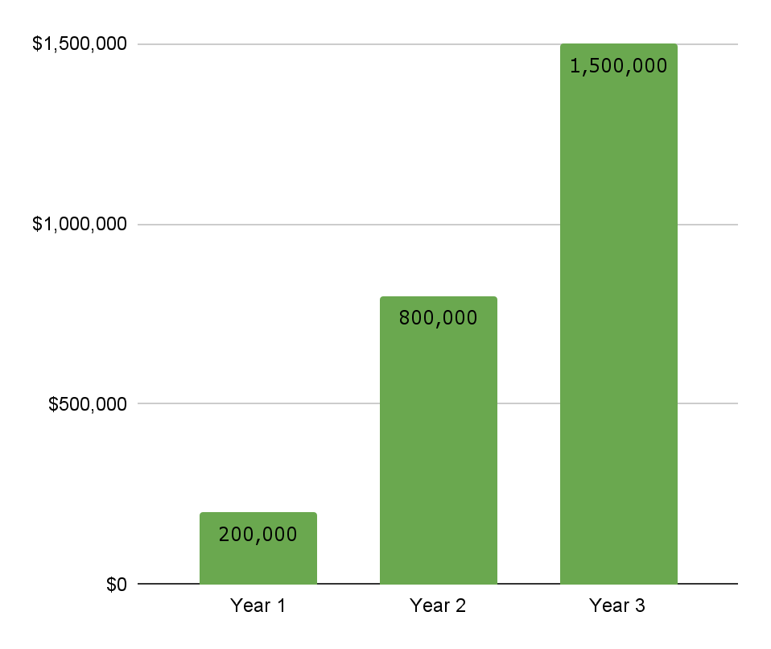
EXECUTIVE SUMMARY
Company Name | DocuSense, Pvt. Ltd. (Pending incorporation)
Industry | Software
Product/Service | AI-powered PDF management solution
Target Audience | Individuals, students, professionals & businesses
Location | Kharagpur, India
Legal Structure | LLC
Management Team | Oindrila Maji (Co-Founder and CEO) Keerthi Sree Marrapu (Founder and CTO) Baibhav Vikas (CFO) Mayank Shukla (Head of Product)
Business History | Founded in May 2023
Problem Statement: PDF document overload, leading to disorganization, version confusion, memory wastage, and ineffective searches.
Solution: DocuSense provides a comprehensive suite of AI features to organize, search, chat and manage PDF files efficiently.
Competitive Landscape
PDF management software market is highly competitive, with many established players.
DocuSense differentiates itself with its AI-powered features - AI-driven chat capabilities, automatic document clustering, text summarization, etc.
Financial Projections
The company expects to break even in its second year of operation.
Mission
To provide a simple and intuitive file management solution that helps users organize their files in an efficient and effective manner
Vision
To make information retrieval seamless, secure, quick and intelligent
Company Strategy
Focus on the target market: We will focus our marketing and sales efforts on our target market of individuals, students, professionals, and small businesses.
Develop innovative features: We will continue to develop new features and solutions that meet the evolving needs of our users.
Provide excellent customer service: We will provide our customers with excellent customer support and help them get the most out of our product.
Business Model
Freemium business model
The basic free version of the app with limited features.
Premium features - unlimited storage, cloud sync, and OCR capabilities, chat on subscription basis.
Company Values
Innovation
Simplicity
Efficiency
Security
Notes:
DocuSense projects to generate $200,000 in revenue in its first year of operation, growing to $800,000 in its second year and $1.5 million in its third year. The company expects to break even in its second year of operation.

Slide 5


To provide a simple and intuitive file management solution that helps users organize their files in an efficient and effective manner.
Mission
Vision
To make information retrieval seamless, secure, quick, and intelligent

Slide 6
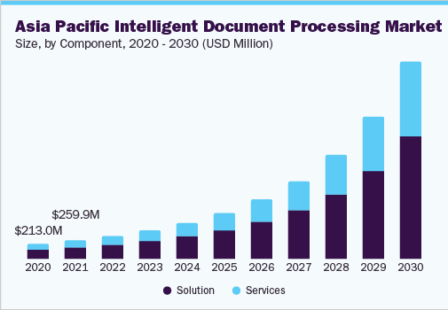
INTELLIGENT DOCUMENT PROCESSING (IDP) MARKET ANALYSIS
Market size value in 2023 | USD 1.79 billion
Revenue forecast in 2030 | USD 11.29 billion
Growth rate | CAGR of 30.1% from 2023 to 2030
Base year for estimation | 2022
Historical data | 2017 - 2021
Forecast period | 2023 - 2030
31.8%
APAC Market CAGR,
2023-2030
IDP is a rapidly growing market fueled by AI adoption.
Utilizes technologies like ML, NLP, OCR, and computer vision for document automation.
Key Drivers
Technology adoption in developing countries
Data privacy concerns
Recognition of IDP's value
Competitive Advantage
AI-powered Features:
Quick and seamless information retrieval.
Automatic document clustering.
Duplicate removal.
Focus on Specific Target Market:
Tailored for individual users and small to medium-sized businesses.
High emphasis on customer support.
IDP Competitive Landscape
Moderately consolidated with established vendors, niche players, and startups.
Key Players: ABBYY, Kofax, Automation Anywhere, UiPath, IBM, Appian, HCL Technologies, AntWorks, HYPERSCIENCE, Datamatics Global Services.
Source: Intelligent Document Processing Market Size, Share & Trends Analysis Report By Component, By Technology (Machine Learning, Computer Vision), By Deployment, By Organization Size, By End-use, By Region, And Segment Forecasts, 2023 - 2030 (Report ID: GVR-4-68040-023-3). GVR. https://www.grandviewresearch.com/industry-analysis/intelligent-document-processing-market-report
Notes:
Competitive Advantage
DocuSense's Unique Selling Points:
AI-powered Features:
Quick and seamless information retrieval.
Automatic document clustering.
Duplicate removal.
Focus on Specific Target Market:
Tailored for individual users and small to medium-sized businesses.
High emphasis on customer support.

Slide 7
SWOT ANALYSIS
Weaknesses
Strengths
S
W
Seamless information retrieval, automatic file organization
Intuitive user interface
Robust security measures
Targeting a niche market
1
2
New entrant to the market
Limited brand awareness
O
T
Opportunities
Threats
Growing demand for PDF management solutions
Increasing awareness of IDP benefits - Efficiency improvement, cost reduction, and data-driven decision-making
Expanding into new markets
3
4
Competition from established players
Changes in user preferences
Technological advancements

Slide 8
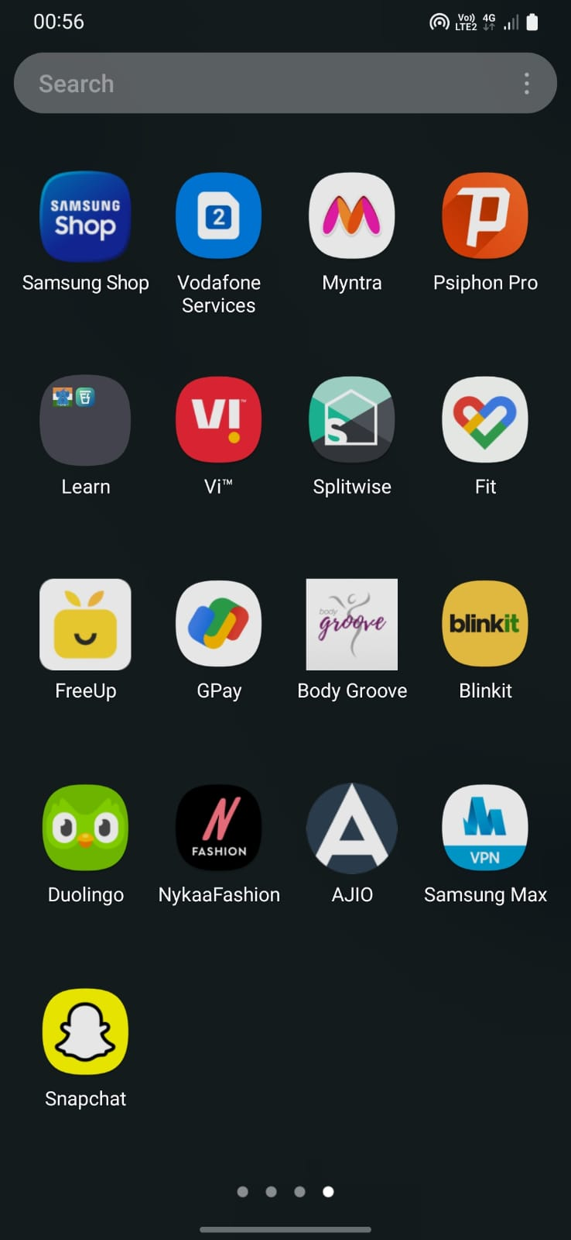








PRODUCT DESCRIPTION
DocuSense is a comprehensive AI-powered document assistant and management solution designed for both mobile and desktop devices
Dashboard
d
KEY FEATURES
PDF Analysis: Gain insights into your PDFs, like memory consumption, duplicate identification, categorization of old & unused files, etc.
Advanced Search Engine: Utilize advanced search techniques like TF-IDF representation and cosine similarity, with manual labeling and search filters for precise and efficient searches.
Memory occupied by PDFs
Document Clustering: An innovative clustering feature for automatic categorization without manual folder creation.
AI-driven Chat Capabilities: Enjoy interactive features like text summarization and AI-driven chat, allowing natural language commands for document retrieval and rapid information extraction.
958.076 MB
COUNTS
See All
#
Total No. of PDFs
416
Duplicates
View
Delete
45
PDFs not accessed since an year
0
COMPUTER APP FOR BUSINESSES
Bulk Processing: Efficiently handle large volumes of PDF files in one go.
Integration with Other Systems: Seamlessly integrate with other business systems, such as CRM and ERP.
Custom Reporting: Generate custom reports on PDF usage and management for comprehensive insights.
BENEFITS
Enhanced Organization
Improved Search and Retrieval
Reduced Storage Costs
Data Security and Privacy
Boosted Productivity
LABELLED FOLDERS
Important
Favourites
Books
Bil

Slide 9


MARKETING AND SALES
1 Lakh
Target Downloads in 1st Year through App Stores
20,000
Target Online downloads through Website
Channels
App Stores, Website, User testimonials, Influencer marketing
MARKETING
Goal: Build awareness and generate interest in the app among our target audience.
Strategies:
Social media advertising
Content marketing
Email marketing campaigns
Digital Marketing: Allocate $50,000 for SEO, social media, and content marketing.
In-App Advertising: Estimate $20,000 for targeted ads.
Partnerships: Collaborate with PDF software vendors, and online marketplaces to bundle or promote Docusense with their products.
PRICING STRATEGY
Goal: Generate revenue through a combination of freemium, in-app purchases, and enterprise licensing.
Freemium Model: The basic version of Docusense will be available for free, allowing users to access essential features. Premium features and additional storage will be offered through a subscription-based pricing model.
In-App Purchases: Users can purchase additional features, such as advanced annotation tools, OCR functionality, or integrations with popular productivity apps.
Enterprise Licensing: The app will offer customized solutions for businesses, including volume licensing and support packages.

Slide 10




OPERATIONAL PLAN
Operations and Support
Dedicated team of developers, product managers, and customer support representatives.
Knowledge base and community forums for users to connect with each other and provide support.
Suppliers and Partners
Cloud infrastructure from Amazon Web Services.
Legal advisors for compliance.
Regulatory and Compliance
Compliant with GDPR
HIPAA (for healthcare professionals)
Data Security Measures
AES-256 encryption for user data.
Development and Technology
In-house development team to maintain and improve the app.

Slide 11

MANAGEMENT TEAM
CEO & Co-Founder
OINDRILA MAJI
Responsible for overall strategic direction, decision-making, and ensuring the alignment of the company with its mission and vision.
CTO & Founder
KEERTHI SREE MARRAPU
Responsible for overseeing the development of the DocuSense app, ensuring its technical excellence and alignment with industry standards.
CFO
BAIBHAV VIKAS
Responsible for encompassing financial strategy, risk management, compliance, and stakeholder relations.
Head of Product
MAYANK SHUKLA
Responsible for overseeing the development team, managing sprints, and ensuring the timely delivery of high-quality features and updates.

Slide 12
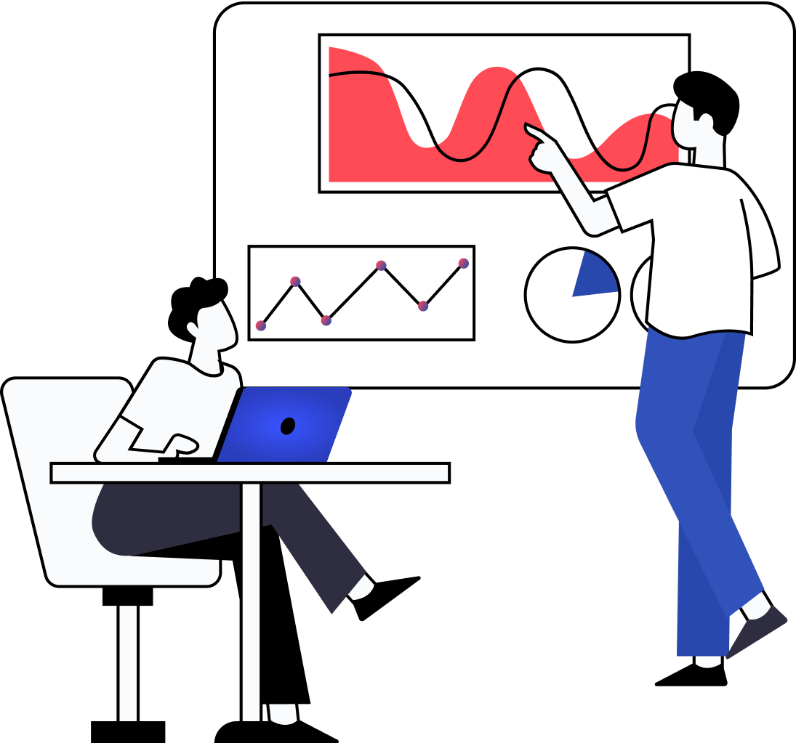
TEAM ROLES AND RESPONSIBILITIES
DATA ANALYSIS TEAM
Data Analysts
Business Analysts
Data Engineers
Responsibilities
Analyze user behavior, trends, and data to extract valuable insights.
Provide actionable recommendations based on data analysis.
Collaborate with other teams to enhance product features and user experience.
DEVELOPMENT TEAM
Front-end Developers
Back-end Developers
Full-stack Developers
Mobile App Developers (iOS and Android)
Responsibilities
Design, develop, & maintain App
Implement new features and update based on feedback.
Ensure App is scalable, reliable, and user-friendly.
AI/ML DEVELOPMENT TEAM
AI/ML Engineers
Natural Language Processing (NLP) Experts
Data Scientists
Responsibilities
Develop and implement chatbot features using AI and NLP.
Train models for understanding user queries & providing relevant responses.
Continuously optimize chat features based on interactions.
SECURITY TEAM
Security Engineers
Responsibilities
Implement and maintain security measures for user data.
Ensure compliance with data protection regulations.
CUSTOMER SUPPORT TEAM
Customer Support Representatives
Technical Support Specialists
Responsibilities
Provide timely and effective customer support for technical and non-technical issues.
Gather user feedback for continuous improvement.

Slide 13
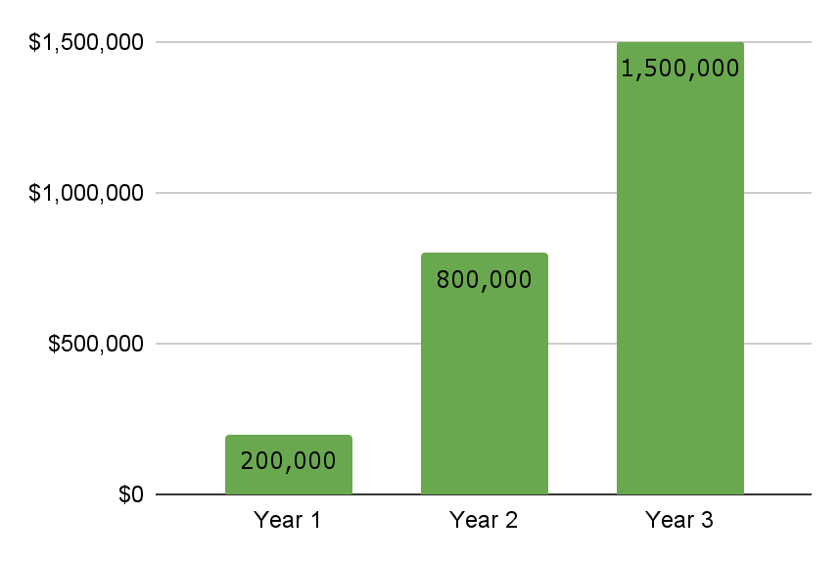
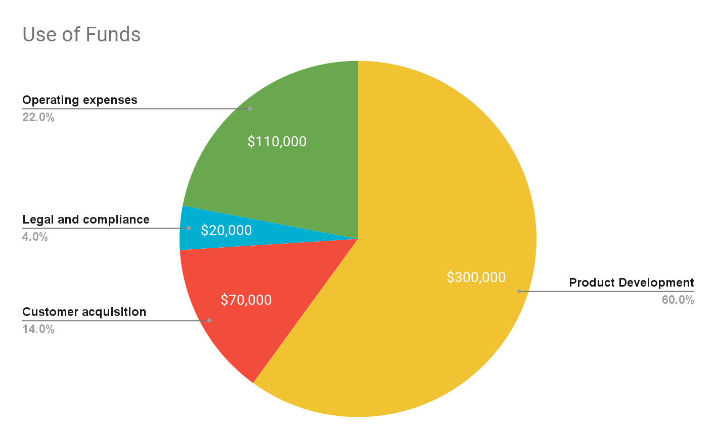
FINANCIAL PLANS
FUNDING REQUIREMENT
Seeking $500,000 in funding through
Equity Investment - Seeking $200,000 in seed funding in exchange for 20% equity stake.
Venture Capital Funding - Targeting $150,000 in VC funding in exchange for 15% equity.
Business Loans - Seeking $100,000 in loans from SBA and other lending programs.
Crowdfunding Campaign - Seeking $50,000 in rewards-based crowdfunding.
Revenue Projections:
Year 1: $200,000 - Anticipated revenue from initial user subscriptions and one-time sales.
Year 2: $800,000 - Projected growth in revenue as the app gains traction and expands its user base.
Year 3: $1.5 million - Continued growth as DocuSense establishes itself as a leading PDF management solution.
Expense Projections, Cash Flow Analysis, Break-even Analysis: Provided in the report attached to this document

Slide 14
DocuSense (Team ID E)
Sep 13, 2023
BUSINESS MODEL CANVAS
Iteration 3
Key Partners
PDF software developers
Cloud storage providers
Marketing and advertising agencies
Legal advisors
Key Activities
Software Development
AI for Chat features
Data Analysis
User data security & encryption
Customer support and updates Marketing and user acquisition
Value Propositions
AI-Powered Document Assistant
Rapid Information Retrieval - Advanced Search, Chat-based assistance
Customer Relationships
Self-service support through the app Email and chat support
Community forums for user interactions
Regular updates and feature enhancements
Personalized onboarding for businesses
Feedback Collection
Customer Segments
Individuals needing PDF management
Students
Young and Mid-Career Professionals
Researchers & Academics
Small and medium-sized businesses
Enterprises with document-intensive workflows
Legal and healthcare professionals
Key Resources
Development team
Network & server infrastructure
User data storage and security measures
Marketing and sales team
Legal and compliance experts
Channels
App stores (iOS, Android)
Website and online downloads
Social media advertising
Content marketing through blogs and videos
Cost Structure
Development & maintenance costs
Server infrastructure expenses
Employee salaries and benefits
Marketing and advertising expenses
Legal and compliance costs
Key Metrics
Monthly Active Users (MAU)
Customer Acquisition Cost (CAC)
Customer Lifetime Value (CLV)
Churn rate
Conversion rate from free to premium users
Revenue Streams
Freemium model with basic features for free and premium features for a subscription fee
Business and enterprise licensing for customized solutions
One-time purchases for individual users
In-app advertisements
Average revenue per user (ARPU)
User satisfaction & NPS scores
Marketing ROI and cost per acquisition

Slide 15
DocuSense
Your Personal Document Concierge
THANK YOU
Explore and manage your PDF collection with ease
20MF10015 | Keerthi Sree Marrapu
20IM30013 | Oindrila Maji
20MT10016 | Baibhav Vikas
20EE10041 | Mayank Shukla

