Slide 1
BLOCKBUSTER REACH
OR CRITICAL ACCLAIM?
SQL SUMMATIVE LAB · PART 2
An exploratory analysis of IMDB movie genres, 2010–2019
Data: IMDB (im.db) · 146,144 movies · 73,856 rated
Notes:
This analysis explores the IMDB database to see how genre relates to audience reach (number of votes) and audience approval (average rating). The goal is to identify a business question a studio could investigate further.

Slide 2
WHAT THE DATA SHOWED
INITIAL EXPLORATION
9,617
83.7k
7.27
5.28
movies have 1,000+ votes. 45,103 of 73,856 rated movies have fewer than 100 votes, so their ratings aren’t reliable.
average votes per Adventure movie, the highest reach of any genre. 21.9% pass 100,000 votes.
average rating for Documentary, the highest, yet no documentary reaches 100,000 votes.
average rating for Horror, the lowest of any genre, despite 1,315 movies.
Runtime
Longer films rate higher and draw more votes: 120–139 min averages 6.78 and about 48k votes, while 80–99 min averages 5.85 and about 13k.
Movies released 2010–2019; genre and runtime figures use movies with 1,000+ votes. 2 / 5
Notes:
Key takeaways from the exploration. Most rated movies have very few votes, so I filtered to movies with at least 1,000 votes for reliable averages. The genres with the largest audiences (Adventure, Sci-Fi, Fantasy) aren’t the highest rated, and the highest-rated genres (Documentary, Biography, History) have smaller audiences. Longer runtimes go with higher ratings and more votes.

Slide 3
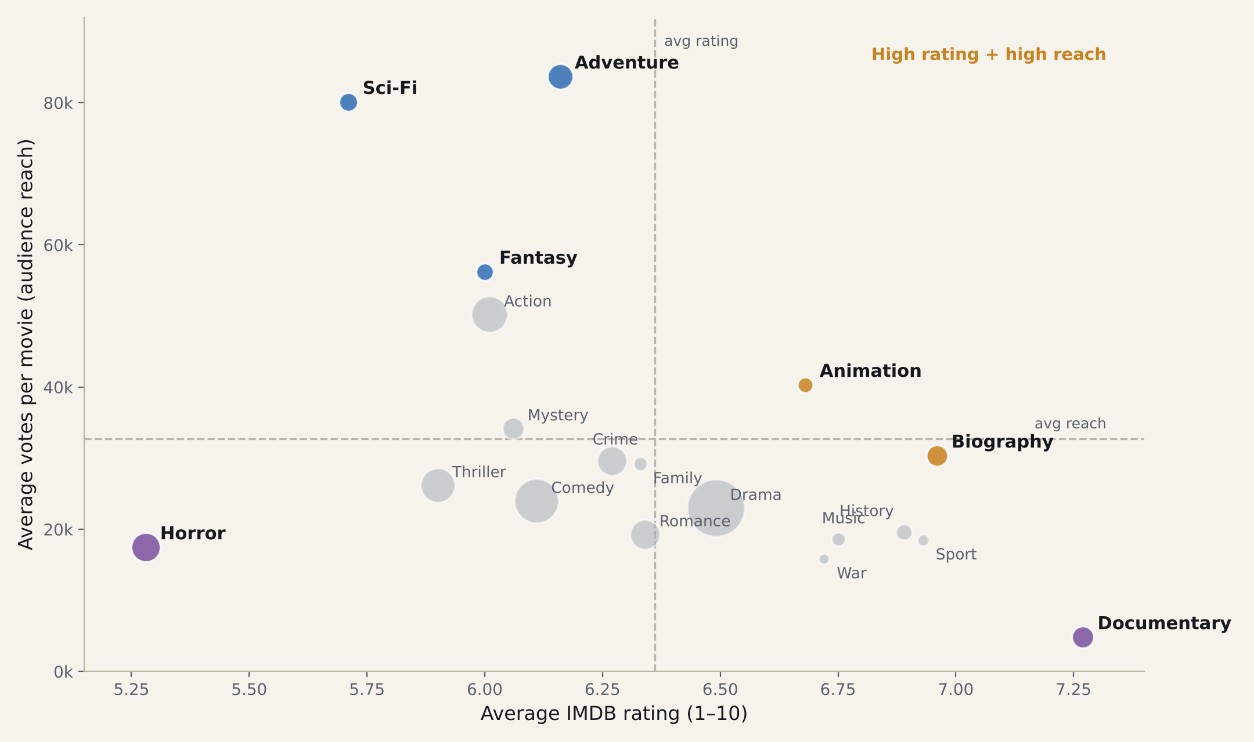
REACH VS RATING BY GENRE
BUSINESS QUESTION
Which genres give a studio the best balance of audience reach and audience approval?
Should a new studio chase blockbuster genres like Adventure and Sci-Fi, or target genres like Animation and Biography that pair strong ratings with solid audiences?
Animation is the only genre above average on both measures (6.68 rating, about 40k votes).
Bubble size = number of movies · dashed lines = average across genres · 19 genres with 150+ movies · 3 / 5
Notes:
This chart is the reason for the business question. Each bubble is a genre. Further right means a higher average rating; higher up means more votes per movie, which I use as a measure of audience reach. The top-left blockbuster genres reach the most people but rate only around 6. The bottom-right genres rate well but reach fewer people. Animation sits alone in the top-right corner, and Biography is just below it. A deeper analysis would test whether these genres are a lower-risk way to produce well-received films that still find an audience.

Slide 4
TASKS BEFORE DEEPER ANALYSIS
DATA CLEANING
1 Year range. Drop 1,063 movies with start_year after 2019; treat 2019 as incomplete.
6 Duplicates. directors has 291,174 rows but only 163,535 distinct movie–director pairs.
2 Null handling. Exclude null runtime (30,765) and genres (5,359); don’t impute.
7 Join on IDs. Titles (“Home” × 24) and person names repeat, so use movie_id and person_id.
3 Normalize genres. Split 1,085 comma-separated combinations into a movie–genre table.
8 Data types. birth_year and death_year are text and mostly null; is_original_title has 25 nulls.
4 Runtime outliers. Up to 51,420 minutes; 123 movies over 300 min and 5,211 under 40 min.
9 Missing ratings. 71,225 movies have no rating, so results describe rated movies only.
5 Vote threshold. Require 1,000+ votes so ratings from a handful of voters don’t skew averages.
Counts for movies released 2010–2019 unless noted · 4 / 5
Notes:
These are the cleaning tasks I found during exploration; I didn’t perform them, as the lab instructs. The biggest issues are out-of-range years, nulls in runtime and genres, genres stored as comma-separated strings, impossible runtimes, and ratings based on very few votes.

Slide 5
TEST ANIMATION AND BIOGRAPHY AS A LOWER-RISK SLATE
NEXT STEPS
Clean first
Go deeper
Add money
Apply the nine cleaning tasks, then rerun the genre analysis on the cleaned tables.
Compare genre combinations, runtimes and directors with track records within Animation and Biography.
Votes aren’t revenue. Join box-office and budget data before making investment decisions.
5 / 5
Notes:
To close: the exploration suggests Animation, and to a lesser extent Biography, combine above-average ratings with solid reach. Before acting on that, the data needs cleaning, the analysis should go one level deeper, and financial data is needed, because votes measure attention, not profit.

