Slide 1
Final Year Project
Oisin Anderson

Slide 2
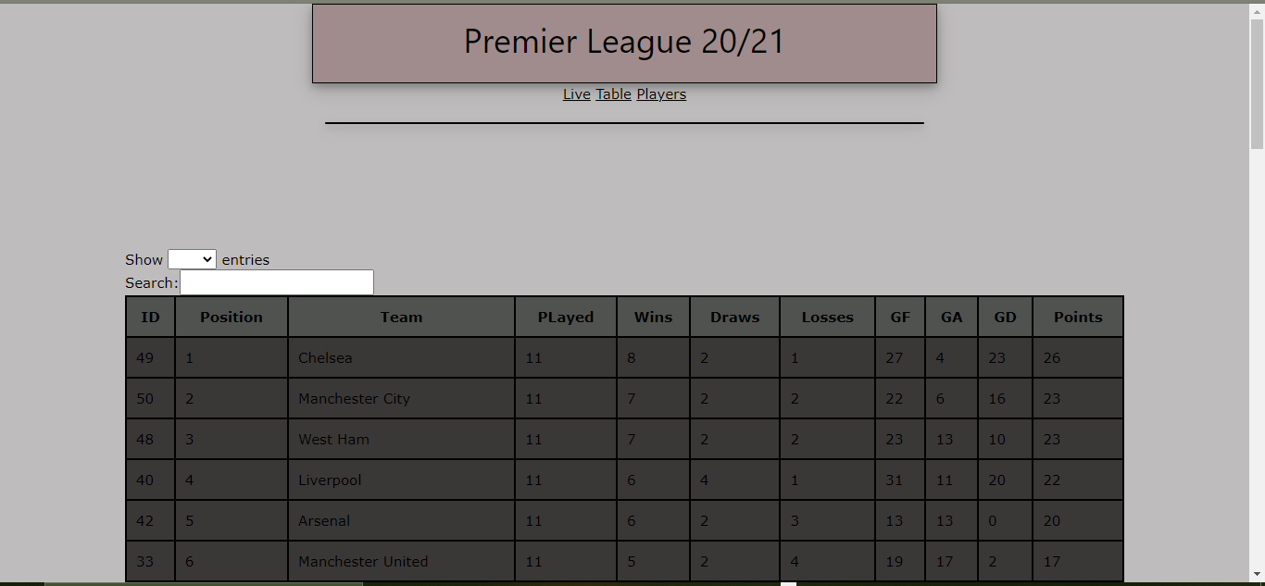
What is my project about
My project is a website that displays soccer results from the premier league.
In this website you will be able to view the table, results, player and team info from the premier league.

Slide 3
Why I chose the project
I chose this project because I have an interest in soccer and specifically the premier league.
I feel like I can add features to my website that I don’t see in many other football websites. Such as a compare teams and players feature.

Slide 4
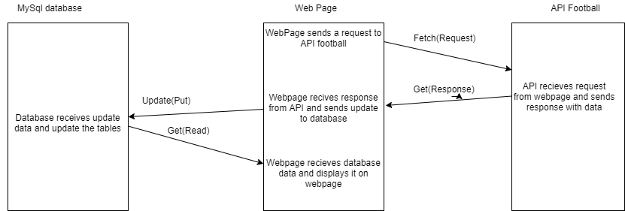
Technologies
The technologies I used in this project are:
PHP
JavaScript/Html
MySQL Database
An API

Slide 5
My Plan Going Forward
Style the Website. Week1
Live match display page. Week2
Fixtures/ Results page. Week2
Home/Away table.
Week3
Form table. Week3
Player/Team info page. Week4
Compare teams/player's page. Week5
Login account feature. Week6
Favourite teams feature. Week6

