Slide 1
ACL
Access Control Lists

Slide 2
On a Cisco router, you can configure a simple firewall that provides basic traffic filtering capabilities using ACLs.
Administrators use ACLs to stop traffic or permit only specified traffic on their networks.

Slide 3
An ACL is a sequential list of permit or deny statements that apply to addresses or upper-layer protocols.
ACLs provide a powerful way to control traffic into and out of a network.
ACLs can be configured for all routed network protocols.

Slide 4
Two Steps to configure
Write the List in global configuration mode.
Attach the list to a particular interface on the router =interface mode.

Slide 5
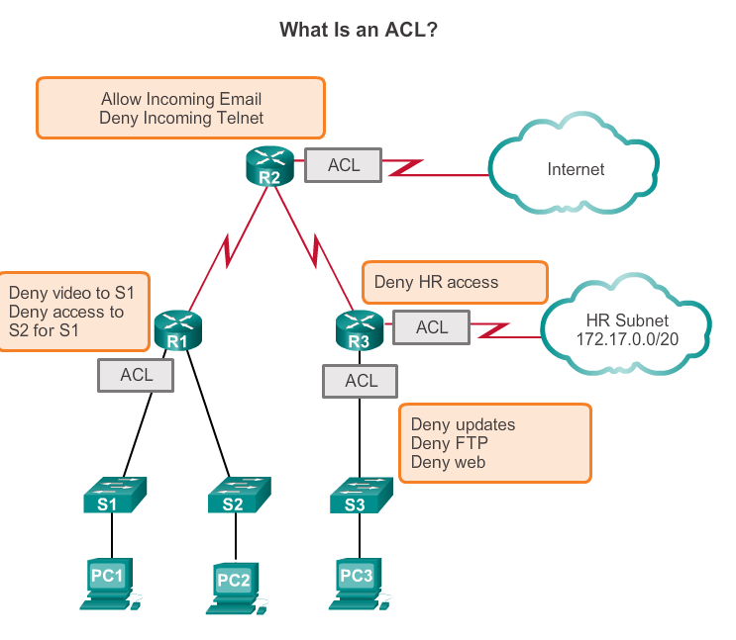

Slide 6
ACLs enable administrators to control traffic into and out of a network.
This control can be as simple as permitting or denying traffic based on network addresses or as complex as controlling network traffic based on the TCP port being requested, = (Extended )

Slide 7
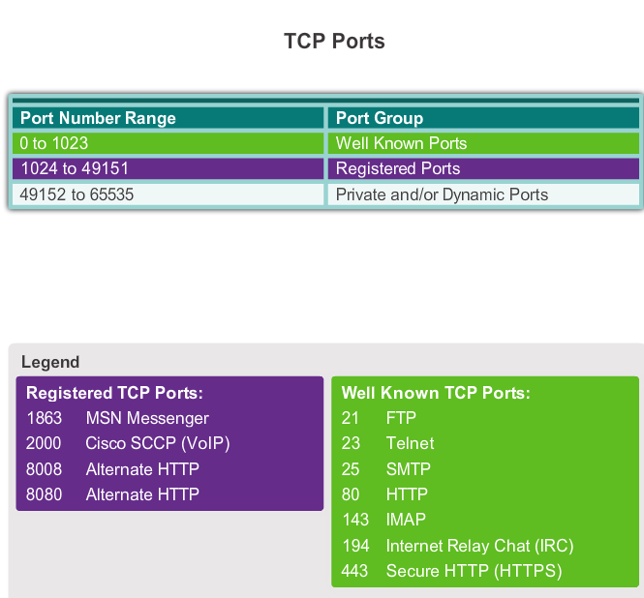
Port Numbers

Slide 8
A router acts as a packet filter when it forwards or denies packets according to filtering rules.
When a packet arrives at the packet-filtering router, the router extracts certain information from the packet header.
Using this information, the router makes decisions, based on configured filter rules, as to whether the packet can pass through or be discarded.

Slide 9
The two types of Cisco IPv4 ACLs are
standard
extended.

Slide 10
Standard ACLs
Standard ACLs can be used to permit or deny traffic only from source IPv4 addresses.
The destination of the packet and the ports involved are not evaluated.

Slide 11
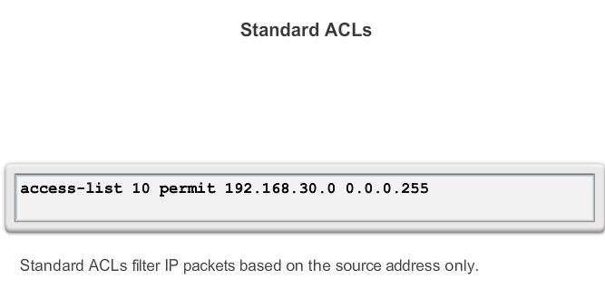
Standard = Simple

Slide 12
Previous slide =
allows all traffic from the 192.168.30.0/24 network.
Because of the implied "deny any" at the end, all other traffic is blocked with this ACL.
Standard ACLs are created in global configuration mode.

Slide 13
Extended =more complex
Extended ACLs
Extended ACLs filter IPv4 packets based on several attributes:
Protocol type
Source IPv4 address
Destination IPv4 address
Source TCP or UDP ports
Destination TCP or UDP ports
Optional protocol type information for finer control

Slide 14
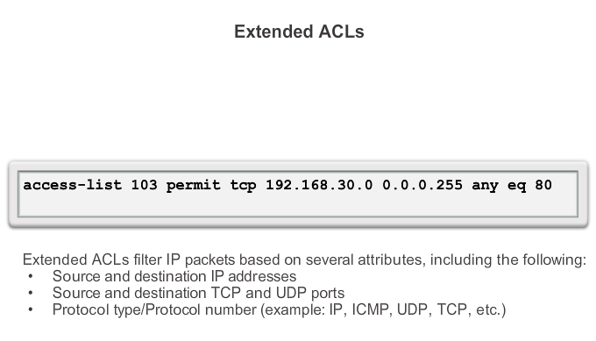
Extended ACL

Slide 15
Previous Slide
ACL 103 permits traffic originating from any address on the 192.168.30.0/24 network to any IPv4 network if the destination host port is 80 (HTTP).
Extended ACLs are created in global configuration mode.

Slide 16
Number/Name
Standard and extended ACLs can be created using either a number or a name to identify the ACL and its list of statements.

Slide 17
Using numbered ACLs is an effective method for determining the ACL type on smaller networks with more homogeneously defined traffic.
However, a number does not provide information about the purpose of the ACL.
For this reason, starting with Cisco IOS Release 11.2, a name can be used to identify a Cisco ACL.

Slide 18
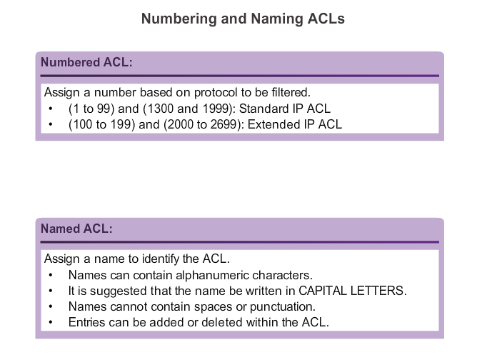
Numbering and Naming

Slide 19
Wildcard Masking
IPv4 ACLs include the use of wildcard masks.
Mask 32 bits because IPv4 = 32 bits.
A wildcard mask is a string of 32 binary digits used by the router to determine which bits of the address to examine for a match.

Slide 20
Wildcard Masking
Where mask is = 0 CHECK bit
Where mask is = 1 IGNORE bit

Slide 21
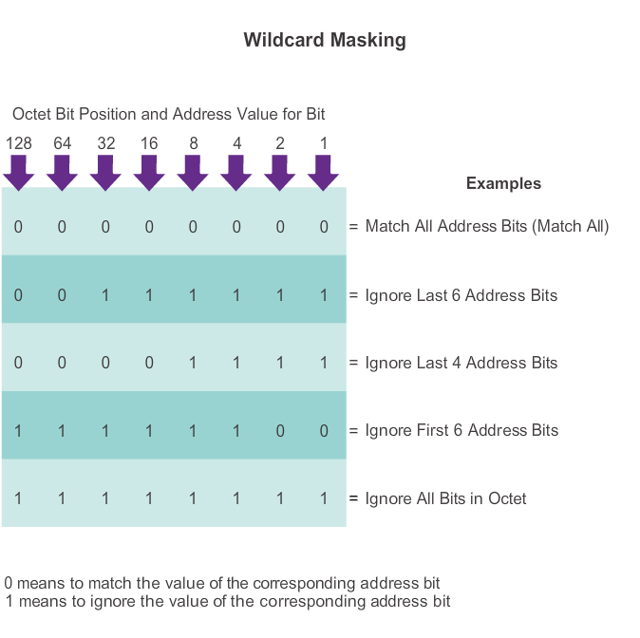
Examples

Slide 22
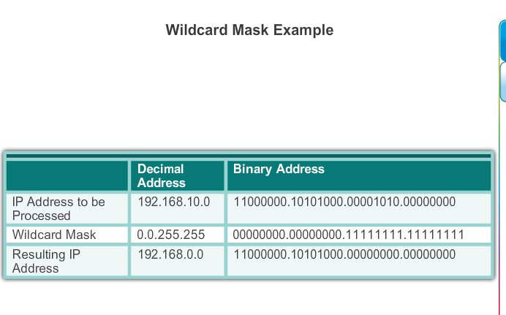

Slide 23
As with subnet masks, the numbers 1 and 0 in the wildcard mask identify how to treat the corresponding IP address bits.
However, in a wildcard mask, these bits are used for different purposes and follow different rules.

Slide 24
Subnet masks use binary 1s and 0s to identify the network, subnet, and host portion of an IP address.
Wildcard masks use binary 1s and 0s to filter individual IP addresses or groups of IP addresses to permit or deny access to resources.

Slide 25
Wildcard masks and subnet masks differ in the way they match binary 1s and 0s. Wildcard masks use the following rules to match binary 1s and 0s:
Wildcard mask bit 0 - Match the corresponding bit value in the address.
Wildcard mask bit 1 - Ignore the corresponding bit value in the address.

Slide 26
Note: Wildcard masks are often referred to as an inverse mask.
The reason is that, unlike a subnet mask in which binary 1 is equal to a match and binary 0 is not a match, in a wildcard mask the reverse is true.

Slide 27
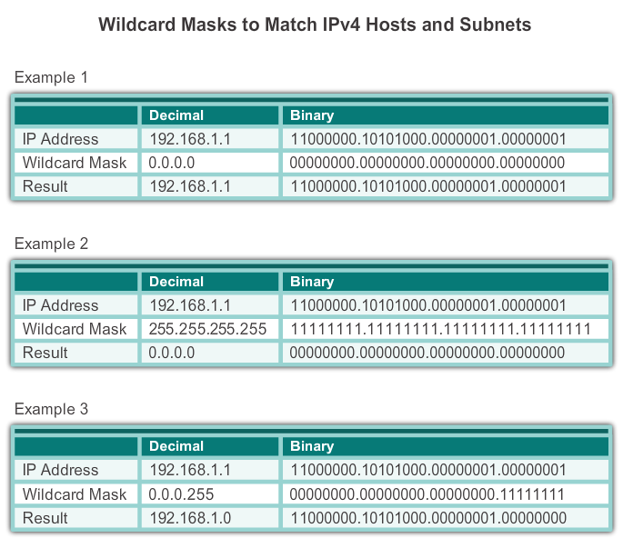

Slide 28
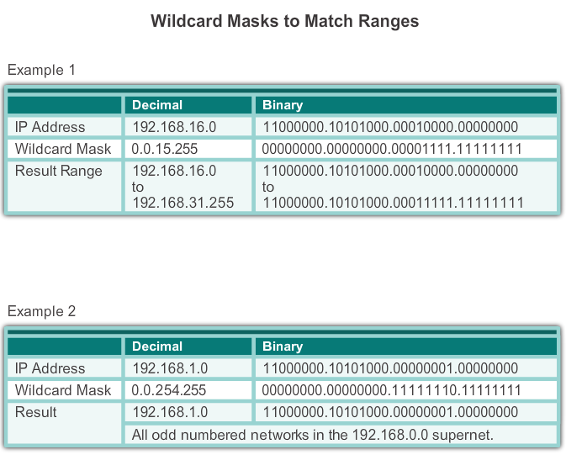

Slide 29
Calculating wildcard masks can be challenging. One shortcut method is to subtract the subnet mask from 255.255.255.255.

Slide 30
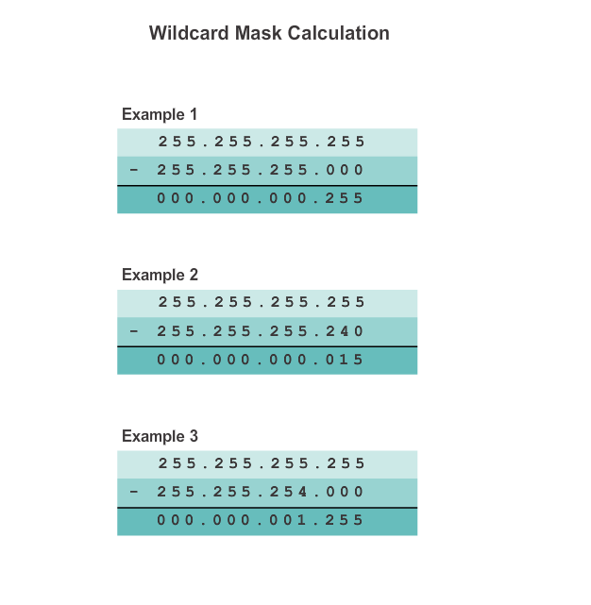

Slide 31
Assume you wanted to permit access to all users in the 192.168.3.0 network.
Because the subnet mask is 255.255.255.0, you could take the 255.255.255.255 and subtract the subnet mask 255.255.255.0.
The solution produces the wildcard mask 0.0.0.255.

Slide 32
Assume you wanted to permit network access for the 14 users in the subnet 192.168.3.32/28.
The subnet mask for the IP subnet is 255.255.255.240, therefore take 255.255.255.255 and subtract the subnet mask 255.255.255.240.
The solution this time produces the wildcard mask 0.0.0.15.

Slide 33
Assume you wanted to match only networks 192.168.10.0 and 192.168.11.0.
Again, you take the 255.255.255.255 and subtract the regular subnet mask which in this case would be 255.255.254.0.
The result is 0.0.1.255.

Slide 34
Standard Example
R1(config)# access-list 10 permit 192.168.16.0 0.0.15.255

Slide 35
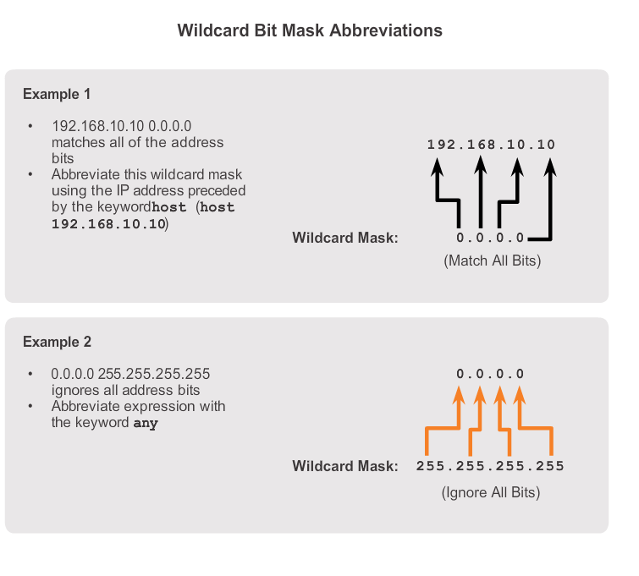
Keywords =ANY and HOST

Slide 36
Wildcard Bit Mask Keywords
Working with decimal representations of binary wildcard mask bits can be tedious.
To simplify this task, the keywords host and any help identify the most common uses of wildcard masking.
These keywords eliminate entering wildcard masks when identifying a specific host or an entire network.
These keywords also make it easier to read an ACL by providing visual clues as to the source or destination of the criteria.

Slide 37
The host keyword substitutes for the 0.0.0.0 mask.
This mask states that all IPv4 address bits must match or only one host is matched.
The any option substitutes for the IP address and 255.255.255.255 mask.
This mask says to ignore the entire IPv4 address or to accept any addresses.

Slide 38
The any and host Keywords
any keyword to substitute for the IPv4 address 0.0.0.0 with a wildcard mask of 255.255.255.255.

Slide 39
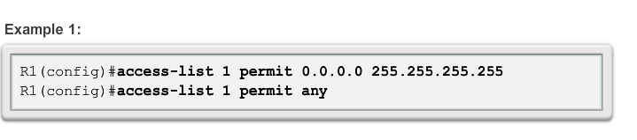
Example of any keyword

Slide 40
The host keyword to substitute for the wildcard mask when identifying a single host.

Slide 41
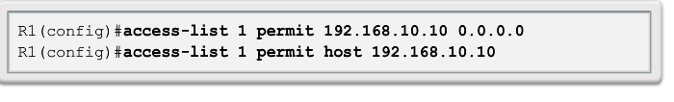
Example of host keyword

Slide 42
Writing ACLs can be a complex task.
For every interface there may be multiple policies needed to manage the type of traffic allowed to enter or exit that interface.
The router in the next figure has two interfaces configured for IPv4 and IPv6.

Slide 43
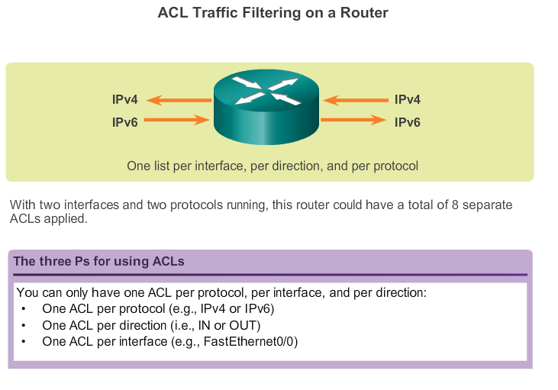
3 P’s

Slide 44
If we needed ACLs for both protocols, on both interfaces and in both directions, this would require eight separate ACLs.
Each interface would have four ACLs;
two ACLs for IPv4 and two ACLs for IPv6.
For each protocol, one ACL is for inbound traffic and one for outbound traffic.

Slide 45
The Three Ps
A general rule for applying ACLs on a router can be recalled by remembering the three Ps. You can configure one ACL per protocol, per direction, per interface:
One ACL per protocol - To control traffic flow on an interface, an ACL must be defined for each protocol enabled on the interface.
One ACL per direction - ACLs control traffic in one direction at a time on an interface.
Two separate ACLs must be created to control inbound and outbound traffic.
One ACL per interface - ACLs control traffic for an interface, for example, GigabitEthernet 0/0.

Slide 46
3Ps

Slide 47
Note: ACLs do not have to be configured in both directions. The number of ACLs and their direction applied to the interface will depend on the requirements being implemented.
Here are some guidelines for using ACLs:
Use ACLs in firewall routers positioned between your internal network and an external network such as the Internet.
Use ACLs on a router positioned between two parts of your network to control traffic entering or exiting a specific part of your internal network.

Slide 48
Configure ACLs on border routers, that is, routers situated at the edges of your networks.
This provides a very basic buffer from the outside network, or between a less controlled area of your own network and a more sensitive area of your network.
Configure ACLs for each network protocol configured on the border router interfaces.

Slide 49
Placement of ACL!!!
The proper placement of an ACL can make the network operate more efficiently.
An ACL can be placed to reduce unnecessary traffic.
For example, traffic that will be denied at a remote destination should not be forwarded using network resources along the route to that destination.

Slide 50
Placement!
Every ACL should be placed where it has the greatest impact on efficiency.
Extended ACLs - Locate extended ACLs as close as possible to the source of the traffic to be filtered.
This way, undesirable traffic is denied close to the source network without crossing the network infrastructure.

Slide 51
Standard ACLs - Because standard ACLs do not specify destination addresses, place them as close to the destination as possible.
Placing a standard ACL at the source of the traffic will effectively prevent that traffic from reaching any other networks through the interface where the ACL is applied.

Slide 52
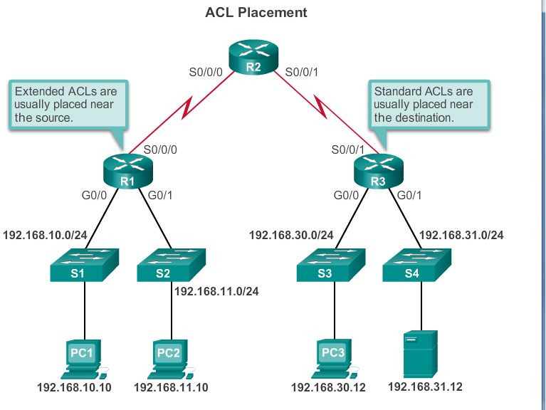

Slide 53
A standard ACL can only filter traffic based on a source address.
The basic rule for placement of a standard ACL is to place the ACL as close as possible to the destination network.
This allows the traffic to reach all other networks except the network where the packets will be filtered.

Slide 54
Example
An administrator wants to prevent traffic originating in the 192.168.10.0/24 network from reaching the 192.168.30.0/24 network.

Slide 55
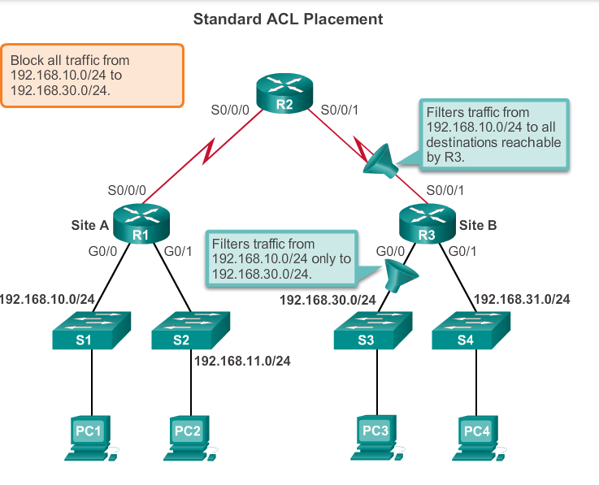
Example

Slide 56
Previous slide
If the standard ACL is placed on the outbound interface of R1, this would prevent traffic on the 192.168.10.0/24 network from reaching any networks reachable through the Serial 0/0/0 interface of R1.

Slide 57
Following the basic placement guidelines of placing the standard ACL close to the destination, the figure shows two possible interfaces on R3 to apply the standard ACL:

Slide 58
Where to Apply??
R3 S0/0/1 interface - Applying a standard ACL to prevent traffic from 192.168.10.0/24 from entering the S0/0/1 interface will prevent this traffic from reaching 192.168.30.0/24 and all other networks reachable by R3.
This includes the 192.168.31.0/24 network. Because the intent of the ACL is to filter traffic destined only for 192.168.30.0/24, a standard ACL should not be applied to this interface.

Slide 59
Where to Apply??
R3 G0/0 interface - Applying the standard ACL to traffic exiting the G0/0 interface will filter packets from 192.168.10.0/24 to 192.168.30.0/24.
This will not affect other networks reachable by R3.
Packets from 192.16810.0/24 will still be able to reach 192.168.31.0/24.

Slide 60
Extended ACL Placement
Like a standard ACL, an extended ACL can filter traffic based on the source address.
However, an extended ACL can also filter traffic based on the destination address, protocol, and port number.
This allows network administrators more flexibility in the type of traffic that can be filtered and where to place the ACL.
The basic rule for placing an extended ACL is to place it as close to the source as possible.
This prevents unwanted traffic from being sent across multiple networks only to be denied when it reaches its destination.

Slide 61
Network administrators can only place ACLs on devices that they control.
Therefore, placement must be determined in the context of where the control of the network administrator extends.

Slide 62
Example of Extended ACL Placement
An administrator of Company A, which includes the 192.168.10.0/24 and 192.168.11.0/24 networks wants to control traffic to Company B.
Specifically, the administrator wants to deny Telnet and FTP traffic from the .11 network to Company B’s 192.168.30.0/24 network.
At the same time, all other traffic from the .11 network must be permitted to leave Company A without restriction.

Slide 63
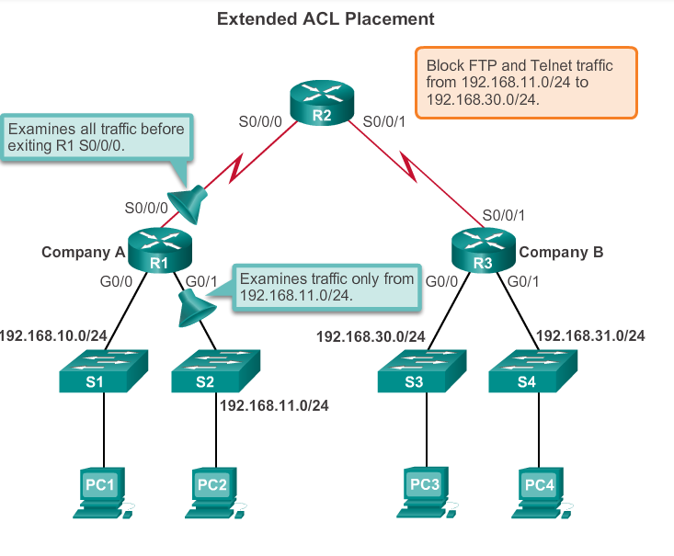

Slide 64
Solution 1???
There are several ways to accomplish these goals.
An extended ACL on R3 that blocks Telnet and FTP from the .11 network would accomplish the task, but the administrator does not control R3. In addition, this solution also allows unwanted traffic to cross the entire network, only to be blocked at the destination.
This affects overall network efficiency.

Slide 65
A better solution is to place an extended ACL on R1 that specifies both source and destination addresses (.11 network and .30 network, respectively), and enforces the rule, "Telnet and FTP traffic from the .11 network is not allowed to go to the .30 network."

Slide 66
Which interface???

Slide 67
R1 S0/0/0 interface (outbound) - One possibility is to apply an extended ACL outbound on the S0/0/0 interface.
Because the extended ACL can examine both source and destination addresses, only FTP and Telnet packets from 192.168.11.0/24 will be denied.
Other traffic from 192.168.11.0/24 and other networks will be forwarded by R1.
The disadvantage of placing the extended ACL on this interface is that all traffic exiting S0/0/0 must be processed by the ACL including packets from 192.168.10.0/24.

Slide 68
Answer!
R1 G0/1 interface (inbound) - Applying an extended ACL to traffic entering the G0/1 interface means that only packets from the 192.168.11.0/24 network are subject to ACL processing on R1.
Because the filter is to be limited to only those packets leaving the 192.168.11.0/24 network, applying the extended ACL to G0/1 is the best solution.

Slide 69
Standard ACL
When traffic enters the router, the traffic is compared to all ACEs (AC Entries) in the order that the entries occur in the ACL.
The router continues to process the ACEs until it finds a match.
The router will process the packet based on the first match found and no other ACEs will be examined.

Slide 70
Standard ACL
If no matches are found when the router reaches the end of the list, the traffic is denied.
This is because, by default, there is an implied deny at the end of all ACLs for traffic that was not matched to a configured entry.
A single-entry ACL with only one deny entry has the effect of denying all traffic.
At least one permit ACE must be configured in an ACL or all traffic is blocked.

Slide 71
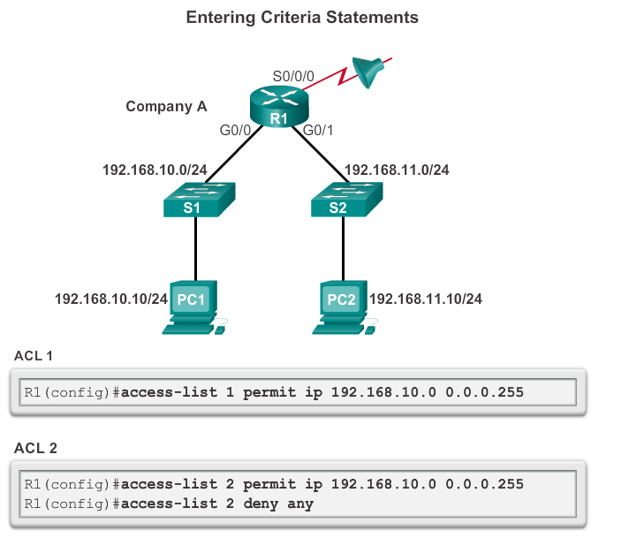
Standard ACL

Slide 72
For the network in the previous figure, applying either ACL 1 or ACL 2 to the S0/0/0 interface of R1 in the outbound direction will have the same effect.
Network 192.168.10.0 will be permitted to access the networks reachable through S0/0/0 while 192.168.11.0 will not be allowed to access those networks.

Slide 73
Configuring Standard ACLs
To use numbered standard ACLs on a Cisco router, you must first create the standard ACL and then activate the ACL on an interface.
The access-list global configuration command defines a standard ACL with a number in the range of 1 through 99.
Cisco IOS Software Release 12.0.1 extended these numbers by allowing 1300 to 1999 to be used for standard ACLs.
This allows for a maximum of 798 possible standard ACLs.
These additional numbers are referred to as expanded IP ACLs.

Slide 74
The full syntax of the standard ACL command is as follows:
Router(config)# access-listaccess-list-number { deny |permit | remark } source [source-wildcard ][ log ]

Slide 75
The next figure provides a detailed explanation of the syntax for a standard ACL.

Slide 76
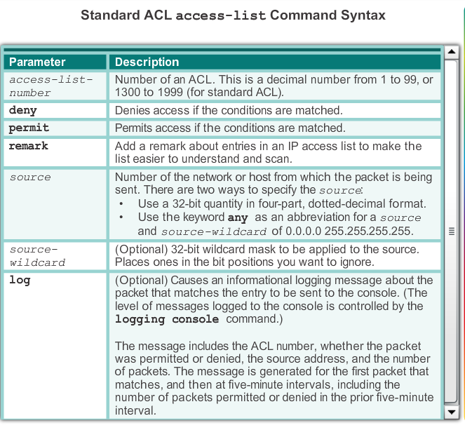

Slide 77
ACEs can deny or permit an individual host or a range of host addresses.
To create a host statement in numbered ACL 10 that permits a specific host with the IP address 192.168.10.0, you would enter:
R1(config)# access-list 10 permit host 192.168.10.10

Slide 78
As shown in the next figure to create a statement that will permit a range of IPv4 addresses in a numbered ACL 10 that permits all IPv4 addresses in the network 192.168.10.0/24, you would enter:
R1(config)# access-list 10 permit 192.168.10.0 0.0.0.255
To remove the ACL,
the global configuration no access-list command is used.
Issuing the show access-list command confirms that access list 10 has been removed.

Slide 79
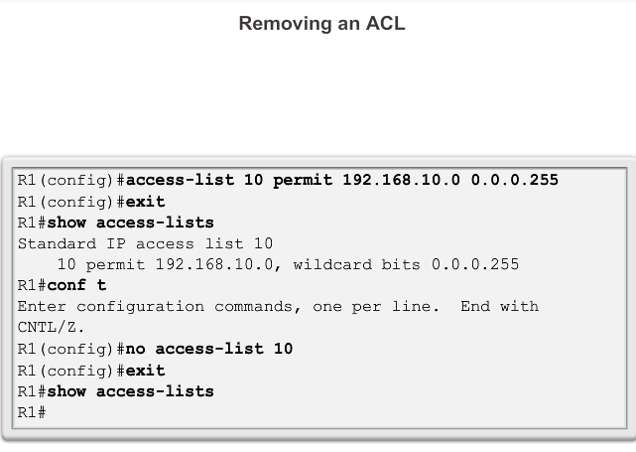

Slide 80
Typically, when an administrator creates an ACL, the purpose of each statement is known and understood.
However, to ensure that the administrator and others recall the purpose of a statement, remarks should be included.
The remark keyword is used for documentation and makes access lists a great deal easier to understand.
Each remark is limited to 100 characters.
The ACL in the next figure, although fairly simple, is used to provide an example.
When reviewing the ACL in the configuration using the show running-config command, the remark is also displayed.

Slide 81
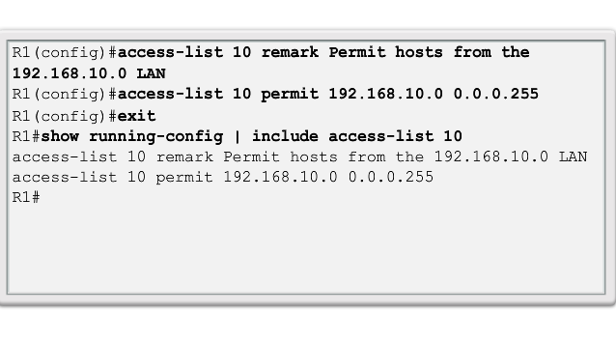

Slide 82
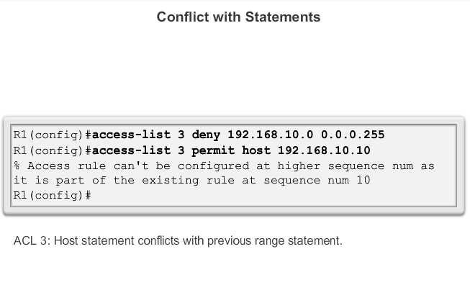
Order is Important!!

Slide 83
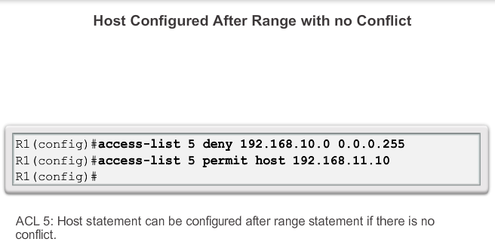
Order is Important!!

Slide 84
Grouping ACLs
After a standard ACL is configured, it is linked to an interface using the
ip access-group command in interface configuration mode:
To remove an ACL from an interface, first enter the
no ip access-group command on the interface, and then
enter the global no access-list command to remove the entire ACL.

Slide 85
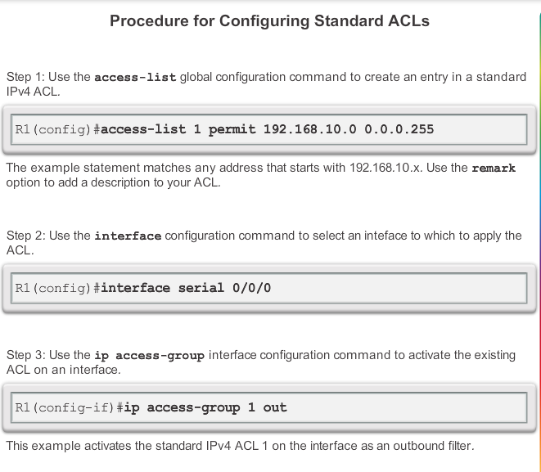

Slide 86
This ACL allows only traffic from source network 192.168.10.0 to be forwarded out of interface S0/0/0.
Traffic from networks other than 192.168.10.0 is blocked.
The first line identifies the ACL as access list 1.
It permits traffic that matches the selected parameters.

Slide 87
In this case, the IPv4 address and wildcard mask identifying the source network is 192.168.10.0 0.0.0.255.
Recall that there is an implicit deny all statement that is equivalent to adding the line
access-list 1 deny 0.0.0.0 255.255.255.255.
The ip access-group 1 out interface configuration command links and ties ACL 1 to the Serial 0/0/0 interface as an outbound filter.
Therefore, ACL 1 only permits hosts from the 192.168.10.0/24 network to exit router R1. It denies any other network including the 192.168.11.0 network.

Slide 88
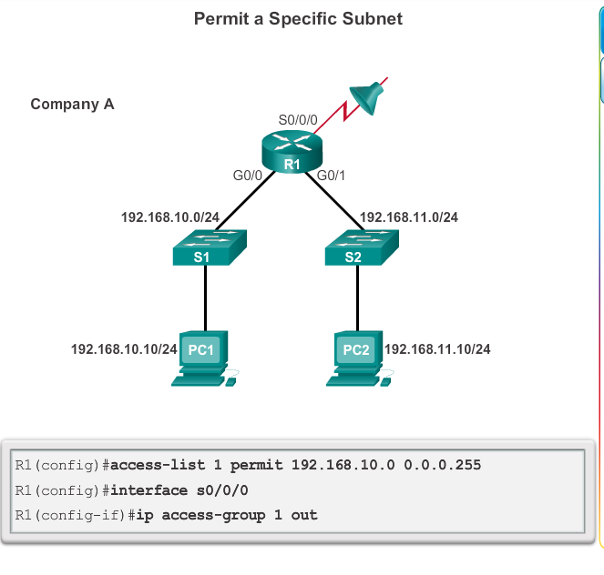

Slide 89
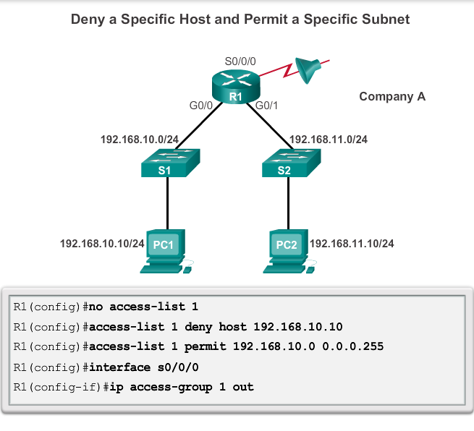

Slide 90
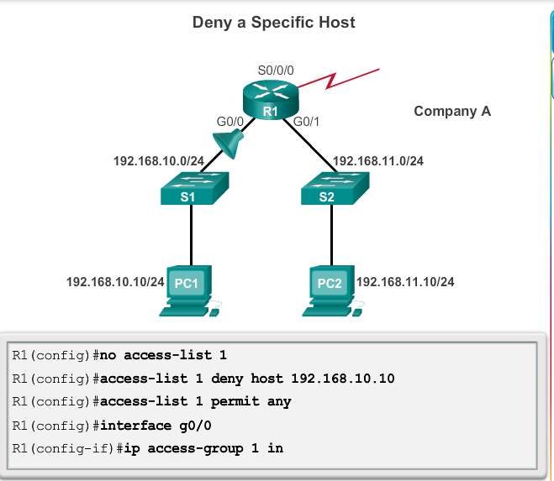

Slide 91
Naming an ACL makes it easier to understand its function.
For example, an ACL configured to deny FTP could be called NO_FTP.
When you identify your ACL with a name instead of with a number, the configuration mode and command syntax are slightly different.

Slide 92
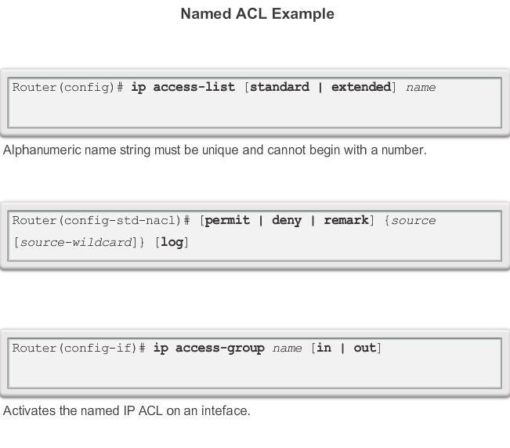

Slide 93
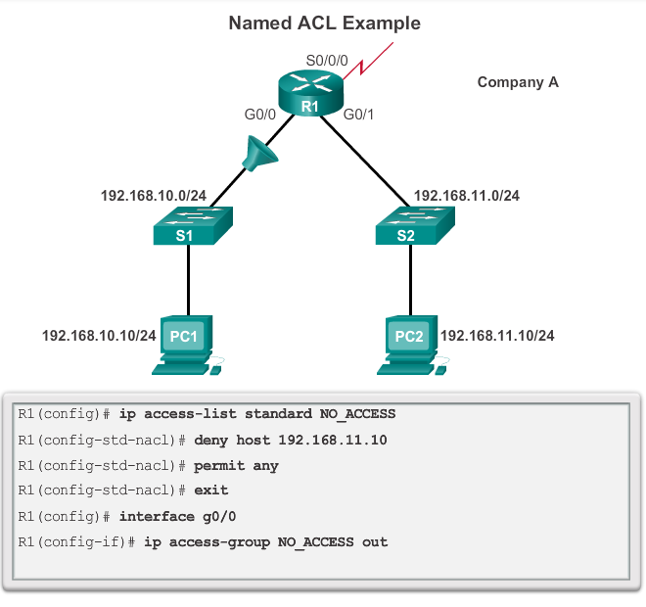

Slide 94
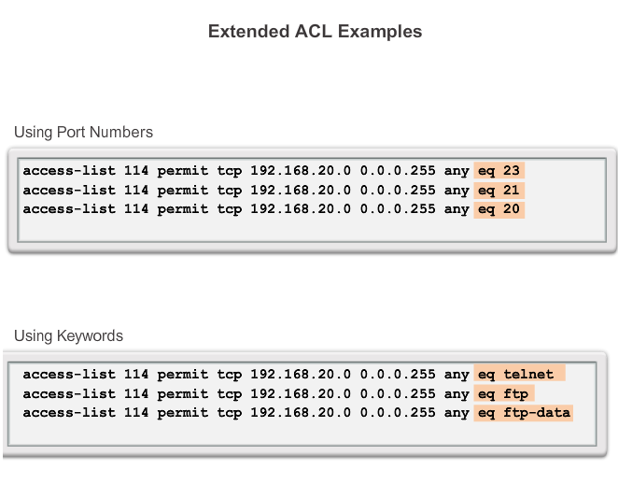
Extended ACL’s

Slide 95
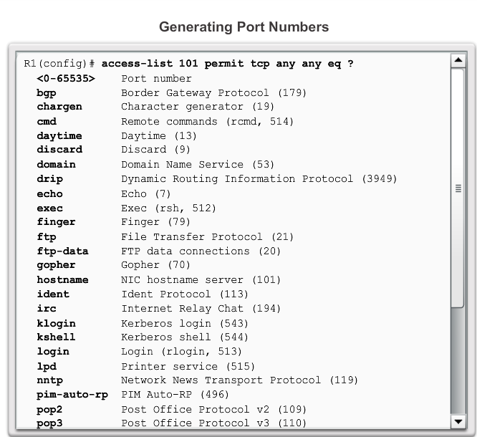
Extended ACL’s

Slide 96
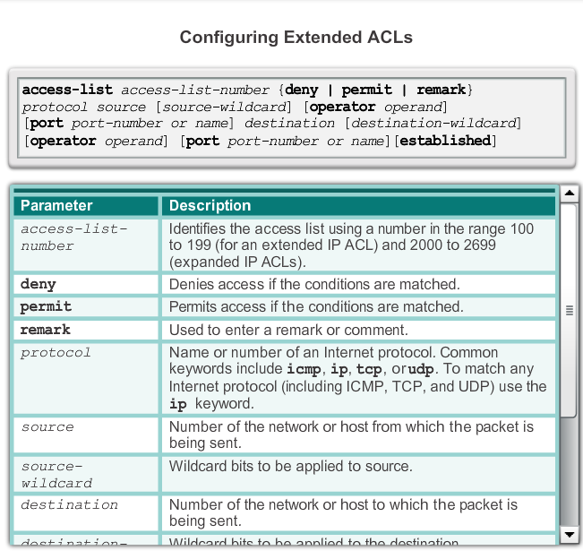
Extended ACL’s

Slide 97
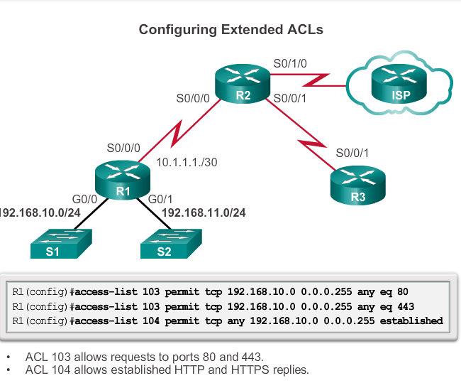
Extended ACL’s

Slide 98
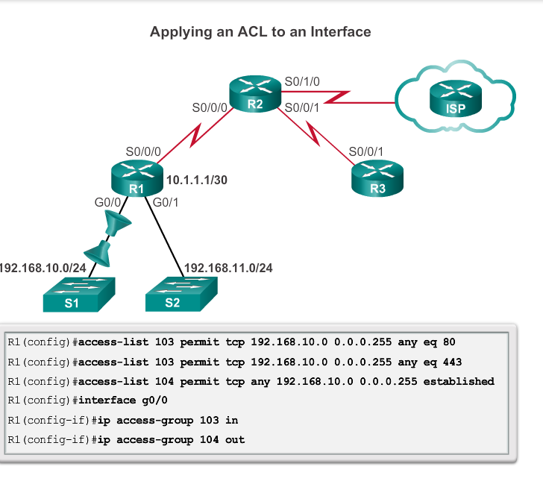
Extended ACL’s

Slide 99
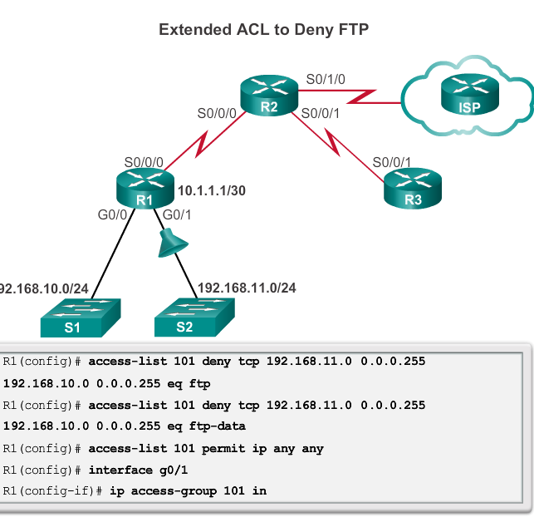
Extended ACL’s

Slide 100
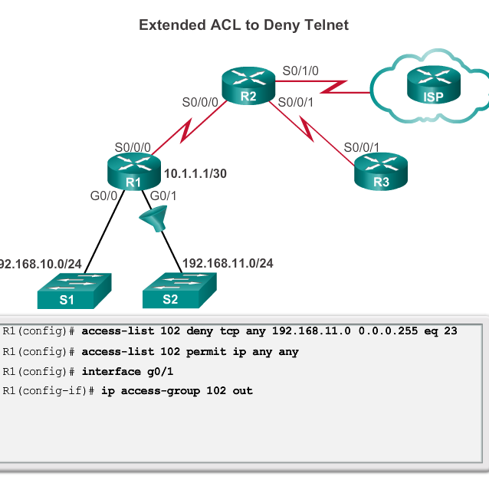
Extended ACL’s

Slide 101
Summary
2 steps to configure;
Write and Group
2 types;
Standard and Extended

Slide 102
Placement Important;
Standard ACL –close as possible to destination.
Not always but Standard usually exit a router.
Extended ACL- close as possible to the source.
Not always but extended usually enter a router

Slide 103
Summary
Order is important
There is an implicit deny so….
You need at least one permit in the ACL

