Slide 1
OSPF

Slide 2
OSPF
Open shortest path first
Open Shortest Path First (OSPF) is a link-state routing protocol that was developed as a replacement for the distance vector routing protocol, RIP.
RIP is only used for initial teaching of Routing protocols.

Slide 3
RIP was an acceptable routing protocol in the early days of networking and the Internet.
However, RIP's reliance on hop count as the only metric for determining best route quickly became problematic.
Using hop count does not scale well in larger networks with multiple paths of varying speeds.

Slide 4
Administrative distance
Administrative distance (AD) is the trustworthiness (or preference) of the route source.
OSPF has a default administrative distance of 110.
OSPF is preferred over IS-IS and RIP.
Connected is the best AD =0, most secure.

Slide 5
Why have AD??
Administrative distance is the feature that routers use in order to select the;
best path when there are
two or more different routes to the same destination from
two different routing protocols.

Slide 6
Administrative distance defines the reliability of a routing protocol.
Each routing protocol is prioritised in order of most to least reliable (believable) with the help of an administrative distance value.

Slide 7
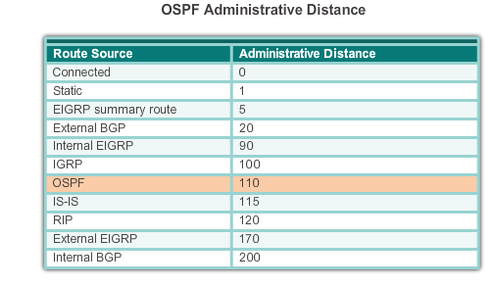
Different ADs

Slide 8
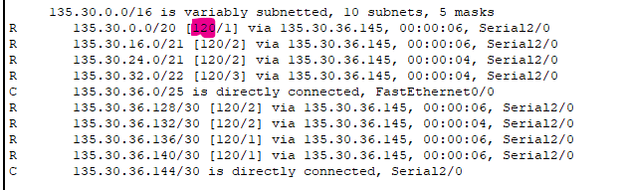
Routing Table
This Autonomous System is running RIP.
This is the output from the command
sh ip route

Slide 9
Convergence
OSPF has significant advantages over RIP in that it offers faster convergence and scales to much larger network implementations.
OSPF is a classless routing protocol that uses the concept of areas for scalability.

Slide 10
OSPF Features
Classless - It is classless by design; therefore, it supports VLSM and CIDR.
Efficient - Routing changes trigger routing updates (no periodic updates). It uses the SPF algorithm to choose the best path.
Fast convergence - It quickly propagates network changes.
Scalable - It works well in small and large network sizes. Routers can be grouped into areas to support a hierarchical system.
Secure - It supports Message Digest 5 (MD5) authentication.
When enabled, OSPF routers only accept encrypted routing updates from peers with the same pre-shared password.

Slide 11
3 Components
All routing protocols share similar components. They all use:
(1) Routing protocol messages to exchange route information.
    The messages help build
(2) Data structures,
    which are then processed using a
(3) Routing algorithm.

Slide 12
So, the 3 main components
Routing Protocol Messages
Data Structures
Algorithm

Slide 13
3 Data Structures
OSPF creates and maintains 3 databases:
Adjacency database - Creates the neighbour table.
Link-state database (LSDB) - Creates the topology table.
Forwarding database - Creates the routing table.
These tables contain a list of neighbouring routers to exchange routing information with.

Slide 14
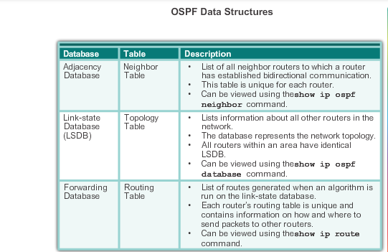
3

Slide 15
Routing Protocol Messages
OSPF exchanges messages to convey routing information using 5 types of packets.
Hello packet
Database description packet
Link-state request packet
Link-state update packet
Link-state acknowledgment packet

Slide 16
Why all these packets??
These packets are used to discover neighbouring routers and also to exchange routing information to maintain accurate information about the network.

Slide 17
Algorithm
The CPU processes the neighbour and topology tables using SPF algorithm.
The SPF algorithm is based on the cumulative cost to reach a destination.
Metric =Cost

Slide 18
I am at the top of the tree!
The SPF algorithm creates a SPF tree by placing each router at the root/top of the tree and calculating the shortest path to each node.
The SPF tree is then used to calculate the best routes.
OSPF places the best routes into the forwarding database, which is used to make the routing table.

Slide 19
Need fast Convergence
To maintain routing information,
OSPF routers complete the following generic link-state routing process to reach a state of convergence….next slide

Slide 20
OSPF Steps to Convergence
Establish
Establish Neighbour Adjacencies
Exchange
Exchange Link-State Advertisements
Build
Build the Topology Table
Execute
Execute the SPF Algorithm

Slide 21
Are you OSPF????
OSPF-enabled routers must recognise each other on the network before they can share information.
An OSPF-enabled router sends Hello packets out all OSPF-enabled interfaces to determine if neighbours are present on those links.
If a neighbour is present, the OSPF-enabled router attempts to establish a neighbour adjacency with that neighbour.

Slide 22
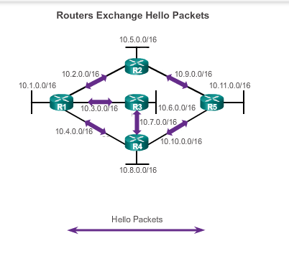

Slide 23
Exchange Link-State Advertisements
After adjacencies are established, routers then exchange link-state advertisements (LSAs).
LSAs contain the state and cost of each directly connected link.
Routers flood their LSAs to adjacent neighbours.
Adjacent neighbours receiving the LSA immediately flood the LSA to other directly connected neighbours, until all routers in the area have all LSAs. (converged).

Slide 24
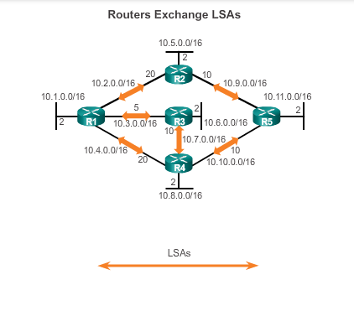
Flood system with LSAs

Slide 25
Build the Topology Table
After LSAs are received, OSPF-enabled routers build the topology table (LSDB) based on the received LSAs.
This database eventually holds all the information about the topology of the network.

Slide 26
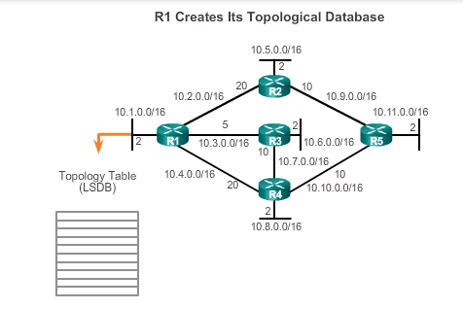

Slide 27
Execute the SPF Algorithm
Routers then execute the SPF algorithm.
The SPF algorithm creates the SPF tree.

Slide 28
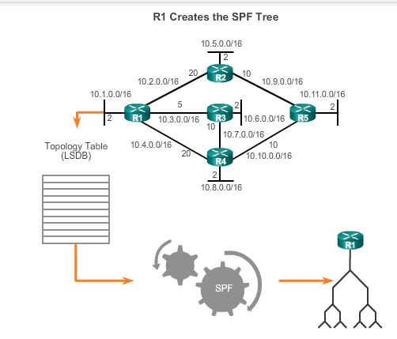

Slide 29
Best Path Entered
From the SPF tree, the best paths are inserted into the routing table.
Routing decisions are made based on the entries in the routing table.

Slide 30
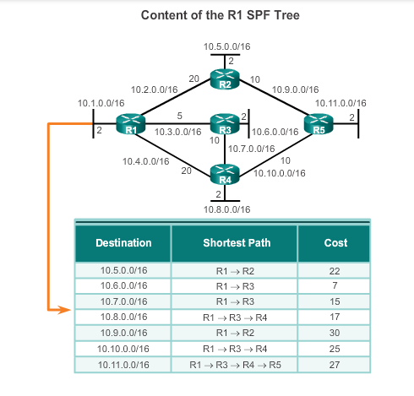

Slide 31
LSDB
To make OSPF more efficient and scalable, OSPF supports hierarchical routing using areas.
An OSPF area is a group of routers that share the same link-state information in their LSDBs.
LSDB = Link State Data Base
LSDB = Creates the topology table

Slide 32
Areas
OSPF can be implemented in one of two ways:
Single-Area OSPF - all routers are in one area called the backbone area (area 0).
Multi-area OSPF - OSPF is implemented using multiple areas, in a hierarchal fashion.
All areas must connect to the backbone area (area 0).
Routers interconnecting the areas are referred to as Area Border Routers (ABR).

Slide 33
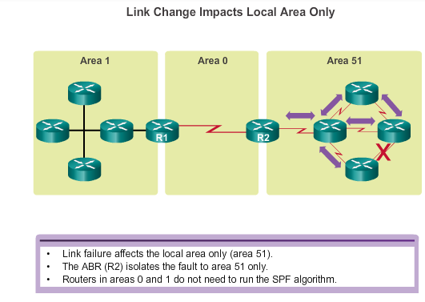

Slide 34
Why Multi-area?
The hierarchical-topology of multi-area OSPF have these advantages:
Smaller routing tables - Fewer routing table entries because network addresses can be summarized between areas.
Route summarization is not enabled by default.

Slide 35
Why Multi-area?
Reduced link-state update overhead- Minimizes processing and memory requirements.
Reduced frequency of SPF calculations - Localizes the impact of a topology change within an area.
For instance, it minimizes routing update impact because LSA flooding stops at the area boundary.

Slide 36
Configuring OSPF
The basic command syntax
Network network-address
wildcard-mask
area area-id.

Slide 37
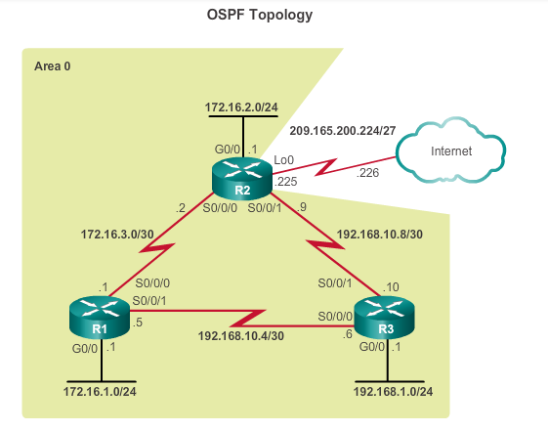

Slide 38
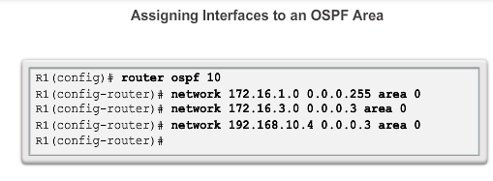

Slide 39
Cost….Metric
Recall that a routing protocol uses a metric to determine the best path of a packet across a network.
A metric gives indication of the overhead that is required to send packets across a certain interface.

Slide 40
Cost
OSPF uses cost as a metric.
A lower cost indicates a better path than a higher cost.
The cost of an interface is inversely proportional to the bandwidth of the interface.

Slide 41
Cost
Therefore:
a higher bandwidth indicates a lower cost.
More overhead and time delays equal a higher cost.
Therefore, a 10-Mb/s Ethernet line has a higher cost than a 100-Mb/s Ethernet line.

Slide 42
OSPF cost
Cost = reference bandwidth /interface bandwidth
The default reference bandwidth is 10^8 (100,000,000); therefore, the formula is:
Cost = 100,000,000 bps / interface bandwidth in bps

Slide 43
Reference bandwidth = 100,000,000
Cost of 10 Mb/s
=100,000,000/10,000,000 =10
Cost of 100Mb/s
=100,000,000/100,000,000 =1

Slide 44
Reference bandwidth changes….
To adjust the reference bandwidth use:
auto-cost reference-bandwidth Mb/s
This command must be configured on every router in the OSPF domain.
Take the
Reference bandwidth = 100,000,000

Slide 45
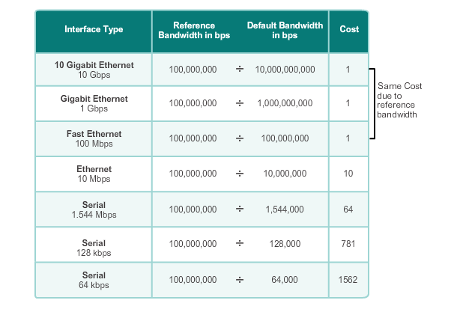
Cost can only be a Natural Number

Slide 46
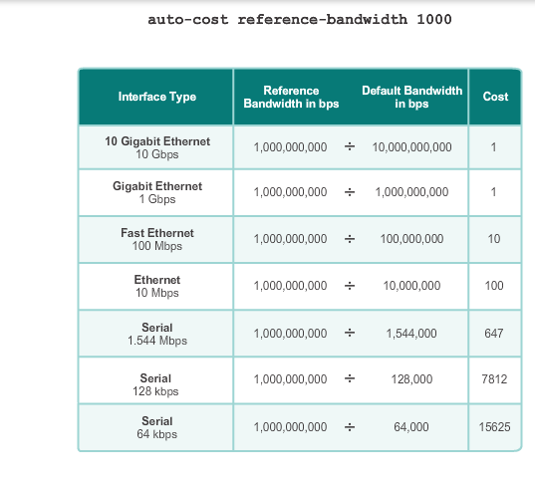

Slide 47
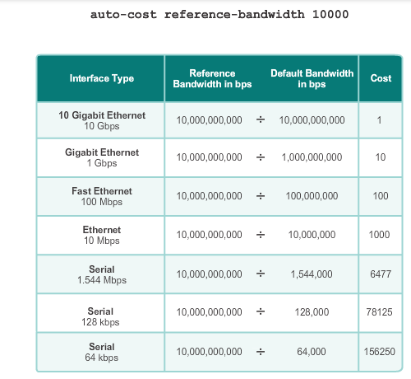

Slide 48
Cost
The cost of an OSPF route is the accumulated value from one router to the destination network.
For example, the cost to reach the R2 LAN 172.16.2.0/24 from R1 should be as follows:
Serial link from R1 to R2 cost = 64
Gigabit Ethernet link on R2 cost = 1
Total cost to reach 172.16.2.0/24 = 65

Slide 49
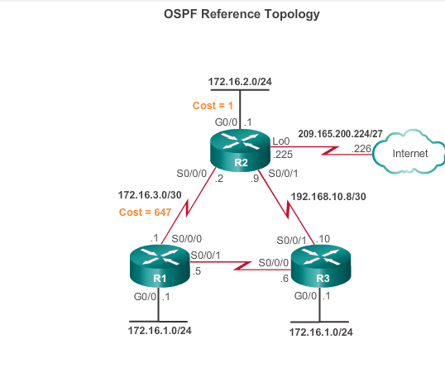

Slide 50
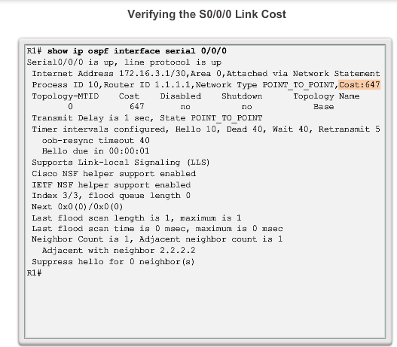

Slide 51
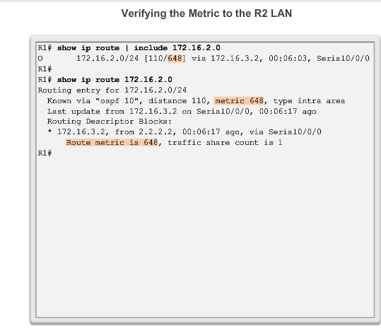

Slide 52
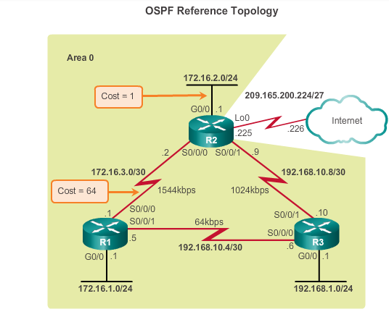

Slide 53
Passive Interfaces
There is no need for R1, R2, and R3 to forward OSPF messages out of their LAN interfaces.
So the configuration identifies the R1 G0/0 interface as passive.

Slide 54
Passive Interface
Use the passive-interface router configuration mode command to prevent the transmission of routing messages through a router interface, but still allow that network to be advertised to other routers.
Specifically, the command stops routing messages from being sent out the specified interface.
However, the network that the specified interface belongs to is still advertised in routing messages that are sent out other interfaces.

Slide 55
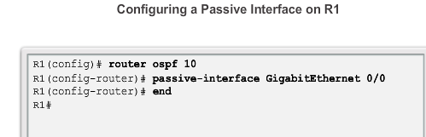

Slide 56
Why use passive?
Inefficient Use of Bandwidth
Available bandwidth is consumed transporting unnecessary messages.
Messages are multicasted; therefore, switches are also forwarding the messages out all ports.
Inefficient Use of Resources
All devices on the LAN must process the message and eventually discard the message.
Increased Security Risk
Advertising updates on a broadcast network is a security risk.
OSPF messages can be intercepted with packet sniffing software.
Routing updates can be modified and sent back to the router, corrupting the routing table with false metrics that misdirect traffic.

Slide 57
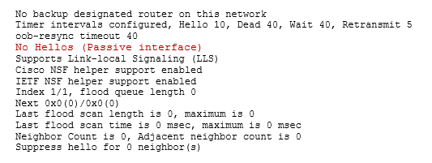
The show ip protocols command is then used to verify that the Gigabit Ethernet interface was passive.

Slide 58
Router can be either.....
DR = Designated Router
BDR = Backup Designated Router
DROTHER =All other routers

Slide 59
Router Priority
Router Priority - Used in a DR/BDR election.
The default priority for all OSPF routers is 1, but can be manually altered from 0 to 255.
The higher the value, the more likely the router becomes the DR on the link.

Slide 60
Router IDs
Designated Router (DR) - Router ID of the DR.
Backup Designated Router (BDR) - Router ID of the BDR.
List of Neighbours - List that identifies the router IDs of all adjacent routers.

Slide 61
Why is a DR and BDR election necessary?
Multi-access networks can create two challenges for OSPF regarding the flooding of LSAs:
Creation of multiple adjacencies
Extensive flooding of LSAs

Slide 62
Creation of multiple adjacencies
Ethernet networks could potentially interconnect many OSPF routers over a common link.
Creating adjacencies with every router is unnecessary and undesirable.
It would lead to an excessive number of LSAs exchanged between routers on the same network.

Slide 63
Extensive flooding of LSAs
Extensive flooding of LSAs - Link-state routers flood their LSAs any time OSPF is initialized, or when there is a change in the topology.
This flooding can become excessive.

Slide 64
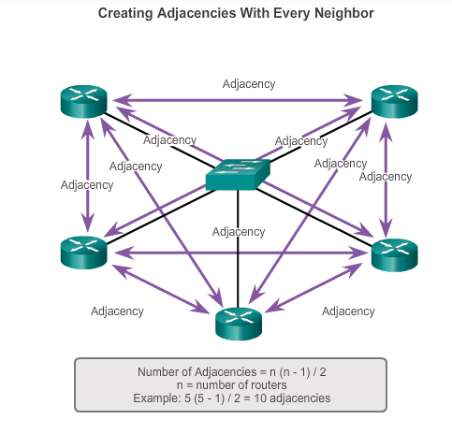

Slide 65
Calculate the number of Adjacencies
Number of router =
10 = how many adjacencies?
20 = how many adjacencies?
100 = how many adjacencies?

Slide 66
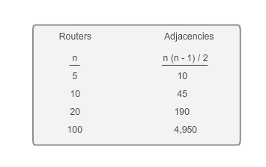
More Routers ……

Slide 67
DR: Designated Router
The solution to managing the number of adjacencies and the flooding of LSAs on a multi-access network is the DR.
On multi-access networks,
OSPF elects a DR to be the collection and distribution point for LSAs sent and received.
Think of it like a post office.

Slide 68
BDR :Back up DR
A BDR is also elected in case the DR fails.
All other routers become DROTHERs.
A DROTHER is a router that is neither the DR nor the BDR.

Slide 69
Router ID in the AS
The OSPF router ID is used to uniquely identify the router in the OSPF routing domain.
Cisco routers derive the router ID in one of three ways and with the following precedence:

Slide 70
First
1) IP address configured with the OSPF router-id command, if present.

Slide 71
Second
2) Highest IP address of any of the router’s loopback addresses, if present.

Slide 72
Third
3) Highest active IP address on any of the router’s physical interfaces.

Slide 73
So if no router IDs or loopback interfaces have been configured on the three routers…
the router ID for each router is determined by the highest IP address of any active interface.

Slide 74
RID by router-id command
Change the router ID on R1 using the router-id command.
The preferred method for setting the router ID is with the router-id command.
R1(config)# router ospf 1
R1(config-router)# router-id 11.11.11.11
Reload or use "clear ip ospf process" command, for this to take effect
You will receive an informational message telling you that you must either reload the router or use the clear ip ospf process command for the change to take effect.
Remember to save configuration first before a reload!!!!!

Slide 75
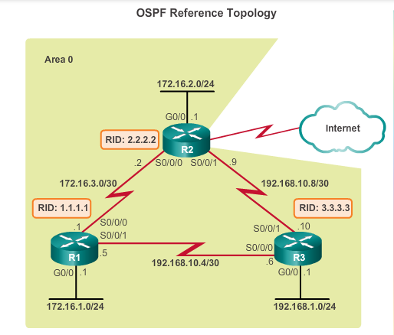

Slide 76
What is a loopback address?
It's an interface like any other and can be assigned its own address.
A loopback interface is often used as a termination address for some routing protocols,
because it never goes down.
Another common use of a loopback address is to identify a router.

Slide 77
RID by loopback
To assign an IP address to loopback 0 on R1
R1(config)# interface lo0
R1(config-if)# ip address 1.1.1.1 255.255.255.255
Remember to save configuration first before a reload!!!!!

Slide 78
No RID or loopbacks..then
Highest active IP address on any of the router’s physical interfaces.
So if no router IDs or loopback interfaces have been configured on the router
the router ID for each router is determined by the highest IP address of any active interface.

Slide 79
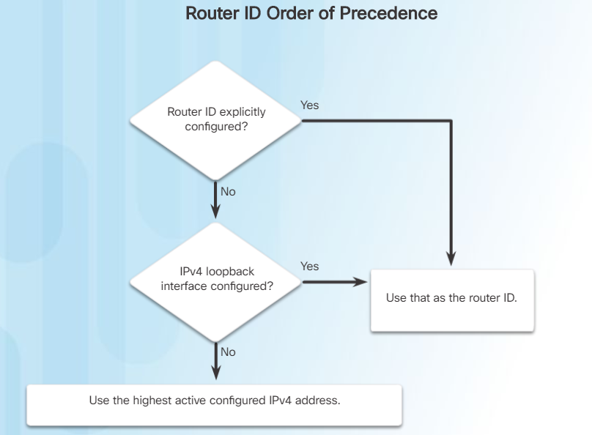
Therefore….

Slide 80
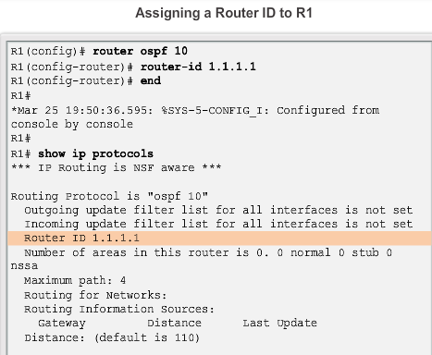

Slide 81
OSPF Messages
OSPF uses link-state packets (LSPs) to establish and maintain neighbour adjacencies and exchange routing updates.
There are five different types of LSPs used by OSPF.
Each packet serves a specific purpose in the OSPF routing process:

Slide 82
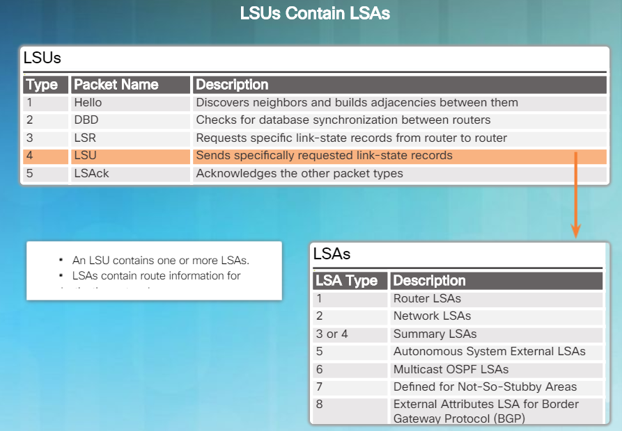

Slide 83
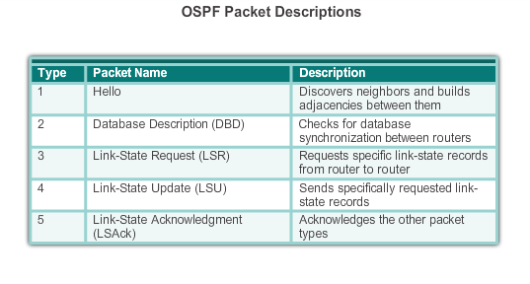
LSU’s

Slide 84
HELLO
Hello Packet
The OSPF Type 1 packet is the Hello packet.

Slide 85
Hello packets are used to:
Discover OSPF neighbours and establish neighbour adjacencies.
Advertise parameters on which two routers must agree to become neighbours.
Elect the Designated Router (DR) and Backup Designated Router (BDR) on multi-access networks like Ethernet and Frame Relay.
Point-to-point links do not require DR or BDR.

Slide 86
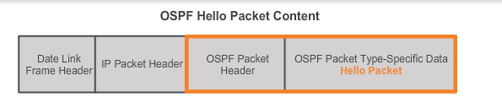

Slide 87
Recap .....Numbers for LSUs
Type - Identifies the type of packet.
(1) = indicates a Hello packet.
(2)= identifies a DBD packet, (database description packet).
(3) a LSR packet, (Link State Request)
(4) a LSU packet, (Link State Update)
(5) a LSAck packet.

Slide 88
Hello Interval
Hello Interval - Specifies the frequency, in seconds, at which a router sends Hello packets.
The default Hello interval on multi-access networks is 10 seconds.
This timer must be the same on neighbouring routers; otherwise, an adjacency is not established.

Slide 89
Dead Interval
Dead Interval - Is the time in seconds that a router waits to hear from a neighbour before declaring the neighbouring router out of service.
By default, the router Dead Interval is four times the Hello interval, (40 secs).
This timer must be the same on neighbouring routers; otherwise, an adjacency is not established.

Slide 90
OSPF States
OSPF progresses through several states while attempting to reach convergence:
Down state
Init state
Two-Way state
ExStart state
Exchange state
Loading state
Full state

Slide 91
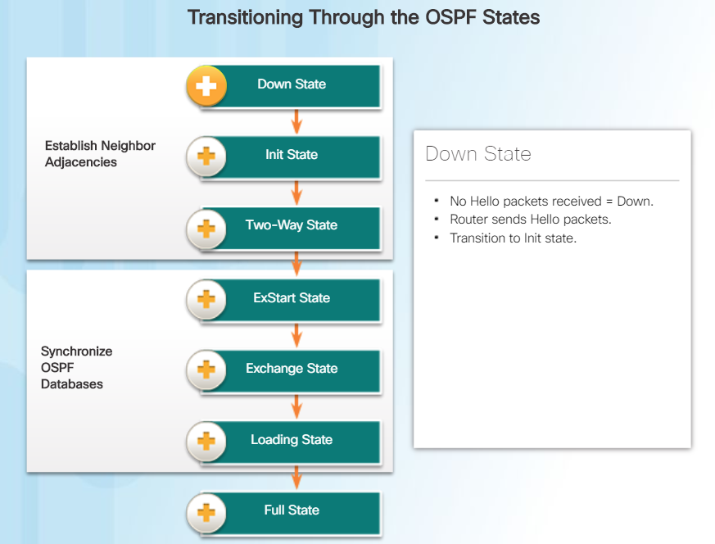

Slide 92
Recap….OSPF Steps
When an OSPF router is initially connected to a network, it attempts to:
Create adjacencies with neighbours (HELLO..)
Exchange routing information (LSAs)
Build Topology (LSDB)
Calculate the best routes (SPF)
Reach convergence

Slide 93
Useful commands
sh ip protocols
sh ip ospf
sh ip ospf int
Debug ip ospf spf
sh ip ospf neighbour
sh ip ospf database

