Slide 1


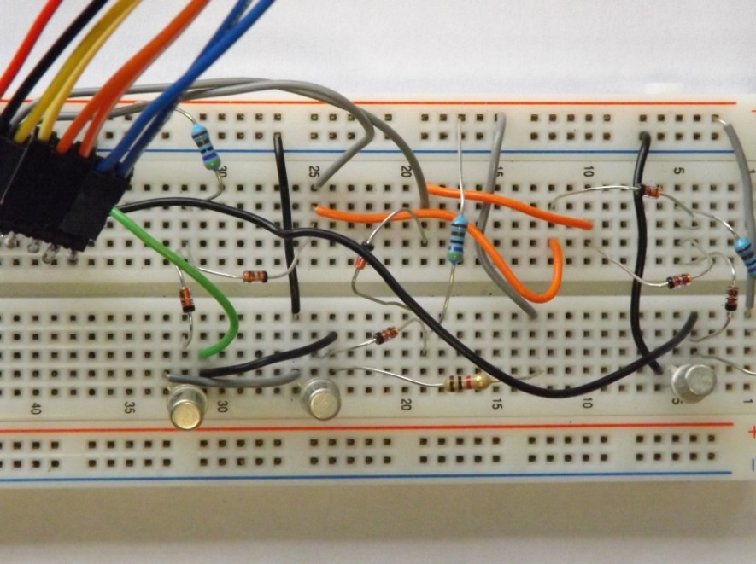
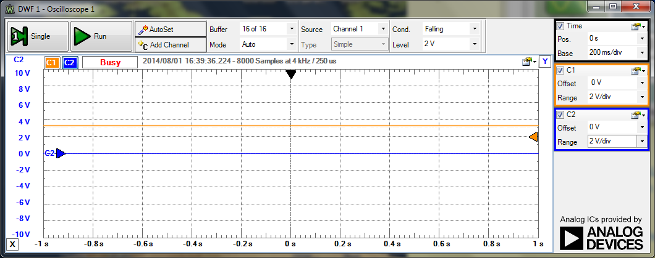
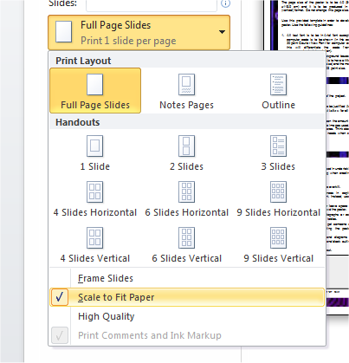

Insert Profile Picture
Here
An Application of 24GHz RADAR for Contactless Heart Rate Monitoring
Oisin Watkins
LM118 Electronic & Computer Engineering – General Stream
Introduction
The page size of the poster is to be A1 (59.4cm x 84.1 cm) and it is to be produced in portrait (vertical) format. Do not change this page size.
Use this provided template in order to develop your poster. Use the following guidelines:
All text font is to be in Arial font except where computer code is to be shown (in this case, use 20 point Courier New Font for computer code as this will differentiate the code from the accompanying text description).
Place content in white background boxes in the style shown here. Each new topic box is to have a title (dark blue colour font in 36 point size) and the main text is to be black colour font in 28 point size.
Caption text to use Arial font, 20 point size, bold.
For simple graphs use MS Excel, or draw the graph directly in PowerPoint.
For data analysis,plots, use MATLAB or MS Excel.
If in doubt about how the poster will look, initially print the poster to a colour A4 size and review before printing to A1. This will save time and costs for reprinting the A1 poster.
The page size of this poster is A1. To print to a printer and fit to the printer paper size (under Powerpoint 2010):
On the File menu, click Print.
Under the Settings option then select the option Scale to Fit Paper.
Caption text to use Arial font, 20 point size, bold.
Caption text to use Arial font, 20 point size, bold.
Text can be placed to the side of a figure.
Aim
Describe here the main aim(s) of the project.
The text in each of the boxes is to be justified (left and right). Use a line spacing of 12pt before for all text.
Try to create a balance between the amount of text used and the number/size of the images used. Don’t squash everything into a small area. Think about the reader of the poster and their needs when creating the poster presentation.
Any computer code included should use 20 point Courier New size.
Scaling the print to the printer paper size in Powerpoint 2010.
Results
When importing / inserting images, make sure that the quality of the image is high enough so that is does not look grainy when printed.
Do not use images from the web unless required.
When appropriate, reference the source of the image.
Don’t use any gimmicks or presentation styles that are difficult to see (such as light colour text on a light background (lack of contrast)). Avoid too many light colours.
Method
Describe here the method(s) used in undertaking the project. Consider the following when creating the poster:
Simplify everything, avoid data overkill.
Never write whole sentences in capitals or underline to stress your point. Instead, use bold characters.
When laying out your poster leave space around the text. Don’t overcrowd the poster.
Where appropriate, use photographs or coloured graphs. Avoid large numerical tables.
Spell check the poster and get someone else to proof-read it before submitting the poster for printing.
Place images, photographs and diagrams within boxes with grey background and black outlines as shown below.
Avoid putting images behind text.
Conclusion and personal reflection
Provide a brief conclusion to the project (what were the results achieved).
In addition, provide a personal reflection on how the project was undertaken, what skills were learnt and if the project was to be undertaken again, what would be different.
What were the key University of Limerick Graduate Attributes (http://www2.ul.ie/pdf/982103103.pdf) developed during the project?
Caption text to use Arial font, 20 point size, bold.
Acknowledgements
Provide any acknowledgements to individuals or organisations/companies that assisted you in undertaking the project.
Caption text to use Arial font, 20 point size, bold.
Caption text to use Arial font, 20 point size, bold.

