Slide 1
Demorad CW Radar Software Manual

Slide 2
Demo Firmware – Data Collection
Allocate two 256 KB (1 frame = 256*128*4*2 bytes) ping-pong buffers in L2 to receive data from the ADC
Quad-SPI DMA fills data from ADC to ‘input pointer’
In parallel, data from ‘output pointer’ is sent out through USB to PC (Step 2, 3 and 4 in the figure are commented. All the processing needs to be done on PC)
Swap ‘input pointer’ and ‘output pointer’, and repeat.
This ensures continuous data collection.
Note:
Ping-Pong buffer mechanism is not implemented on the default Demo firmware on Demorad. Instead,
BF706 waits for a USB command from PC (Python/Matlab)
Enables ADF4159 to generate chirp/pulse and start data collection
Send out one chirp data out on USB
FFT is not implemented on the default Demo firmware on Demorad. Instead, chirp data is directly sent out on USB.

Slide 3
Demo Firmware - Sequence
BF706 (running from CrossCore Embedded Studio)
Configure
BF706
RF – ADF5901, ADF5904, ADF4159 (Ramp output is Off)
ADC – ADAR7251
Wait for USB command
Start data collection
Send out time-domain data on USB
PC
Run USB command on command prompt
Receive USB data and write to file
Process and/or Plot data on Matlab
Note: Refer to Appendix (slides 18-22) for more details on setup and running.

Slide 4
BF70x and CrossCore Embedded Studio
Bf70x related info - Datasheet, Hardware Reference Manual, Programming Reference Manual, etc. (http://www.analog.com/en/products/processors-dsp/blackfin/adsp-bf707.html)
Bf70x Datasheet - memory size, rom size, core speed, number of peripherals, etc. (http://www.analog.com/media/en/technical-documentation/data-sheets/ADSP-BF700_BF701_BF702_BF703_BF704_BF705_BF706_BF707.pdf)
ICE-1000 or ICE-2000 Emulator for debugging code on BF70x (http://www.analog.com/media/en/dsp-documentation/evaluation-kit-manuals/ICE_emu_1000_2000_rev_manual.pdf)
CrossCore Embedded Studio - http://www.analog.com/en/design-center/processors-and-dsp/evaluation-and-development-software/adswt-cces.html (download latest version)

Slide 5
Blackfin Libraries and Software Modules
CCES Compiler and Library Manual for Blackfin (http://www.analog.com/media/en/dsp-documentation/software-manuals/cces-BlackfinCompiler-library-manual.pdf)
C/C++ Run-Time Library
DSP Run-Time Library
Blackfin Software Modules (http://www.analog.com/en/design-center/landing-pages/001/blackfin-software-modules.html)

Slide 6
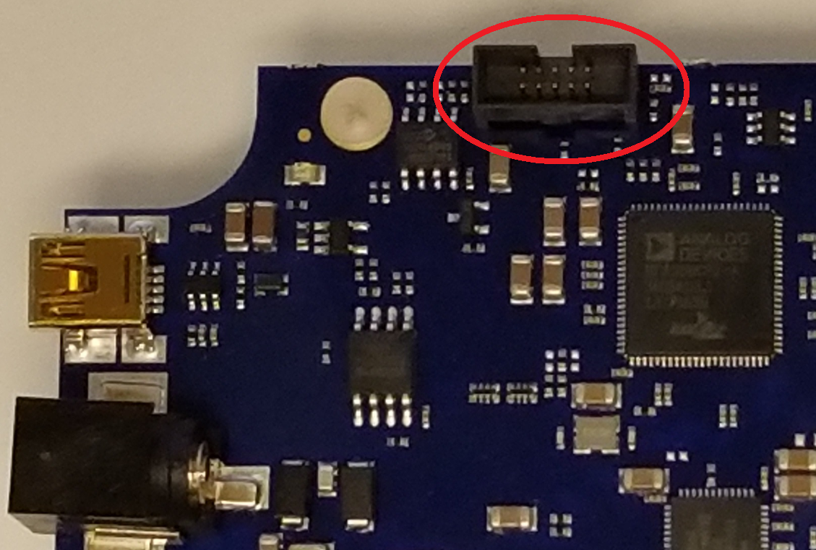
Appendix: Loading and Running the CCES Project
Create workspace
After opening CCES, browse for folder where the “Radar_CW” is located and choose it as workspace folder
Load the project into CCES
Menu > File > Import > General > Existing Projects into Workspace
Browse for folder where the “Radar_CW” is located
Select “Radar_CW” and click Finish
Build the project
F7 or Menu > Project > Build Project
After project is loaded, CCES modifies the “system/startup_ldf/app.ldf” file. Hence expect compilation error (Error el2012 and el2013). Just open “system/startup_ldf/app.ldf” and comment lines
MEM_L2_SRAM { TYPE(RAM) START(0x08002000) END(0x080EFFFF) WIDTH(8) }
MEM_L2_SRAM_UNCACHED { TYPE(RAM) START(0x080F0000) END(0x080FFFFF) WIDTH(8) }
Build again
Run the project
Connect ICE-1000 or ICE-2000 emulator to Demorad (connector shown in figure)
1st time:
Right click on project ‘Radar_CW’ > Debug As > Application with CrossCore Debugger.
Select Processor: ADSP-BF706; Connector Type: Emulator; Platform: ADSP-BF706 via ICE-2000. Click Finish.
Click Add, Project: Radar_CW; Program: Debug/Radar_CW.dxe. Click OK, Apply, Debug.
Subsequent times: F5 or Menu > Run > Debug
Accept CCES prompt to go to Debug Perspective
F5 or Menu > Run > Resume
If everything is successful, the BF706 configures the RF frontend and waits for USB command.

Slide 7
Appendix: User configurations (UserConfig.h)
Find these preprocessor directives in UserConfig.h and modify as per need, before building the CCES project
DBG_PRINT: Print on Console when running on CCES

Slide 8
Appendix: Running usb.exe to collect data on PC
usb.exe <outFILE> <COUNT> <BEAMS> <SAMPPERRAMP> <RAMPS> <ConfigFILE>
outFILE = path/filename to save data
COUNT = # of cubes to receive
BEAMS = # of beams (Note: Not supported in current example. Hence provide ‘0’)
SAMPPERRAMP = half of number of samples per ramp (Note: Half because after FFT there will be real and imaginary)
RAMPS = number of ramps
FILE = filename to send a file to board before streaming (Note: It’s a dummy file in current example)
Note: Change only outFILE and COUNT. Other parameters keep same as below Example
Open command prompt and browse to “…\Radar_CW\Radar_CW\usb” folder
Example: Receive 100 time domain data cubes
DOS Command: usb.exe data/test1.csv 100 0 128 128 writeregs.txt

Slide 9
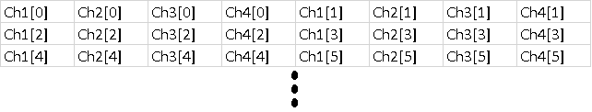
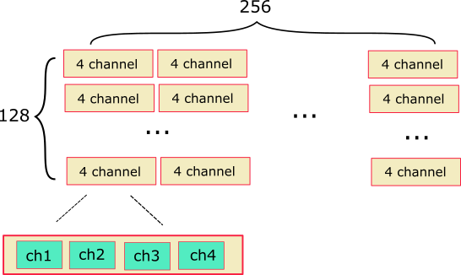
Appendix: Received Data file format
Time Domain Data
The usb.exe still thinks it collects Complex FFT output. Hence it creates csv file with 8 columns instead of 4. Refer below for data file format.

Slide 10
Appendix: Running the Matlab script
readDemoradData.m
Read the data files collected from Demorad
Matlab Command – data = readDemoradData('usb\data\test1',100);

