Slide 1
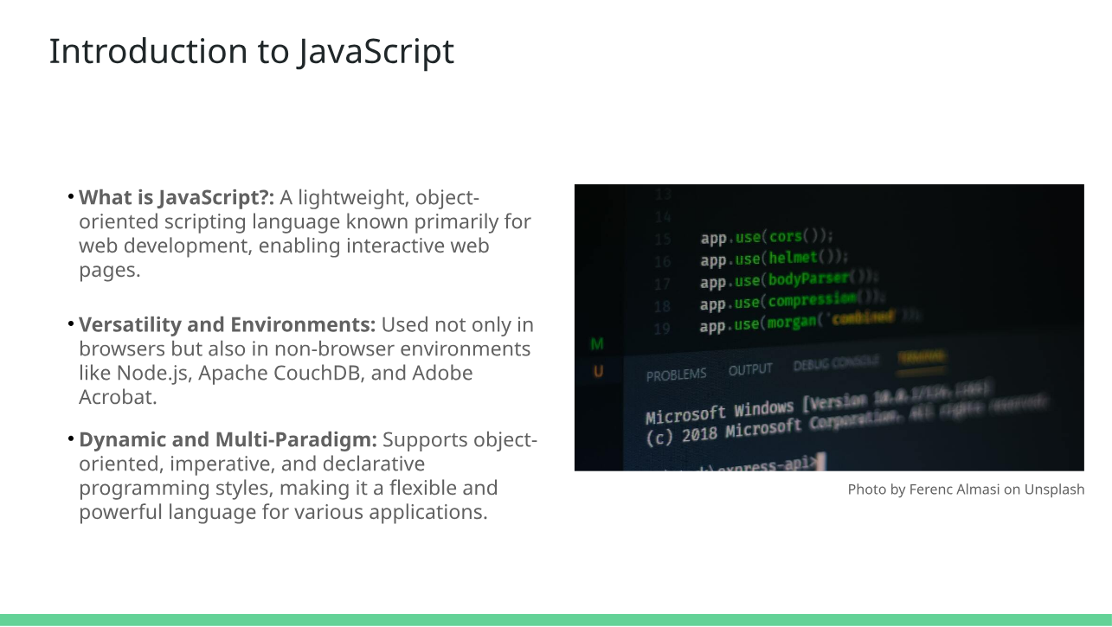

Slide 2
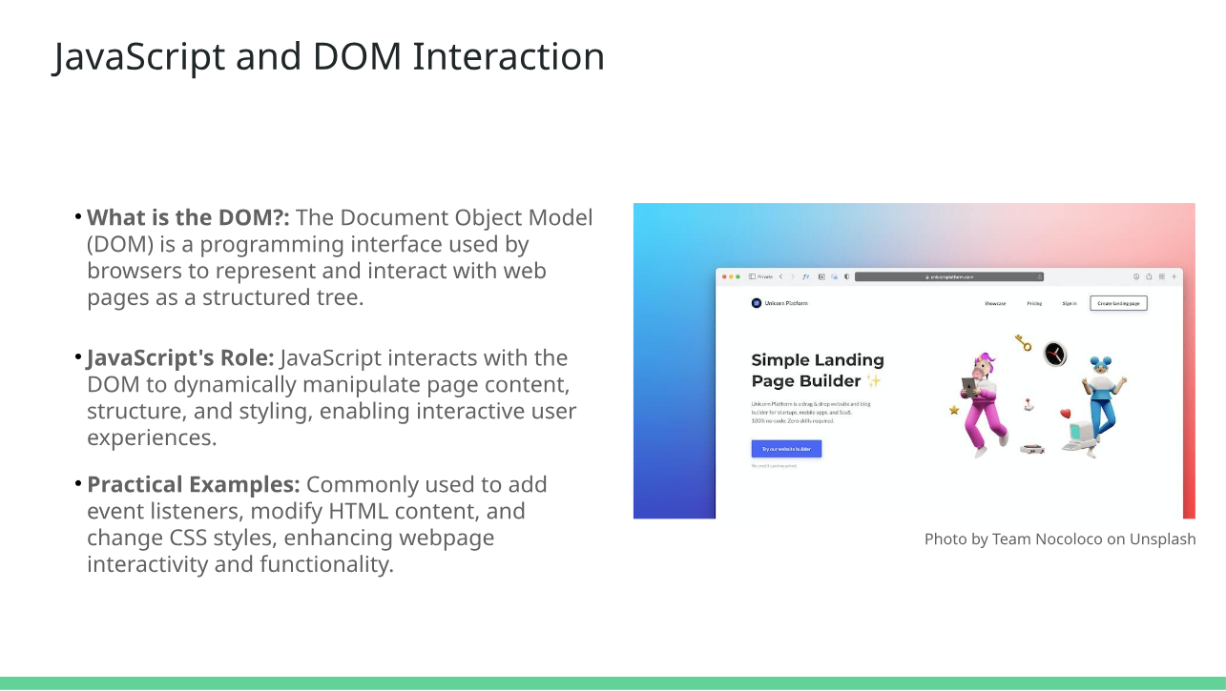

Slide 3
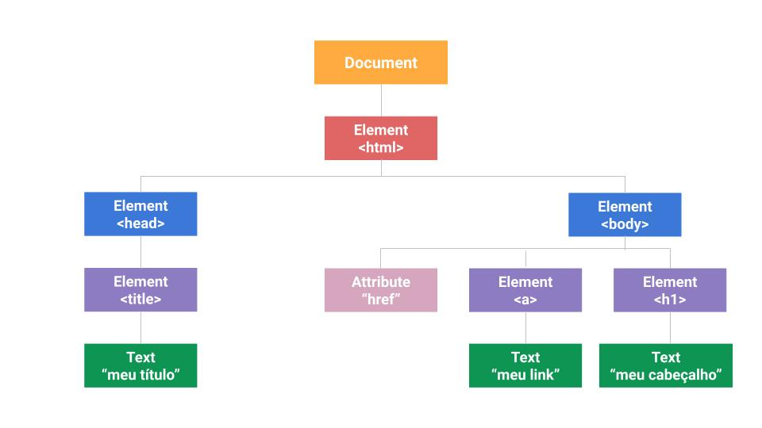
DOM(Document Object Model)

Slide 4
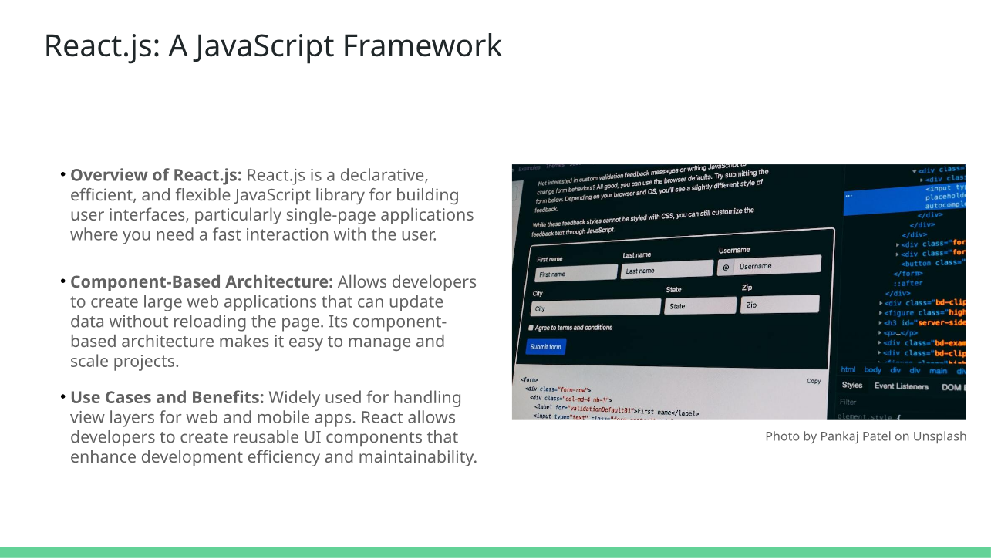

Slide 5
Material
https://www.youtube.com/watch?v=VW8kNAous88&list=PLVvjrrRCBy2JS8__NYlhPeaoNz2p1aPEN
https://www.youtube.com/watch?v=BXqUH86F-kA&list=PLntvgXM11X6pi7mW0O4ZmfUI1xDSIbmTm
https://www.youtube.com/watch?v=1-w1RfGIov4&list=PLHz_AreHm4dlsK3Nr9GVvXCbpQyHQl1o1&index=1
https://www.youtube.com/watch?v=TkD0QMyBa28&list=PLnDvRpP8BneysKU8KivhnrVaKpILD3gZ6

Slide 6
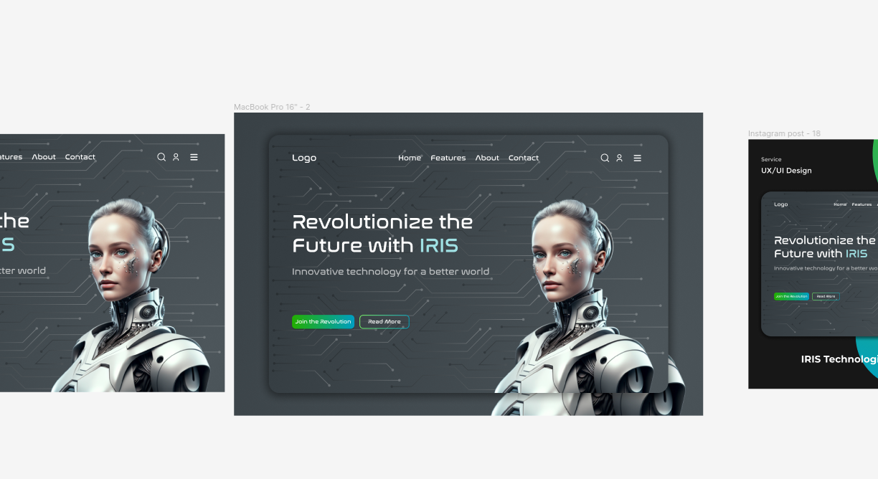
Projetos
https://www.figma.com/file/6NTobEu9dCEkiRuaIvONZy/Technologie-Website-(Community)?type=design&node-id=0-1&mode=design&t=DkV1Z2GKcuMzuw61-0

Slide 7

Projetos
https://www.figma.com/community/file/1365273665764881282

Slide 8

Projetos
https://www.figma.com/community/file/1365233025361049437

