Slide 1
Trajectory inference in the
E7.0–E10.0 mouse embryonic brain
La Manno E7–E10, joint integration with Brooks 2025, preliminary CellRank
68,166
107,629
8
cells, 19 libraries
cells once Brooks is joined
CellRank kernel weightings
Yubin · Moskowitz Lab · 30 October 2026

Slide 2
1
The La Manno dataset on its own
Quality control, feature selection, PCA, UMAP and hedgehog expression — before any integration.

Slide 3
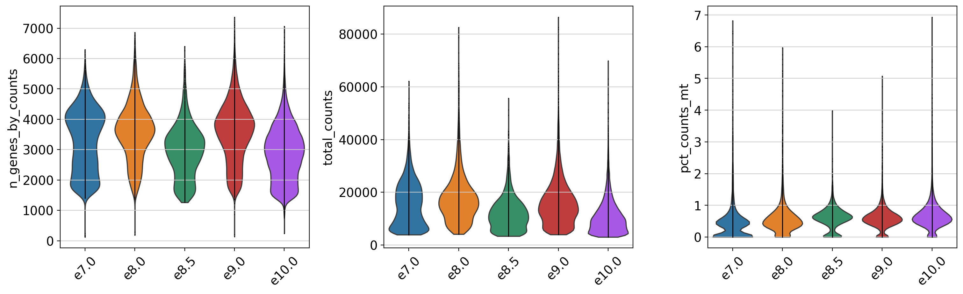
Quality control by stage
Comparable across all five stages — no stage needed special handling.
Notes:
Median 3,188 genes and 11,692 UMIs per cell. Mitochondrial fraction is under 1% everywhere, which is unusually clean. Filtering removed only 11 cells and 2,448 genes.

Slide 4
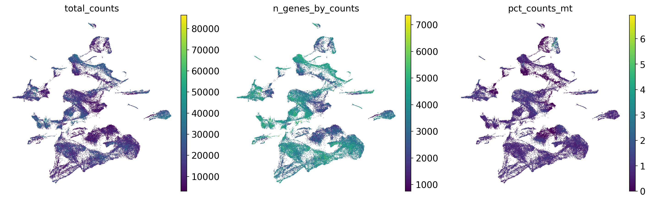
Quality metrics on the UMAP
No cluster is defined by depth or mitochondrial content — structure is not an artifact.

Slide 5
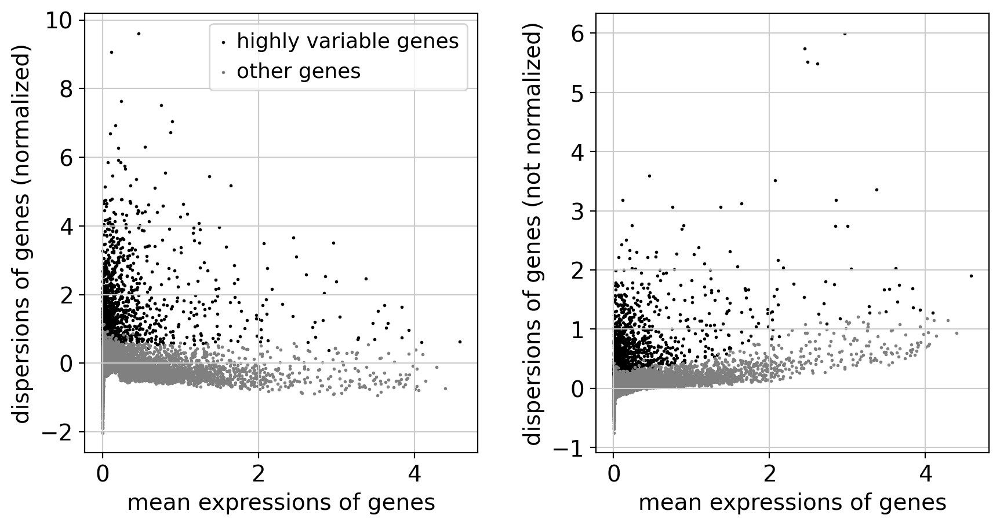
Highly variable gene selection
2,000 genes per batch; hedgehog genes retained explicitly, being too sparse to survive.

Slide 6
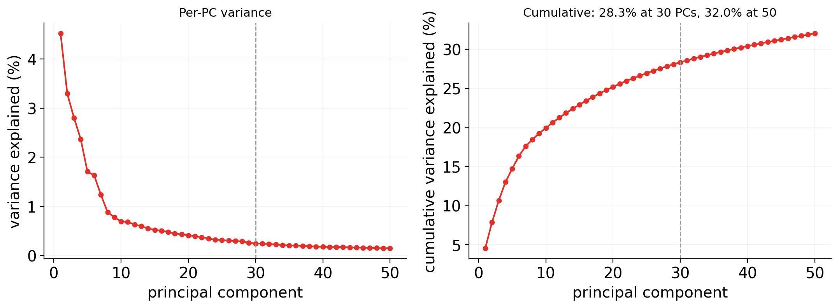
PCA variance is spread thin
PC1 carries 4.5%; 50 components computed, the first 30 feed the neighbour graph.
Notes:
sc.tl.pca(n_comps=50) then sc.pp.neighbors(n_neighbors=15, n_pcs=30) - 50 computed, 30 used. Elbow at PC8-10 and flat past PC15, so 30 is adequate-to-generous. Variance: PC1 4.5%, PC2 3.3%, first 10 19.9%, first 30 28.3%, all 50 32.0%. The flatness means the graph rests on many weak directions, which is part of why E7.0 separates so completely. Note the CellRank notebook rebuilds its graph as n_neighbors=30 over the full 50-component Harmony representation, so the PC count differs there.

Slide 7
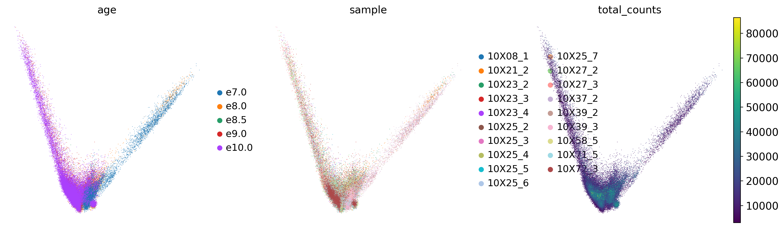
PCA by stage and by sample
Stage separates on the leading components; E7.0 sits apart already in PCA space.

Slide 8
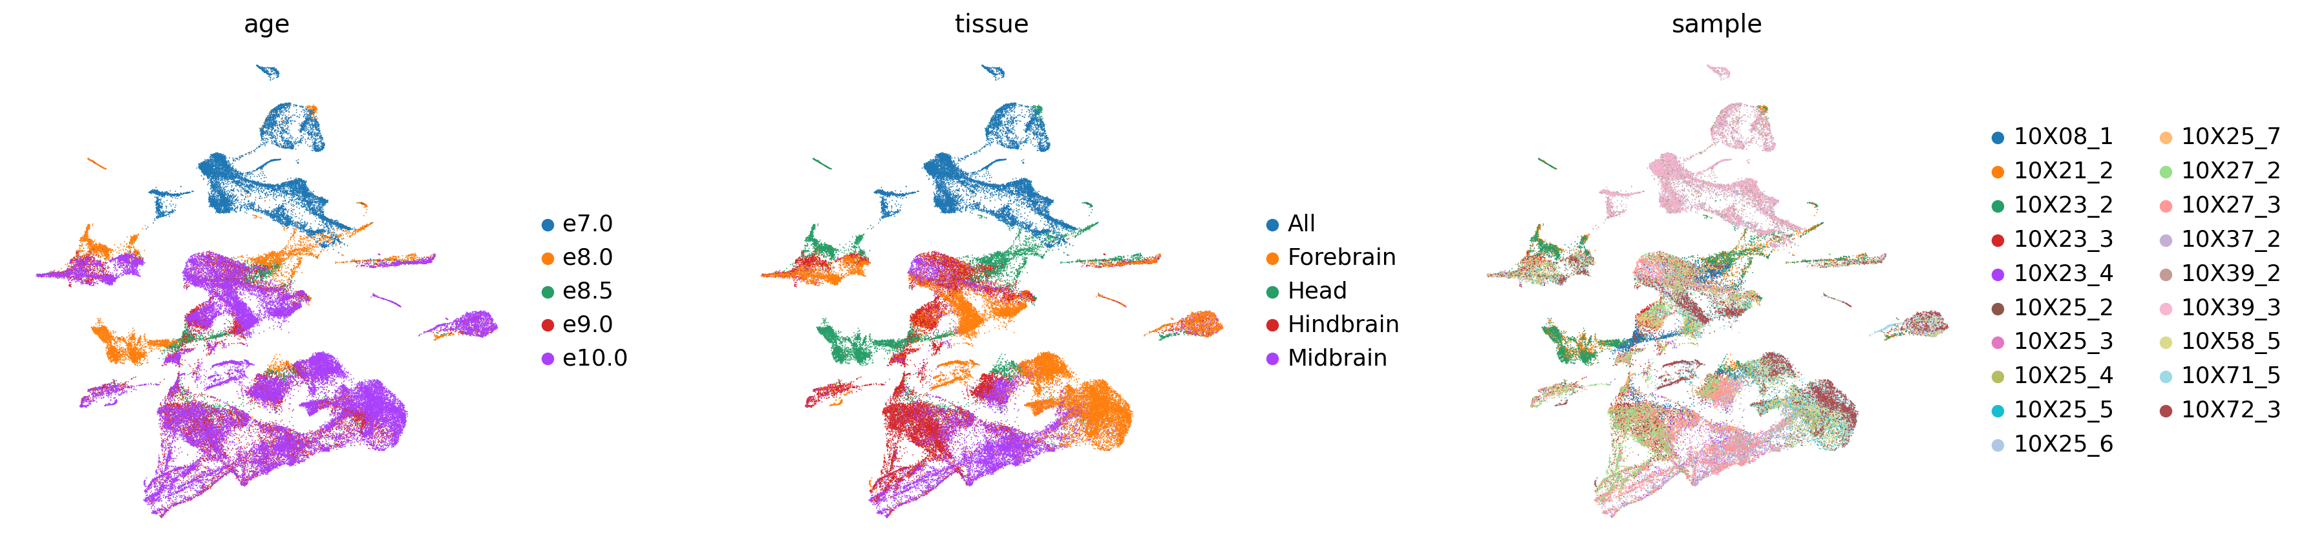
Unintegrated UMAP
By stage, region and library — hard to tell apart, because they covary by design.

Slide 9
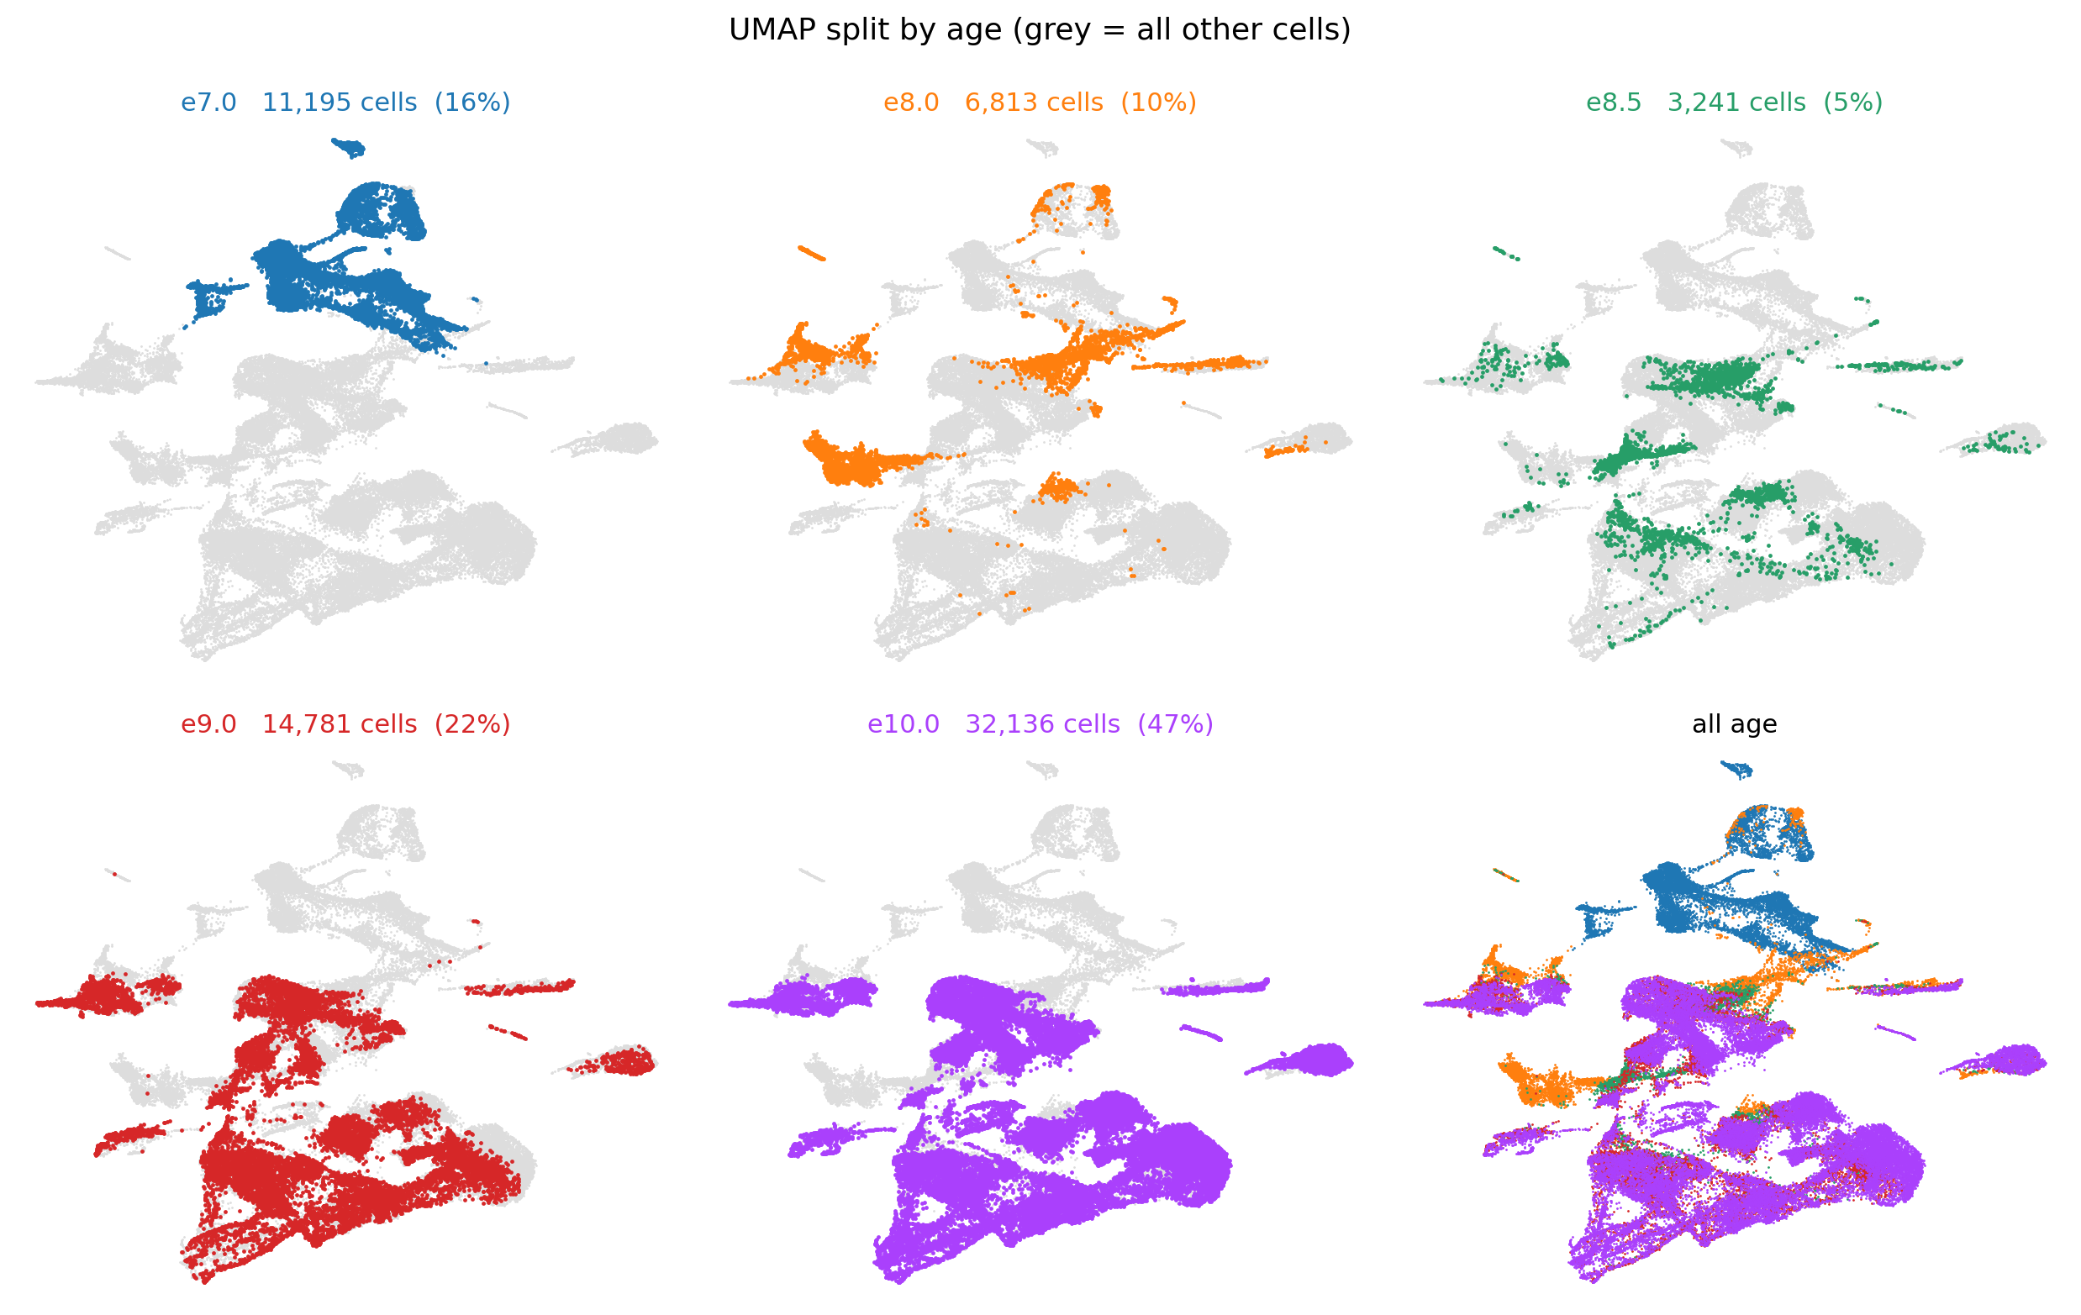
One panel per stage
E7.0 touches nothing else: 98.6% self-neighbours, 0.0% reaching E9.0 or E10.0.
Notes:
This is the central problem of the project. The graph has no path from E7.0 to the later stages, so a trajectory rooted there is unsupported by the graph it runs on.

Slide 10
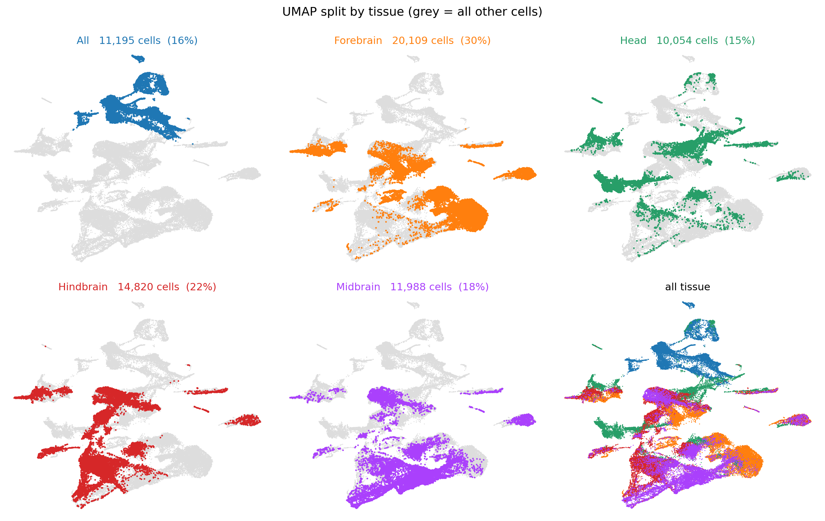
One panel per dissected region
Dissection widens with stage, so region and stage cannot be separated.
Notes:
Quantified: library pairs matching region across different stages correlate 0.9576, and pairs matching stage across different regions 0.9579. Indistinguishable. One region is worth about one stage step.

Slide 11
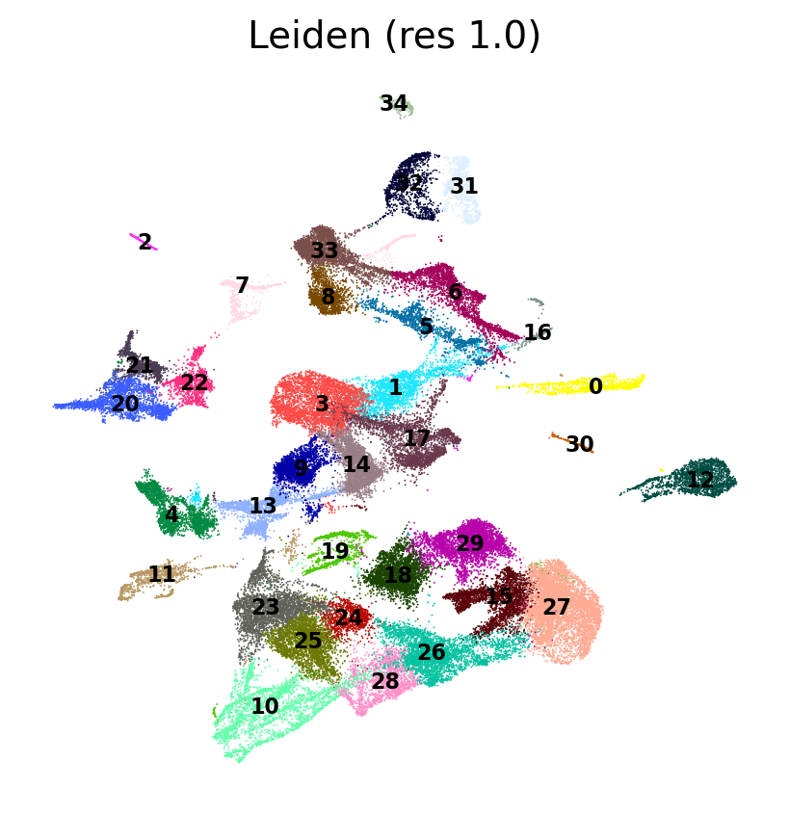
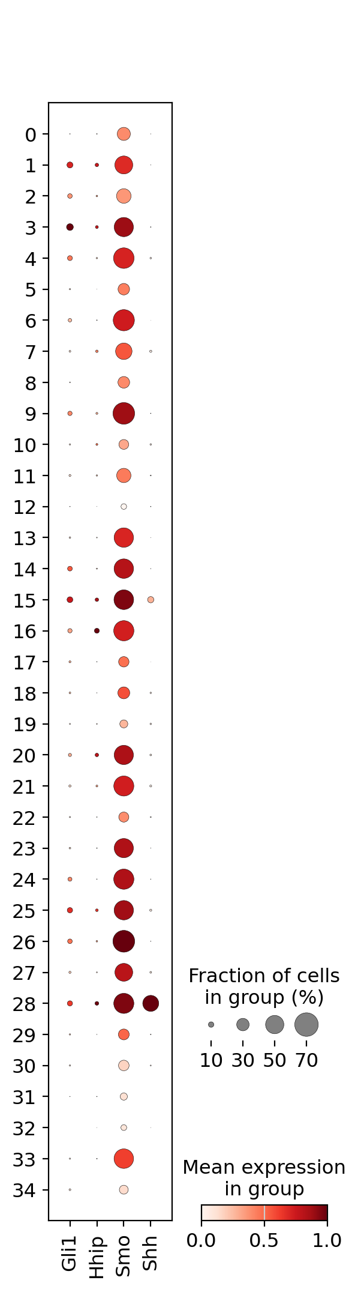
Leiden clusters and hedgehog expression per cluster
Expression is cluster-restricted rather than uniform — what a readout needs.
Leiden clusters
Hh by cluster

Slide 12
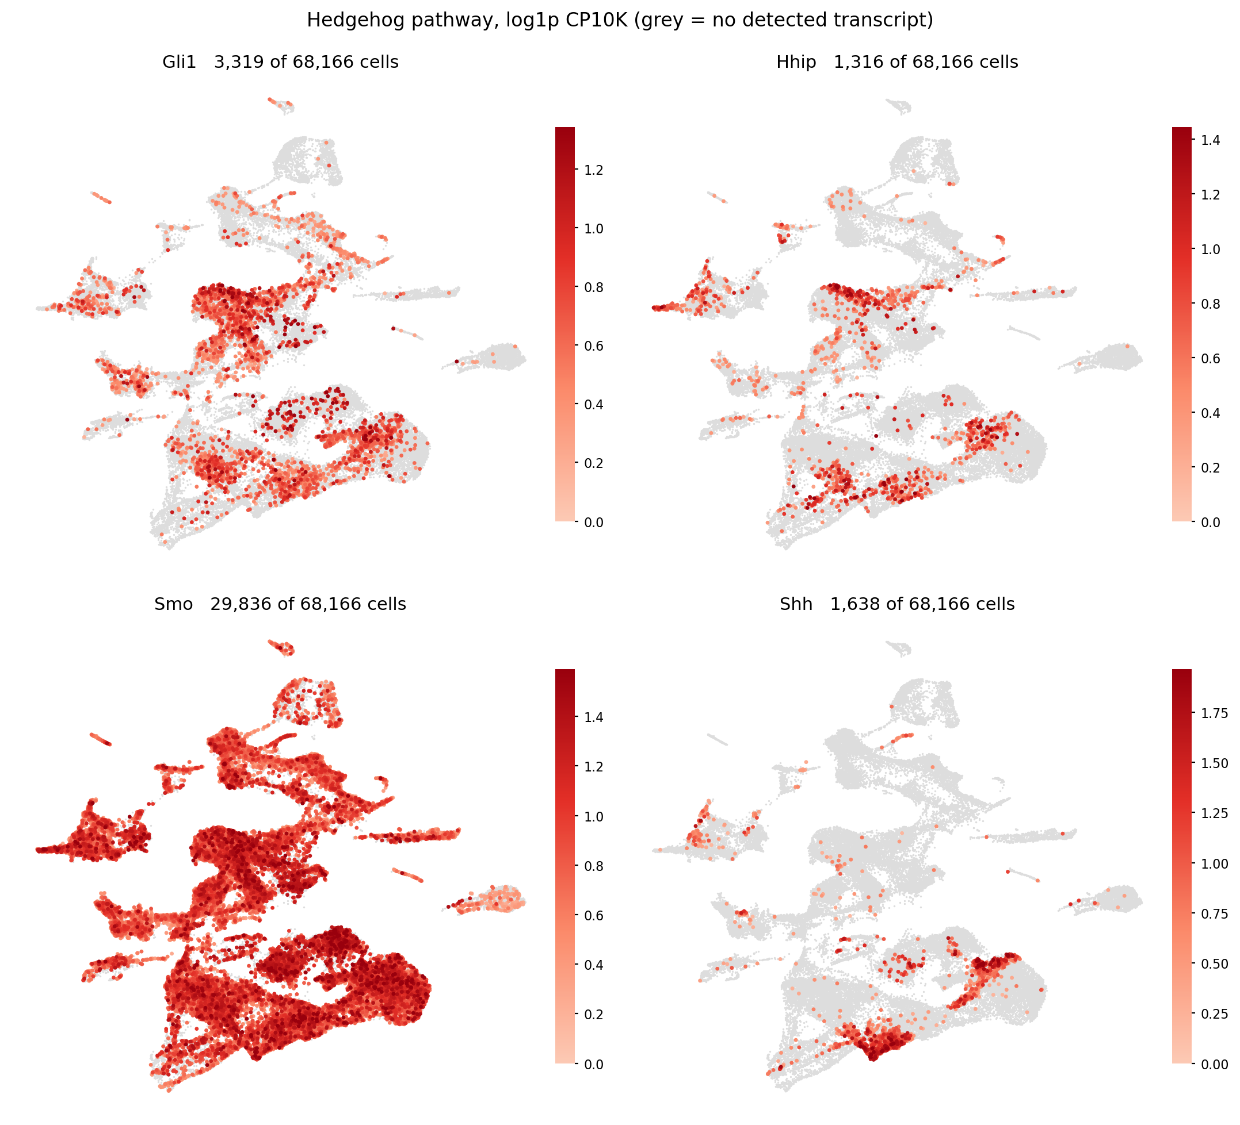
Hedgehog pathway on the UMAP
Shh and Gli1 sparse and localised, Smo and Ptch1 broad; non-expressors in grey.
Notes:
Scanpy's default viridis puts its darkest end at zero, which on a mostly-zero matrix buries the expressing cells under the majority. These plots paint non-expressors flat grey and the brightest cells last.

Slide 13
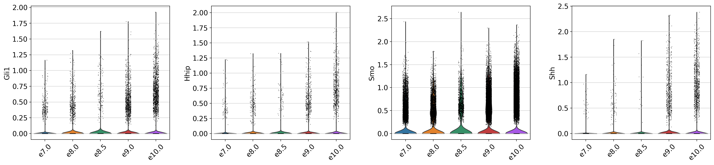
Hedgehog expression by stage
Activity rises after E8.0, as Shh signalling begins once the neural tube forms.

Slide 14
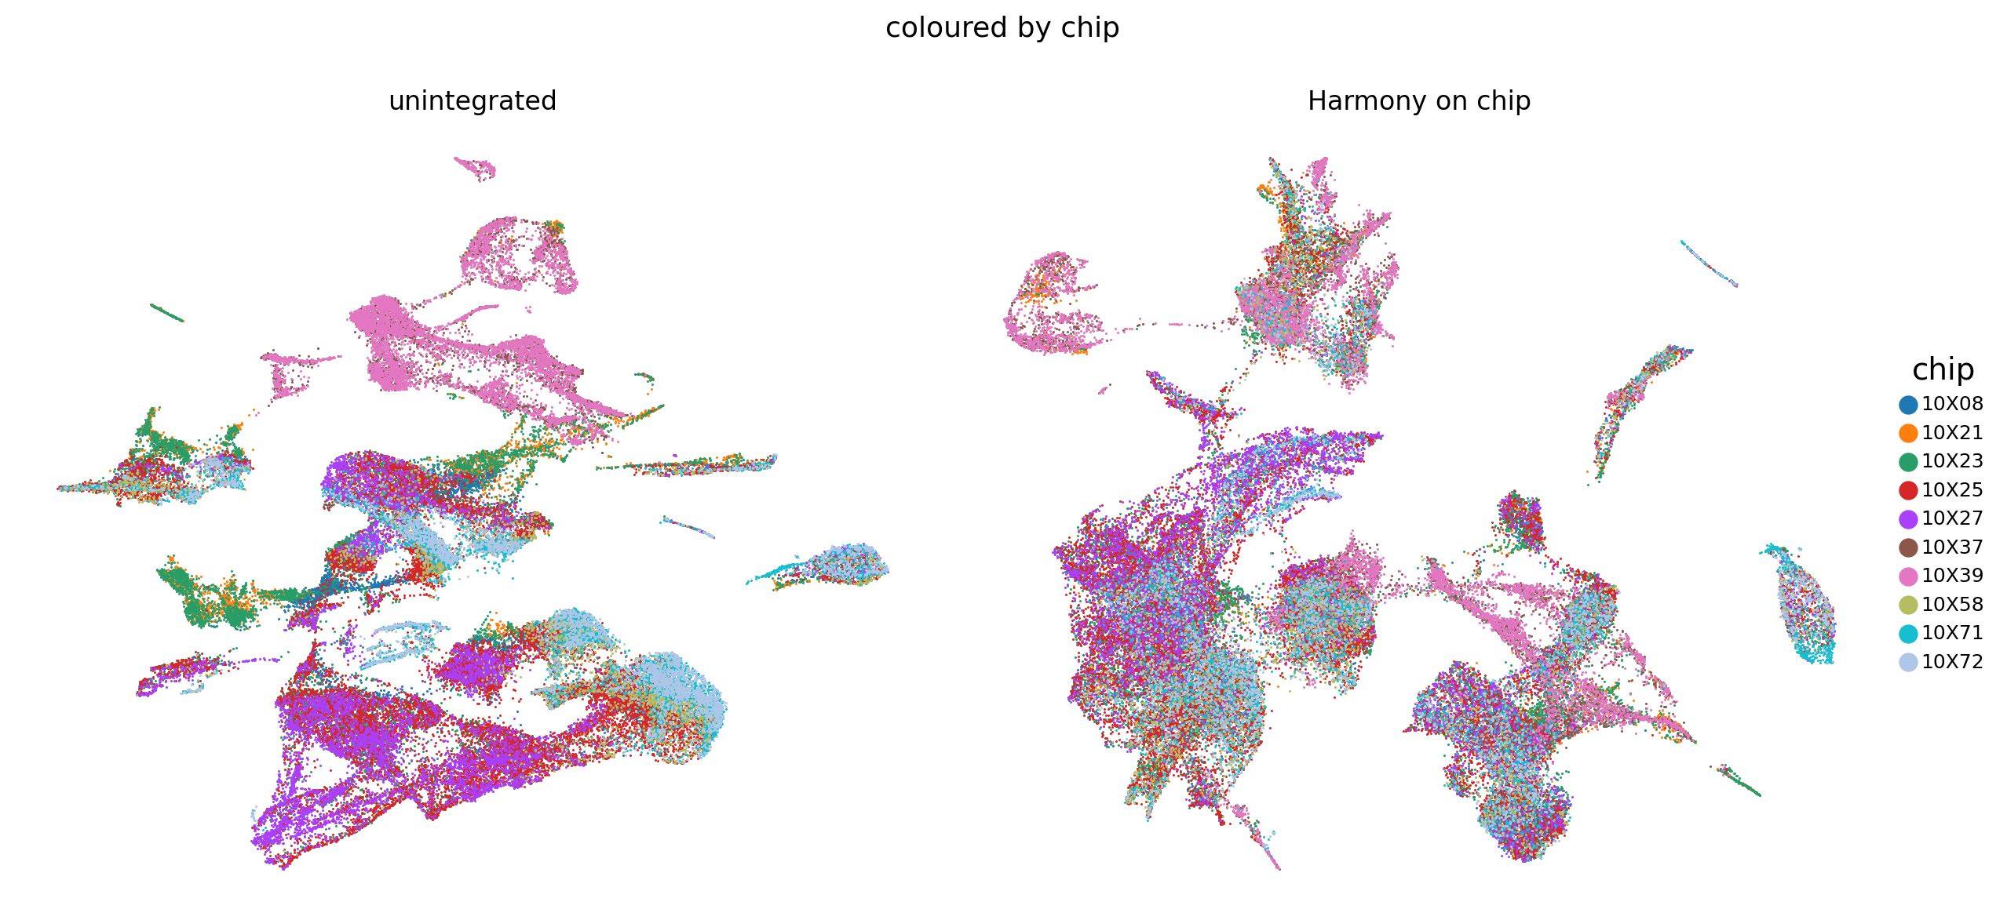
Harmony on chip — tested, then rejected
Mixing rose 0.01% → 6.22%, but no chip spans both ends, so there was nothing to correct.
Notes:
Harmony removes variation shared between batches. With no chip spanning both ends, the mixing it produced cannot be a corrected batch effect — it was manufactured because the key asserted the clouds were the same batch. Rejected, and we went looking for a real bridge instead.

Slide 15
2
Joining Brooks 2025, and a first CellRank run
A second dataset to bridge the E7.0–E8.0 gap, then velocity and optimal transport on the result.

Slide 16
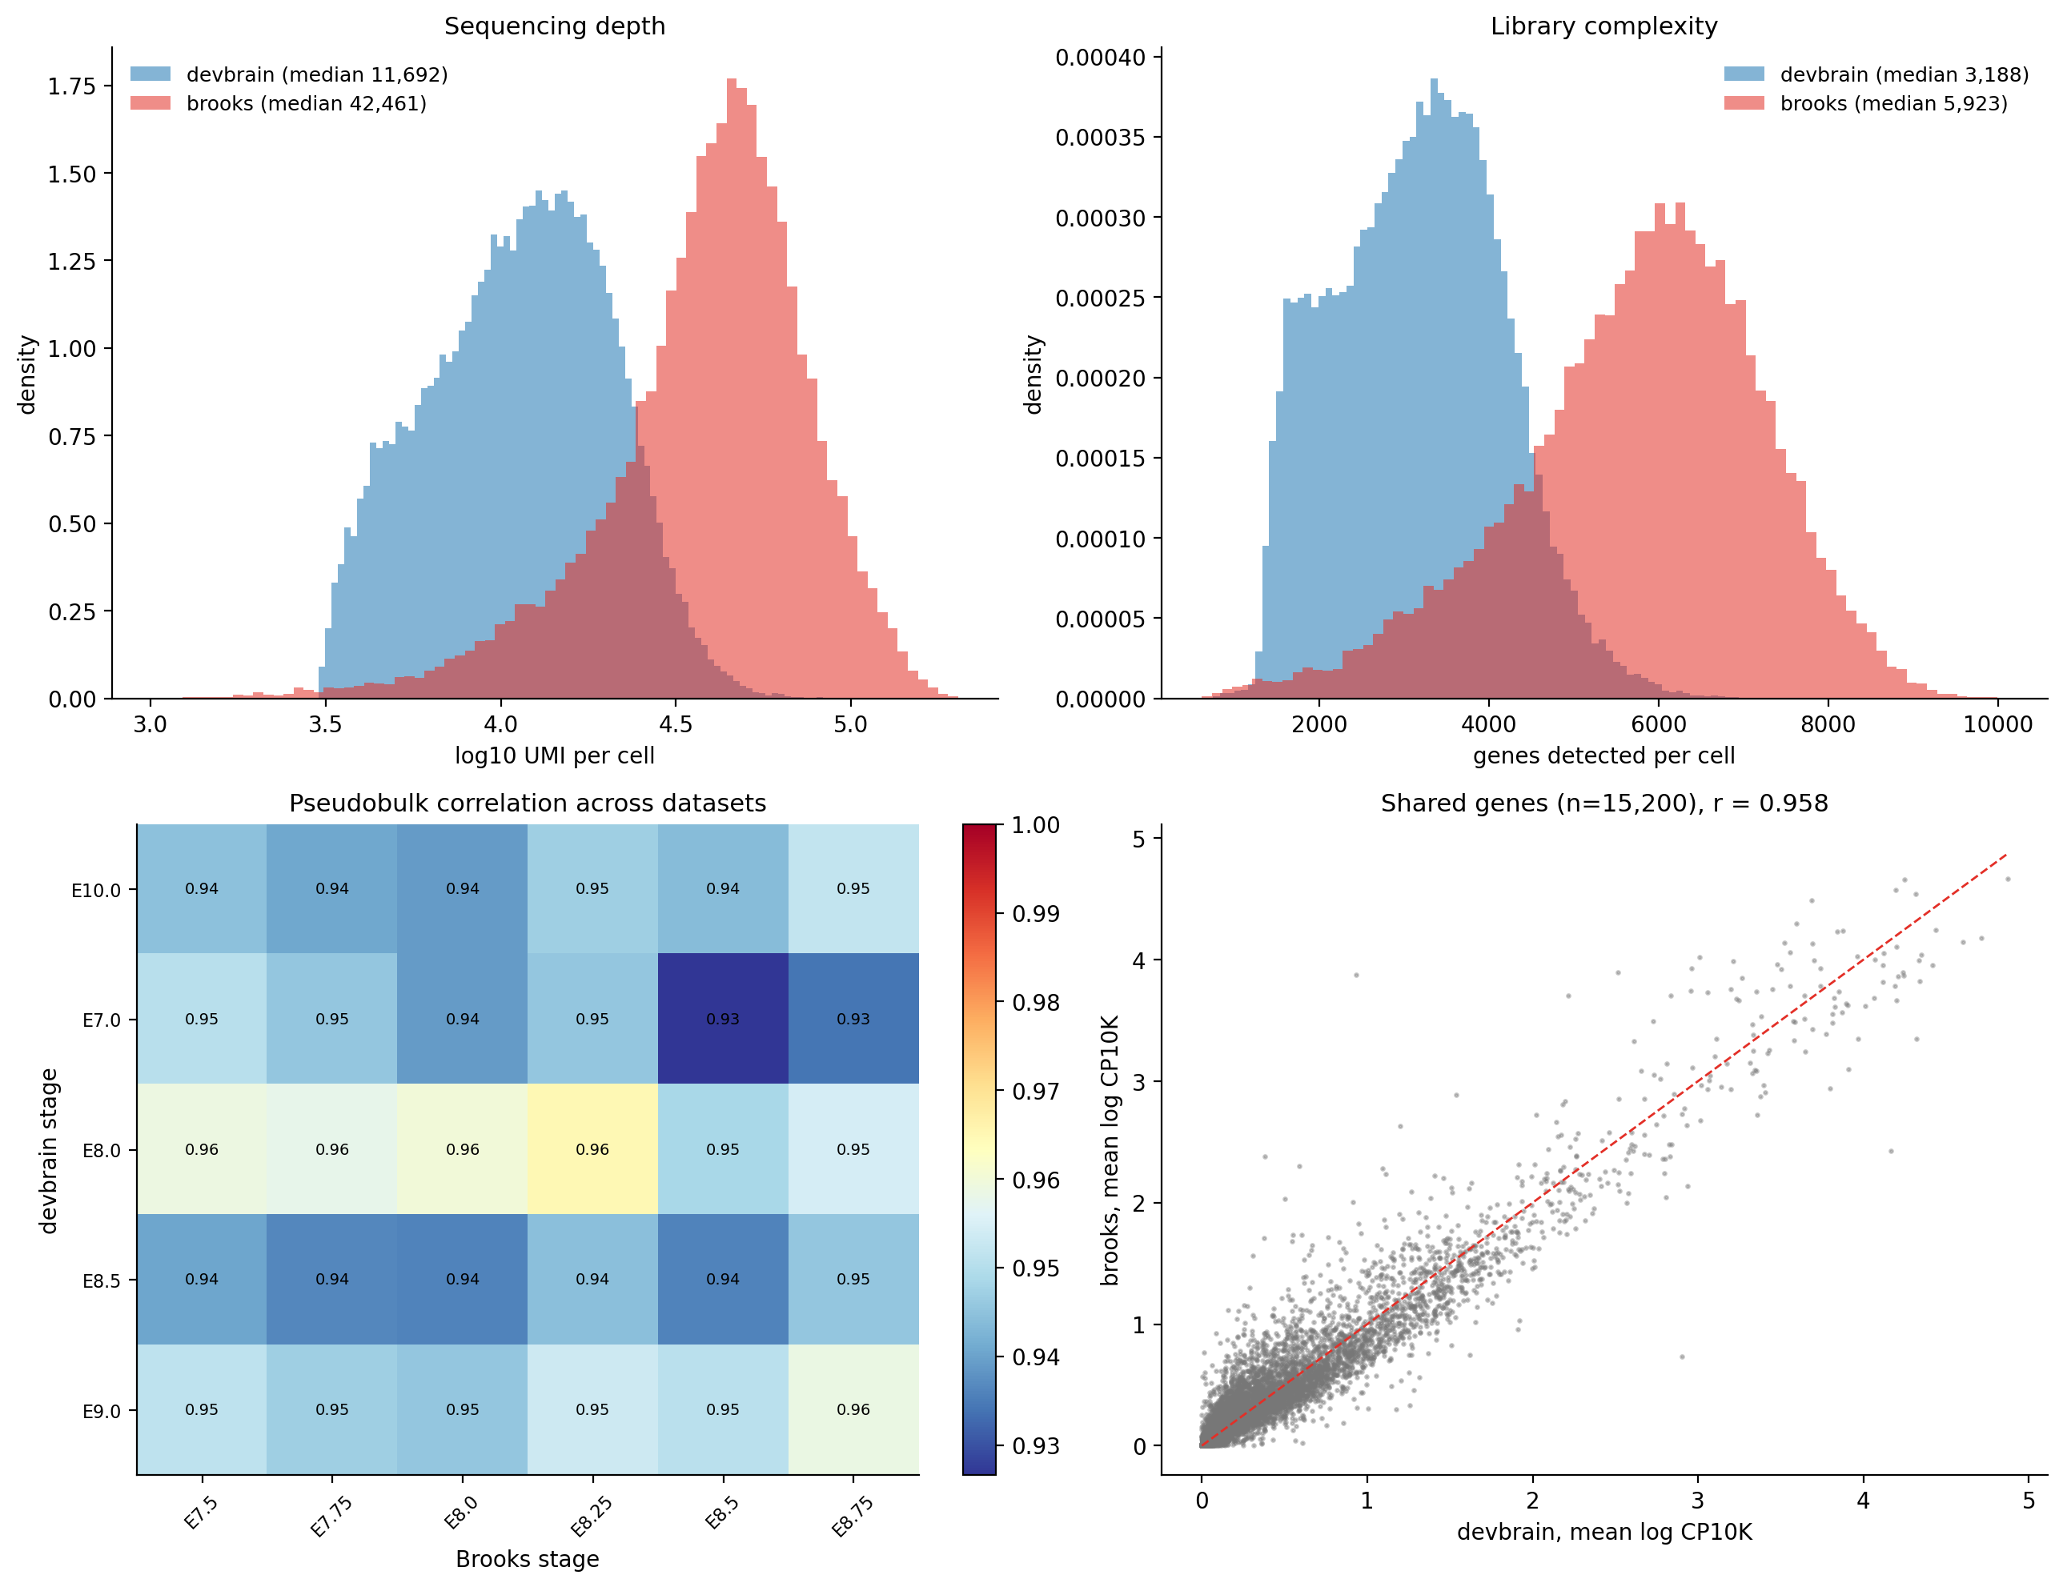
The two datasets are not technically alike
3.6× deeper per cell, yet every cross-dataset stage pair sits at r = 0.93–0.96.
Notes:
The flat heatmap is the point. If pseudobulk correlation cannot tell E7.0-vs-E8.5 apart from E8.0-vs-E8.0, it is not measuring developmental distance - it is measuring the shared mean-expression axis. The ceiling from two random halves of one stage is 0.9999, so 0.95 is far from identical.

Slide 17
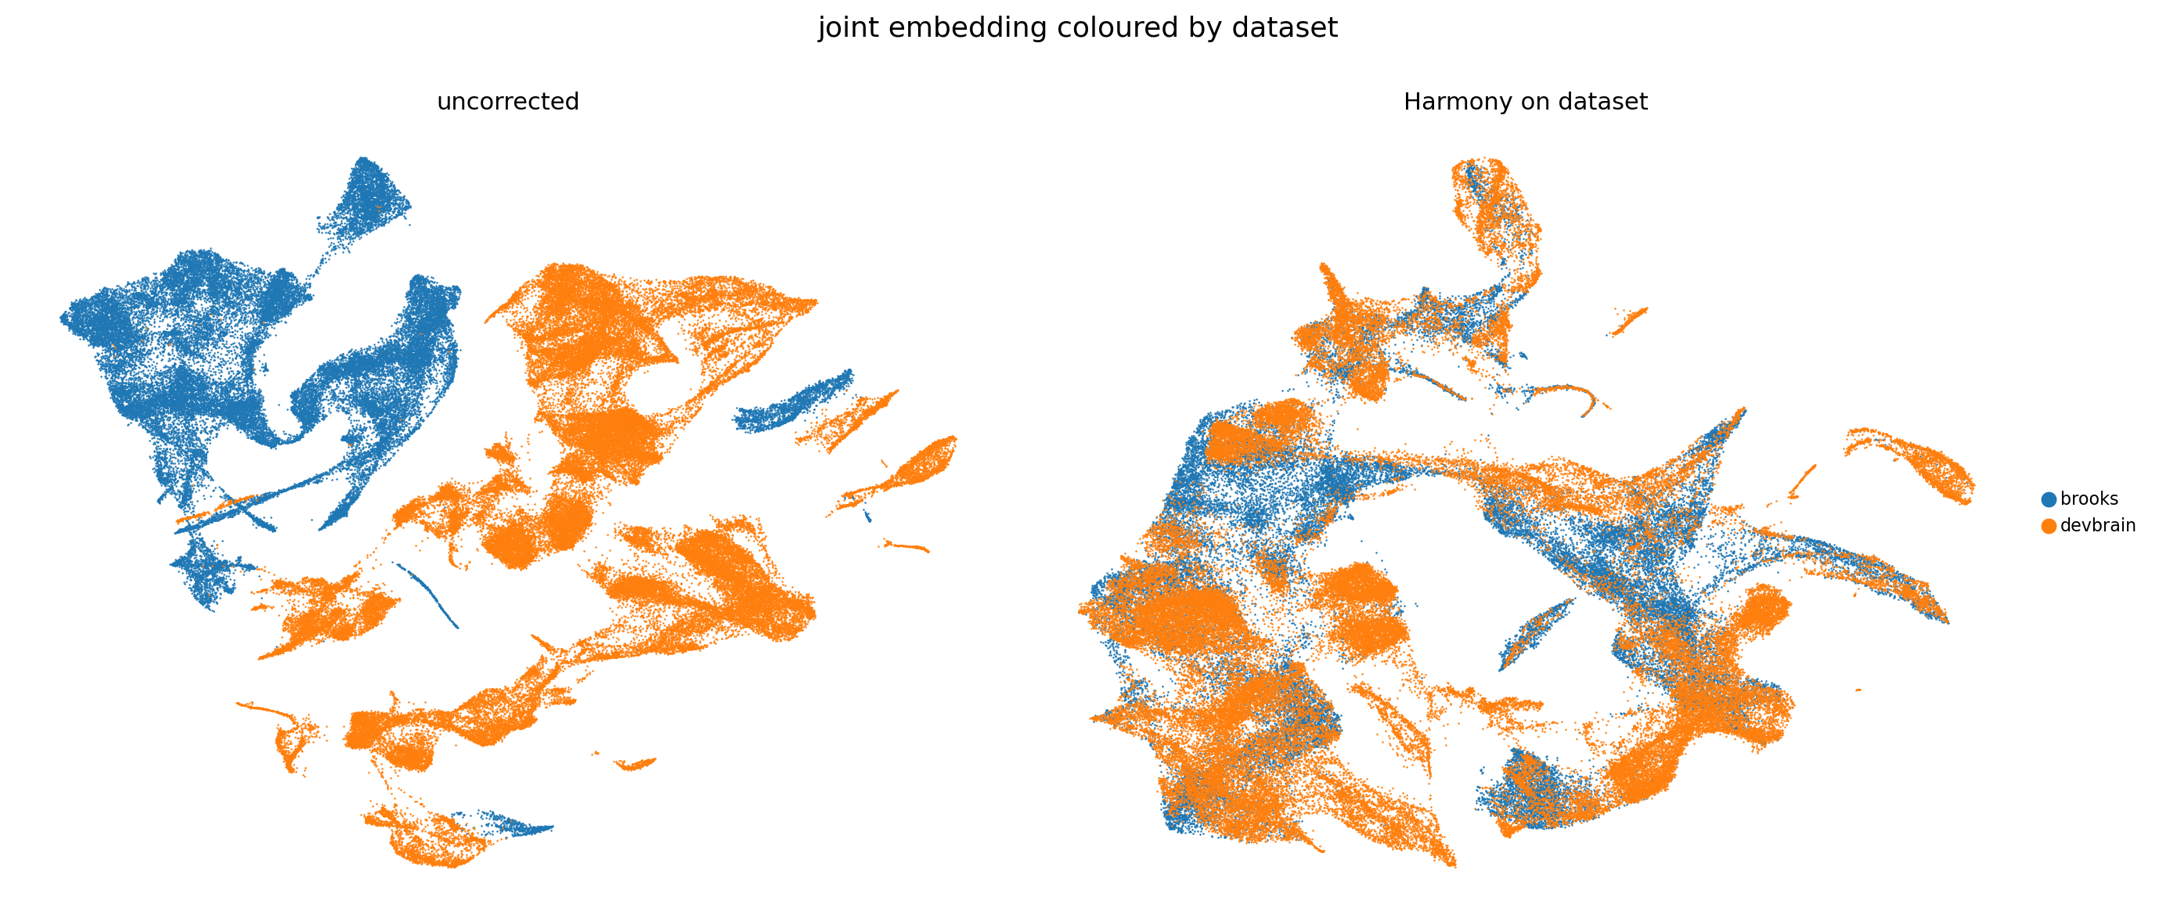
Integration by dataset, before and after Harmony
Self-neighbour share falls from 99.6% / 99.8% to 80.3% / 86.3% — they interdigitate.

Slide 18
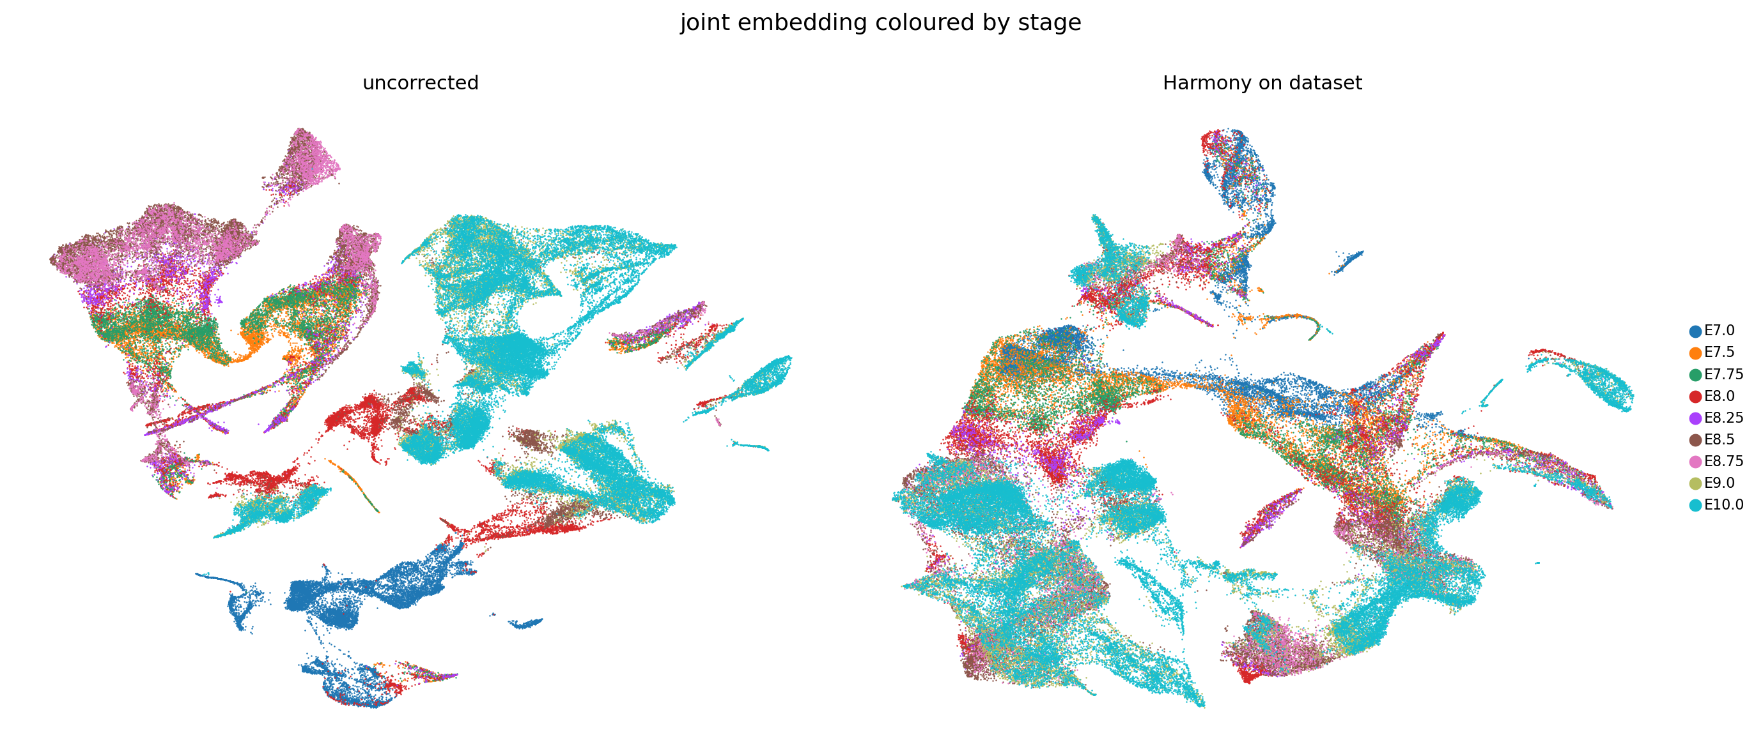
Integration by stage, before and after Harmony
Nine stages form one gradient; the graph is now a single component, 100% of cells.
Notes:
E7.0 to E7.5 neighbour share went from 0.05% to 8.75%, and to E7.75 from 0.03% to 3.33%. Critically, E7.0 to E9.0/E10.0 stayed at 0.01% - the bridge added intermediate stages rather than inventing a shortcut across three days.

Slide 19
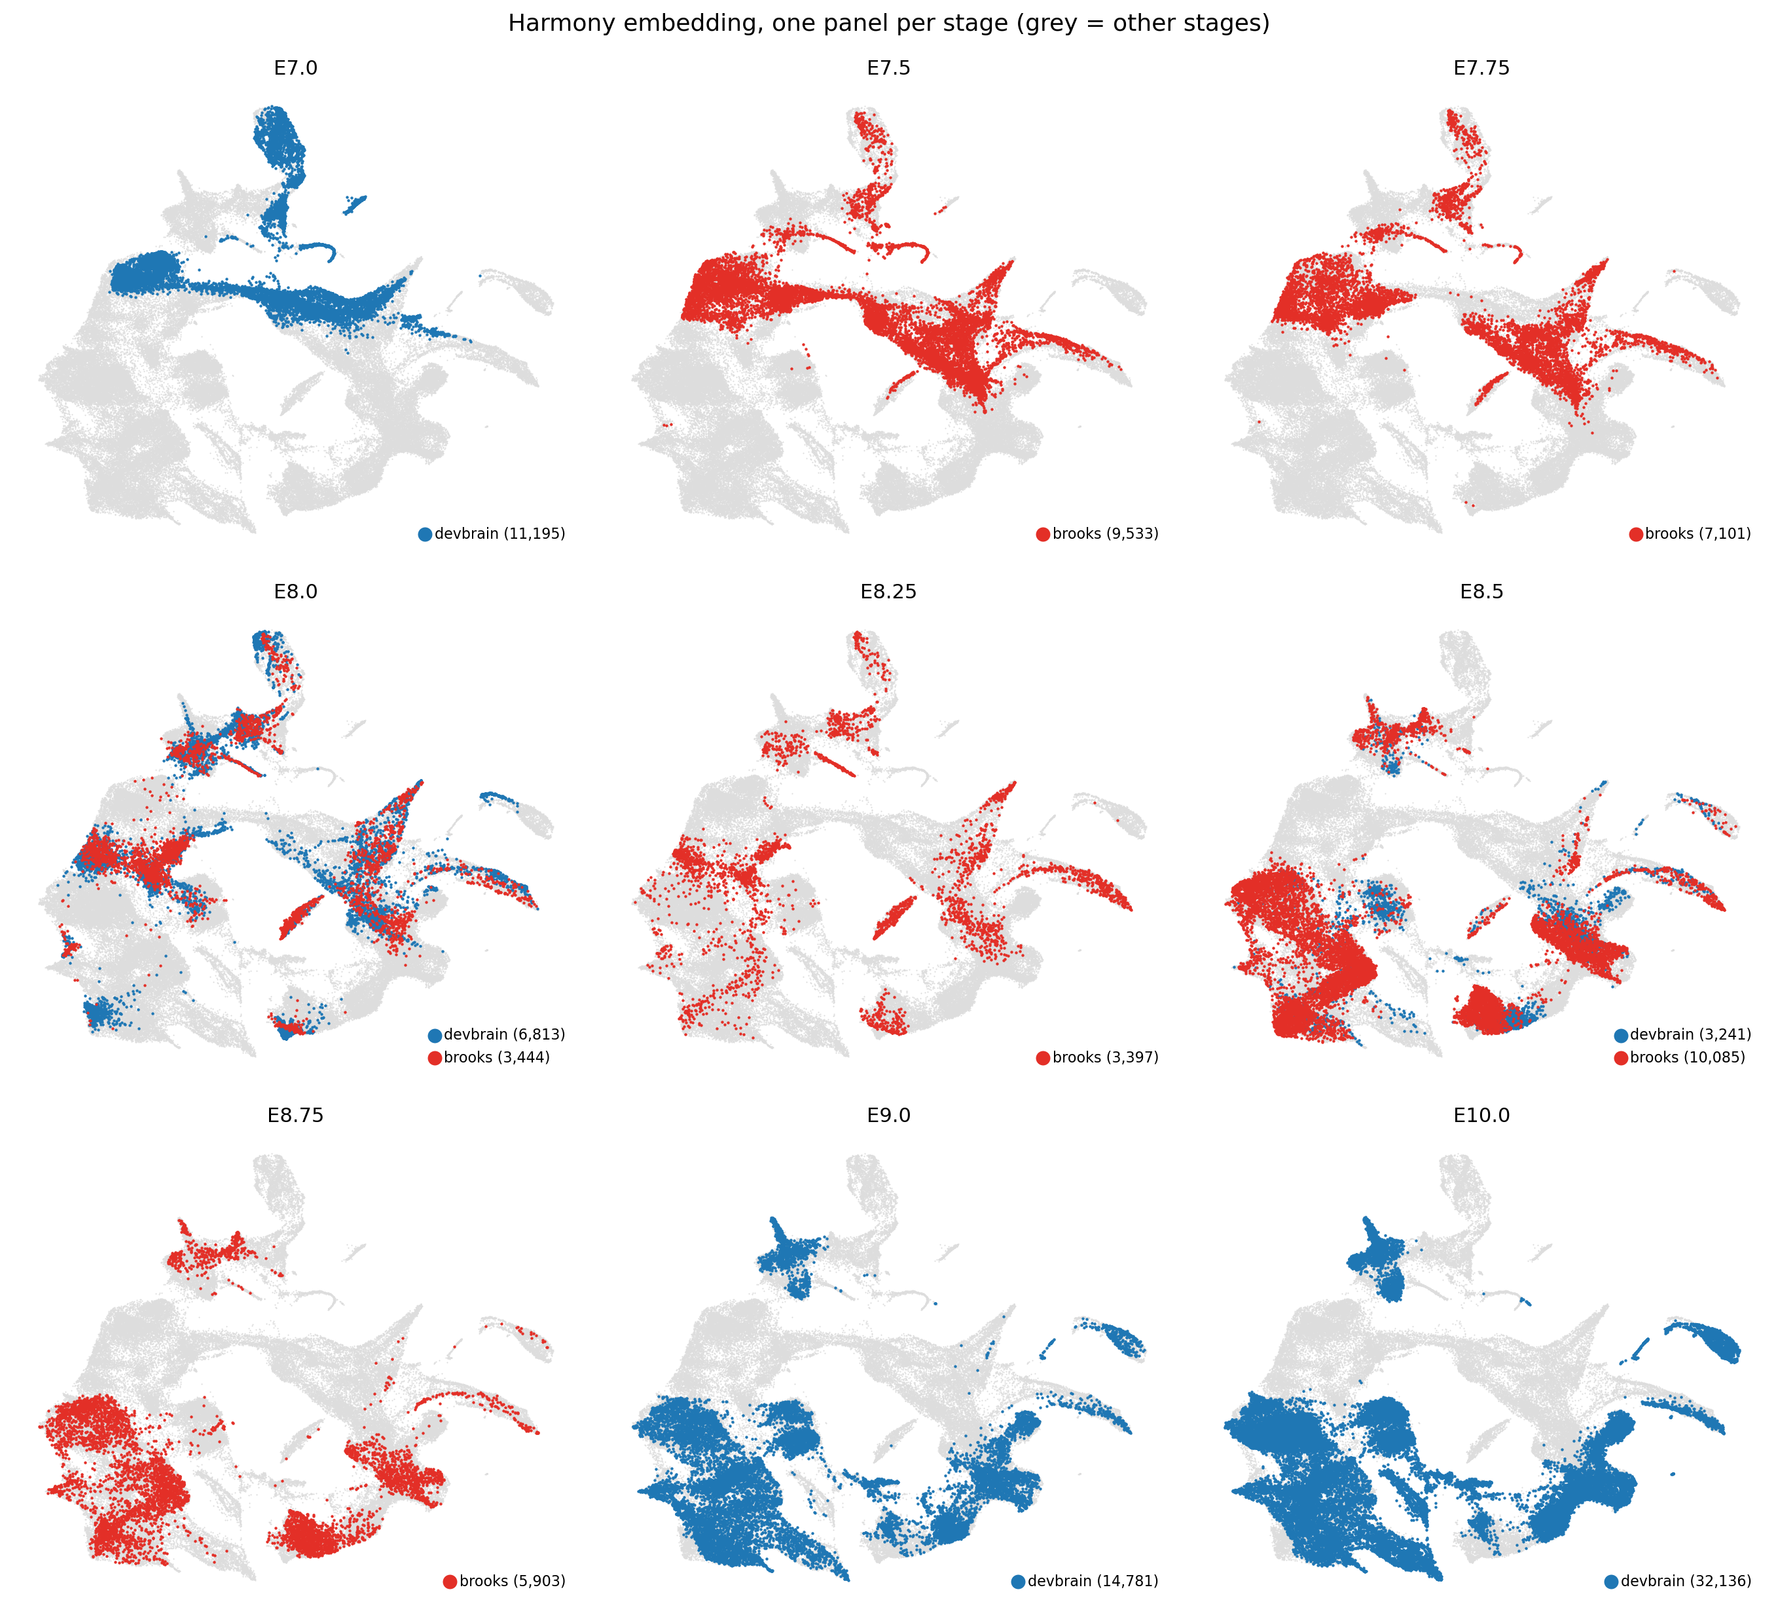
Joint object, one panel per stage
Brooks supplies E7.5 to E8.75 — exactly the window the La Manno series skips.

Slide 20
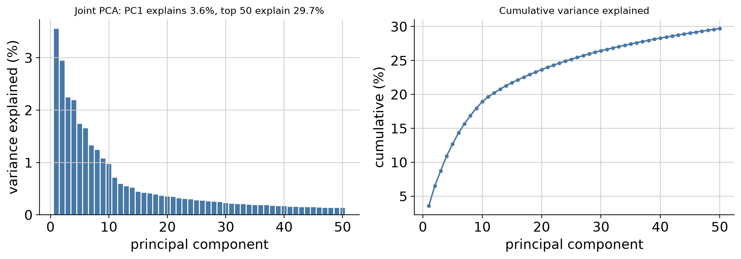
Joint PCA variance
PC1 explains 3.6%, the top 50 only 29.7% — two platforms spread the variance thinner.

Slide 21
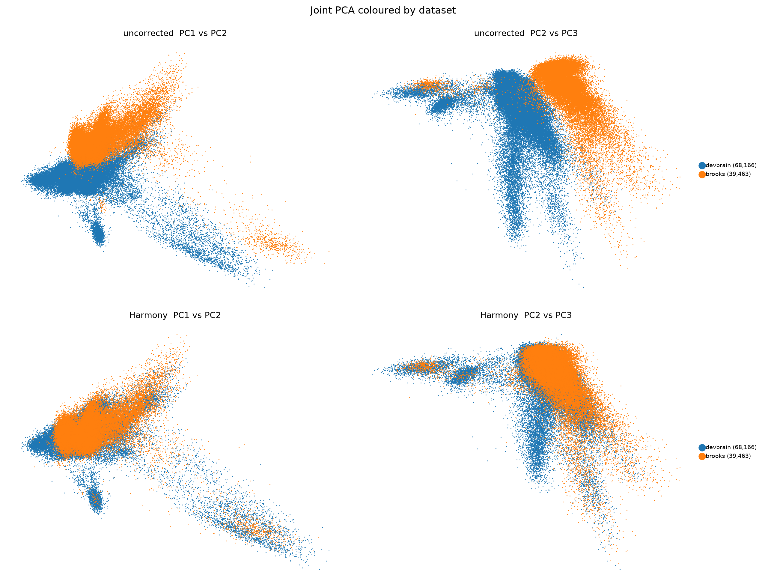
Joint PCA, uncorrected versus Harmony
Components that separated the datasets no longer do — the intended behaviour.

Slide 22
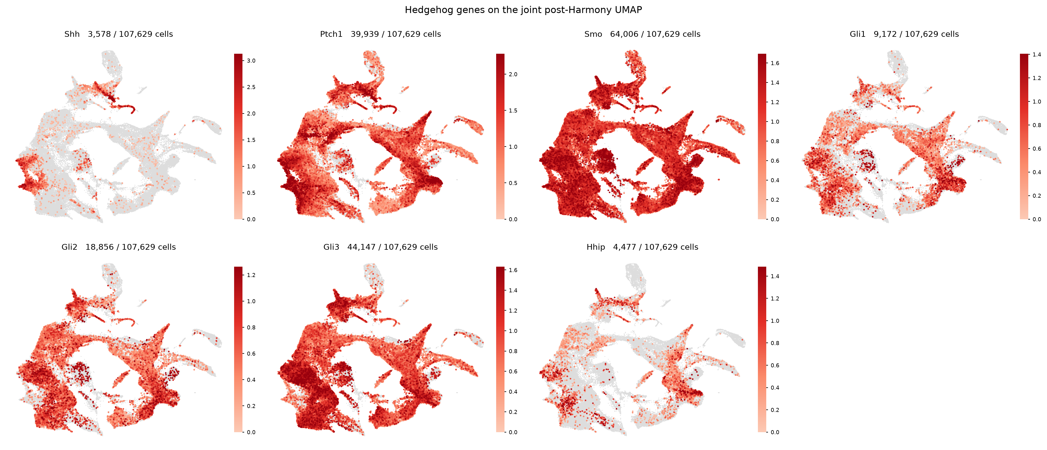
Hedgehog pathway on the joint UMAP
All seven genes survive the 15,200-gene intersection; Shh in 3,578 of 107,629 cells.

Slide 23
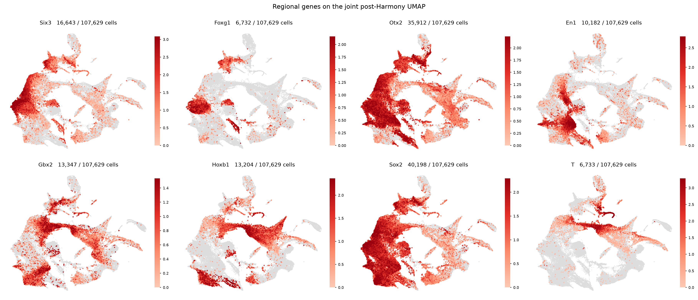
Regional markers on the joint UMAP
Six3, Otx2, En1, Gbx2 and Hoxb1 occupy distinct territory along the A–P axis.

Slide 24
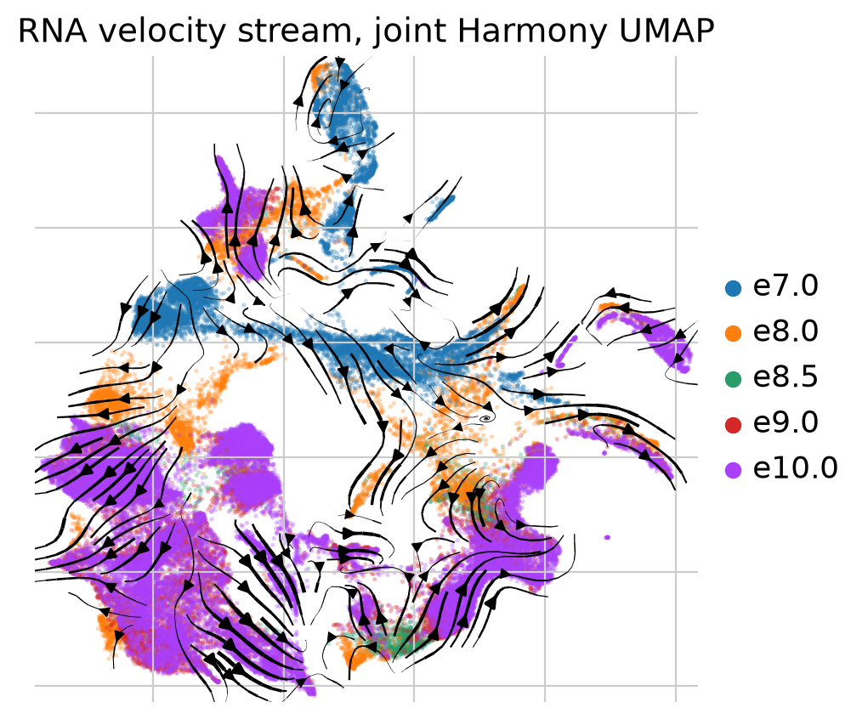
RNA velocity stream
Regenerated with velocyto: 19.1% of reads unspliced vs the authors' 19.3%.
Notes:
The published loom is no longer downloadable - the bucket 404s, and surviving mirrors either hold only pooled counts or exclude Gli1, Hhip and Shh. So it was rebuilt from the original BAMs.

Slide 25
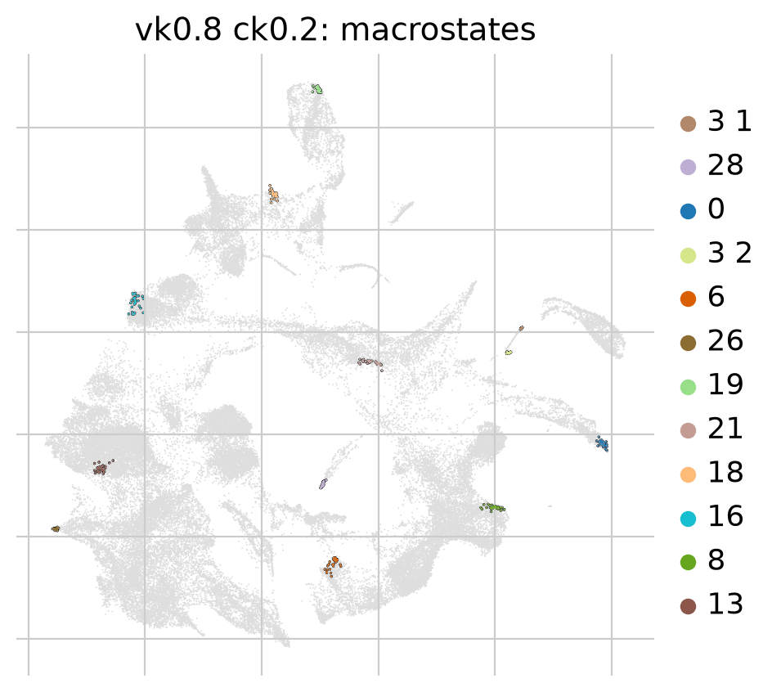
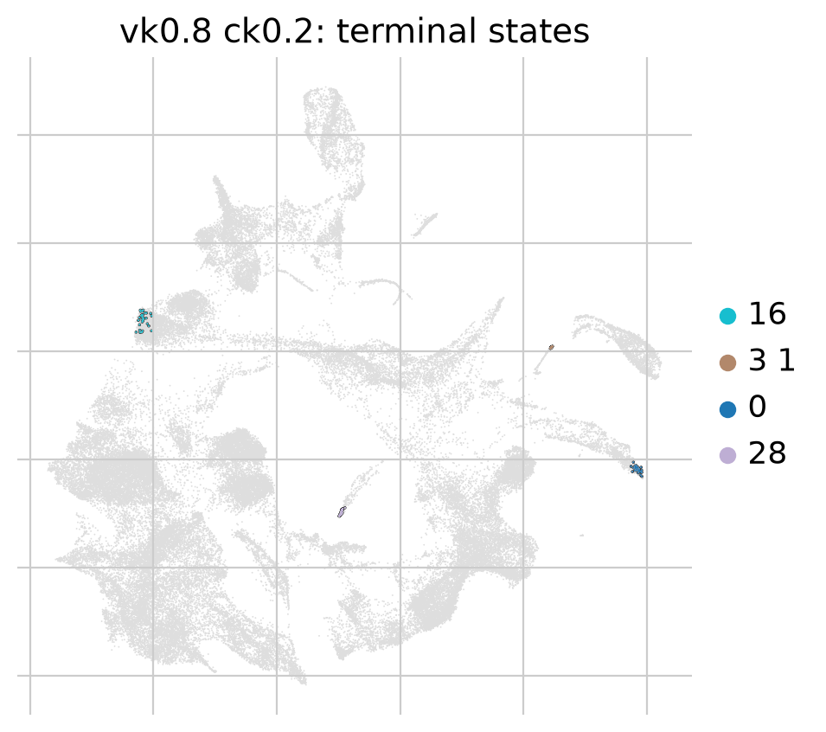
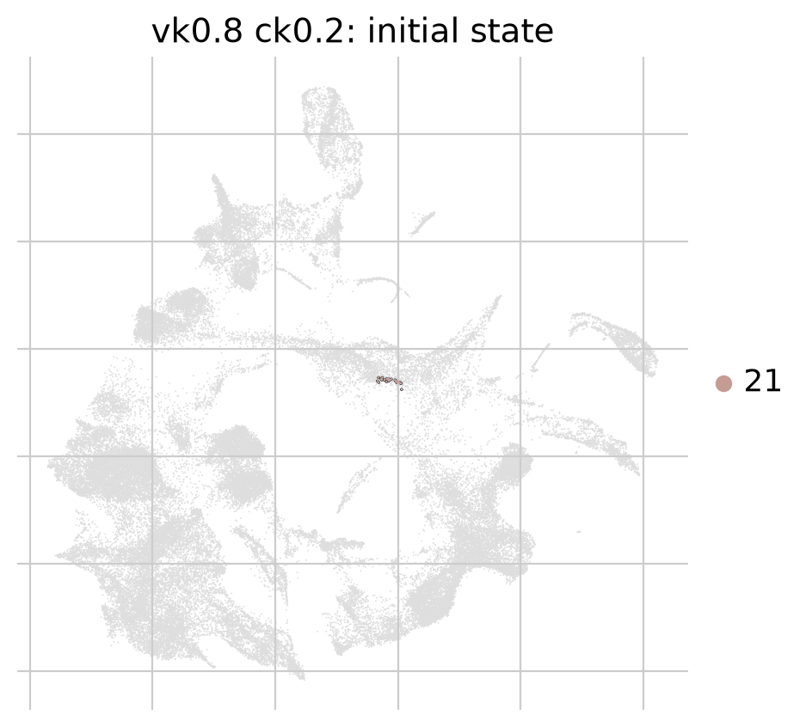
CellRank macrostates, terminal and initial states
velocity 0.8 + connectivity 0.2, the only weighting placing a root in E7.0.
12 macrostates
4 terminal states
initial state
Notes:
Macrostate 21 is nominated as the root and is 100% E7.0 - but also 100% from the one whole-embryo dissection, so the two readings cannot be told apart.

Slide 26
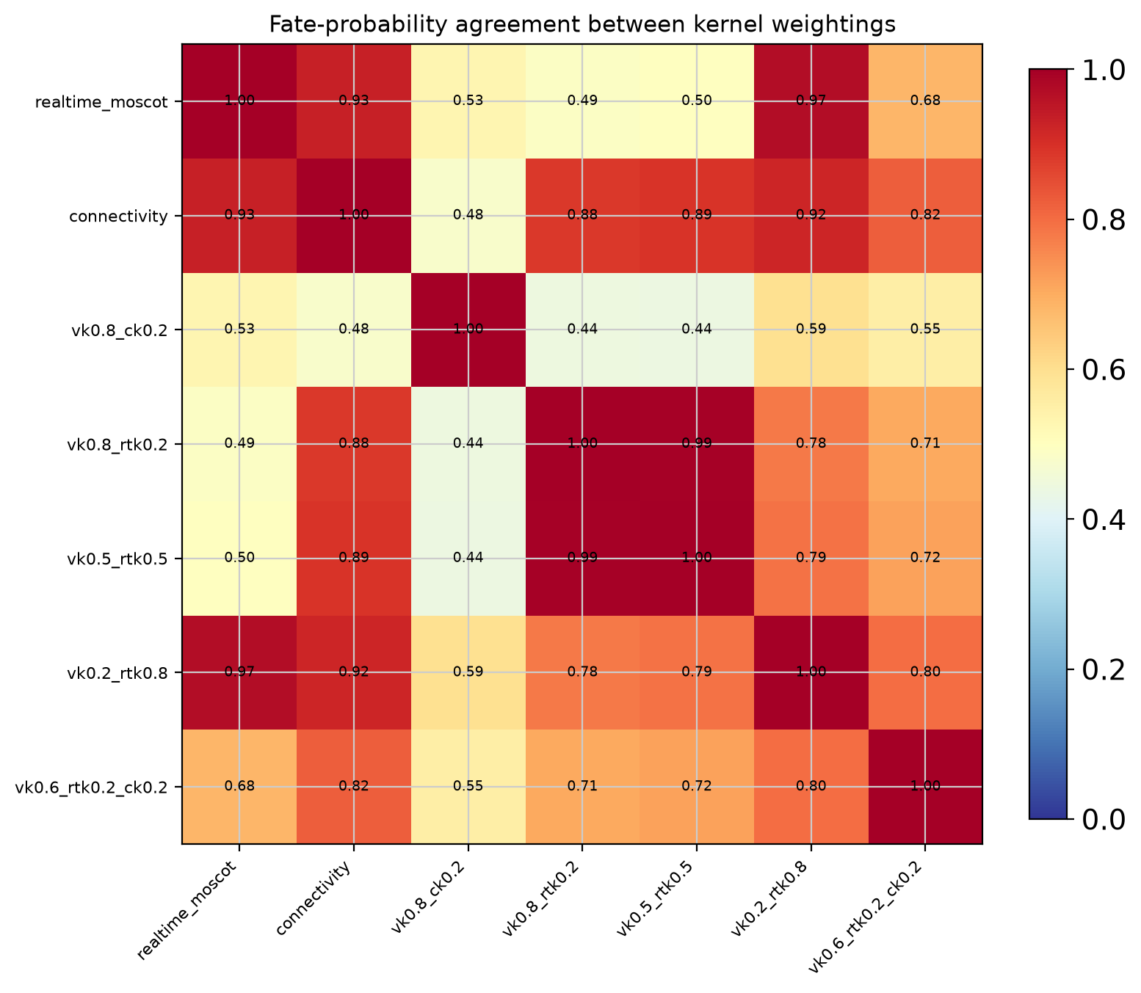
Do the kernel weightings agree?
Pairwise fate-probability correlation across the seven completed runs, 0.44 to 0.99.
Notes:
This figure was empty on the first attempt. All eight runs had raised and the loop caught each exception while printing only its message, so the matrix was 0x0 and imshow produced a blank panel with no error anywhere.

Slide 27
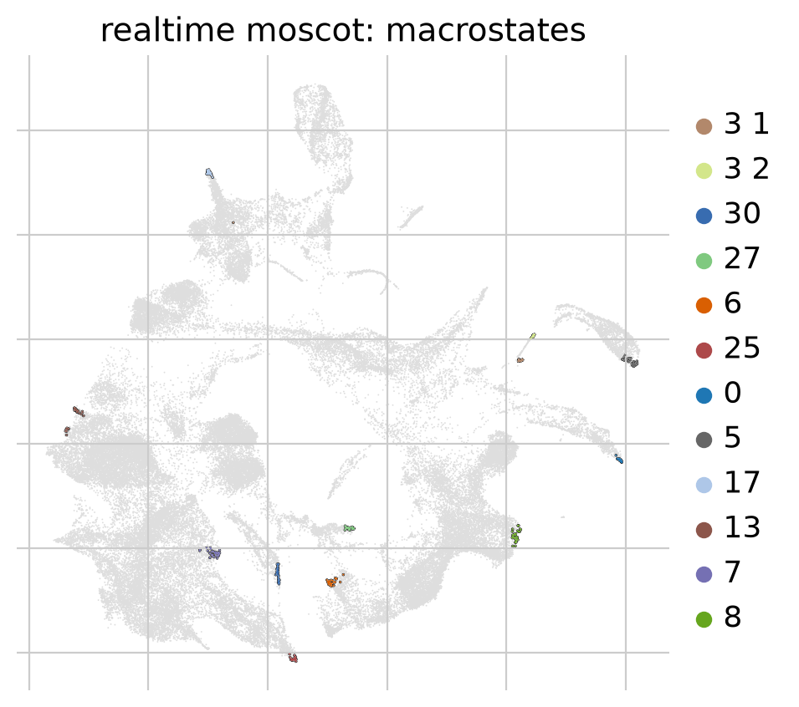
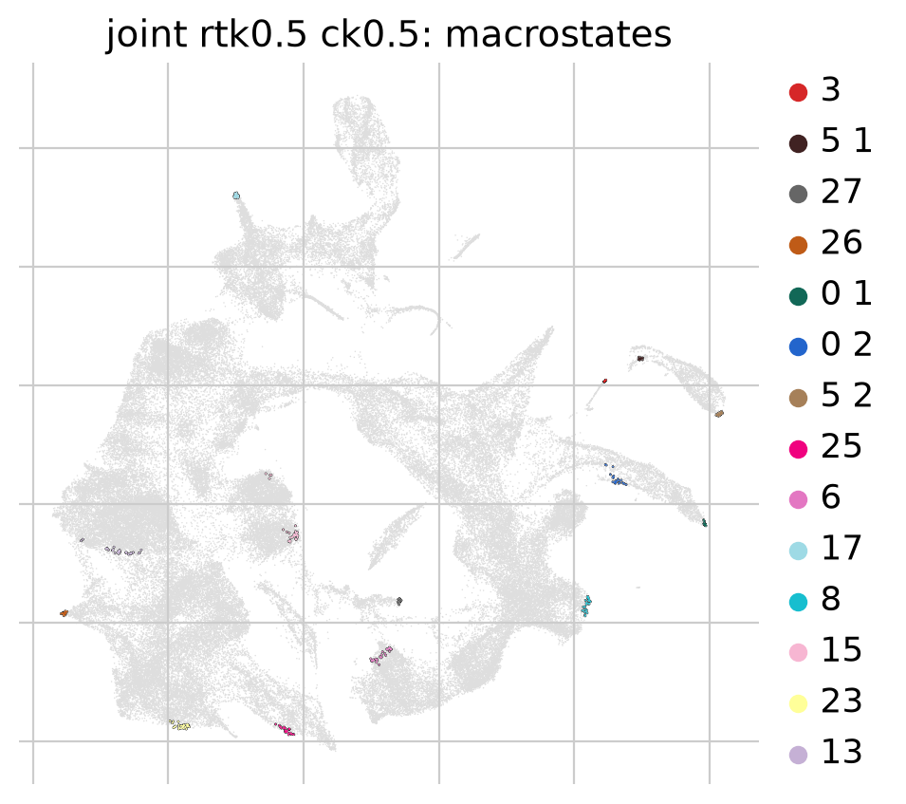
Optimal transport places no state in the early stages
Neither run puts a macrostate in E7.0 — every state sits at E9.0 or later.
devbrain, moscot only
joint, moscot + connectivity
Notes:
This is the finding that matters. Moscot was added specifically to carry early cells forward. In the joint object nothing lands before E8.0, so E7.0, E7.5 and E7.75 - 26% of the cells - are entirely unrepresented, Brooks bridge notwithstanding.

Slide 28
3
Assumptions and open problems
What the analysis currently takes for granted, and where that could bite.

Slide 29
What this analysis assumes
Each of these is load-bearing — if one is wrong, the conclusions move
Assumption | Why we need it | How safe
Harmony on dataset removes platform, not biology | Only way to put two chemistries in one graph | Weakest link
Brooks E7.5 is a valid intermediate between La Manno E7.0 and E8.0 | The bridge depends on it | Untested
Splicing ratios from our velocyto run match the authors' | Velocity kernel depends on it | Checked: 19.1 vs 19.3%
30-cell macrostate anchors represent their surrounding region | CellRank's default | Unexamined
Stage, not dissection, drives the transitions we recover | The whole trajectory reading | Known to be false

Slide 30
Open problems, in the order they matter
Three of the four are structural rather than bugs
1
No metastable state at E7.0 under any transport kernel
Macrostates need stationary probability mass; a directed OT kernel gives early stages almost none, so they cannot be macrostates by construction. Root cell therefore unidentifiable.
2
Stage and dissection are confounded, irreparably in this design
Matching region across stages scores 0.9576; matching stage across regions 0.9579. Every E7.0 macrostate is also 100% whole-embryo. No sample breaks the tie.
3
Cross-platform integration may be removing real biology
Same-stage across datasets (Spearman 0.674) is less similar than three days of development within one dataset (0.870). Harmony cannot tell which part is chemistry.
4
Velocity alone fails to solve, and is the least trustworthy kernel
60,762 of 68,166 rows did not sum to 1 — a solver failure, fixable. But 10x v1 chemistry and 3' bias make unspliced estimates weak here regardless.
Next: test a less absorbing transport kernel on a subsample before committing another eight-kernel run

