Slide 1
Next Gen UI Framework for WS/PWG
Intern Name: Ojas Mehta
College: IIT Madras
Degree: M.Tech. (CSE)
Manager Name: Hari Rajagopalan
Mentor Name: Bhargav Reddy
Division: Surfscan-ADE
July 17, 2019
Notes:
division :SFS
Team: PWG(Patterned Wafer Geometry)/WS

Slide 2
Agenda
Problem Statement
My Role
Current progress
Timeline
Challenges Faced
Learnings

Slide 3
Problem Statement
DGA’s current UI framework was designed 15+ years ago. Architectural choices for it that were made back then are not so relevant now. WS/PWG customers want advanced features which current software can’t support. There is a limitation on the creation of custom widgets. The existing UI is not very user friendly. It also has more turnaround time for developers which results in poor productivity.

Slide 4
Problem Statement
DGA’s current UI framework was designed 15+ years ago. Architectural choices for it that were made back then are not so relevant now. WS/PWG customers want advanced features which current software can’t support. There is a limitation on the creation of custom widgets. The existing UI is not very user friendly. It also has more turnaround time for developers which results in poor productivity.
My Role:
To recommend a suitable framework for modernizing UI and come up with some working prototype as a proof of concept.

Slide 5
Current progress
Figured out the requirements which UI should fulfill based on the use cases.
Chosen Qt as the framework after comparing WPF, Qt, UWP and Electron.js.
Notes:
Learned UseCases
Gathered Requirements
Chosen frameworks to consider, WPF, UWP, Electron and Qt.
Compared them on set of criterias/requirements.
Discovered that electron’s apps were taking too much time.
Picked Qt.
Development in Qt, applications

Slide 6
Current progress
Figured out the requirements which UI should fulfill based on the use cases.
Chosen Qt as the framework after comparing WPF, Qt, UWP and Electron.js.
Developed the following prototypes as a proof of concept:
App with C++ backend and QML frontend supporting MVC architecture.
App which uses QML and JavaScript in UI.
App which uses Third party JavaScript library( D3.js in this case).
App which can take a wafermap as csv file and plot its 3D visualization.
App which has GUI built using QWidgets and QML both integrating QApplication and QGUIApplication.
Notes:
Learned UseCases
Gathered Requirements
Chosen frameworks to consider, WPF, UWP, Electron and Qt.
Compared them on set of criterias/requirements.
Discovered that electron’s apps were taking too much time.
Picked Qt.
Development in Qt, applications

Slide 7
Current progress
Figured out the requirements which UI should fulfill based on the use cases.
Chosen Qt as the framework after comparing WPF, Qt, UWP and Electron.js.
Developed the following prototypes as a proof of concept:
App with C++ backend and QML frontend supporting MVC architecture.
App which uses QML and JavaScript in UI.
App which uses Third party JavaScript library( D3.js in this case).
App which can take a wafermap as csv file and plot its 3D visualization.
App which has GUI built using QWidgets and QML both integrating QApplication and QGUIApplication.
App that can connect to DLL and use its functionalities.
Notes:
Learned UseCases
Gathered Requirements
Chosen frameworks to consider, WPF, UWP, Electron and Qt.
Compared them on set of criterias/requirements.
Discovered that electron’s apps were taking too much time.
Picked Qt.
Development in Qt, applications

Slide 8
Current progress
Figured out the requirements which UI should fulfill based on the use cases.
Chosen Qt as the framework after comparing WPF, Qt, UWP and Electron.js.
Developed the following prototypes as a proof of concept:
App with C++ backend and QML frontend supporting MVC architecture.
App which uses QML and JavaScript in UI.
App which uses Third party JavaScript library( D3.js in this case).
App which can take a wafermap as csv file and plot its 3D visualization.
App which has GUI built using QWidgets and QML both integrating QApplication and QGUIApplication.
App that can connect to DLL and use its functionalities.
App which uses Qt canvas to plot heatmap of wafer.
Notes:
Learned UseCases
Gathered Requirements
Chosen frameworks to consider, WPF, UWP, Electron and Qt.
Compared them on set of criterias/requirements.
Discovered that electron’s apps were taking too much time.
Picked Qt.
Development in Qt, applications

Slide 9
Current progress
Figured out the requirements which UI should fulfill based on the use cases.
Chosen Qt as the framework after comparing WPF, Qt, UWP and Electron.js.
Developed the following prototypes as a proof of concept:
App with C++ backend and QML frontend supporting MVC architecture.
App which uses QML and JavaScript in UI.
App which uses Third party JavaScript library( D3.js in this case).
App which can take a wafermap as csv file and plot its 3D visualization.
App which has GUI built using QWidgets and QML both integrating QApplication and QGUIApplication.
App that can connect to DLL and use its functionalities.
App which uses Qt canvas to plot heatmap of wafer.
WS/PWG UI with framework to extend the functionalities.
Notes:
Learned UseCases
Gathered Requirements
Chosen frameworks to consider, WPF, UWP, Electron and Qt.
Compared them on set of criterias/requirements.
Discovered that electron’s apps were taking too much time.
Picked Qt.
Development in Qt, applications

Slide 10
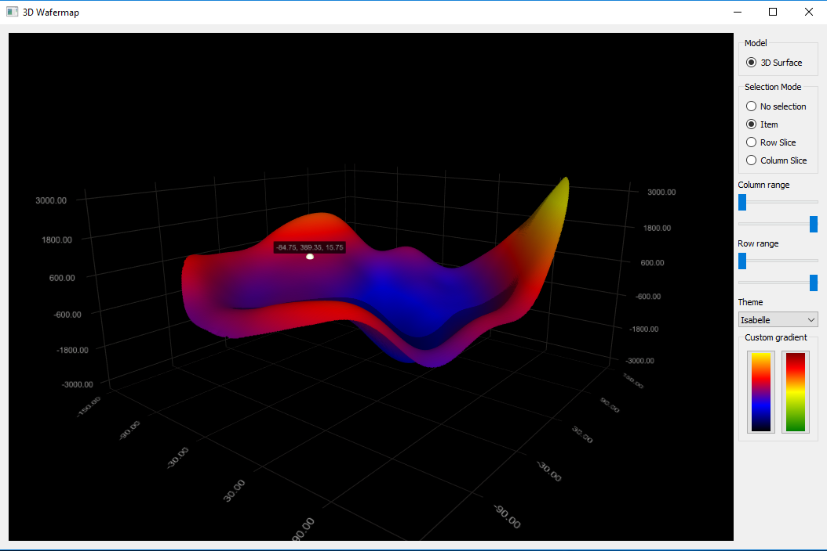
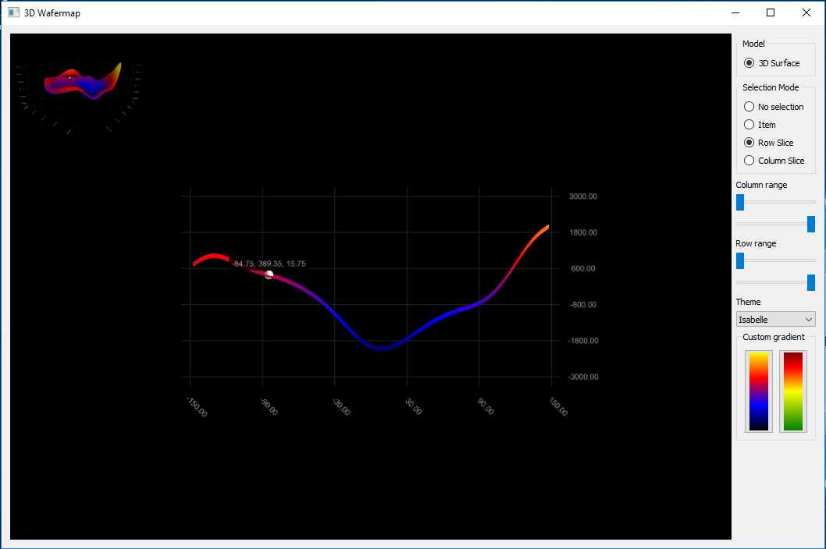

Slide 11
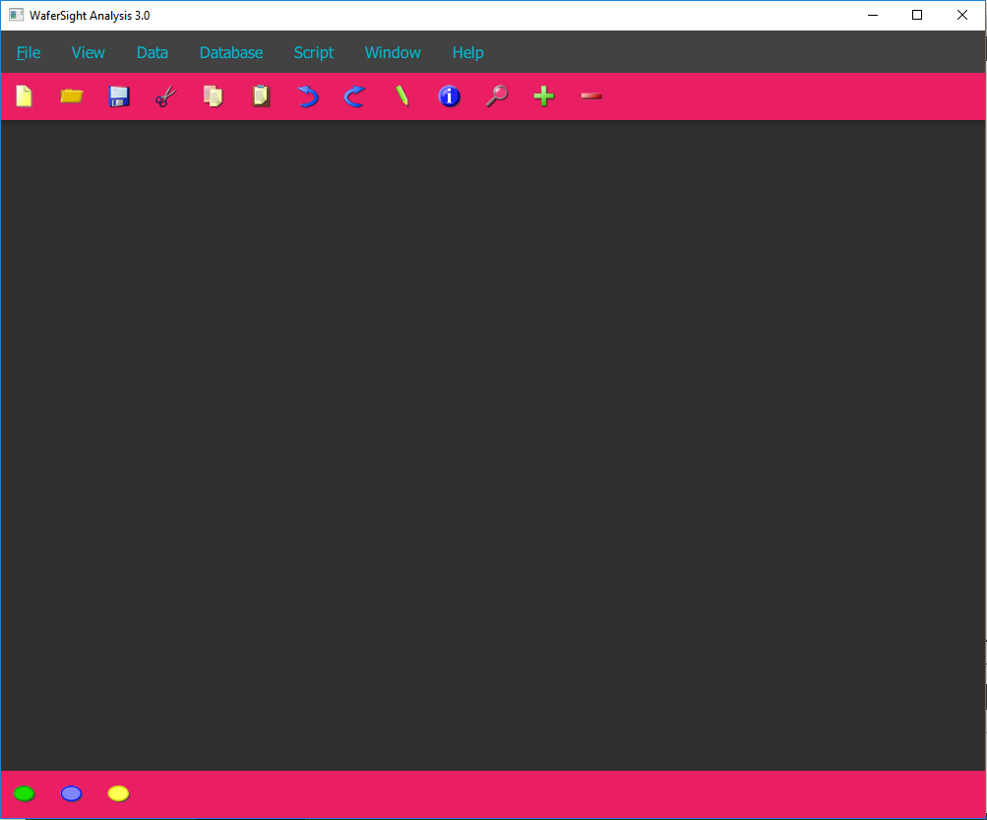

Slide 12
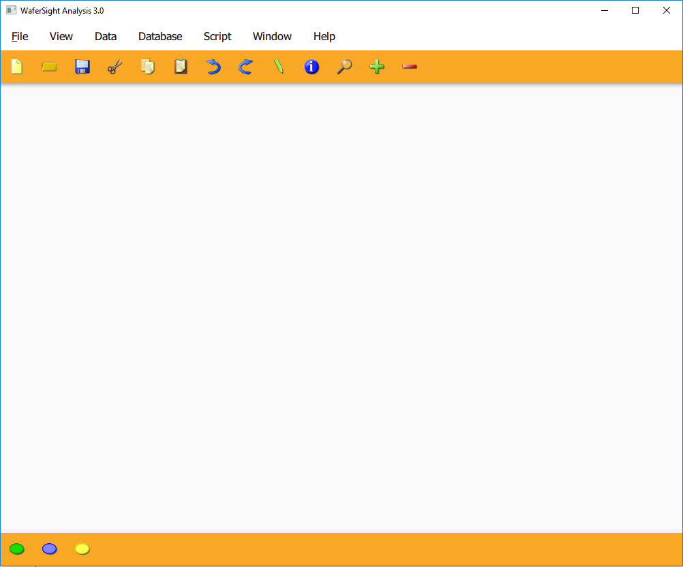

Slide 13
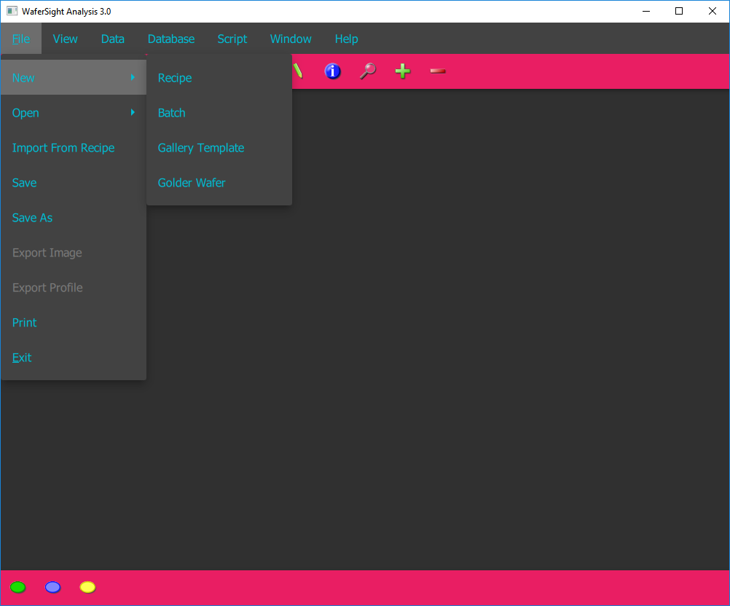

Slide 14
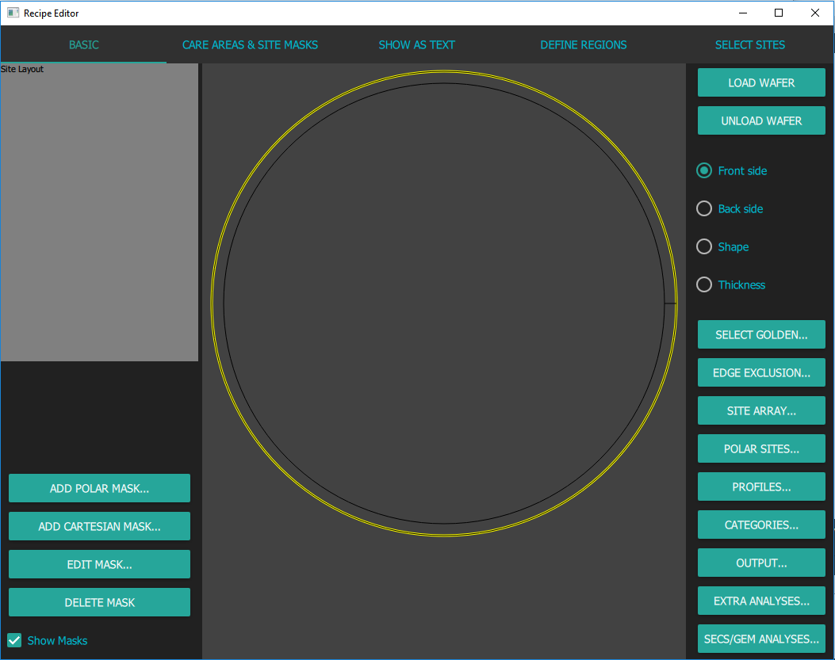

Slide 15
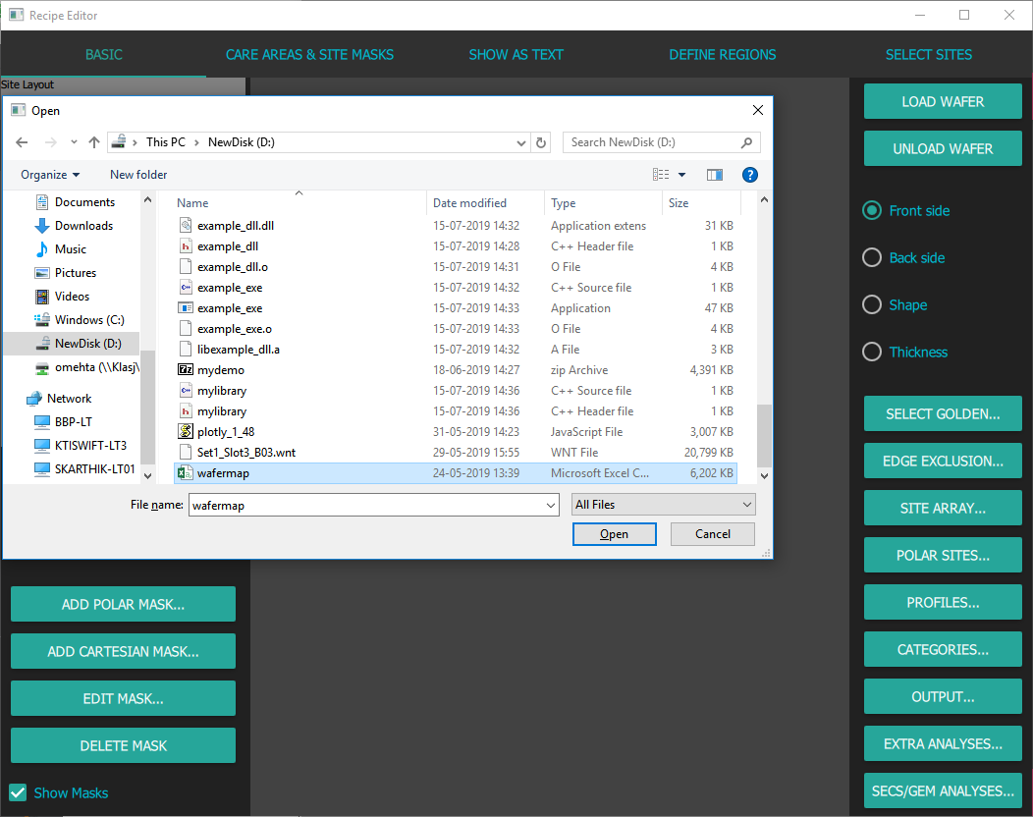

Slide 16
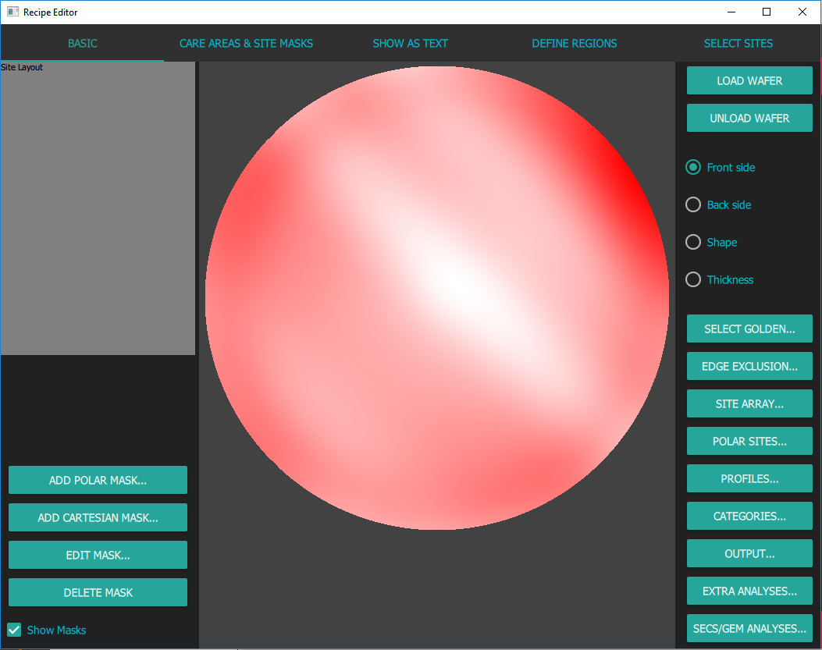

Slide 17
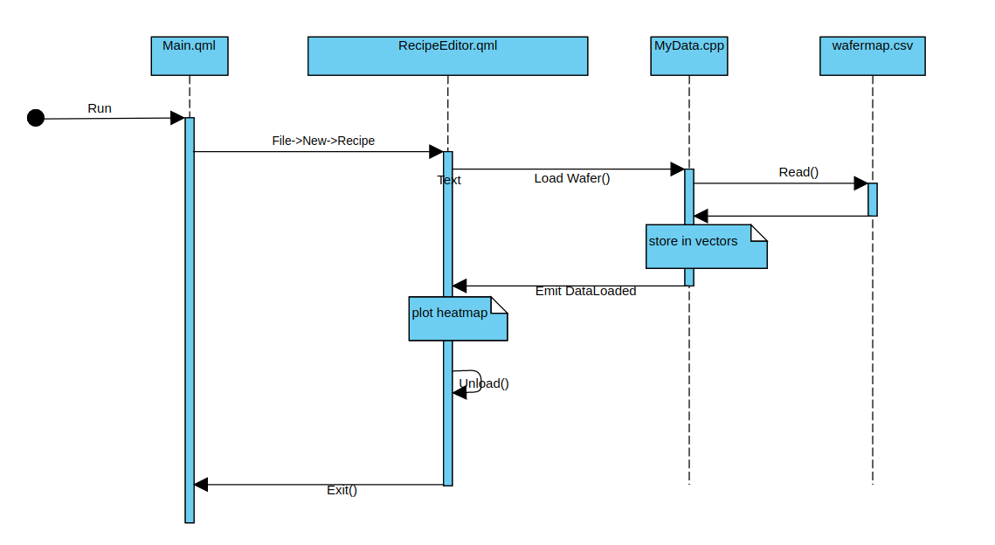

Slide 18
Timeline: Weekly activity and milestone summary
Select Framework
Experiment
Build
Notes:
Usecase of WS/PWG

Slide 19
Timeline: Weekly activity and milestone summary
Select Framework
Experiment
Build
Week 1
Week 2
Week 3
Week 4
Week 5
Week 6
Week 7
Week 8
Problem analysis.
Explore WS/PWG use cases.
Notes:
Usecase of WS/PWG

Slide 20
Timeline: Weekly activity and milestone summary
Select Framework
Experiment
Build
Week 1
Week 2
Week 3
Week 4
Week 5
Week 6
Week 7
Week 8
Problem analysis.
Explore WS/PWG use cases.
Gather requirements.
Explore various frameworks.
Evaluate the frameworks.
Notes:
Usecase of WS/PWG

Slide 21
Timeline: Weekly activity and milestone summary
Select Framework
Experiment
Build
Week 1
Week 2
Week 3
Week 4
Week 5
Week 6
Week 7
Week 8
Problem analysis.
Explore WS/PWG use cases.
Gather requirements.
Explore various frameworks.
Evaluate the frameworks.
Learn software development in Qt.
Create a Prototype using QML and JavaScript.
Notes:
Usecase of WS/PWG

Slide 22
Timeline: Weekly activity and milestone summary
Select Framework
Experiment
Build
Week 1
Week 2
Week 3
Week 4
Week 5
Week 6
Week 7
Week 8
Problem analysis.
Explore WS/PWG use cases.
Gather requirements.
Explore various frameworks.
Evaluate the frameworks.
Learn software development in Qt.
Create a Prototype using QML and JavaScript.
Add Third party libraries to the prototype.
Build Qt app for 3D visualization of wafermap.
Notes:
Usecase of WS/PWG

Slide 23
Timeline: Weekly activity and milestone summary
Select Framework
Experiment
Build
Week 1
Week 2
Week 3
Week 4
Week 5
Week 6
Week 7
Week 8
Problem analysis.
Explore WS/PWG use cases.
Gather requirements.
Explore various frameworks.
Evaluate the frameworks.
Learn software development in Qt.
Create a Prototype using QML and JavaScript.
Add Third party libraries to the prototype.
Build Qt app for 3D visualization of wafermap.
Integrate different types of Qt apps.
Run DGA engine in Qt App.
Notes:
Usecase of WS/PWG

Slide 24
Timeline: Weekly activity and milestone summary
Select Framework
Experiment
Build
Week 1
Week 2
Week 3
Week 4
Week 5
Week 6
Week 7
Week 8
Problem analysis.
Explore WS/PWG use cases.
Gather requirements.
Explore various frameworks.
Evaluate the frameworks.
Learn software development in Qt.
Create a Prototype using QML and JavaScript.
Add Third party libraries to the prototype.
Build Qt app for 3D visualization of wafermap.
Integrate different types of Qt apps.
Run DGA engine in Qt App.
Analyze use cases for workspace
Design the workspace.
Notes:
Usecase of WS/PWG

Slide 25
Timeline: Weekly activity and milestone summary
Select Framework
Experiment
Build
Week 1
Week 2
Week 3
Week 4
Week 5
Week 6
Week 7
Week 8
Problem analysis.
Explore WS/PWG use cases.
Gather requirements.
Explore various frameworks.
Evaluate the frameworks.
Learn software development in Qt.
Create a Prototype using QML and JavaScript.
Add Third party libraries to the prototype.
Build Qt app for 3D visualization of wafermap.
Integrate different types of Qt apps.
Run DGA engine in Qt App.
Analyze use cases for workspace
Design the workspace.
Develop the workspace frame.
Design recipe editor.
Implement the recipe editor.
Notes:
Usecase of WS/PWG

Slide 26
Timeline: Weekly activity and milestone summary
Select Framework
Experiment
Build
Week 1
Week 2
Week 3
Week 4
Week 5
Week 6
Week 7
Week 8
Problem analysis.
Explore WS/PWG use cases.
Gather requirements.
Explore various frameworks.
Evaluate the frameworks.
Learn software development in Qt.
Create a Prototype using QML and JavaScript.
Add Third party libraries to the prototype.
Build Qt app for 3D visualization of wafermap.
Integrate different types of Qt apps.
Run DGA engine in Qt App.
Analyze use cases for workspace
Design the workspace.
Develop the workspace frame.
Design recipe editor.
Implement the recipe editor.
Add further features to recipe editor.
Implement the support for multitasking.
Documentation.
Notes:
Usecase of WS/PWG

Slide 27
Timeline: Weekly activity and milestone summary
Select Framework
Experiment
Build
Week 1
Week 2
Week 3
Week 4
Week 5
Week 6
Week 7
Week 8
Problem analysis.
Explore WS/PWG use cases.
Gather requirements.
Explore various frameworks.
Evaluate the frameworks.
Learn software development in Qt.
Create a Prototype using QML and JavaScript.
Add Third party libraries to the prototype.
Build Qt app for 3D visualization of wafermap.
Integrate different types of Qt apps.
Run DGA engine in Qt App.
Analyze use cases for workspace.
Design the workspace.
Develop the workspace frame.
Design recipe editor.
Implement the recipe editor.
Add further features to recipe editor.
Implement the support for multitasking.
Documentation.
Notes:
Usecase of WS/PWG

Slide 28
Challenges Faced
In using third party javascript library.
No setTimeout()/clearTimeout() in qml, solved it using Timer().
Unable to use Plotly.js, then used D3.js for plotting.
Determining Architectural Workflow of IMC
Debugging
Notes:
When trying to use Plotly.js for plotting errors came like no such function but they were because the library due to large size was not able to be loaded before the function call was being made. Used D3.Js and successfully used bubbles. Had to create stub for setTimeout().

Slide 29
Challenges Faced
In using third party javascript library.
No setTimeout()/clearTimeout() in qml, solved it using Timer().
Unable to use Plotly.js, then used D3.js for plotting.
While integrating DGA-Engine with Qt app.
Unexpected crash while starting up the DGA-Engine.
Debugger couldn’t step into the source code of DGA in Qt creator.
To solve it, built a custom DLL in Qt and integrated it in the app.
Determining Architectural Workflow of IMC
Debugging
Notes:
When trying to use Plotly.js for plotting errors came like no such function but they were because the library due to large size was not able to be loaded before the function call was being made. Used D3.Js and successfully used bubbles. Had to create stub for setTimeout().

Slide 30
Challenges Faced
In using third party javascript library.
No setTimeout()/clearTimeout() in qml, solved it using Timer().
Unable to use Plotly.js, then used D3.js for plotting.
While integrating DGA-Engine with Qt app.
Unexpected crash while starting up the DGA-Engine.
Debugger couldn’t step into the source code of DGA in Qt creator.
To solve it, built a custom DLL in Qt and integrated it in the app.
Drawing heatmap in canvas
Plotting without using any library.
Setting up the color gradient.
Determining Architectural Workflow of IMC
Debugging
Notes:
When trying to use Plotly.js for plotting errors came like no such function but they were because the library due to large size was not able to be loaded before the function call was being made. Used D3.Js and successfully used bubbles. Had to create stub for setTimeout().

Slide 31
Challenges Faced
In using third party javascript library.
No setTimeout()/clearTimeout() in qml, solved it using Timer().
Unable to use Plotly.js, then used D3.js for plotting.
While integrating DGA-Engine with Qt app.
Unexpected crash while starting up the DGA-Engine.
Debugger couldn’t step into the source code of DGA in Qt creator.
To solve it, built a custom DLL in Qt and integrated it in the app.
Drawing heatmap in canvas
Plotting without using any library.
Setting up the color gradient.
Speeding up the plotting.
Moved the logic to read wafer file to C++ and QML is used only for plotting.
Determining Architectural Workflow of IMC
Debugging
Notes:
When trying to use Plotly.js for plotting errors came like no such function but they were because the library due to large size was not able to be loaded before the function call was being made. Used D3.Js and successfully used bubbles. Had to create stub for setTimeout().

Slide 32
My learnings
Gained knowledge about the domain and WS/PWG.
Determining Architectural Workflow of IMC
Debugging

Slide 33
My learnings
Gained knowledge about the domain and WS/PWG.
Overview of popular technologies of UI Development.
Determining Architectural Workflow of IMC
Debugging

Slide 34
My learnings
Gained knowledge about the domain and WS/PWG.
Overview of popular technologies of UI Development.
Some basic concepts of OOPS, JavaScript, MVC architecture.
Determining Architectural Workflow of IMC
Debugging

Slide 35
My learnings
Gained knowledge about the domain and WS/PWG.
Overview of popular technologies of UI Development.
Some basic concepts of OOPS, JavaScript, MVC architecture.
Qt framework, Qt widgets and QML
Determining Architectural Workflow of IMC
Debugging

Slide 36
My learnings
Gained knowledge about the domain and WS/PWG.
Overview of popular technologies of UI Development.
Some basic concepts of OOPS, JavaScript, MVC architecture.
Qt framework, Qt widgets and QML
Three dimensional visualization of a wafermap in Qt.
Determining Architectural Workflow of IMC
Debugging

Slide 37
My learnings
Gained knowledge about the domain and WS/PWG.
Overview of popular technologies of UI Development.
Some basic concepts of OOPS, JavaScript, MVC architecture.
Qt framework, Qt widgets and QML
Three dimensional visualization of a wafermap in Qt.
Static and dynamic libraries.
Determining Architectural Workflow of IMC
Debugging

Slide 38
My learnings
Gained knowledge about the domain and WS/PWG.
Overview of popular technologies of UI Development.
Some basic concepts of OOPS, JavaScript, MVC architecture.
Qt framework, Qt widgets and QML
Three dimensional visualization of a wafermap in Qt.
Static and dynamic libraries.
Develop and debug Qt application.
Determining Architectural Workflow of IMC
Debugging

Slide 39
My learnings
Gained knowledge about the domain and WS/PWG.
Overview of popular technologies of UI Development.
Some basic concepts of OOPS, JavaScript, MVC architecture.
Qt framework, Qt widgets and QML
Three dimensional visualization of a wafermap in Qt.
Static and dynamic libraries.
Develop and debug Qt application.
Using HTML5 Canvas.
Determining Architectural Workflow of IMC
Debugging

Slide 40
My learnings
Gained knowledge about the domain and WS/PWG.
Overview of popular technologies of UI Development.
Some basic concepts of OOPS, JavaScript, MVC architecture.
Qt framework, Qt widgets and QML
Three dimensional visualization of a wafermap in Qt.
Static and dynamic libraries.
Develop and debug Qt application.
Using HTML5 Canvas.
Signal-Slot mechanism of QML.
Determining Architectural Workflow of IMC
Debugging

Slide 41
My learnings
Gained knowledge about the domain and WS/PWG.
Overview of popular technologies of UI Development.
Some basic concepts of OOPS, JavaScript, MVC architecture.
Qt framework, Qt widgets and QML
Three dimensional visualization of a wafermap in Qt.
Static and dynamic libraries.
Develop and debug Qt application.
Using HTML5 Canvas.
Signal-Slot mechanism of QML.
Object oriented approach to software development.
Determining Architectural Workflow of IMC
Debugging

Slide 42
My learnings
Gained knowledge about the domain and WS/PWG.
Overview of popular technologies of UI Development.
Some basic concepts of OOPS, JavaScript, MVC architecture.
Qt framework, Qt widgets and QML
Three dimensional visualization of a wafermap in Qt.
Static and dynamic libraries.
Develop and debug Qt application.
Using HTML5 Canvas.
Signal-Slot mechanism of QML.
Object oriented approach to software development.
Software Design principles.
Determining Architectural Workflow of IMC
Debugging

Slide 43
Thank You

Slide 44
Additional slides

Slide 45
Comparison of Technologies
 | Qt | Electron | WPF | UWP
Organization | Open-source, Maintained by Qt company. | Open-source, Maintained by github. | Microsoft | Microsoft
Technology | C++, JavaScript, QML | Web Technologies like CSS, JavaScript, Jquery. | C# | C#
Platform compatibility | Cross platform. | Cross platform. | Windows desktop. | Windows 10, windows phone and tablets.
Performance | Native hence faster. | Similar to a web application. | Native hence faster. | Native hence faster.
Determining Architectural Workflow of IMC
Debugging

Slide 46
Comparison of Technologies
 | Qt | Electron | WPF | UWP
Drag-drop widgets feature | Available | Not available | Available | Available
Online support | 70,000+ questions | 500 questions | 1,49000+ questions | 500 questions
Future prospects | Promising, large community(1 million developers). | Poor, not powerful like a native app. | Obsolete | Narrow user base of windows phones/tablets.
License | Dual-licensed under commercial and open source(GPLv3) licenses. | Free, No- support. | Free, MIT License, No-support. | Free, MIT License, No-support.
Determining Architectural Workflow of IMC
Debugging

Slide 47
Comparison of Technologies
 | Qt | Electron | WPF | UWP
Additionals | Codebase(Backend) is in C++, So, Higher compatibility expected. Rich UI, flexibility by integration of JavaScript. | Easy for web-developers. JavaScript for Rich GUI. Vulnerable to web-related attacks. Runs on Chromium engine, which is resource | Mature technology but getting obsolete, specific to windows desktop. | Relatively new, launched in 2015, Less online support, Specific to windows desktop.
Determining Architectural Workflow of IMC
Debugging

Slide 48
Requirements
The UI should be:
Fast
Rich
Robust
Easy to develop
Easy to use
Resource efficient
Platform Independent
Sustainable
Determining Architectural Workflow of IMC
Debugging

Slide 49
Benchmarking:
45 mb when application is open.
135 mb with 2 windows and a plot.
Plotting takes 1ms.
It can be speed up with various ways like by using GPU or fake threads or compatible datatypes.
Deployment: For static linking, the Qt run-times can be compiled into the executable. For dynamic linking, it needs separate compilation.
Notes:
31 seconds for entire process of selecting a file, reading csv data, transferring to qml, and plotting. In which 30 seconds for accessing each element of javascript array.

