Slide 1













Technical Partner
Team Name: Kishta Coders
Team Leader Name: Ojaswee Upadhyay
Problem Statement: Problem ID: CSIHACK02
IT Solutions for PMDDKY Scheme Implementation (Uttarakhand)

Slide 2


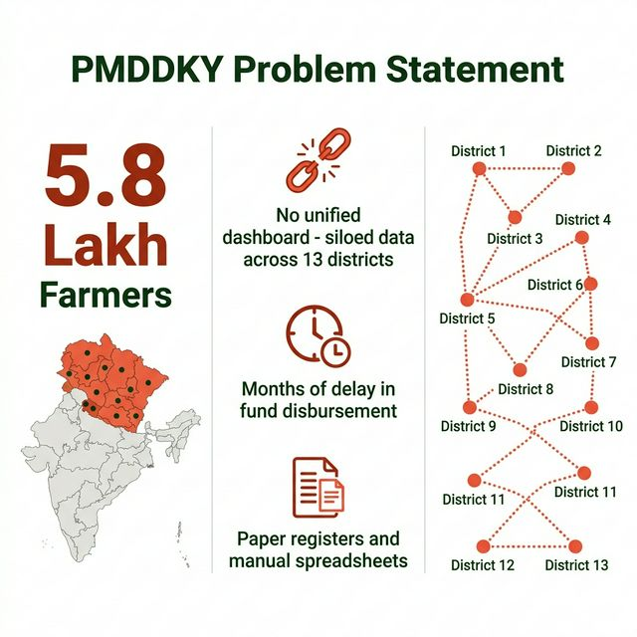
Problem Statement:
5.8 LAKH
Farmers eligible in Uttarakhand under PMDDKY
13 Backward Districts
Zero unified visibility
MONTHS of delay
in fund disbursement
District officials rely on paper registers & siloed Excel files — no central platform, no real-time visibility, no anomaly detection

Slide 3
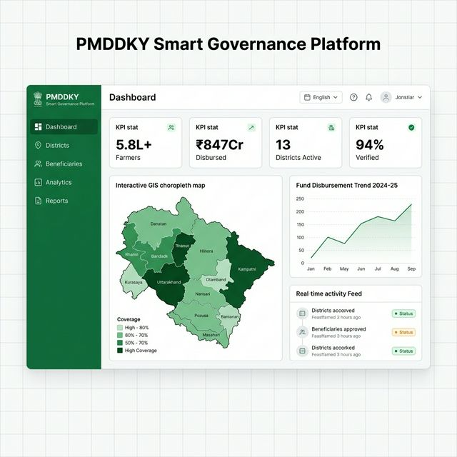
📡 Real-Time Dashboard
Live KPI cards — beneficiaries, funds, district progress, % verified
🗺️ GIS District Map
Choropleth map of Uttarakhand's 13 districts — click to drill down
🤖 AI Analytics
Anomaly detection, trend forecasting, district performance ranking
📋 Beneficiary Management
⚡ Socket.IO Real-Time
Aadhaar-verified records, status badges
Live push — no page reload needed

Slide 4
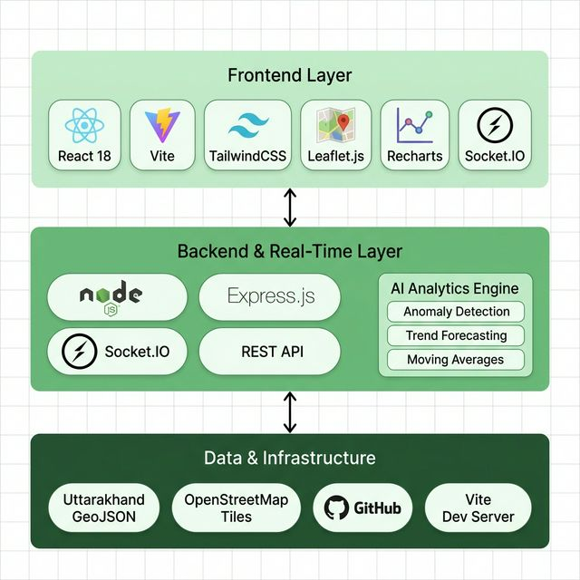
100% Open Source Zero licensing cost
Deployable on ₹500/mo VPS or govt NIC servers
Real-time via Socket.IO
Handles concurrent district-level users

Slide 5
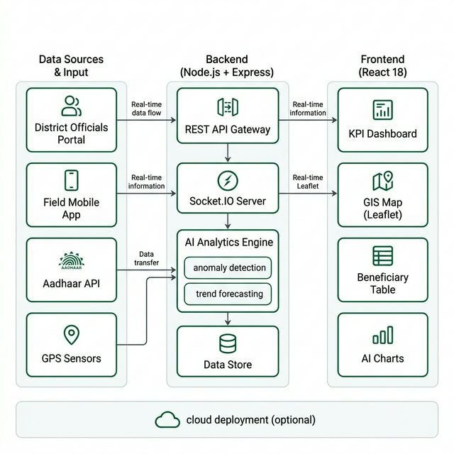
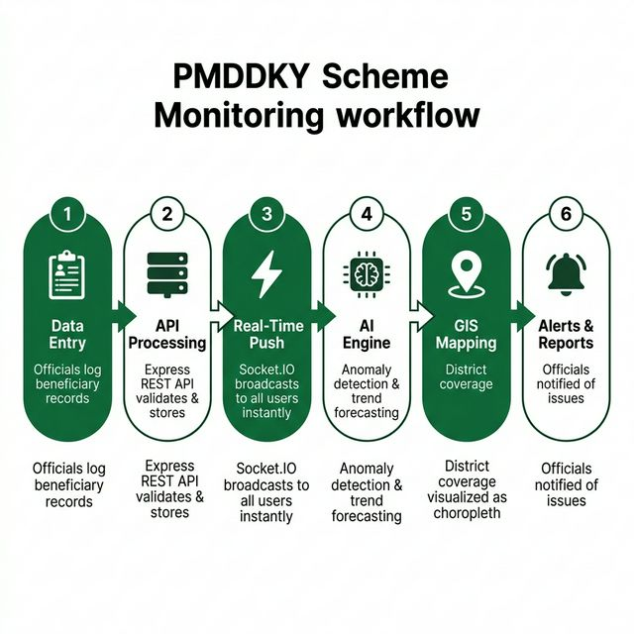
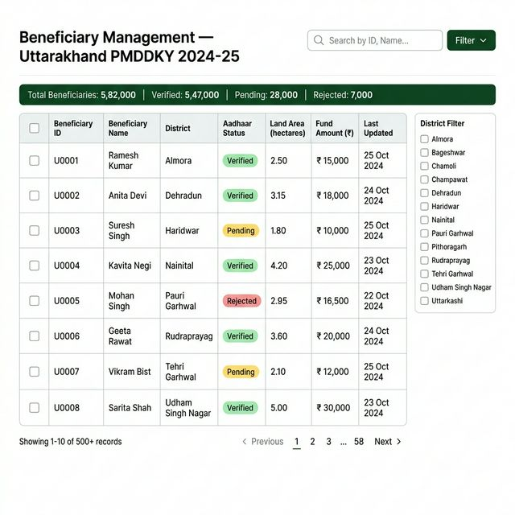
3-tier architecture: Field Input → Node.js + Socket.IO Backend → React Frontend | AI Engine: Anomaly Detection + Forecasting

Slide 6
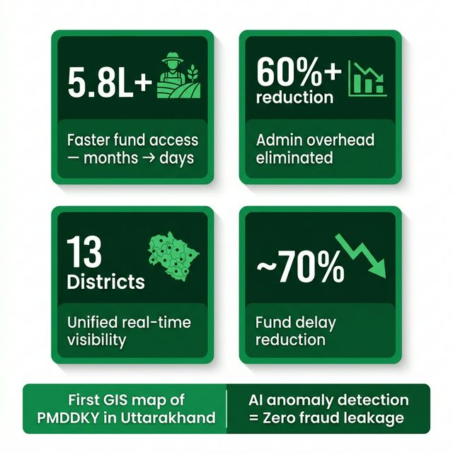
IMPACT — TECH FOR COMMUNITY
👨‍🌾 5.8L+ Farmers
Faster verified fund access — months → days
🏛️ 13 District Admins
Single dashboard replaces manual reports
📈 State Policymakers
Compare all districts, reallocate proactively
🌱 Agriculture
Better seeds & irrigation from timely fund flow

Slide 7
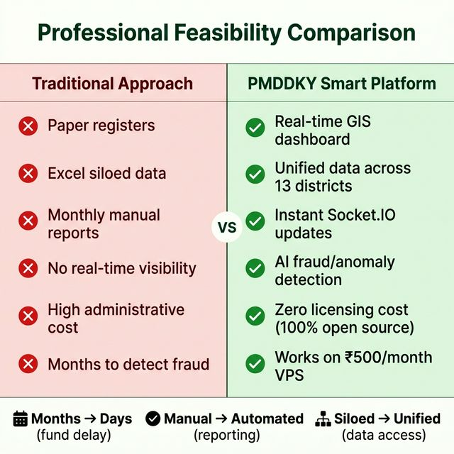
🗺️ First GIS-Mapped PMDDKY Dashboard
Choropleth map of Uttarakhand — district-level beneficiary density live
🤖 AI Anomaly Detection
Flags unusual fund spikes or enrollment drops before they become crises
⚡ Zero-Reload Real-Time
Socket.IO — field officers and HQ see the same data change simultaneously
💰 ₹500/month Deployment
100% open-source, runs on cheap VPS or government NIC servers

Slide 8
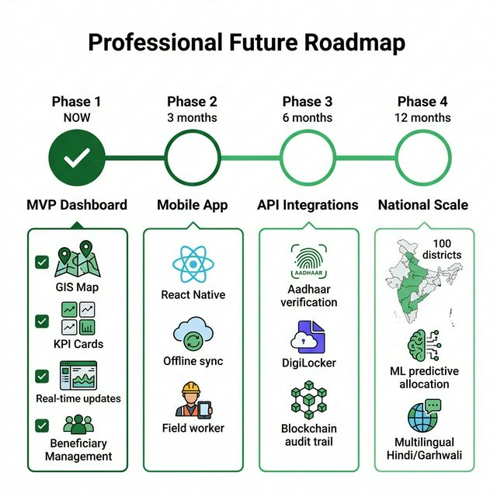
📱 Mobile App
React Native offline-first for field officers
🔗 Aadhaar API
Real integration for instant beneficiary verification
🔒 Blockchain
Immutable audit trail for RTI compliance
🌐 100 Districts
National rollout to all PMDDKY districts

Slide 9
Thank You

