Slide 1
SCHOOL OF COMPUTER SCIENCE
MeitY Startup Hub | UNDP | CSI | Anritsu | runway
©UPES
BUILD4भारत
KISHTA CODERS
HACKATHON 9.0
Team Name: Kishta Coders
Hack for Humanity · Build for Community
Team Leader: ________________________________
Technical Partner: D❖LL Technologies
PROBLEM STATEMENT
Real-time Smart Governance for PMDDKY Live Monitoring & AI-powered Analytics Dashboard for Uttarakhand's 13 Districts
5.8L+
13
₹847Cr
Farmers
Districts
Target Funds
SLIDE 1 OF 9

Slide 2
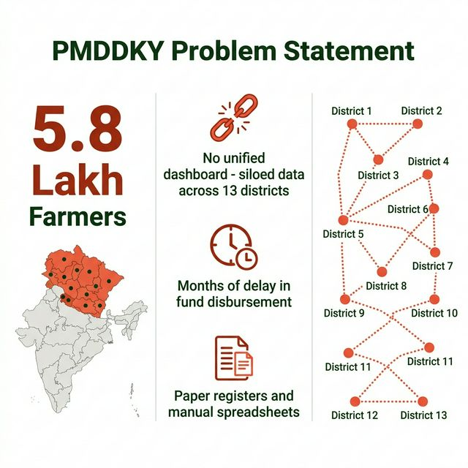
BUILD4भारत
D❖LL Technologies
MeitY | UNDP | CSI | Anritsu | runway
PROBLEM STATEMENT
5.8 LAKH
Farmers eligible in Uttarakhand under PMDDKY
13 Backward Districts
Zero unified visibility
MONTHS of delay
in fund disbursement
District officials rely on paper registers & siloed Excel files — no central platform, no real-time visibility, no anomaly detection
SLIDE 2 OF 9

Slide 3
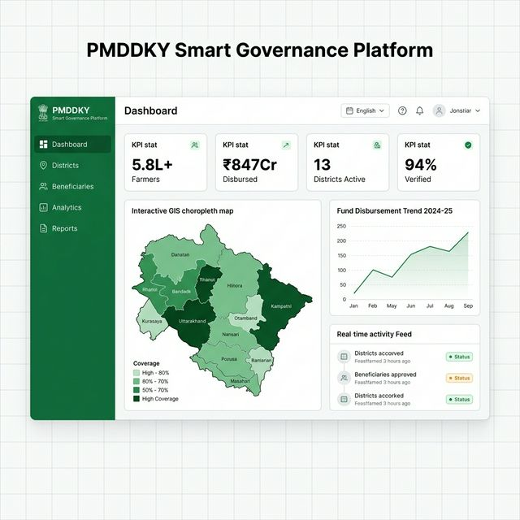
BUILD4भारत
D❖LL Technologies
MeitY | UNDP | CSI | Anritsu | runway
PROPOSED SOLUTION
📡 Real-Time Dashboard
Live KPI cards — beneficiaries, funds, district progress, % verified
🗺️ GIS District Map
Choropleth map of Uttarakhand's 13 districts — click to drill down
🤖 AI Analytics
Anomaly detection, trend forecasting, district performance ranking
📋 Beneficiary Management
⚡ Socket.IO Real-Time
Aadhaar-verified records, status badges
Live push — no page reload needed
▶ Dashboard Wireframe — PMDDKY Smart Governance Platform (React 18 + Leaflet + Socket.IO)
SLIDE 3 OF 9

Slide 4
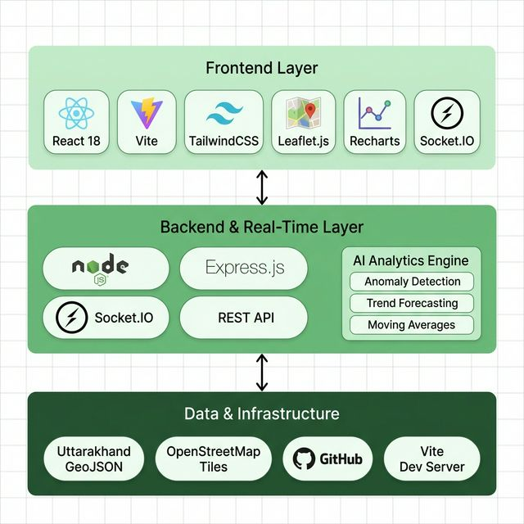
BUILD4भारत
D❖LL Technologies
MeitY | UNDP | CSI | Anritsu | runway
TECHNOLOGY STACK
100% Open Source Zero licensing cost
Deployable on ₹500/mo VPS or govt NIC servers
Handles concurrent district-level users
Real-time via Socket.IO
SLIDE 4 OF 9

Slide 5
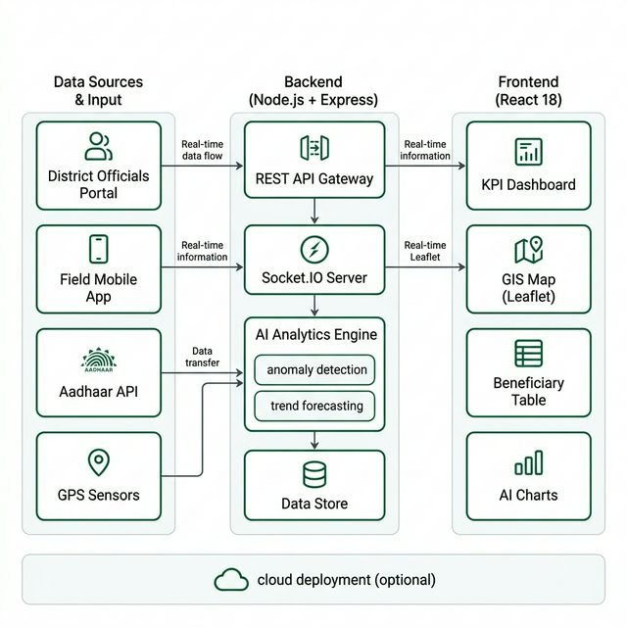
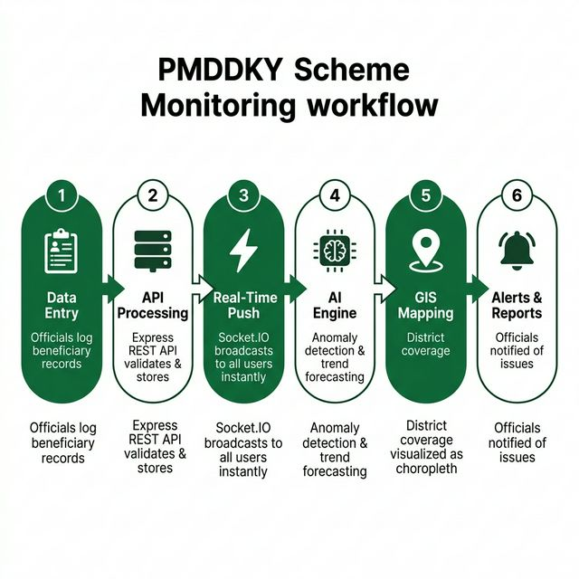
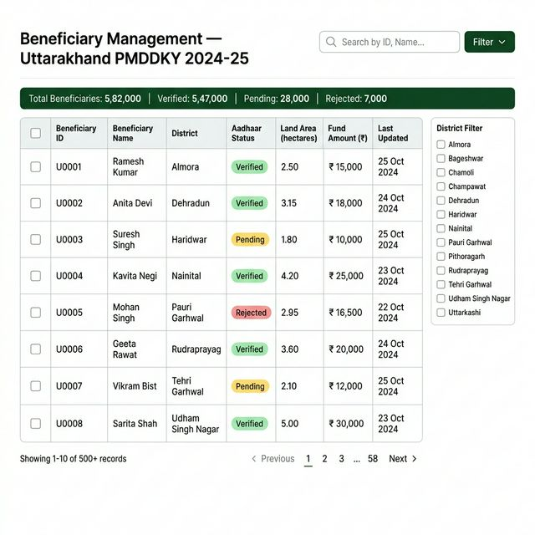
BUILD4भारत
D❖LL Technologies
MeitY | UNDP | CSI | Anritsu | runway
METHODOLOGY & SYSTEM ARCHITECTURE
3-tier architecture: Field Input → Node.js + Socket.IO Backend → React Frontend | AI Engine: Anomaly Detection + Forecasting
SLIDE 5 OF 9

Slide 6
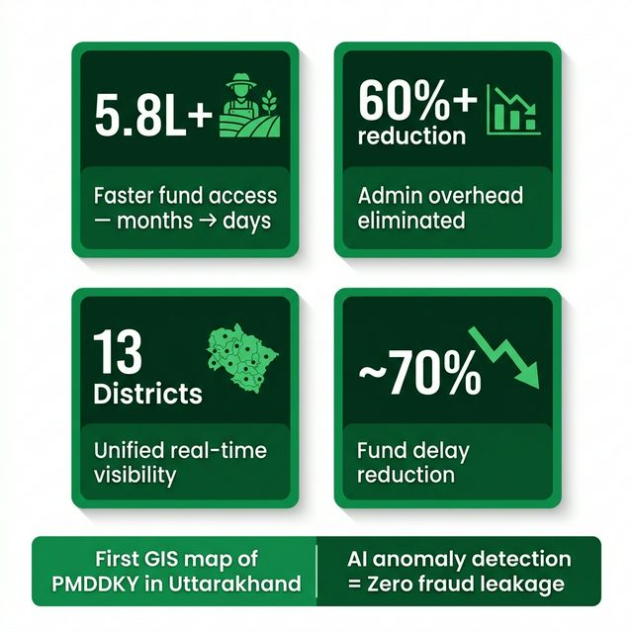
BUILD4भारत
D❖LL Technologies
MeitY | UNDP | CSI | Anritsu | runway
IMPACT — TECH FOR COMMUNITY
👨‍🌾 5.8L+ Farmers
Faster verified fund access — months → days
🏛️ 13 District Admins
Single dashboard replaces manual reports
📈 State Policymakers
Compare all districts, reallocate proactively
🌱 Agriculture
Better seeds & irrigation from timely fund flow
SLIDE 6 OF 9

Slide 7
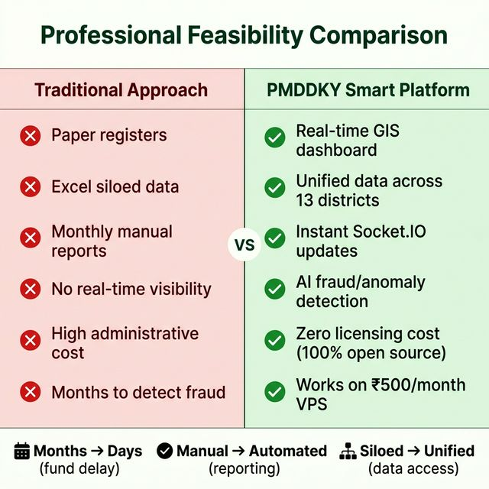
BUILD4भारत
D❖LL Technologies
MeitY | UNDP | CSI | Anritsu | runway
FEASIBILITY & INNOVATION
🗺️ First GIS-Mapped PMDDKY Dashboard
Choropleth map of Uttarakhand — district-level beneficiary density live
🤖 AI Anomaly Detection
Flags unusual fund spikes or enrollment drops before they become crises
⚡ Zero-Reload Real-Time
Socket.IO — field officers and HQ see the same data change simultaneously
💰 ₹500/month Deployment
100% open-source, runs on cheap VPS or government NIC servers
SLIDE 7 OF 9

Slide 8
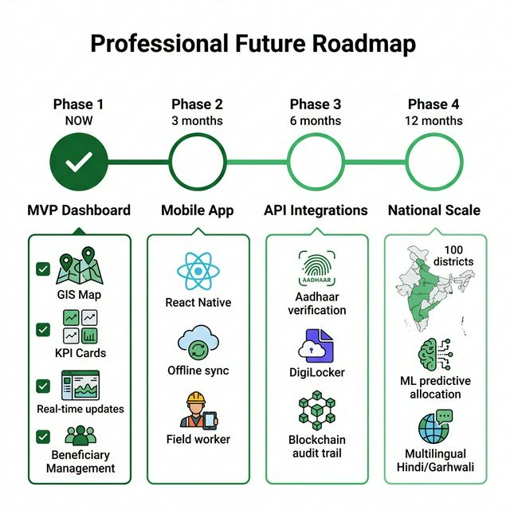
BUILD4भारत
D❖LL Technologies
MeitY | UNDP | CSI | Anritsu | runway
FUTURE SCOPE & ROADMAP
📱 Mobile App
React Native offline-first for field officers
🔗 Aadhaar API
Real integration for instant beneficiary verification
🔒 Blockchain
Immutable audit trail for RTI compliance
🌐 100 Districts
National rollout to all PMDDKY districts
SLIDE 8 OF 9

Slide 9
Thank You
KISHTA CODERS | BUILD4BHARAT HACKATHON 9.0
PMDDKY Smart Governance Platform — Hack for Humanity, Build for Community
Real-time Dashboard · GIS Mapping · AI Anomaly Detection · Socket.IO · 100% Open Source
SLIDE 9 OF 9

