Slide 1
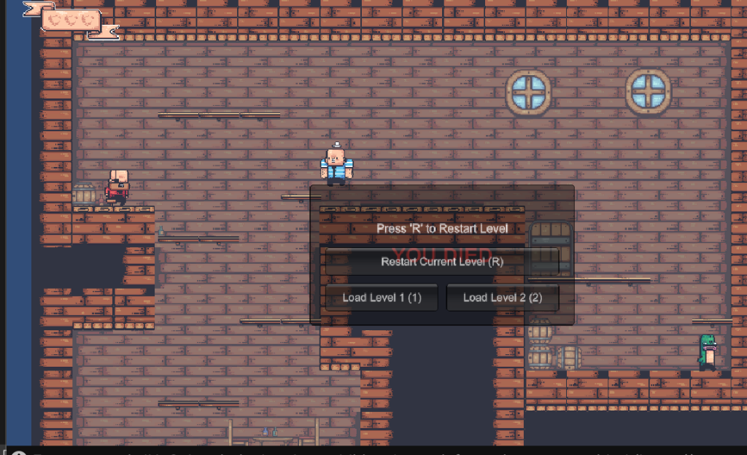
THE BOMB GAME
Pirate Action-Platformer in Unity 6 & URP 2D
Technical Post-Mortem, Systems Architecture, and Design Analysis
Core Objective
Engine & Tech
Sensory Style
- Navigate multi-level pirate fortresses
- Use timed bombs to defeat unique pirates
- Reach exit doors to progress across stages
- Engine: Unity 6 (6000.4.1f1)
- Graphics: Universal Render Pipeline (URP 2D)
- C# Custom Event & Physics Framework
- Authentic 16-bit retro pirate pixel art
- Dynamic 2D volumetric light sources
- Responsive sound design with footstep cadence

Slide 2



01. GAME DESIGN
Gameplay Goals & Progression
Primary Goal: Stage Clear
Bomb Mastery & Tactical Combat
Survival & Health Economy
- Navigate from start position to the level exit door.
- Level 1: Climb interior platforms to reach Door at (6.45, 3.87).
- Level 2: Conquer multi-tiered gauntlet with high-density enemy placement.
- Door trigger initiates scene loading to the next chapter.
- Time 3.5s bomb fuses to hit enemies before they react.
- Manage projectile arcs and throw force.
- Prevent enemy counter-attacks (kicks, catches, swallows).
- Blast radius (1.6u) applies both direct damage and physical knockback.
- Start each run with 3 maximum health hearts.
- Enemy contact deals 1 heart damage + knockback.
- Temporary invulnerability flashing (1.2s) prevents instant death traps.
- Bottomless pit boundaries trigger instant restart.

Slide 3



02. CORE SYSTEMS
Key Game Features & Mechanics
Physics-Driven Bomb Warfare
Reactive Pirate AI Archetypes
- Parabolic projectile launch with custom horizontal/vertical impulses.
- Dynamic countdown visualizer (charging, pulsing, closing, exploding).
- Physics2D OverlapCircle damage and knockback calculation.
- 5 distinct enemy behaviors that directly interact with player bombs.
- Bald Pirate kicks bombs away; Big Guy catches and throws back.
- Whale swallows bombs whole; Captain flees in panic; Cucumber bites.
Zero-Downtime Instant Respawn
Dedicated Main Menu & Level Flow
- Instantaneous restart of the exact current level upon player death.
- No disruptive game over popups or blocking overlay screens.
- Dedicated 'R' hotkey allows instant manual level restart anytime.
- Standalone retro main menu scene with keyboard-first controls.
- Interactive selection: Play Level 1, Jump to Level 2, or Quit.
- Seamless LevelManager singleton coordinating scenes in background.

Slide 4

03. PLAYER FEEL
Controls and Player Experience
Input Mapping (Arcade Feel)
Responsive Platforming Feel
- A / D or Left / Right: Smooth horizontal run (6.5 speed).
- Spacebar: Precision jump (11.5 impulse force).
- F / J / E / Left Click: Throw ignited bomb with projectile arc.
- R Key: Instant active level restart (during life or death).
- Menu Navigation: UP / DOWN arrows and ENTER (per specification).
- 1 / 2 Keys: Quick level switching for development and test.
- Coyote Time (0.12s): Jump remains valid for 120ms after leaving ledge.
- Jump Buffer (0.12s): Pre-landing space presses queue jump automatically.
- Dual Ground Detection: Composite box check + downward slope raycast.
- Strict Collision Isolation: Enemies and bombs ignored for ground check.
- Audio Cadence: Footstep sound plays rhythmically only while grounded.
- Impact Punchiness: Knockback impulse and sprite invulnerability flicker.

Slide 5

04. ENGINEERING
Unity Architecture & Script Implementation
Player & Combat
Managers & Flow
Audio & Interface
- PlayerMovement.cs: Rigidbody2D velocity control, health events, bomb throw.
- IDamageable.cs: Decoupled damage interface implemented across Player & AI.
- Bomb.cs: Timer management, SpriteRenderer fuse charge, Physics2D blast.
- Ground Check: OverlapBox + Raycast avoiding tag collisions.
- LevelManager.cs: Persistent singleton managing scene switches & restarts.
- LevelDoor.cs: Trigger & distance dual-sensing script loading next scene.
- MainMenuController.cs: Retro keyboard UI responding to Up/Down/Enter.
- EditorBuildSettings: Indices mapped (0: Menu, 1: Level1, 2: Level2).
- SoundManager.cs: Central audio engine with randomized clip variations.
- Dedicated 2D SFX channel and separate walking footstep channel.
- GameHUD.cs: Subscribes to player events, toggling active hearts.
- Clean Death Loop: Removed OnGUI blocking boxes for rapid replay.

Slide 6
05. LEVEL ARCHITECTURE
World and Level Design
Level 1: The Interior Hold
Level 2: The Upper Quarters
- Aesthetic: Warm wooden ship cabin with candle chandeliers and windows.
- Platforming: Gentle introductory elevation climb with wide jump landings.
- Pacing: Low-to-moderate threat density; introduces Bald Pirate & Big Guy.
- Exit Goal: Climb to top-right landing to enter Door at (6.45, 3.87).
- Lighting: Global 2D ambient + 2D Point Lights casting soft shadows.
- Hazard Zones: Fall boundary configured at y = -6.5.
- Aesthetic: Expansive multi-deck pirate fortress with vertical shafts.
- Platforming: Precision jumping over chasms, narrow wooden ledges.
- Enemy Gauntlet: Heavy combination of Cucumbers, Big Guys, Bald Pirates.
- Combat Depth: Requires utilizing high ground to drop bombs on patrol routes.
- Fall Danger: Wide gaps require mastering Coyote Time & Jump Buffering.
- Atmosphere: Volumetric light beams shining through decorative portholes.

Slide 7




06. ENEMY AI
Enemy & Boss System
Bald Pirate
Big Guy (Heavy Boss)
Cucumber
- Tactics: Kicks bombs away with high horizontal velocity.
- Durability: 1 bomb explosion.
- Counter: Drop bomb on higher ledge or time fuse.
- Tactics: Picks up active bombs and throws them back at player!
- Durability: Takes 3 bombs to eliminate.
- Role: High-threat mini-boss requiring hit-and-run tactics.
- Tactics: Aggressive speed, charges player with melee bite.
- Durability: Takes 2 bombs to eliminate.
- Challenge: Fast approach forces rapid platform retreat.
Captain (Cowardly Commander)
Whale (Bomb Devourer)
- Behavior: High detection range; flees in panic when a bomb is nearby.
- Durability: 1 bomb explosion to defeat.
- Gameplay Dynamic: Cornering the captain while dodging other threats.
- Special Power: Literally swallows ignited bombs whole, nullifying them!
- Vulnerability: Immune to direct bombs; eliminated via fall hazards.
- Puzzle Element: Luring whale off platform edges.

Slide 8
07. SENSORY EXPERIENCE
UI / HUD and Audio Design
Interface & HUD System
Sound Effects Mapping
- Health Bar HUD: Stylized pirate ribbon banner at top-left screen.
- Dynamic Hearts: 3 interactive heart sprites toggle on health change.
- Bomb Fuse Bar: Shows charging, full pulsing, and closing phases.
- Clean Death Experience: Removed all blocking black dialog boxes.
- Standalone Main Menu: Retro typography with selection cursor (>).
- Specification Compliance: Prominent 'Use UP / DOWN and ENTER' footer.
- Walking: Gravel.ogg footstep audio rhythmically plays on ground movement.
- Bomb Initiation & Blast: 01_Explosion_v1..v3 trigger on spawn & detonation.
- Jump: 01_Jump_v1.ogg plays crisp jump launch sound.
- Damage & Hit: 01_Hurt_v1..v4 with slight random pitch modulation.
- Death: 01_Death_v1.ogg plays instant game over demise cue.
- Pit Fall: 01_Fall_v1.ogg plays cartoon descent whistle into chasms.
- Menu Navigation: Punch sound on arrow change, Start sound on Enter.

Slide 9
08. COMPARATIVE ANALYSIS
Outcomes Without Unity (Raw Custom Code)
Low-Level Math & Physics
Graphics & Rendering Pipeline
Animation & Audio Overhead
- Must write custom SAT / AABB 2D collision resolution from scratch.
- Manual implementation of velocity integration, friction, and gravity.
- Risk of tunneling and clipping without continuous collision checks.
- Dozens of engineering hours wasted on basic physics bugs.
- Must write custom OpenGL / DirectX / Metal sprite batcher.
- Manual atlas slicing, UV calculation, and sprite matrix transforms.
- Complex shader programming required for 2D lighting and shadows.
- No visual scene hierarchy or visual camera viewport tools.
- Custom state machine code required for frame timing and transitions.
- Direct integration with OS audio APIs (XAudio2, CoreAudio, ALSA).
- No visual tilemap painting; level data stored in manual text arrays.
- Severe development friction; 80% time spent on boilerplate.

Slide 10
09. ENGINE ADVANTAGES
Outcomes With Unity (Engine Acceleration)
Turnkey Physics & Lighting
Visual Workflow & Tooling
Focus on Gameplay Depth
- Robust Box2D integration (Rigidbody2D, CompositeCollider2D).
- URP 2D Light sources out-of-the-box (Point, Global, Freeform).
- LayerMask filtering for ground, enemy, and bomb layers.
- Instant visual debugging with Gizmos (check sizes, fall lines).
- Interactive Tilemap palette for organic level design in minutes.
- Animator controllers with visual state graphs, parameters & blends.
- Prefab workflow: change Player or Bomb once, propagates everywhere.
- SceneManager API: instantaneous scene reloads and asynchronous jumps.
- Engine handled 95% of rendering, audio spatialization & physics.
- 100% of engineering focused on unique enemy behaviors & game feel.
- Rapid iteration: polished coyote time, jump buffering & footstep timers.
- Cross-platform readiness: one codebase targets PC, WebGL & consoles.

Slide 11
10. POST-MORTEM
Key Learning Outcomes & Takeaways
Architecture & C# Patterns
Game Feel & Platforming
Iterative Problem Solving
- Event-Driven Design: Decoupling health changes and UI via C# Actions.
- Singleton Managers: Robust persistent controllers (LevelManager, SoundManager).
- Interface Polymorphism: IDamageable applied cleanly across player & AI.
- Defensive Programming: Automatic fallback searches prevent null references.
- Coyote Time & Input Buffering transform stiff jumps into fluid platforming.
- Footstep Cadence: Timer-based footsteps sound infinitely better than loops.
- Friction & Zero-Drift: Direct horizontal velocity creates tight arcade control.
- Instant Retry Loops: Fast respawns keep player immersion unbroken.
- Resolving internal namespace collisions (Unity internal AudioManager vs custom).
- Removing visual friction: eliminating disruptive UI boxes upon death.
- Multi-Scene Build Pipeline: Proper build indexing for standalone builds.
- Specification Rigor: Implementing exact menu controls per design document.

