Slide 1
PROBLEM 2
Two-Agent Neuro-Symbolic Verification System for CAD Layout Generation with Interior Constraints
Gemini generates · Mistral gives feedback · Z3 SMT formally verifies — across four locations
Swara Wankhede · 6 June 2026
Agent 1: Gemini 2.5 Flash · Agent 2: Mistral · Verifier: Z3 SMT · Locations: Seattle Downtown, Bellevue, Bothell, Redmond

Slide 2
1. Problem Statement
Extend the two-agent system from the outer boundary to the complete interior
Building on Problem 1 (outer-boundary verification), the system must now generate and formally verify the full interior of the house.
Required floor plan:
3 bedrooms · 2 bathrooms · 1 kitchen · 1 living room · 1 corridor
The layout must satisfy the given architectural constraints, verified by Z3.
8 rooms
INCLUDING THE CORRIDOR
25
INTERIOR CONSTRAINTS IN Z3
4
LOCATIONS WITH OWN CODES
Problem 2 · Swara Wankhede
2 / 12

Slide 3
2. System Overview
A fully automated two-agent pipeline with two Z3 verification stages
Agent 1 — Gemini 2.5 Flash
Generates Python ezdxf code for the outer boundary, then the interior, room by room
Agent 2 — Mistral
Reads the Z3 output and writes specific fix instructions back to Agent 1
Verifier — Z3 SMT
Two stages: outer boundary vs location codes, interior vs IRC + spatial rules
Flow: pick a location → A1 outer boundary → AST parser → Z3 (SAT/UNSAT + JSON) → A2 feedback loop (max 5) → A1 interior → Z3 interior (25 rules) → A2 loop → final .dxf in Autodesk Viewer.
Problem 2 · Swara Wankhede
3 / 12

Slide 4
3.1 Sequential Room Generation
Generate the interior room by room — not all at once (June 5 feedback)
Generating the whole layout in one step makes it hard for the LLM to satisfy every spatial constraint simultaneously. A defined order improves spatial consistency.
1
Living room
~20% — nearest the south entry
2
Kitchen
~10% — adjacent to living, no corridor
3
Corridor
~5% — 4 ft wide, public → bedroom zone
4
Bedroom 1 + Bath 1
15% + 6% — ensuite pair
5
Bedroom 2 + Bath 2
15% + 6% — ensuite pair
6
Bedroom 3
~13% — remaining area
Problem 2 · Swara Wankhede
4 / 12

Slide 5
3.2 Layers & 3.3 Spatial Rules in the Prompt
Each room type on its own DXF layer; the spatial rules are stated to Agent 1
DXF LAYERS
SPATIAL RULES (in A1 prompt)
LIVING · KITCHEN · CORRIDOR · BEDROOMS · BATHROOMS · WINDOWS · DOORS
Living nearest the entry, touching the south wall
Kitchen adjacent to living, no corridor between
Each bedroom has its own attached bathroom (shared wall)
Bathrooms never adjacent to the kitchen
The two bathrooms never adjacent to each other
Each bathroom smaller than its attached bedroom
Each bedroom: exactly 2 windows on different walls
Corridor width ≥ 4 ft
Each room type is drawn on a separate layer for clarity and independent verification.
Problem 2 · Swara Wankhede
5 / 12

Slide 6
4. Z3 Interior Verification Framework
Constraints sourced from IRC R304 and the meeting feedback; checked deterministically
4.1 Constraint sources
IRC Section R304 — room area and minimum-dimension requirements.
June 5 meeting feedback — adjacency, ensuite attachment and spatial placement rules.
4.3 How Z3 verifies
A Python AST parser reads the generated interior file and extracts 32 coordinate variables (x, y, w, h for each of 8 rooms incl. the corridor).
It computes room areas, adjacency relationships, containment and the living-room position.
run_z3_interior() encodes each constraint as a Z3 boolean, adds them all under one And() clause, and calls solver.check().
Returns SAT or UNSAT with a full JSON breakdown — including a fix instruction for each failed constraint.
Problem 2 · Swara Wankhede
6 / 12

Slide 7
4.2 The 25 Interior Constraints
Seven groups — IRC sizing plus the meeting's adjacency and attachment rules
Group 1 · Room areas (7)
Group 2 · Min dimension (6)
Group 3 · Max dimension (2)
Group 4 · Bath < bedroom (2)
living/kitchen/bed ≥ 70 · bath ≥ 25 sq ft
living & bedrooms ≥ 7 ft · baths ≥ 5 ft
bathrooms ≤ 15 ft / side (added after testing)
each ensuite smaller than its bedroom
Group 5 · Bath adjacency (3)
Group 6 · Bath attachment (2)
Group 7 · Spatial & coverage (3)
25
baths not adj. kitchen, not adj. each other
bath shares a wall with its bedroom
living near south · inside · ±5% area
constraints, all checked by Z3
Problem 2 · Swara Wankhede
7 / 12

Slide 8
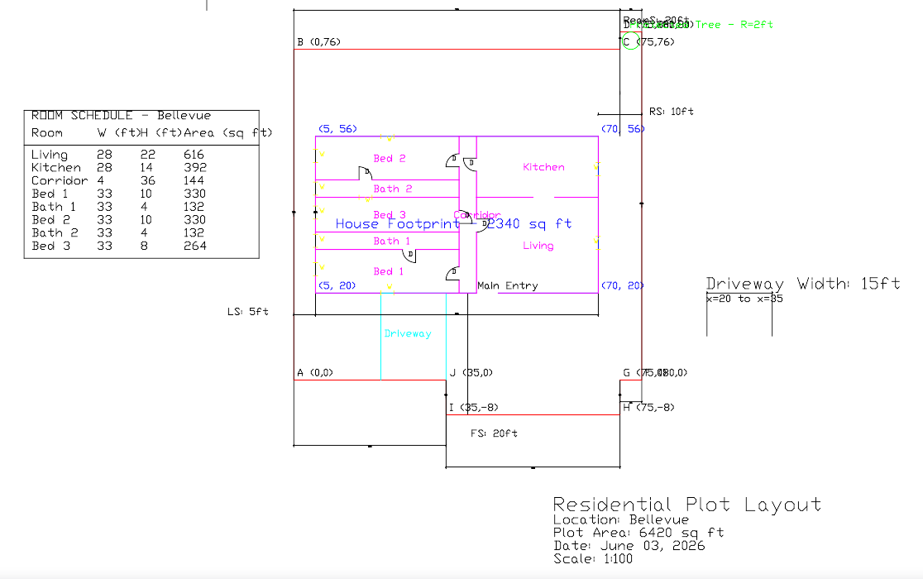
5. Test Run 6 — Bellevue (UNSAT → fix)
Outer boundary reused (SAT, 2 iters); interior iteration 1 fails 2 of 25
ITERATION 1 — UNSAT
Passed 21 / 25
Failed: bath1 & bath2 min dimension = 4 ft (need ≥ 5 ft).
A2 FIX INSTRUCTION
Increase each bathroom's smaller side to at least 5 ft while preserving the 21 passing constraints; regenerate.
Problem 2 · Swara Wankhede
8 / 12

Slide 9
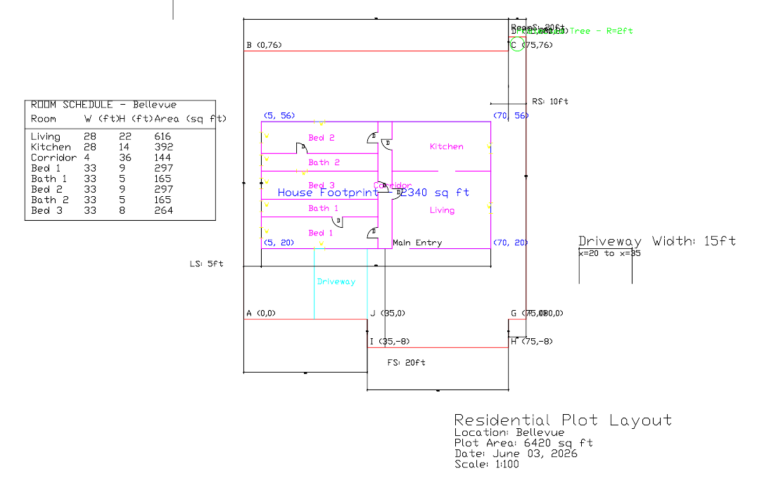
6. Test Run 7 — Bellevue (SAT)
First fully-verified run: interior converges in 2 iterations, 25 / 25 passed
FINAL — SAT
25 passed · 0 failed
Iter 1 caught a 33 ft-wide bath; bath_max_dimension added.
OBSERVATIONS
The max-dimension constraint correctly flagged the 33 ft bathroom.
Gemini repeatedly sets a bathroom's width equal to its bedroom's; the Z3 max-dimension rule is the enforcement layer.
Problem 2 · Swara Wankhede
9 / 12

Slide 10
7. Cutting-Plane Algorithm — Future Direction
From verify-and-fix to generate-and-guarantee with a MILP solver
A cutting-plane algorithm (Mixed-Integer Linear Programming) starts from a relaxed layout, adds a linear cut whenever a constraint is violated, and repeats until only valid solutions remain. The solver would generate optimal layouts rather than verify existing ones.
Current approach (Z3) | Future approach (MILP + cutting planes)
Gemini generates the layout, Z3 verifies | MILP solver generates and guarantees satisfaction
Verify-and-fix loop | Generate-and-guarantee
May take multiple iterations to converge | Mathematically optimal on the first solve
LLM output is non-deterministic | Solver output is deterministic and reproducible
Recommended tool: OR-Tools CP-SAT — native no-overlap support, scales to 20+ rooms.
Problem 2 · Swara Wankhede
10 / 12

Slide 11
8–9. File & Output Structure
Modular code; every iteration's artifacts are logged
CODE
OUTPUTS (per iteration N)
File | Role
main.py | Orchestration, location selection, logging
agent1.py | Gemini prompts (outer + sequential interior)
agent2.py | Mistral feedback from Z3 JSON
parser.py | AST coordinate extractor
z3_verifier.py | run_z3 / run_z3_interior (25 rules)
rules/ | 4 location building-code files
generated_layout_iterN.py / interior_iterN.py
z3_output_iterN.json / z3_interior_iterN.json
feedback_iterN.txt / interior_feedback_iterN.txt
logs/run_log.json — token counts + timing per iteration
Problem 2 · Swara Wankhede
11 / 12

Slide 12
Takeaways
Z3 is the formal judge
25 interior constraints from IRC R304 and the meeting feedback are checked deterministically with SAT/UNSAT and a JSON fix breakdown.
Sequential generation improves consistency
Generating room by room (living → kitchen → corridor → ensuite pairs → bedroom 3) helps the LLM satisfy spatial rules.
Testing hardened the constraints
Test runs exposed a 4 ft bath and a 33 ft bath; min- and max-dimension rules were added so Z3 enforces what the prompt cannot.
Cutting-plane MILP is the next step
Moving from verify-and-fix to generate-and-guarantee (PuLP / OR-Tools CP-SAT) for optimal, deterministic layouts.
Swara Wankhede · Problem 2 · 6 June 2026

