Slide 1
PS-II · SEMINAR 1
Neuro-Symbolic Floor Plans
An LLM draws the house; the Z3 solver proves every building rule
Ojas Marathe · AI Gurukul · June 2026
Z3 SMT · MILP (PuLP+CBC) · Gemini / Llama (Groq) · ezdxf · Streamlit

Slide 2
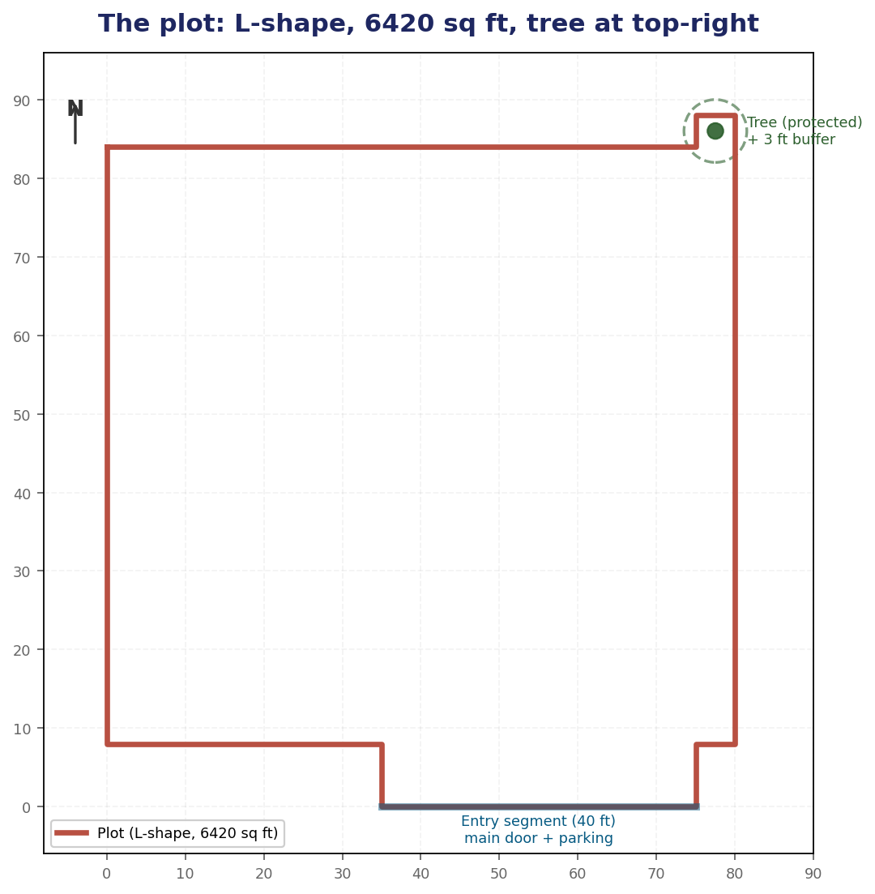
The problem & the idea
Generate a code-compliant house drawing — and prove it's correct
Two problems on one constrained L-shaped plot:
• Exterior: house outline + door (Seattle Building Code)
• Interior: 3 bed + 2 bath + kitchen + living (IRC)
The idea (neuro-symbolic): LLMs generate well but hallucinate geometry. So the LLM proposes, and the Z3 SMT solver is the deterministic judge — generated code is never executed.
PS-II Seminar 1 · Ojas
2 / 8

Slide 3
The pipeline — two phases, one principle
Generator proposes · Z3 proves · human/LLM explains
PHASE 1 — EXTERIOR
PHASE 2 — INTERIOR
Z3 Optimize → provable max-area footprint
Gemini draws outline; parser extracts coords
Z3 verifies 9 SBC rules
Llama (Groq) feedback → loop
Seed: tiled template OR MILP/CBC solve
Conversational edits: chips + free-text (LLM)
Z3 verifies the interior rule set
Only VALID layouts are shown
Never executes LLM code — geometry is parsed; the .dxf is rendered from Z3-verified numbers.
PS-II Seminar 1 · Ojas
3 / 8

Slide 4
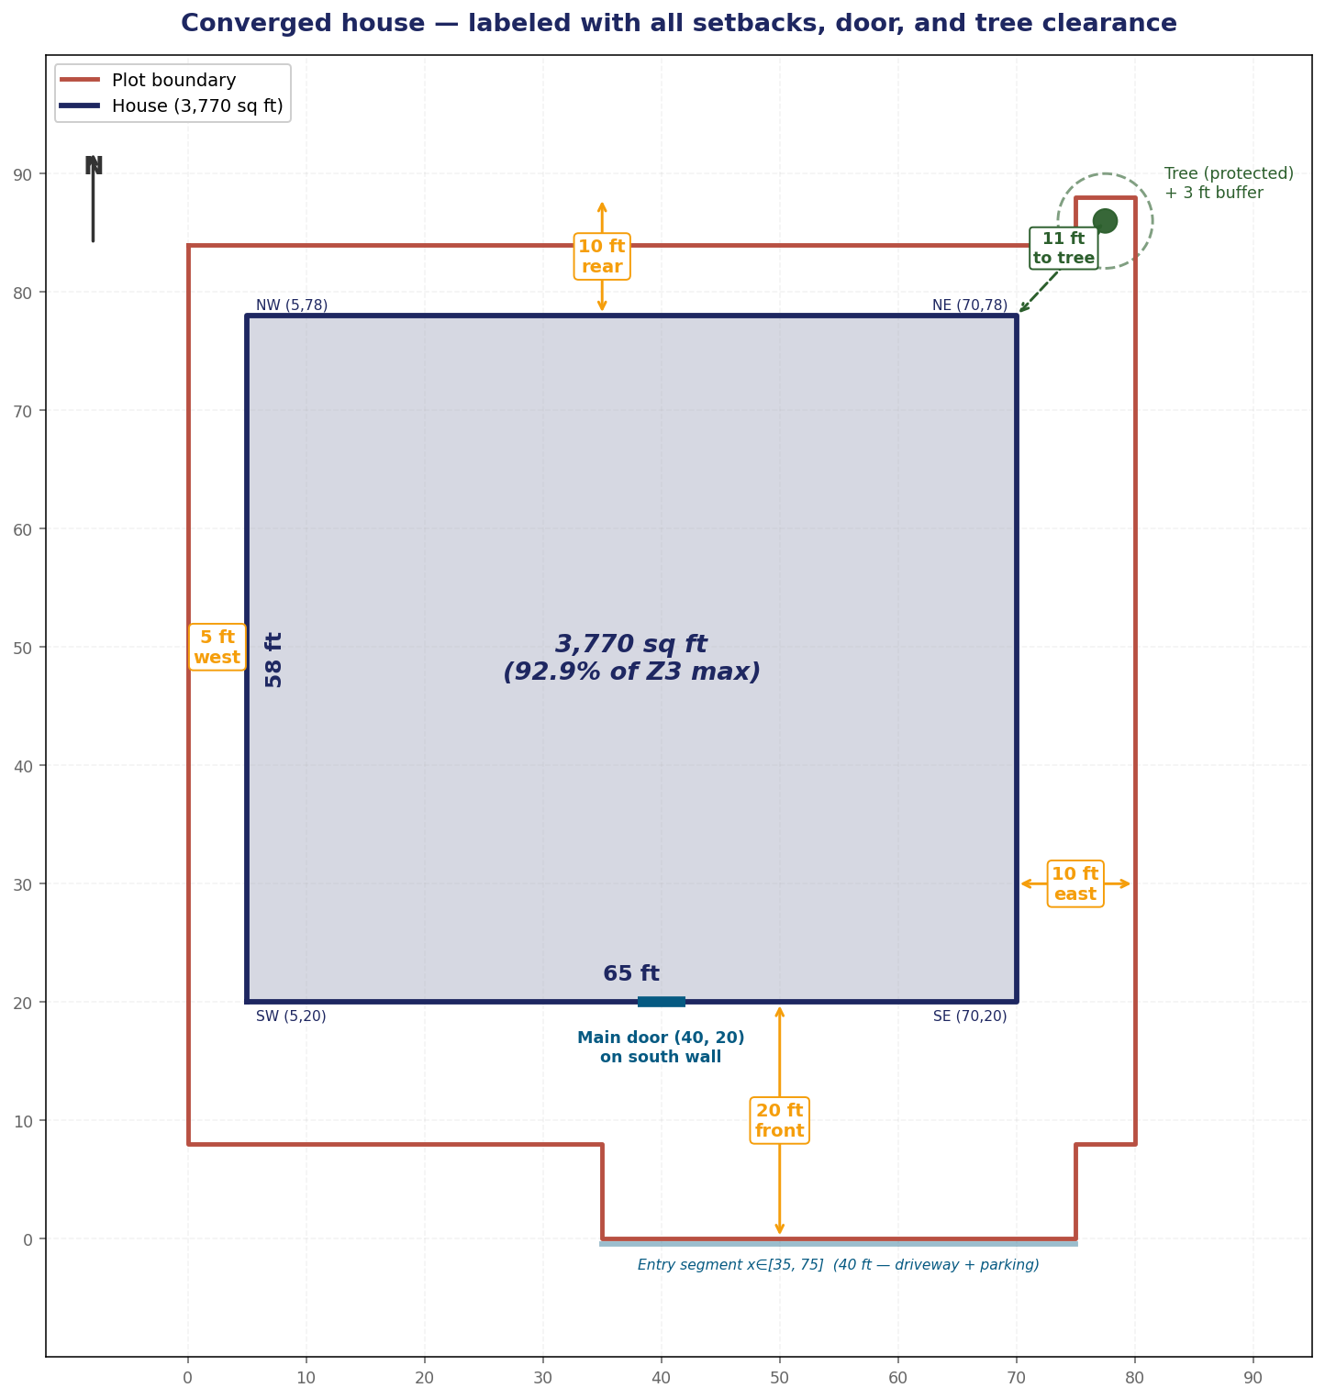
Exterior — Z3 makes “maximise area” a hard rule
Converged to 90% of the provable maximum in 2 iterations
6,420
4,060
PLOT (sq ft)
Z3 MAX HOUSE
3,654
2
BUILT — 90% of max
ITERATIONS
Z3 Optimize proves the largest legal house; the verifier then enforces ≥90% of it — so the LLM must push to the legal limit, and Z3 caught & corrected a 57% first attempt.
PS-II Seminar 1 · Ojas
4 / 8

Slide 5
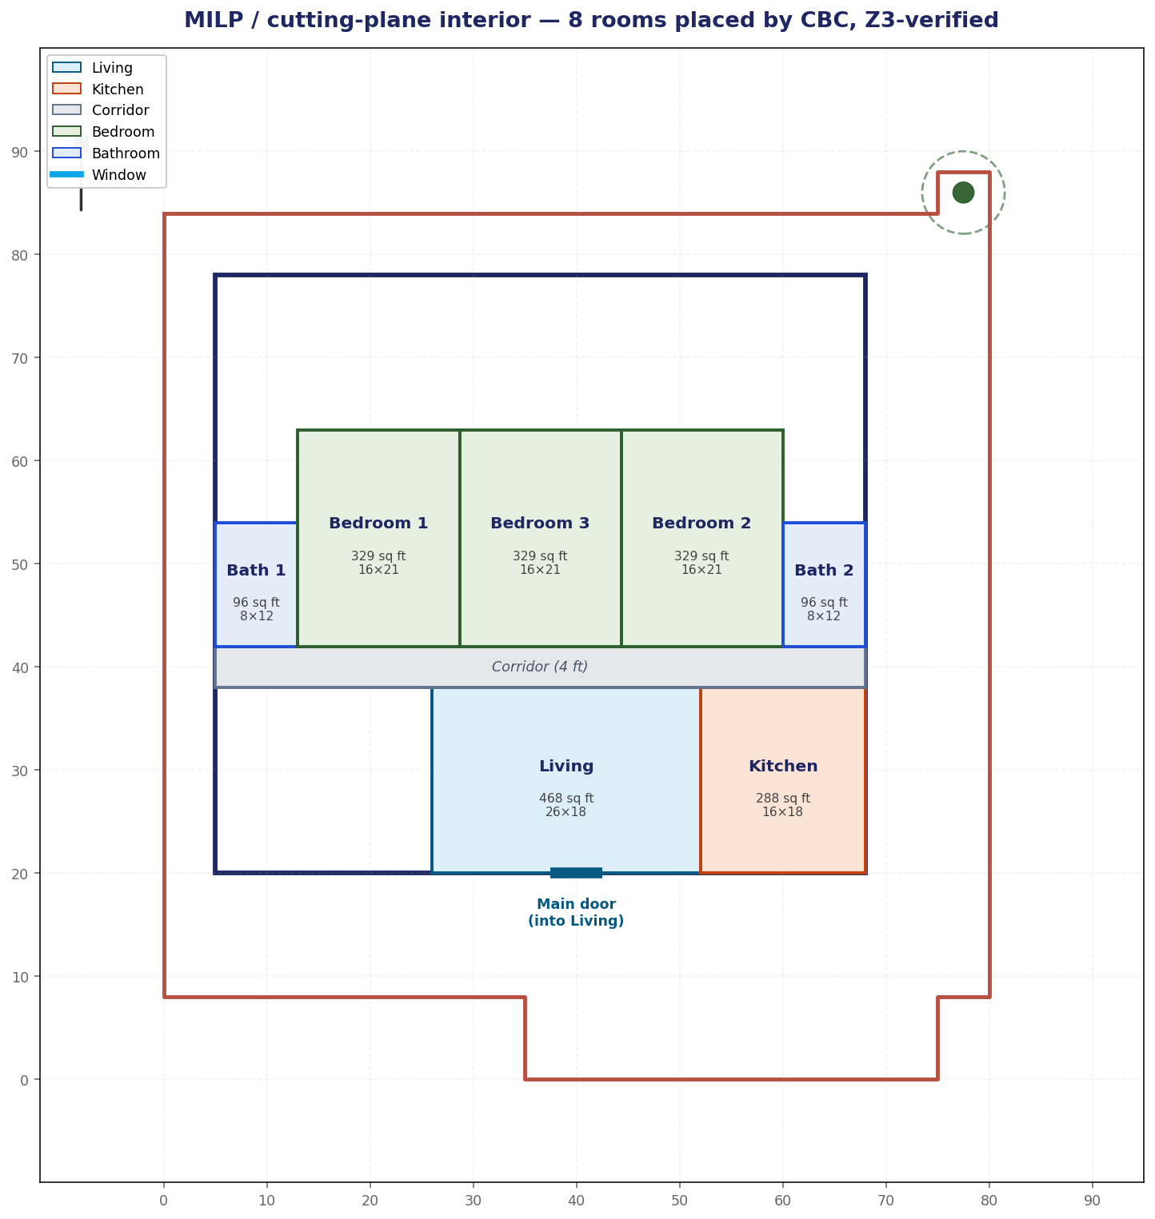
Interior — three generators, one verifier
Templates (instant) · MILP/cutting-plane · LLM (conversational)
Templates
Hand-designed tiled layouts; instant, always valid.
MILP / CBC (cutting-plane)
Big-M non-overlap, solved by branch-and-cut — generate-and-guarantee.
LLM (conversational)
Places rooms from a description; Z3 confirms; loop on failure.
All verified vs IRC sizes, non-overlap, door-in-living, connectivity — 100% tiled.
PS-II Seminar 1 · Ojas
5 / 8

Slide 6
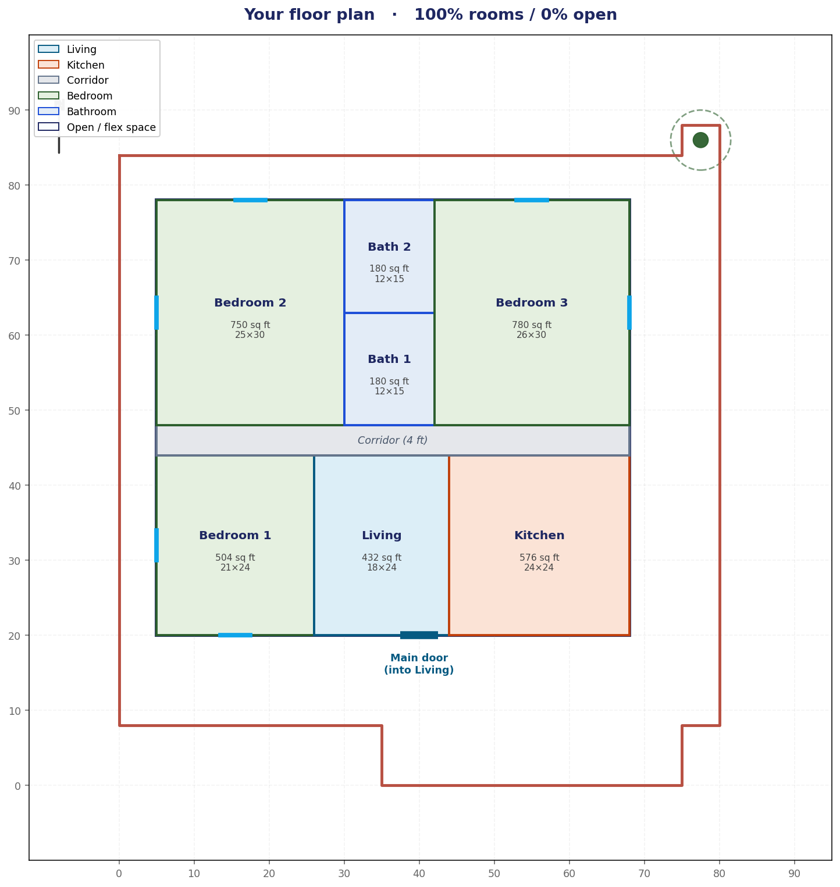
A conversational design studio (Streamlit)
“Describe it in words, the solver proves it” — human-in-the-loop
Pick a vibe → instant tiled plan.
Quick-changes (bigger bedrooms/kitchen…) = deterministic, always valid.
Free-text (“bedrooms in the three corners, kitchen between the top two”) → the LLM lays it out; Z3 checks it.
A plan is shown only if Z3 fully accepts it.
Live Z3 badge + one-click .dxf download.
PS-II Seminar 1 · Ojas
6 / 8

Slide 7
Findings — problems hit & fixed, and the models
Most surfaced from live testing
Problem | Fix
~35% wasted as one “corridor” block | tiling templates (100%) + ≥4-ft halls
Bedrooms long / vibes looked identical | square-ish, 4 distinct tiled templates
Chat left invalid plans | commit only if Z3-valid (else revert)
Gemini quota (20/day) exhausted | swap generator to Llama 3.3 (Groq)
Models: Gemini 2.5 Flash — best spatial reasoning, but 20 req/day cap. Llama 3.3 (Groq) — fast, huge quota, weaker layouts. Kimi K2 — 404, never ran.
Key observation: LLMs are good at intent, weak at constraint-preserving edits — so deterministic for simple edits, LLM for descriptions, Z3 as the always-on judge (which let us swap models freely).
PS-II Seminar 1 · Ojas
7 / 8

Slide 8
Conclusions & what's next
Z3 is the judge — that's the whole point
Reproducible, citable verdicts; lets us swap any generator (LLM / MILP / templates) and still guarantee a code-valid plan.
Generate-and-guarantee + human-in-the-loop
The solver owns compliance; the human steers comfort through a conversation.
What's next
Multi-floor · roof-plan (straight skeleton) · 3D & elevations · persistence/DB · MCP services · multi-jurisdiction codes.
Thank you — questions?

