Slide 1
PS1 · ENGINEERING DRAWING
Layout Studio
Conversational, Z3-verified floor plans — an AI places the rooms, a solver proves every building rule
Ojas Marathe
Z3 SMT · MILP (PuLP+CBC) · Gemini / Llama (Groq) · ezdxf · Streamlit

Slide 2
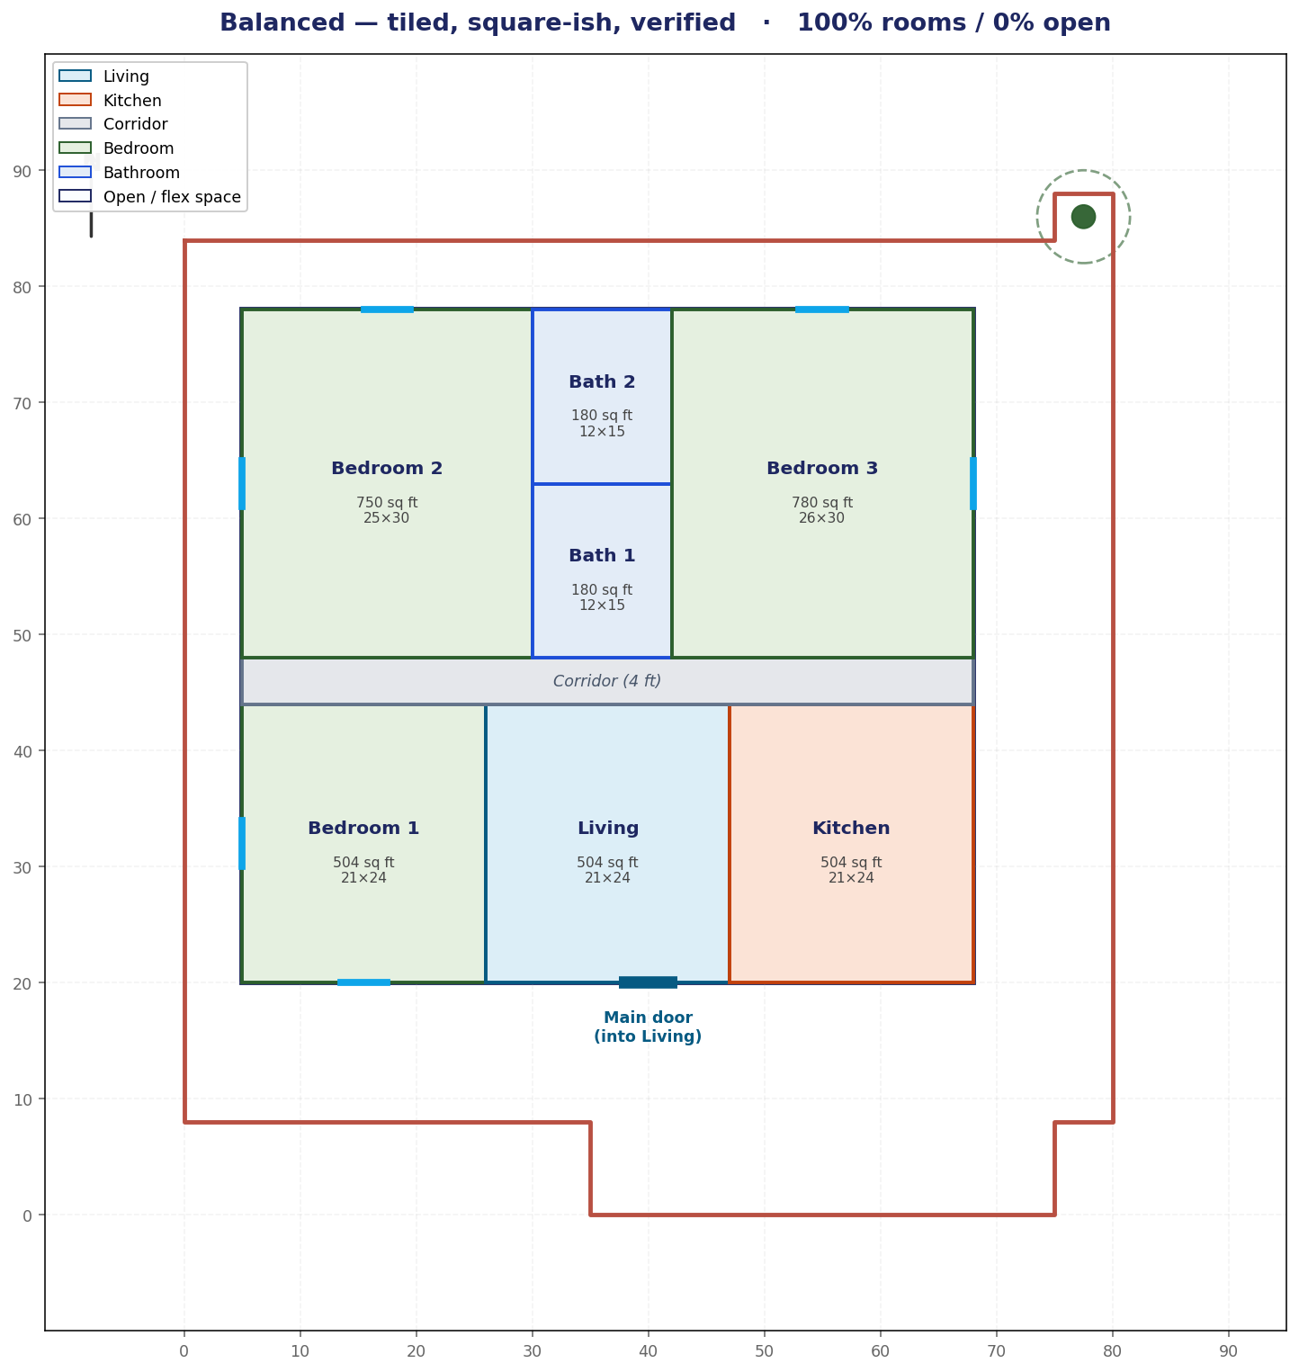
The brief
Generate a complete, code-compliant house drawing — and let a human steer it
EXTERIOR
Draw the house outline on an L-shaped plot with a protected tree, respecting Seattle Building Code setbacks; maximise the footprint.
INTERIOR
Subdivide it into 3 bedrooms + 2 bathrooms + 1 kitchen + 1 living room + circulation, satisfying IRC room-size and architectural rules.
PRINCIPLE
An LLM generates, the Z3 SMT solver is the deterministic judge, and the human stays in the loop — a conversational designer.
Layout Studio · Ojas
2 / 14

Slide 3
The pipeline — two phases, one principle
Generator proposes · Z3 proves · human/LLM explains
PHASE 1 — EXTERIOR
PHASE 2 — INTERIOR
Z3 Optimize → provable max-area footprint
Gemini draws the outline; parser extracts coords
Z3 verifies 9 SBC rules
Llama (Groq) writes feedback → loop
Seed: tiled vibe template (instant) OR MILP/CBC
Conversational edits: chips + free-text (LLM)
Z3 verifies the interior rule set
Only VALID layouts are shown (else revert)
→ verified footprint + door
→ complete floor plan + layered .dxf
Never executes LLM code: geometry comes from parsed “magic comments”, and the .dxf is rendered deterministically from Z3-verified numbers.
Layout Studio · Ojas
3 / 14

Slide 4
Exterior — Z3 turns “maximise area” into a hard rule
9 Seattle Building Code constraints, plus a provable maximum
6,420
4,060
PLOT AREA (sq ft, L-shaped)
Z3-PROVABLE MAX HOUSE (70×58 ft)
≥ 90%
2
OF MAX ENFORCED AS A HARD RULE
ITERATIONS TO CONVERGE
Constraints: front/rear/side setbacks · tree buffer (cannot be removed) · door + parking on the same entry side (fire egress) · minimum footprint · all corners inside the L-shape · footprint ≥ 90% of the Z3-computed maximum.
Layout Studio · Ojas
4 / 14

Slide 5
Interior — the rules Z3 checks
IRC room sizing + architectural spatial rules
Group | Rule
Room areas | living / kitchen / bedrooms ≥ 70 sq ft · bathrooms ≥ 25 sq ft (IRC R304)
Dimensions | habitable side ≥ 7 ft · bath side 5–15 ft (no slivers, no slabs)
Containment | every room inside the footprint · no two rooms overlap
Door / egress | the front door opens into the living room on the south wall
Circulation | ≥ 4 ft corridor; every room reachable (connected)
Coverage | rooms tile the footprint — only thin halls left over
The same verifier runs in a strict mode (ensuite/sanitation arrangement) and a freeform mode (user-driven layouts) — the geometry rules always hold.
Layout Studio · Ojas
5 / 14

Slide 6
How the interior is generated — three tools
Each room is verified by Z3 no matter who proposes it
Templates
MILP / CBC
LLM (conversational)
Hand-designed tiled layouts per “vibe”. Instant, always valid. The seed + the deterministic quick-changes.
Cutting-plane solver places rooms with big-M non-overlap. Generate-and-guarantee, the approach sir suggested.
Gemini / Llama reads a natural-language description and places the rooms; Z3 confirms; loop on failure.
Quick-changes use Templates (deterministic). Free-text uses the LLM. Both end on a Z3-verified plan.
Layout Studio · Ojas
6 / 14

Slide 7
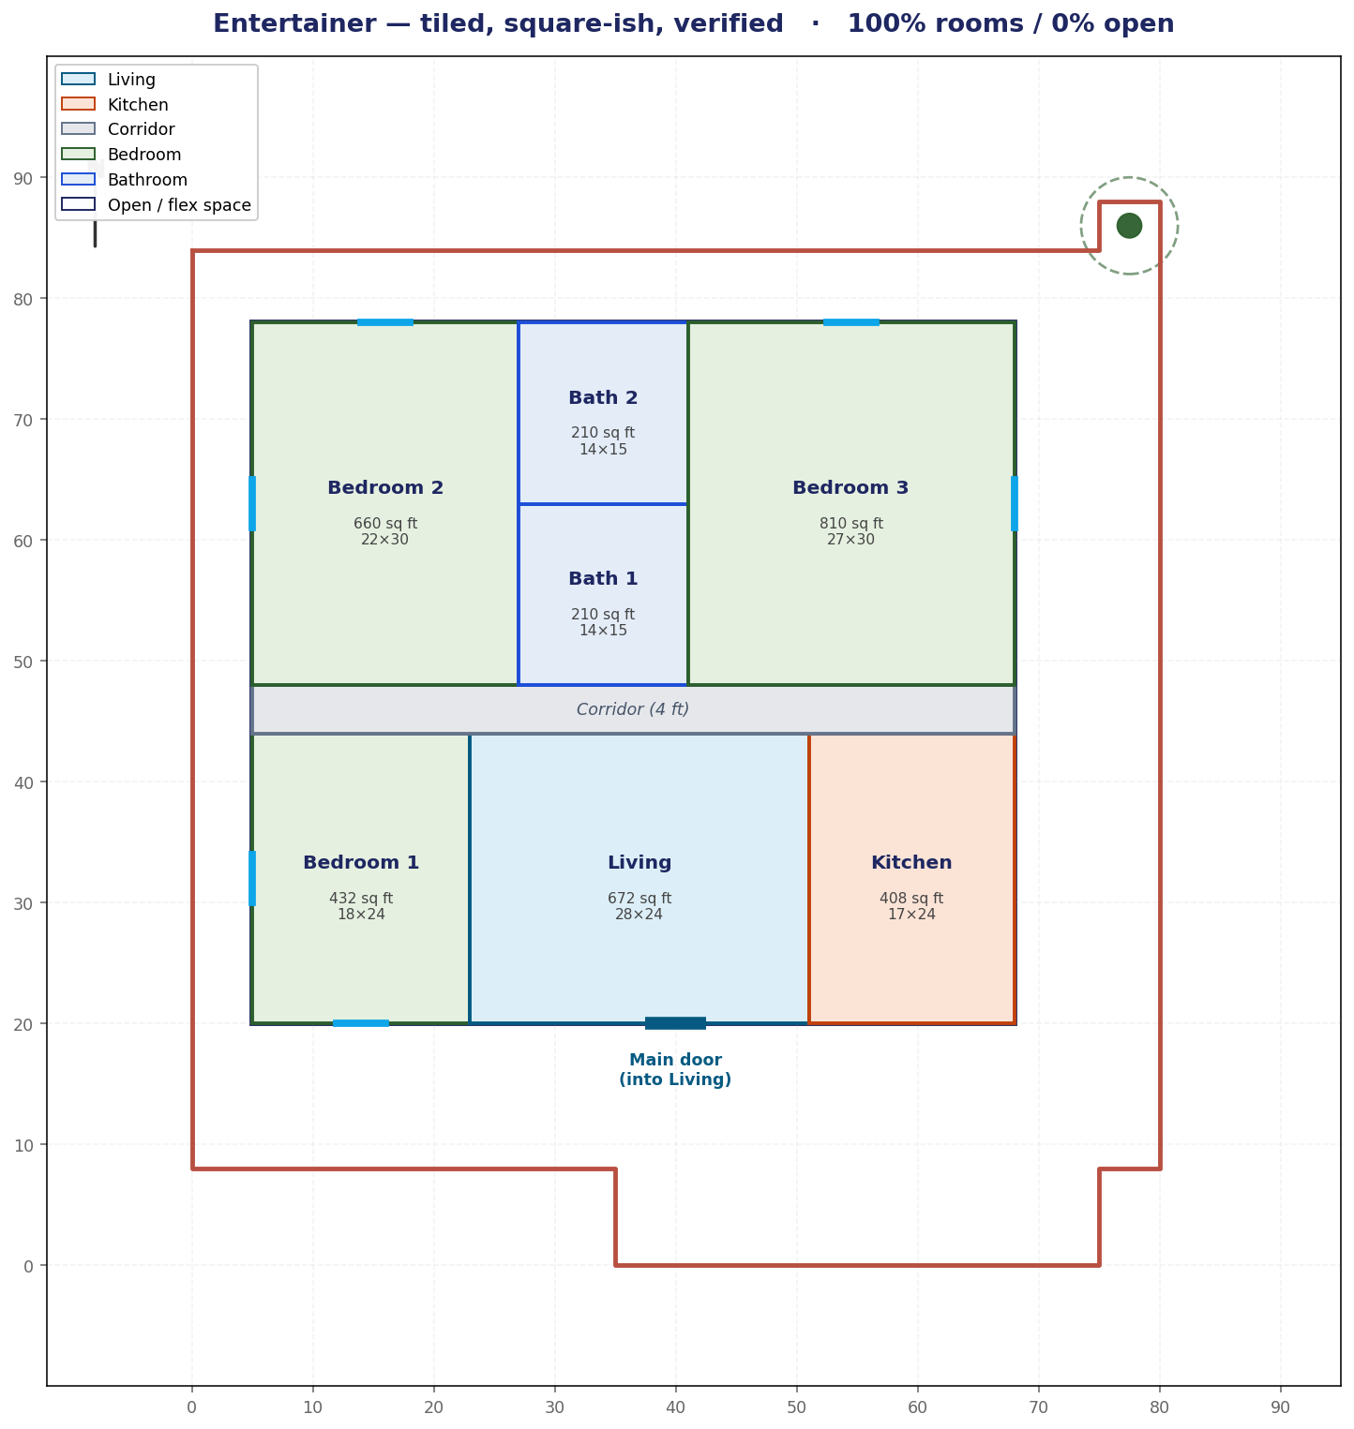
The app — a conversational design studio (Streamlit)
“ChatGPT for floor plans”: describe it, the studio draws & proves it
Pick a vibe
Family / Entertainer / Work-from-home / Balanced — an instant tiled starting plan.
Quick changes
“Bigger bedrooms / kitchen / bathrooms…” — instant, always valid.
Describe in words
“bedrooms in the three corners, kitchen between the top two” — the LLM lays it out; Z3 checks it.
Live Z3 badge + one-click .dxf download.
Layout Studio · Ojas
7 / 14

Slide 8
Findings — the problems we hit, and the fixes
Most came out of live testing in the studio
Problem observed | Root cause | Fix
Tiny bedrooms, enormous living/kitchen | fixed band dumped all depth into the public zone | tunable room sizes + balanced templates
~35% left empty as one big “corridor” block | rooms floated; leftover dumped as one rectangle | tiling templates (100%) + 4-ft-min halls
Bedrooms too long & skinny (16×29) | bedrooms filled the full band depth | square-ish templates (aspect ≤ 1.3)
All 4 vibes looked identical | same layout with tiny size nudges | 4 genuinely distinct tiled templates
Chat left broken plans (“✗ connected”) | LLM broke a rule; app showed the best invalid try | commit only if valid (else revert) + deterministic chips
Gemini quota (20/day) ran out mid-demo | free-tier daily cap | switched generator to Llama 3.3 on Groq
Layout Studio · Ojas
8 / 14

Slide 9
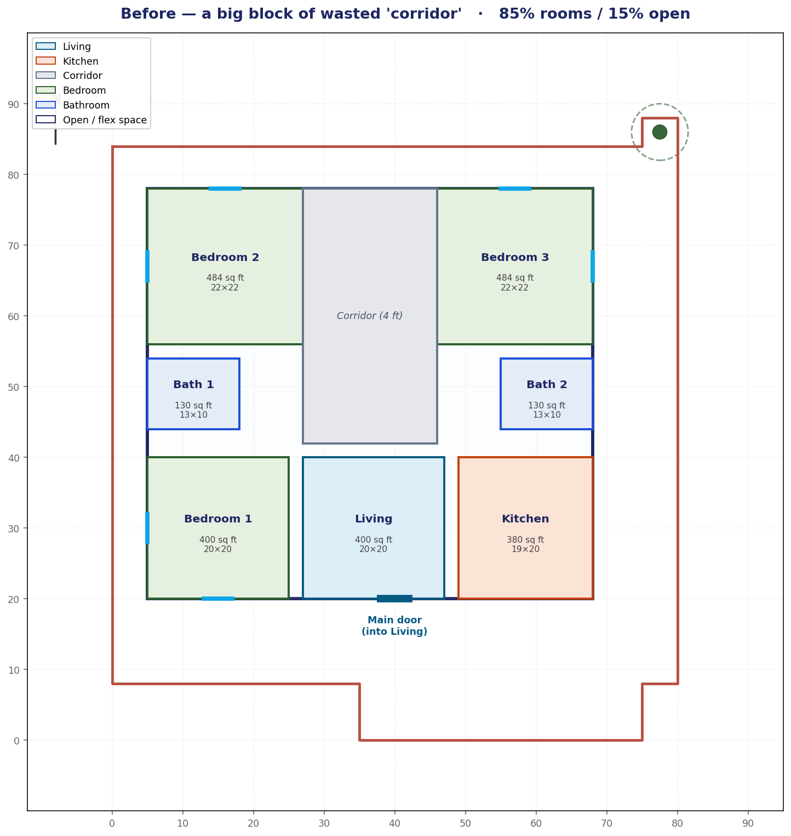
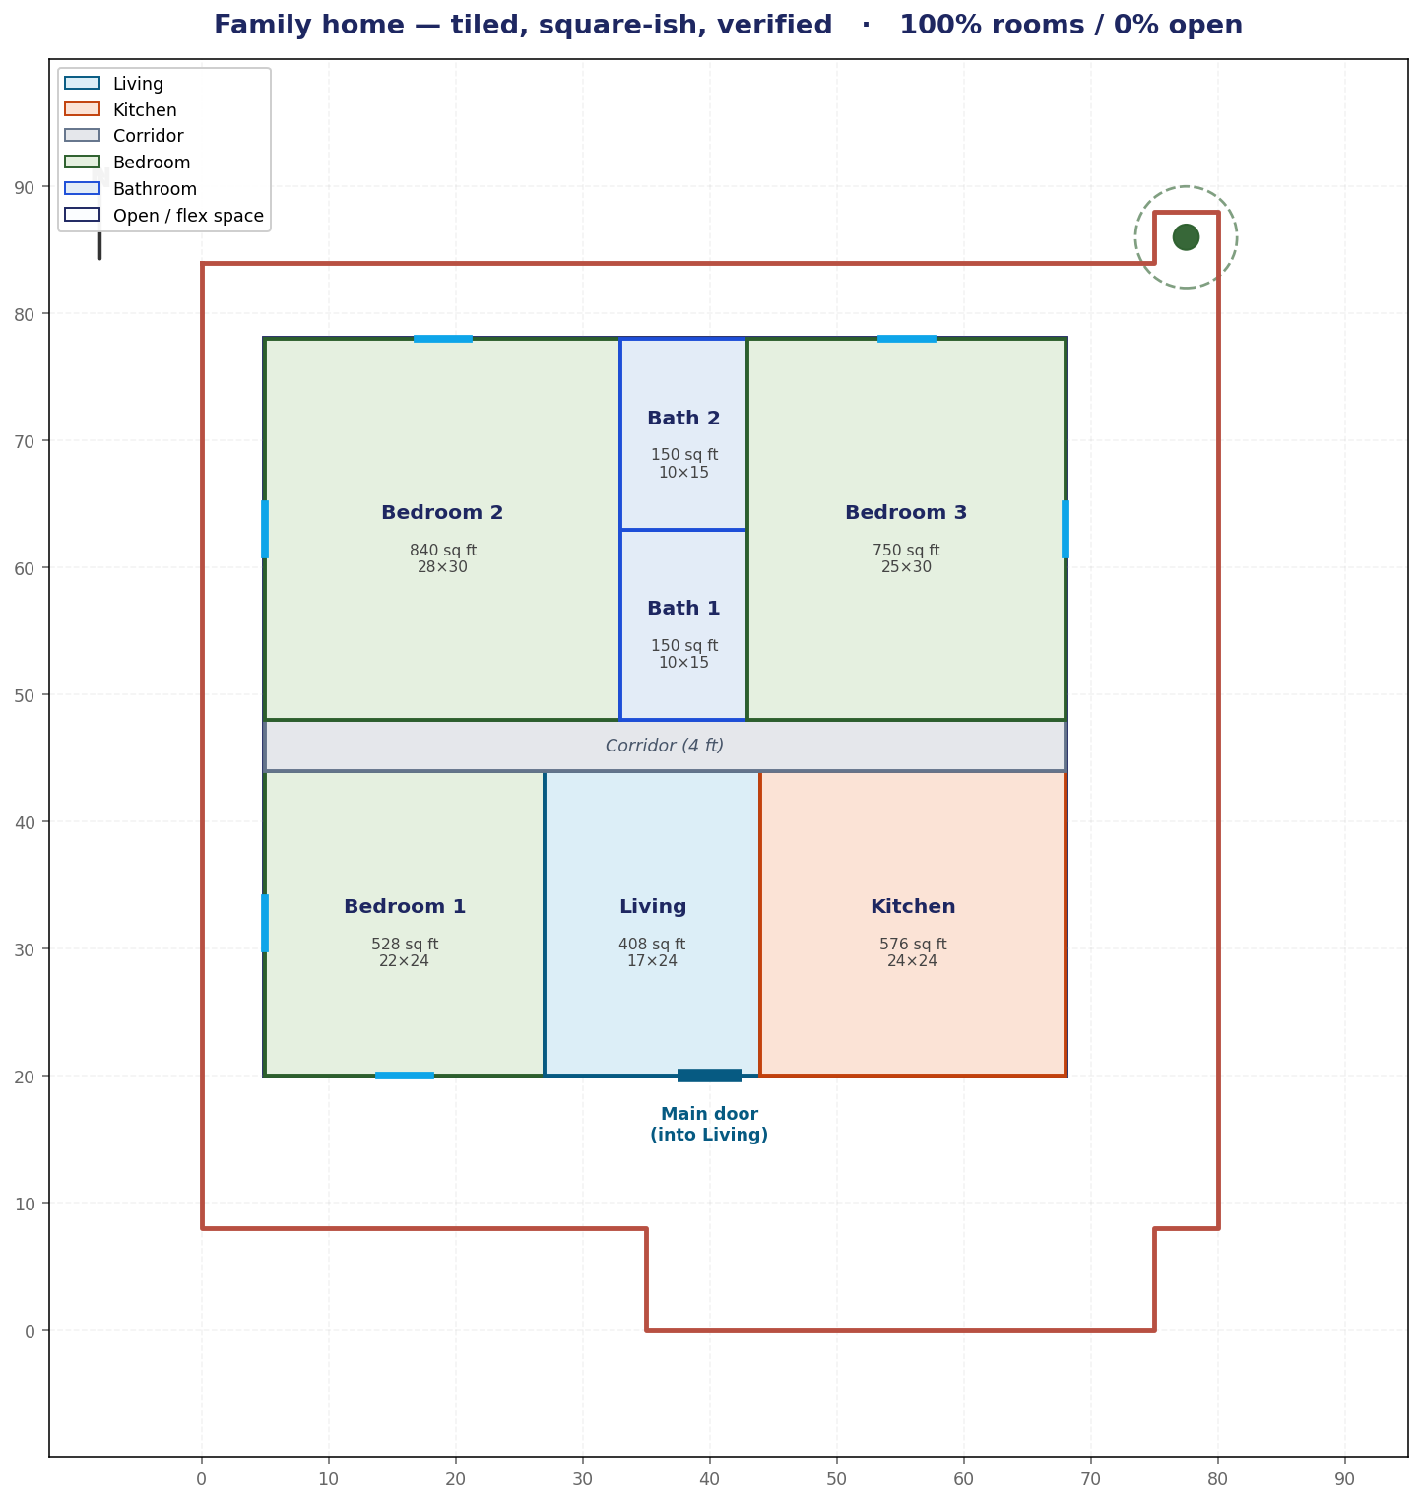
Fix in pictures (1) — balance & wasted space
No SBC reason for the empty space — it was a design choice, now fixed
BEFORE — 85% rooms, a big block of “corridor”
AFTER — 100% tiled, thin hall, big square-ish rooms
Layout Studio · Ojas
9 / 14

Slide 10
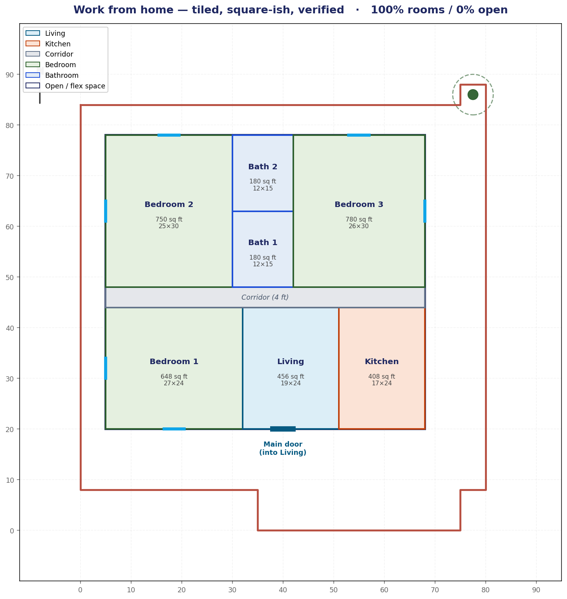
Fix in pictures (2) — four visibly different vibes
Square-ish bedrooms · no two bedrooms adjacent · all Z3-verified
Balanced
Family — big bedrooms
Entertainer — big living
Work-from-home — big study
Layout Studio · Ojas
10 / 14

Slide 11
Reliability — the studio never shows a broken plan
Two changes that fixed the “it does it then says error” problem
Quick changes → deterministic
Free-text → commit only if valid
Buttons adjust the layout’s cut positions with built-in clamping.
Cannot break a rule. Cannot be declined.
Instant — no model call, no waiting.
LLM proposes; Z3 checks; up to 4 retries with feedback.
If still invalid, keep the current plan and say which rule blocked it.
You never see an overlapping or disconnected layout.
Layout Studio · Ojas
11 / 14

Slide 12
Key observations
What the build taught us
LLMs are great at intent, weak at constraint-preserving edits. Asking “make the kitchen bigger” often broke another rule. We route simple edits to a deterministic solver and reserve the LLM for genuine spatial descriptions.
Z3 as an always-on judge is the safety net. Because every layout is independently verified, we can swap generators (Gemini ↔ Groq ↔ MILP ↔ templates) freely and still guarantee correctness.
Geometry has hard trade-offs. On a 58-ft-deep plot, perfectly square bedrooms + full tiling + a 15-ft bathroom cap can’t all hold — “square-ish + fully tiled” is the sweet spot.
Human-in-the-loop ≠ free-for-all. The human sets comfort/intent; the solver owns code-compliance. That division is what makes it usable.
Layout Studio · Ojas
12 / 14

Slide 13
Stack
Each layout is verified before it’s ever shown
Verifier (the judge)
Z3 SMT solver
exterior 9 rules · interior room/spatial rules
Generators
Templates · MILP (PuLP+CBC) · LLM
tiled seeds · cutting-plane solve · conversational
LLMs
Gemini 2.5 Flash · Llama 3.3 70B (Groq)
swappable; Groq default after quota limits
Drawing
ezdxf · matplotlib
layered .dxf + labeled PNGs, from verified numbers
App
Streamlit (Python 3.14)
conversational human-in-the-loop studio
Layout Studio · Ojas
13 / 14

Slide 14
Takeaways
Z3 is the judge — that’s the whole point
Reproducible, citable verdicts; lets us swap any generator and still guarantee a code-valid plan.
Generate-and-guarantee + human-in-the-loop
MILP/templates produce valid plans; the human steers comfort via a conversation, not a config file.
We found and fixed real problems
Balance, wasted space, long bedrooms, look-alike vibes, broken edits, and an API quota — all resolved.
Right tool for each edit
Deterministic for simple changes, LLM for descriptions — reliable AND expressive.
Repo: /Users/ojas/ps1-house-layout/ · run: streamlit run app.py

