Slide 1
PS1
Engineering Drawing Verification
Automated workflow: a verified exterior shell + a verified interior floor plan
Ojas · Cohort PS1 · Two-phase loop: exterior → interior
Generator: Gemini 2.5 Flash · Verifier: Llama 3.3 70B (Groq) + Z3

Slide 2
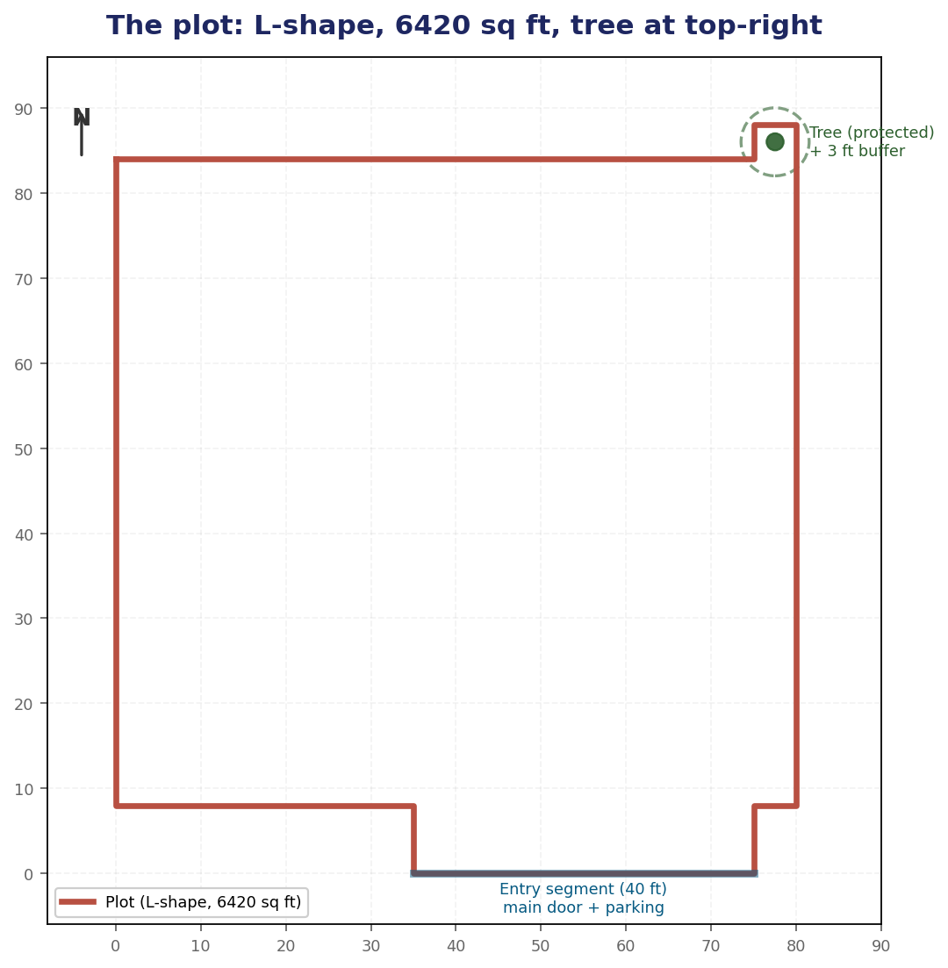
The problem
Build a two-agent system that produces a verified house drawing on a tricky plot
WHAT THE BRIEF ASKS
Agent 1 (Generator)
Write Python (ezdxf) that draws the outer periphery of a house on the plot.
Agent 2 (Verifier)
Check the design against Seattle Building Code (SBC) using Z3. On fail, send actionable feedback to A1.
HARD REQUIREMENTS
Protected tree cannot be touched (~$50k fine)
Setbacks per SBC
Single entry side: door + parking together (fire egress)
Maximize area coverage
Complete interior: 3 bedrooms · 1 kitchen · 2 bathrooms · 1 living
PS1 · House Layout · Ojas
2 / 18

Slide 3
Design principle
Z3 is the judge. LLMs only generate and explain.
THE TRAP
OUR SPLIT
LLM-as-verifier
Judge ≠ Explainer
The verifier is also an LLM, so it agrees too easily, hallucinates measurements, and you cannot reproduce its decisions.
Two chatbots discussing whether one number is bigger than another.
Generation = LLM job (Gemini)
Judging = SMT solver job (Z3)
Explanation = LLM job (Llama on Groq)
Z3 is deterministic: same house + same rules → same verdict every time. Reproducible, traceable.
PS1 · House Layout · Ojas
3 / 18

Slide 4
Architecture
Agent 1 generates · Agent 2 (parser + Z3 + Llama) verifies · loop
AGENT 2 — Verifier
Parser
Z3
Llama
Agent 1
Gemini 2.5 Flash
regex on magic
comments
verifier + optimizer
(judge)
feedback writer
on Groq
ezdxf code
✓ PASS → emit .dxf
✗ FAIL → violations sent to Llama
"Out of 9 constraints, you missed N — fix and regenerate."
feedback (only on fail)
PS1 · House Layout · Ojas
4 / 18

Slide 5
The plot
L-shape from Anupam's hand-drawn sketch — closes exactly to 6,420 sq ft
CLOCKWISE FROM TOP-LEFT
Edge | Length
top E | 75 ft
step up | 4 ft
tree-notch top | 5 ft
right edge S | 80 ft
bottom-right inset W | 5 ft
entry tab right | 8 ft
entry tab bottom W | 40 ft (door + parking)
entry tab left | 8 ft
bottom-left W | 35 ft
left edge N | 76 ft (closes ✓)
Plot area = 6,420 sq ft
PS1 · House Layout · Ojas
5 / 18

Slide 6
9 SBC constraints encoded in Z3
Every rule has a numeric threshold, a Z3 expression, and a citation
# | Rule | Z3 expression | Source
1 | Front (south) setback ≥ 20 ft | y_min - 0 ≥ 20 | SDCI Tip 320
2 | Rear (north) setback ≥ 10 ft | 88 - y_max ≥ 10 | SDCI Tip 320
3 | Side setbacks ≥ 5 ft (each) | x_min ≥ 5 ∧ 80 - x_max ≥ 5 | SDCI Tip 320
4 | Minimum footprint ≥ 20 × 20 ft | (x_max-x_min) ≥ 20 ∧ ... | derived
5 | All 4 corners inside L-shape polygon | ray-cast point-in-polygon | sketch
6 | Distance to tree ≥ 4 ft | dx² + dy² ≥ 16 | SMC 25.11.090
7 | Door on south wall, inset ≥ 2 ft | door_y = y_min ∧ ... | IBC 2021 §1006
8 | Door in entry segment x ∈ [35, 75] | 35 ≤ door_x ≤ 75 | fire egress
9 | Footprint ≥ 90% of Z3-computed max | area ≥ 0.9 · MAX | brief: "maximize area"
Rule 9 turns the brief's vague 'maximize' from a prompt suggestion into a verifiable hard constraint.
PS1 · House Layout · Ojas
6 / 18

Slide 7
Z3 doesn't just verify — it computes the maximum
Declare house corners as symbolic Reals · Add all SBC rules · Optimize area
from z3 import Real, Optimize x_min, x_max, y_min, y_max = Reals(...) opt = Optimize() opt.add(x_min >= 5, x_max <= 75) # side setbacks opt.add(y_min >= 20, y_max <= 78) # front+rear opt.maximize(x_max - x_min) opt.maximize(y_max - y_min) opt.check()
Z3 OUTPUT
4,060 sq ft
Provable maximum legal house
Corners: (5, 20) → (75, 78)
Dimensions: 70 × 58 ft
Then we plug the Z3-computed max back into the verifier as rule #9: house_area ≥ 0.9 · 4060 = 3,654 sq ft.
Now A1 actually has to push, or Z3 will reject.
PS1 · House Layout · Ojas
7 / 18

Slide 8
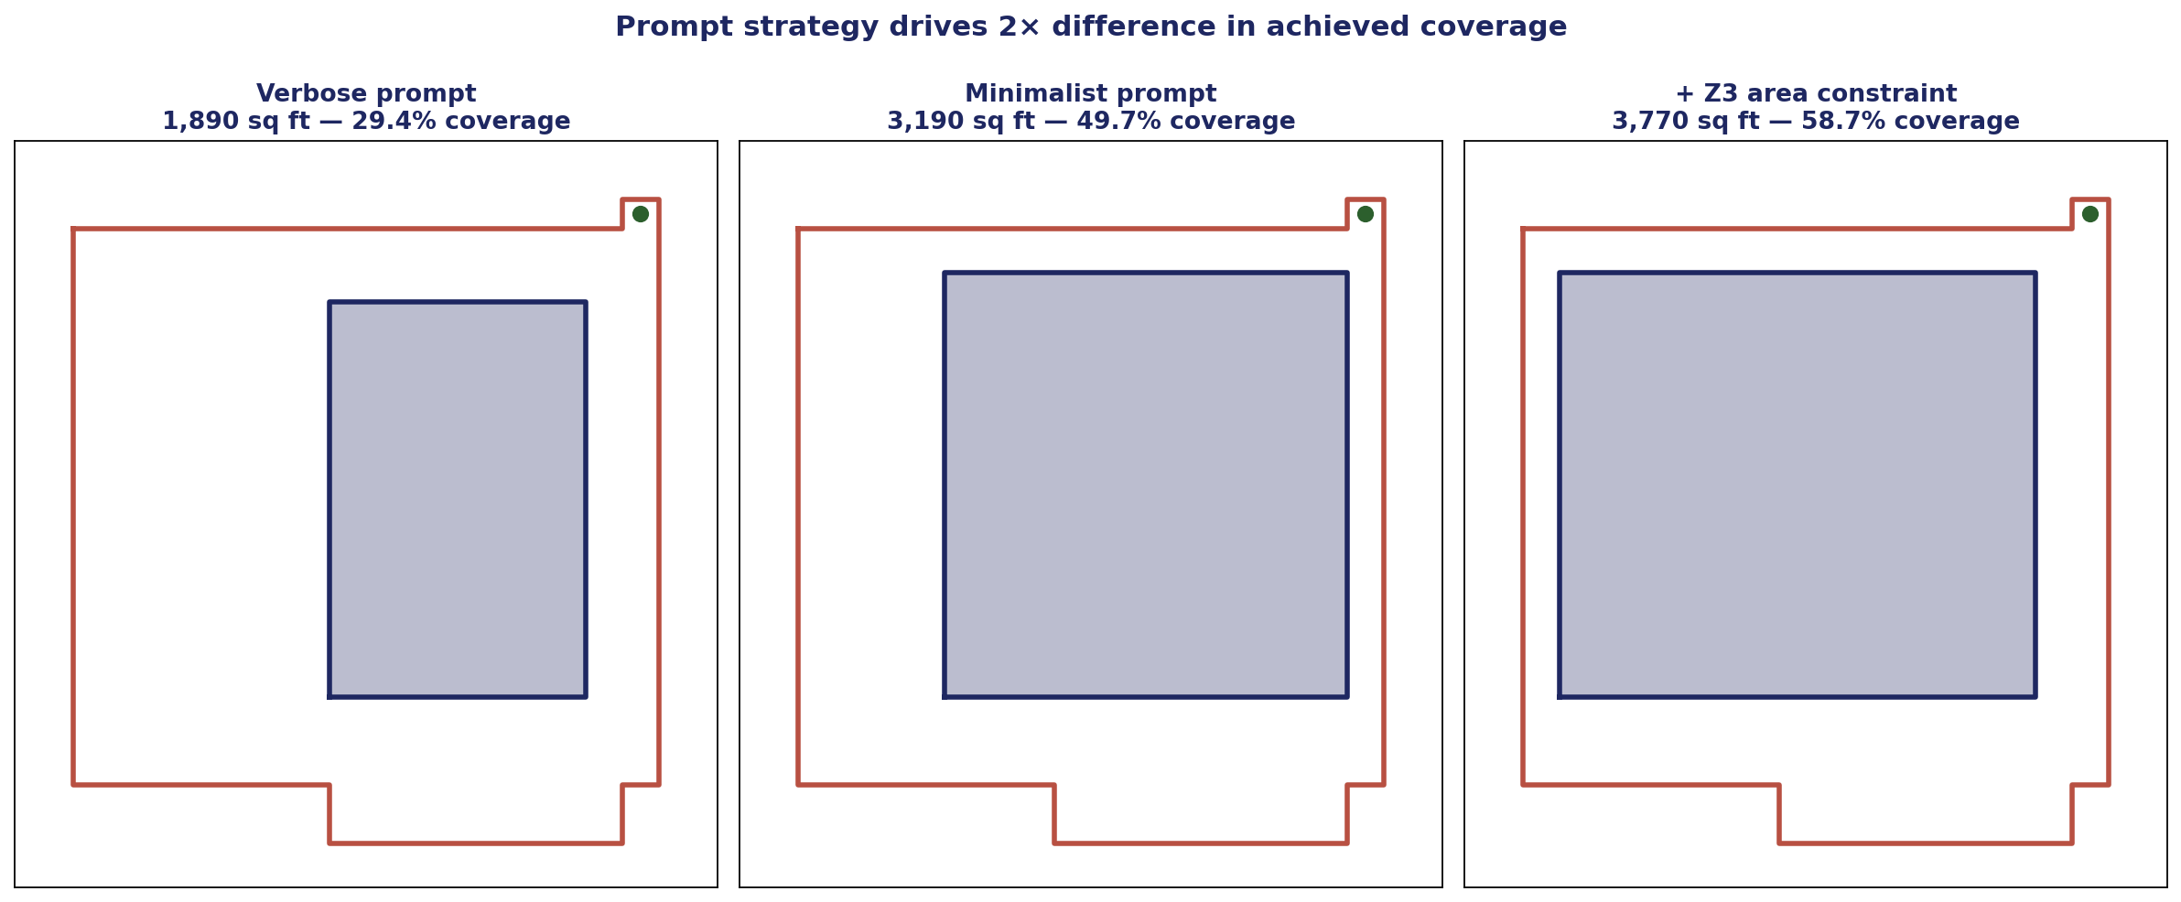
Prompt strategy moved coverage from 29% → 59%
Same model, same Z3, same plot — only the prompt to A1 changed
Verbose prompt anchored Gemini to the entry-tab x-range (35→70). Stripping the polygon coordinates and emphasizing the maximize-area objective freed it to push against legal limits. Adding the Z3 area constraint forced one feedback round and got us to 59%.
PS1 · House Layout · Ojas
8 / 18

Slide 9
Demo trace — the loop in action
Iter 1 fails area-coverage · A2 explains · iter 2 lands above threshold
ITER 1 — ✗ Z3 rejected
A2 (Llama on Groq) writes:
Gemini → 3,190 sq ft (78.6% of Z3 max)
Z3: min_area_coverage FAILS — need ≥ 3,654
"Out of 9 SBC constraints, you missed 1 — fix and regenerate.
* Increase house footprint to at least 3,654 sq ft by reducing setbacks; consider tightening any setback with available slack to expand the footprint by at least 464 sq ft.”
ITER 2 — ✓ Z3 PASSES
Gemini → 3,770 sq ft (92.9% of Z3 max, 58.7% of plot)
Z3: ALL 9 constraints satisfied
Emitter writes final_iter_02.dxf — deterministic, decoupled from any LLM execution.
PS1 · House Layout · Ojas
9 / 18

Slide 10
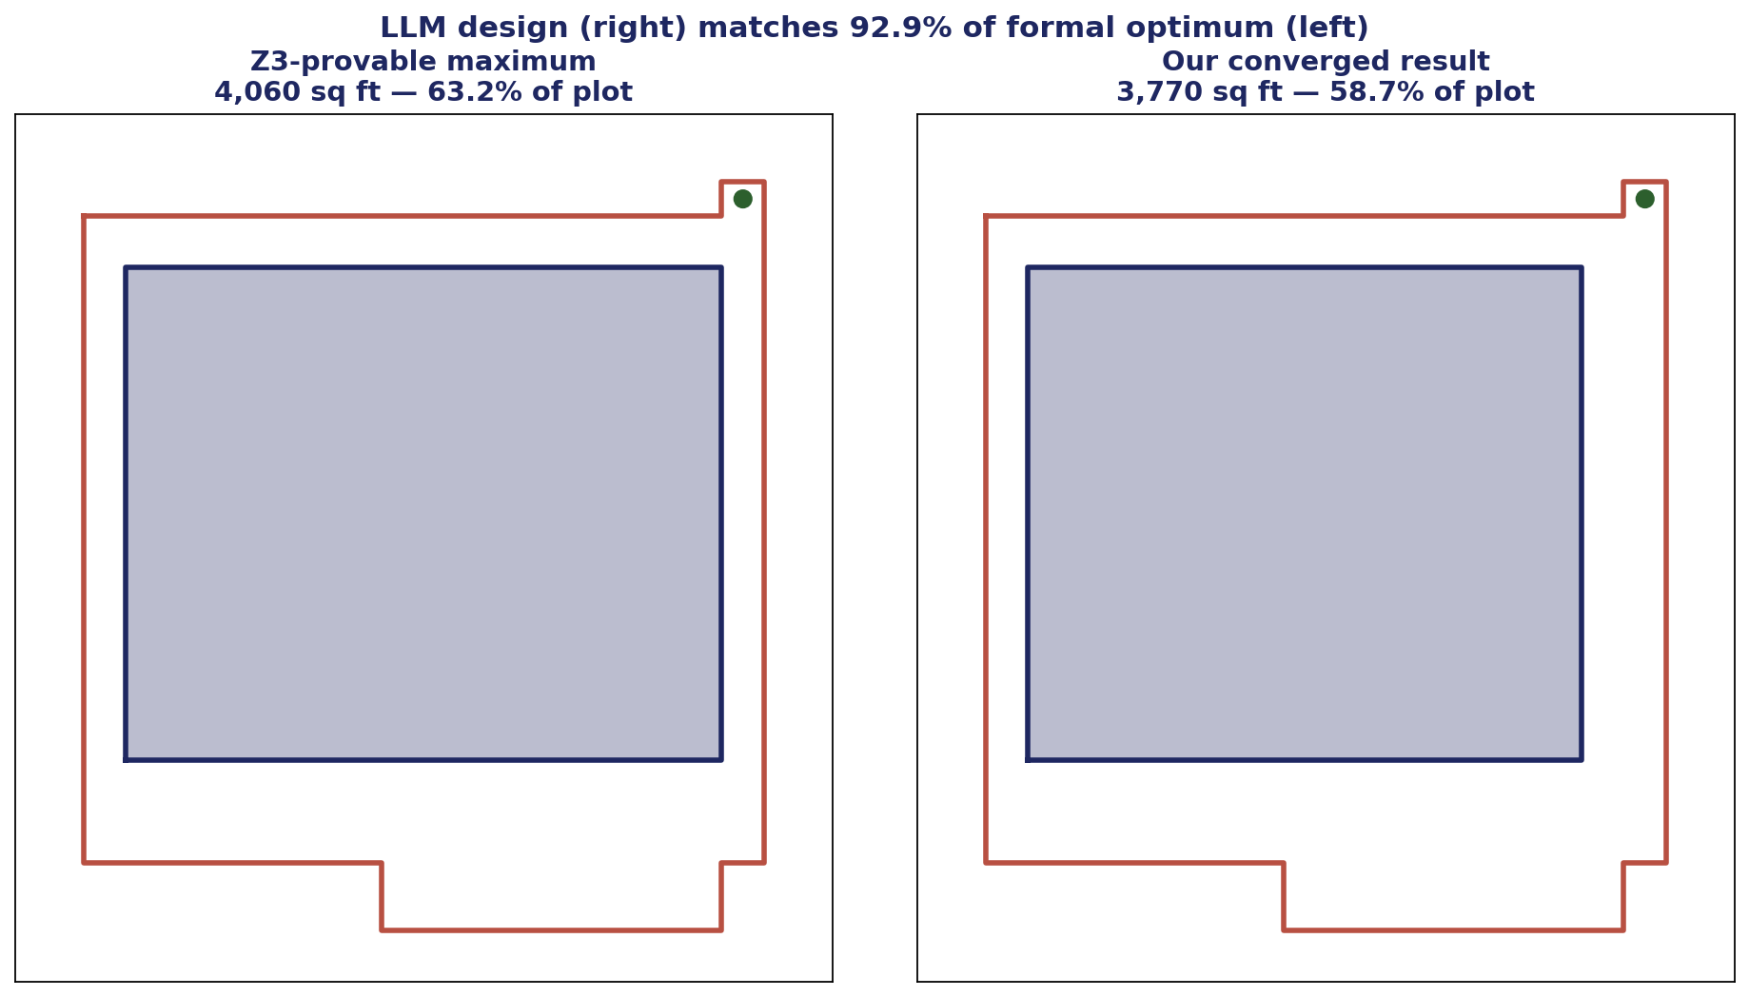
Final result
3,770 sq ft house — 92.9% of the formal optimum
PS1 · House Layout · Ojas
10 / 18

Slide 11
One automated workflow, two phases
The same neuro-symbolic loop runs twice — exterior shell, then interior plan
PHASE 1 — EXTERIOR
PHASE 2 — INTERIOR
Z3 Optimize → provable max-area target
A1 (Gemini) draws the house outline
Z3 verifies 9 SBC rules
A2 (Llama) explains any failure → loop
Z3 synthesizes a provable 7-room tiling
A1 (Gemini) partitions the footprint
Z3 verifies 10 interior rules
A2 (Llama) explains any failure → loop
→ verified 63 × 58 ft footprint + door
→ complete 7-room floor plan + .dxf
Same pattern both phases: LLM proposes · Z3 proves · LLM explains. If A1 ever stalls, the Z3-synthesized layout is a guaranteed fallback — the run always ends Z3-verified.
PS1 · House Layout · Ojas
11 / 18

Slide 12
The interior: 7 rooms, 10 Z3 rules
A required room program, checked exactly the way the setbacks were
ROOM PROGRAM
10 RULES (Z3 rejects any violation)
Count | Room | Minimum
3 × | Bedroom | ≥ 100 sq ft, side ≥ 9 ft
1 × | Kitchen | ≥ 80 sq ft, side ≥ 7 ft
2 × | Bathroom | ≥ 40 sq ft, side ≥ 5 ft
1 × | Living | ≥ 200 sq ft, side ≥ 12 ft
STRUCTURE
exact room counts · all rooms inside footprint · no overlaps · tiles the footprint with no gaps
SIZE
each room meets its minimum area · and its minimum side (no slivers)
DESIGN
front door opens into the living room · kitchen adjoins living · wet wall (kitchen ↔ a bathroom) · every room reachable through a ≥ 2.5 ft doorway
Minimums modeled on the International Residential Code (IRC R304).
PS1 · House Layout · Ojas
12 / 18

Slide 13
Z3 doesn't just check a plan — it proves one exists
A 3-band slicing layout makes the tiling exact by construction; Z3 solves the cuts
The hard part of a floor plan is tiling — filling the footprint with no gaps or overlaps.
We fix the topology to three horizontal bands and let Z3 solve the cut positions.
Any choice of cuts tiles exactly — so feasibility is guaranteed. All the size rules are linear, so Z3 solves in the fast (LRA) fragment.
The result is certified by the same verifier the agent loop uses, and serves as the guaranteed fallback.
3 × Bedroom
2 × Bathroom
Living
Kitchen
door → living
PS1 · House Layout · Ojas
13 / 18

Slide 14
Interior demo trace — Z3 catches a real mistake
Iter 1 puts the door on the living-room corner · A2 explains · iter 2 passes all 10 rules
ITER 1 — ✗ Z3 rejected
A2 (Llama on Groq) writes:
Gemini → living spans x∈[5,40], door at x=40
Z3: door_in_living FAILS — door sits on the corner, not inset ≥ 2 ft
"Out of 10 interior rules, you missed 1 — fix and regenerate.
* Widen the living room east past the door (or move the living/kitchen split right) so the door is ≥ 2 ft inside the living room — and shrink the kitchen to match so there is no gap.”
ITER 2 — ✓ Z3 PASSES
Gemini → 7 rooms tiling 3,770 sq ft (living 989 · kitchen 506 · 2 baths 276 · 3 bedrooms ~575)
Z3: ALL 10 interior rules satisfied
Converged to Gemini's own layout — the Z3 fallback was not needed.
PS1 · House Layout · Ojas
14 / 18

Slide 15
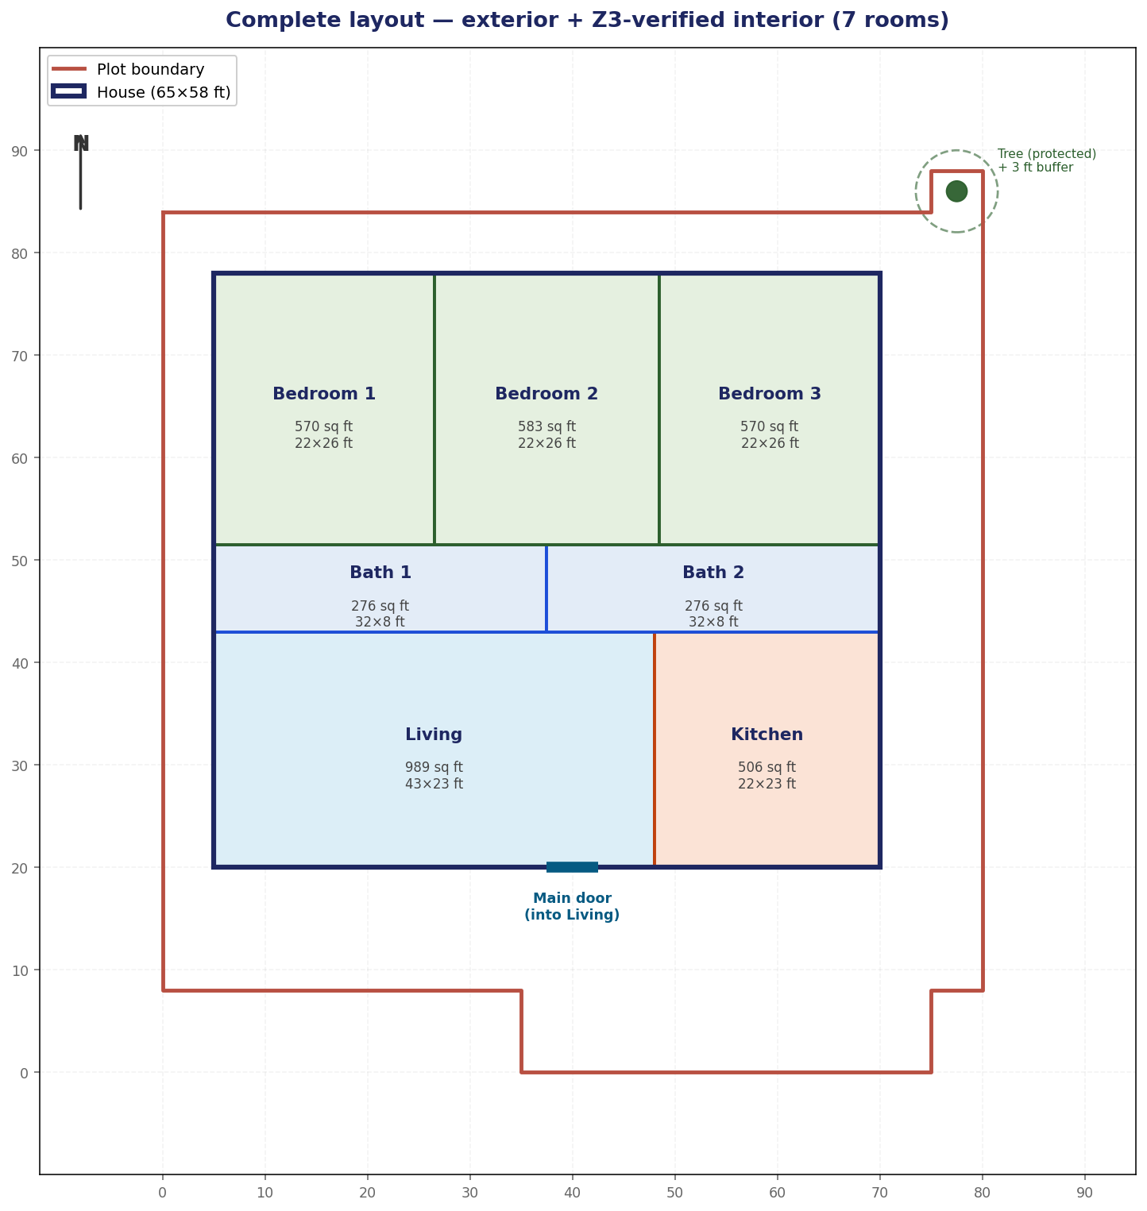
Complete layout — exterior + interior
Plot · protected tree · house shell · 7 Z3-verified rooms · door into the living room
PS1 · House Layout · Ojas
15 / 18

Slide 16
The numbers
Verified by Z3 — exterior footprint and interior floor plan
6,420
4,060
PLOT AREA (sq ft)
Z3-PROVABLE MAX HOUSE (sq ft)
3,770
58.7%
OUR HOUSE (sq ft) — 92.9% of Z3 max
PLOT COVERAGE ACHIEVED
2 + 2
9 + 10
7
ITERATIONS (exterior + interior)
Z3 RULES (SBC + interior)
ROOMS PLACED — ALL Z3-VERIFIED
PS1 · House Layout · Ojas
16 / 18

Slide 17
Stack
Assigned Claude + Kimi · Pivoted to Gemini + Groq mid-build (key availability)
Agent 1 — Generator
Gemini 2.5 Flash
Exterior outline + interior room partition · thinking off · backoff
Agent 2 — Verifier (judge)
Z3 SMT solver
Exterior: verify + optimize · Interior: verify + synthesize (tiling)
Agent 2 — Verifier (explainer)
Llama 3.3 70B (Groq)
Rewrites Z3 violations as feedback · both phases · sub-second
Drawing emitter
ezdxf 1.4
dxf_full.py · plot + house + 7 rooms from verified numbers only
Visualization
matplotlib
Slide PNGs · plot + house + tree + labeled floor plan
Orchestrator
Python 3.14 + python-dotenv
loop_full.py · two-phase exterior → interior · Z3 fallback
PS1 · House Layout · Ojas
17 / 18

Slide 18
Takeaways
Z3 is the judge — that's the whole point
Using an LLM as a verifier collapses to two chatbots agreeing. A SMT solver gives reproducible, citable verdicts.
One loop builds the whole house — exterior, then interior
The same propose → prove → explain loop runs twice: 9 SBC rules for the shell, 10 room rules for the plan. Z3 even synthesizes a provable fallback layout.
Make 'maximize area' a verifiable constraint, not a vibe
Z3 Optimize computes the formal max once; the verifier enforces ≥ 90% of it. The brief's 'maximize' becomes something Z3 can reject.
The prompt is part of the architecture
Same model, same rules, +30 percentage points of coverage from rewriting A1's plot description from verbose to minimalist.
Don't execute untrusted LLM code
Magic comments + regex parser get the geometry without running anything. The .dxf is written from verified numbers only.
Repo: /Users/ojas/ps1-house-layout/ · Ojas · exterior + interior

