Slide 1
PROBLEM 2
MILP-Verified CAD Floor Plans
Generate-and-guarantee interiors: CBC cutting planes propose, Z3 proves
Ojas Marathe · 7 June 2026
Generator: PuLP + CBC · Judge: Z3 SMT · LLMs: Gemini 2.5 Flash + Llama 3.3 70B (Groq)

Slide 2
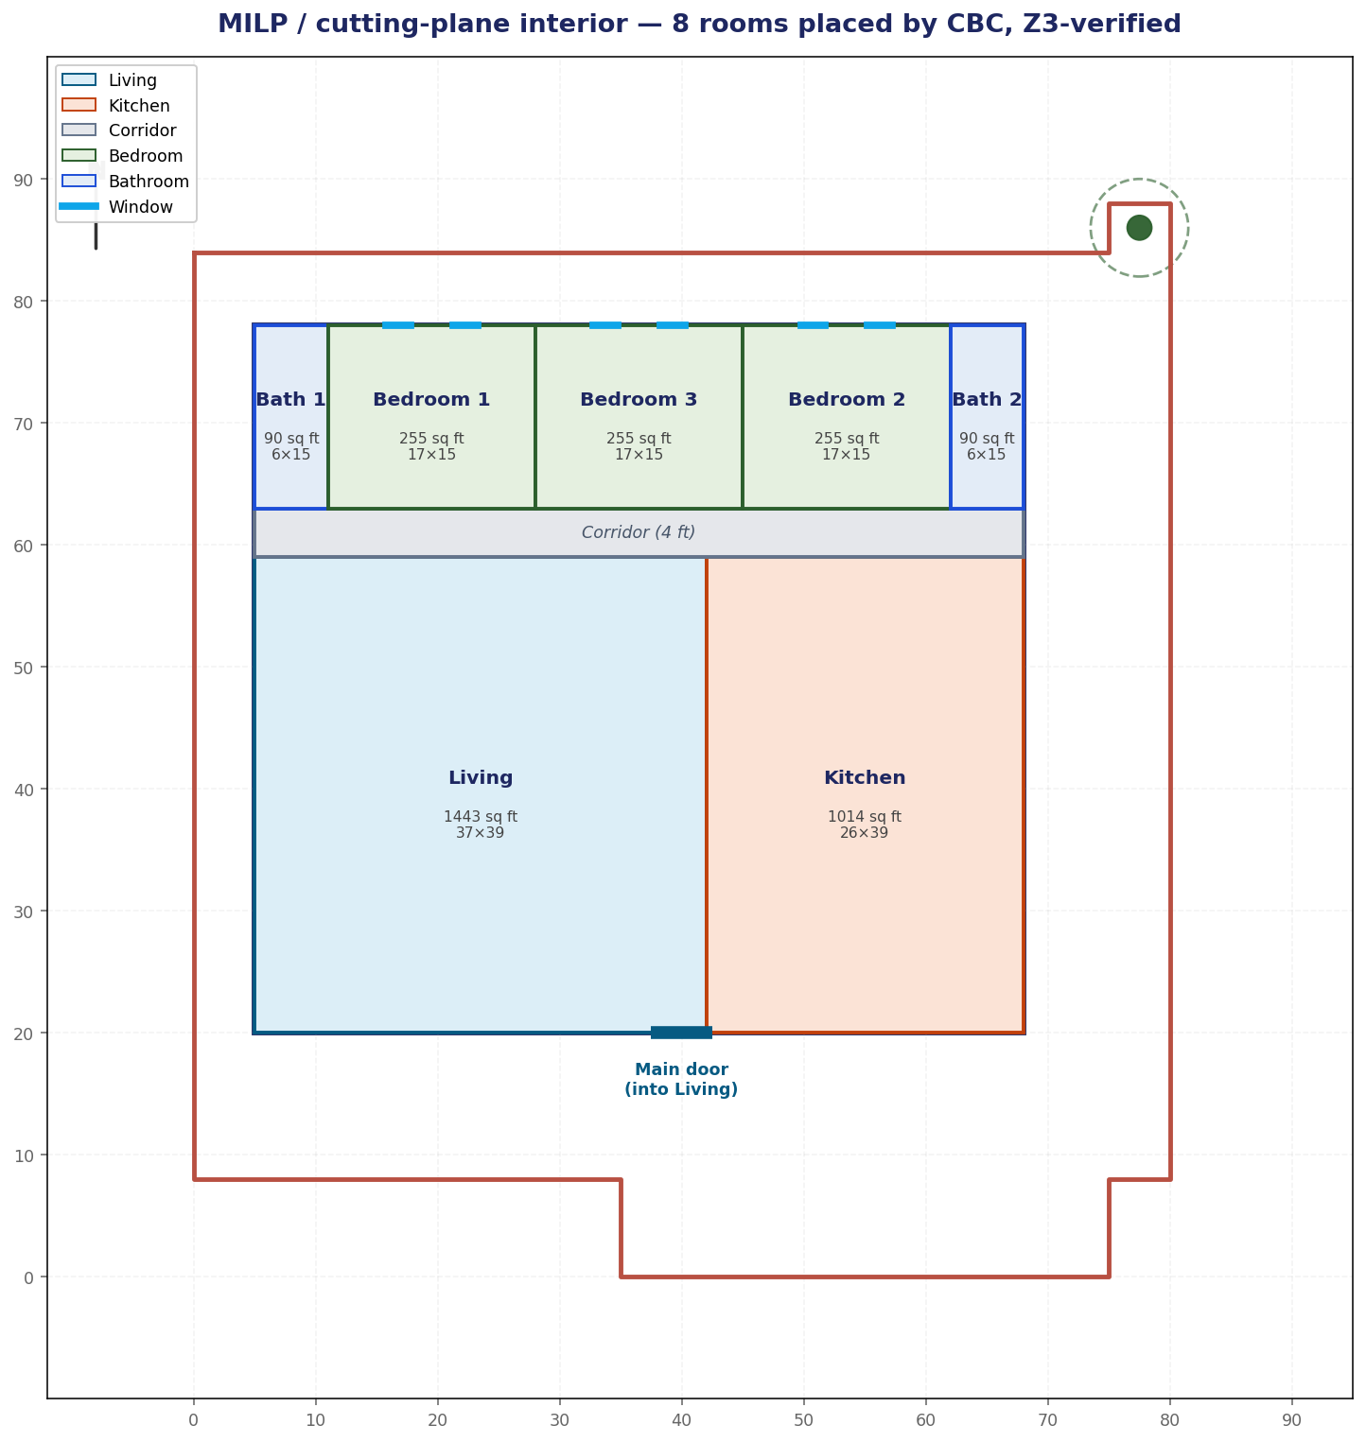
The problem
Extend the verified exterior to a complete, code-checked interior
WHAT THE BRIEF ASKS
Generate a full residential floor plan:
3 bedrooms · 2 bathrooms · 1 kitchen · 1 living · 1 corridor
Formally verify it against IRC R304/R305 room-size rules and architectural spatial rules (ensuite, sanitation, circulation).
THE KEY SHIFT
Don't let the LLM guess and then repair (verify-and-fix). Have a MILP solver generate a layout that is guaranteed correct by construction (generate-and-guarantee). Z3 stays the independent judge.
PS1 · Problem 2 · Ojas
2 / 11

Slide 3
System overview — two automated phases
A generator proposes geometry · Z3 is the deterministic judge · an LLM explains failures
PHASE 1 — EXTERIOR
PHASE 2 — INTERIOR (MILP)
Z3 Optimize → provable max-area target
Gemini draws the outline; parser extracts coords
Z3 verifies 9 SBC rules
Llama explains failures → loop
PuLP + CBC solve the 8-room layout (cutting planes)
Guaranteed valid by construction
Z3 verifies 25 + 4 interior rules
LLM verify-and-fix optional (MILP = fallback)
→ verified footprint + door
→ complete floor plan + layered .dxf
Same neuro-symbolic principle both phases: a generator proposes · Z3 proves · an LLM explains.
PS1 · Problem 2 · Ojas
3 / 11

Slide 4
Phase 1 — exterior in numbers
Z3 Optimize turns 'maximize area' into a hard, verifiable constraint
6,420
4,060
PLOT AREA (sq ft, L-shaped)
Z3-PROVABLE MAX HOUSE (70 × 58 ft)
3,654
2
CONVERGED FOOTPRINT — 90% of max
ITERATIONS TO SAT
Z3 declares the 4 corners as symbolic reals, adds the setbacks, and maximizes the footprint. The verifier then demands ≥ 90% of that max — so the generator must push to the legal limit.
PS1 · Problem 2 · Ojas
4 / 11

Slide 5
The big idea: generate-and-guarantee
A cutting-plane MILP places the rooms; the LLM no longer has to get geometry right
VERIFY-AND-FIX (baseline)
GENERATE-AND-GUARANTEE (ours)
LLM guesses a layout
Z3 checks, sends back failures
LLM tries again … (multiple rounds)
output is non-deterministic
CBC solves the layout as a MILP
Cutting planes remove infeasible layouts until only valid ones remain
valid on the first solve — no LLM loop
solver output is reproducible
Z3 independently confirms the result.
PS1 · Problem 2 · Ojas
5 / 11

Slide 6
The 3-band structure makes the rules structural
Encode the spatial rules in the topology so the optimum is always code-valid
PRIVATE band (15 ft)
Corridor between public & private → no bath can ever touch the kitchen (sanitation)
Each bath flanks only its own bedroom → ensuite by construction
Bedroom 3 sits between the two pairs → the two baths are never adjacent
Fixed band heights keep every area linear → CBC stays in the fast linear fragment; ~100% tiling
Bath 1
Bed 1
Bed 3
Bed 2
Bath 2
Corridor (4 ft)
Living
Kitchen
door → living
PS1 · Problem 2 · Ojas
6 / 11

Slide 7
The MILP model (PuLP + CBC)
Big-M disjunctive non-overlap → a true branch-and-cut MILP
Component | Formulation
Variables | Room widths / band cut positions (continuous) · per-pair non-overlap selectors (binary)
Non-overlap | Big-M disjunction per pair: at least one of {i left / right / below / above j}
Containment + tiling | Every room inside the footprint; bands span full width & height → ~100% coverage
Door / egress | Living spans the door, inset ≥ 2 ft, on the south wall
Ensuite / sanitation | Band ordering: Bath_i flanks only Bed_i; corridor isolates baths from the kitchen
Objective | Maximise the smallest bedroom width (balanced bedrooms); keep the kitchen generous
CBC runs branch-and-cut, adding Gomory / clique / cover cutting planes to tighten the relaxation. That is the cutting-plane algorithm doing the work.
PS1 · Problem 2 · Ojas
7 / 11

Slide 8
Z3 verifies 25 + 4 interior constraints
The independent judge — IRC room sizing plus architectural spatial rules
1 · Room areas (7)
2 · Min dimension (6)
3 · Max dimension (2)
4 · Bath < bedroom (2)
living/kitchen/bed ≥ 70 · bath ≥ 25 sq ft
habitable ≥ 7 ft · bath ≥ 5 ft side
bathrooms ≤ 15 ft / side
each ensuite smaller than its bedroom
5 · Sanitation (3)
6 · Ensuite (2)
7 · Spatial / coverage (3)
8 · Ours, extra (4)
baths not adj. kitchen, not adj. each other
each bath shares a wall with its bedroom
living on south · inside · within ±5%
door→living · kitchen↔living · connectivity · count
Scalar rules go through Z3 (measured < required); geometry (overlap, connectivity) is computed directly. Empty violation list = SAT.
PS1 · Problem 2 · Ojas
8 / 11

Slide 9
Result — MILP interior, Z3-verified
8 rooms · 100% coverage · 0 violations · CBC Optimal
Room | W×H | sq ft
Living | 37×39 | 1,443
Kitchen | 26×39 | 1,014
Corridor | 63×4 | 252
Bath 1 → Bed 1 | 6×15 | 90
Bedroom 1 | 17×15 | 255
Bedroom 3 | 17×15 | 255
Bedroom 2 | 17×15 | 255
Bath 2 → Bed 2 | 6×15 | 90
TOTAL | 63×58 | 3,654
Every square foot is assigned; the corridor is the circulation.
PS1 · Problem 2 · Ojas
9 / 11

Slide 10
What's novel vs the verify-and-fix baseline
We built the part the reference only proposed — and matched its full checker
 | Verify-and-fix baseline | Ours (MILP + Z3)
Room placement | Gemini guesses, Z3 checks | CBC solves, Z3 confirms
Constraint satisfaction | after 1+ feedback rounds | guaranteed on first solve
Determinism | LLM output varies | solver output reproducible
Cutting-plane MILP | listed as future work | implemented (PuLP + CBC)
Interior constraints | 25 rules | 25 rules + 4 extras
Bottom line: the reference proposed cutting-plane MILP as a future direction; ours runs it today, with Z3 confirming all 29 constraints.
PS1 · Problem 2 · Ojas
10 / 11

Slide 11
Takeaways
Generate-and-guarantee beats verify-and-fix
A cutting-plane MILP returns a valid layout on the first solve — no LLM iteration, fully reproducible.
Z3 stays the judge
The SMT solver independently confirms 25 IRC/spatial rules + 4 extras; same neuro-symbolic principle as the exterior.
Topology encodes the hard rules
A corridor + ensuite band structure makes sanitation, ensuite and non-adjacency true by construction.
We built the proposed future work
The reference listed cutting-plane MILP as future work; ours implements it end-to-end (PuLP + CBC).
Repo: /Users/ojas/ps1-house-layout/ · Ojas · Problem 2

