Slide 1
PS1
Engineering Drawing Verification
A two-agent system where Z3 is the judge and LLMs do the talking
Ojas · Cohort PS1 · 31 May 2026 · Checkpoint 3pm IST
Generator: Gemini 2.5 Flash · Verifier: Llama 3.3 70B (Groq) + Z3

Slide 2
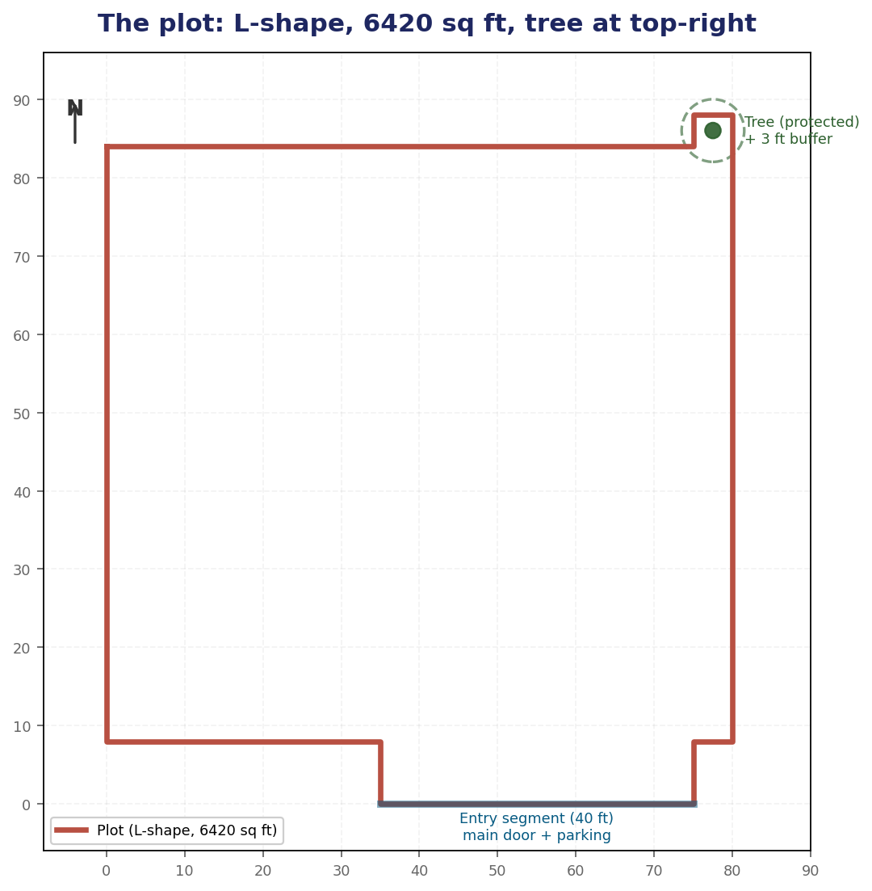
The problem
Build a two-agent system that produces a verified house drawing on a tricky plot
WHAT THE BRIEF ASKS
Agent 1 (Generator)
Write Python (ezdxf) that draws the outer periphery of a house on the plot.
Agent 2 (Verifier)
Check the design against Seattle Building Code (SBC) using Z3. On fail, send actionable feedback to A1.
HARD REQUIREMENTS
Protected tree cannot be touched (~$50k fine)
Setbacks per SBC
Single entry side: door + parking together (fire egress)
Maximize area coverage
PS1 · Ojas · 31 May 2026
2 / 13

Slide 3
Design principle
Z3 is the judge. LLMs only generate and explain.
THE TRAP
OUR SPLIT
LLM-as-verifier
Judge ≠ Explainer
The verifier is also an LLM, so it agrees too easily, hallucinates measurements, and you cannot reproduce its decisions.
Two chatbots discussing whether one number is bigger than another.
Generation = LLM job (Gemini)
Judging = SMT solver job (Z3)
Explanation = LLM job (Llama on Groq)
Z3 is deterministic: same house + same rules → same verdict every time. Reproducible, traceable.
PS1 · Ojas · 31 May 2026
3 / 13

Slide 4
Architecture
Agent 1 generates · Agent 2 (parser + Z3 + Llama) verifies · loop
AGENT 2 — Verifier
Parser
Z3
Llama
Agent 1
Gemini 2.5 Flash
regex on magic
comments
verifier + optimizer
(judge)
feedback writer
on Groq
ezdxf code
✓ PASS → emit .dxf
✗ FAIL → violations sent to Llama
"Out of 9 constraints, you missed N — fix and regenerate."
feedback (only on fail)
PS1 · Ojas · 31 May 2026
4 / 13

Slide 5
The plot
L-shape from Anupam's hand-drawn sketch — closes exactly to 6,420 sq ft
CLOCKWISE FROM TOP-LEFT
Edge | Length
top E | 75 ft
step up | 4 ft
tree-notch top | 5 ft
right edge S | 80 ft
bottom-right inset W | 5 ft
entry tab right | 8 ft
entry tab bottom W | 40 ft (door + parking)
entry tab left | 8 ft
bottom-left W | 35 ft
left edge N | 76 ft (closes ✓)
Plot area = 6,420 sq ft
PS1 · Ojas · 31 May 2026
5 / 13

Slide 6
9 SBC constraints encoded in Z3
Every rule has a numeric threshold, a Z3 expression, and a citation
# | Rule | Z3 expression | Source
1 | Front (south) setback ≥ 20 ft | y_min - 0 ≥ 20 | SDCI Tip 320
2 | Rear (north) setback ≥ 10 ft | 88 - y_max ≥ 10 | SDCI Tip 320
3 | Side setbacks ≥ 5 ft (each) | x_min ≥ 5 ∧ 80 - x_max ≥ 5 | SDCI Tip 320
4 | Minimum footprint ≥ 20 × 20 ft | (x_max-x_min) ≥ 20 ∧ ... | derived
5 | All 4 corners inside L-shape polygon | ray-cast point-in-polygon | sketch
6 | Distance to tree ≥ 4 ft | dx² + dy² ≥ 16 | SMC 25.11.090
7 | Door on south wall, inset ≥ 2 ft | door_y = y_min ∧ ... | IBC 2021 §1006
8 | Door in entry segment x ∈ [35, 75] | 35 ≤ door_x ≤ 75 | fire egress
9 | Footprint ≥ 90% of Z3-computed max | area ≥ 0.9 · MAX | brief: "maximize area"
Rule 9 turns the brief's vague 'maximize' from a prompt suggestion into a verifiable hard constraint.
PS1 · Ojas · 31 May 2026
6 / 13

Slide 7
Z3 doesn't just verify — it computes the maximum
Declare house corners as symbolic Reals · Add all SBC rules · Optimize area
from z3 import Real, Optimize x_min, x_max, y_min, y_max = Reals(...) opt = Optimize() opt.add(x_min >= 5, x_max <= 75) # side setbacks opt.add(y_min >= 20, y_max <= 78) # front+rear opt.maximize(x_max - x_min) opt.maximize(y_max - y_min) opt.check()
Z3 OUTPUT
4,060 sq ft
Provable maximum legal house
Corners: (5, 20) → (75, 78)
Dimensions: 70 × 58 ft
Then we plug the Z3-computed max back into the verifier as rule #9: house_area ≥ 0.9 · 4060 = 3,654 sq ft.
Now A1 actually has to push, or Z3 will reject.
PS1 · Ojas · 31 May 2026
7 / 13

Slide 8
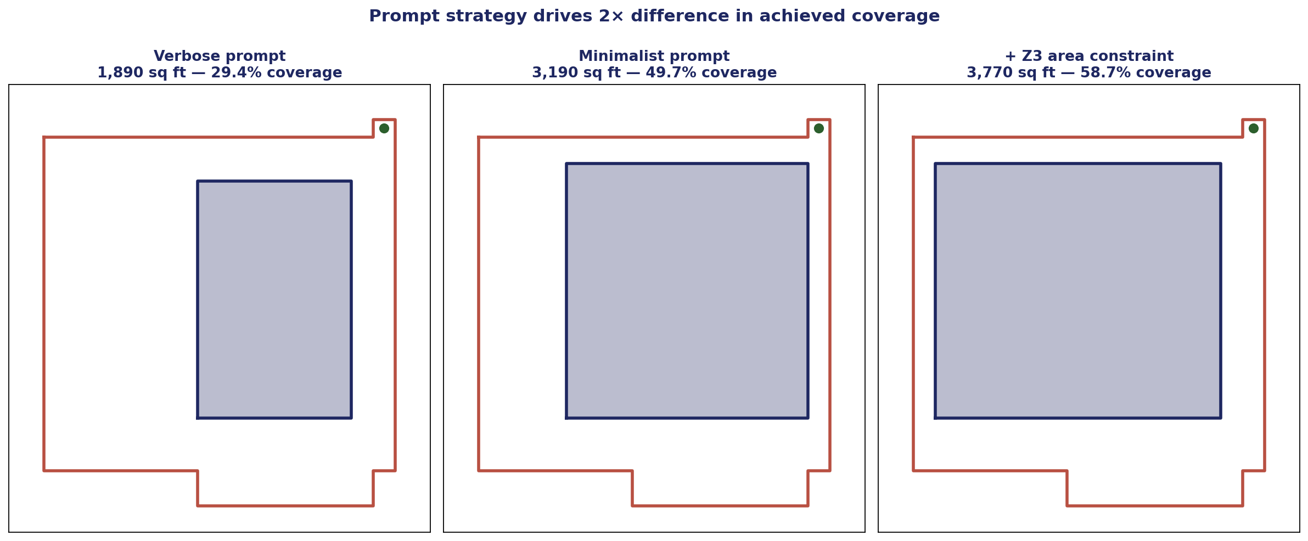
Prompt strategy moved coverage from 29% → 59%
Same model, same Z3, same plot — only the prompt to A1 changed
Verbose prompt anchored Gemini to the entry-tab x-range (35→70). Stripping the polygon coordinates and emphasizing the maximize-area objective freed it to push against legal limits. Adding the Z3 area constraint forced one feedback round and got us to 59%.
PS1 · Ojas · 31 May 2026
8 / 13

Slide 9
Demo trace — the loop in action
Iter 1 fails area-coverage · A2 explains · iter 2 lands above threshold
ITER 1 — ✗ Z3 rejected
A2 (Llama on Groq) writes:
Gemini → 3,190 sq ft (78.6% of Z3 max)
Z3: min_area_coverage FAILS — need ≥ 3,654
"Out of 9 SBC constraints, you missed 1 — fix and regenerate.
* Increase house footprint to at least 3,654 sq ft by reducing setbacks; consider tightening any setback with available slack to expand the footprint by at least 464 sq ft.”
ITER 2 — ✓ Z3 PASSES
Gemini → 3,770 sq ft (92.9% of Z3 max, 58.7% of plot)
Z3: ALL 9 constraints satisfied
Emitter writes final_iter_02.dxf — deterministic, decoupled from any LLM execution.
PS1 · Ojas · 31 May 2026
9 / 13

Slide 10
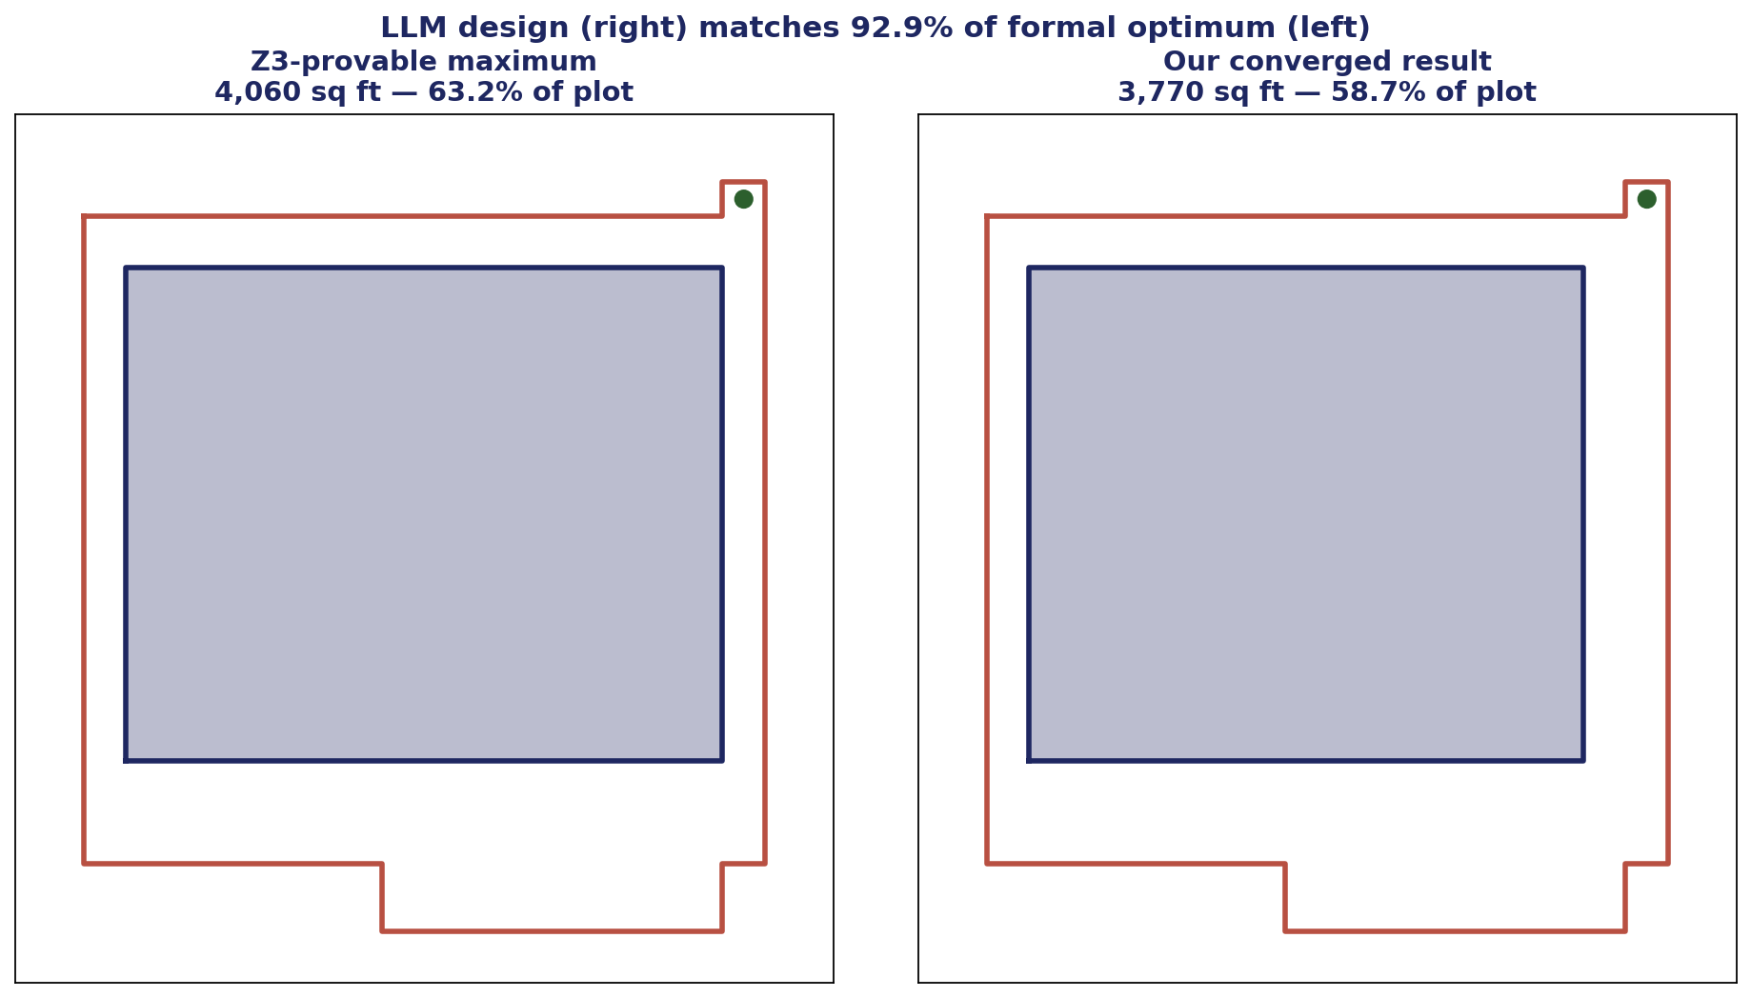
Final result
3,770 sq ft house — 92.9% of the formal optimum
PS1 · Ojas · 31 May 2026
10 / 13

Slide 11
The numbers
Verified by Z3 on the converged design
6,420
4,060
PLOT AREA (sq ft)
Z3-PROVABLE MAX HOUSE (sq ft)
3,770
58.7%
OUR HOUSE (sq ft) — 92.9% of Z3 max
PLOT COVERAGE ACHIEVED
2
9
~12 s
ITERATIONS TO CONVERGE
SBC CONSTRAINTS ENCODED IN Z3
TOTAL WALL-CLOCK (Gemini + Llama + Z3)
PS1 · Ojas · 31 May 2026
11 / 13

Slide 12
Stack
Assigned Claude + Kimi · Pivoted to Gemini + Groq mid-build (key availability)
Agent 1 — Generator
Gemini 2.5 Flash
google-genai SDK · thinking off · backoff on 503/429
Agent 2 — Verifier (judge)
Z3 SMT solver
Microsoft Research · z3-solver pip · Solver + Optimize
Agent 2 — Verifier (explainer)
Llama 3.3 70B (Groq)
OpenAI-compatible SDK · sub-second latency
Drawing emitter
ezdxf 1.4
Deterministic .dxf from Z3-verified geometry only
Visualization
matplotlib
Slide PNGs · plot + house + tree + door
Orchestrator
Python 3.14 + python-dotenv
loop.py · 5 max iterations · per-iter artifacts saved
PS1 · Ojas · 31 May 2026
12 / 13

Slide 13
Takeaways
Z3 is the judge — that's the whole point
Using an LLM as a verifier collapses to two chatbots agreeing. A SMT solver gives reproducible, citable verdicts.
Make 'maximize area' a verifiable constraint, not a vibe
Z3 Optimize computes the formal max once; the verifier enforces ≥ 90% of it. Now the brief's 'maximize' is something Z3 can actually reject.
The prompt is part of the architecture
Same model, same rules, +30 percentage points of coverage from rewriting A1's plot description from verbose to minimalist.
Don't execute untrusted LLM code
Magic comments + regex parser get the geometry without running anything. The .dxf emitter writes the file from verified numbers only.
Repo: /Users/ojas/ps1-house-layout/ · Ojas · 31 May 2026

