Slide 1
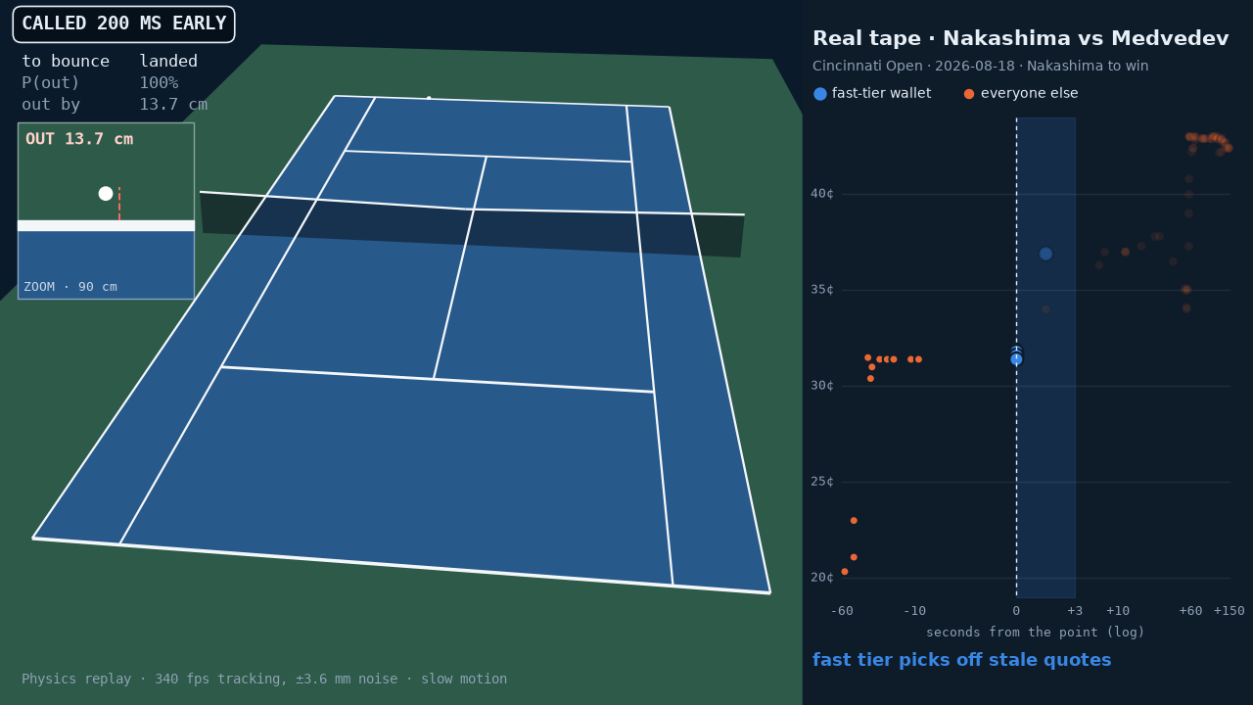
COURTSIDE
GATOR QUANT HACKS 2026 · SYSTEMATIC TRADING
Every point
moves a market.
Who gets paid?
13,084 matches $2.84B traded
Real Polymarket tape (Nakashima v Medvedev, 2026-08-18) beside a simulated Hawk-Eye-style call
Every resolved Polymarket ATP/WTA singles moneyline ≥ $5k, Oct 2025 – Oct 2026
github.com/OjasMishra32/courtside
Notes:
[0:00 to 0:40] TITLE + HOOK
Every tennis point moves a prediction market. An average point moves a player's fair value by about six cents; the biggest, by more than fifty.
So we asked: when the price jumps, who is on the other side, and who gets paid?
We took every resolved ATP and WTA moneyline on Polymarket for a year: 13,084 matches, 2.84 billion dollars traded, every print classified by side, net of its own fee.
The video: a real tape beside a simulated line call. Blue dots are the fast tier. This is COURTSIDE.
[Timing plan for the 5 minutes: about 40 s per slide for slides 1 to 7, 20 s spare. Backups 8 to 12 are for Q&A only.]
[PRE-FLIGHT, on the presenting machine: open the .pptx once in PowerPoint (not Keynote, Google Slides or a PDF; they may not autoplay the videos). Check that this video autoplays and loops, that the slide 4 video autoplays, and that the slide 5 table stays clear of the footer. Bring results/viz/courtside_replay.mp4 and results/tracking/demo/supercut.mp4 as separate files. If a video fails, talk over its poster frame.]
[The replay pairs the real Nakashima v Medvedev, 2026-08-18 tape with a simulated groundstroke (scripts/render_hawkeye_video.py); it is not that point's line call.]
[Sources: results/summary.json universe; results/leverage_stats.json (mean |leverage| 5.7%, max 56%); results/viz/viz_data.json tape.]

Slide 2
A point ends in tiers. Slow tiers pay fast ones
01 · ECONOMIC FOUNDATION
TIER 0
Ball tracking
in the venue
100–300 ms
before the bounce
WHO PAYS WHOM
$4.2
TIER 1
Chair umpire
at the bounce
total |fair-value move| per $1 share over a simulated ATP best-of-3 (161 points, 5.7% mean per point)
1 s
TIER 2
Market makers
Kalshi (6.1× volume) reprices with them; PM lags ~2 s, mostly its own delay
−1.2 s
vs the official stamp,
≈ 0–2 s after landing
Polymarket holds every marketable sports order 1 s so makers can reprice
TIER 3
Public feeds
ESPN · PM score feed · WTA API
+27 to +43 s
after the stamp
The gaps are physical, so they persist.
Tier 0: physics simulation. Kalshi: in-sample tapes (106,347 repricings). Tiers 2–3: live books vs the WTA official point stamp (umpire-entered, may lag landing 1–3 s), 2026-10-03, 9 WTA matches, n = 482.
COURTSIDE · Gator Quant Hacks 2026 · Systematic Trading
2
Notes:
[0:40 to 1:20] ECONOMIC FOUNDATION: THE INFORMATION LADDER
Why does anyone lose? Because a point ends in tiers.
Ball tracking knows the landing point mid-air. The umpire knows at the bounce. Market makers reprice Polymarket 1.2 seconds before the official stamp, typed in after the ball lands. Kalshi, six times bigger, reprices with them; Polymarket's lag is mostly its own order delay. Public feeds arrive 27 to 43 seconds late.
Over a match, a one-dollar share's fair value moves about four dollars in total, and whoever trades on an older tier sells to someone faster. The venue admits it: it holds every marketable order one second so makers can reprice.
[If asked "why not trade Kalshi, it is 6x bigger?": Kalshi's taker fee is 0.07·p(1−p), 1.75¢ at p = 0.5, and the hedged Polymarket-laggard trade nets +0.06¢ [−1.17, 1.48] on 119 trades in today's 1 s / 5% regime. Most of Polymarket's ~2 s lag is mechanical (its order delay plus ~2 s block-time stamps), not an information gap, and the fast tier trades at the same moment Kalshi reprices (research/v2/kalshi/RESULTS.md TL;DR 1, 2, 4, 6).]
[If asked about the clocks: the official WTA stamp has 1 s resolution and may sit 1–3 s after the ball lands, so the book probably reacts about 0–2 s after the real point end (research/v2/latency/RESULTS.md 3a). One day, 9 WTA matches, mostly Beijing; ATP has no public official point clock.]
[Sources: docs/NOTE.md sections 1 and 5; research/v2/latency/RESULTS.md (n = 482 points, 9 WTA matches; ESPN +27.5 s, PM feed +29.1 s, WTA API +43.3 s); research/v2/kalshi/RESULTS.md (68.9% of 106,347 in-sample repricings; ~2 s once block lag is removed; 6.1x in-play notional); results/leverage_stats.json ($4.2 total travel, 161 points, mean |leverage| 5.7%; simulated ATP best-of-3 from the exact Markov model).]

Slide 3
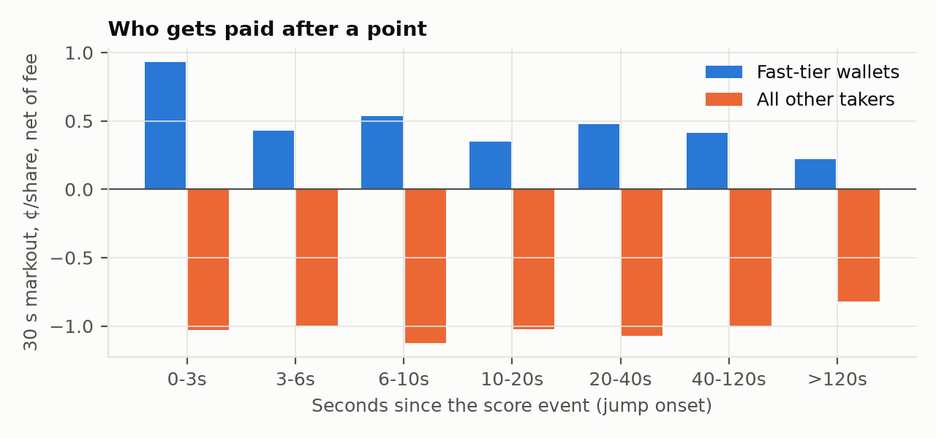
The fast tier wins every month. Copying it loses
02 · EVIDENCE
11/11
months > 0, walk-forward: 8 in sample + 3/3 out of sample (+0.4 to +0.8¢). H6 came after the in-sample wallet study, so only OOS is a test.
Fig. 1 30 s markout per taker print, net of fee. Onset-aligned ex-post event study; tradable numbers (slide 5) use the causal window (D9).
30 s net ¢/share by month. Pale bars: out of sample (Aug = Aug 25–31 only; Oct = 3 days).
Copy the same trades 3 s later: negative every month. The edge is speed.
COURTSIDE · Gator Quant Hacks 2026 · Systematic Trading
3
Notes:
[1:20 to 2:00] EVIDENCE: WHO GETS PAID
Every taker print, by seconds since the score event, marked out thirty seconds later, net of fees.
A small group of wallets, the fast tier, trades within three seconds and wins. Everyone else in that window loses about a cent a share.
Picked each month from earlier months only, it won eleven of eleven: eight in sample, where we found it, and three out of sample, the real test.
The control: copy their exact trades three seconds later and you lose, every month. So it is not who they are. The edge is speed.
[Honest framing if asked: H6 was written after the in-sample wallet study (DEVIATIONS D4, D5), so only the 3 out-of-sample months test it. Fig. 1 and the H6 months use onset-aligned windows, an ex-post event study; every tradable v2 number uses the causal window (D9). December 2025 is small (14 matches, 4 wallets, $8.8k of fast-tier volume). The Aug bar is Aug 25-31 only (in-sample Aug 1-24 was +0.87¢); Oct is 3 days (133 matches), and its fast-tier P&L held to resolution was −0.54¢ even though its 30 s markout was positive.]
[Sources: results/summary.json is/oos h6_walkforward (fast tier +0.6 to +2.4 ¢ in sample, +0.4 to +0.8¢ out of sample; everyone else negative every month); docs/NOTE.md Table 1 (copy 3 s later < 0 every month); results/figures/fig1_tiers.png.]

Slide 4
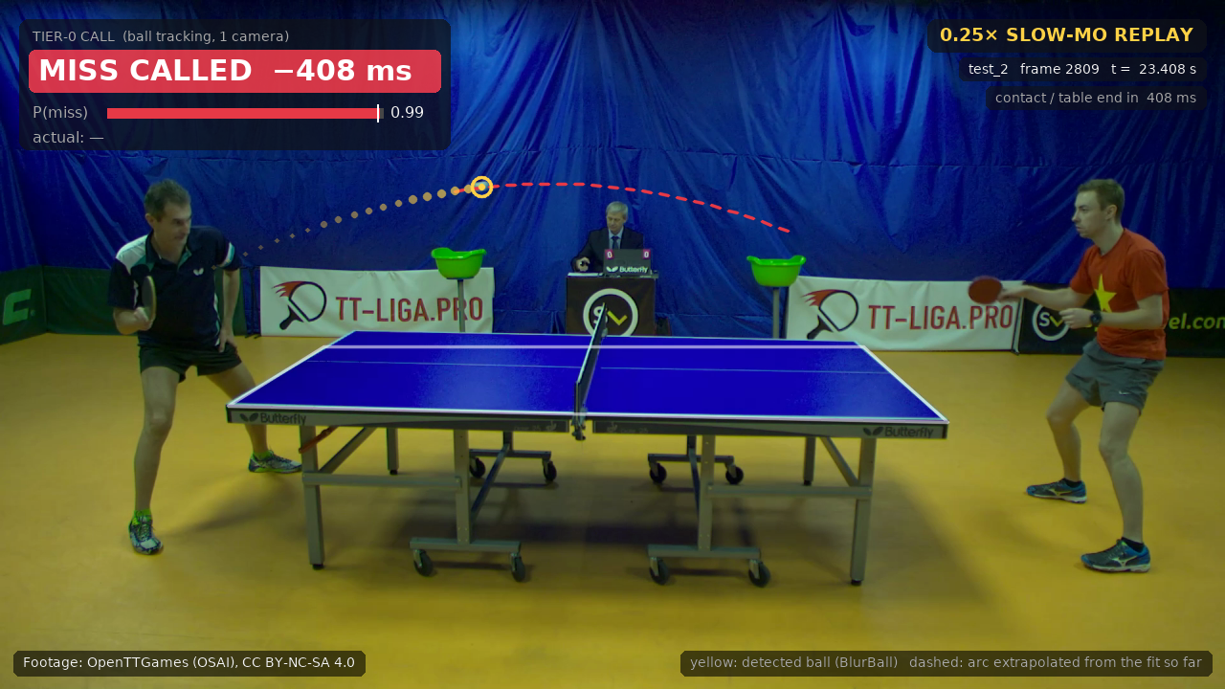
Tier 0 is measurable: call the point before it lands
03 · INNOVATION
11/11
table-tennis miss calls correct, 50 ms before contact, held-out games. Called 11 of 41 misses (recall 27%); 95% lower bound 74%
±2.4 cm
simulated Hawk-Eye-class tracking (340 fps, ±3.6 mm): landing error, 1 SD, 100 ms before the bounce
0.7–1.2 m
25 fps broadcast tennis, median landing error: useless
Real 120 fps table-tennis footage (OpenTTGames, CC BY-NC-SA 4.0), frozen model, run on HiPerGator. Selected clips: calls at −408, −83, −25 ms; median first-call lead on held-out misses 25 ms.
COURTSIDE · Gator Quant Hacks 2026 · Systematic Trading
4
Notes:
[2:00 to 2:40] INNOVATION: BUILDING TIER 0
Can anyone reach the top rung? This is real 120-frame-per-second table-tennis footage, run on HiPerGator: OpenTTGames is the public labelled high-speed set, and table tennis itself isn't tradable.
On held-out games, all 11 of our frozen model's miss calls, 50 milliseconds before contact, were right; it called 11 of 41 misses. Small sample: lower bound 74%.
For tennis, simulated Hawk-Eye-class tracking has a 2.4-centimetre standard deviation 100 milliseconds before the bounce. Broadcast video at 25 frames a second is 70 centimetres to 1.2 metres off.
The lead comes from frame rate and cameras, so it lives in the venue.
[If asked "what recall?": 27% (11 of 41 test misses called at 50 ms). Post-hoc label audit (DEVIATIONS H3-D10): the frozen model is 8/8 at 38% recall on corrected labels. The demo clips are selected for presentation (manifest: "presentation only", online rule); the median first-call lead on called held-out misses is 25 ms (n = 8, p90 210 ms). Tennis Hawk-Eye numbers are a physics Monte Carlo (340 fps, 3.6 mm noise), not a measurement.]
[Sources: results/summary.json tracking_table_tennis_video (test precision at 50 ms 11/11, Wilson 95% lower bound 74%; pre-registered H3) and tracking_tennis_physics (landing error SD ±2.4 cm at 100 ms, ±10.7 cm at 300 ms); results/tracking/summary.json; results/tracking/demo/manifest.json; results/tennis_tracking/summary.json (broadcast median landing error 0.7–1.2 m, 33 to 300 ms; docs/NOTE.md section 5 still says 0.6–1.2 m).]

Slide 5
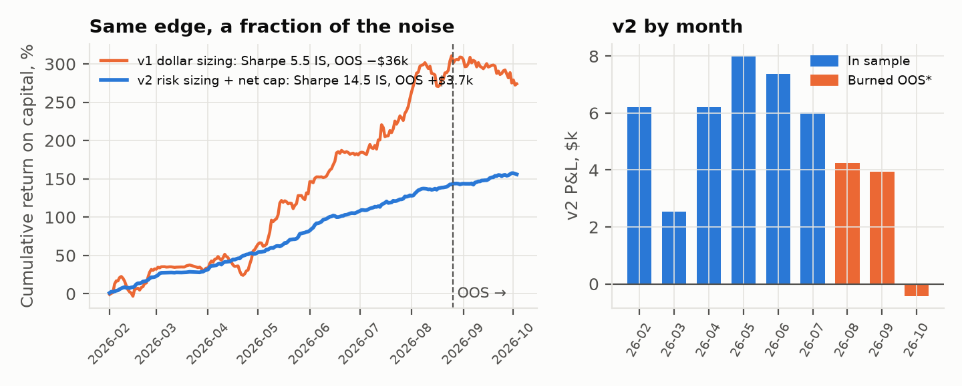
v2: the same edge, a fraction of the noise
04 · PERFORMANCE
Paper book on the fast tier's own fills: it prices the opportunity at their speed, not our execution (that needs in-venue tracking + a co-located gateway).
FROZEN v2 RULES
Fig. 6 v1 vs v2: return on each book's own capital; v2 P&L by month (*Aug includes IS days).
v1 OOS: −$36.1k, max DD −75%, worst day −26.8%.
v2 burned OOS: +$3.7k, max DD −2.1%, worst day −2.1%.
1
0–3 s fast-tier window, causal
2
Wallet edge must beat today's fee
3
Price 0.05–0.95; risk-parity size
4
≤ $1k/order; ≤ 100 shares net/match
5
Hold to resolution: no exits
v2, causal window net of fees, held to resolution | In sample Feb–Aug 2026 | Burned OOS (non-blind) Aug 25 – Oct 3; v2 built after v1 failed here | Forward (blind) from Oct 3, 14:00 UTC
Net per share, fast-tier fills | +1.38¢ [1.17, 1.59] | +0.60¢ [0.09, 1.13] | PLACEHOLDER: blind test not run Runs once ~11:30 UTC, Oct 4 2026; reported either way. Primary A: fast tier − others, 30 s net [FWD_A] Primary B: v2 book, 30 s net per share [FWD_B] Pass iff the match-clustered 95% CI excludes 0. Under 1 day of matches, a B fail may be underpowered (A1). Resolution P&L at left is secondary.
… +½ tick worse entry | +0.88¢ [0.67, 1.09] | +0.10¢ [−0.41, 0.63]
… +1 tick worse entry | +0.38¢ [0.17, 0.59] | −0.40¢ [−0.91, 0.13]
Sharpe · max DD · months > 0 | 14.5 · −2.0% · 7/7 | 6.7 · −2.1% · 2/3 (Oct = 3 days)
Why the Sharpe is so high: ~270 small bets a day (55,662 in 206 days), each held to a binary outcome, net-capped per match. Best Sharpe from luck alone over 3,386 tried variants ≈ 4.8 (Bailey & López de Prado).
COURTSIDE · Gator Quant Hacks 2026 · Systematic Trading
5
Notes:
[2:40 to 3:20] STRATEGY v2 AND PERFORMANCE
Then we priced that opportunity as a paper strategy on the fast tier's own fills. Version one copied their tickets and lost 36 thousand dollars out of sample: big tickets on cheap tokens.
Version two adds five rules: a causal window, fee-beating wallets, risk-parity sizing, a net cap per match, and hold to resolution.
In sample: plus 1.38 cents a share, Sharpe 14.5, two percent max drawdown, positive even at a full tick. On the burned, non-blind out-of-sample: plus 0.60 cents, gone at half a tick. The blind forward test runs once on October 4th; its pass rule is already on the slide.
[FORWARD TEST: not run at build time; it runs once ~11:30 UTC Oct 4 2026. If results/v2/forward.json exists by talk time, read Primary A (fast tier minus others, 30 s net) and Primary B (v2 book, 30 s net per share) with their match-clustered 95% CIs; each passes only if its CI excludes 0 (HYPOTHESIS_V2.md A1.5). Then replace FORWARD_* and [FWD_A]/[FWD_B] in build_deck.py and rebuild. Resolution P&L in the left rows is secondary for the forward window.]
[If asked "whose fills are these?": the fast tier's. v2 is a paper book that measures the opportunity at their speed, not our execution (docs/NOTE.md section 8); out of sample the edge is gone at +½ tick (+0.10¢ [−0.41, 0.63]), so second place earns nothing. If asked "you redesigned after v1 failed OOS?": yes, HYPOTHESIS_V2.md says so, which is why that window is labelled burned; the hindsight fix (D9) lowered the burned-OOS number from +0.75 to +0.60¢, and the forward run is the only clean test.]
[Sources: results/v2/causal.json (IS 55,662 trades, 206 days, P&L +$40.4k on $28.3k; burned OOS 10,412 trades, 40 days, +$3.7k on $22.8k); HYPOTHESIS_V2.md (frozen rule incl. price zone 0.05–0.95, amendment A1); results/summary.json oos h6_shadow (v1 OOS −$36.1k, max DD −75%, worst day −26.8%); results/figures/fig6_v2.png. About 270 small bets a day, each held to an exogenous binary outcome: that is why the Sharpe is high; the expected best Sharpe from luck over 3,386 variants is ~4.8 (docs/NOTE.md section 8).]

Slide 6
Small by design, with hard limits, on a deep book
05 · RISK MANAGEMENT · LIQUIDITY & CAPITAL
LIMITS AND KILL SWITCHES
LIQUIDITY AND CAPACITY
100
$1k
> 2 s
TENNIS
TABLE TENNIS
$61k
89¢
net shares per match, max
max per order
feed/tracking dropout, or order latency > p95: kill
within 2¢
median spread
1¢ median spread
$8.1k at the touch
live sample, one day (Oct 3)
$23 at the touch
~$2 per match
not tradable
< 0.3¢
5% fee
4 → 131
trailing edge: halve; ≤ 0: stop
alone halved the edge (1.19 → 0.54¢): venue risk
fast-tier wallets: crowding
RETURN ON CAPITAL (PAPER, AT FAST-TIER FILLS) AND CAPACITY
+$40.4k on $28.3k in 206 IS days (+143%)
+$3.7k on $22.8k in 40 burned-OOS days (+16%)
Stale depth before a reprice: median $222–565, mean $1.3–3.1k per point (live, Oct 3)
Whole prize: fast-tier 0–3 s volume $0.3–3.1M a month (from Jan 2026); v2 trades ~$7.2k a day of it ($1.48M in 206 days)
Worst backtest match −$206 (v1: −$3,098) · capital = 3× peak locked
Worst day −1.9% IS / −2.1% OOS · trade calls only at P ≥ 0.95
Legal and access: deployment needs licensed data, a permitted venue (Polymarket's international venue restricts US persons) and legal review; courtsiding breaks most ticket terms. This repo only reads public data and never places an order.
COURTSIDE · Gator Quant Hacks 2026 · Systematic Trading
6
Notes:
[3:20 to 4:00] RISK MANAGEMENT, LIQUIDITY AND CAPITAL
Net exposure is capped at a hundred shares a match, orders at a thousand dollars. The worst backtested match lost 206 dollars. Kill switches fire on dropouts or slow orders.
The biggest risk is the venue: the five percent fee alone halved the edge, and qualifying wallets grew from 4 to 131. So we halve size below 0.3 cents of trailing edge and stop at zero.
Tennis is deep: 61 thousand dollars within two cents. On paper, v2 made 40 thousand dollars on 28 thousand of capital in sample. Deploying it needs licensed data, a permitted venue and legal review.
[Also in the note if asked: only calls with P >= 0.95 are traded; the kill switch also fires when measured order latency exceeds its 95th percentile; 2.9% of matches settled 50/50 (retirements), included in all P&L. Legal: courtsiding breaks most tournaments' ticket terms, live tracking data is licensed, Polymarket's international venue restricts US persons. The repo only reads public data and never places orders. Peak locked $9.4k.]
[Fee effect (DEVIATIONS D6, in-sample shadow book per share): 3 s/3% 1.64¢, 1 s/3% 1.19¢, 1 s/5% 0.54¢. The fee alone (1.19 to 0.54) is about −55%; fee plus the 3 s to 1 s delay change is about −67%, the "two-thirds" in docs/NOTE.md section 6.]
[Capacity: v2 traded $1.48M of paper notional in 206 in-sample days (~$7.2k a day). Fast-tier 0–3 s volume was $0.3–3.1M a month from Jan 2026 (Dec 2025: $8.8k). Stale depth resting before a reprice: median $565 / $379 / $222 and mean $3,116 / $1,866 / $1,254 at 2 s / 1 s / 0.25 s before it (live, 2026-10-03, 482 points).]
[Sources: docs/NOTE.md sections 6 and 7; results/v2/causal.json (P&L, capital, worst day −1.9% IS / −2.1% OOS); worst match −$205.76: docs/NOTE.md section 6 and data/v2_trades_is_oos.parquet grouped by match; research/v2/latency/RESULTS.md section 5; results/summary.json h6_walkforward usd_k.]

Slide 7
Pre-registered, every look logged, failures reported
06 · INTEGRITY
INTEGRITY TRAIL
FIVE IDEAS THAT FAILED, ALL REPORTED
1
H1–H4 committed before any result
commit 7232986 · H5, H6 written after in-sample results, frozen before OOS (DEVIATIONS D3, D5)
×
Chasing the move −2.1¢ out of sample
OOS opened once, for v1
v2 was built knowing v1 lost $36k there, so it is burned: v2 is shown on it twice, labelled non-blind (3 lines in oos_peeks.log)
×
Favourite bias prices calibrated
2
×
Maker exits adversely selected
3
Verifiers caught onset hindsight
81% of a draft's OOS P&L: fixed, re-run
×
Side markets sniping ≈ 0; best maker only ~$2k/month
4
Blind forward test pre-registered
runs once ~11:30 UTC Oct 4: the clean test
×
Copying Kalshi ≈ 0 net today
The edge pays whoever is first.
We showed what first requires: in-venue tracking + a gateway co-located with the matching engine.
Polymarket's API sits behind Cloudflare's Miami edge, origin consistent with London; co-locating saves ~130 ms per round trip.
COURTSIDE · Gator Quant Hacks 2026 · Systematic Trading
7
Notes:
[4:00 to 4:40] INTEGRITY, WHAT FAILED, AND THE PUNCHLINE
Why trust this? H1 to H4 were committed before any result; H5 and H6 came later, so only out-of-sample counts for them. Out-of-sample was opened once, for version one; version two came after, so we label it burned. Every look is logged.
Verifiers caught hindsight in our first v2 draft: 81 percent of its out-of-sample P&L came before our detector could fire. We fixed it and re-ran.
Five ideas failed; all are reported.
What is left held on the burned window only at the fast tier's own fills, under a tick; the blind test decides. We showed what first requires: in-venue tracking and a co-located gateway. Thank you.
[Then: "Happy to take questions." Backups: 8 calibration, 9 latency, 10 Table 1, 11 slippage and the hindsight fix, 12 reproduce.]
[Q&A CRIB (one line each; sources in brackets):
1. "These are someone else's fills." Yes: v2 is a paper book at the fast tier's fills; it prices the opportunity, not our execution, and out of sample it is gone at +½ tick, so second place earns nothing (docs/NOTE.md section 8; results/v2/causal.json).
2. "You redesigned after v1 failed OOS." Yes, and we say so (HYPOTHESIS_V2.md); that window is labelled burned, the D9 fix lowered its number from +0.75 to +0.60¢, and the blind forward run is the only clean test.
3. "Does a 50–300 ms call beat a 1 s hold?" To meet a stale quote an order must leave ≥ 1.3 s before the reprice; fast-tier prints already know ≥ 1–1.5 s before the book; tier 0 adds tens to hundreds of ms on top, not yet shown end to end (research/v2/latency/RESULTS.md section 5; backup slide 9).
4. "Is this courtsiding? Can US persons trade it?" Courtsiding breaks most ticket terms, tracking data is licensed, Polymarket's international venue restricts US persons; deployment needs licensed data, a permitted venue and legal review, and this repo only reads public data (docs/NOTE.md section 6).
5. "Sharpe 14.5?" ~270 small bets a day, each held to a binary outcome and net-capped per match; luck-only best Sharpe over 3,386 variants ≈ 4.8; burned OOS 6.7.
6. "11/11 at 50 ms, but what recall?" 27% (11 of 41); post-hoc label audit: 8/8 at 38% recall (DEVIATIONS H3-D10).
7. "December has 14 matches and 4 wallets." True; 11/11 includes a tiny month, and only the 3 OOS months test H6.
8. "Latency is one day." Yes: 9 WTA matches, mostly Beijing; ATP has no public official point clock (research/v2/latency/RESULTS.md section 8).
9. "Kalshi is 6x bigger; why not trade there?" Kalshi's taker fee is 1.75¢ at p = 0.5, and the hedged laggard trade nets +0.06¢ [−1.17, 1.48] in today's regime (research/v2/kalshi/RESULTS.md).
10. "Oct OOS fast-tier P&L to resolution?" −0.54¢ over 3 days (133 matches); the 30 s markout was +0.44¢.
Known source inconsistencies (outside the deck): docs/NOTE.md section 2 and DEVIATIONS D8 still give the forward start as 13:00 UTC; HYPOTHESIS_V2.md A1.6 moved it to 14:00 (the deck uses 14:00). HYPOTHESIS.md says "written ~10:15 UTC" while DEVIATIONS dates commit 7232986 at 09:50 UTC: cite the hash only, and check it on GitHub before the talk. results/summary.json "v2" still holds the pre-fix onset numbers (Sharpe 16.8); the deck uses results/v2/causal.json.]
[Sources: HYPOTHESIS.md (commit 7232986; H1–H4); DEVIATIONS.md D3, D5 (H5, H6 after in-sample); results/oos_peeks.log (3 looks: v1 10:42 UTC, v2 13:24, v2-causal 13:53); DEVIATIONS.md D9 and HYPOTHESIS_V2.md A1 (81%); docs/NOTE.md Table 1 and sections 4 and 5; research/v2/livefill/RESULTS.md (36% within 60 s); research/v2/crossmarket/RESULTS.md (sniping +0.93¢ [−2.8, 4.7], $472 over six months; leaning maker ~$2.1k per 30 days); docs/DEVPOST.md Challenges.]

Slide 8
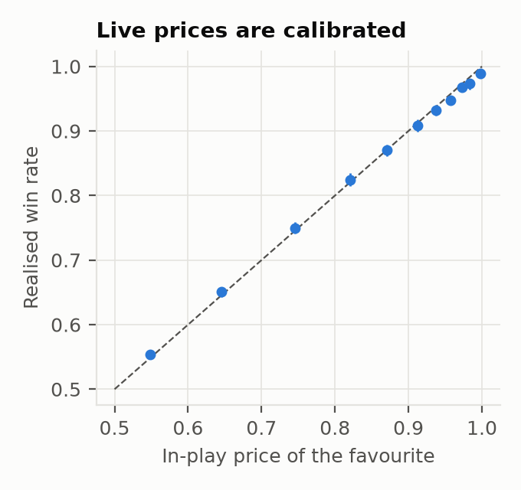
Live prices are calibrated: slow money has no edge
BACKUP · CALIBRATION (H2)
1.0¢
largest gap between price and realised win rate, across all 11 bands from 0.50 to 1.00 (in sample)
H2: buy favourites at 0.85–0.97, hold | Net ¢/share [95% CI]
In sample | −0.41¢ [−1.44, 0.59]
Out of sample (opened once) | +0.80¢ [−1.36, 2.66]
No favourite-longshot edge. The only edge left is speed.
Fig. 2 In-play favourite price vs realised win rate, in sample
COURTSIDE · Gator Quant Hacks 2026 · Systematic Trading
8
Notes:
BACKUP: CALIBRATION (H2)
If asked "isn't there a favourite-longshot bias?": no. In-play prices of the favourite match realised win rates to within about 1.0¢ in every band from 0.50 to 1.00 across 11 bands in sample (results/summary.json is.calibration; the note rounds this to "within ~1¢").
The pre-registered H2 trade, buying favourites as they enter 0.85 to 0.97 and holding to resolution, earned −0.41¢ [−1.44, 0.59] in sample and +0.80¢ [−1.36, 2.66] out of sample. Both intervals include zero: no edge, reported as failed.
So slow money has no edge, which is why the economic story is about speed and not mispricing.
If pressed on the top bands: in 3 of them ([0.95, 0.97), [0.98, 0.99), [0.99, 1.0)) the realised win rate's 95% CI sits below the price, by at most 1.0¢ (for example [0.99, 1.0): price 0.997, won 0.990 [0.986, 0.992]). Favourites are slightly rich, the opposite of a favourite-longshot bias, and H2's trade CI includes 0 both in and out of sample.

Slide 9
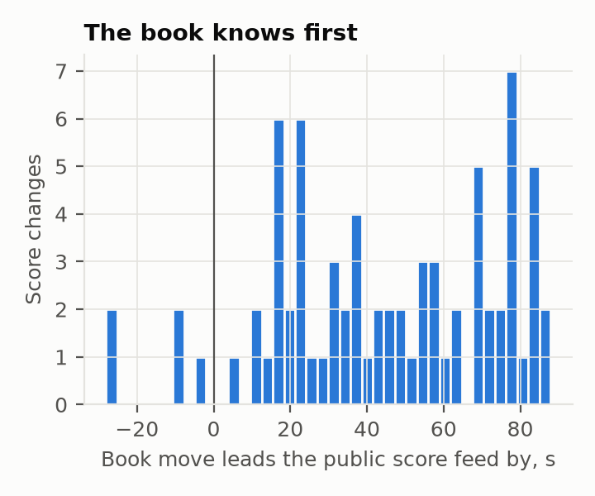
Public score feeds are the slow tier
BACKUP · LATENCY (H4)
Source | vs official stamp | vs the book
Polymarket book | −1.2 s | —
ESPN scoreboard | +27.5 s | 28.2 s behind
Polymarket sports feed | +29.1 s | 30.0 s behind
WTA public API | +43.3 s | 44 s behind
0 of 295 public score changes beat the book by more than 1.3 s (1 s venue delay + 0.3 s).
WHAT FIRST REQUIRES
To meet a stale quote, an order must leave ≥ 1.3 s before the reprice. Fast-tier prints landing 0–0.5 s before it earned +0.91¢ and were sent ≥ 1 s earlier, so they know ≥ 1–1.5 s before the book. Tier 0 adds tens to hundreds of ms on top of that; not yet shown end to end.
API behind Cloudflare's Miami edge: 67 ms one-way from Gainesville; origin consistent with London.
Co-locating saves ~130 ms per round trip: queue order behind the 1 s delay.
Fig. 5 Pre-registered H4: book moved first on 93% of 75 score changes, median lead 44.5 s
COURTSIDE · Gator Quant Hacks 2026 · Systematic Trading
9
Notes:
BACKUP: LATENCY
On the WTA's official point clock (umpire-entered timestamps), the Polymarket moneyline reprices a median 1.2 s before the official stamp (n = 482 points, 9 WTA matches, live 2026-10-03). ESPN reports a game 27.5 s after the stamp, Polymarket's own sports websocket 29.1 s, the WTA public API 43.3 s. Of 295 source-observed score changes matched to a book reprice, none led the book by more than 1.3 s.
Fig. 5 is the pre-registered H4 test: the book moved before Polymarket's public score feed on 93% of 75 score changes, median lead 44.5 s. H4 holds. H4 (n = 75, all matches, book vs feed message) and the official-clock table (PM sports feed 30.0 s behind the book, n = 61, WTA only) use different samples and methods; both put the feed tens of seconds behind.
Timing budget (research/v2/latency/RESULTS.md section 5): the stale depth is gone 0.5 s after the reprice, and with the 1 s order delay an order must be sent at least 1.3 s before the reprice, i.e. at least 2.5 s before the official stamp. Prints landing 0 to 0.5 s before the reprice were 98% with the move and earned +0.91¢/share net; they were submitted at least 1 s earlier, so those takers have the point at least 1 to 1.5 s before the book. Tier-0 tracking adds tens to hundreds of ms on top of whatever that signal is; we have not shown a tier-0 order reaching a stale quote end to end.
Tape timestamps are on-chain block times, a median 1.98 s after the true match time (5,472 trades joined by transaction hash), which is why every tape result charges the real delay.
Infrastructure: Polymarket's API sits behind Cloudflare's Miami edge, 67 ms median one-way from Gainesville, origin consistent with London; co-locating saves about 130 ms per round trip, which decides queue order behind the 1 s delay.
[Sources: research/v2/latency/RESULTS.md; docs/NOTE.md sections 2 and 5; results/summary.json h4.]

Slide 10
Table 1: every test, net of fees and traded spreads
BACKUP · EVERY TEST · H1–H4 PRE-REGISTERED; H5, H6 ADDED AFTER IS (†)
Test | In sample | Out of sample (opened once) | Verdict
H1 Follow the jump after the delay | −1.61 [−1.65, −1.57]; all 20 variants < 0 | −2.08 [−2.17, −1.98] | Fails
H2 Buy favourites entering 0.85–0.97 | −0.41 [−1.44, 0.59]; prices calibrated | +0.80 [−1.36, 2.66] | No edge
H5† Maker quoting after jumps | +0.22 [−0.01, 0.43] | +0.16 [−0.49, 0.87] | Inconclusive
H6† Fast tier, walk-forward, 30 s | +0.6 to +2.4; 8/8 months > 0 | +0.4 to +0.8; 3/3 months > 0 | Holds
Everyone else, same 0–3 s window | −0.5 to −1.7, every month | −1.2 to −1.9
Copying the fast tier 3 s later | < 0 every month | < 0 every month | Edge is speed
H3 Miss called 50 ms early (video) | train CV precision 0.95 (frozen model) | 11/11 correct; recall 27% | Holds
H4 Book moves before public feed | — (live test, 2026-10-03) | book first: 93% of 75 | Holds
¢/share, 95% CI clustered by match. H1–H4 pre-registered (commit 7232986). † Written after in-sample results (DEVIATIONS D3, D5) and frozen before OOS: only their walk-forward / OOS results count.
H1–H6 use onset-aligned windows (ex-post event study); every tradable v2 number uses the causal window.
COURTSIDE · Gator Quant Hacks 2026 · Systematic Trading
10
Notes:
BACKUP: TABLE 1, EVERY TEST
Rows H1, H2, H5 and H6 are the note's Table 1 (docs/NOTE.md); H3 and H4 come from results/summary.json. H1 to H4 are pre-registered (HYPOTHESIS.md, commit 7232986). H5 and H6 were added after the in-sample results (DEVIATIONS D3, D5) and frozen before OOS, so only their walk-forward and OOS results count as tests.
H1, chasing the move, fails in every one of its 20 variants and out of sample. H2 has no edge because prices are calibrated. H5, maker quoting after jumps, is inconclusive. H6 holds: the fast tier, selected each month on earlier months only, is positive in all 8 in-sample and all 3 out-of-sample months, while everyone else in the same window loses every month, and copying the fast tier 3 s later loses every month.
H3: the frozen model's out-of-fold train precision at 50 ms was 0.95; on held-out test games it was 11/11 (Wilson lower bound 74%), calling 11 of 41 misses (recall 27%). A post-hoc label audit (DEVIATIONS H3-D10) found incomplete test labels; the frozen model is 8/8 at 38% recall on corrected labels. The pre-specified result is the one of record.
Multiple testing: 44 strategy variants for H1-H6 plus 3,342 across the six v2 lenses, all reported. The expected best Sharpe from luck over that many trials is about 4.8 (Bailey and Lopez de Prado); v2 shows 14.5 in sample and 6.7 on the burned OOS, and the blind forward test is the clean check.

Slide 11
v2 survives a tick in sample; out of sample, only at the front
BACKUP · SLIPPAGE AND THE HINDSIGHT FIX
NET ¢/SHARE BY ENTRY SLIPPAGE (CAUSAL WINDOW)
CAUSAL WINDOW VS ONSET (HINDSIGHT)
Window | In sample | Burned OOS
Onset (hindsight) re-run, draft's window | +1.58¢ [1.36, 1.80] | +0.76¢ [0.29, 1.21]
Causal window from detection, frozen v2 | +1.38¢ [1.17, 1.59] | +0.60¢ [0.09, 1.13]
Sharpe, causal | 14.5 | 6.7
Trades, causal | 55,662 | 10,412
WHAT THE VERIFIERS FOUND (D9)
The onset label is the first print of a 10 s window the detector confirms later. 81% of the draft's OOS P&L came before detection. Fixed before the forward window opened.
Sharpe by slippage: IS 14.5 / 9.8 / 4.3 (7/7 months each); OOS 6.7 / 1.1 / −4.4
COURTSIDE · Gator Quant Hacks 2026 · Systematic Trading
11
Notes:
BACKUP: SLIPPAGE AND THE HINDSIGHT FIX
Slippage stress, causal window, held to resolution (results/v2/causal.json):
In sample: +1.38 [1.17, 1.59] at fast-tier fills, +0.88 [0.67, 1.09] at +1/2 tick, +0.38 [0.17, 0.59] at +1 tick; positive in 7 of 7 months at every level; max DD −2.0% / −3.7% / −5.9%.
Burned OOS: +0.60 [0.09, 1.13], +0.10 [−0.41, 0.63], −0.40 [−0.91, 0.13]; months positive 2/3, 1/3, 0/3.
Reading: in today's regime (1 s delay, 5% fee, 131 qualifying wallets) the edge is positive only at the fast tier's own fill prices and gone at half a tick. It pays whoever is first to the stale quote. That is the case for in-venue tracking plus a co-located gateway, and the reason a remote copy cannot work.
Hindsight fix (DEVIATIONS D9, HYPOTHESIS_V2 A1): the first v2 draft measured the 0-3 s window from the jump onset, which the detector only confirms up to 10 s later. Re-run from detection, burned-OOS v2 fell from about +0.75 to +0.60 cents. The "Onset (hindsight)" row is causal.json's re-run of the onset window (+1.58 / +0.76); the first draft's own numbers (results/summary.json "v2") were +1.59¢ [1.35, 1.81] in sample and +0.75¢ [0.30, 1.20] on the burned OOS, Sharpe 16.8 / 11.1. H1-H6 keep onset labels as an ex-post event study; every tradable number uses the causal window.

Slide 12
Reproduce the backtest
BACKUP · REPRODUCE
$ pip install -r requirements.txt
# in a fresh venv
$ .venv/bin/python scripts/fetch_polymarket.py
# public APIs, no keys; ~1–2 h, cached in data/
$ bash reproduce.sh
# H1–H6, v2, figures, leverage stats, PDF
$ python run_all.py --oos
# H1–H6, calibration, tiers, fast tier
$ python scripts/v2_causal.py
# v2 on IS + burned OOS -> results/v2/causal.json
$ python scripts/forward_test.py
# blind forward test: one shot, logged
$ pytest tests
# unit tests
INTEGRITY TRAIL
HYPOTHESIS.md
H1–H4 pre-registered, commit 7232986
DEVIATIONS.md
every change and why (H5, H6: D3, D5)
HYPOTHESIS_V2.md
v2 frozen before its forward test
results/oos_peeks.log
every look at held-out data (3 lines)
results/v2/forward.json
forward result (after the run)
Reads public data only and never places an order.
Tracking (H3): sbatch hpg/track_*.sbatch on HiPerGator; outputs cached in results/tracking/ (not in reproduce.sh).
Live-book numbers (latency, liquidity, fills) come from 2026-10-03 recordings in data/ (not committed).
COURTSIDE · Gator Quant Hacks 2026 · Systematic Trading
12
Notes:
BACKUP: REPRODUCE
The backtest regenerates from public data with no API keys. scripts/fetch_polymarket.py pulls the Polymarket tapes (1 to 2 hours, cached in data/). bash reproduce.sh runs run_all.py --oos (H1-H6, calibration, tiers, the walk-forward fast tier), scripts/v2_causal.py (v2 on in-sample and burned OOS with slippage stress), the figures, the leverage stats and the PDF. scripts/v2_causal.py is the current script behind results/v2/causal.json, which every v2 number in this deck reads; the note's header still cites scripts/v2_burned_oos.py, the earlier onset-window run (results/v2/burned_oos.json). The forward test is a one-shot: scripts/forward_test.py, pre-registered window, and every run is logged. Tests: pytest tests.
Not in reproduce.sh: tracking (H3) runs on HiPerGator GPUs via sbatch hpg/track_*.sbatch (table tennis) and hpg/tennis_*.sbatch (broadcast tennis), with outputs cached in results/tracking/ and results/tennis_tracking/. Live-book numbers (latency, liquidity, live fills) come from the 2026-10-03 recordings: python -m src.live_recorder, research/v2/latency, research/v2/livefill; the recordings sit in data/, which is not committed. The worst-match figure (−$206) is computed from data/v2_trades_is_oos.parquet, not written by any script.
Integrity trail: HYPOTHESIS.md (H1-H4 pre-registered, commit 7232986), DEVIATIONS.md (every change, including H5 and H6 being added after in-sample results, D3 and D5), HYPOTHESIS_V2.md (v2 frozen before its forward test), results/oos_peeks.log (3 looks: v1 once, then v2 twice on the burned window, labelled non-blind) and the forward log.
This deck rebuilds with: .venv/bin/python docs/deck/build_deck.py
[Source: README.md, reproduce.sh, hpg/.]

