Slide 1
SecurePay
Simulator
FinTech payment security with fictional data
Group 8:
Smit Shah
Rugved Chavan
Ahmad Azmi
Ojas Zende
Problem Statement 03
01
Notes:
A local educational payment simulator. The project demonstrates security controls using fictional records. It does not connect to a payment network or establish PCI DSS certification. Source: README.md.

Slide 2
Project purpose
Payment data needs protection at every stage
Storage exposure
Compare readable customer details with encrypted email stored in SQLite.
Tampering and access
Demonstrate integrity checks, authenticated APIs, and signed receipts.
Excess collection
Reject unnecessary fields and explain the purpose of collected data.
02
Notes:
Project requirements and implemented scope come from README.md and the dashboard in web/index.html. The unprotected examples are educational comparisons, not a second production storage system.

Slide 3
System architecture
One local Python application serves the dashboard and APIs
Layer | Technology | Responsibility
Browser | HTML / CSS / JavaScript | Dashboard and interactive labs
API server | FastAPI + Uvicorn | HTTPS, authentication, validation
Security logic | cryptography + pwdlib | Encryption, PKI, password hashing
Local persistence | SQLite + .secrets/ | Records, audit events, key files
03
Notes:
Sources: app/main.py serves web/index.html, web/style.css and web/app.js. app/core.py implements SQLite storage, encryption and hashing. app/pki.py creates certificates and signatures. requirements.txt lists FastAPI, uvicorn[standard], cryptography, pwdlib[argon2], pytest and httpx. .secrets is a separate local directory, not an HSM or isolated key service.

Slide 4
Simulated payment lifecycle
01 Authenticate
The API checks the admin username and generated password.
02 Validate
Pydantic accepts customer ID, positive amount, and last four digits.
03 Record
SQLite stores a demo token and payment. The same transaction adds an audit event.
04 Sign
The server signs receipt data with its RSA private key.
04
Notes:
Source: app/main.py::require_admin, Payment and payment; app/core.py::create_payment. POST /api/payments returns 201 for an accepted request. An unknown customer yields 404. Unexpected fields yield 422. A payment token is tok_demo_ plus a random hex value. Every accepted simulated payment receives status approved. No issuer authorization, settlement, token vault or real card processing occurs. amount_cents represents integer minor units and records default to INR.

Slide 5
Email encryption and tamper detection
AES-256-GCM
Encryption inputs
A 256-bit key, a random 96-bit nonce, and customer-email as authenticated context.
Stored value
Base64 encoding of the nonce, ciphertext, and 128-bit authentication tag.
Tamper experiment
Flipping a bit causes tag verification to fail and blocks decryption.
05
Notes:
Source: app/core.py::encrypt, decrypt and inspect_encryption; tests/test_simulator.py::test_encrypted_storage_and_tampering. Additional Authenticated Data (AAD) is the literal byte string customer-email. KEY is .secrets/data-key.bin, separate from data/securepay.sqlite3. Base64 is an encoding, not the encryption algorithm. The cryptography AESGCM implementation appends a 16-byte authentication tag. Customer names and transaction metadata remain readable to someone with database access. The entire database is not encrypted.

Slide 6
PKI and secure communication
HTTPS transport
Interactive PKI lab
A local CA signs an RSA-3072 server certificate for localhost and 127.0.0.1.
The server uses TLS. API requests over HTTP receive status 426.
1 Verify the certificate signature
2 Wrap an AES key with RSA-OAEP
3 Encrypt a message with AES-GCM
4 Unwrap the key and decrypt
5 Sign and verify a receipt
The PKI lab is an application demonstration, separate from the actual TLS handshake.
06
Notes:
Sources: app/pki.py::create_certificates, inspect_certificates, simulate_pki_communication and sign_data; app/main.py::require_https_for_api; app/verify_tls.py. Certificate SANs contain localhost and 127.0.0.1. Server validity is 7 days and CA validity is 30 days at generation. The application demonstration uses RSA-OAEP with SHA-256 and ephemeral AES-256-GCM, with RSA PKCS#1 v1.5/SHA-256 signatures. This does not describe the negotiated TLS key exchange. The browser requires trust in the local CA. Certificates, encryption keys and password hashes should never be included in the presentation.

Slide 7
Access control and input validation
Admin access
HTTP Basic authentication protects the application APIs over HTTPS.
Credential storage
Setup prints a random one-time password. Only an Argon2id hash is stored.
Strict request models
Customer and payment schemas forbid extra fields. Invalid requests return 422.
Database writes
Bound SQL parameters keep submitted values separate from SQL statements.
07
Notes:
Sources: app/main.py::require_admin, Payment and CustomerCreate; app/core.py::initialize, verify_password and create_payment. Setup uses secrets.token_urlsafe(18). PASSWORD_HASH is .secrets/admin-hash.txt. Username comparison uses secrets.compare_digest. The password checker demonstrates a six-part policy: 12 characters, uppercase, lowercase, digit, special character and exclusion from a short weak-password list. That checker is a lab endpoint, not a registration flow. The current app has a single admin account and does not implement MFA, roles or login throttling.

Slide 8
Privacy through data minimization
Data category | Project handling
Customer name and email | Keep name for display. Encrypt email at rest.
Payment details | Store customer link, amount, demo token and last four.
Phone, address, date of birth | Omit from customer and payment schemas.
Full PAN, CVV and PIN | Do not accept in customer or payment creation.
The payload inspector explains whether candidate fields are needed, unnecessary, or prohibited by the demo policy.
08
Notes:
Sources: app/core.py::FIELDS, EXCESS_FIELDS, analyze_payload_privacy and audit_report; app/main.py::privacy and check_privacy_payload. PAN means Primary Account Number. The inspector classifies PAN as prohibited by this simulator policy; do not generalize that classification into a claim that PCI DSS bans all PAN storage. The arbitrary JSON inspector can receive test fields for classification and does not persist them. Customer and payment creation models reject extra fields. All demonstrations should use fictional values. The app does not actually send email receipts.

Slide 9
Seeded data: before and after
Comparison for the two fictional customers created by setup
Measure | Illustrative baseline | Protected storage
Readable emails in storage | 2 | 0
Encrypted customer emails | 0 | 2 of 2 (100%)
Excess field types | 5 | 0
Payment audit coverage | Not modeled | 2 of 2 (100%)
The baseline exists only in memory. These are seed-data measurements, not performance benchmarks.
09
Notes:
Sources: app/core.py::initialize and audit_report; tests/test_simulator.py::test_access_minimization_and_measurement. Seed data contains 2 customers, 2 transactions and 2 payment_created audit events. The in-memory baseline assembles five excess field types: phone, address, birth_date, pan and cvv. It does not create a plaintext comparison database. Counts can change when a user creates customers or transactions. Audit coverage is the count of audit rows divided by the transaction count, not a cryptographic integrity or event-linkage check.

Slide 10
Selected PCI DSS principles
Theme | Implementation evidence
Stored data and privacy | Email encryption, minimal schemas, demo payment tokens
Secure transmission | Local CA certificate, HTTPS enforcement, TLS verifier
Application security | Pydantic validation and parameterized SQLite writes
Access and credentials | Admin authentication and salted Argon2id hashes
Activity monitoring | Timestamped payment audit events
The dashboard demonstrates selected principles. Passing its checks does not establish PCI DSS compliance or certification.
10
Notes:
Project-specific source: README.md and app/main.py::overview. This slide summarizes the project educational mapping and does not provide a current standards interpretation or independent compliance assessment. The dashboard labels requirements 3.2/3.3, 3.5/3.6, 4.2, 6.2, 7.2/8.3 and 10.2. Those mappings are not independently validated here. The audit_events table has no implemented immutability control, even though some project UI text calls it immutable. A production assessment would need broader technical, operational and organizational evidence.

Slide 11
Automated verification
6 / 6
Test coverage
Encryption at rest and ciphertext tampering
Authentication, storage metrics and payments
HTTP rejection and strict customer schemas
PKI delivery, password checks and privacy inspection
tests passed
Local run on 30 October 2026
Functional tests use temporary data. They do not establish production readiness.
11
Notes:
Source: tests/test_simulator.py. Executed .venv\Scripts\python.exe -m pytest -q on 30 October 2026: 6 passed, 1 deprecation warning, in 5.57 seconds. The warning concerns the Starlette TestClient httpx integration. The pytest demo fixture monkeypatches database and secret paths into tmp_path, creates its own generated credential and certificates, and uses TestClient with https://testserver. The suite contains six test functions, some of which cover several scenarios. These are functional application tests, not browser tests or a network penetration assessment.

Slide 12
Live demonstration
01 Dashboard
Sign in, compare stored ciphertext with the authorized readable view, and add a customer.
02 Security labs
Run encryption and PKI delivery once normally, then repeat with tampering enabled.
03 Privacy checks
Compare an excessive candidate payload with the minimal payment fields.
04 Payment evidence
Create a simulated payment and inspect its token, signature, and audit event.
12
Notes:
Sources: web/index.html, web/app.js and the application API endpoints. Suggested sample email: demo@example.test. Use only fictional inputs. The dashboard login asks for the generated admin password. No secrets are embedded in this deck. A successful encryption run returns VERIFIED. A tampered run returns TAMPER_BLOCKED_INVALID_TAG. PKI simulation returns SECURE_DELIVERY or BLOCKED_TAMPER_DETECTED. The current dashboard decrypts customer emails for an authenticated administrator, so encryption at rest does not hide data from an authorized app session.

Slide 13
Running the project on Windows
Initial setup in the project folder
py -3.13 -m venv .venv
.\.venv\Scripts\python.exe -m pip install -r requirements.txt
.\.venv\Scripts\python.exe -m app.setup
Start the HTTPS server
.\.venv\Scripts\python.exe -m uvicorn app.main:app `
--host 127.0.0.1 --port 8443 `
--ssl-keyfile .secrets/server-key.pem --ssl-certfile .secrets/server.pem
Open https://127.0.0.1:8443 and log in as admin with the password printed by setup.
13
Notes:
Source: README.md and app/setup.py. Commands run in PowerShell from the repository root. The start-server command is one command shown across lines for readability: join the three displayed lines with spaces, or use PowerShell backtick line continuations. Direct use of .venv\Scripts\python.exe requires no virtual-environment activation. On an initialized project, skip creating the environment, installing existing dependencies and setup as appropriate. The generated password appears in terminal output after One-time generated password:. It cannot be recovered from the stored hash. app.setup --reset recreates demo records, encryption keys and certificates, so reset is destructive to the current demo data. A local certificate trust warning may appear. Optional checks: .venv\Scripts\python.exe -m app.verify_tls and .venv\Scripts\python.exe -m pytest -v. The current local server certificate lasts 7 days.

Slide 14
Project scope and next steps
Implemented learning outcome
The simulator makes protection visible through encrypted storage, integrity failures, certificate checks, and minimal request schemas.
Current scope
Local fictional payments, one admin account, local key files, and a regular SQLite audit table.
Future development
Role-based access and MFA, managed key rotation, stronger audit integrity, and production deployment testing.
14
Notes:
Sources for current scope: README.md; app/core.py::initialize and create_payment; app/main.py::require_admin; app/pki.py::create_certificates. Future items are proposed extensions, not implemented capabilities or commitments. Other limitations include no real payment gateway, no payment settlement, no production token vault, no external certificate authority and no implemented key rotation. The simulated approved status does not represent authorization by a bank. Existing local key separation does not provide process-level isolation. The project is educational and provides no PCI DSS certification.

Slide 15
Github Repo Link:
https://github.com/OjasZende/securepay_simulator_LnT
Website Screenshots ahead →

Slide 16
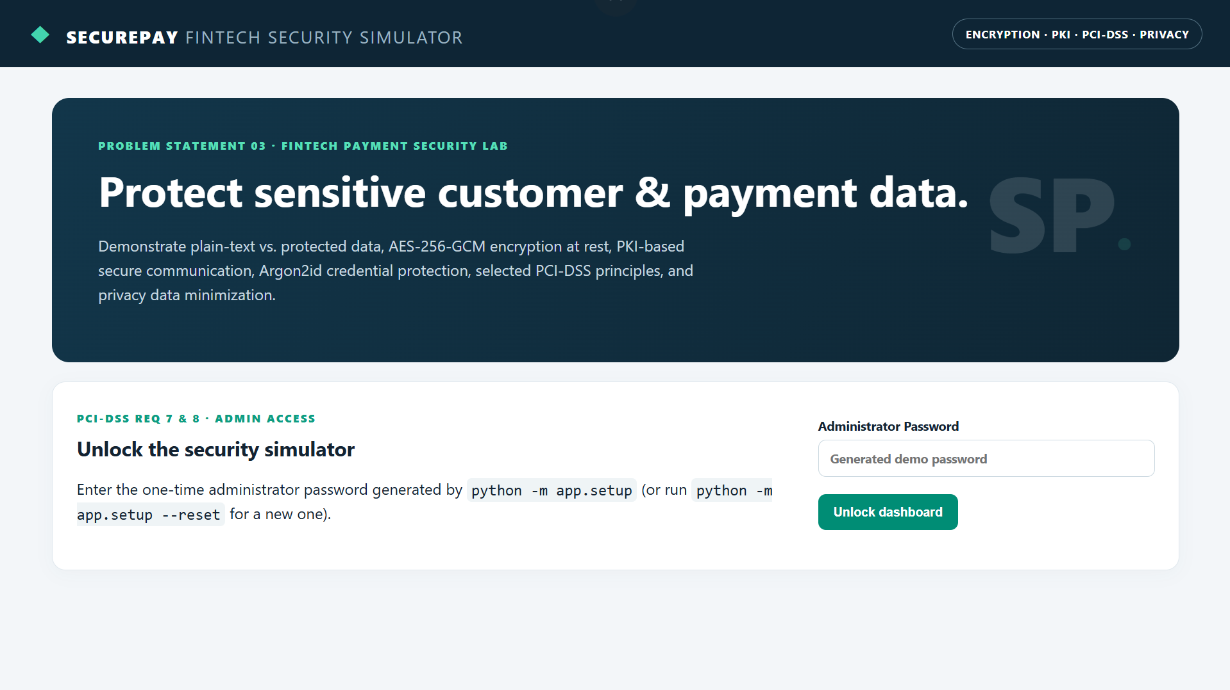

Slide 17
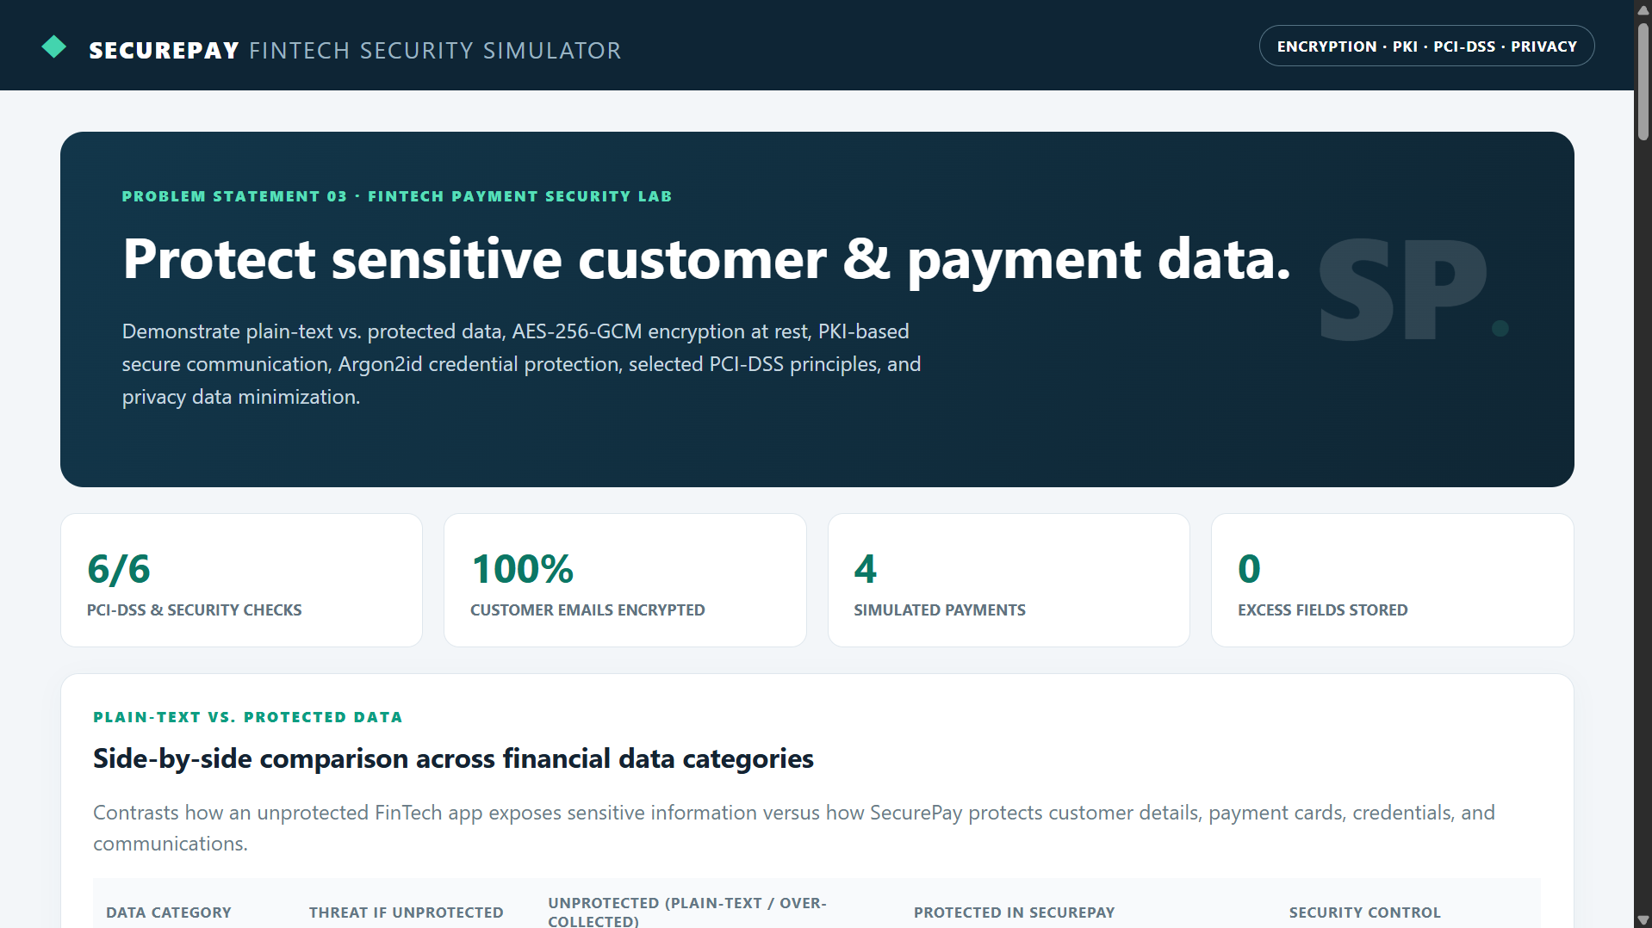

Slide 18
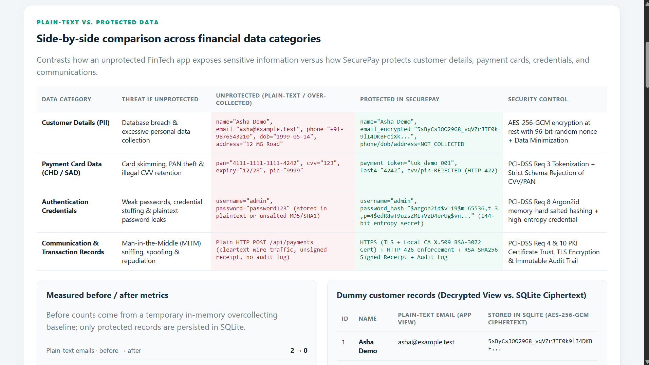

Slide 19
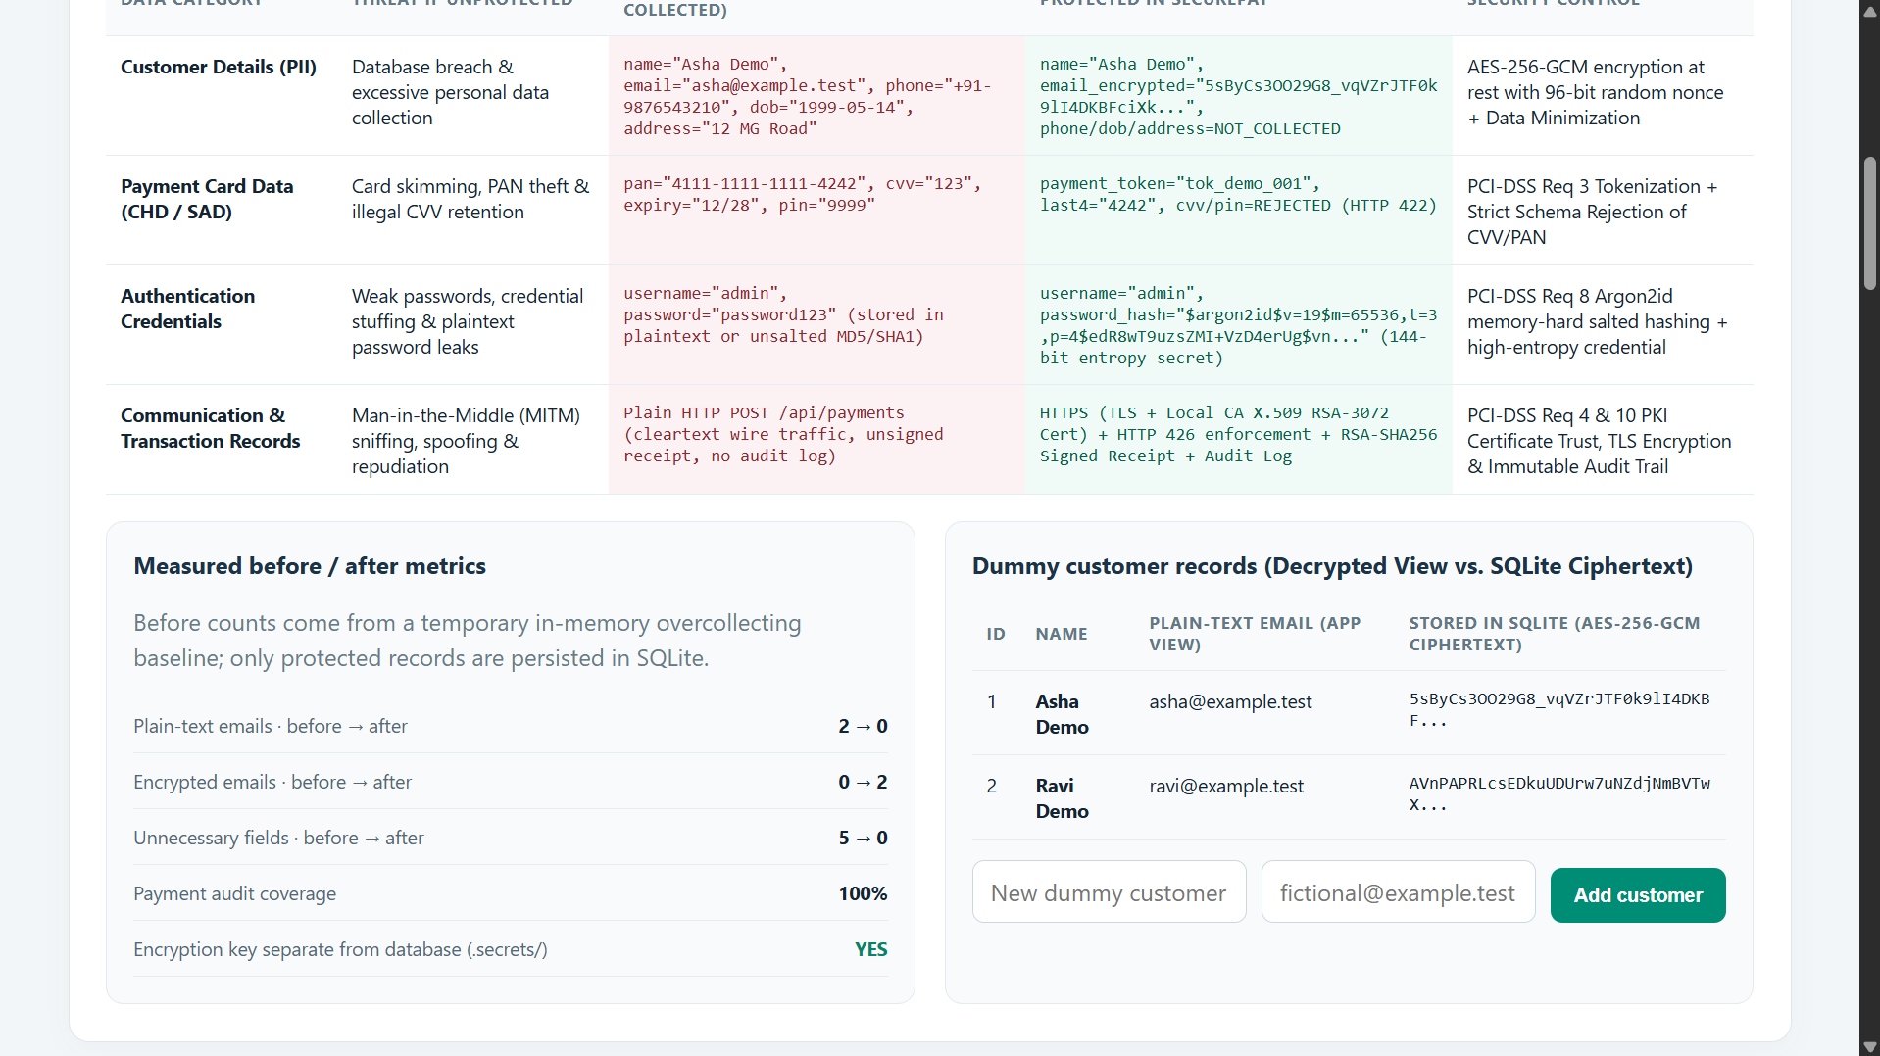

Slide 20
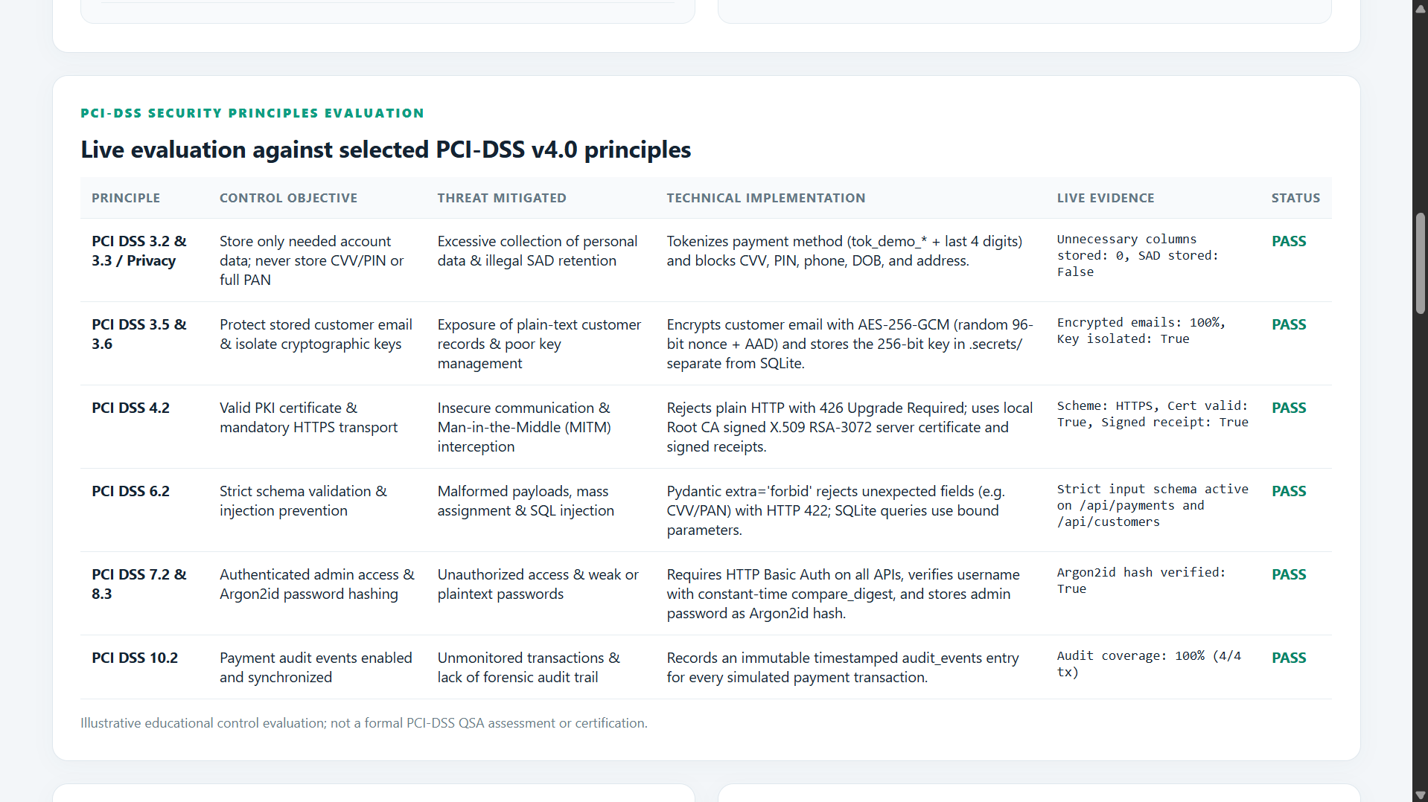

Slide 21
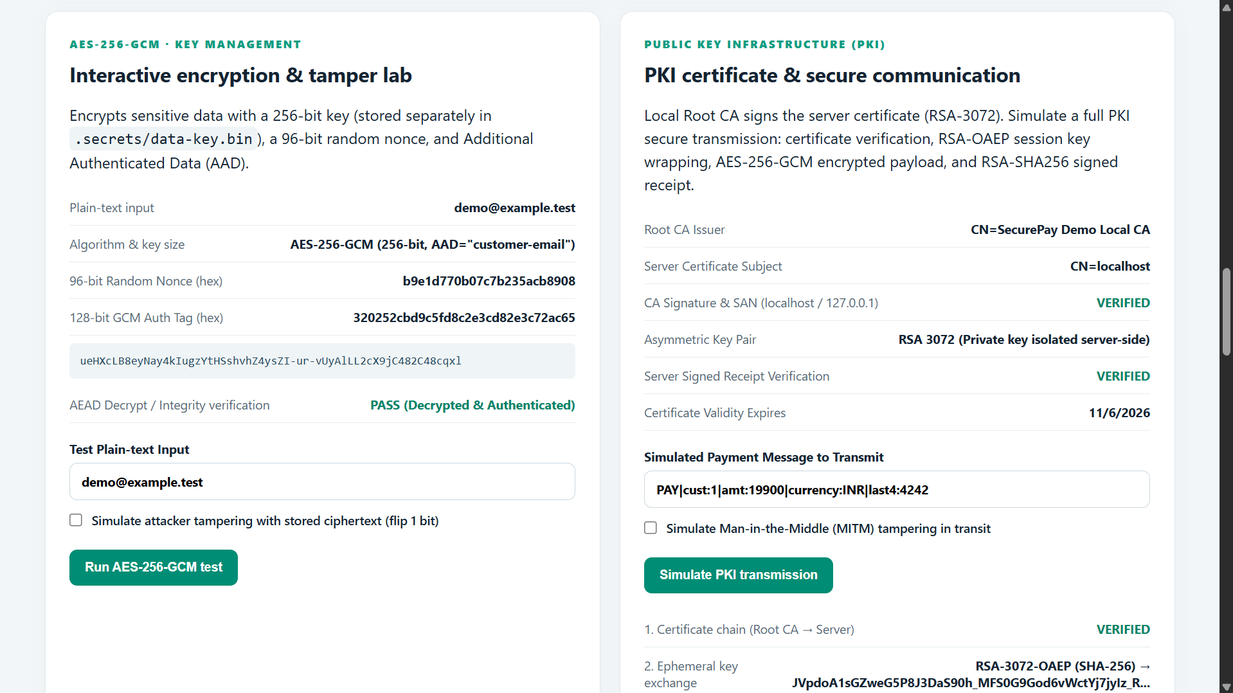

Slide 22
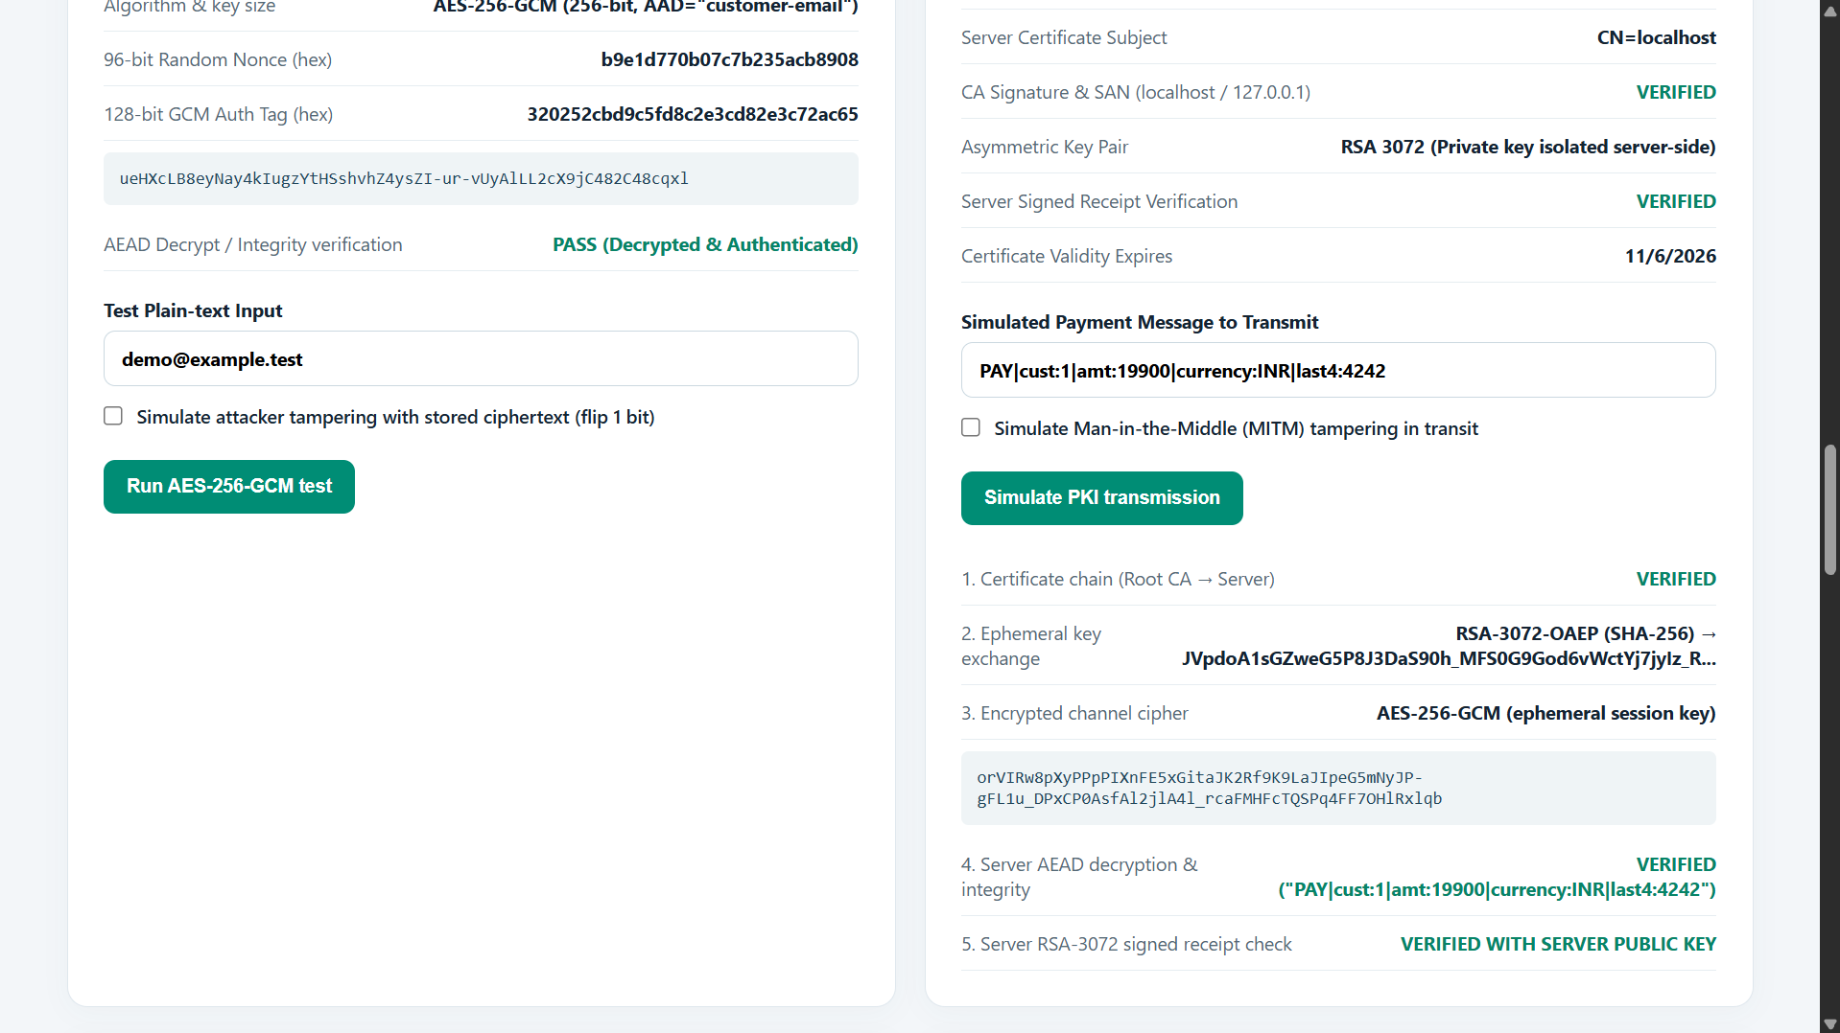

Slide 23
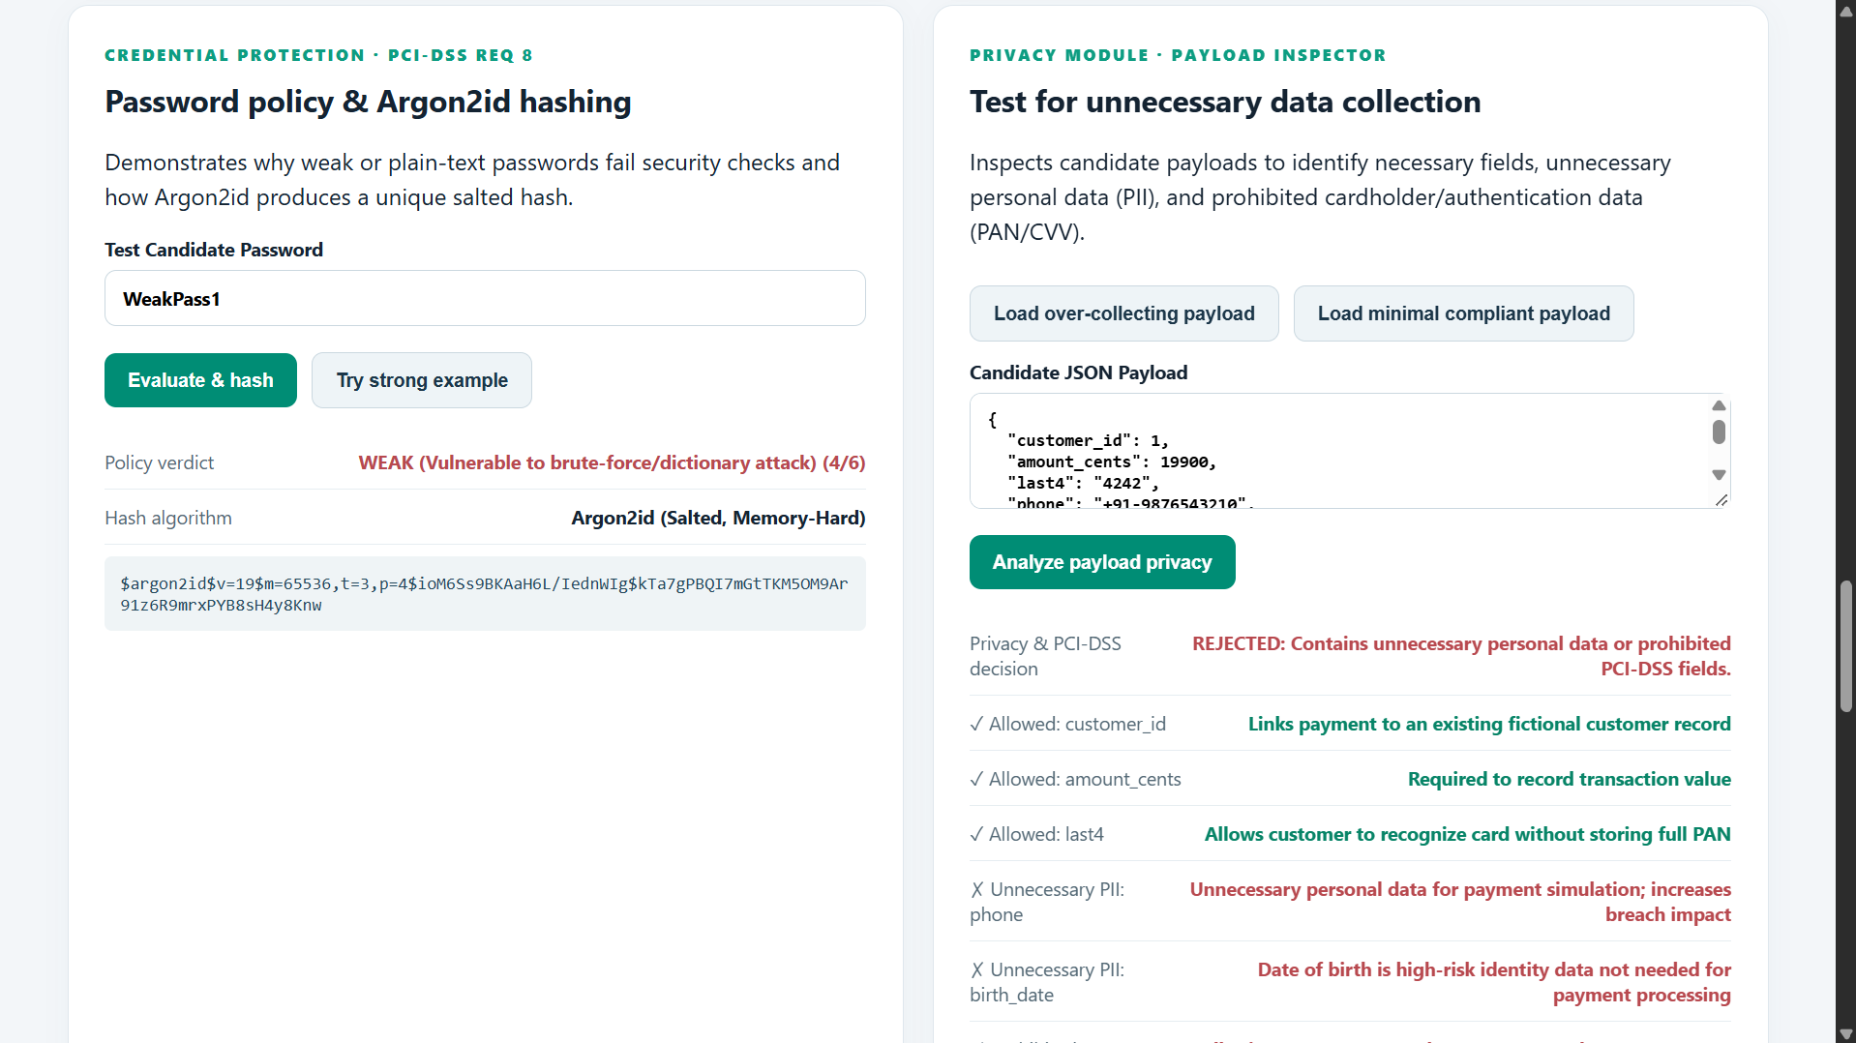

Slide 24
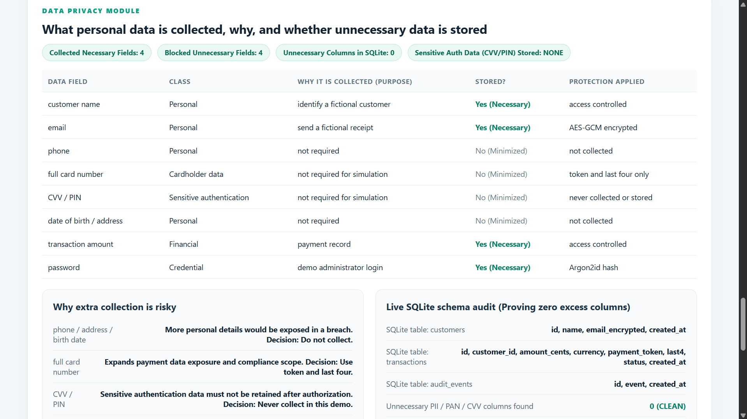

Slide 25
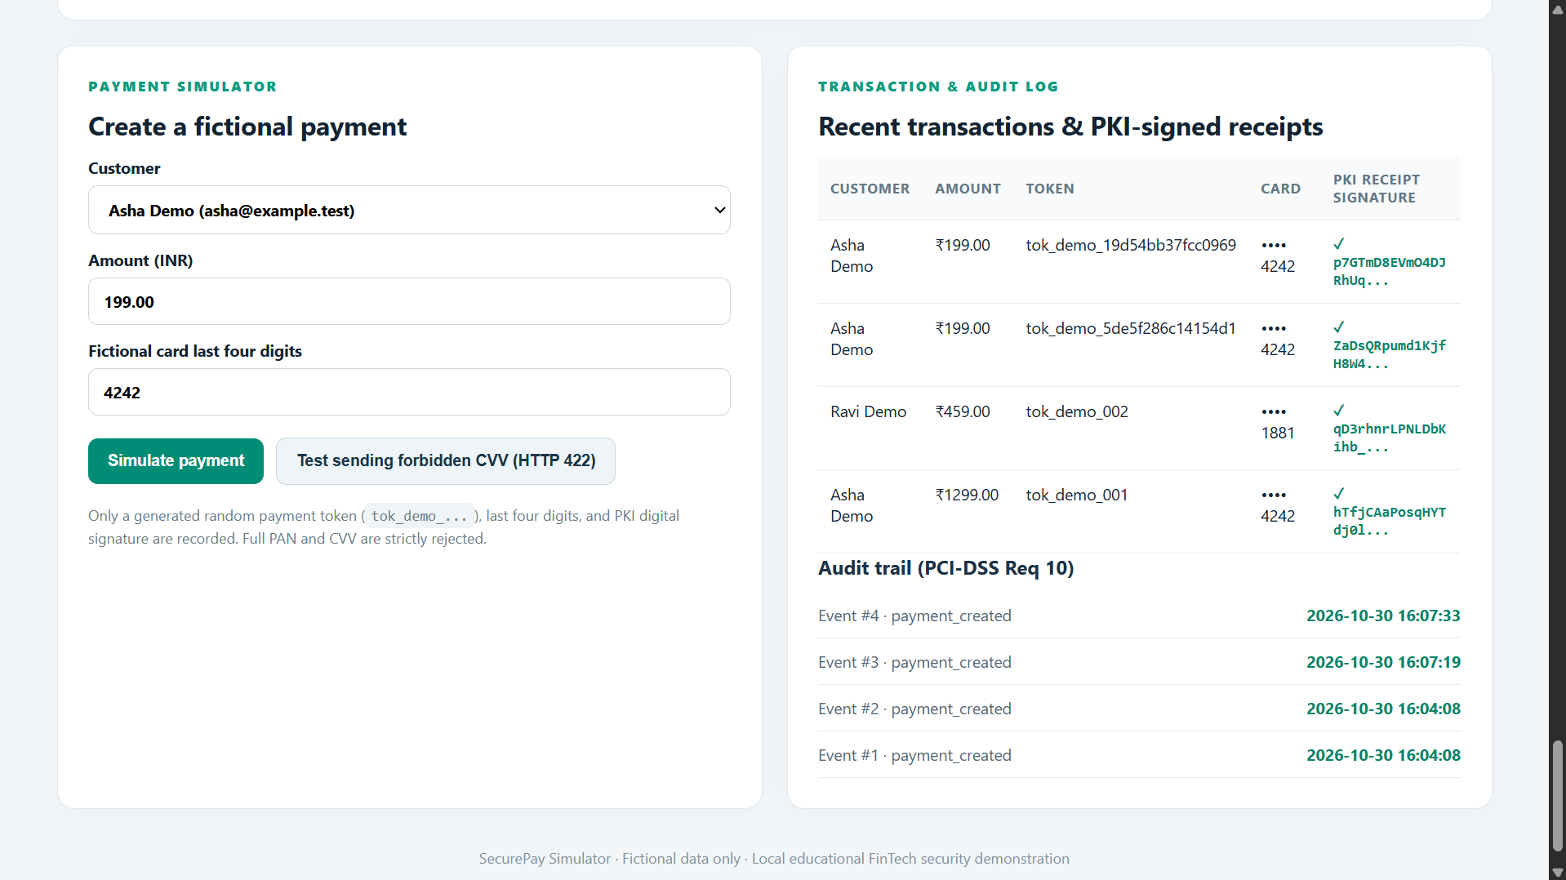

Slide 26
Thank You

