Slide 1

AI-ML Project
Sentiment
Analyser
Rahul Saravanan
Ojasvi s

Slide 2

Introduction
Our project is based on analyzing a provided sentence and classifying it based on the inner mood. Chats help us convey our message but what they miss is the emotion that we wish to convey along with the text we type. This can be solved by generating a model that can predict if the given message sentence is positive(happy) or negative(sad).

Slide 3

Tone in the text
Now once the message is classified based on the mood of the texter, it can be added with emoticons or stickers that add the emotion we would like to convey. This ensures that the tone if the speaker is conveyed along with the text.

Slide 4

Text mining
Text mining is the process of extracting meaningful information and patterns from unstructured or semi-structured text data. It involves techniques such as natural language processing (NLP), machine learning, and statistical analysis to identify trends, relationships, or insights within large text datasets.
Text mining can be used for tasks like sentiment analysis, topic modelling, and document classification, helping businesses and researchers turn raw text into valuable knowledge for decision-making, predictions, or deeper understanding of content.

Slide 5
Challenges Faced
Generating a very accurate model
Hunting for a long data list
Contextual Understanding (Sarcasm and irony)
Word Ambiguity
Out-of-Vocabulary Words and Native-slangs

Slide 6
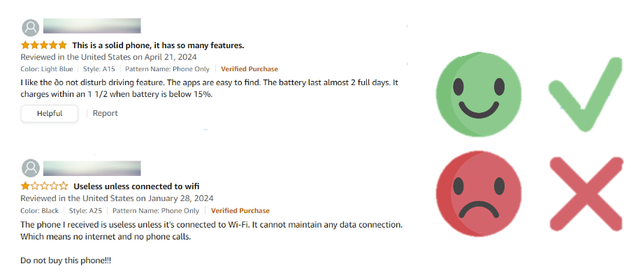
Review System
Applications of text mining

Slide 7
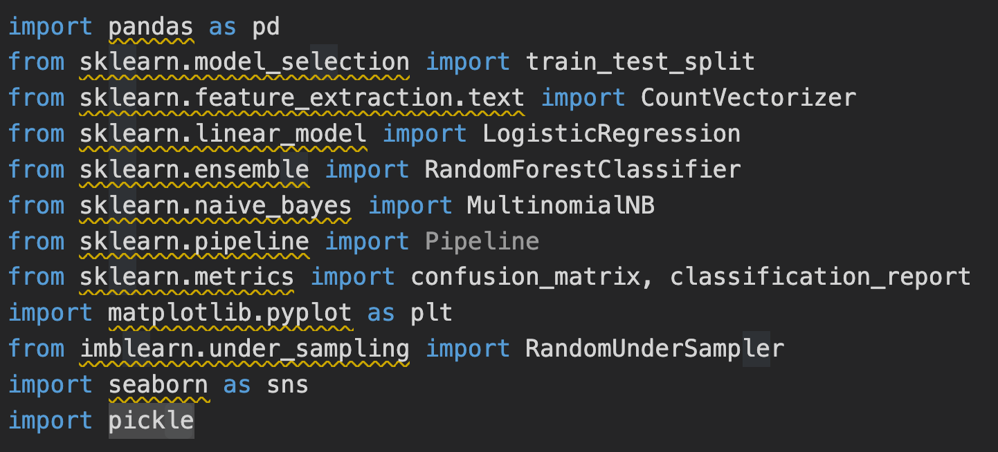
Self made app
Machine learning Packages to import

Slide 8
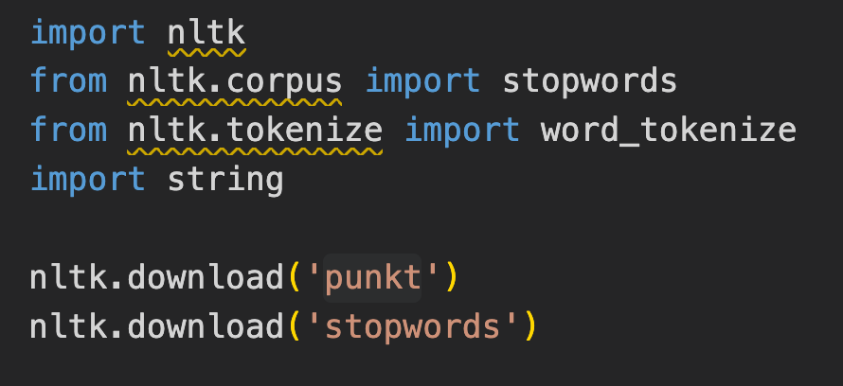
Self made app
Language processing Packages to import

Slide 9
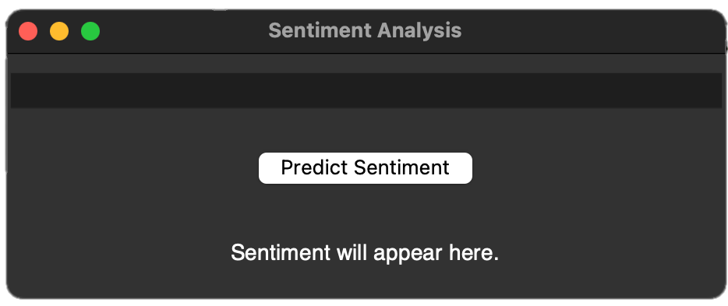
Self made app

Slide 10
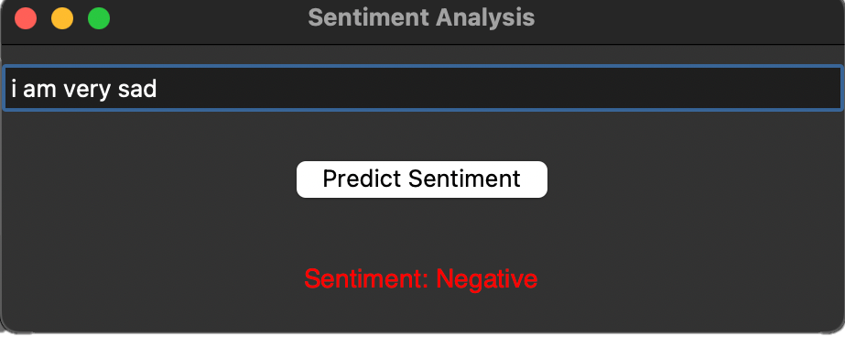
Self made app

Slide 11
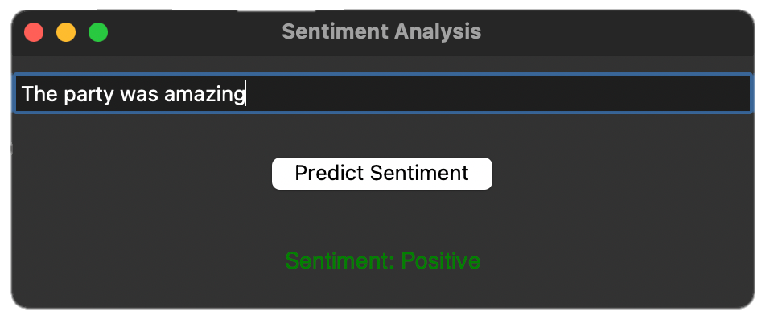
Self made app

Slide 12
Thank you!!!

