Slide 1
MASTER OF SCIENCE THESIS DEFENSE
On the Robustness of Decentralized
Federated Learning against Byzantine
Attacks and Channel Noise
Ojaswi Sinha
Advisor: Dr. Animesh Yadav
MS Computer Science | Ohio University
Notes:
Slide 1: On the Robustness of Decentralized Federated Learning against Byzantine Attacks and Channel Noise
Introduce yourself as Ojaswi Sinha, an MS Computer Science student at Ohio University, advised by Dr. Animesh Yadav. The title is copied from the latest supplied thesis.tex. No defense date has been invented.
Sources: thesis.tex: title and advisor fields
Suggested time: 30 seconds.

Slide 2
OVERVIEW
The thesis in one slide
Research question
Methodology
How can a receiver learn reliably from
peers under attacks, channel noise and
label skew?
FedSharp: guarded exchange + noise-aware
training.
FedSharp+: class-aware admission + update
checks.
Result
Core references
FedSharp+: 28.98% on CIFAR-10 non-IID
joint cases.
No gain over FedSharp on MNIST.
[1] McMahan et al., AISTATS 2017
Federated averaging
[2] Elkordy et al., IEEE JSAC 2022
BASIL
Ojaswi Sinha | MS Computer Science | Ohio University
02
Notes:
Slide 2: The thesis in one slide
Read the four quadrants briefly. The question is joint robustness under Byzantine attacks, link noise and label skew. The methods are FedSharp and its class-aware extension, FedSharp+. The result is conditional: the extension helps CIFAR-10 non-IID joint cases, but does not improve MNIST relative to base FedSharp. These are means across three seeds, not significance tests. The two core references establish federated learning and the BASIL baseline.
Sources: Verified 50-group summary; references.bib: mcmahan_fedavg, basil
Suggested time: 60 seconds.

Slide 3
MOTIVATION
Collaborative learning has three practical constraints
Local data
No central server
Unreliable exchange
Clients keep their
fitting examples.
Peers exchange model
parameters.
Malicious updates and
noisy links.
Removing the server does not remove the need to decide which model to trust.
Ojaswi Sinha | MS Computer Science | Ohio University
03
Notes:
Slide 3: Collaborative learning has three practical constraints
The motivating setting is a collection of institutions or devices that retain training data locally. A central coordinator may be unavailable or undesirable. Even without an aggregator, a peer can transmit a corrupted model and communication can perturb parameters. The experiment is a simulation of parameter noise, not a measured wireless deployment.
Sources: Thesis scope and verified experiment documentation
Suggested time: 50 seconds.

Slide 4
BACKGROUND
Federated learning keeps training data at the clients
Client 1
Client 2
Client 3
Local
training
Local
training
Local
training
Data
Data
Data
Exchange model parameters
The data remain local; the models connect the clients.
Ojaswi Sinha | MS Computer Science | Ohio University
04
Notes:
Slide 4: Federated learning keeps training data at the clients
Define a client, local dataset and model parameters. Each client uses local examples to update a common model structure. Model exchange can still reveal information; this thesis does not prove differential privacy or cryptographic privacy. The diagram is conceptual and does not imply a particular aggregation algorithm.
Sources: [1] McMahan et al., 2017; thesis background
Suggested time: 55 seconds.

Slide 5
BACKGROUND
Centralized federated learning uses a coordinating server
Aggregate updates
Server
Distribute the model
Client 1
Client 2
Client 3
Client 4
Clients train locally, but coordination still depends on one server.
Ojaswi Sinha | MS Computer Science | Ohio University
05
Notes:
Slide 5: Centralized federated learning uses a coordinating server
Contrast federated learning with centralized data collection. In centralized federated learning, the server coordinates and aggregates model updates while data stay at clients. Do not call it centralized training on pooled data. This establishes the server dependency that DFL removes.
Sources: [1] McMahan et al., 2017
Suggested time: 55 seconds.

Slide 6
BACKGROUND
Decentralized FL moves model exchange to the peers
1
What changes?
8
2
No central aggregator.
A receiver makes its own decision.
Local data may differ across clients.
7
3
6
4
5
Peer-to-peer topology
This thesis studies a sequential directed ring within the broader DFL setting.
Ojaswi Sinha | MS Computer Science | Ohio University
06
Notes:
Slide 6: Decentralized FL moves model exchange to the peers
General DFL includes several graph structures and gossip or consensus approaches. A directed ring is one topology, not the definition of DFL. The thesis uses sequential client activation in a directed ring, with predecessor memory rather than a central aggregator.
Sources: [2] BASIL; [3] Hsieh et al., 2020
Suggested time: 55 seconds.

Slide 7
PRIOR WORK
BASIL provides the starting point for the ring study
Byzantine resilience
Statistical
heterogeneity
Communication noise
BASIL evaluates
received models on the
receiver's local data. [2]
Non-IID data can make
local model preferences
disagree. [3]
Link perturbations can
accumulate during
repeated exchange. [4]
Study attacks and channel noise together, then address receiver-level class recognition.
Ojaswi Sinha | MS Computer Science | Ohio University
07
Notes:
Slide 7: BASIL provides the starting point for the ring study
Summarize selected prior work rather than claim a complete survey. BASIL supplies sequential ring learning and local performance-based model selection. Hsieh and colleagues explain difficulties caused by non-IID data. Ang and colleagues motivate noisy communication in federated learning. BASIL with ACDS adds anonymous cyclic data sharing; in our experiment it shares fitting examples and has a different data-access budget. This thesis investigates the combination of threats with receiver-local safeguards.
Sources: [2] BASIL; [3] Hsieh et al.; [4] noisy communication
Suggested time: 65 seconds.

Slide 8
PROBLEM SETTING
One model can carry several kinds of error
Sender
Attack
Channel
Receiver
Trained model
Outgoing corruption
Gaussian link noise
Label-skewed data
Byzantine model
replacement
Fresh noise + inherited error
The receiver sees the combined effect, not a label identifying the source of error.
Ojaswi Sinha | MS Computer Science | Ohio University
08
Notes:
Slide 8: One model can carry several kinds of error
Use this slide to separate Byzantine corruption, fresh link noise and inherited error. The Hidden attack in the experiment is its implemented blend, not necessarily the single-coordinate theoretical example. IID and non-IID refer to the data partition. These are distinct sources of difficulty.
Sources: Thesis scope and verified experiment documentation
Suggested time: 60 seconds.

Slide 9
RESEARCH QUESTIONS
Three research questions guide the evaluation
RQ1
Can guarded exchange and noise-aware training improve
joint attack and noise performance?
1
RQ2
Can receiver-local class evidence improve learning on
non-IID data without sharing examples?
2
RQ3
Where do these methods help, and what performance
costs remain?
3
Ojaswi Sinha | MS Computer Science | Ohio University
09
Notes:
Slide 9: Three research questions guide the evaluation
RQ1 asks about guarded exchange and noise-aware training under the combined threats. RQ2 asks whether private class-recognition evidence improves non-IID decisions without sharing fitting examples. RQ3 asks where those choices help or hurt relative to BASIL and ACDS. These are empirical questions for the tested models and conditions, not a universal robustness claim.
Sources: Thesis scope and verified experiment documentation
Suggested time: 55 seconds.

Slide 10
SYSTEM MODEL
Each receiver uses a memory of predecessor models
1
8
2
Memory
Decision
Update
Received
versions
Select or admit
Five SGD steps
7
3
6
4
BASIL: up to 34 copies
FedSharp: up to 66 copies
5
Schematic: 8 of 100 clients
Ojaswi Sinha | MS Computer Science | Ohio University
10
Notes:
Slide 10: Each receiver uses a memory of predecessor models
There are 100 clients in a fixed directed ring. One round activates all 100 clients, and each activation uses five SGD steps. In impaired cases, BASIL considers up to 34 predecessors, while FedSharp uses up to 66 with a Byzantine design budget of 33. The diagram shows eight clients only for readability. The window is not 66 independent fresh training runs. Noise is keyed by receiver, sender and model version; re-reading the same copy does not draw fresh noise.
Sources: research_protocol.py; sharp_protocol.py; basil_sharp_thesis.py
Suggested time: 65 seconds.

Slide 11
METHODOLOGY
The evaluation follows a fixed, auditable pipeline
Data
Partition
Ring
Evaluate
Verify
Training archives
IID or non-IID
500 rounds
Common holdout
Sources +
inference
Match the data and training budget before comparing the methods.
Ojaswi Sinha | MS Computer Science | Ohio University
11
Notes:
Slide 11: The evaluation follows a fixed, auditable pipeline
Show the evaluation process. Both datasets use a common 1000-image development holdout from original training data, with 100 images per class. Official test sets are not loaded. Partitions, initialization and keyed batches are matched where controls are compared. Results include saved fresh CPU inference receipts and source snapshots. This is not a claim that a final independent test set was used.
Sources: Thesis scope and verified experiment documentation
Suggested time: 55 seconds.

Slide 12
BASELINE
BASIL forwards one locally preferred candidate
Window
Score
Choose
Train
Up to 34 copies
Local mini-batch loss
One lowest-loss model
Five local steps
A low local loss may not reflect recognition across all classes.
Ojaswi Sinha | MS Computer Science | Ohio University
12
Notes:
Slide 12: BASIL forwards one locally preferred candidate
For the impaired BASIL baseline, the receiver evaluates up to 34 predecessor candidates and copies the single candidate with the lowest local cross-entropy. It does not average the three lowest models or the 33 lowest models. The current clean controls follow a separate defense-disabled immediate-predecessor transfer rule, explained later.
Sources: basil_sharp_thesis.py; research_protocol.py; [2]
Suggested time: 60 seconds.

Slide 13
FEDSHARP
FedSharp adds safeguards before and during training
Screen
Rank
Check pool
Train
Peak deviations
Local loss
Accept or reduce q
Noise + drift penalties
What enters local training?
An accepted parameter vector, after the receiver checks the realized average.
Ojaswi Sinha | MS Computer Science | Ohio University
13
Notes:
Slide 13: FedSharp adds safeguards before and during training
Explain every block briefly: coordinate-wise median and peak-ratio screening, local loss ranking, checked averaging, and robust proximal training. The evaluated selector uses survivor-dependent budgets and checks the realized pool loss. It can reduce the pool or choose a single model. Do not describe the evaluated implementation as always averaging 33 models. The word pool refers to parameter vectors, not averaging loss values.
Sources: sharp_math.py; sharp_checked_pool.py; guarded selection and worker sources
Suggested time: 70 seconds.

Slide 14
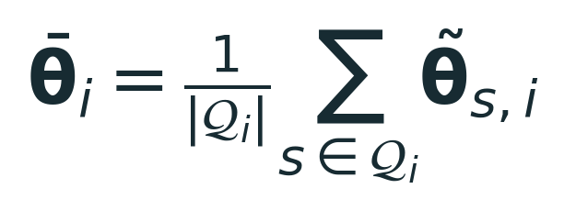
FEDSHARP SELECTION
FedSharp averages model parameters, not the lowest losses
Rank parameters
Test their average
Reduce if needed
Use local loss values
Check the realized loss
Actual count q can be 1
The maximum budget is 33; the accepted count is a measured outcome.
Ojaswi Sinha | MS Computer Science | Ohio University
14
Notes:
Slide 14: FedSharp averages model parameters, not the lowest losses
Correct a frequent interpretation issue. Loss values rank complete parameter vectors. The actual checked pool averages selected parameter vectors. The count q is at most 33 and can be much smaller. The thesis aggregate equation is reproduced unchanged. Code adds a realized-pool loss check and fallback behavior beyond the older Algorithm 1 description. Current measured joint-case mean q values are approximately 1.94 to 9.75 across dataset/split/attack groups over rounds 21 to 500, not a fixed 33.
Sources: sharp_math.py: peak_screen, ranked_indices; sharp_checked_pool.py: selector
Suggested time: 75 seconds.

Slide 15
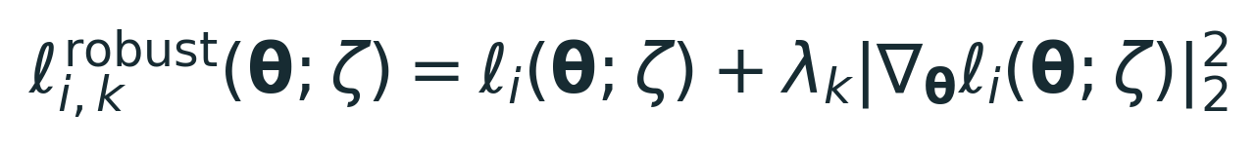
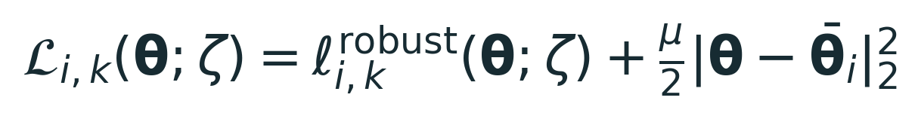
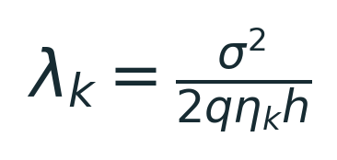
FEDSHARP OBJECTIVE
The training objective addresses noise and local drift
Gradient penalty
Proximal anchor
Reduce local loss
sensitivity.
Limit movement from
initialization.
q is the realized count in code.
Thesis robust and proximal objectives, unchanged. Proximal training: Li et al. [5].
Ojaswi Sinha | MS Computer Science | Ohio University
15
Notes:
Slide 15: The training objective addresses noise and local drift
Reproduce the thesis equations without editing them. The robust loss adds the squared gradient norm, and the proximal objective anchors training at the admitted initialization. The gradient penalty requires Hessian-vector products through automatic differentiation. In the measured impaired implementation, the lambda denominator uses the realized q, not a fixed 33. The impaired runs use mu=1; the new defense-disabled clean controls use mu=0. In FedSharp+ the same objective structure uses adjusted training CE. The idealized fresh-noise covariance argument does not prove exact post-selection noise reduction or inherited-noise removal.
Sources: thesis.tex: eq:method_robust_loss, eq:method_proximal_objective, eq:method_lambda
Suggested time: 85 seconds.

Slide 16
WHY FEDSHARP+?
Under label skew, one loss value may hide class failures
Illustrative local label distribution
Receiver-local question
Does this candidate preserve
the classes this receiver can
already recognize?
0
1
2
3
4
Class
Schematic only. Class counts are illustrative, not experimental measurements.
Ojaswi Sinha | MS Computer Science | Ohio University
16
Notes:
Slide 16: Under label skew, one loss value may hide class failures
This schematic motivates the extension; it is not measured data. Local class imbalance can make low average loss compatible with weak recognition of less frequent classes. FedSharp+ compares complete models using class recognition on two receiver-private probes. It does not combine per-class pieces from different models. No raw fitting examples are shared by this extension. Model sharing alone does not establish formal privacy.
Sources: Thesis scope and verified experiment documentation
Suggested time: 65 seconds.

Slide 17
FEDSHARP+ ADMISSION
FedSharp+ admits models using local class evidence
Candidates
Two probes
Class evidence
Admission
Pool + peers + owned
Fit and check, local
Recognition +
allowance
Complete model +
anchor
Little class support
Uninformative owned model
Informative owned model
Use the checked pool
Prefer the nearest candidate
Compare class-aware utility
Ojaswi Sinha | MS Computer Science | Ohio University
17
Notes:
Slide 17: FedSharp+ admits models using local class evidence
Candidates are the checked FedSharp pool, up to eight eligible individual peers, and the owned model when available. Fit and checking probes are fixed disjoint samples from the receiver fitting data, up to 16 examples per class per probe. Recognition is one-vs-rest MCC from raw logits, not F1. Qualification and informativeness are different checks. With fewer than two supported classes, use the checked pool. With supported classes but uninformative ownership, use the nearest-priority candidate. Otherwise admit the highest-priority candidate within 0.01 of best utility. The priority order puts nearest peers before pool before own. Perturbation allowances use 19 keyed draws when conditions hold; this is an empirical local allowance, not a statistical confidence interval.
Sources: cart_prior_neutral_commit.py; cart_peer_candidates.py; cart_class_skill.py
Suggested time: 80 seconds.

Slide 18
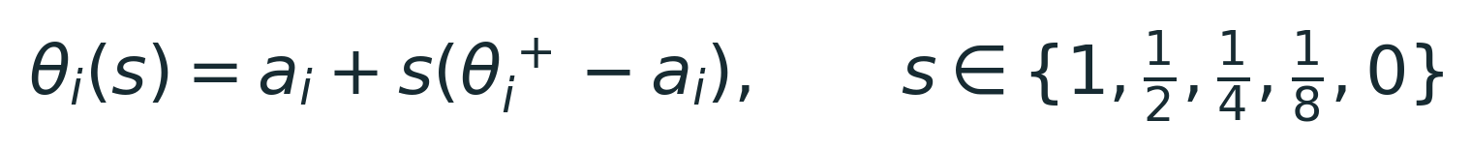
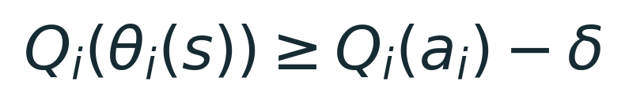
FEDSHARP+ TRAINING AND COMMITMENT
FedSharp+ checks the whole update before sending it
Train
Repair
Commit
Local prior + five SGD steps
Classifier, when eligible
Whole-model scale check
Accept the full update, a smaller update, or the admitted model.
Training-time class-prior adjustment follows Menon et al. [6]. Utility checks are local, not population guarantees.
Ojaswi Sinha | MS Computer Science | Ohio University
18
Notes:
Slide 18: FedSharp+ checks the whole update before sending it
After admission, perform five SGD steps with training-only local class-prior adjustment and the robust proximal objective. Ranking, class probes, repair, commitment and final evaluation use raw logits. An inherited repair stage can adjust only the final affine classifier using two local probes and a stored repair reference. The later commitment step checks the entire model, including backbone layers. It tests scales 1, 1/2, 1/4, 1/8, 0 in order and takes the first utility check that passes. Zero returns to the admitted model, which need not be the owned model. There are no extra SGD steps in this scale check. The unchanged equations are reproduced from the commented FedSharp+ section in supplied thesis.tex for presentation; the thesis itself is not edited. The utility guarantee is finite-probe and single-activation, not population accuracy or every-class preservation.
Sources: thesis.tex: commented eq:commit_scales, eq:commit_gate; cart_local_prior.py; sharp_cart_v2.py; cart_prior_neutral_commit.py
Suggested time: 90 seconds.

Slide 19
EXPERIMENTAL DESIGN
The study covers two datasets and three independent seeds
100
500
5
3
clients
rounds
SGD steps / activation
seeds
Data and partitions
Evaluation
MNIST + CIFAR-10
IID + Dirichlet non-IID (alpha = 0.5)
1,000-image development holdout
Endpoint: rounds 491 to 500, mean ±
sample SD
Ojaswi Sinha | MS Computer Science | Ohio University
19
Notes:
Slide 19: The study covers two datasets and three independent seeds
There are 150 current configurations grouped into 50 condition groups, with seeds 2025, 2026, 2027. Use three independent seeds per curve; do not pool historical repetitions as six seeds. Non-IID uses Dirichlet alpha 0.5. The MNIST model is 784-64-32-10 MLP, the CIFAR-10 model is the BASIL paper CNN. One common 1000-image training-derived holdout per dataset has 100 examples per class. Holdout is development evaluation, not official independent test data. Mean accuracy includes all 100 retained trained client models, including those with attacked outgoing copies. Report the mean over rounds 491 through 500 per seed, then seed mean and sample SD.
Sources: Thesis scope and verified experiment documentation
Suggested time: 65 seconds.

Slide 20
CONTROLS AND COMPARISON SCOPE
Clean controls establish the transfer baseline
Clean environment
Impaired environment
No attack or channel noise.
Accept the immediate predecessor.
No selection or regularization.
Attack only, or attack + noise.
Selection and defenses remain
enabled.
FedSharp+ is tested on non-IID
joint cases.
Joint tests: 33 attackers | Noise SD = 0.01 | Attack onset: round 21
BASIL and FedSharp clean accuracy arrays match exactly in all 12 pairs.
Ojaswi Sinha | MS Computer Science | Ohio University
20
Notes:
Slide 20: Clean controls establish the transfer baseline
The latest BASIL and FedSharp clean controls both use immediate-predecessor transfer, no attack, no channel noise, mu=0, window=1 and no screening, ranking or pooling. Their entire measured 500-round accuracy and class arrays are identical across all 12 paired runs. Do not claim checkpoint parameter-byte identity because checkpoints are not exported. Impaired cases retain selection and regularization, so clean versus impaired comparisons change both environment and policy. Joint conditions use sigma=0.01 and 33 outgoing attacker identities after 20 warm-up rounds. The Hidden implementation is a blend; avoid equating it with a single-coordinate illustrative attack. FedSharp+ and ACDS are only present for joint non-IID cases. ACDS shares 5% of fitting examples, so data access differs.
Sources: Thesis scope and verified experiment documentation
Suggested time: 65 seconds.

Slide 21
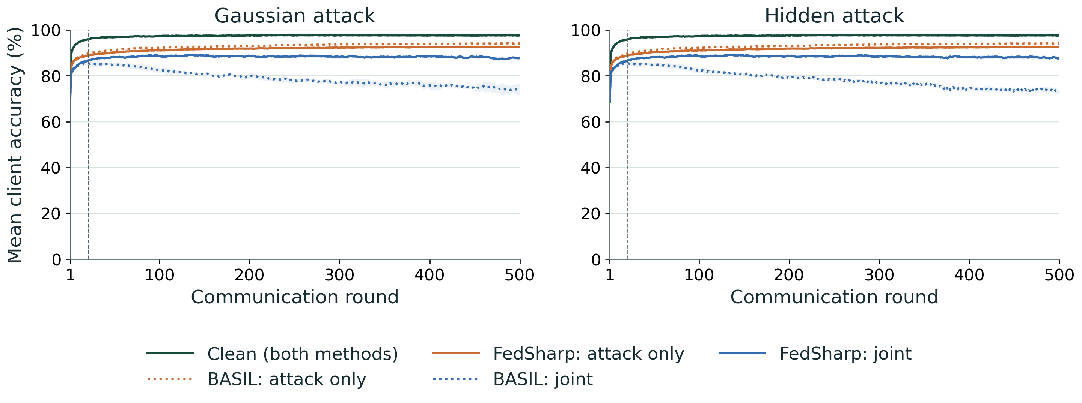
RESULTS
MNIST IID: accuracy through 500 rounds
FedSharp improves the joint-impaired result.
Joint = attack + noise. Three seeds; bands = sample SD. Clean curves coincide. Development-holdout accuracy.
Ojaswi Sinha | MS Computer Science | Ohio University
21
Notes:
Slide 21: MNIST IID: accuracy through 500 rounds
Clean control: 97.60%. Attack-only BASIL is about 94.09%, higher than FedSharp about 92.56 to 92.60%. Joint FedSharp is about 87.81%, higher than BASIL about 73.37 to 74.18%. These are endpoint means; no significance claim. FedSharp+ was not tested here. The separate BASIL noise-only control, not plotted on this presentation panel, is 73.645%. Noise-only exists only for BASIL on MNIST. Solid/dotted styles distinguish families. Bands are sample SD over three seeds, not confidence intervals. Plot curves are the raw unsmoothed means over all retained client models. The dashed vertical line marks attack onset at displayed round 21. One combined clean curve represents the two exactly matching control curves. See companion chart audit for run IDs and arrays.
Sources: Verified 150-run current matrix; current 50-group endpoint summary
Suggested time: 70 seconds.

Slide 22
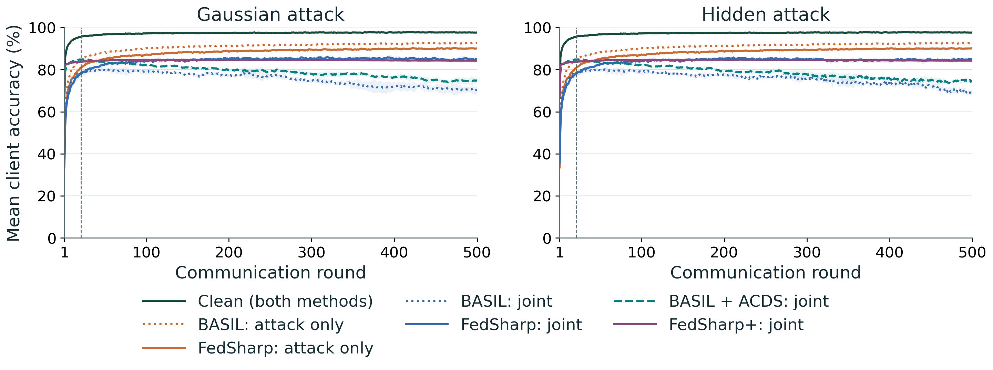
RESULTS
MNIST non-IID: accuracy through 500 rounds
FedSharp+ does not improve the MNIST mean over FedSharp.
Joint = attack + noise. Three seeds; bands = sample SD. Clean curves coincide. Development-holdout accuracy.
Ojaswi Sinha | MS Computer Science | Ohio University
22
Notes:
Slide 22: MNIST non-IID: accuracy through 500 rounds
Clean control: 97.63%. Joint base FedSharp is 84.902% Gaussian and 84.841% Hidden. FedSharp+ is 84.264% and 84.296%, respectively, slightly lower. Both exceed BASIL and ACDS here. Attack-only BASIL remains higher than FedSharp. FedSharp+ is not a universal improvement. ACDS has additional fitting-data access. Solid/dotted styles distinguish families. Bands are sample SD over three seeds, not confidence intervals. Plot curves are the raw unsmoothed means over all retained client models. The dashed vertical line marks attack onset at displayed round 21. One combined clean curve represents the two exactly matching control curves. See companion chart audit for run IDs and arrays.
Sources: Verified 150-run current matrix; current 50-group endpoint summary
Suggested time: 70 seconds.

Slide 23
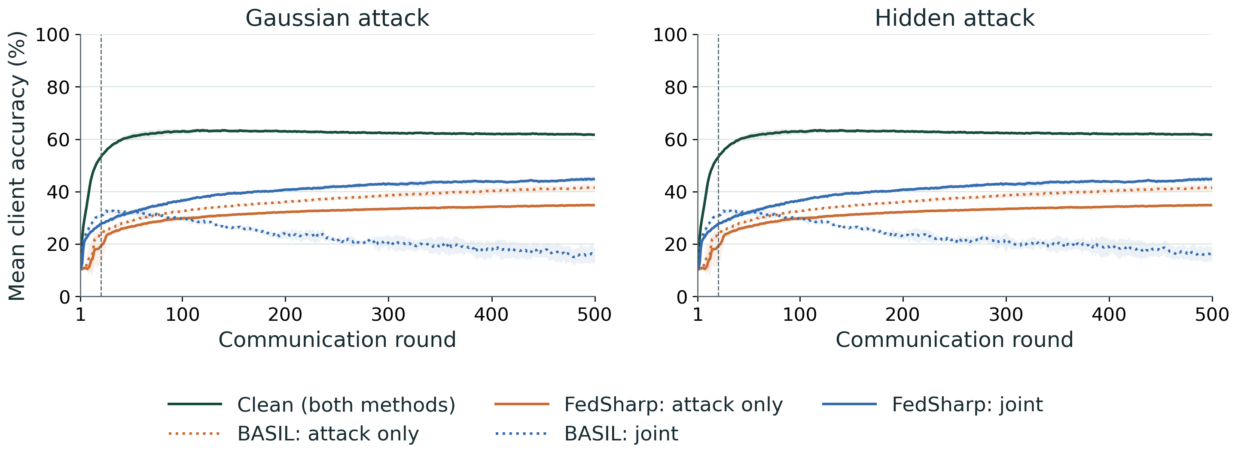
RESULTS
CIFAR-10 IID: accuracy through 500 rounds
FedSharp helps under joint impairments; clean remains highest.
Joint = attack + noise. Three seeds; bands = sample SD. Clean curves coincide. Development-holdout accuracy.
Ojaswi Sinha | MS Computer Science | Ohio University
23
Notes:
Slide 23: CIFAR-10 IID: accuracy through 500 rounds
Clean control is 61.754%. Joint FedSharp reaches 44.757%, above BASIL 15.960% Gaussian and 16.201% Hidden. Attack-only BASIL is 41.488%, higher than FedSharp 34.855%. Joint FedSharp exceeding attack-only does not isolate a benefit of noise because the gradient penalty and other policy effects differ. FedSharp+ was not tested on IID. Solid/dotted styles distinguish families. Bands are sample SD over three seeds, not confidence intervals. Plot curves are the raw unsmoothed means over all retained client models. The dashed vertical line marks attack onset at displayed round 21. One combined clean curve represents the two exactly matching control curves. See companion chart audit for run IDs and arrays.
Sources: Verified 150-run current matrix; current 50-group endpoint summary
Suggested time: 70 seconds.

Slide 24
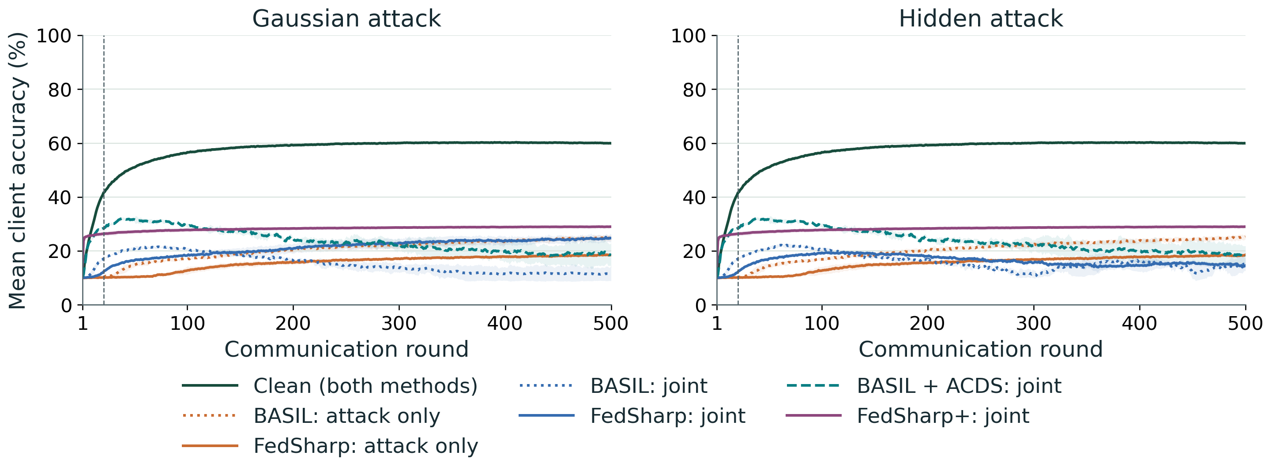
RESULTS
CIFAR-10 non-IID: accuracy through 500 rounds
FedSharp+ has the highest joint-impaired mean in this setting.
Joint = attack + noise. Three seeds; bands = sample SD. Clean curves coincide. Development-holdout accuracy.
Ojaswi Sinha | MS Computer Science | Ohio University
24
Notes:
Slide 24: CIFAR-10 non-IID: accuracy through 500 rounds
Clean control is 59.980%. FedSharp+ is 28.983% in both attack types. Base FedSharp is 24.680% Gaussian and 14.626% Hidden; BASIL is 11.488% and 14.770%. The Hidden base difference versus BASIL is small and does not support a superiority claim. ACDS is 19.081% Gaussian and 18.475% Hidden. Equal Gaussian and Hidden FedSharp+ curves are observed, not proof that communication never matters. Solid/dotted styles distinguish families. Bands are sample SD over three seeds, not confidence intervals. Plot curves are the raw unsmoothed means over all retained client models. The dashed vertical line marks attack onset at displayed round 21. One combined clean curve represents the two exactly matching control curves. See companion chart audit for run IDs and arrays.
Sources: Verified 150-run current matrix; current 50-group endpoint summary
Suggested time: 70 seconds.

Slide 25
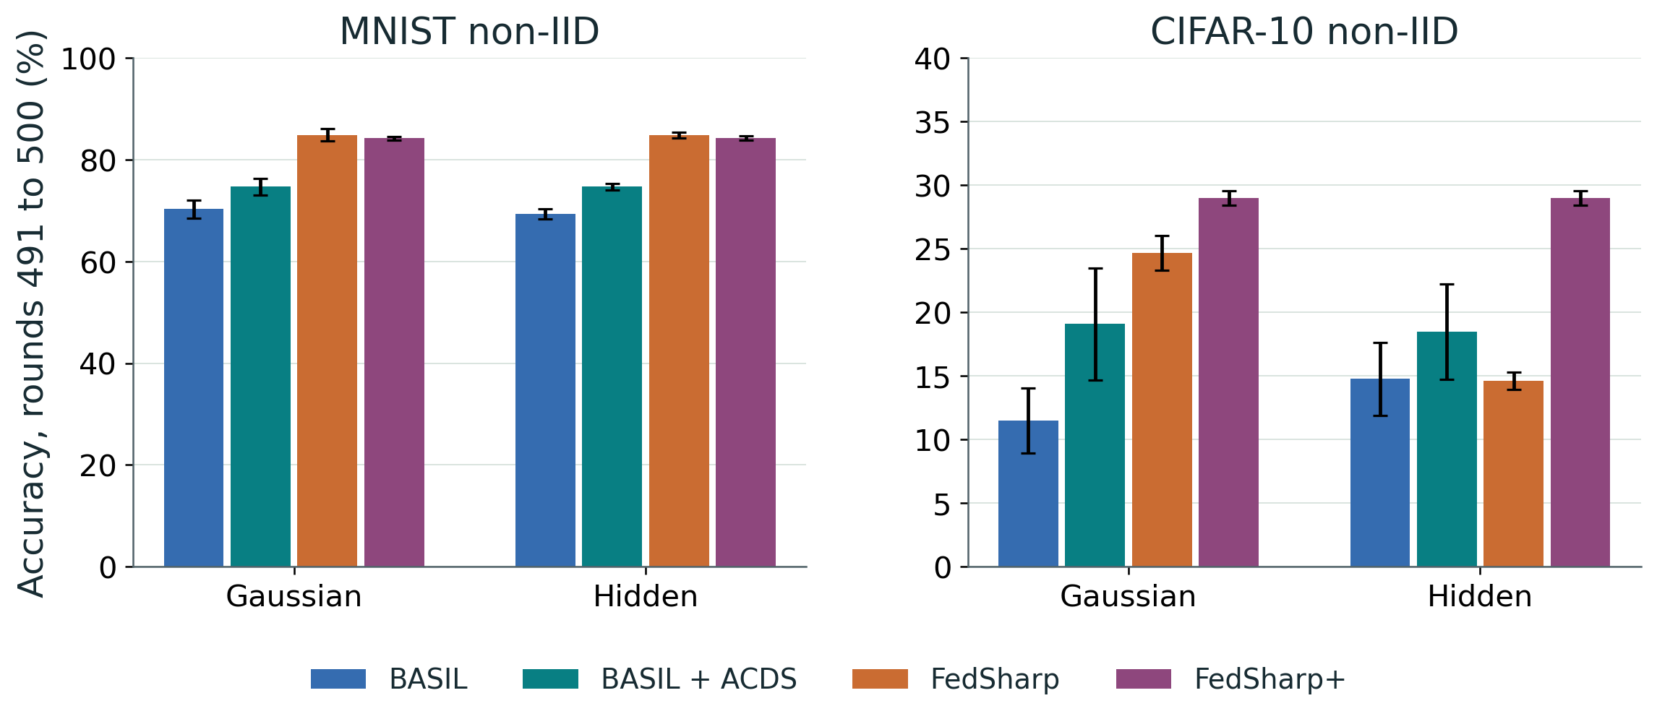
RESULTS COMPARISON
FedSharp+ helps CIFAR-10, but the MNIST gain is absent
The extension is setting-dependent, rather than a consistent improvement.
Joint attack + noise only. Endpoint means ± sample SD, three seeds. Note the different dataset scales.
Ojaswi Sinha | MS Computer Science | Ohio University
25
Notes:
Slide 25: FedSharp+ helps CIFAR-10, but the MNIST gain is absent
The bars report the mean endpoint over rounds 491 to 500, with sample SD across three seeds. CIFAR-10 uses a different vertical scale from MNIST; both axes are explicitly labeled. Relative to base FedSharp, FedSharp+ changes CIFAR-10 by +4.302 percentage points Gaussian and +14.357 Hidden; MNIST by -0.638 and -0.545. ACDS is a fitting-data-sharing baseline. No formal significance tests have been performed.
Sources: condition_summary.csv, joint non-IID rows
Suggested time: 65 seconds.

Slide 26
MECHANISM ANALYSIS
Mechanism records help explain the remaining tradeoff
CIFAR-10 non-IID
CIFAR-10 non-IID
99.6%
owned-model admission
28.9%
zero-scale commitment
Receiver checks often retain a locally established model.
The checks limit change on local probes; they do not guarantee every class improves.
Ojaswi Sinha | MS Computer Science | Ohio University
26
Notes:
Slide 26: Mechanism records help explain the remaining tradeoff
These are descriptive mechanism records across rounds 21 to 500, averaged across seeds. On CIFAR-10 non-IID, FedSharp+ admits the owned model in about 99.619% of activations for each attack type, while roughly 28.909% of active commitment checks choose scale zero. Owned admission sets the fresh-link coefficient to zero but does not remove historical error. On MNIST non-IID, owned admission is about 94.758 to 95.103%, and zero commitment is about 12.660 to 12.938%. These associations help interpret outcomes; they do not isolate causation or show all classes are protected. Final worst-client MNIST mean is lower for the extension than the base method.
Sources: mechanism_summary.csv; per_run_mechanisms.csv; rounds 21 to 500
Suggested time: 70 seconds.

Slide 27
CONCLUSIONS
The answer depends on the condition being tested
FedSharp
FedSharp+
Clean controls
Higher means in many
joint-impaired cases;
BASIL remains
stronger in attack-only
cases.
CIFAR-10 non-IID
gains, with no
consistent gain over
FedSharp on MNIST.
Highest accuracy in
each group, with
identical BASIL and
FedSharp trajectories.
Ojaswi Sinha | MS Computer Science | Ohio University
27
Notes:
Slide 27: The answer depends on the condition being tested
Answer the research questions without claiming dominance. Guarded exchange with the robust objective helps many joint-impaired cases, while BASIL has higher attack-only means. The class-aware extension improves tested CIFAR-10 non-IID joint means but not MNIST relative to base FedSharp. Current matched clean controls are highest in each group. Longer training is not uniformly better; for example CIFAR-10 non-IID Hidden base FedSharp declines from the 100-round endpoint to the 500-round endpoint. These conclusions apply to the tested experimental matrix.
Sources: Thesis scope and verified experiment documentation
Suggested time: 60 seconds.

Slide 28
LIMITATIONS AND FUTURE WORK
Test generalization and isolate each component
Generalization
Untouched final test data and more seeds.
Attribution
Separate admission, prior adjustment, repair and
commitment.
Deployment
Adaptive threats, changing topologies and real
channel measurements.
Keep local probe guarantees separate from claims about population accuracy.
Ojaswi Sinha | MS Computer Science | Ohio University
28
Notes:
Slide 28: Test generalization and isolate each component
Separate completed evidence from proposed work. The current study uses a development holdout, three seeds, two small benchmark models, a fixed ring and fixed attacker identities. Future work should use a final untouched test split, more seeds and uncertainty analysis; ablate admission, prior adjustment, repair and commitment separately; evaluate adaptive attacks, dynamic topologies and realistic channels; and measure per-activation runtime and memory. No differential privacy, population accuracy, convergence, or universal Byzantine guarantee is established by the local utility checks.
Sources: Thesis scope and verified experiment documentation
Suggested time: 65 seconds.

Slide 29
REFERENCES
Selected references
[1] H. B. McMahan et al. Communication-Efficient Learning of Deep Networks From Decentralized Data.
AISTATS, 2017.
[2] A. R. Elkordy, S. Prakash and S. Avestimehr. Basil: A Fast and Byzantine-Resilient Approach for
Decentralized Training. IEEE JSAC, 2022.
[3] K. Hsieh et al. The Non-IID Data Quagmire of Decentralized Machine Learning. ICML, 2020.
[4] F. Ang et al. Robust Federated Learning With Noisy Communication. IEEE Transactions on
Communications, 2020.
[5] T. Li et al. Federated Optimization in Heterogeneous Networks. MLSys, 2020.
[6] A. K. Menon et al. Long-Tail Learning via Logit Adjustment. ICLR, 2021.
Ojaswi Sinha | MS Computer Science | Ohio University
29
Notes:
Slide 29: Selected references
The references are taken from the supplied bibliography. Citation keys are mcmahan_fedavg, basil, hsieh_noniid_quagmire_2020, NoiseComm, fedprox and logit_adjustment. The core references also appear on slide 2. These references cover centralized FL, the BASIL ring baseline, statistical heterogeneity, noisy communication, proximal training and training-time logit adjustment.
Sources: Entries reproduced from supplied references.bib; keys retained in companion notes
Suggested time: 30 seconds.

Slide 30
Thank you
Questions and discussion
Ojaswi Sinha
Advisor: Dr. Animesh Yadav
Notes:
Slide 30: Thank you
Invite questions. If asked for details, use the separate plot appendix and the slide-by-slide notes. The deck is a draft for review with your advisor.
Sources: Thesis scope and verified experiment documentation
Suggested time: 10 seconds.

