Slide 1







IBM DATA ANALYSIS CAPSTONE PROJECT: TECHNOLOGY TRENDS
LABIJA WILSON OJOCHONU
03/12/2024

Slide 2



OUTLINE
Executive Summary
Introduction
Methodology
Results
Visualization – Charts
Dashboard
Discussion
Findings & Implications
Conclusion
Appendix

Slide 3

EXECUTIVE SUMMARY
Current technology usage in terms of programming languages and databases trends.
Future technology trend in terms of Language desire next year, database desire next year, platform desire next year, and webframe desire next year.
Demographics survey in terms of age, gender, location and education level was taken.

Slide 4

INTRODUCTION
About: Analyzing the trends in software development
Purpose:
Identify skill requirements for the future
What are the top programming languages and databases in demand?
What gender should get more involved with technology?
What are the popular IDEs?
Audience: HRM and IT Head

Slide 5

METHODOLOGY
Data Collection
Stack Overflow Developer 2019 Survey
GitHub Job Postings
Programming Languages Annual Salary
Data Exploration
Data Wrangling
Data Analysis
Data Visualization
Presentation of findings

Slide 6
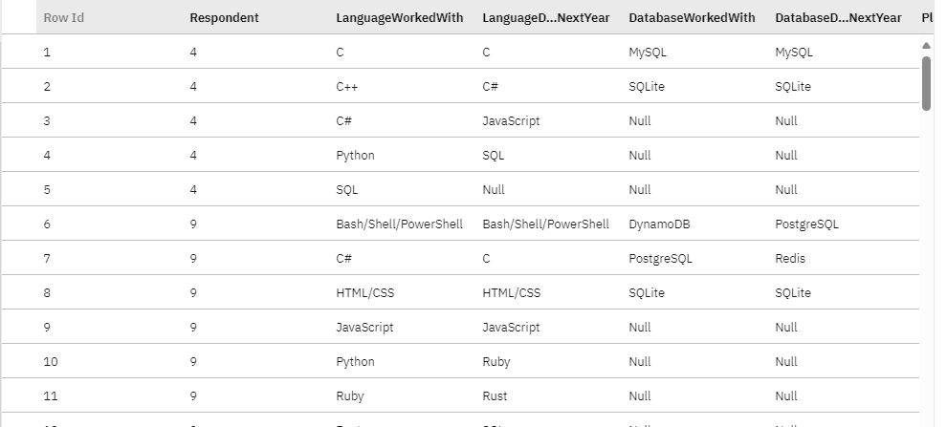
RESULTS

Slide 7
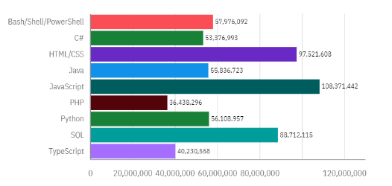
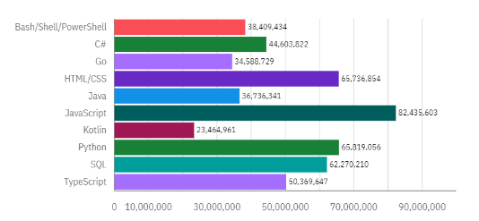
PROGRAMMING LANGUAGE TRENDS
Current Year
Next Year

Slide 8
PROGRAMMING LANGUAGE TRENDS - FINDINGS & IMPLICATIONS
Findings
HTML/CSS, SQL and JavaScript the top 3 languages this year.
Python and TypeScript becoming popular next year.
PHP edged out next year.
Implications
Web and App development still in high demand.
There’ll still be great need for SQL to query big data.
With AI and ML coming into limelight, Python is a sure bet.

Slide 9
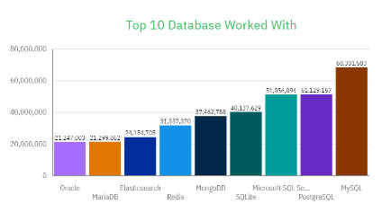
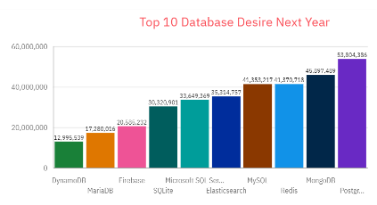
DATABASE TRENDS
Current Year
Next Year

Slide 10
DATABASE TRENDS - FINDINGS & IMPLICATIONS
Findings
New database: Elasticsearch.
MySQL, PostgreSQL and Microsoft SQL Server are the top 3 databases.
Oracle and MariaDB are the least most used databases.
PostgreSQL will be the topmost used database.
Implications
Pre tuned search website, app or ecommerce store.
Variety of opensource databases to choose from next year.
No SQL databases will make an impact for storing non relational data.
Redis supports abstract data types.

Slide 11

DASHBOARD
https://github.com/OjayL/rep/blob/main/Dashboard%20Current%20Technology%20Usage.pdf

Slide 12
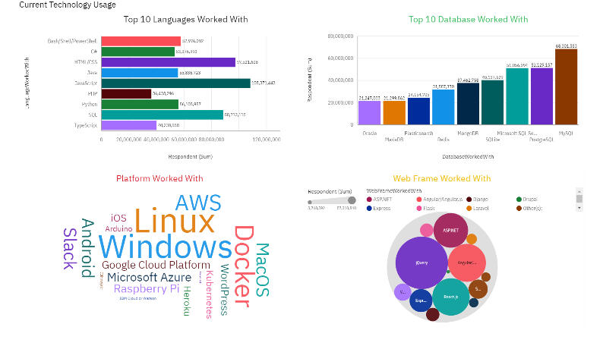
DASHBOARD TAB 1

Slide 13
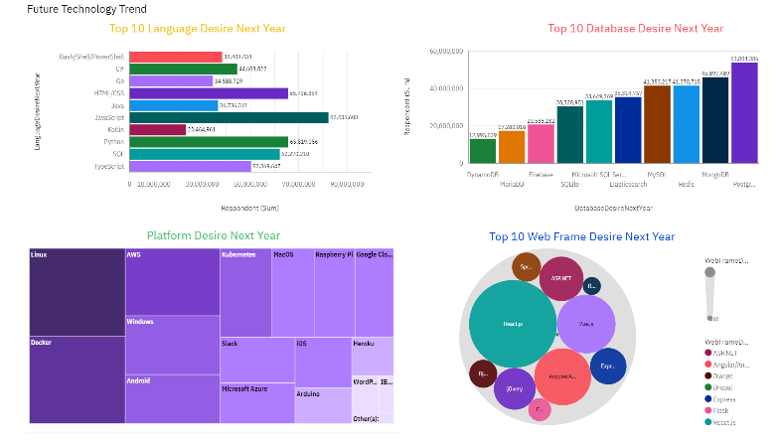
DASHBOARD TAB 2

Slide 14
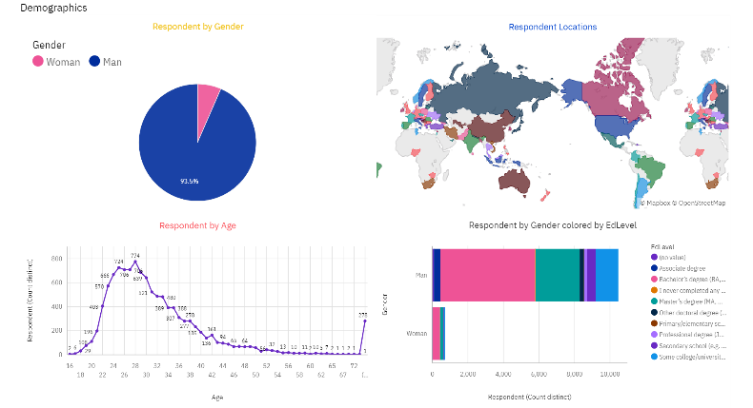
DASHBOARD TAB 3

Slide 15
DISCUSSION
Technology trends now and future.
Participation of both male and female in technology, especially the females.
Training and upskilling technocrats for the betterment of society.
Bridging the gap in education and exposure for the inexperienced and uneducated.

Slide 16
OVERALL FINDINGS & IMPLICATIONS
Implications
Increase in jobs for web developers, analysts, software developers to mention a few.
Create awareness and infrastructure for upskilling in technology in underdeveloped companies.
Shifting to cloud platforms for better scalability like AWS and Docker.
Findings
Growth in technology each passing year
Concentration in developed countries and a few developing countries like India.
Gender gap in technology.

Slide 17

CONCLUSION
Technology trends for current year and next year.
Programming languages, databases and platform overview.
Demographics overview.
Use machine learning to create models that’ll predict future trends.

Slide 18
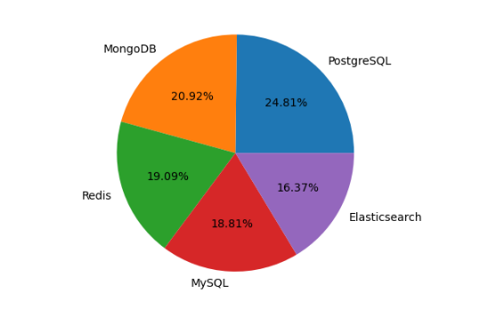

APPENDIX

Slide 19
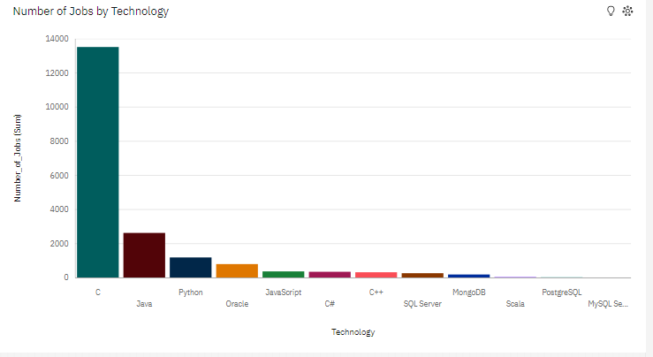
JOB POSTINGS

Slide 20
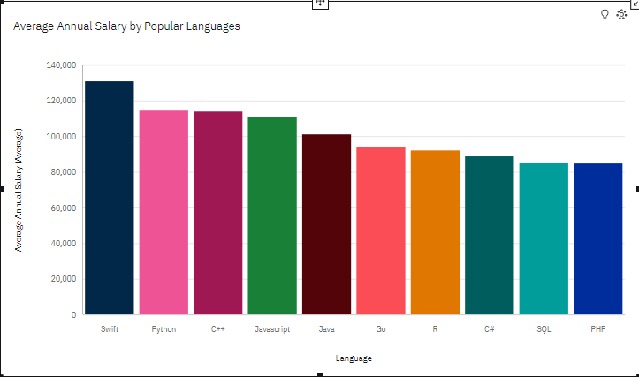
POPULAR LANGUAGES

