Slide 1


The Beginner’s Guide To
Presented By: Jack Yang , Jingnan Qi , Oje Williams , Wei Chi Yeh , Yichuan Hu , Sanket Patel

Slide 2
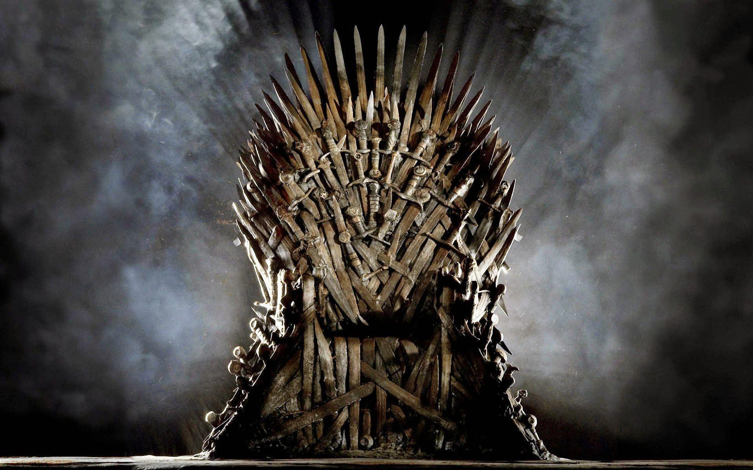

Game Of Thrones – The Phenomenon
73
Episodes
8
Seasons
17.4 mil
Average Viewership
10
Guinness World Records
63
Awards

Slide 3
Our Objectives
How does the sentiments of characters change over time ?
What words are used most by each family ?
Between Cersei and Daenerys : Who says more times the word “kill” ? Who says more times the word “love”?

Slide 4
Our Data
We Are Using GOT Script Dataset
Columns | Description
Release Date | Original Air Date Of Episode
Season | Season Number
Episode | Episode Number
Title | Episode Title
Name | Character Name
Sentence | Sentence Spoken
Data source : https://www.kaggle.com/albenft/game-of-thrones-script-all-seasons

Slide 5


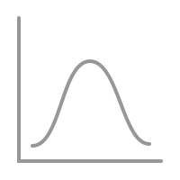

Pre - Processing Flow
Cleaning
Tokenization
Normalization
Stemming / Lemmatization

Slide 6



Text Analysis
Named Entity Recognition
(NER)
Sentiment Analysis
Aspect Mining

Slide 7
Practical Implications
Help the audience understand the impact of each main character, how the story revolves around them, and the importance of their actions.
Classify the overall attitude of each character & family as positive, negative, and neutral.
Help the audience compare the two main characters, Cersei and Daenerys, answering the question “who is the better queen ?”.

Slide 8
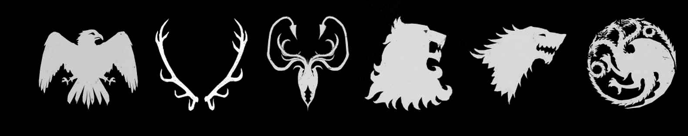
Thank you
Jack
yang
Jingnan
Qi
Oje
williams
Wei chi
yeh
Yichuan
hu
Sanket
Patel

