Slide 1

AI-Driven Scheduling in 6G Networks: A Neural Network Approach to Multi-User Resource Allocation
Created with Pi

Slide 2


CONTENTS
1. Motivation & Research Gap
4. Results
2. Problem Formulation
5. Research Relevance & Future Work
3. Methodology
6. Conclusion & Call to Action

Slide 3




01
Motivation & Research Gap
6G Vision
Problem
Gap
Ultra-low latency, high throughput, and energy efficiency.
Traditional schedulers (e.g., Round-Robin) ignore real-time channel dynamics.
Need for AI-driven, adaptive scheduling algorithms.

Slide 4
Motivation & Research Gap
References:
Zhang et al., "AI for 6G: Research Visions and Challenges," IEEE Access, 2020.
Saad et al., "A Vision of 6G Wireless Systems: Applications, Trends, Technologies," IEEE Network, 2020.
Björnson et al., "Intelligent Reflective Surfaces and AI in 6G," IEEE Communications Magazine, 2023.

Slide 5

02
Problem Formulation
Objective
System Setup
Performance Metrics
Design a learning-based scheduler for multi-user wireless systems under Rayleigh fading.
10 users, 100 time slots.
• Throughput (Gbps).
Rayleigh fading (fast time-varying channels).
• Energy consumption.

Slide 6
03
Methodology
Baseline
Proposed Approach
Round-Robin scheduler.
Feedforward Neural Network (FNN).
Component | Design
Input | Channel gains (10 users)
Hidden Layer | 64 neurons, ReLU activation
Output | User to schedule (softmax)
Training Data | 1000 simulated fading scenarios
Tool | MATLAB Deep Learning Toolbox

Slide 7
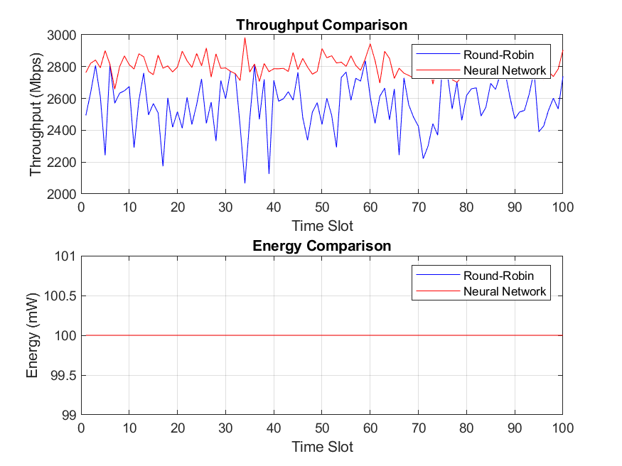
04
Results
Metric | Round-Robin | Neural Network
Avg. Throughput | 2.56 Gbps | 2.80 Gbps
Gain | — | 9.37% ↑
Variance (Mbps²) | 26,514.98 | 3,659.09

Slide 8
04
Future Work
Future Directions
• Federated learning for user privacy.
• Integration with MIMO and beamforming.
“The important thing is not to stop questioning. Curiosity has its own reason for existing.” — Albert Einstein

Slide 9
Thank You

