Slide 1


Chinook music store database analysis
Ankit Kumar Ojha

Slide 2

INTRODUCTION
🎵 Chinook Database Highlights
Simulates a digital music store with data on customers, sales, and inventory.
Covers artists, albums, tracks, invoices, and employee details.
Models both online and in-store purchases.
Includes global customer base and local sales teams.

Slide 3
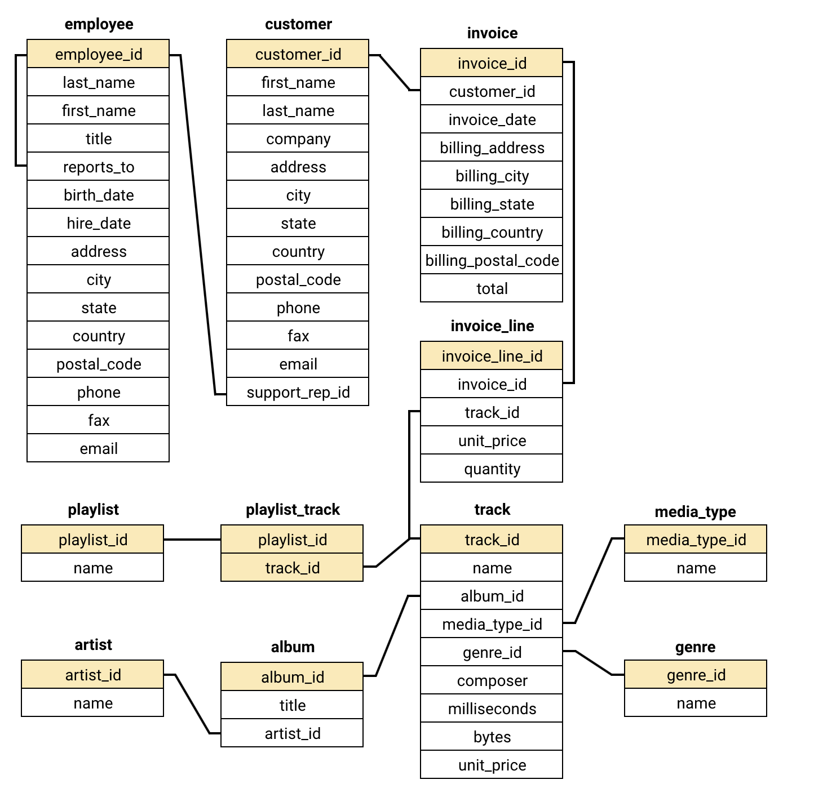
Database schema

Slide 4
AIMS OF ANALYSIS
Understand customer behavior by analyzing purchase patterns, frequency, and preferences.
Identify top-performing products—albums, artists, and genres that drive the most revenue.
Evaluate sales trends across time periods, regions, and platforms (online vs. offline).
Detect churn risks and segment customers based on engagement and transaction history.
Support strategic decisions such as marketing focus, inventory planning, and loyalty programs.

Slide 5
DATA OVERVIEW
Customer Data: Includes details like name, contact info, country, and assigned support reps—useful for segmentation and regional insights.
Music Catalog: Captures artists, albums, tracks, and genres, forming the backbone of the product inventory.
Sales & Invoices: Records transaction history, invoice dates, total amounts, and purchase methods.
Employee Structure: Stores employee roles, territories, and reporting hierarchy—helpful for sales performance mapping.
Geographic Reach: Covers customer distribution across countries, enabling regional sales and marketing analysis.

Slide 6
METHODOLOGY
Data Understanding & Schema Exploration Review tables like Customer, Invoice, Track, Album, Genre, and Employee to understand data relationships and business context.
Data Cleaning & Preparation Handle missing values, normalize data types, and create relevant joins across tables for a unified analytical dataset.
Exploratory Data Analysis (EDA) Use SQL queries and visual tools to uncover patterns in customer purchases, top-selling tracks, revenue distribution, and regional performance.

Slide 7
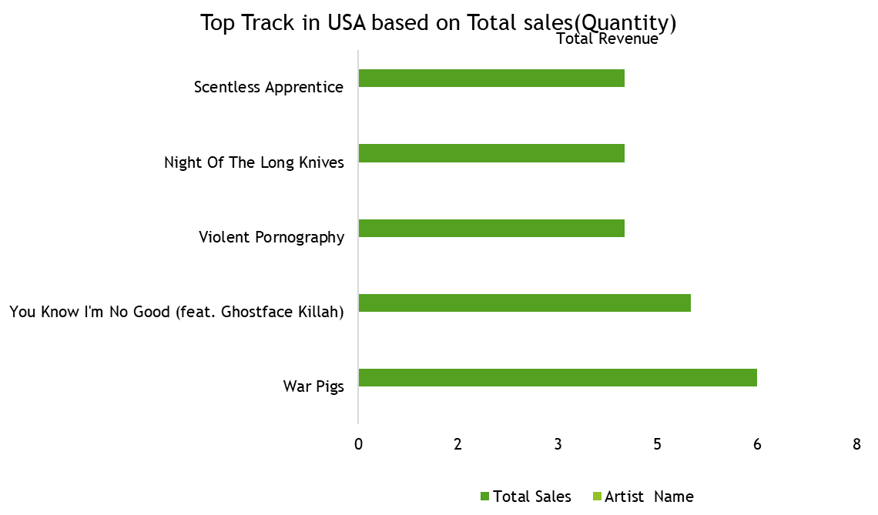

ANALYASIS
Rock genre dominates in total track sales compared to other genres.
Pop, Latin, and Jazz follow closely with similar lower sales, showing balanced interest.
Van Halen is the top-selling artist with 43 sales.
Rock genre leads, matching Van Halen’s sales—strong genre-artist link.

Slide 8
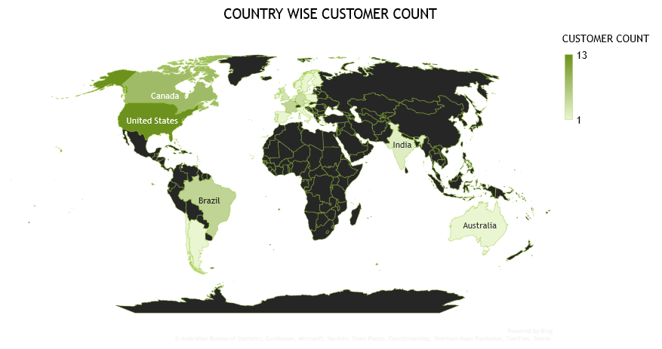
USA leads in intensity, indicating highest Customer count.
Europe and Australia follow, showing strong global presence.

Slide 9
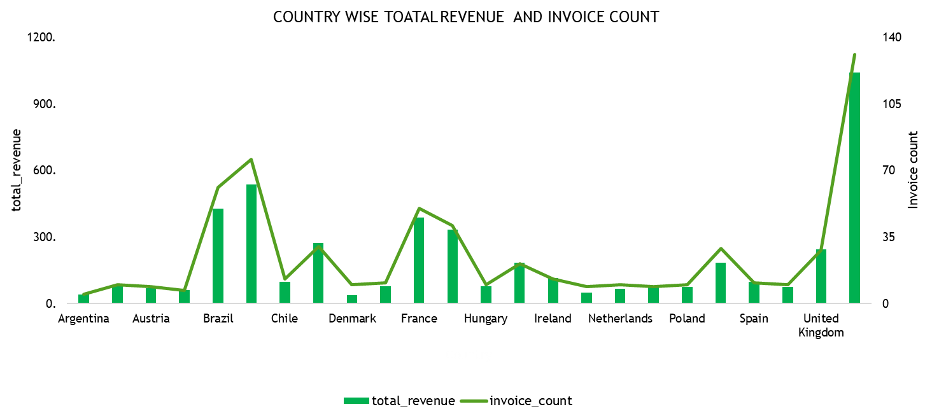
USA dominates in both revenue and invoice volume.
UK and Canada follow, indicating strong but distant performance.

Slide 10
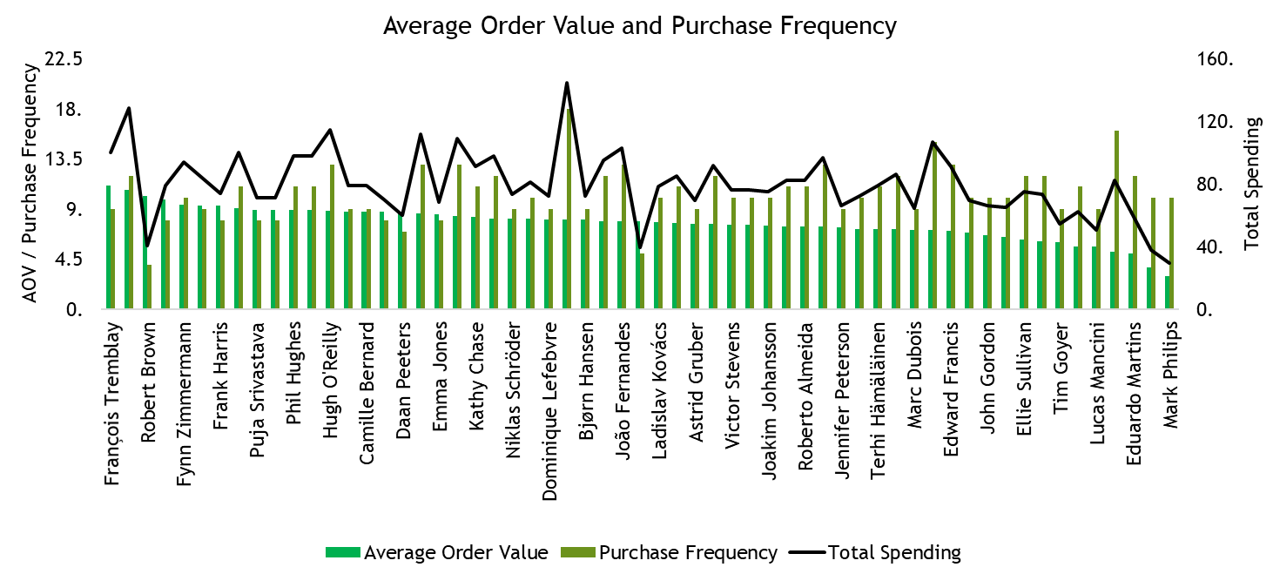
Highest Spender: Dominique Lefebvre shows peak total spending despite moderate AOV and frequency.
Efficient Buyers: François Tremblay and Niklas Schröder have high frequency with above-average AOV.

Slide 11
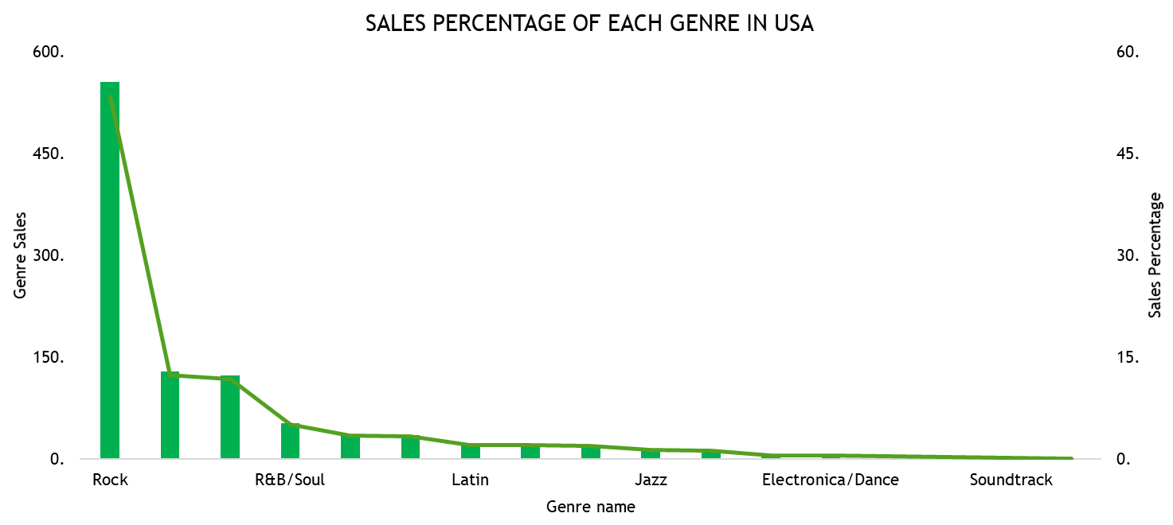
Rock Dominates: Rock music leads with the highest sales share by far.
📉 Low Genre Diversity: Other genres show minimal sales, indicating niche appeal.

Slide 12
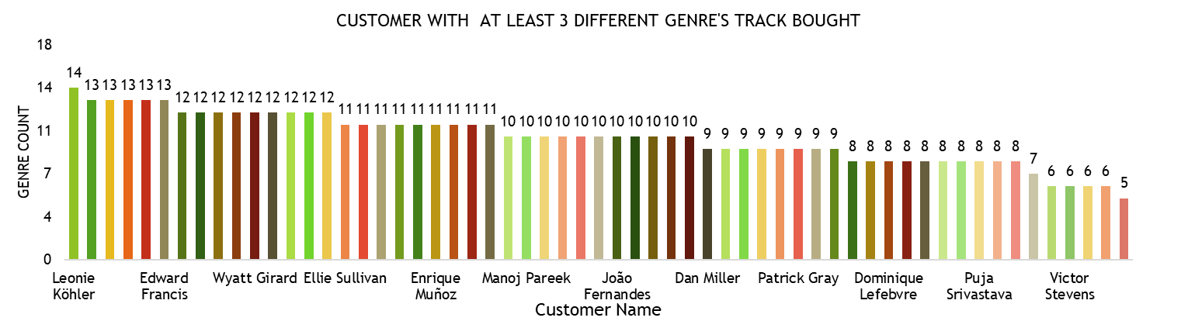
🎧 Top Explorers: Leonie Köhler has highest genre diversity.
📊 Engaged Listeners: Majority explored 7+ genres—signs of broad musical interest.

Slide 13
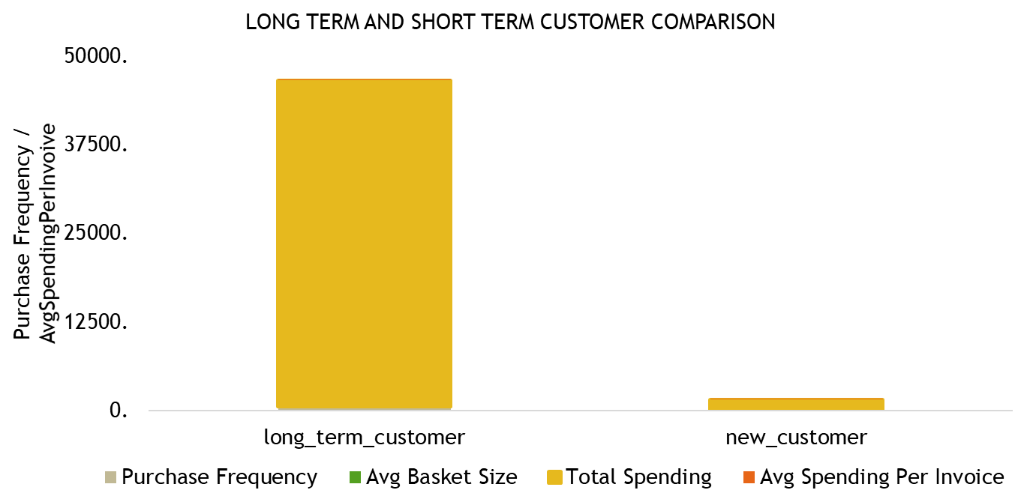
Long-term customers buy far more often and spend much more overall.
New customers have low frequency and low total spending.

Slide 14
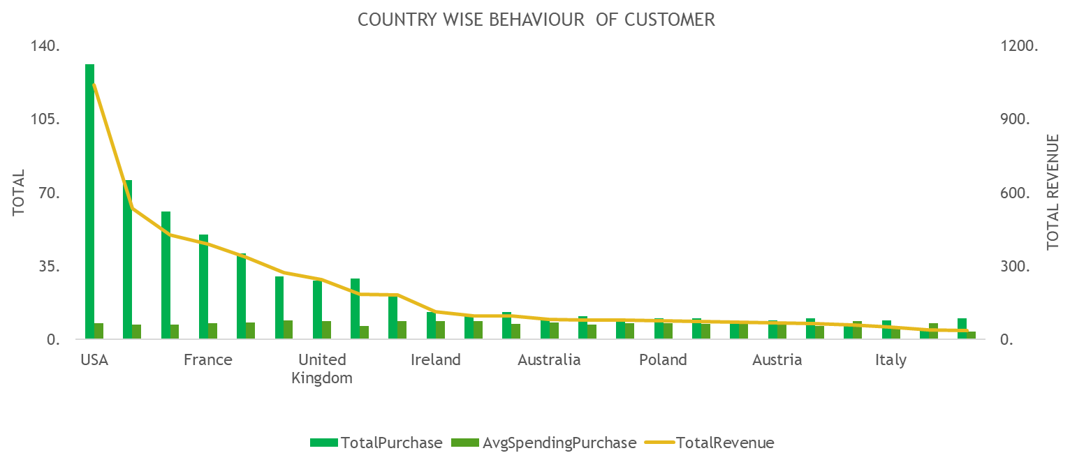
USA leads in purchases and revenue by a large margin.
Other countries show lower but steady spending; no single country rivals the USA’s volume or revenue.

Slide 15
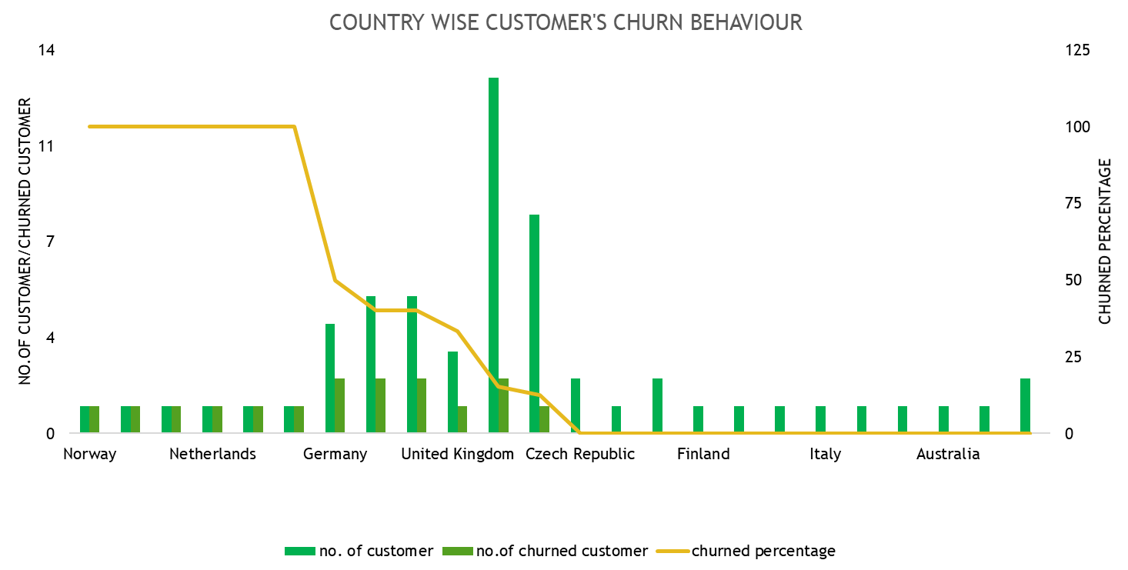
Norway, Belgium, and Denmark have 100% churn despite low customer counts.
USA has the most customers and lower churn rate, showing stronger retention.

Slide 16
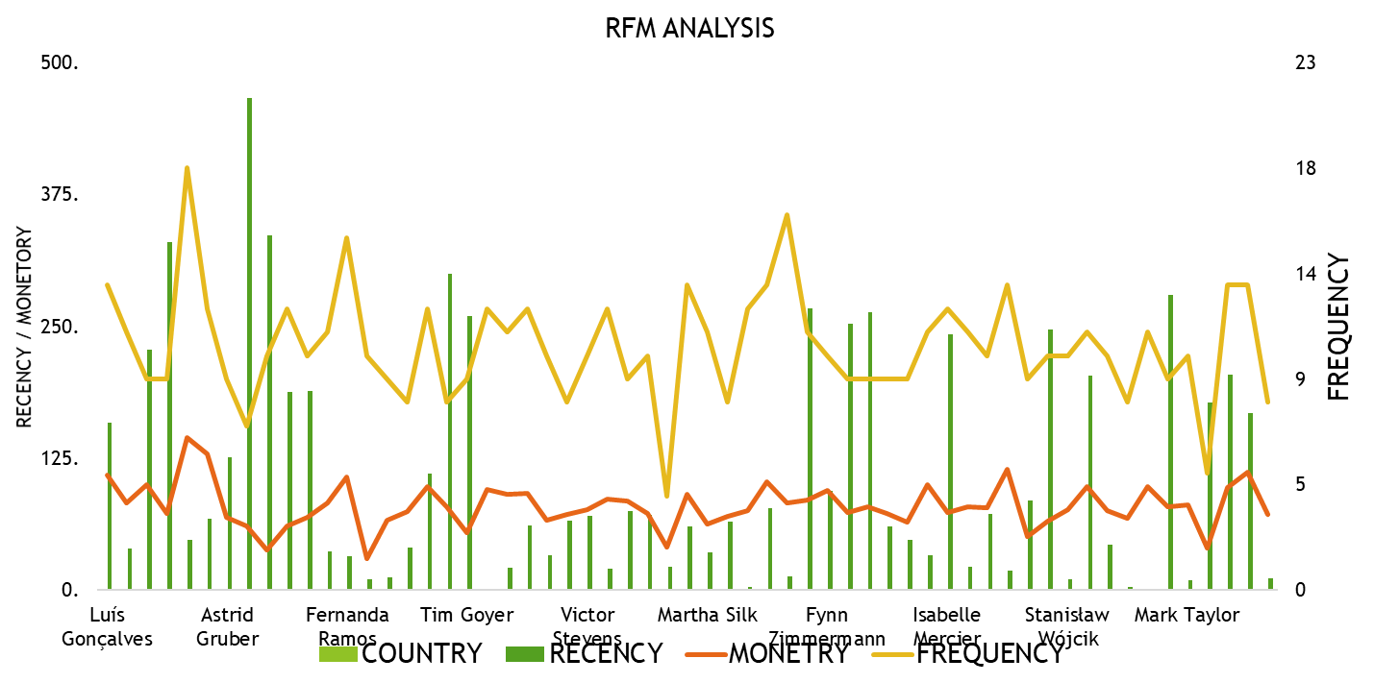
Frequency varies widely, with some customers buying 15-18 times, others very little.
Most customers have moderate monetary value and low recency, suggesting recent purchases are sparse.

Slide 17
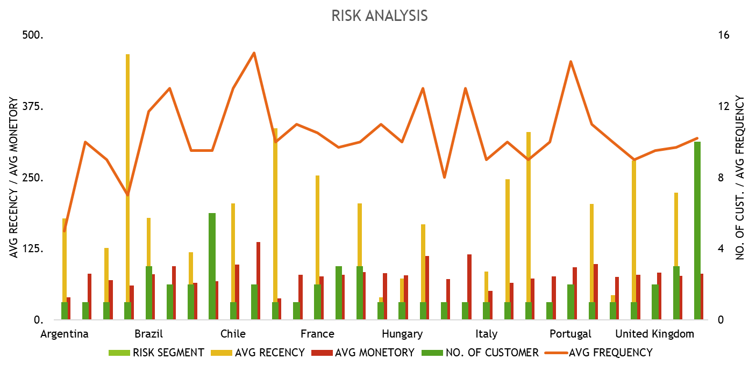
USA has the highest customer count and frequency, lowering risk.
.
Many countries show high recency but low monetary values, signaling potential churn risk.

Slide 18
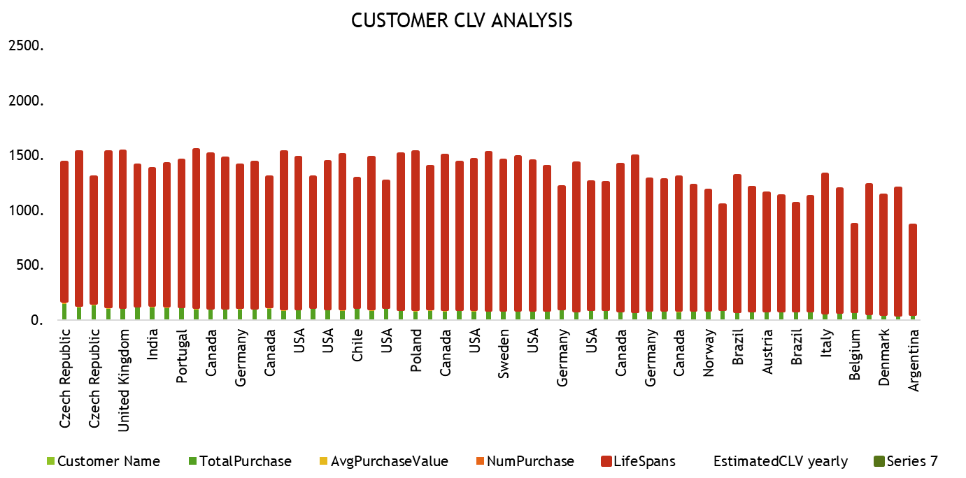
Czech Republic and India show high total purchases and estimated CLV.
Lifespans are generally stable across countries, mostly above 1000 days.
Argentina and Denmark have low CLV and purchase activity.
Avg purchase value varies less than total purchase volume, indicating volume drives CLV differences.

Slide 19
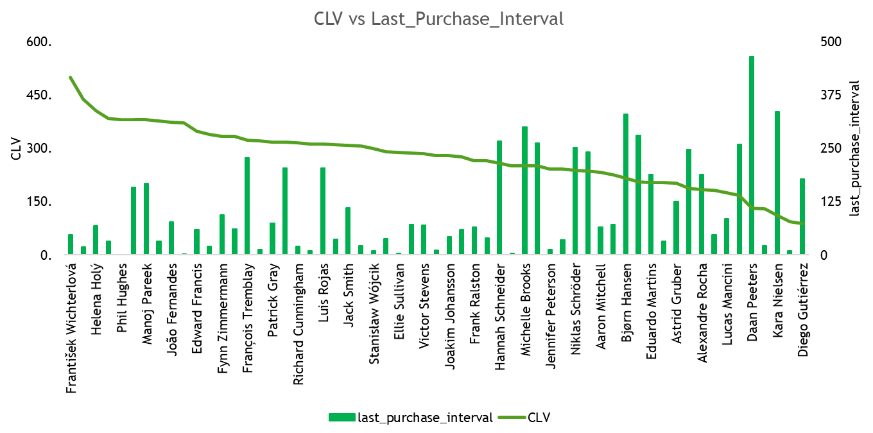
High CLV customers generally have shorter last purchase intervals, indicating loyalty.
Customers with long gaps since last purchase mostly have lower CLV.
Frantisek Wichterlová leads CLV despite a moderate interval.
Diego Gutierrez has low CLV and the longest interval, signaling churn risk.

Slide 20
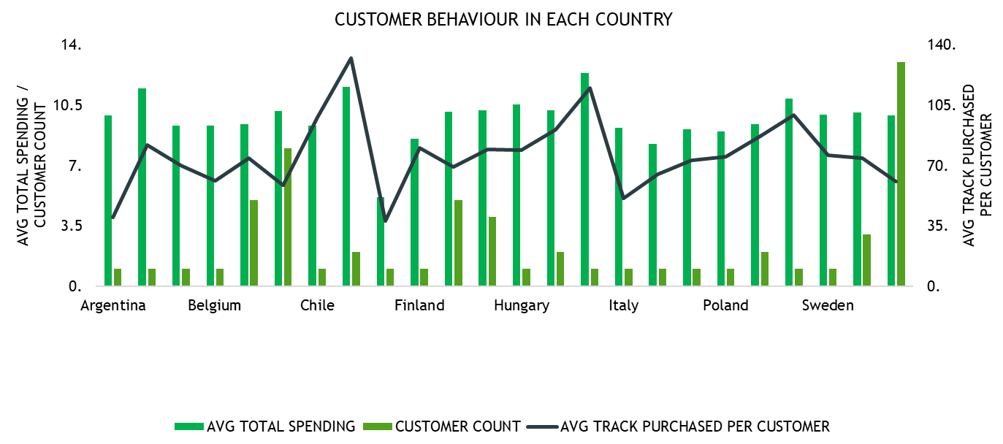
USA leads in customer count and track purchases per customer.
Czech Republic shows high average spending and track purchases despite lower customer count.
Most countries cluster around moderate spending and track purchases.
Argentina and Denmark have lower average tracks purchased per customer.

Slide 21
STRATEGIC RECOMMENDATION
Goal: Boost Revenue
Reward frequent buyers with loyalty perks.
Upsell bundles in low-spending countries.
Goal: Reduce Churn
Target at-risk customers with win-back offers.
Focus churn reduction in Norway, Belgium, Denmark.
Goal: Grow Key Markets
Invest in USA, Czech Republic, India with local promos.
Offer region-specific content and pricing.
Goal: Improve Engagement
Personalize track recommendations.
Use RFM data to tailor offers by customer type.

Slide 22


