Slide 1
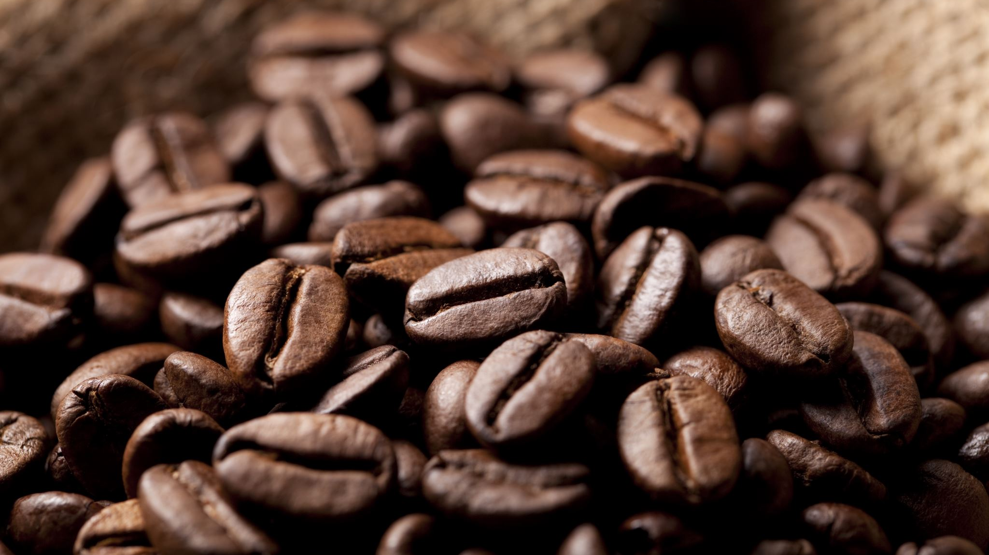
Forecasting International Price of Coffee Beans
Wyatt Nesbit

Slide 2
Table of Contents
Data source
Project Details
Data Analysis Figure 1
Data Analysis Figure 2
Data Analysis of 1975
Data Analysis Figure 3 and Figure 4
Comparison
Statistical Test
Results
Conclusion

Slide 3
International Coffee Organization(ICO)
The data cost about £250($312.23), but it is free for educational purposes with the following two conditions:
- that it will be used for research purposes only; - the International Coffee Organization (ICO) will be clearly acknowledged as the source
https://icocoffee.org

Slide 4
Project Details
The goal of this project is to forecast the international price of coffee.
I used data from March 1965 to March 2023 to forecast the coffee price in April,
I compared my forecast and the realized data of price in April.
Details that require forecasting knowledge will be on the paper: https://github.com/Ojika897893/forecasting_international_price_of_coffee.git.
The PowerPoint will cover only the basics.

Slide 5
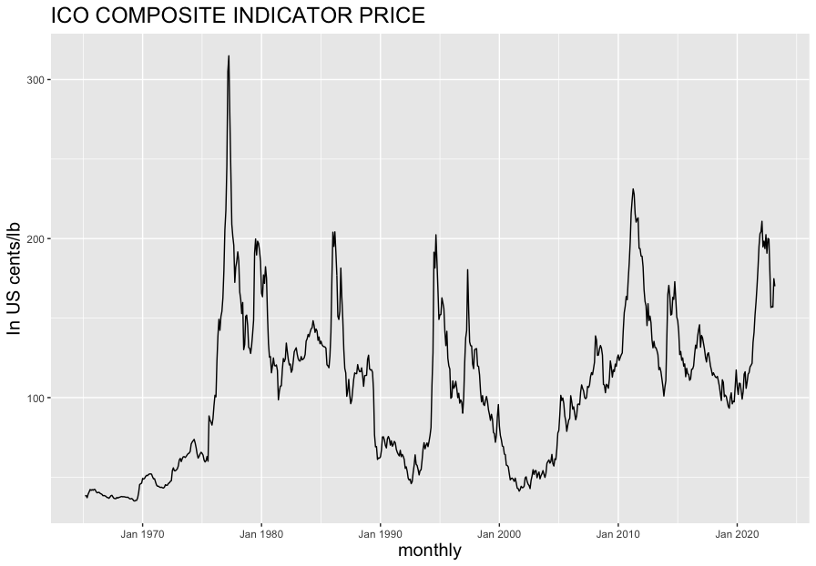
Data Analysis: Figure 1
Figure1 is a graph generated using the basic data without any transformation.
While the data appears fine, it does not tell the real story because it is not adjusted for the inflation.

Slide 6
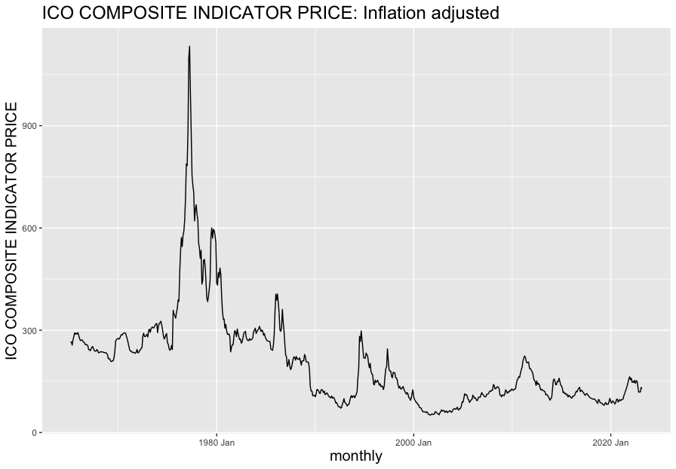
Data Analysis: Figure 2
Figure 2 is Figure 1 with inflation adjustments, 2010 = 100 CPI.
Unlike Figure 1, Figure 2 shows that the international price is decreasing in the long run.
The outlier in 1975 is even more prominent.

Slide 7
Data Analysis: Figure 2
Figure 2 is Figure 1 with inflation adjustments, 2010 = 100 CPI.
Unlike Figure 1, Figure 2 shows that the international price is decreasing in the long run.
The outlier in 1975 is even more prominent.

Slide 8
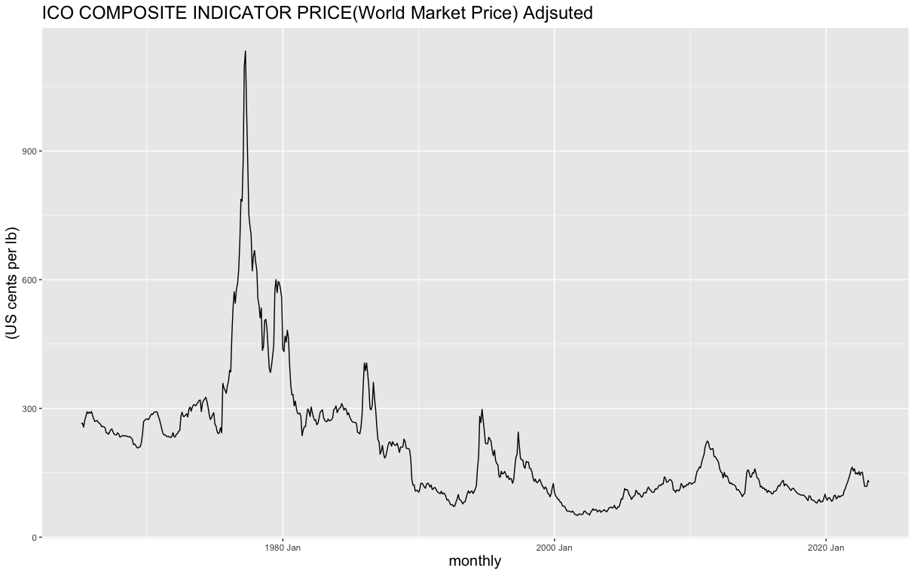
Data analysis of 1975
“serious frost in Brazil in 1975”
I need to eliminate the effect of the outlier around 1975, so I transforemed the data.
Source: International Coffee Organization(ICO)

Slide 9
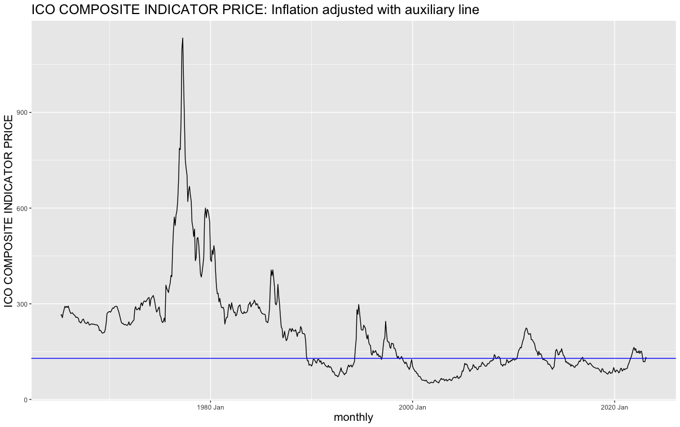
Auxiliary Line
I added an auxiliary line at 128.5, which is the coffee price of March 2023.
By disregarding anything before July 1989, I can keep stationarity and still take the advantage of the long data.
From this auxiliary line, I created Figure 3 and Figure 4.

Slide 10
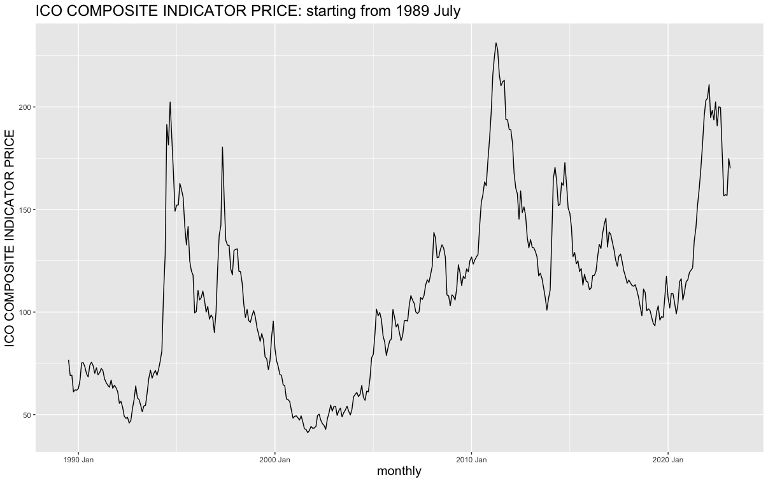
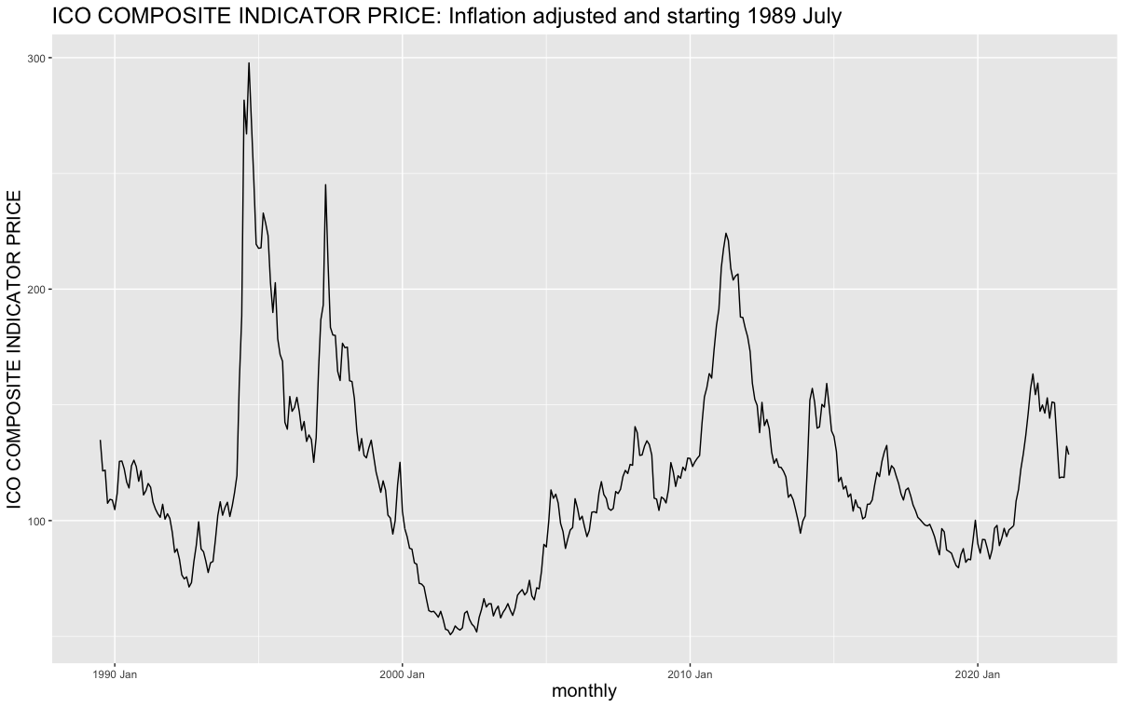
Figure 3 and Figure 4
The above is Figure 3, which starts from July 1989 to adjust the outlier. It is not adjusted for the inflation.
The data below is Figure 4, which starts from July 1989 to adjust the outlier. It is adjusted for the inflation.

Slide 11
Comparison
Figure 1, no adjustments.
Figure 2, inflation adjustment. No outlier adjustment.
Figure 3, outlier adjustment. No inflation adjustment.
Figure 4, inflation and outlier adjustments.

Slide 12
Statistical Test
Failed
Figure 2 and 3 failed the statistical test called Ljung-Box test
Passed
Figure 1 and Figure 4 passed the statistical test called Ljung-Box test.

Slide 13
Results
ICO reported that April 2023 price was 178.71 cents/lb.
Figure 4 with two adjustments generated the closest result.
Note that Figure 4 results are re-adjusted to nominal cost using 2010 =100 CPI.
Realized data in April 2023
Realized data | 178.71
Figure 1 models
ARIMA213001 | 171.96
VAR(5) | 170
Figure 4 models
ARIMA 105 | 174.636
VAR (5) | 173.313

Slide 14
Conclusion
In order to forecast international price of coffee beans, we need to first adjust the data for the inflation and find the outlier of 1975.
By eliminating the outlier of 1975 and keeping the inflation adjustment, I was able to obtain a forecasting result that is better than normal adjustments.

Slide 15
Skills
Excel VBA – to clean the data
https://github.com/Ojika897893/excel-VBA-.git
R programming and forecasting knowledge
https://github.com/Ojika897893/forecasting_international_price_of_coffee.git

Slide 16
References
International Coffee Organization [ICO]. (2019). Coffee Development Report 2019. International Coffee Organization. http://www.ico.org/documents/cy2021-22/coffee-development-report-2019.pdf
World development report, 2008: agriculture for development. (2008). Choice Reviews Online, 45(09), 45–4765. https://doi.org/10.5860/choice.45-4765
SOUTHWEST JIAOTONG UNIVERSITY [西南交通大学学报]. (2020). DYNAMIC MODELLING AND FORECASTING OF DATA EXPORT OF AGRICULTURAL COMMODITY BY VECTOR AUTOREGRESSIVE MODEL. JOURNAL OF SOUTHWEST JIAOTONG UNIVERSITY, Vol. 55(No. 3). https://doi.org/10.35741/issn.0258-2724.55.3.41
Forestal, R. L., & Pi, S. (2021). Using Artificial Neural networks and Optimal Scaling Model to Forecast Agriculture Commodity Price: An Ecological-economic Approach. Advances in Management and Applied Economics, 29–55. https://doi.org/10.47260/amae/1133
Times, N. Y. (1975, August 4). Frost in Brazil Sending Coffee Prices Up. The New York Times. https://www.nytimes.com/1975/08/04/archives/frost-in-brazil-sending-coffee-prices-up-frost-in-brazil-raises.html

