Slide 1
My CIT360 Semester Journal
By Justice Okai

Slide 2

Wk1: SETUP
Create a GitHub account.
Make an availability post on the discussion board in order to be assigned to a group.
Download and install NetBeans.
Link up the NetBeans to my GitHub account and test.
Create a google Hangout account: Remember Justice “Always attend to group meetings every week”

Slide 3
Wk2: My Team
We all agreed to communicating and working together using Google Hangout. We also agreed our meeting days will always be on Tuesdays and Fridays.
Members
Alkire, Jeremy
Ankomah, Nana Baah
Gannon, Sophia
Hysi, Jetmir
Okai, Justice
Palmer, Robert

Slide 4
Wk3: List of Code Topic discussed by My team on Tuesday, Two treated on same week. ‘Friday’
Java Collections
Hibernate
QCJSON & JSON
HTTPURLConnection from Android
JUnit Tests
Threads, Executors, Runnables, and Updating the Android UI
MVC
Application Controller Pattern
Servlets
Use Case Diagrams
Use Case Documents
State Diagrams
Sequence Diagrams
System Level Tests

Slide 5


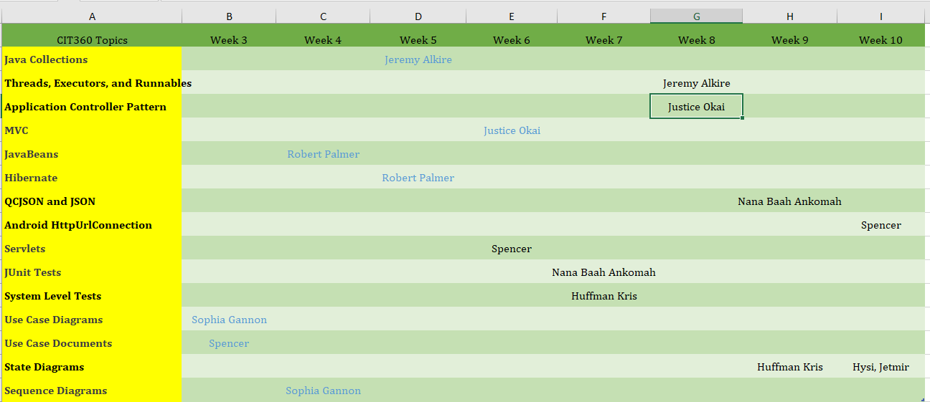

Wk4: Team Topic Schedules/Teaching Presentations
We did our very best to uphold to this schedule and used a SCUM method to track, report and analyze our process for a successful plan.

Slide 6

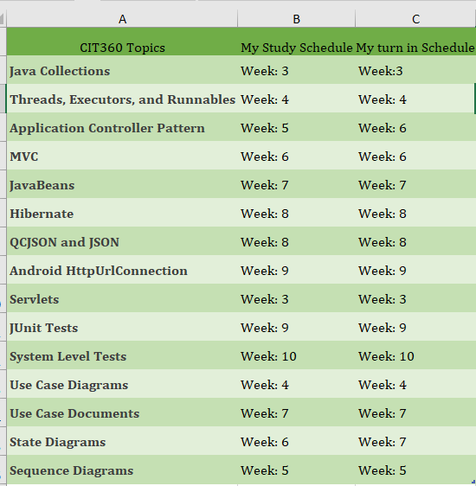
Wk5: My Individual Schedule
This schedule I have planned and as well tried as much as possible to uphold. To help me gain good feedback from my wonderful instructor on how to improve and better my work.

Slide 7
Wk6: Research topics reference /links
Collected links based on my research, inline with the topics. My Team Teaching Presentation on MVC and Request for familiarity assessment.
Java Collections:
The official Collections tutorial*](http://java.sun.com/docs/books/tutorial/collections/index.html)
Another Collections
tutorial*](http://www.tutorialspoint.com/java/java_collections.htm)
Hibernate:
The Singleton
Pattern*](http://en.wikipedia.org/wiki/Singleton_pattern)
*The Proxy Pattern*](http://en.wikipedia.org/wiki/Proxy_pattern
The Factory
Pattern*](http://en.wikipedia.org/wiki/Factory_method_pattern)
[*HQL*](https://docs.jboss.org/hibernate/orm/3.3/reference/en-US/html/queryhql.html)
definition*](http://en.wikipedia.org/wiki/Many-to-many_%28data_model%29)
[*Many To Many example and
diagrams*](http://www.tomjewett.com/dbdesign/dbdesign.php?page=manymany.php)
[*Full Hibernate annotations declaration and description*](http://docs.jboss.org/ejb3/app-server/HibernateAnnotations/reference/en/pdf/hibernate_annotations.pdf)

Slide 8
Wk7: Research topics reference /links continues
JSON Data Serialization: *JSON Introduction (follow the links on the
left)(http://www.w3schools.com/json/default.asp)
HTTP Communication:
Simple Tutorial*](http://www.vogella.com/articles/AndroidNetworking/article.html)
Some Initial Options*](http://android-developers.blogspot.com/2011/09/androids-http-clients.html)
JUnit Definition (http://en.wikipedia.org/wiki/JUnit)
JUnit Home Page (http://www.junit.org/)
[*Unit Testing*](http://en.wikipedia.org/wiki/Unit_testing)
An example of a JUnit
test(http://mars.byui.edu/barneyl/CaseSupports/StatisticsTest.java.zip)
Safe Parallel Processing:
Threading example*](http://java.sun.com/docs/books/tutorial/essential/concurrency/simple.html)
Simple Runnable Example*](http://www.roseindia.net/java/java-get-example/get-current-thread.shtml)
Updating the view using Android
Handlers (http://mindtherobot.com/blog/159/android-guts-intro-to-loopers-and-handlers/) (Look
at the examples at the bottom of the page)

Slide 9
Wk8: continues Teaching Presentation on ACP
Java(http://java.sun.com/developer/technicalArticles/ALT/Reflection/index.html)
The Model, View, Control (MVC) Software Design Pattern:
http://www.bennadel.com/blog/2379-A-Better-Understanding-Of-MVC-Model-View-Controller-Thanks-To-Steven-Neiland.htm)
Socket IO: [*Serialization*](http://en.wikipedia.org/wiki/Serialization#Example_2)
UML:
UML(http://en.wikipedia.org/wiki/Unified_Modeling_Language)
UML Class Diagrams*](http://en.wikipedia.org/wiki/Class_diagram)
UML Sequence Diagrams*](http://en.wikipedia.org/wiki/Sequence_diagram)
UML State
Diagrams*](http://en.wikipedia.org/wiki/State_diagram#UML_State_diagram)
UML Use Case Diagrams*](http://en.wikipedia.org/wiki/Use_case_diagram)

Slide 10
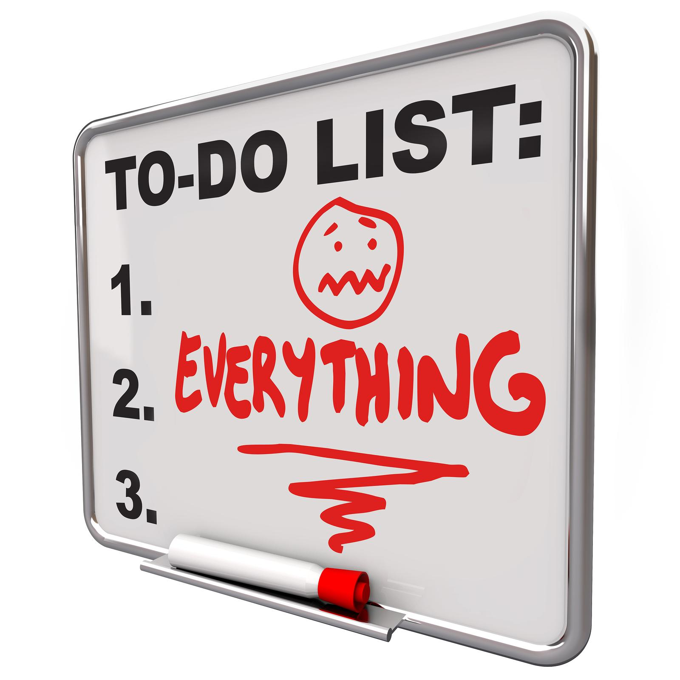
Wk9: Activities
Working on Code Topics and UML Diagrams based on wonderful instructor’s feedback as well as working on an individual APP.

Slide 11

Wk10: Justice ‘Make submission’ and Reach out to Instructor
Fluency Review
Professional Behavior
Personal Plan
Written Proposal.
Wow!!! Achieved a basic level in all topics, hope to progress more…

Slide 12
Wk11: Working on APP
Dragon Knight Application.
Simple mobile adventure game.

Slide 13
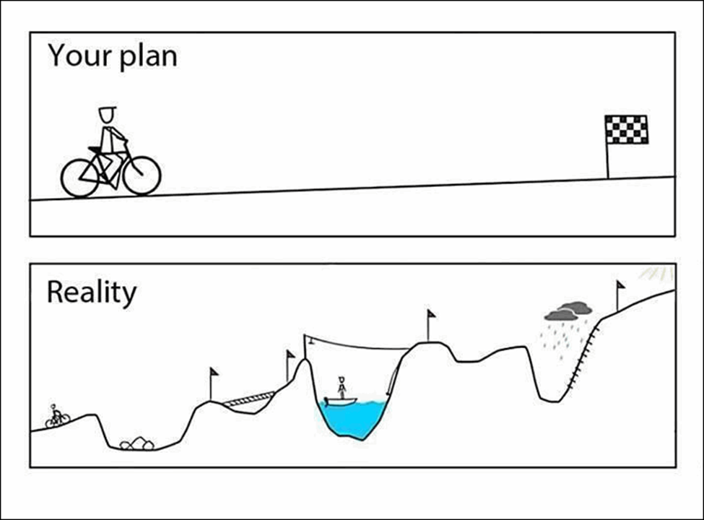

Wk 12: Weight
The end of the semester on the edge and getting everything done and checked to my portfolio.

Slide 14

Wk. 13&14
Without the help of team as well as my wonderful instructor, I wouldn’t have had the opportunity to make it. Am so grateful to my team as well as my wonderful instructor with his inspiring feedback.

